Slide 1
INTERNAL REVIEW · CONFIDENTIAL
JULY 2026
Transaction Irregularity Review
Reimbursement payments to PT Mitra Pajakku processed without a valid underlying agreement
COUNTERPARTY
SCOPE
PERIOD REVIEWED
PT Mitra Pajakku
Procurement & Compliance
Jan – Jun 2026
Notes:
Internal review of a transaction irregularity involving PT Mitra Pajakku.

Slide 2
01 · FINDING
Executive Summary
1
The cooperation agreement with PT Mitra Pajakku (No. 20220278/PKS/MP/OPS-AMFS/IV/2023) expired 31 August 2023 and was not renewed.
2
From January to June 2026, 8 payments to the same vendor were processed through the reimbursement channel instead of Procurement.
CUMULATIVE VALUE, JAN–JUN 2026
IDR 925,126,800
3
The items paid — e-materai top-up, cloud hosting, e-PPT/e-Bunifikasi services — sit within Procurement scope, not reimbursement.
≈ nearing IDR 1 billion, across 8 transactions
4
Result: recurring, contract-based spend with no underlying agreement in place — a transaction breach.
TIME WITHOUT A VALID AGREEMENT
~29 months
Aug 2023 expiry to first flagged transaction, Jan 2026
Notes:
The agreement expired in 2023; payments continued in 2026 with no contract in place, routed as reimbursement instead of procurement.

Slide 3
02 · CHRONOLOGY
Timeline of Events
1 SEP 2022
31 AUG 2023
20 JAN – 23 JUN 2026
JUL 2026
Agreement effective
Agreement expires
8 reimbursement payments processed
Finding raised
PKS No. 20220278/PKS/MP/OPS-AMFS/IV/2023 signed with PT Mitra Pajakku
No extension or new PKS executed with the vendor
Monthly e-materai top-ups, cloud hosting, and e-PPT/e-Bunifikasi fees to PT Mitra Pajakku — IDR 925,126,800 total — with no agreement on file
Irregularity identified for internal review
Notes:
Agreement started Sept 2022, expired Aug 2023. Transactions resumed via reimbursement starting Jan 2026, continuing monthly through June 2026.

Slide 4
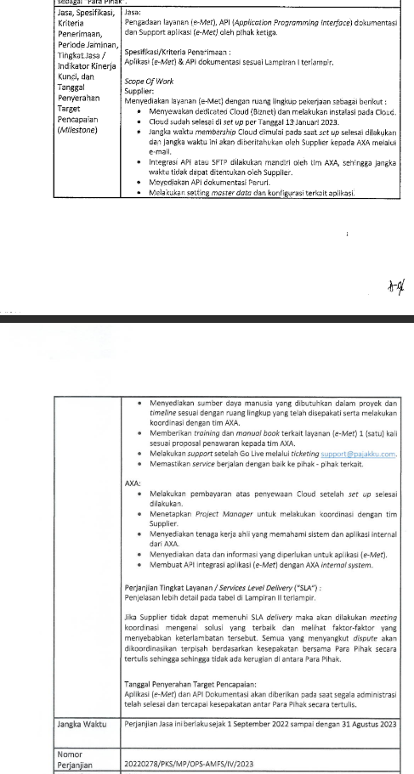
03 · EVIDENCE
Agreement Status
Clause from PKS No. 20220278/PKS/MP/OPS-AMFS/IV/2023 defines the jangka waktu — the agreement's contractual term.
TERM ON FILE
1 Sep 2022 – 31 Aug 2023
No extension or renewal document identified
Term ends 31 Aug 2023 — expired ~29 months before the flagged transactions
Notes:
The cooperation agreement clause shows the term ran from Sept 2022 to Aug 2023 only.

Slide 5
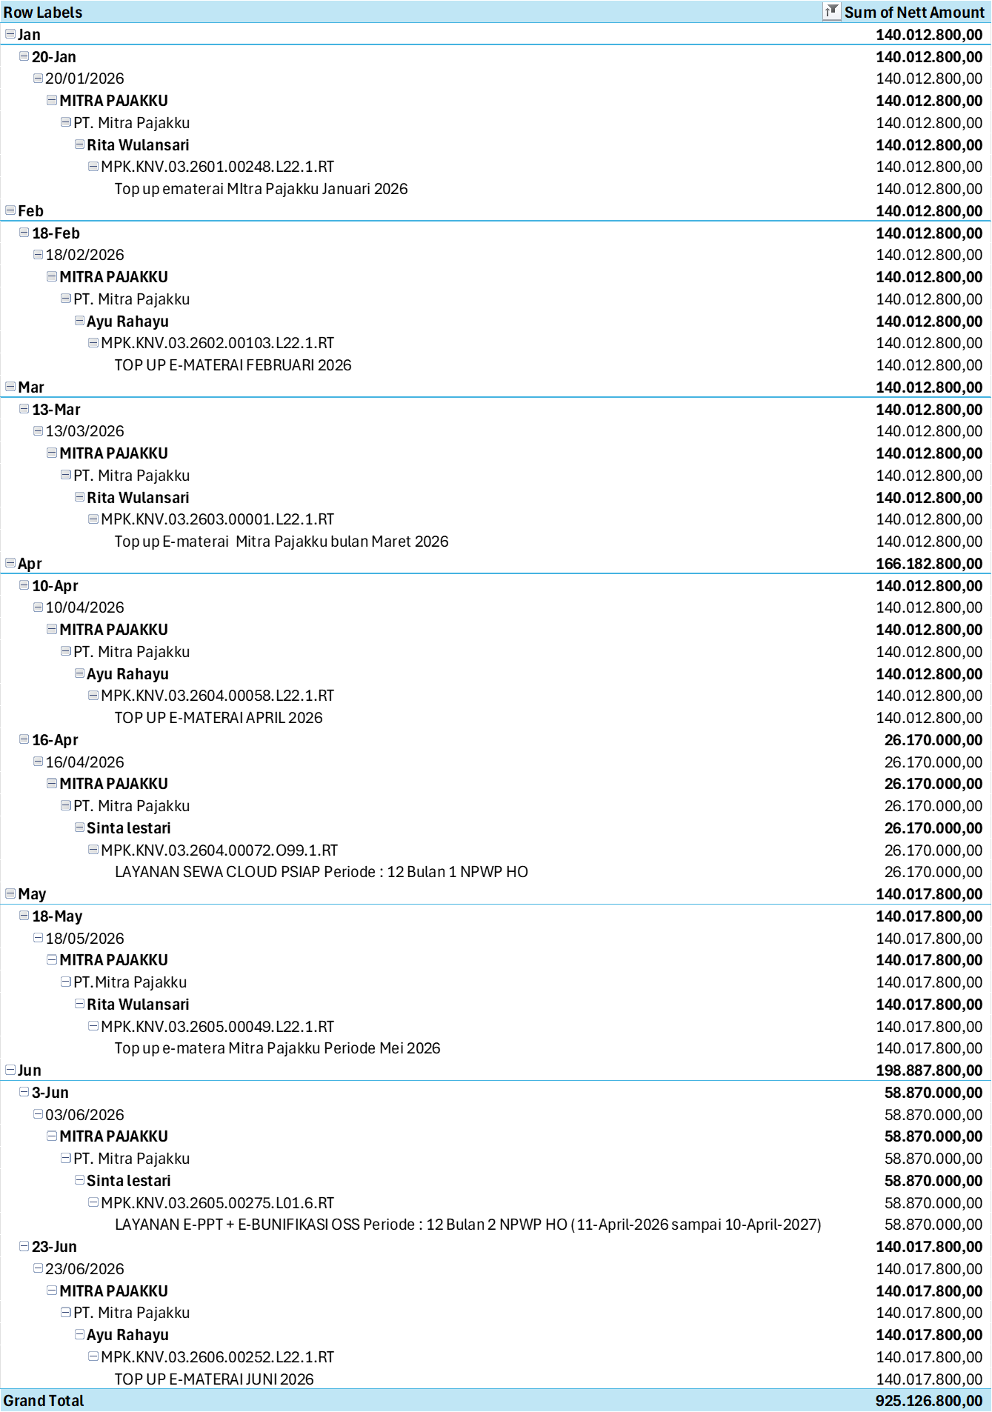
03 · EVIDENCE
Transaction Pivot
First payment, 20 Jan 2026 — over 2 years after the agreement expired
Reimbursement pivot, Jan–Jun 2026, grouped by date and vendor — PT Mitra Pajakku appears in every month with a recurring nett amount.
GRAND TOTAL
IDR 925,126,800
FIRST FLAGGED ENTRY
20 Jan 2026 — e-materai top-up, IDR 140,012,800 — first of eight monthly payments
Grand total: IDR 925,126,800
Notes:
The transaction pivot shows eight recurring payments to PT Mitra Pajakku from January through June 2026, totaling IDR 925,126,800.

Slide 6
04 · CLOSE
Summary of Findings
AGREEMENT
PROCESS
EXPOSURE
PKS No. 20220278 expired 31 Aug 2023 and was never renewed.
Procurement-scope spend was routed through reimbursement, bypassing contract controls.
IDR 925,126,800 paid across 8 transactions, Jan–Jun 2026, with no valid underlying agreement.
Chronology and evidence submitted for internal review and determination of appropriate follow-up.
Notes:
This chronology is submitted as-is for review and determination of appropriate follow-up.

