Slide 1


FLIPFIT
Your Fitness, Simplified

Slide 2

Problem Statement
Create a Gym Management Enterprise Application for Flipkart. Build the intuitive UI, seamless user experience, and robust backend system with the help of Java and Dropwizard

Slide 3

FRAMEWORK FOR 1 WEEK
Everyday discussions about tools, technologies, frameworks, etc
Step by Step Project progress with Trainer and doubt clearance sessions

Slide 4

STAKEHOLDERS
Sponsors - Flipkart
Trainer - Amit Kumar Balyan

Slide 5

OUR TEAM
Kartik Aggarwal
Yashvardhan Yadav
Shivansh Sinha
Sujal Mishra
Abdul Razique
Trilekya Kallkuri

Slide 6
TEAM STRUCTURE
Kartik Aggarwal - Implemented GymCustomer Business Logic
Yashvardhan Yadav - Implemented GymOwner Business Logic
Shivansh Sinha - Implemented GymOwner Business Logic
Sujal Mishra - Implemented Client Logic and Rest APIs
Abdul Razique - Connected MySQL Database with application
Trilekya Kallkuri - Created UML Artifacts and code beautification

Slide 7

OUR VISION
Our Gym Management System, Flipfit, is built on a robust and scalable tech stack. The backend is powered by Java and Dropwizard, providing a high-performance and efficient framework, while MySQL serves as our reliable database for all operational data.
For seamless collaboration and tracking of changes, we utilize Git for version control, with GitHub as our central repository. This ensures smooth development cycles and code integrity.

Slide 8






TECH STACK

Slide 9
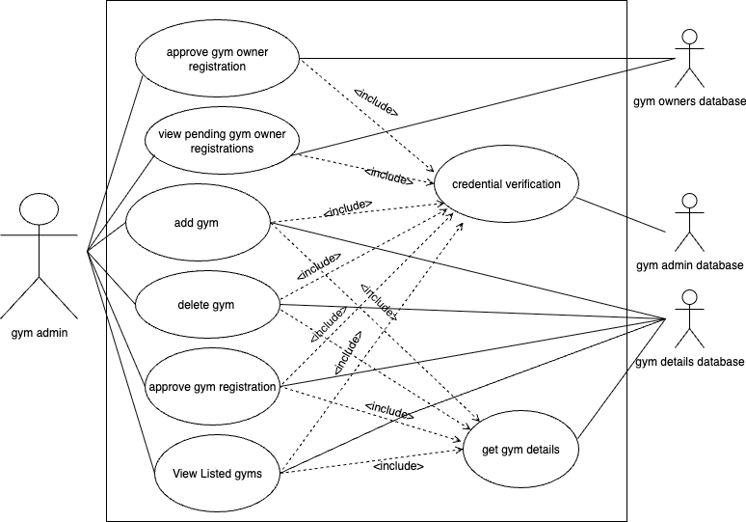
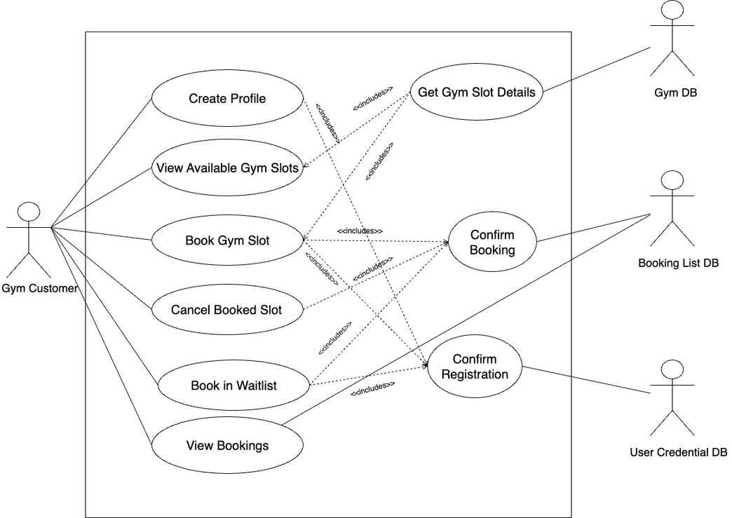
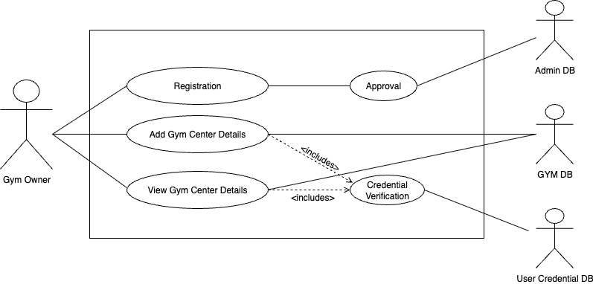
DEVELOPMENT - USECASE DIAGRAM

Slide 10
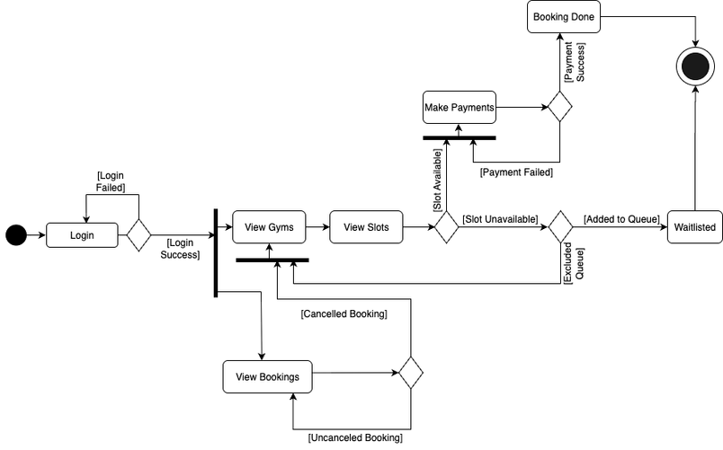
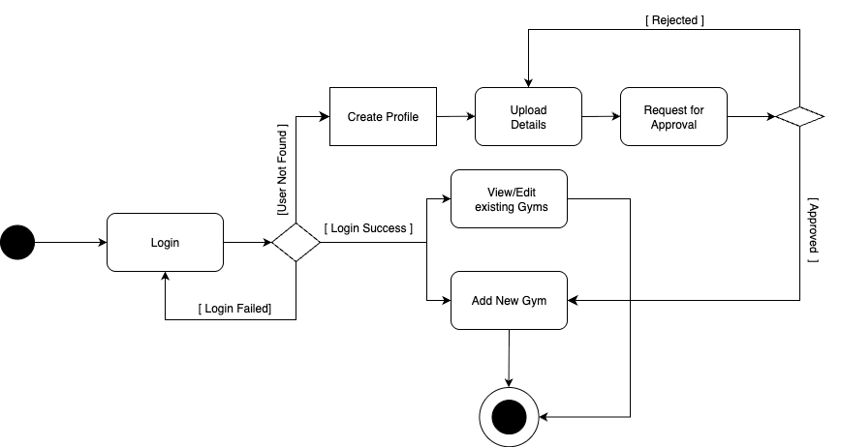
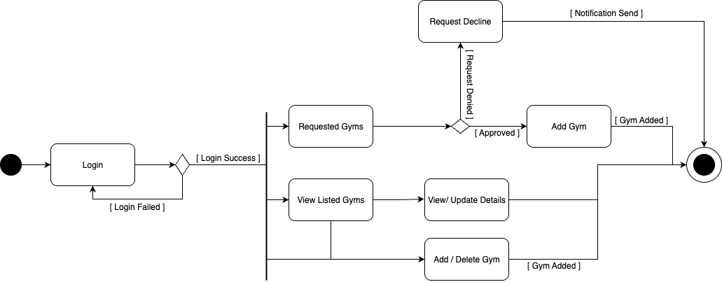
DEVELOPMENT - ACTIVITY DIAGRAM

Slide 11
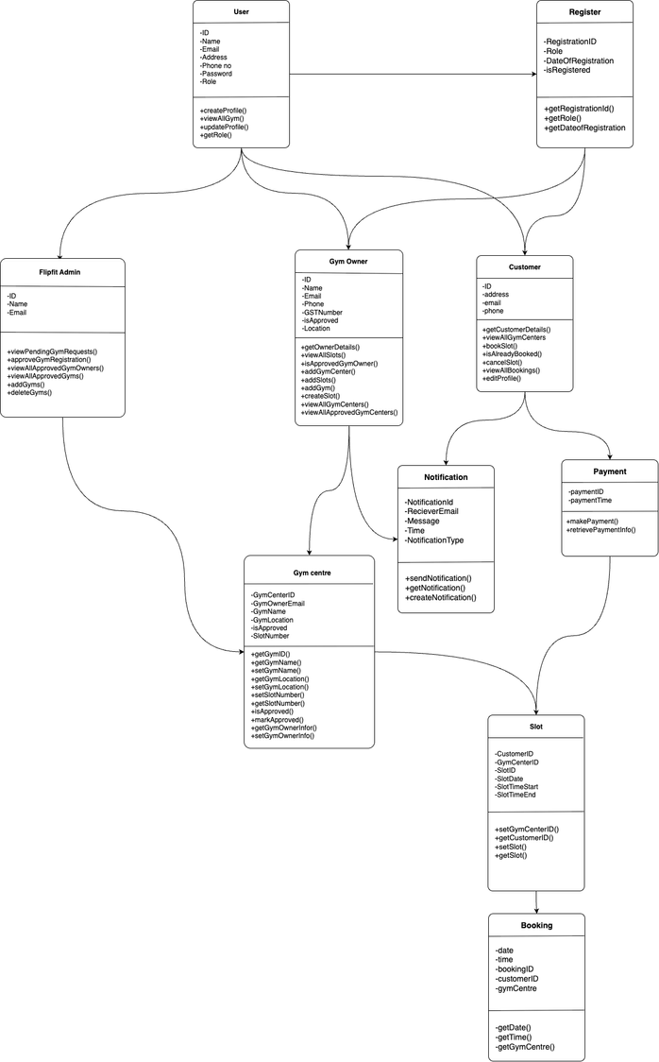
DEVELOPMENT - CLASS DIAGRAM

Slide 12
DEMO OF OUR APPLICATION
FLIPFIT
Your Fitness, Simplified

Slide 13

QUESTIONS ??

