Slide 1

Hypospadias
Supervisor
Msr. Isam Allsanjak
Dr. Rahiq Mahmoud
Medical Officer

Slide 2
Development :
Phallus forms Penis ( glans P , Corpora Cavernosa & Corpus spongiosum).
Urogenital folds ventral aspect of the Penis (Penile raphe).
labio Scrotal Swellings Scrotum.

Slide 3
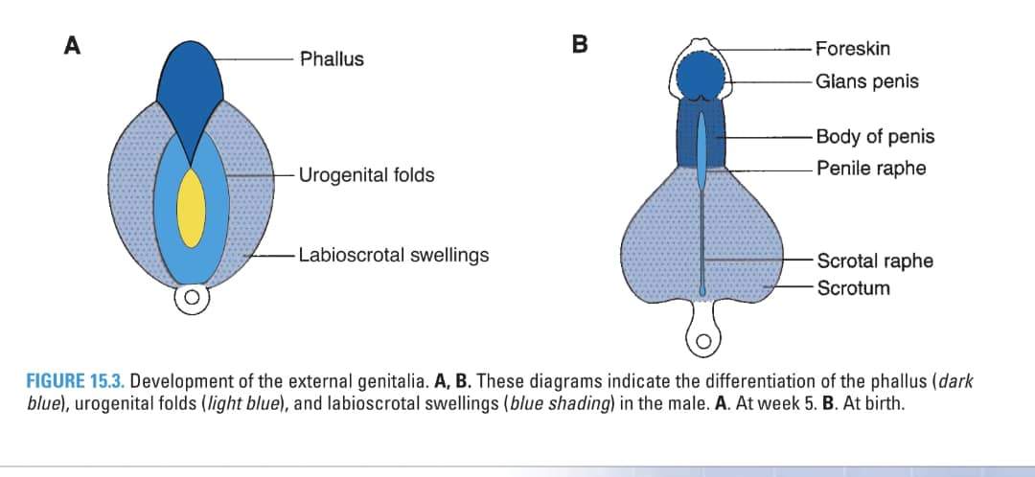

Slide 4
Definition
Hypospadias is Congenital deformity where the meatus is sited on ventral part of the Penis .

Slide 5
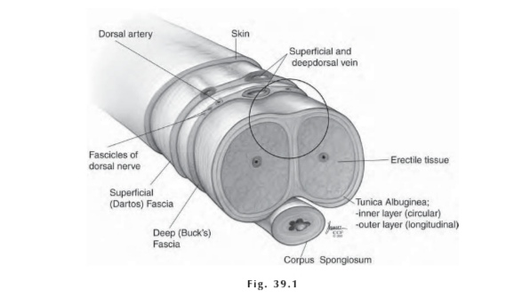
Anatomy

Slide 6
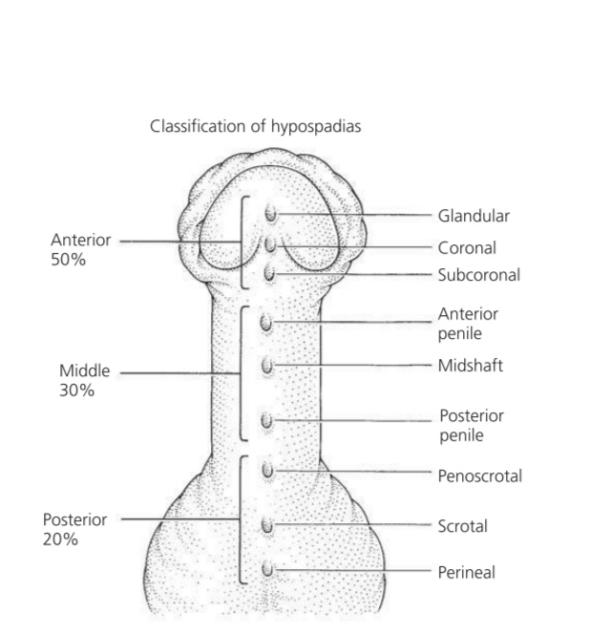
classification

Slide 7
Associated Anomalies
Undescended tests in 10%
Inguinal hernia + or – hydrocele in 15%
Disorders of sexual development in 15% or boys with palpable UDT + hypospadias, and 50% of boys with impalpable UDT + hypospadias.
Persistence of Mullerian structures (i.e. dilated utricle).

Slide 8
Treatment
Chordee correction.
Single-stage urethroplasty.
Two-stage urethroplasty.

Slide 9
Others repairs described for hypospadias:
Distal hypospadias repairs
TIP urethroplasty.
Snodgrass urethroplasty.
Tubularization (Thiersch Duplay).
Meatal advancement and glanuloplasty .
Mathieu procedure.

Slide 10
Middle Hypospadias repairs:
TIP urethroplasty.
Snodgrass UR.
Thiersch Duplay.
Onlay island flap.
Mathieu procedure.

Slide 11
Proximal hypospadias repairs
Transverse preputial island flap.
OIF repair.
TIP urethroplasty.

Slide 12
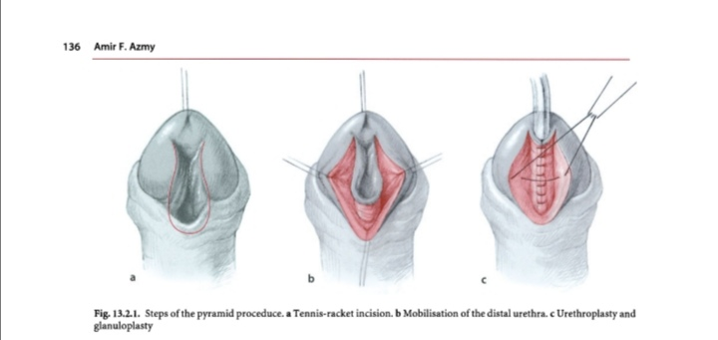

Slide 13
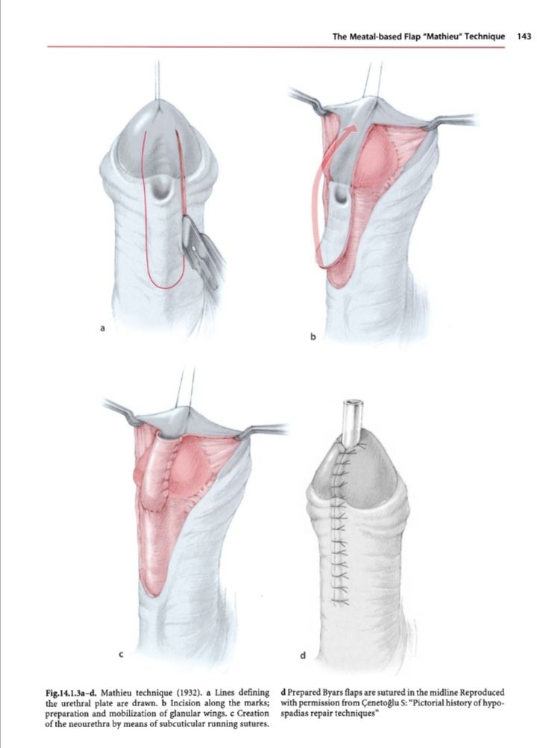

Slide 14
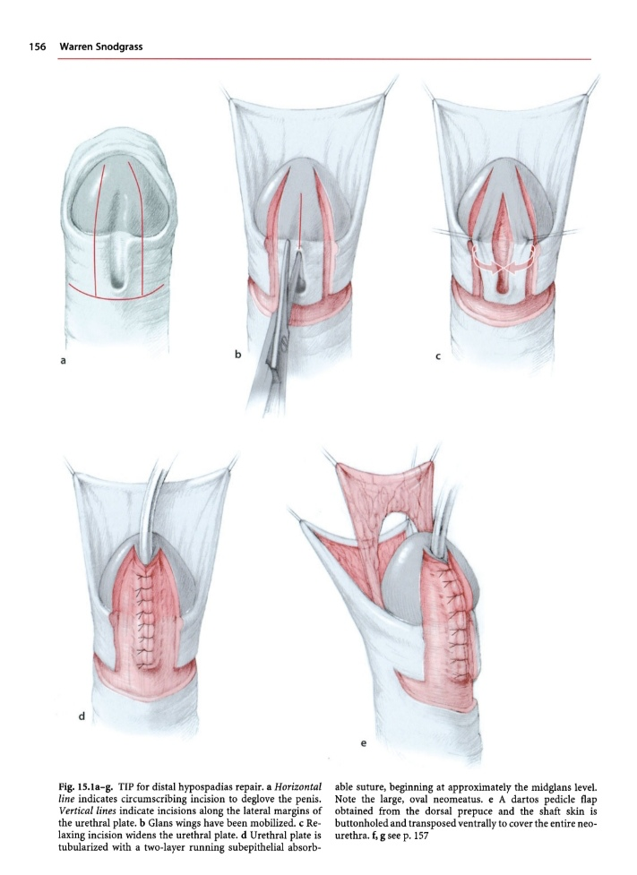

Slide 15
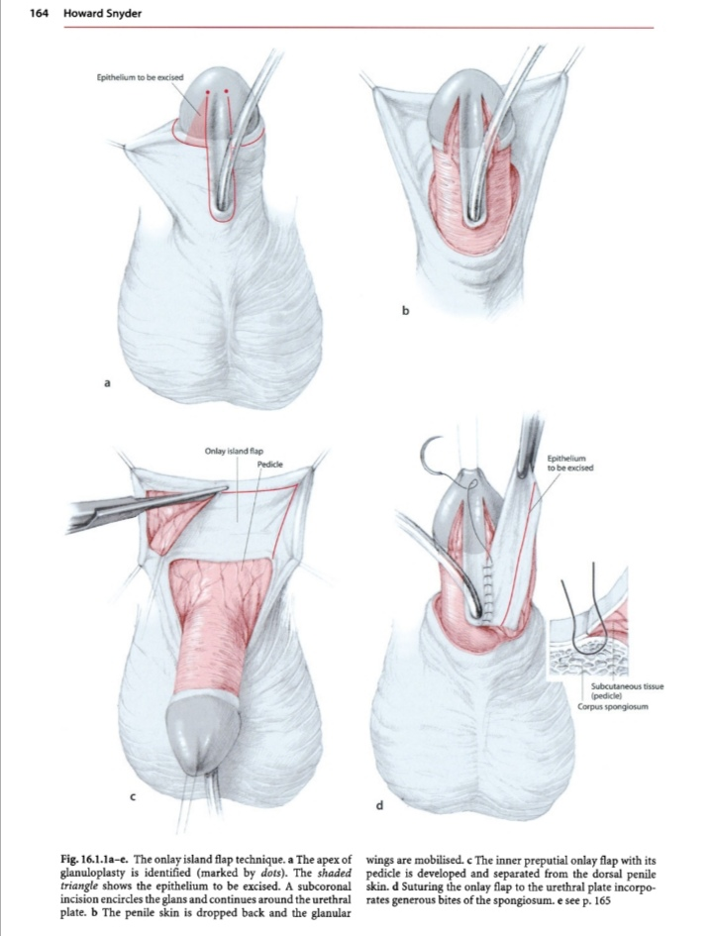

Slide 16
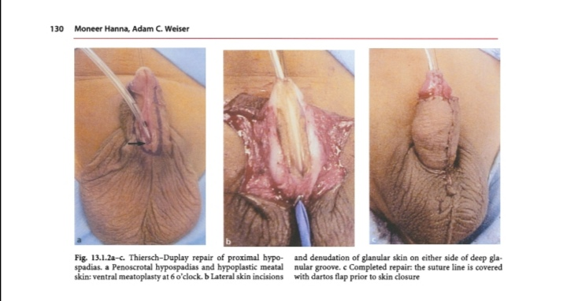

Slide 17
Complications
Early.
Late.

Slide 18
References:
1- BRS Embryology.
2- Operative pediatric surgery.
3- Operative Urology.
4- Hypospadias Surgery

Slide 19
Thank you

Slide 20
