Slide 1
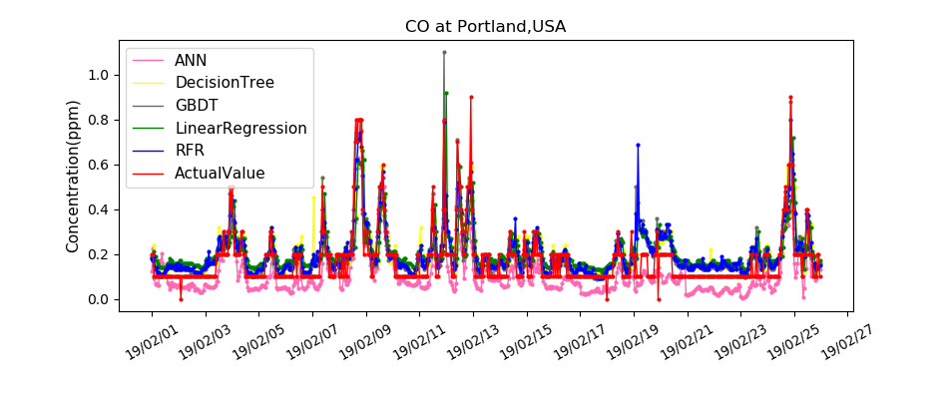
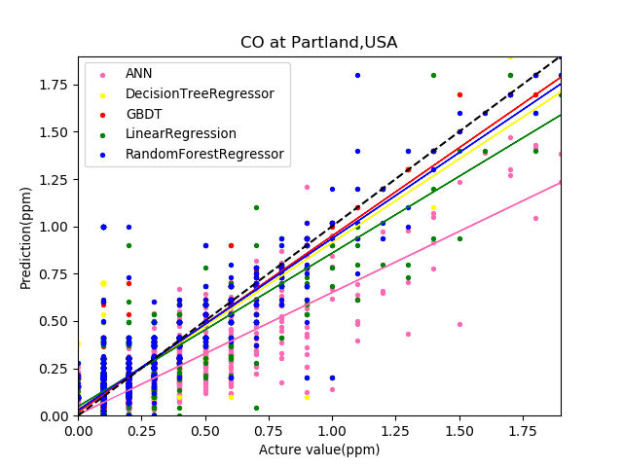
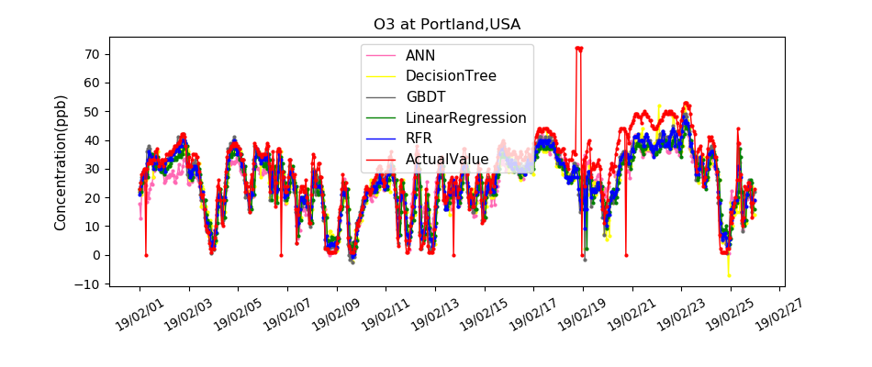
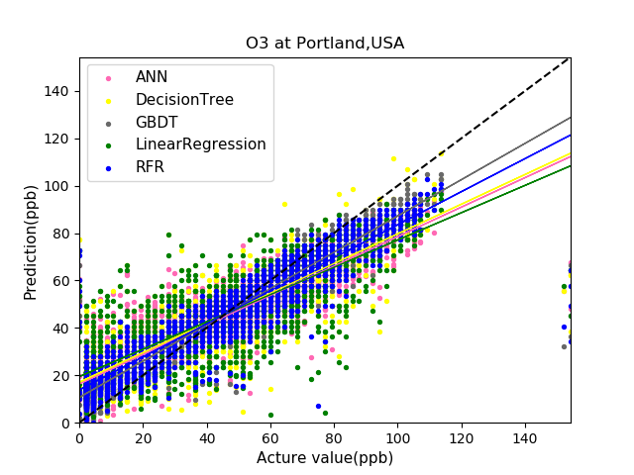
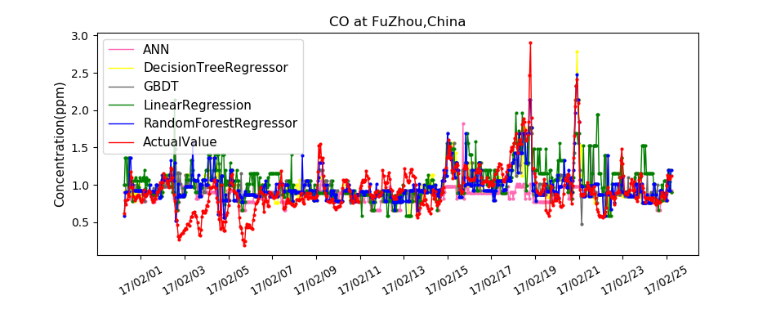
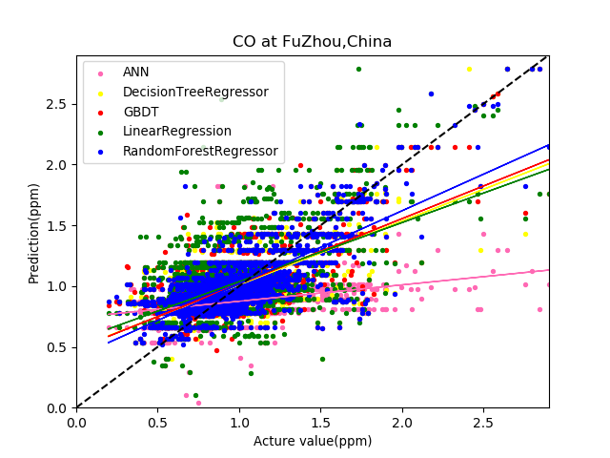
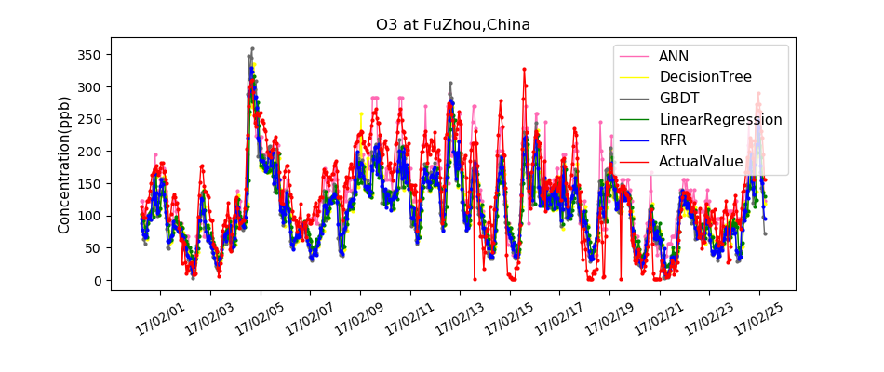
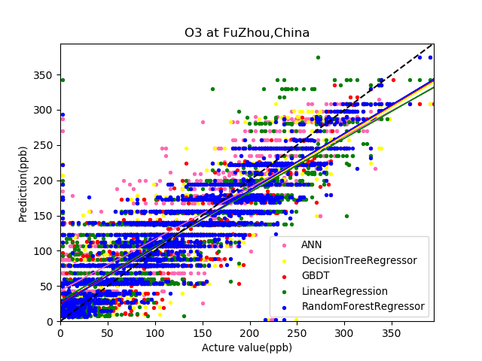
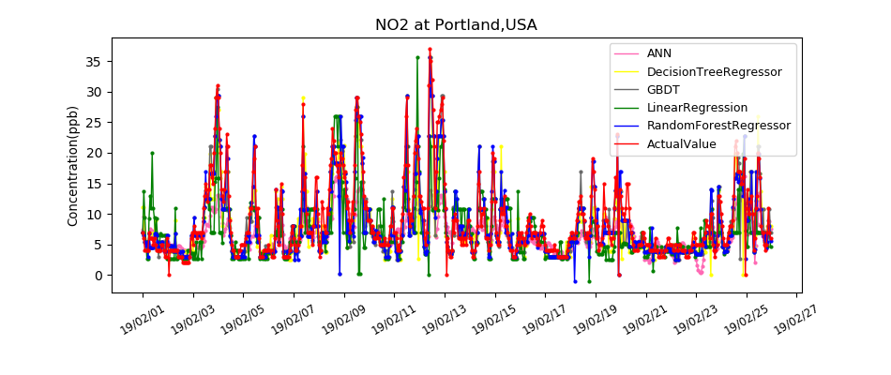
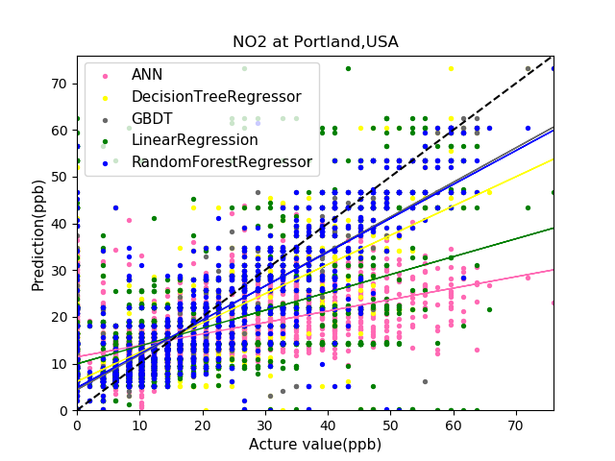
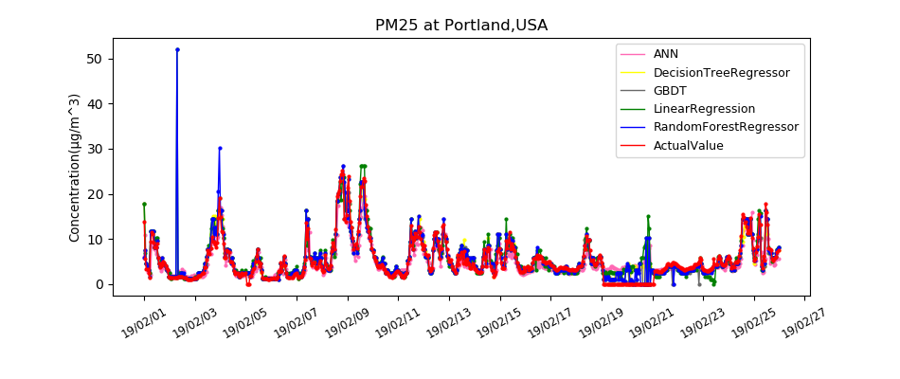
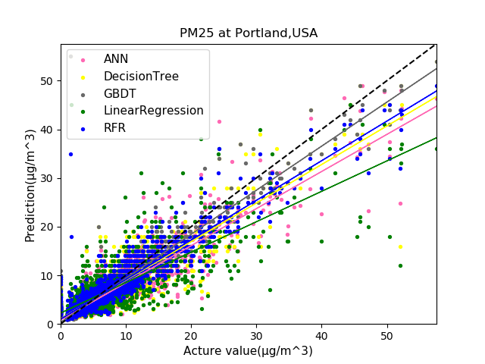
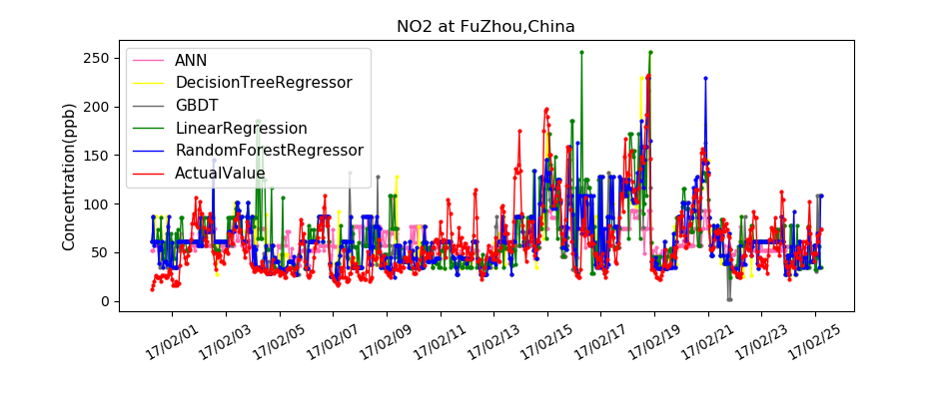
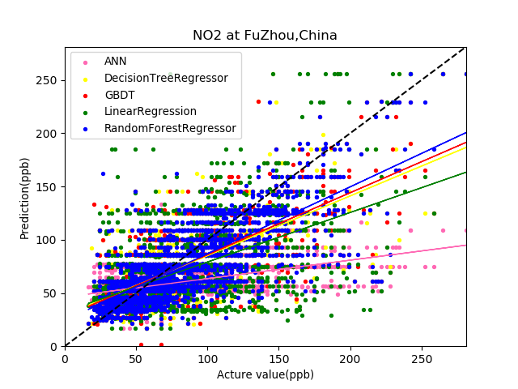
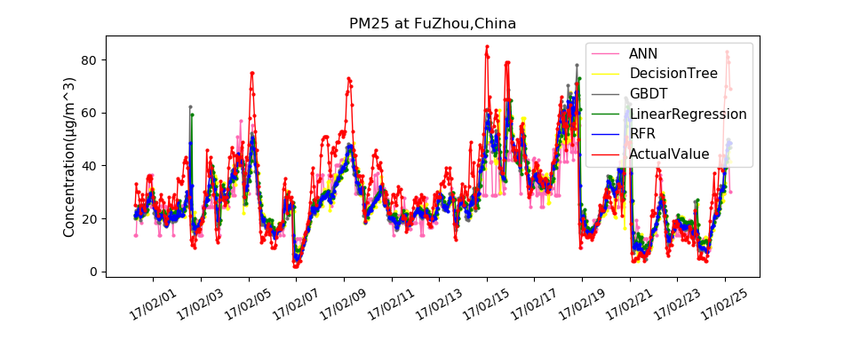
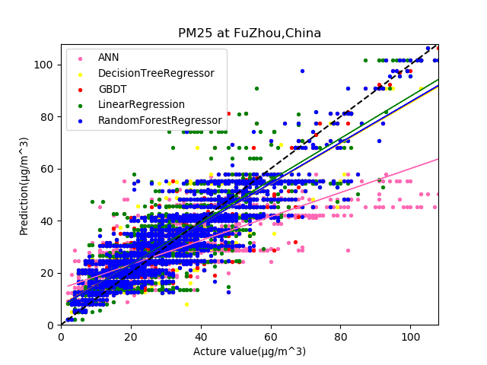
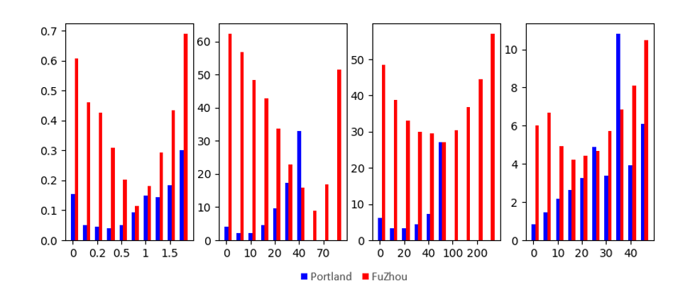
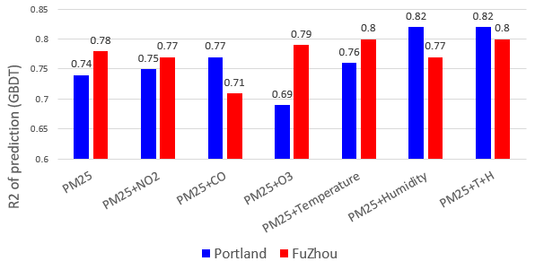
Comparison of Predictions of Air Pollutants Concentrations in Portland and Fuzhou by Various Models
Abstract
CO
GBDT(R²=0.7) and RFR(R²=0.7) get the better performance at CO prediction in both Portland and Fuzhou. The reason is that: the range of CO concentration is in a small interval. It is a good condition for decision tree model with a certain tree depth.
By comparison, NO₂, O₃, PM_{2.5} have no positive effect on the prediction of CO.
Temperature and humidity play positive roles in the prediction of CO concentration. Max(R²) from 0.70 to 0.75
O₃
ANN and RFR get the best performance at O₃ prediction in both Portland and Fuzhou.
NO₂, humidity play positive roles in the prediction of O₃. Max(R²) from 0.65 to 0.70
Temperature and humidity have no significant effect on CO concentration prediction. Max(R²) from 0.70 to 0.71.
The rapid development of low-cost sensors greatly improves the accuracy of their monitoring data. At the meanwhile, with the increasing popularity of low-cost sensors, the amount of air pollution monitoring data in the time and space dimensions is growing rapidly. In such case, the deep integration of air pollution monitoring and machine learning that rely on big data will become an inevitable trend. One of the ways is to predict the future concentrations of air pollutants by learning the monitoring data that we acquired using machine learning. In this study, We predicted four concentrations of air pollutants in Portland U.S.A. and Fuzhou China. Four concentrations of air pollutants: CO, NO₂, O₃, PM_{2.5} .We used multiple methods including liner model: Liner-Regression(LR); nonlinear model: Artificial Neural Network (Long-Short-Term-Memory LSTM), Decision Tree (DT), Support Vector Regression (SVR) and integrated algorithm: Gradient Boosting Decision Tree (GBDT), Random Forest Regression(RFR). We evaluated the performances of each model by calculating coefficients of determination (R²), mean normalized error(MNE%) and mean normalized bias(MNB%). The experimental results demonstrate that: GBDT and RFR performed well in the prediction of CO and NO₂. ANN and RFR yielded the best performance in prediction of O₃. For the prediction of PM_{2.5}, ANN, GBDT, RFR can get good accuracy. Then, we studied the cross interference of temperature, humidity and other pollutants on the prediction of pollutant concentrations. The experimental results demonstrate that: temperature and humidity have positive impact on the prediction of CO concentration; NO₂ has positive impact on O₃ concentration prediction; humidity has significant positive impact on PM_{2.5} concentration prediction.
PM_{2.5}
All models can show good results in PM_{2.5} concentration prediction. The optimal model are RFR and GBDT.
CO has a positive effect on PM_{2.5} concentration prediction. Max(R²) from 0.74 to 0.77.
O₃,NO₂ have no significant effect on PM_{2.5} concentration prediction.
Humidity plays a significant positive role in the prediction of PM_{2.5}. Max(R²) from 0.74 to 0.82.
NO₂
GBDT gets the best performance at CO prediction in both Portland and Fuzhou.
CO, NO₂, O₃, PM_{2.5}, temperature and humidity have no positive effect on the prediction of NO₂.
Analysis of results
Target Gas | Model Type | R² |  | MNE (%) |  | MNB (%)
 |  | Portland,USA | FuZhou,China | Portland,USA | FuZhou,China | Portland,USA | FuZhou,China
CO | ANN | 0.6 | 0.0 | 40.3 | 33.0 | -29.7 | 10.7
 | Decision Tree | 0.6 | 0.3 | 36.2 | 29.9 | 20.7 | 9.4
 | GBDT | 0.7 | 0.2 | 28 | 30.0 | 14.9 | 12.1
 | LinearRegression | 0.5 | -0.1 | 45.5 | 34.0 | 25.4 | 12.9
 | RandomForestRegressor | 0.7 | 0.3 | 32.5 | 29.0 | 20.6 | 10.0
 | SVR | 0.2 | -0.2 | 98.4 | 45.3 | 94.8 | 34.4
NO₂ | ANN | 0.3 | 0.2 | 44.6 | 52.1 | 6.6 | 24.5
 | Decision Tree | 0.2 | 0.4 | 43.6 | 45.5 | 16.1 | 25.1
 | GBDT | 0.4 | 0.5 | 45.4 | 41.8 | 24.1 | 21.3
 | LinearRegression | 0.2 | 0.3 | 60.3 | 45.9 | 15.3 | 20.4
 | RandomForestRegressor | 0.3 | 0.5 | 38.8 | 39.8 | 16.5 | 19.7
 | SVR | 0.2 | 0.0 | 67.7 | 66.7 | 44.1 | 44.7
O₃ | ANN | 0.7 | 0.6 | 63.4 | 154.7 | 42.5 | 154.7
 | Decision Tree | 0.5 | 0.7 | 76.7 | 133 | 53.2 | 133
 | GBDT | 0.6 | 0.5 | 46.8 | 12.7 | 29.9 | 12.7
 | LinearRegression | 0.6 | 0.6 | 81.3 | 15.9 | 60.5 | 15.9
 | RandomForestRegressor | 0.7 | 0.7 | 57.1 | 12.5 | 40.1 | 12.5
 | SVR | -0.8 | 0.6 | 111.6 | 16.8 | 108.7 | 16.8
PM_{2.5} | ANN | 0.8 | 0.5 | 25.1 | 25.1 | -3.4 | -3.4
 | Decision Tree | 0.7 | 0.7 | 18.7 | 30.3 | 6.7 | 5.5
 | GBDT | 0.8 | 0.7 | 17.3 | 22.9 | 3.7 | -1.5
 | LinearRegression | 0.6 | 0.7 | 27.2 | 34.5 | -7.2 | 9.2
 | RandomForestRegressor | 0.8 | 0.8 | 19.5 | 24.9 | 7.2 | 3.6
 | SVR | 0.3 | 0.4 | 83.5 | 77.9 | 77.9 | 69.1
For each pollutant, the best model is marked in red. In general, the integrated algorithm related to decision trees: GBDT, and RFR perform better than other models. ANN model performed better when predicting the concentration of O₃ and PM_{2.5}. SVR showed the worst performance in each prediction.
Right image shows the MAE values predicted by GBDT in different concentration ranges.
CO(ppm)
NO₂(ppb)
O₃(ppb)
PM25(μg/m³)
Methods
MAE(GBDT)
1. Normalization is required so that all the inputs are at a comparable range to solve the cross interference issue, also because the characteristics of SVR and ANN model.
2. After some comparisons, we selected 2-layer-LSTM model and DT,RFR model with maximum tree depth of 8 to capture the information in pollutant concentration series.
3. Models training at the small data, in such case, overfitting is a serious problem in such models. We limit the maximum depth of the tree and utilize Dropout and L2-regularization technique to address this problem, at the same time maintain the prediction accuracy.
4. For the above models, manually selecting witch pollutant should be input to model based on the prior knowledge will greatly improve the accuracy of prediction. Because this can minimize the fluctuations bring by unrelated parameters.
Left bar chart plot the R₂ of PM_{2.5} prediction in Portland and Fuzhou by GBDT model. The experiment selected different input parameters. We discussed the effects of NO₂, CO, O₃, temperature and humidity on PM25 prediction.
At Portland, It can be seen that humidity has the greatest impact on PM_{2.5} prediction, followed by CO and temperature. O₃ has a negative impact on PM_{2.5} prediction. At Fuzhou, temperature has the greatest impact on PM_{2.5} prediction.

Slide 2
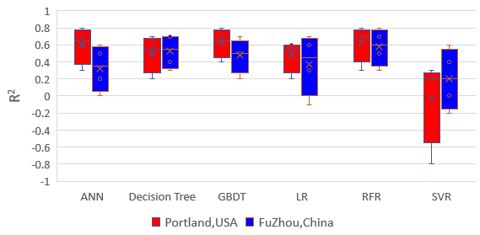
多种模型对波特兰及福州大气污染物浓度预测比较
摘要
CO
GBDT(R2=0.7)及RFR(R2=0.7)在波特兰地区CO浓度预测以及福州地区CO浓度的预测效果最好. 其原因是: CO浓度的取值范围始终在较小的区间内. 这是具有一定深度的决策树以及其扩展方法很好的适用条件.
通过对比发现, NO2,O3,PM25对CO的预测没有积极作用, 温度,湿度对CO浓度的预测起积极作用. max(R2) from 0.70 to 0.75
O3
对O3浓度预测的最优模型是ANN和RFR.
NO2对O3浓度预测起积极作用max(R2) from 0.65 to 0.70
温度,湿度对CO浓度预测无明显影响max(R2) from 0.70 to 0.71.
低成本传感器的快速发展不仅使其监测数据的准确性大大提高,同时随着低成本传感器的应用越来越普及,环境监测数据在时间和空间维度上的数据量飞速增长.这种情况下, 需要大数据支持的机器学习与环境监测的深入融合将成为必然趋势. 其中一种结合方式便是通过机器学习的方法, 学习已获得的监测数据并对未来的污染物浓度进行预测。在此次研究中,我们对美国波特兰地区,中国福州地区的大气污染物传感器监测数据进行预测. 预测的污染物包括CO, NO2, O3, PM2.5 .使用的模型包括线性算法:线性回归(LR);非线性算法:人工神经网络(长短时记忆网络LSTM), 决策树(DT), 支持向量回归(SVR)以及集成算法: 梯度提升树(GBDT), 随机深林(RFR).通过计算预测值与实际值的可决系数(R²), 平均标准偏差(MNE%), 平均标准偏置(MNB%)讨论在不同污染物上表现最好的模型. 得到结果:预测CO, NO2浓度的最优模型是GBDT和RFR,预测O3浓度的最优模型是ANN, 对PM2.5的浓度测,ANN,GBDT,RFR模型都能达到较好的精度. 其次,我们对比试验分析了温度,湿度及其它污染物对污染物浓度预测的影响. 得到结果: 温度,湿度对CO浓度的预测起一定积极影响;NO2对O3浓度预测起积极影响;湿度对PM2.5浓度预测起明显积极影响.
PM2.5
各模型都能在PM2.5浓度预测上表现出较好效果. 其中浓度预测的最优模型是RFR和GBDT.
CO,对PM2.5浓度预测起一定积极作用max(R2) from 0.74 to 0.77,
O3,NO2,对PM2.5浓度预测未起明显作用.
湿度对PM2.5浓度预测起明显积极作用max(R2) from 0.74 to 0.82.
NO2
对NO2浓度预测的最优模型是GBDT.
CO, NO2, O3, PM2.5,温度,湿度对NO2的预测都没有明显作用.
预测结果分析
Target Gas | Model Type | R2 |  | MNE (%) |  | MNB (%)
 |  | Portland,USA | FuZhou,China | Portland,USA | FuZhou,China | Portland,USA | FuZhou,China
CO | ANN | 0.6 | 0.0 | 40.3 | 33.0 | -29.7 | 10.7
 | Decision Tree | 0.6 | 0.3 | 36.2 | 29.9 | 20.7 | 9.4
 | GBDT | 0.7 | 0.2 | 28 | 30.0 | 14.9 | 12.1
 | LinearRegression | 0.5 | -0.1 | 45.5 | 34.0 | 25.4 | 12.9
 | RandomForestRegressor | 0.7 | 0.3 | 32.5 | 29.0 | 20.6 | 10.0
 | SVR | 0.2 | -0.2 | 98.4 | 45.3 | 94.8 | 34.4
NO2 | ANN | 0.3 | 0.2 | 44.6 | 52.1 | 6.6 | 24.5
 | Decision Tree | 0.2 | 0.4 | 43.6 | 45.5 | 16.1 | 25.1
 | GBDT | 0.4 | 0.5 | 45.4 | 41.8 | 24.1 | 21.3
 | LinearRegression | 0.2 | 0.3 | 60.3 | 45.9 | 15.3 | 20.4
 | RandomForestRegressor | 0.3 | 0.5 | 38.8 | 39.8 | 16.5 | 19.7
 | SVR | 0.2 | 0.0 | 67.7 | 66.7 | 44.1 | 44.7
O3 | ANN | 0.7 | 0.6 | 63.4 | 154.7 | 42.5 | 154.7
 | Decision Tree | 0.5 | 0.7 | 76.7 | 133 | 53.2 | 133
 | GBDT | 0.6 | 0.5 | 46.8 | 12.7 | 29.9 | 12.7
 | LinearRegression | 0.6 | 0.6 | 81.3 | 15.9 | 60.5 | 15.9
 | RandomForestRegressor | 0.7 | 0.7 | 57.1 | 12.5 | 40.1 | 12.5
 | SVR | -0.8 | 0.6 | 111.6 | 16.8 | 108.7 | 16.8
PM25 | ANN | 0.8 | 0.5 | 25.1 | 25.1 | -3.4 | -3.4
 | Decision Tree | 0.7 | 0.7 | 18.7 | 30.3 | 6.7 | 5.5
 | GBDT | 0.8 | 0.7 | 17.3 | 22.9 | 3.7 | -1.5
 | LinearRegression | 0.6 | 0.7 | 27.2 | 34.5 | -7.2 | 9.2
 | RandomForestRegressor | 0.8 | 0.8 | 19.5 | 24.9 | 7.2 | 3.6
 | SVR | 0.3 | 0.4 | 83.5 | 77.9 | 77.9 | 69.1
对于每种污染物,预测结果最好的模型由红色标出.评价指标采用可决系数(R²), 平均标准偏差(MNE%), 平均标准偏置(MNB%).
总体来说决策树相关的两种集成方法:梯度提升树,随机深林在六种模型中表现最佳.
ANN模型在预测O3和PM2.5浓度时,表现较好.支持向量回归在各污染物浓度预测上表现最差.
预测方法
1. 因为SVR,ANN模型本身的特点,需要先对输入数据进行归一化处理.
2. 多次对比实验后,选用选用最大树深度为8的DT,RFR模型和2层的LSTM模型来充分学习污染物浓度变化的时序信息.
3. 小数据集训练得到的模型存在过拟合现象,为了在保持预测精度的基础上缓和过拟合现象,我们在LSTM模型上采用了随机丢弃(Dropout)方法,以及L2范数正则化(L2-Regularization),并控制树的最大深度.
4. 对于以上几个模型, 通过先验知识根据需要预测的污染物手动选择不同的预测输入,将大大提高模型预测的准确度.因为这能最大程度地减少无关参数的波动对模型预测的影响.
左图是GBDT模型在波特兰以及福州PM2.5浓度数据预测结果的R2直方图. 实验选用了各个不同的输入参数.以此讨论NO2,CO,O3,温度,湿度对PM25预测的影响.
对于波特兰数据,可以看出湿度对PM2.5预测的影响最大,其次是CO和温度.O3对PM2.5的预测起负面影响.对于福州数据,温度对PM2.5预测影响最大.

