Slide 1
Final Project
Data Visualization and Acquisition

Slide 2
Amazon Delivery Data
Dataset description:
These data are a set of information consisting of 2291 individual records and 16 fields that give information about specific deliveries made by Amazon delivery drivers.
Among the 16 fields we have one field that gives the amount of time taken to deliver the package. For analysis we consider this to be the response variable because this is a business case and Amazon is seeking to reduce cost and increase efficiency in performance.
For the remaining fields we examine them to see if there are any trends in how they affect the amount of time it takes to deliver a package.
Dataset was taken from Kaggle.com

Slide 3
Amazon Delivery Data
Potential Predictor Field Summary
Delivery_person_Age, Numeric
Delivery_person_ratings, Numeric
Weatherconditions, factor
Road_traffic_density, factor
Vehicle_condition, factor
Type_of_order, factor
Type_of_vehicle, factor
Multiple_deliveries, factor
Festival, factor
City, factor

Slide 4
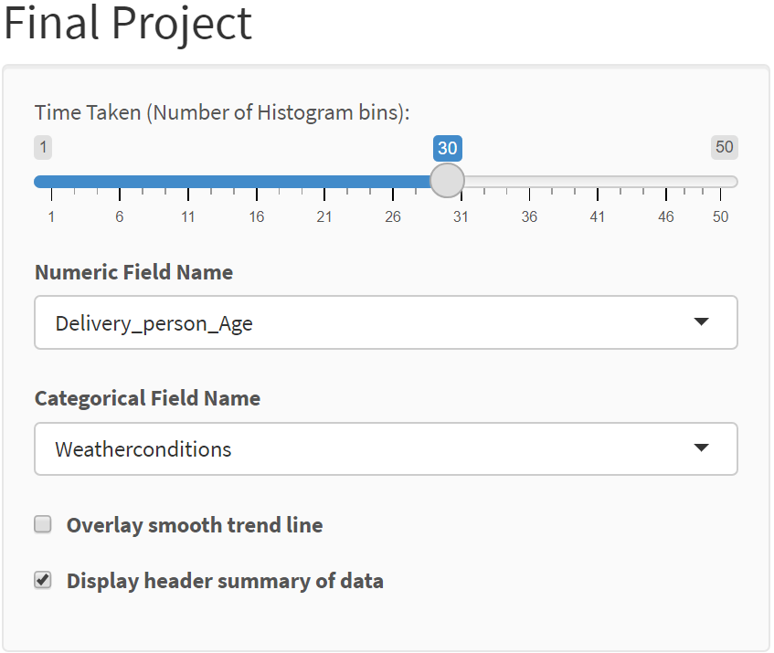
Exploratory Data Analysis
Using this App we can very quickly examine our company data. We can look at the distribution of Delivery times, examine some of the raw data, and display how certain fields affected our delivery times to quickly narrow our approach in improving company efficiency.

Slide 5
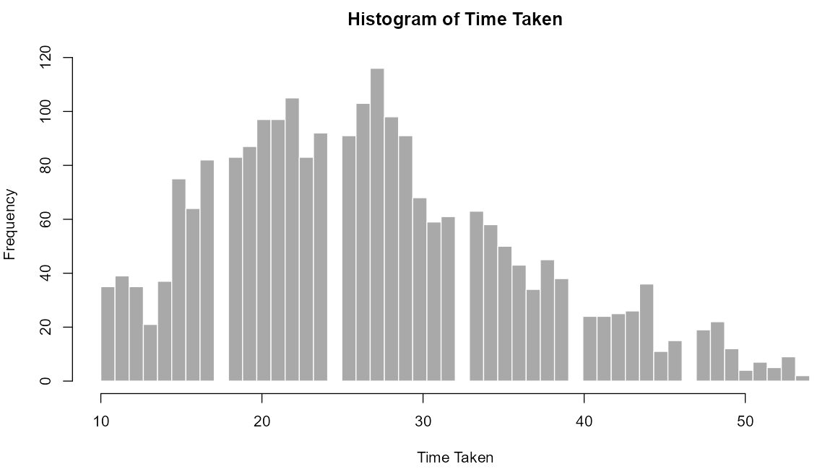
Exploratory Data Analysis
This histogram shows an almost normal spread of values of the time it took to deliver packages with a slight shift of the bulk to the left and longer flatter tail out to the right. The question is how can we as a company cut out the deliveries taking over 40 and 50 minutes? (Taken from Shiny App)

Slide 6
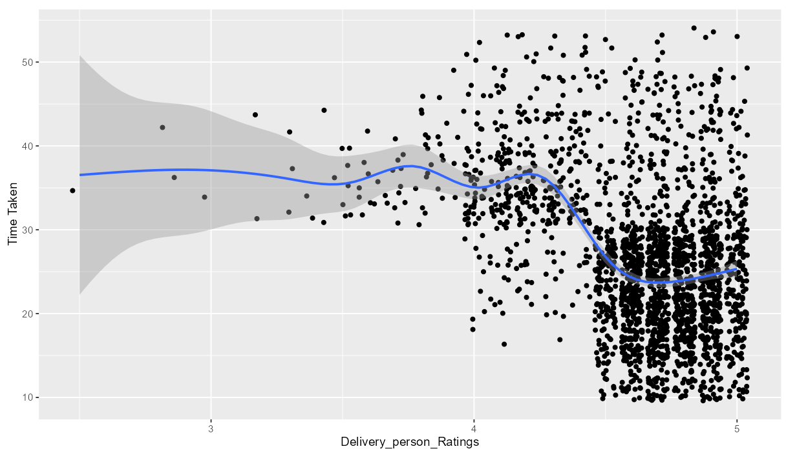
Exploratory Data Analysis
While not largely discriminant, there does seem to be a drop in delivery time as driver ratings increase. (Taken from Shiny App)

Slide 7
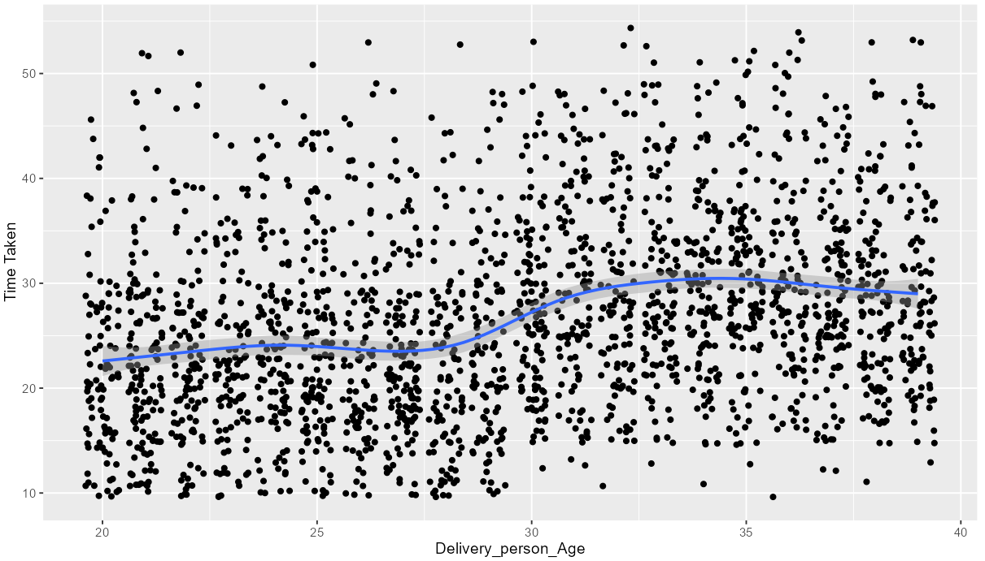
Exploratory Data Analysis
While there is a lot of variation across all ages, there does seem to be an increase in delivery time for drivers who are classified as over the age of 30 compared to the younger drivers. (Taken from Shiny App)

Slide 8
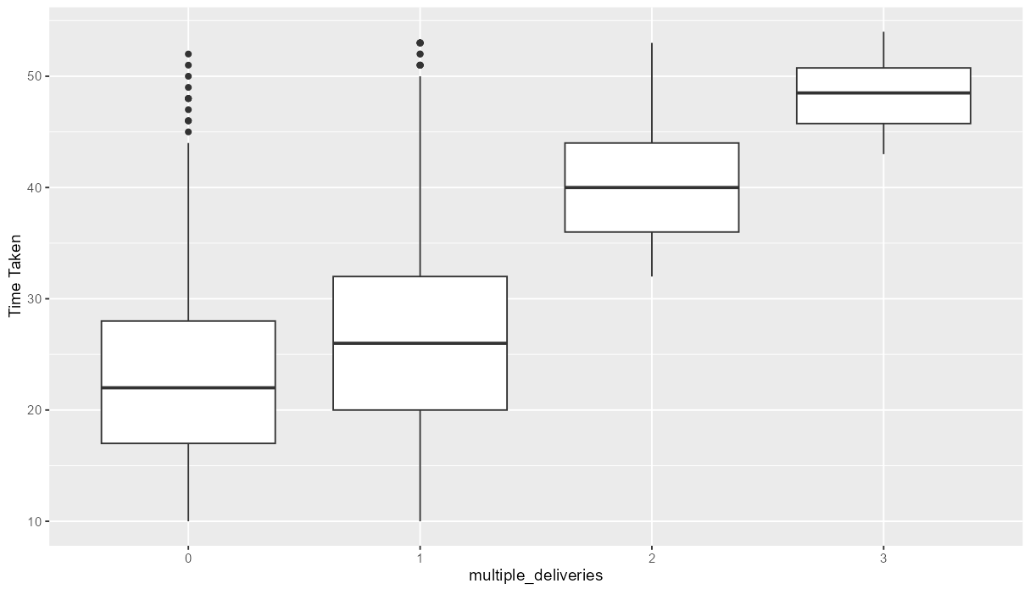
Exploratory Data Analysis
The number of deliveries definitely seems to affect the delivery time. (Taken from Shiny App)

Slide 9
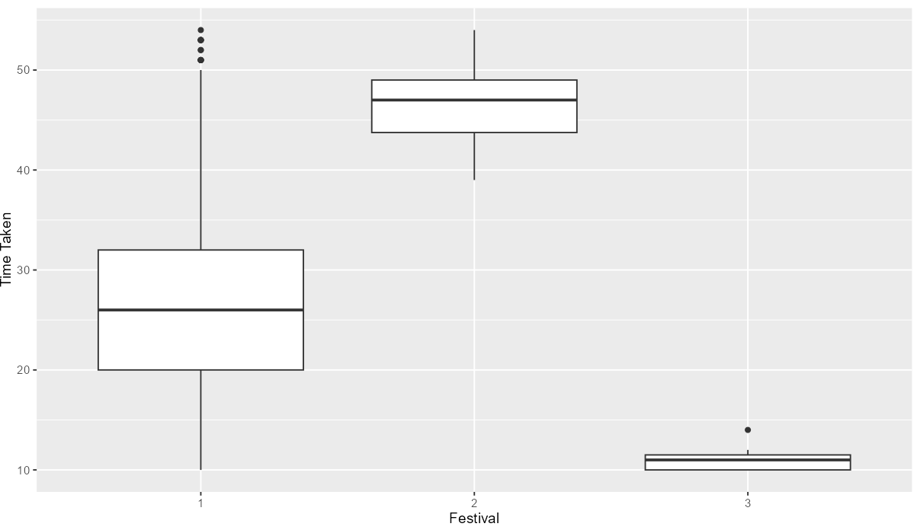
Exploratory Data Analysis
What type of festival or no festival seems to cause one of the most drastic effects on delivery time. (Taken from Shiny App)

Slide 10
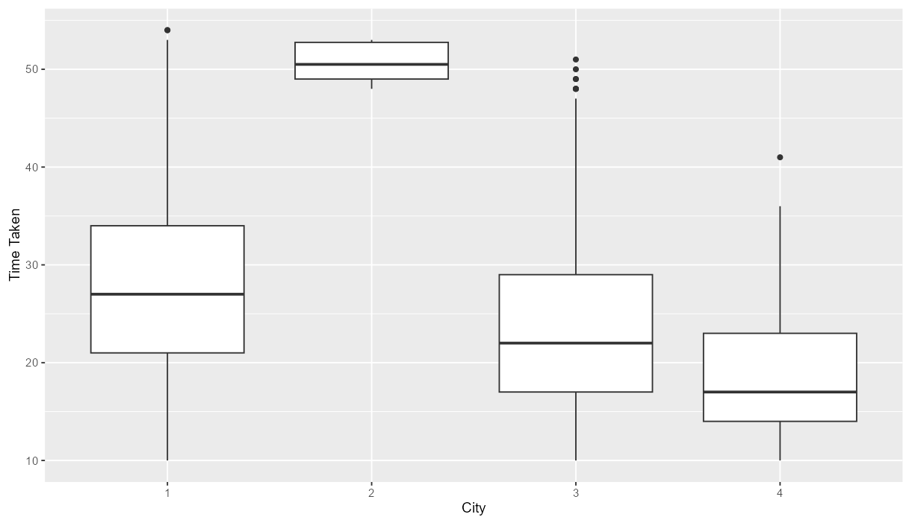
Exploratory Data Analysis
Some of the cities have a similar affect on delivery time but one of them especially adds a lot of time. What improvement can be made in efficiency in City “2”? (Taken from Shiny App)

Slide 11
Conclusion
In examining the rest of the fields, it is clear that these 5 fields presented so far are by far having the most impact on our delivery times.
In order to improve the efficiency of our company we need to look into Ratings, Multiple Deliveries, Festivals, and Cities and see where we can make improvements that would save on resources and save on money.
The only field of the 5 that we can’t look into to improve on is age because it is illegal to discriminate against our employees based on age.

Slide 12
Github
Link to Github:
https://github.com/Wdeni6/Data-Viz-Final.git

