Slide 1
LizzoLytics
An artist event analysis
Group Members:
Stephanie walters Ziyan LU
Jodaisha palmer Nasim azimi

Slide 2
If you are confident in yourself and however you want yourself to be presented, and you're doing well and doing it because you want to do it and not because someone is pressuring you, then more power to you. -Lizzo

Slide 3


know lizzo?
Melissa Viviane Jefferson (born April 27, 1988), known professionally as Lizzo, is an American singer, songwriter, rapper, and actress.
In 2019, she attained mainstream success with the release of her third studio album, cuz I love you which peaked at #4 on the billboard 200. (source: wikipedia)
Notes:
Biography Source: Wikipedia
Biography URL: https://en.wikipedia.org/wiki/Lizzo
Photo Source: TicketMaster API
Photo Source URL: https://s1.ticketm.net/dam/a/87c/bf775ca2-e6cd-463a-9ff6-60459f33d87c_1094781_CUSTOM.jpg

Slide 4
Evaluation structure
Motivation & overview
Questions & Data
Data CleanUp & Exploration
Interest in rising artist data
Why are Lizzo Tickets more expensive in other cities?
Hypothesis: Lizzo tickets are more expensive in zip codes where the mean income is above the nationwide average of $56K.
What kind of data is needed?
3rd Party Event data
Demographic data for our population
What sources where used?
Ticketmaster api
Census.org
Make API calls for upcoming lizzo events in the us through ticketmaster
Identify max ticket price per event and day of the week
Identify MEAN age, population, and per capita income through census.org
Explore demographics vs ticket price correlation
Notes:
Discuss the steps you took to analyze the data and answer each question you asked in your proposal
Present and discuss interesting figures developed during analysis, ideally with the help of Jupyter Notebook

Slide 5
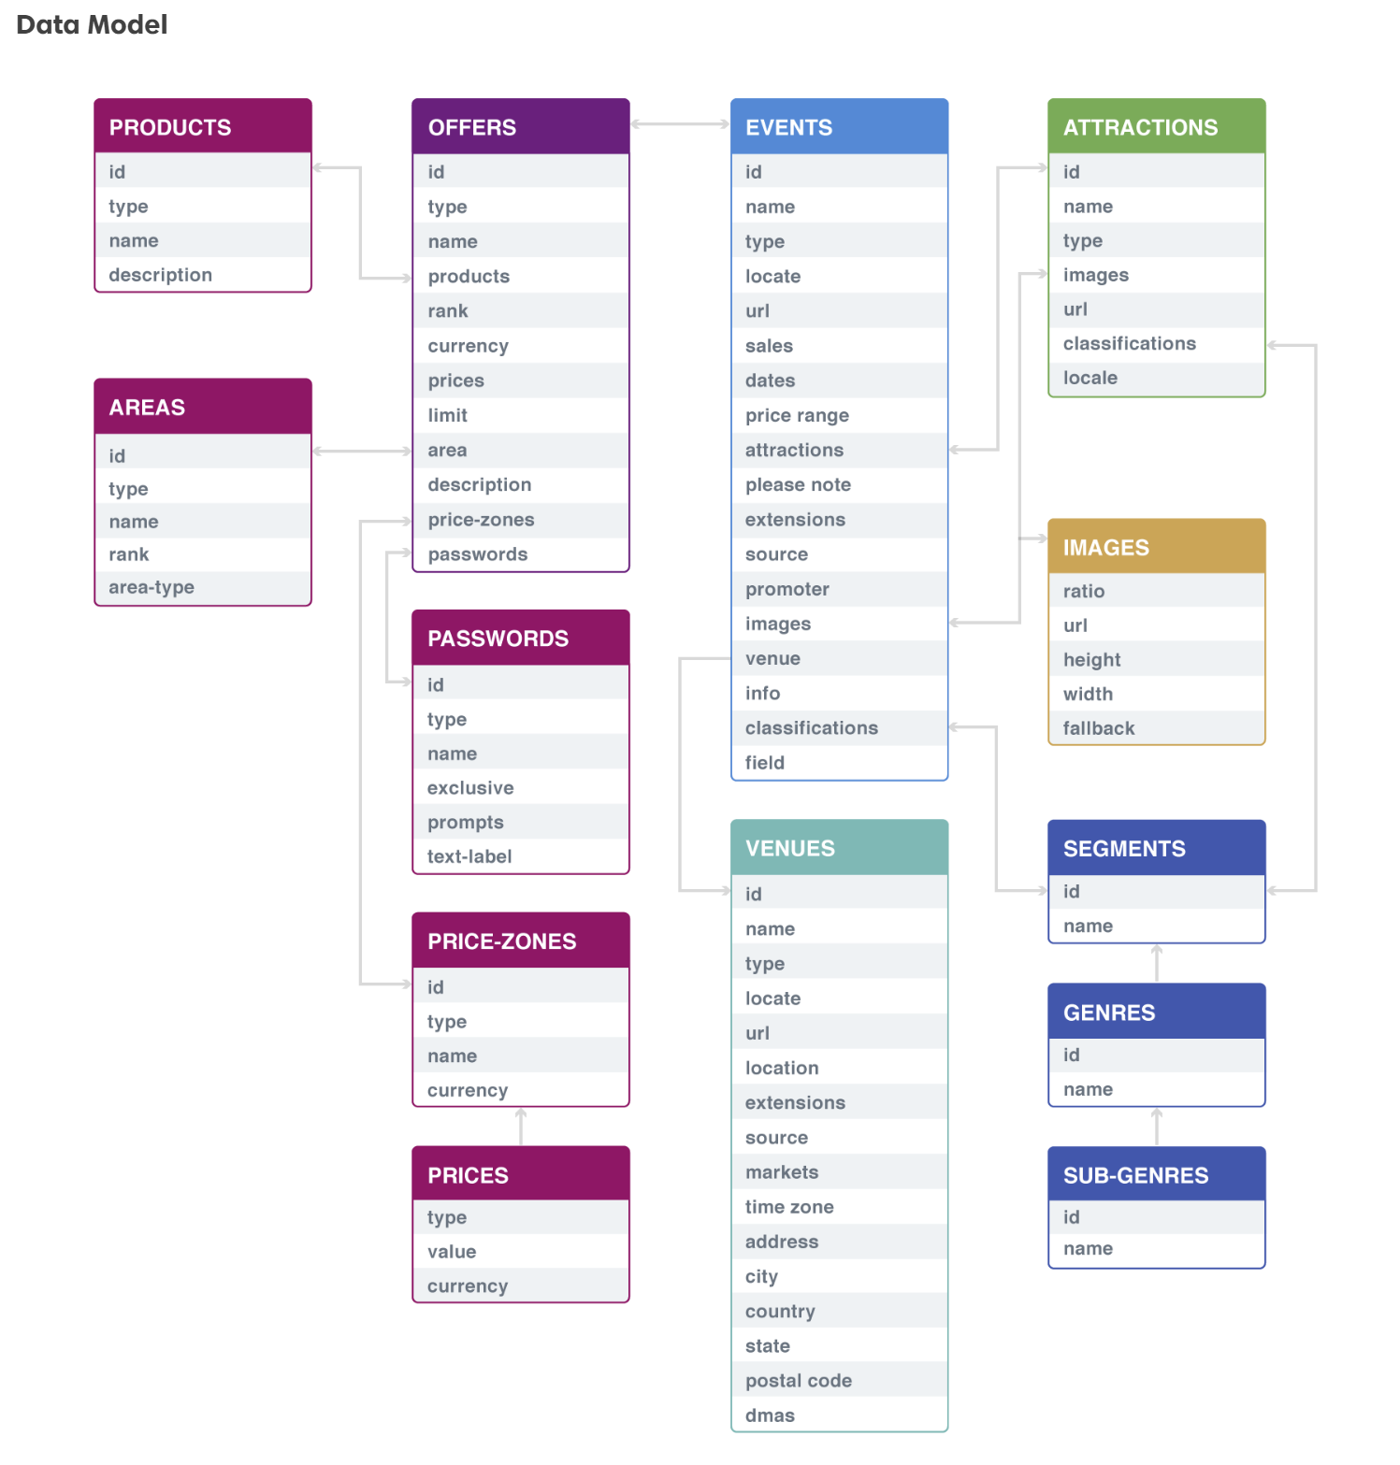
TicketMaster
Notes:
Screen shot taken from: https://developer.ticketmaster.com/products-and-docs/apis/getting-started/

Slide 6
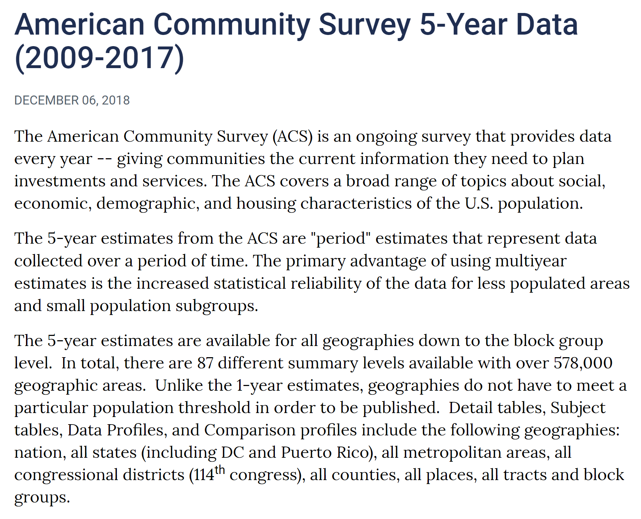
US Census
Notes:
Screen shot taken from: https://www.census.gov/data/developers/data-sets.html

Slide 7
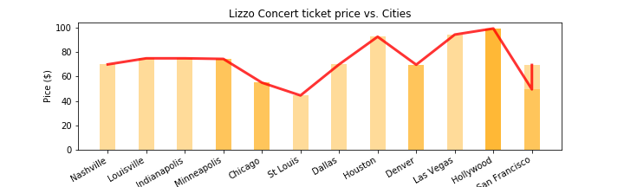
Ticket Price Per City
Notes:
Discuss your findings. Did you find what you expected to find? If not, why not? What inferences or general conclusions can you draw from your analysis?

Slide 8
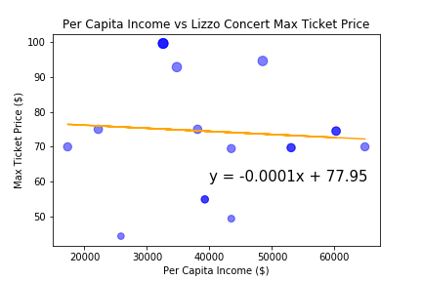
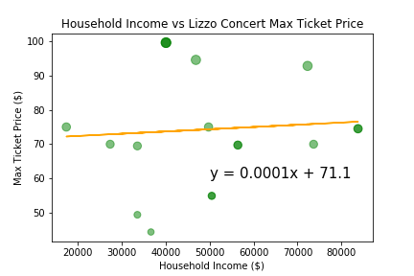
Income and Ticket Price
Notes:
Discuss your findings. Did you find what you expected to find? If not, why not? What inferences or general conclusions can you draw from your analysis?

Slide 9
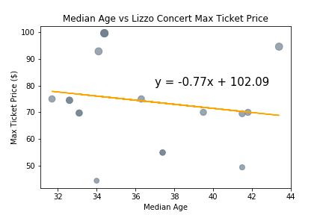
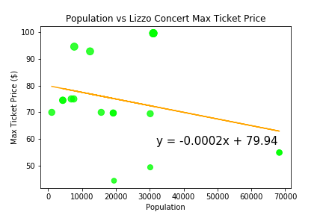
Ticket Price per Age and Population
Notes:
Discuss your findings. Did you find what you expected to find? If not, why not? What inferences or general conclusions can you draw from your analysis?

Slide 10
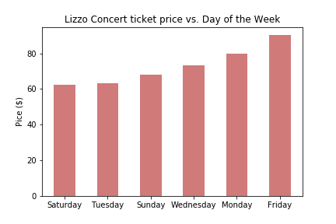
Ticket Price by Day of the Week
Notes:
Discuss your findings. Did you find what you expected to find? If not, why not? What inferences or general conclusions can you draw from your analysis?

Slide 11

Our Hypothesis
Inconclusive
Lizzo tickets are more expensive in zip codes where the mean income is above the nationwide average of $56K.

Slide 12
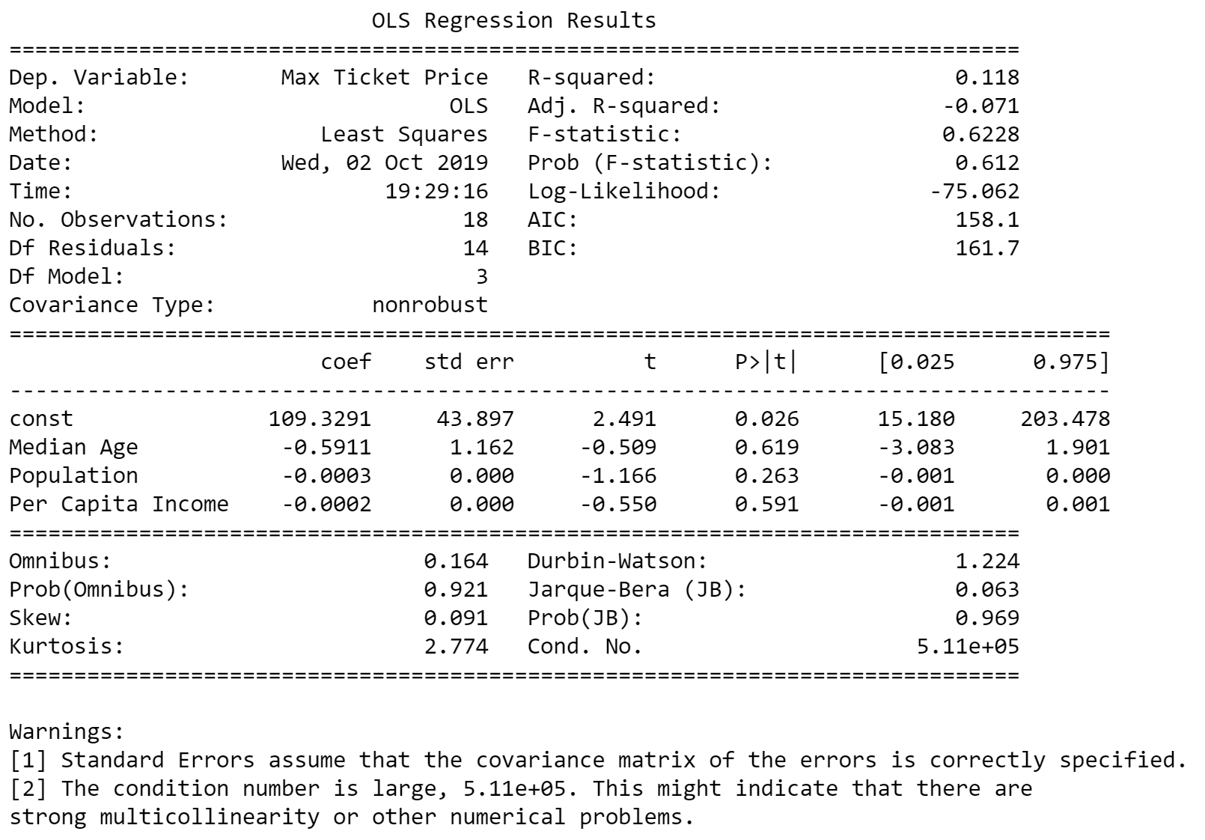

Slide 13
Postmortem
Challenges
Lack of available “Lizzo” Data
No available Historical Lizzo Events Data
Few data points
Incomplete data
Time Constraints
Lack of technical knowledge
What if we had more time?!
Venue Data
Capacity
GA vs. reserved seats
Stubhub API
Compare to a control group
Alternative view visualizations
Javascript?
Notes:
Discuss your findings. Did you find what you expected to find? If not, why not? What inferences or general conclusions can you draw from your analysis?

