Slide 1
THE WEIGHT LOSS & LIFESTYLE ACADEMY · LIVE WORKSHOP
How Women 45+ Are Losing Up To 2 Stone
Without Calorie Counting Or Miserable Diets

Slide 2
Today we will ensure you walk away with everything you need to
lose up to 2 stone over the next 12 weeks.
What you do with this information is your choice
but today we are getting into action!

Slide 3
Access a fun reward for hanging out today, until the end…
Access a whole year of coaching for the price of 12 weeks plus announcing our two winners that get FREE access into brand NEW WLA 12 Week Summer Challenge

Slide 4
Any person that has transformed their weight loss journey,
their health and wellbeing, has taken serious action. Is committed. Overcame struggles, setbacks and difficult days.
Use today as the day that you show up for your future self!

Slide 5
What I Learned (and this is what most people do to lose weight)
Low calorie diets | Weight loss harder, weight gain faster BMR adjusts to low calories Eat “normally” weight increases Weight loss becomes harder next time Metabolism adaptation (takes time to change)
Cut all foods you love | Increase overeating periods Restricting caused me to overeat foods Periods of being “good” Followed by periods of “bad” = weight gain
Low quality food | Increase hunger and cravings Less filling = bigger appetite
Starve yourself | Increase overeating periods Starve all day Binge all evening

Slide 6
Traditional Diets Never Worked For Me
They cut out all the foods I loved
I couldn’t be social
I couldn’t eat with people
I couldn’t actually be consistent with it, start and stop
With what I learned at university I could start to understand nutrition and how the body functioned
Started to lose weight
Fuel for fat loss

Slide 7
After my own weight loss journey, I have worked with over 50,000 clients, 1-2-1 clients, small groups, big groups, you name it.
Based on that experience, knowledge I have acquired over the years
and overcoming my own struggles…
here's what actually gets women 45+ the BEST results.

Slide 8

The Simple Fat Loss Formula
Helping Women 45+ Lose Weight

Slide 9
I did a 4 year degree at university, I did a one year internship at The Institute For Public Health and the Environment in The Netherlands. Rather than staying in the corporate world, I I decided I wanted to start helping clients achieve what I have been able to do but without doing unrealistic diets that don’t work anyway!

Slide 10
But I needed a way to explain to my clients what I had learned myself, how could I teach my clients about the nutrition that got me to my goal, so they can reach their goals?
Enter The WLA Nutrition Formula

Slide 11
What Is The WLA Nutrition Formula
At university I learned how to create meal guides using recommended portion sizes
Most people are eating too much food (obvious) and their portions are a problem
Portion food properly
Balance meals effectively (don’t have a sandwich for lunch and pasta for dinner, balance your carbs)
Ensure each meal has a protein element
Bulk up meals with high fibre foods
Aim for 80% consistency across the week, allow a weekly indulgence for consistency

Slide 12
The WLA Nutrition Formula
Monday | Tuesday | Wednesday | Thursday | Friday | Saturday | Sunday
LC or HC | LC or HC | LC or HC | LC or HC | LC or HC | LC or HC | LC or HC
Low Carb | Low Carb | Low Carb | Low Carb | Low Carb | Low Carb | Low Carb
High Carb | High Carb | High Carb | High Carb | High Carb | High Carb | High Carb
** LC or HC - Breakfast - Smoothie or Porridge
** Low Carb/High Protein - Omelette / Pasta
** Medium / Medium Carb

Slide 13
Overall Nutrition + Weekend Solution
Mon | Tues | Wed | Thurs | Fri | Sat | Sun
Porridge Yoghurt Cereal Smoothie | Porridge Yoghurt Cereal Smoothie | Porridge Yoghurt Cereal Smoothie | Porridge Yoghurt Cereal Smoothie | Porridge Yoghurt Cereal Smoothie | Smoothie | Smoothie
Salad + Protein Omelette Wraps Bento Box LOW CARB | Salad + Protein Omelette Wraps Bento Box LOW CARB | Salad + Protein Omelette Wraps Bento Box LOW CARB | Salad + Protein Omelette Wraps Bento Box LOW CARB | Salad + Protein Omelette Wraps Bento Box LOW CARB | Sausages, Eggs, Avo, Mushrooms LOW CARB | Sausages, Eggs, Avo, Mushrooms LOW CARB
Chicken Curry + Rice HIGH CARB | Chicken Curry + Naan HIGH CARB | Pesto Pasta HIGH CARB | Freezer Dinner HIGH CARB | Wrap Pizza HIGH CARB | Take Away INDULGENCE | Sunday Roast HIGH CARB

Slide 14
Same Formula + Busy Week Solution
Mon | Tues | Wed | Thurs | Fri | Sat | Sun
Cereal | Cereal | Cereal | Cereal | Cereal | Smoothie | Smoothie
Shop bought salad Shop bought soup LOW CARB | Shop bought salad Shop bought soup LOW CARB | Shop bought salad Shop bought soup LOW CARB | Shop bought salad Shop bought soup LOW CARB | Shop bought salad Shop bought soup LOW CARB | Sausages, Eggs, Avo, Mushrooms LOW CARB | Sausages, Eggs, Avo, Mushrooms LOW CARB
Pesto Pasta HIGH CARB | Pesto Pasta HIGH CARB | Freezer HIGH CARB | Freezer Dinner HIGH CARB | Chicken Goujons Wrap HIGH CARB | Take Away INDULGENCE | Sunday Roast HIGH CARB

Slide 15
Busy Day Nutrition Solution
Does your nutrition have freezer foods options for days that are so busy? If not, you need that. You won’t cook fresh everyday
Do you know what pre-made foods that can be grabbed from the supermarket, requiring no cooking but still will support fat loss?
Grab and go foods, do you know which items can be picked up in the shop?
* You must have solutions for when you can’t cook or maybe you don’t want to cook as much, you need to be able to make nutrition decisions that will still support your goals. Life is busy, you need an easy solution.

Slide 16
Weekend Nutrition Solution
Do you try to limit social events while trying to lose weight? If so this is why you can stick with your diet
Do you know how to balance your meals at the weekend for fat loss?
The weekend needs a strategy, if you “do well” between Monday and Friday lunch time but then go off track because you don’t know how to manage the weekend, you won’t get to your goal before summer
The weekend is a large part of the week
You need a strategy that allows you to live your life and get results at the same time

Slide 17
Why The Formula is a Game Changer!
Freedom over foods
No foods are excluded
Eat out and socialise but still get results
Eat same foods as family
Fuels for fat loss
Works for maintenance
Works on holiday
Portion control
Balance of meals
No calorie counting
Biggest problems I see - (over-consuming carbs / low quality foods that increase appetite)
The formula addresses these problems head on!

Slide 18
Here’s What Will Support 2 Stone Loss in 12 Weeks
Glass of water upon waking
3 meals per day (using The WLA Formula)
Healthy snacking in between based on hunger
Balance between meals (carb balancing)
Protein included in each meal
High fibre meals
Approx 8 glasses of water per day
1 milky coffee per day (in fat loss phase)
Alcohol consideration, indulgences, steps, evening snacking
These are the my 12 week summer challenge foundations - AIM IS SIMPLICITY

Slide 19
The Key To Best Results
Nutrition strategy that works anywhere. At home, on the road, busy days, no time to cook. You need a strategy that’s easy to be consistent. Guess what? Most diets feel impossible to stick with long term, that’s why you give up.

Slide 20
The dieting industry tells us that we can all follow the same nutrition strategy but a 45 year old women with 3 kids needs a different strategy to a woman that’s retired. And someone that doesn't like cooking, needs a different strategy to someone that enjoys cooking.
You need a formula you can personalise. Only then can you be consistent!

Slide 21

Still Using The Formula Today For Maintenance,
Used Before Pregnancy And After

Slide 22
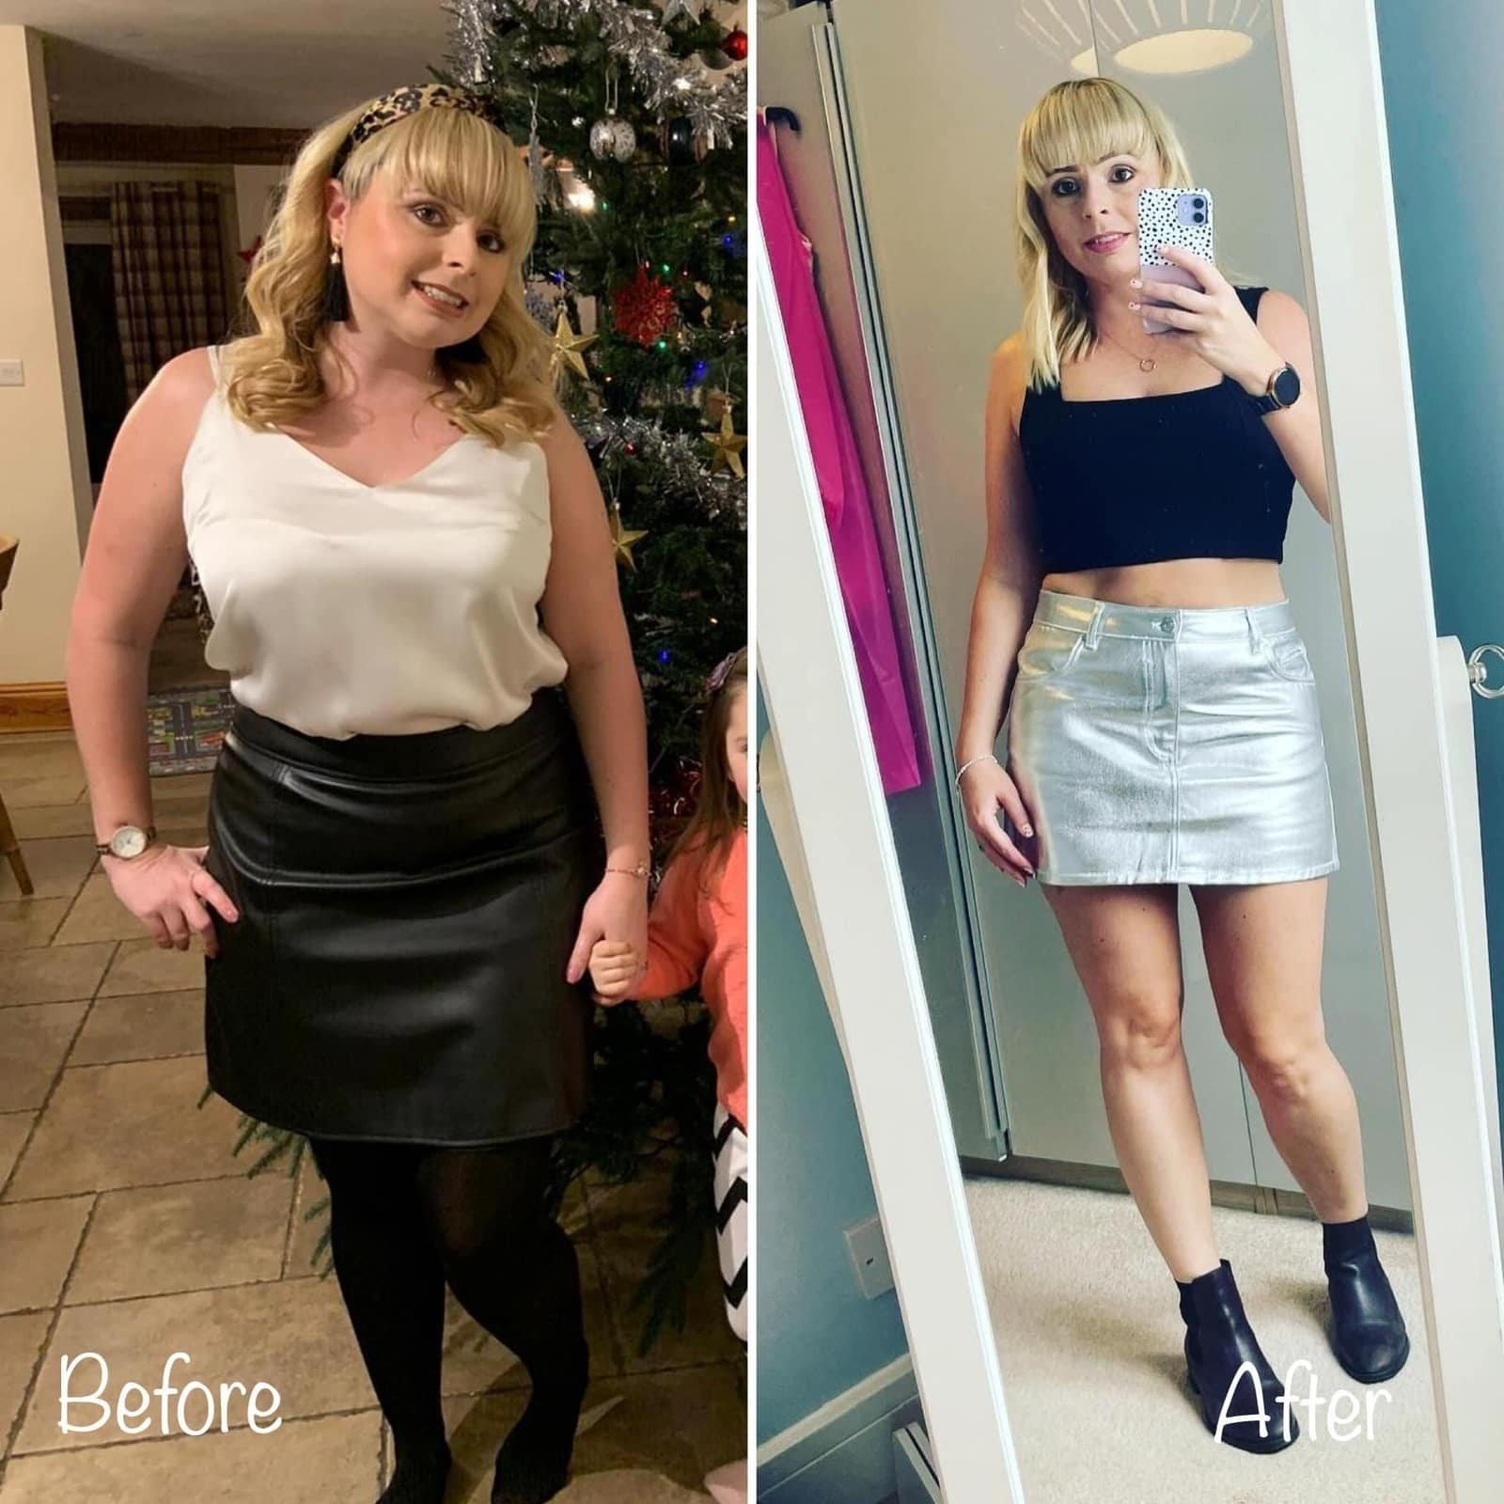

And My WLA Clients Are Using The Formula, Getting Incredible Results

Slide 23
The Power Of A Clear Roadmap
& Monthly Focus

Slide 24
The women who get the BEST results usually don’t just “try to eat healthy”.
They have:
✔ A clear goal
✔ A clear timeline
✔ A clear focus
✔ A plan they can actually follow
Because without that…
You lose direction.

Slide 25
You don’t know what you’re aiming for.
You try to change everything at once.
You lose focus when life gets busy.
You stop tracking progress.
And eventually… you give up.

Slide 26
But when you have:
✔ A start date ✔ An end goal ✔ Monthly focus points ✔ Action steps to work on
Everything changes.

Slide 27
Because instead of relying on motivation…
You have structure.
Instead of feeling overwhelmed trying to “be perfect”…
You focus on improving ONE thing at a time.

Slide 28
Most women have a weight loss WISH. Very few have a weight loss PLAN. There’s a big difference between:
“I want to lose weight this summer…”
vs
“I’m going to lose 2 stone over the next 12 weeks and this month I’m focusing on consistency, reducing snacking and increasing my steps.”
One is a vague hope. The other creates direction, focus and action.

Slide 29
Accountability & Support
That Keeps You Consistent

Slide 30
After working with clients for over 11 years I realised that MOST struggle with consistency, they give up shortly after starting! They fall off the wagon. They are not self accountable. This is a recurring pattern! People need help with cementing new habits and routines.

Slide 31
People underestimate the power of coaching and accountability. This is what really keeps people focused, motivated and consistent. This is because people can let themselves off the hook, give up quickly and give into negative mindsets.

Slide 32
Do You Do This?
Start your weight loss journey but then stop within days or maybe sometimes weeks?
Give up too quickly?
Can’t get yourself to take action consistently?
Lose and gain the same weight over and over?
Have all the cookbooks in the world but are not at your goal?
If this is you…. you have an action, accountability, application and implementation problem and this is why high accountability would make you take action!!

Slide 33
Accountability Is The Secret To Great Results
Consistent Support: Regular check-ins keep individuals motivated and on track. When setbacks occur, we can navigate challenges and prevents a spiral back into old habits.
Accountability Increases Commitment: Knowing that someone else is monitoring progress motivates individuals to stay committed to their goals. This accountability reduces the likelihood of quitting when motivation wanes or when temptations arise.
Encourages Action: Accountability creates a sense of responsibility to take consistent action, turning intentions into concrete results. This constant action over time leads to sustainable weight loss rather than temporary success.

Slide 34
How do you be consistent?
Well if you can’t be consistent yourself, get accountability and support so you stay consistent!

Slide 35
If an athlete performs better with a coach and accountability in a skill that they are already a professional in, imagine what the right accountability could do for you with something you struggle with?

Slide 36
Lapse (I feel guilty)
Relapse (fall off the wagon)
Collapse (gain all weight back)
(This is why coaching is fundamental)

Slide 37
Want to lose up to 2 stone over the summer? The Simple Fat Loss Formula Helping Women 45+ Lose Weight
The Power Of A Clear Roadmap & Monthly Focus
Accountability & Support That Keeps You Consistent

Slide 38
In reality you have 3 options moving forward

Slide 39
Option # 1 Continue on after the reset on your own
But will you stay consistent?

Slide 40
Option # 2 Do an expensive detox
Lose weight and gain it back once you start eating normally again

Slide 41
Option # 3 Invest and join our brand new WLA summer challenge.
Get every single tool needed to lose up to 2 stone in 12 weeks

Slide 42
Today I want to invite to our brand new
The WLA 12 Week Summer Challenge
(The WLA's new game-changing 12-week weight loss program)
Kick off Monday 8th June
Lose up to 2 stone this summer
Feel confident in your clothes again
Take back control around food without miserable diets

Slide 43
BIGGEST BONUS OF THE YEAR
Join our brand new WLA 12 Week Summer Challenge
+ get a whole year of coaching INCLUDED for FREE

Slide 44
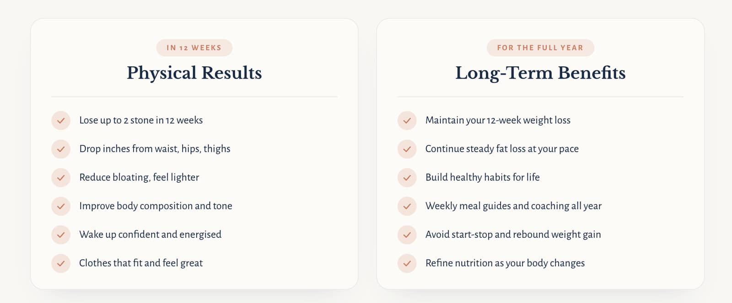

Slide 45
The WLA Summer Challenge
To help you lose up to 2 stone
Step 1
The WLA Nutrition Formula
Flexible approach to nutrition with everyday foods. No foods excluded. We balance for results and enjoyment. Feel lighter within days, lose weight consistently, increase energy and say goodbye to fad diets.
Step 2
12 Week Weight Loss Roadmap + Monthly Focus
Have a clear start date, a goal to work towards and a roadmap that keeps you focused instead of constantly “starting again”. Track your monthly progress and stay accountable to your goals.
Step 3
Expert Coaching & High Accountability
High-level coaching and accountability so you keep showing up, even on the harder days. Expert coaching to help you stay consistent, make better decisions and achieve better results.

Slide 46
What's Included
✦ The 12 Week WLA Summer Challenge
✦ Monthly Accountability + Results Tracker
✦ Weekly LIVE Zoom Coaching Sessions With Anna
✦ New recipes added every week
✦ New fat loss meal guide dropped every Friday
✦ Daily Coaching & Accountability Support
✦ Female-Only Coaching Community
✦ Access To ALL WLA Challenges + Resets For 12 Months
✦ The WLA Nutrition Formula Masterclass
✦ Access To The WLA Recipe Collection with 500+ recipes
✦ WLA Movement Classes With Linda
✦ WLA Nutrition & Lifestyle Guides
✦ Access To The Brand New Tools (including new app once released)

Slide 47
SPECIAL ONE-OFF BONUS
Join the 12 Week Summer Challenge
+ get the whole year of coaching for FREE
✦ 52 Weekly Fat Loss Meal Guides
✦ 200+ Fresh Weekly Recipes
✦ 12 Monthly Sprint Challenges
✦ 52 Weekly LIVE Coaching Zooms with Anna
✦ 365 Days of Daily Coaching & Support

Slide 48
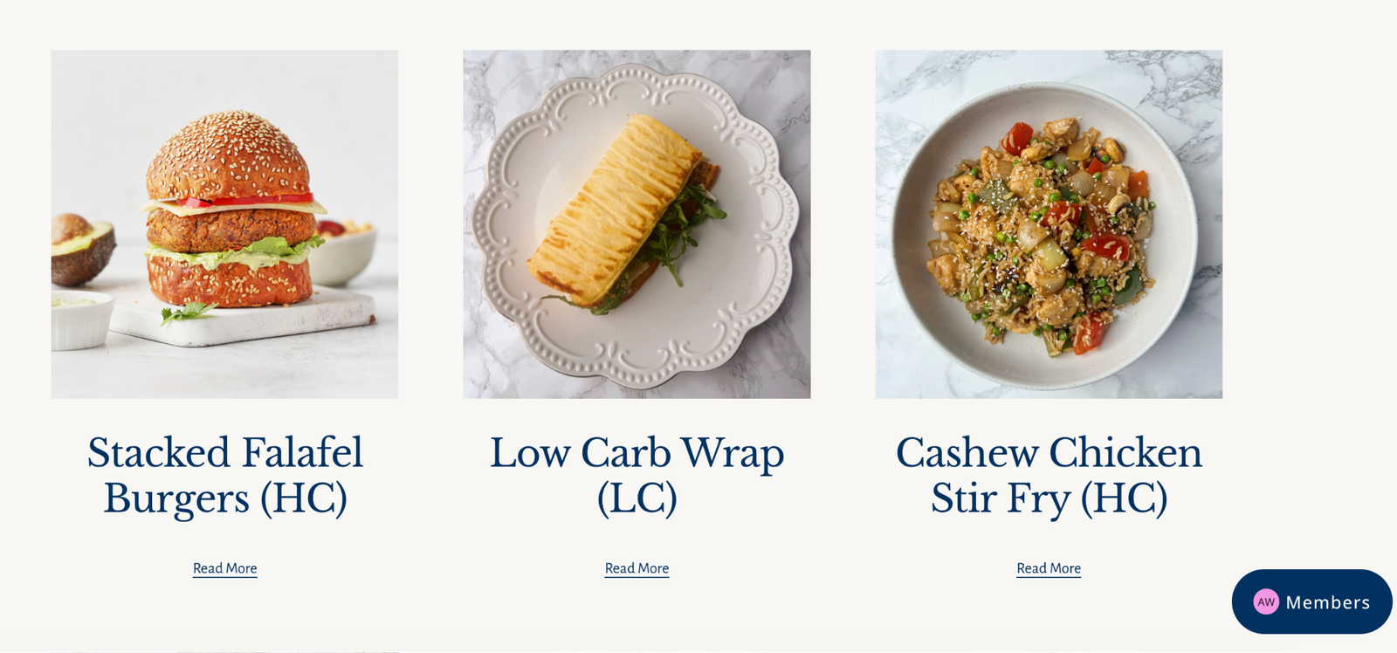
Get Access To Our Members Area

Slide 49
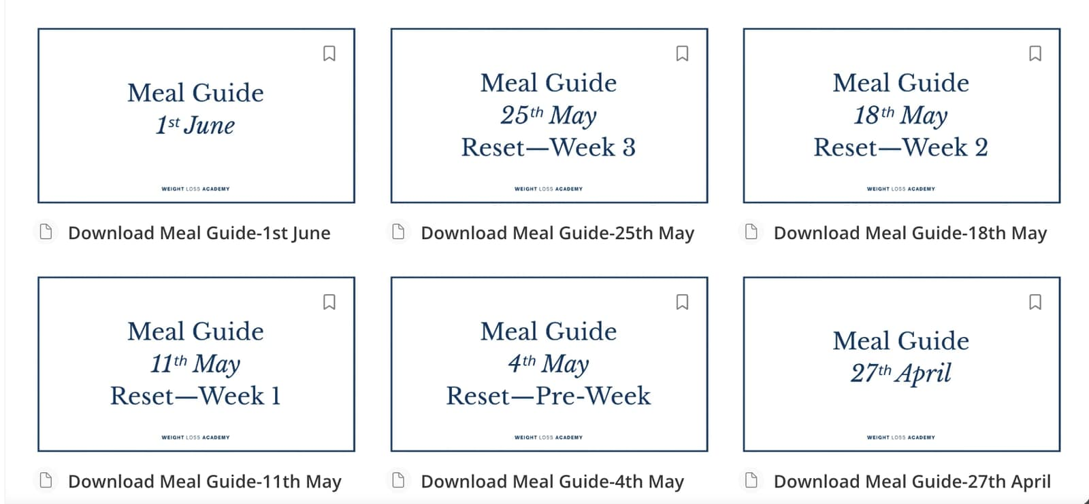
Brand New Fat Loss Meal Guide Every Week

Slide 50
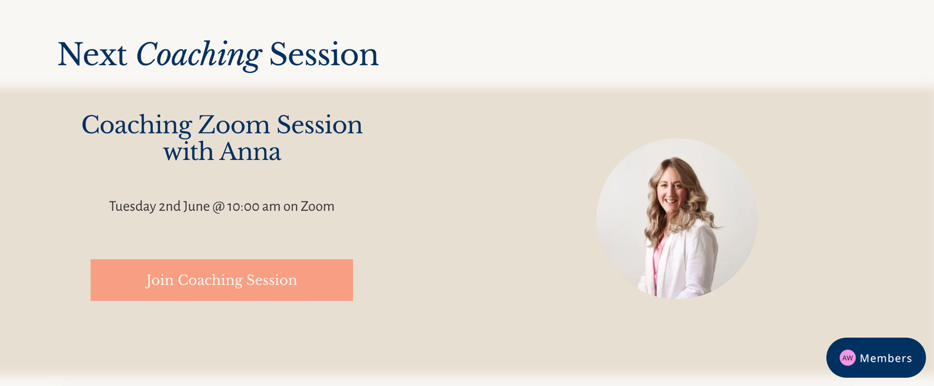
Get Hands on Personalised Advice

Slide 51
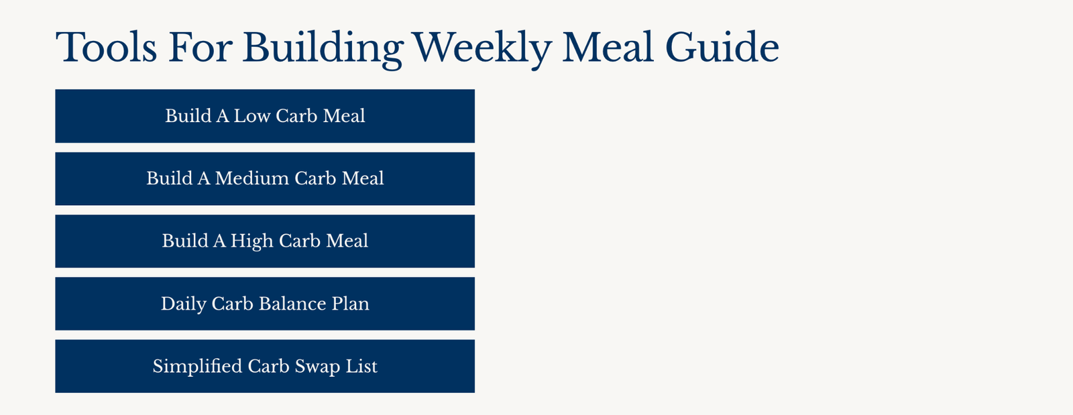
The WLA Nutrition Formula Tools

Slide 52
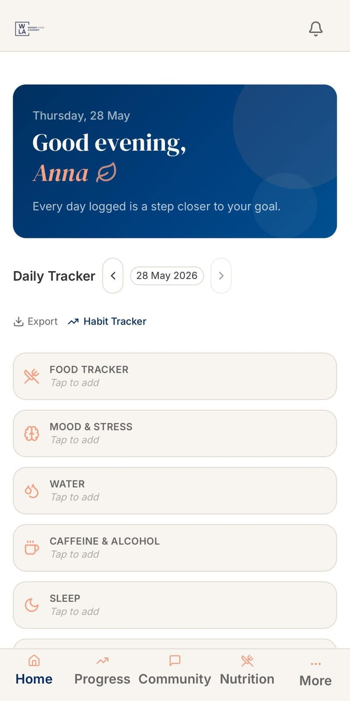
EXTRA FREE BONUS
Access To The New WLA App (once it launches)
Advanced daily tracking
Lifestyle tracking
Progress dashboards
Habit tracking
Meal planning
Shopping lists
Future feature updates

Slide 53
500 places available
100 already gone
(as 100 of my existing clients signed up)
400 places left, 7500 women in this group
On Sunday, I open to my whole community
Grab a place while you can

Slide 54
Join for only £97 (normally £397)
Get 12 Week Summer Challenge
Plus FULL year of coaching, members area
+ accountability for FREE
26p per day! Pay £97 in full or get started for as little less than £25 with payment plans with paypal, Klarna and Clearpay at checkout

Slide 55
This is a one off opportunity
We're upgrading the entire WLA experience (a slight name change from The Weight Loss Academy - The Weight Loss & Lifestyle Academy) with improved coaching, accountability, tracking and support tools designed to help women achieve even better long-term results.
To celebrate this evolution, this is your one-off opportunity to get early access to everything we're building, before prices increase later this year.

Slide 56
Reserve your space now!
Link in comments!
Limited places!
One time offer and discount!
Pop LINK into comments if you need the link to join

Slide 57
This Is For You If…
Time
You want a simple, easy nutrition solution that gives you results without taking over your life.
Want Results
You are tired of not seeing results and you want real support to finally make it happen.
Consistency
You need high accountability so you stay consistent and stop quitting every few weeks.
Energy
You want a nutrition setup that gives you real energy without depending on sugar and caffeine.
Snacking
You want the support and accountability to break the evening snacking that has just become habit.
Weekends
You want a rock-solid weekend strategy so you don't undo all your weekly hard work.
Ready
You are ready to take action and show up for your goals.

Slide 58
This Is NOT For You If…
Quick Fixes
You are looking for a magic pill or detox tea solution.
No Commitment
You are not ready to take action, stay consistent or show up for yourself.
Perfection
You think you need to be "perfect" to get results instead of being consistent.
Excuses
You are not willing to make changes or take responsibility for your progress.
All Or Nothing
You quit the moment life gets busy instead of learning how to adapt and keep going.
No Support
You prefer doing everything alone rather than being coached, supported and held accountable.

Slide 59
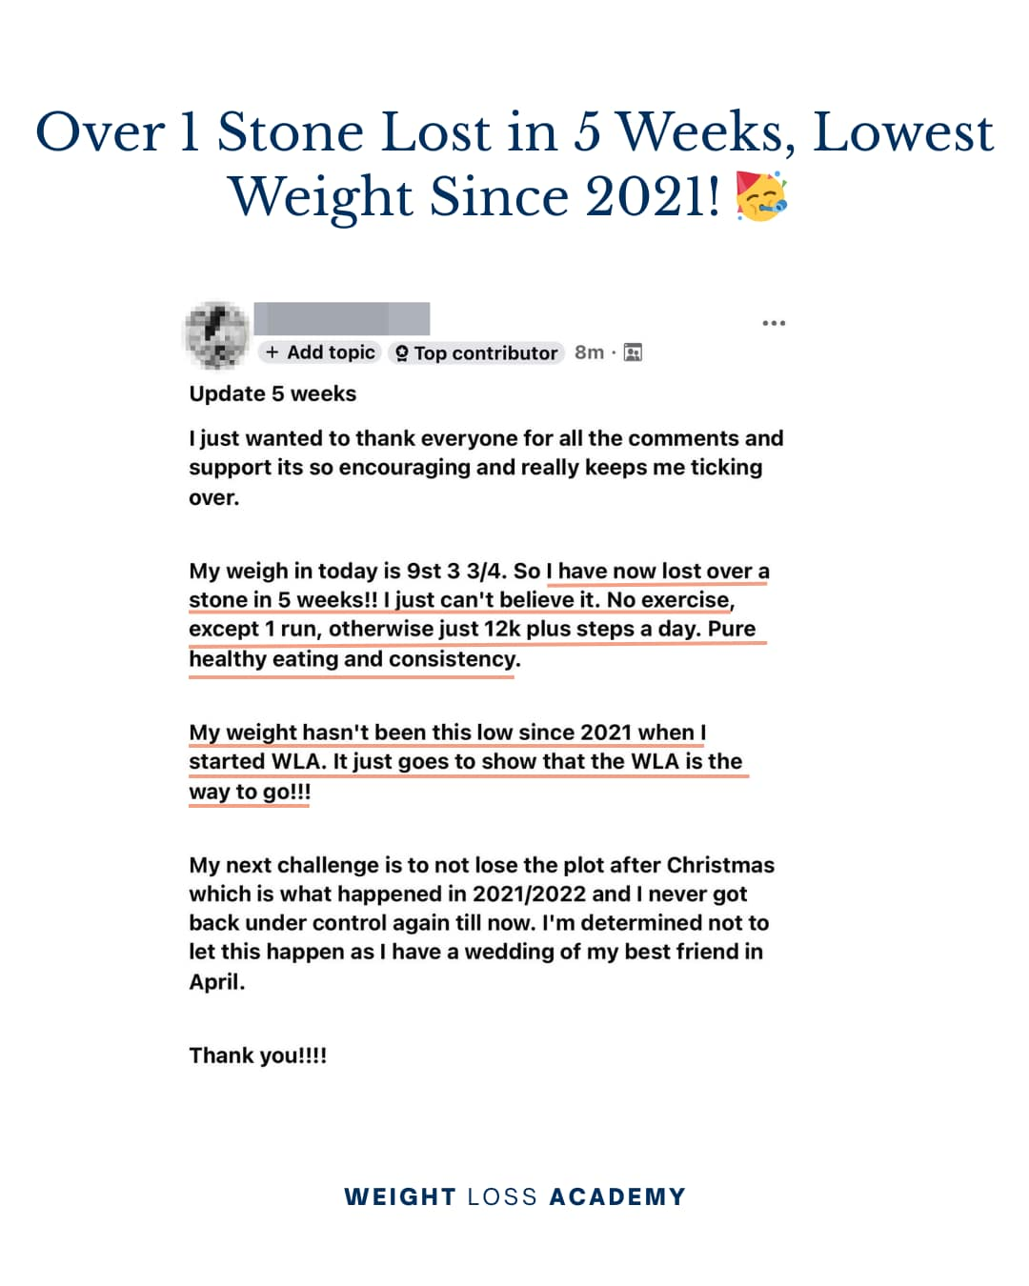
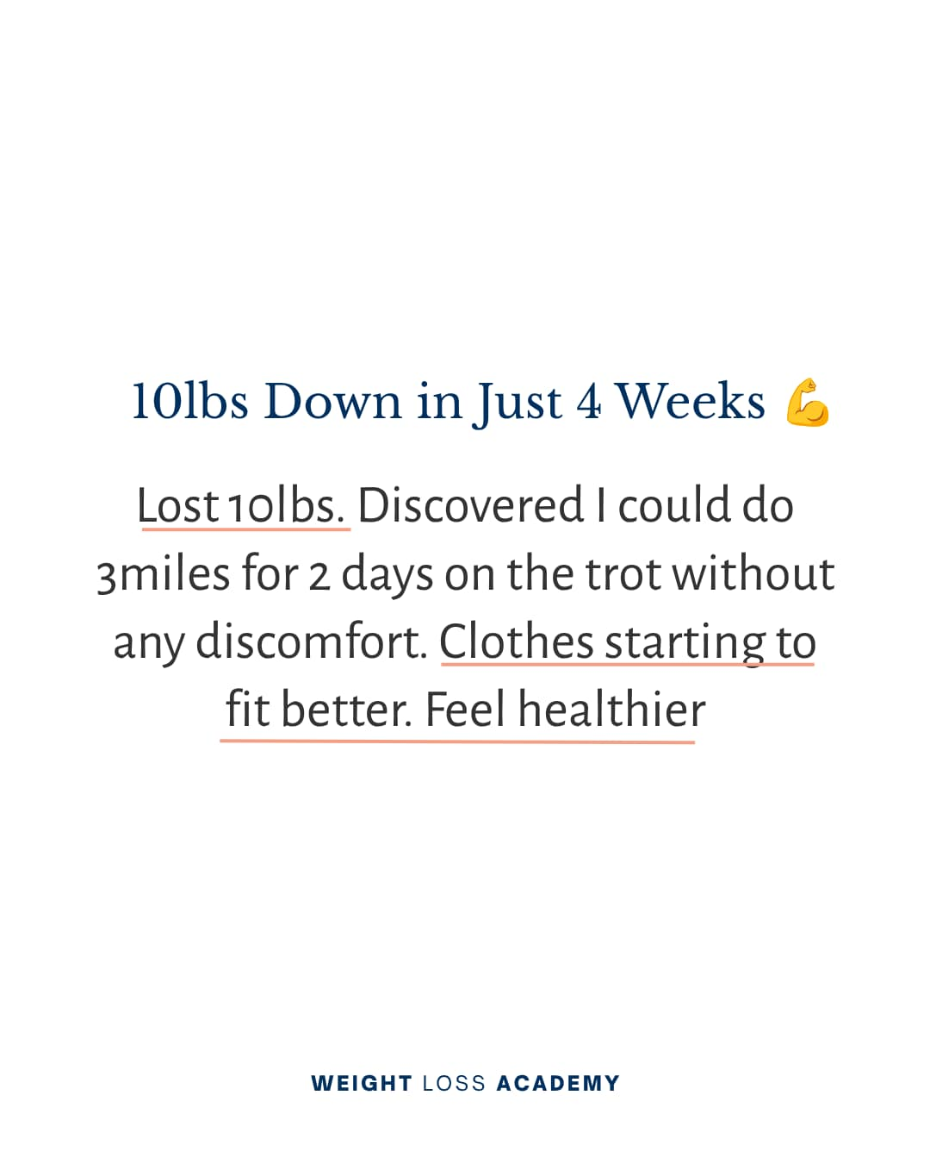
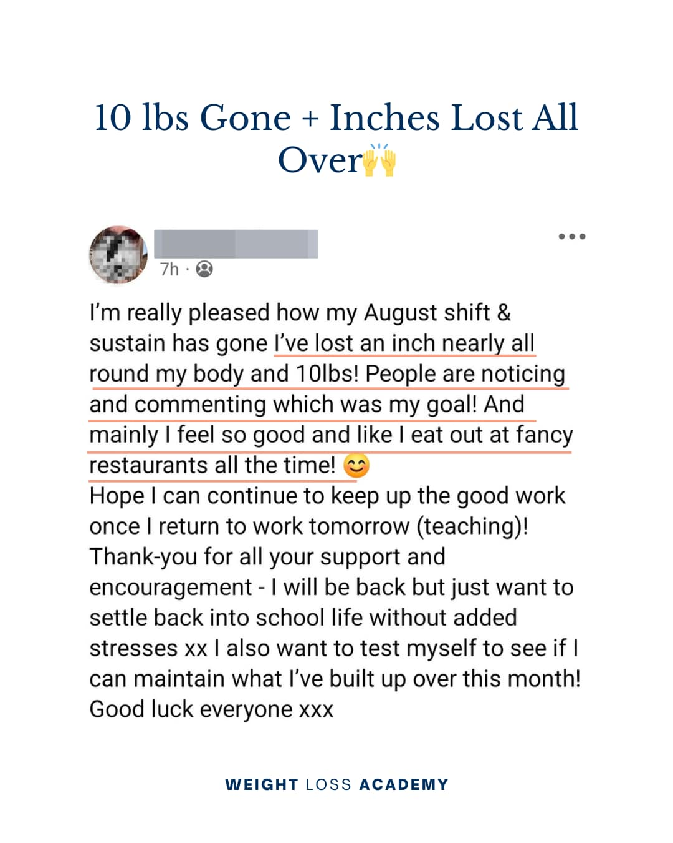
What Our Clients Say

Slide 60
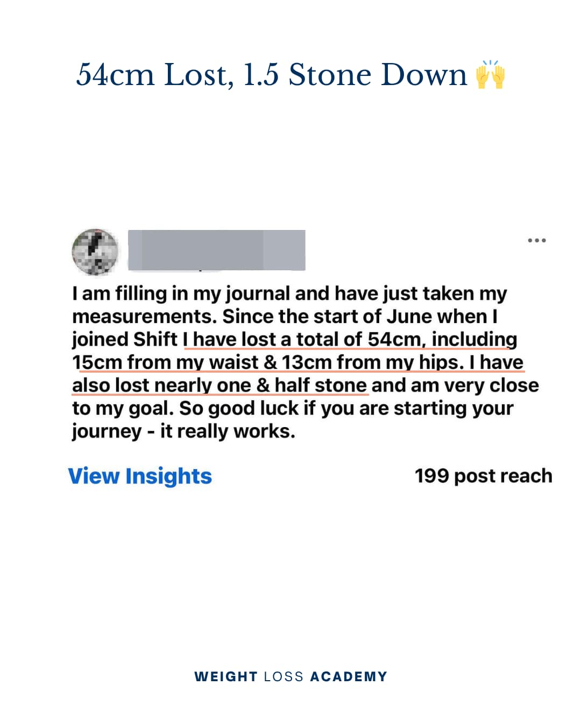
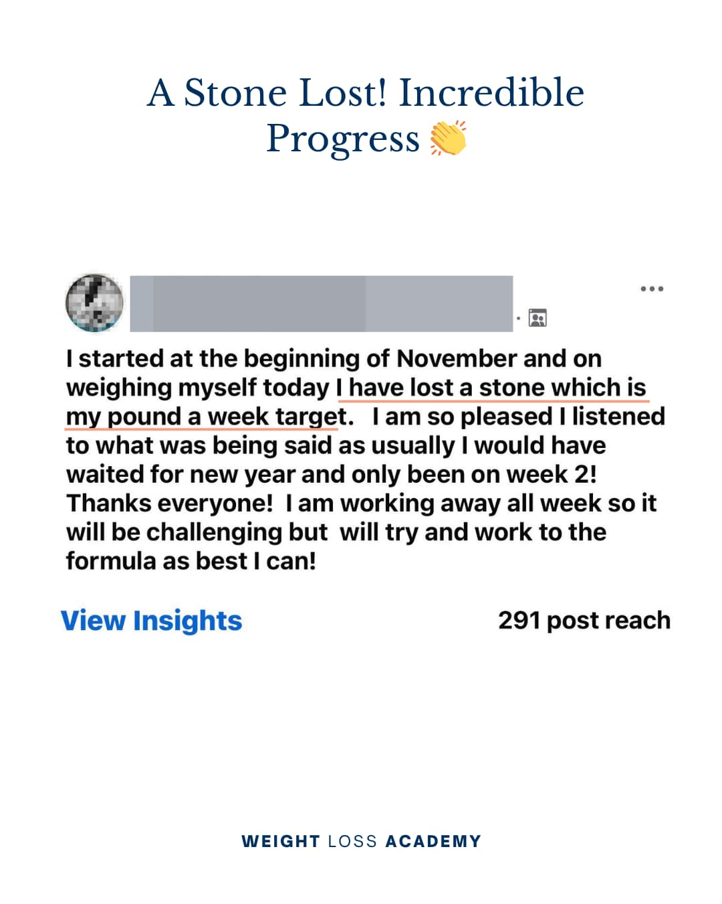
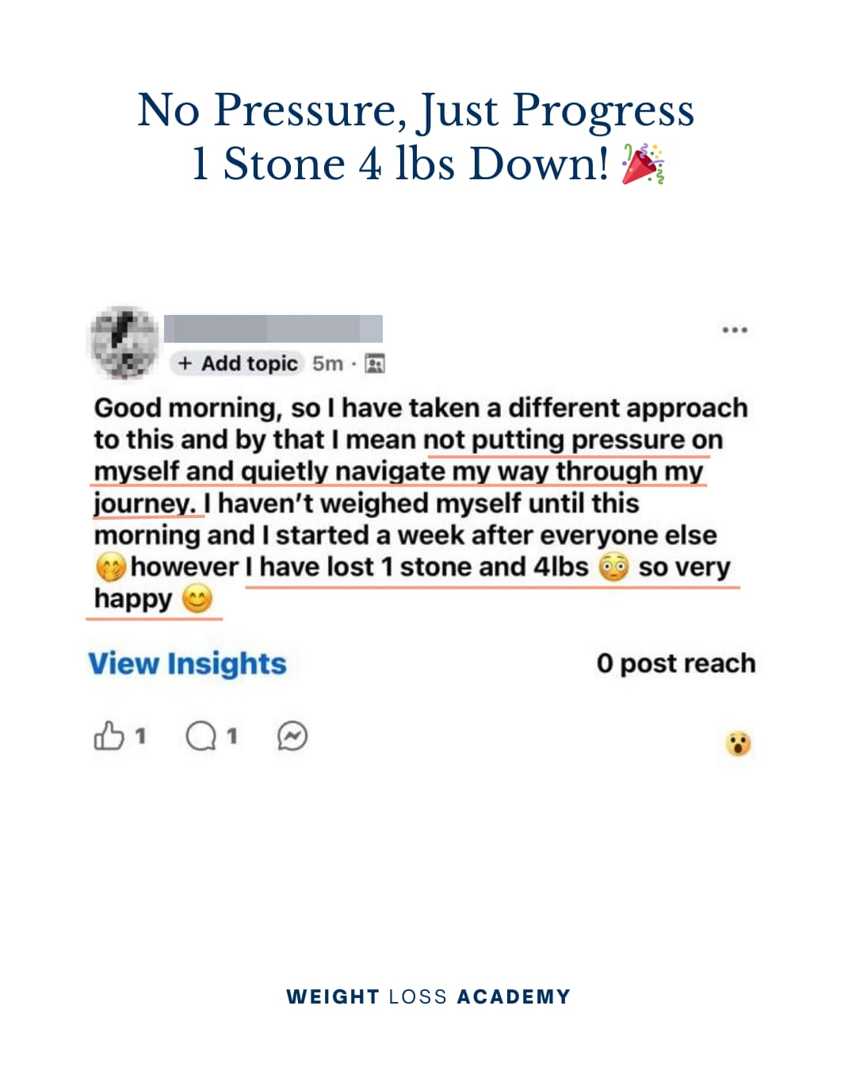
What Our Clients Say

Slide 61
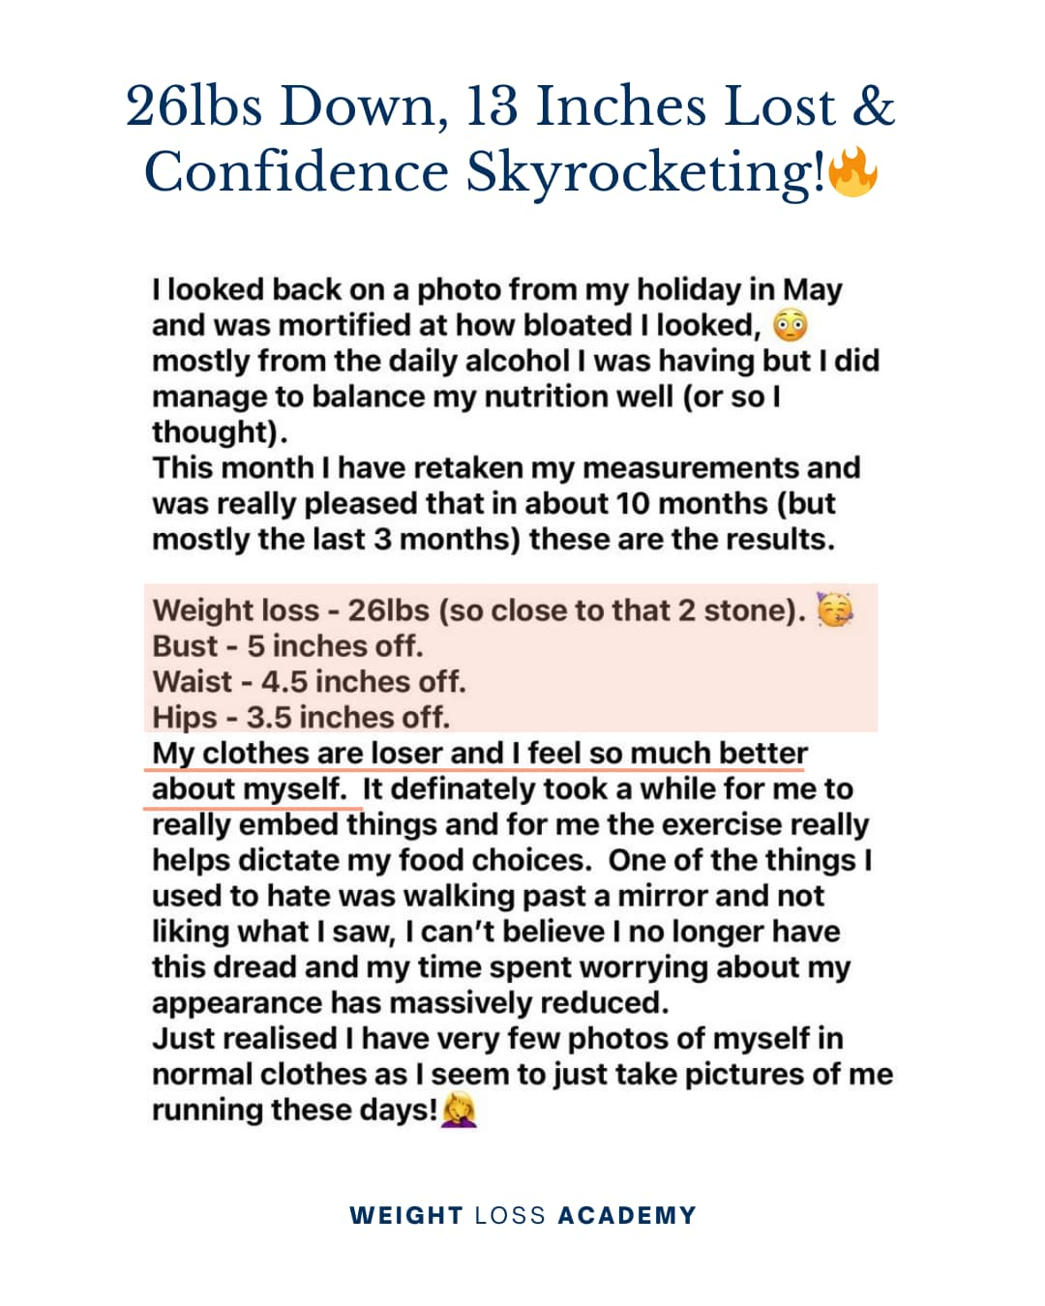
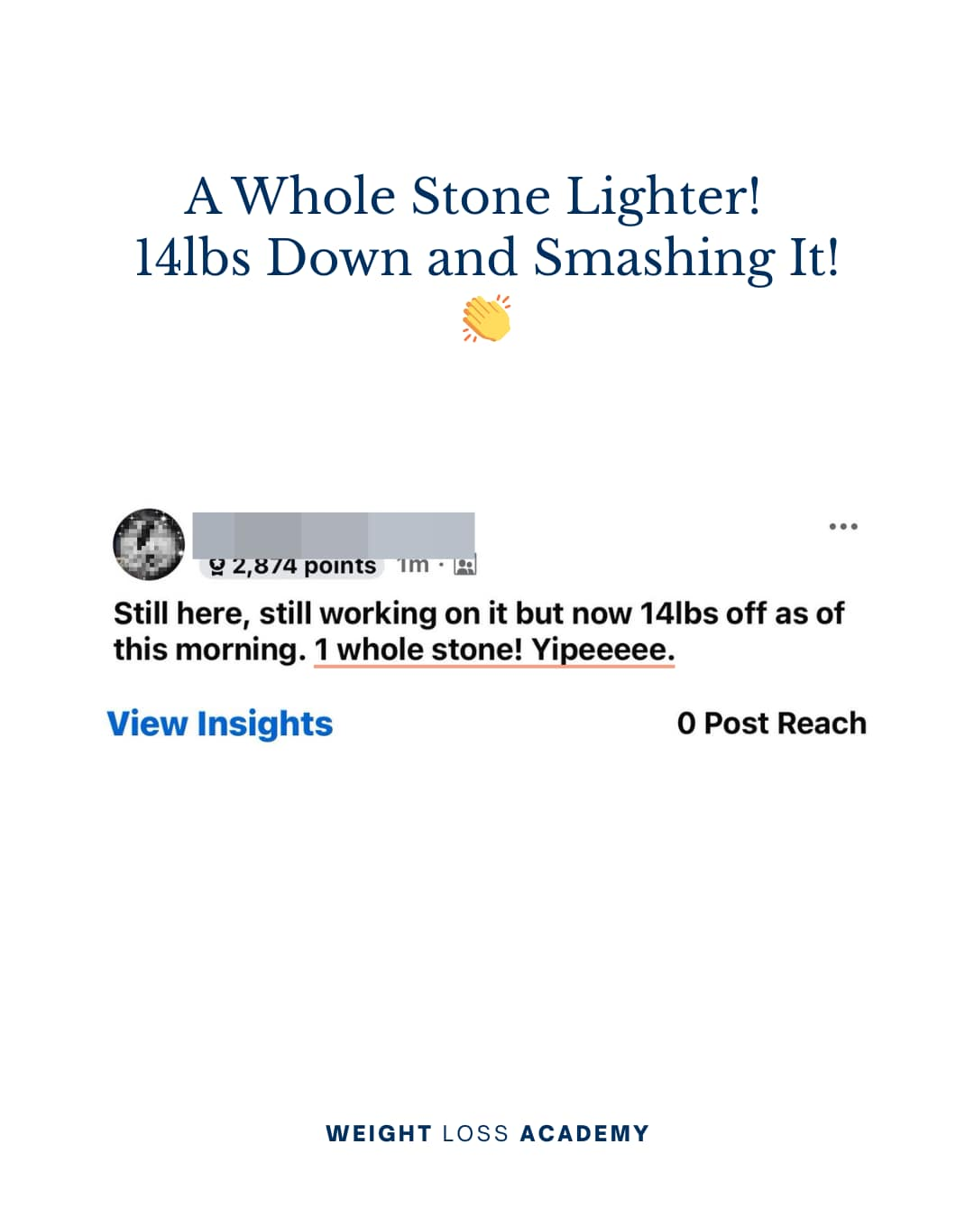
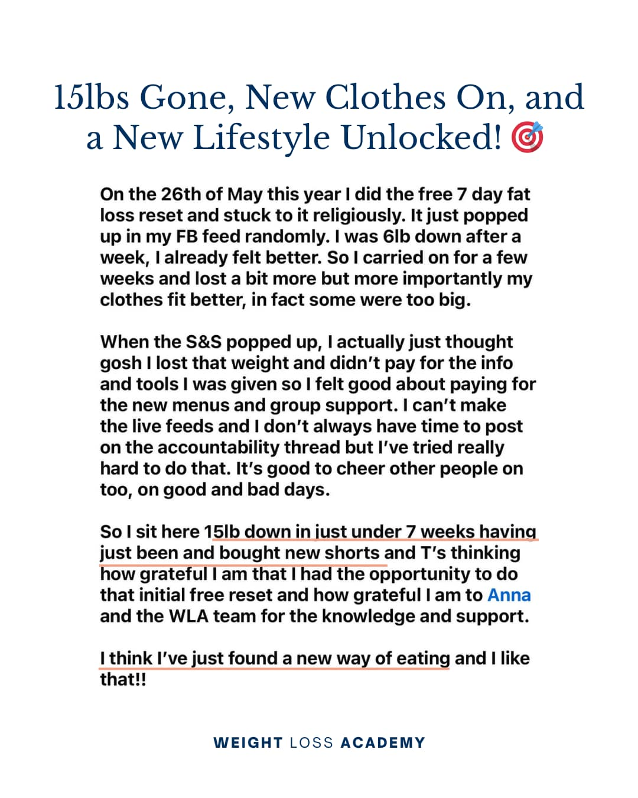
What Our Clients Say

Slide 62
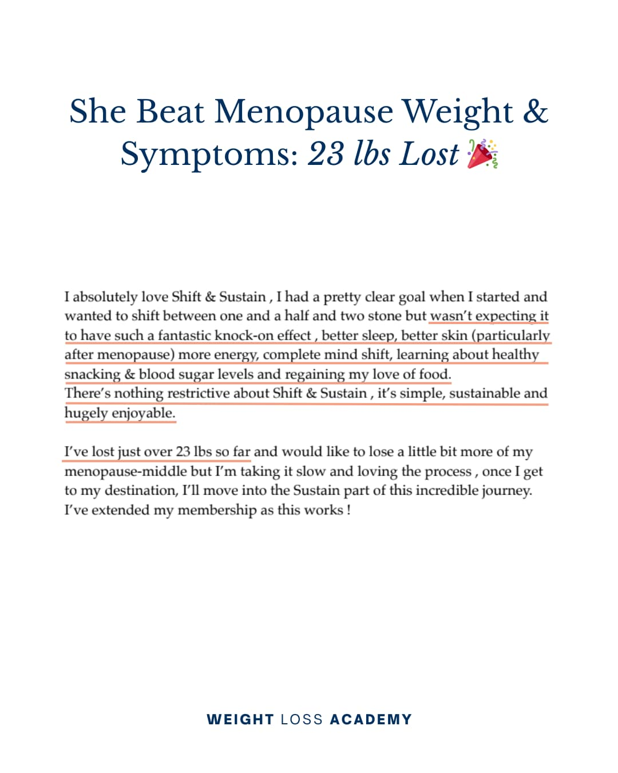
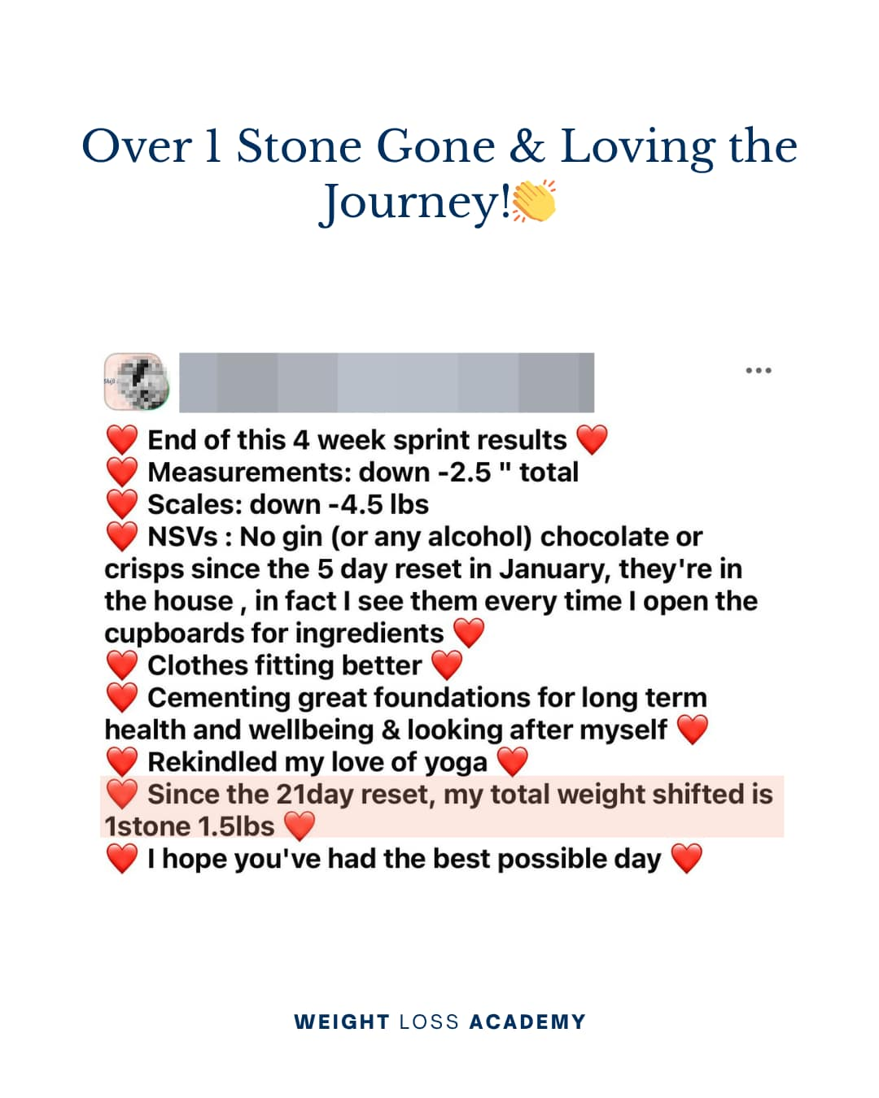
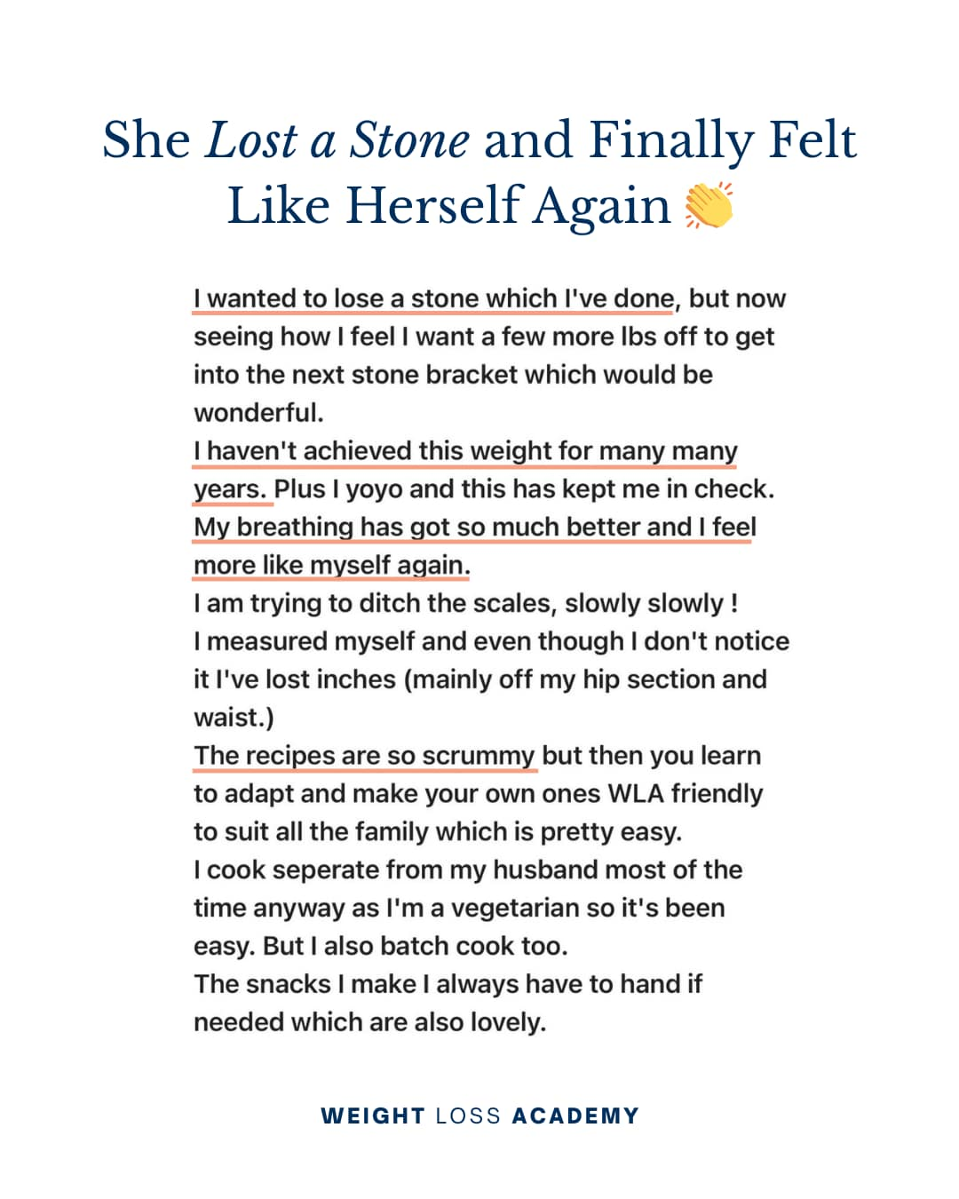
What Our Clients Say

Slide 63
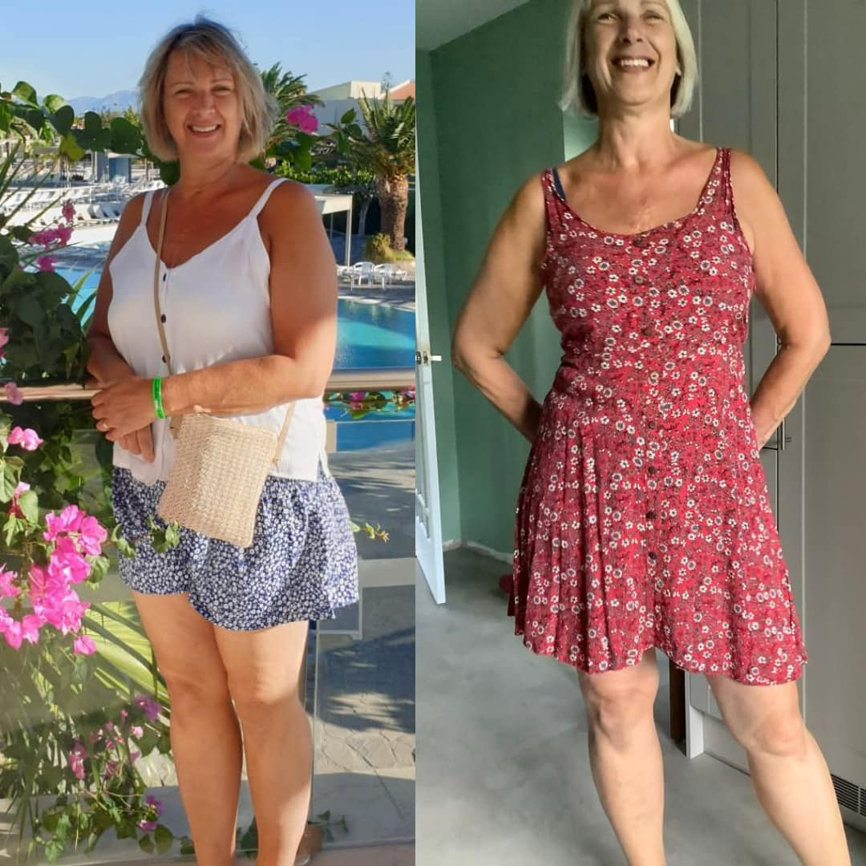
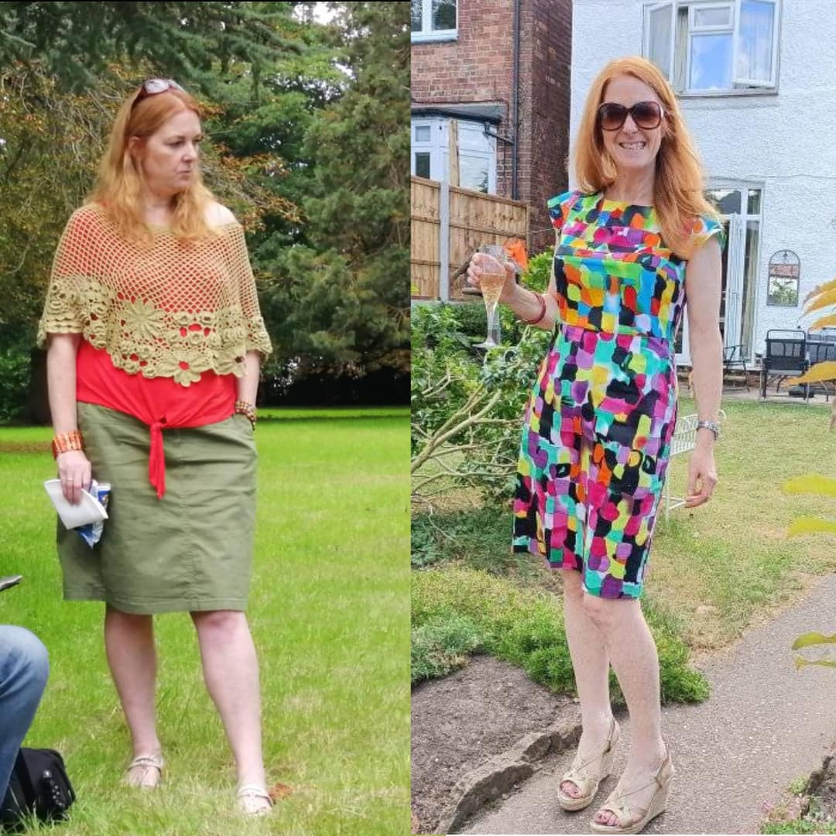
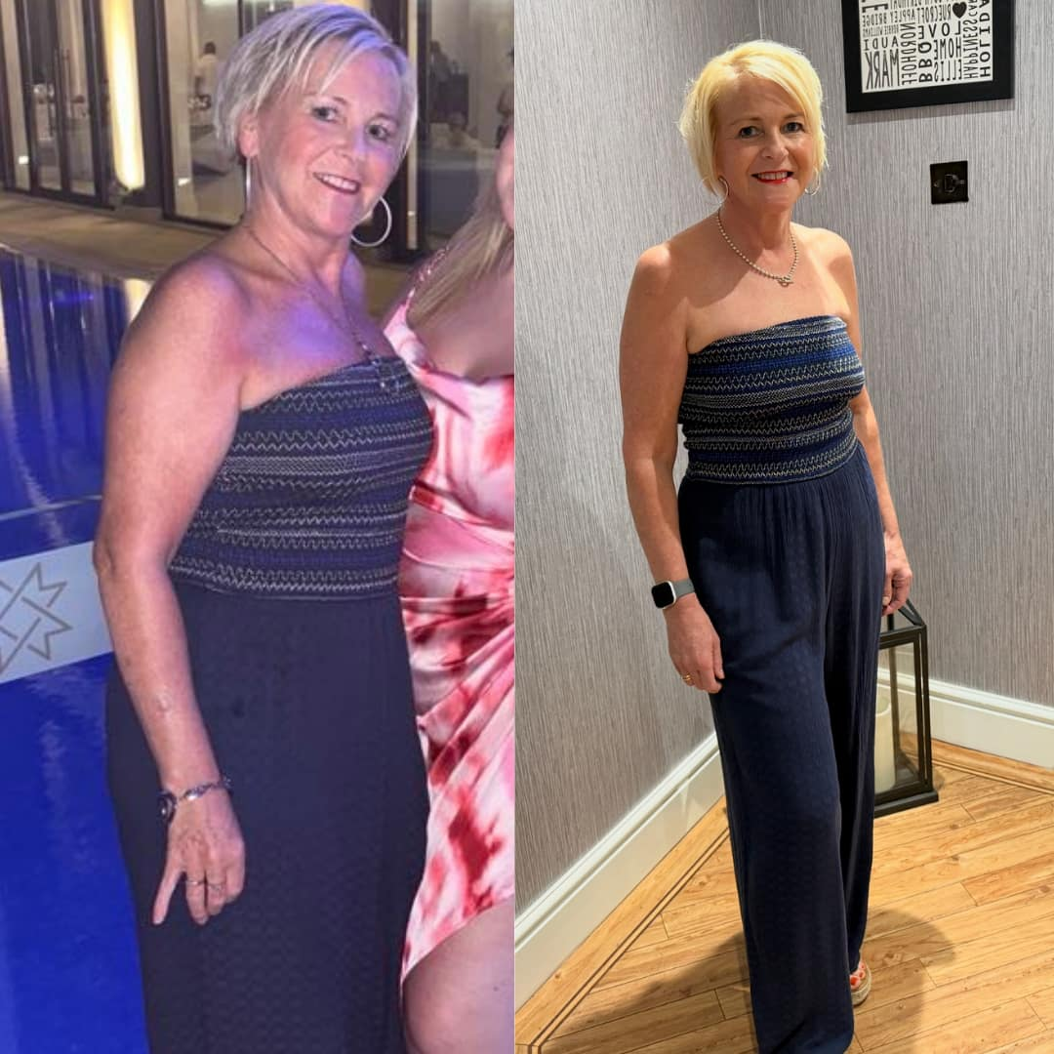
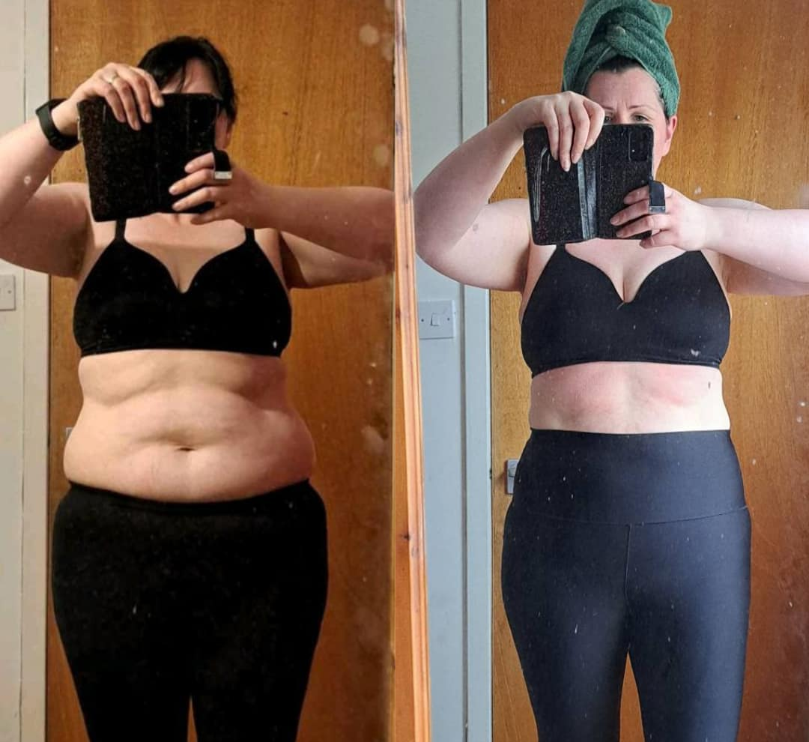
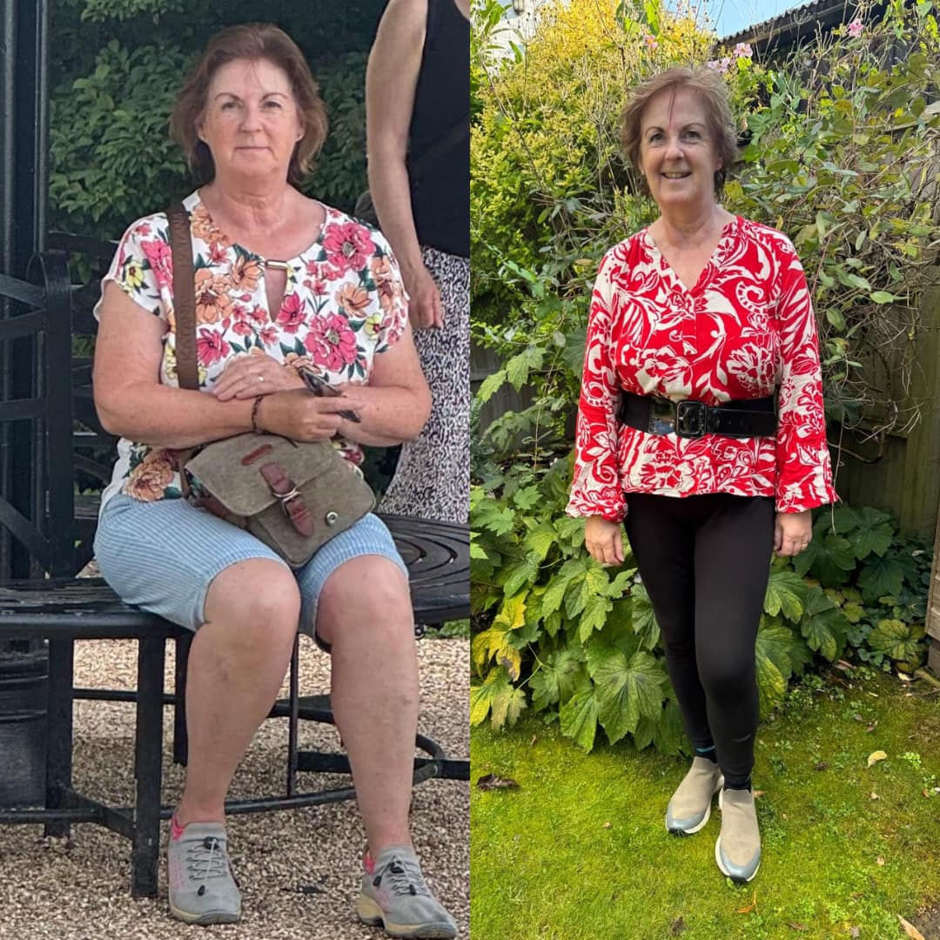
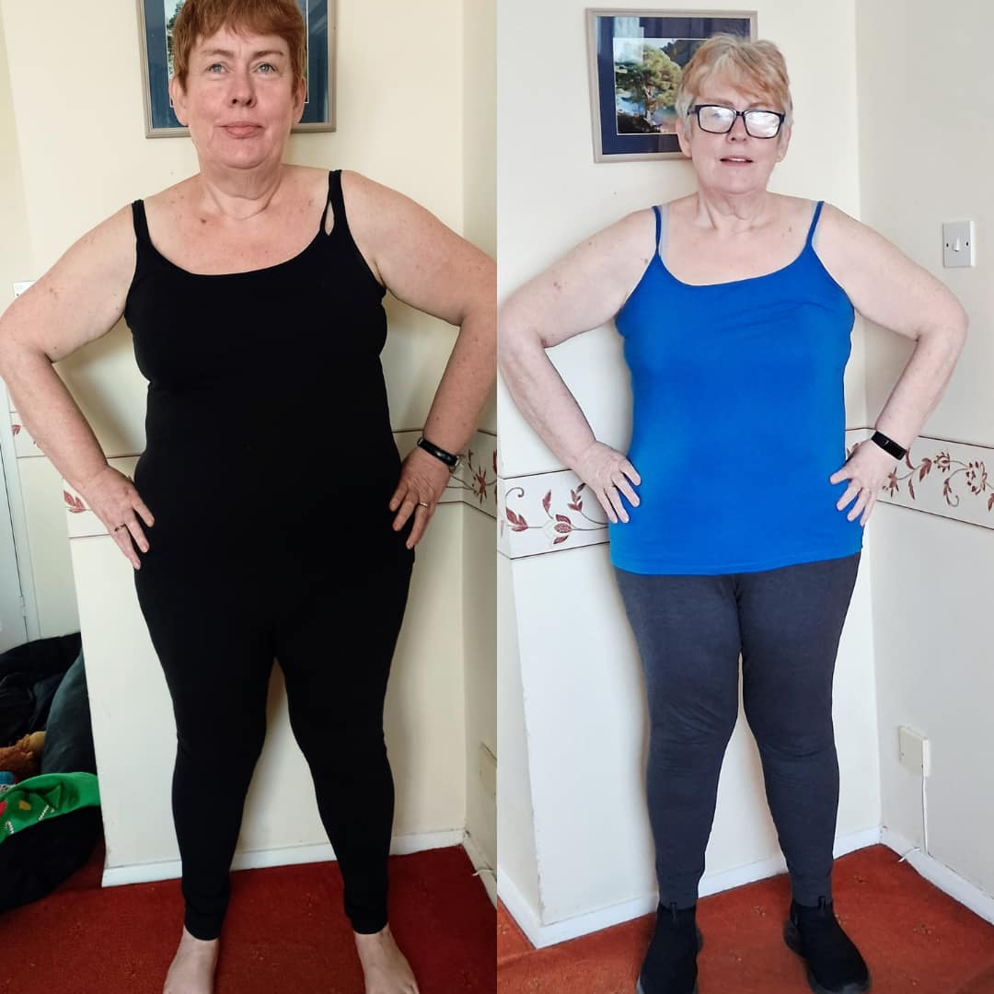

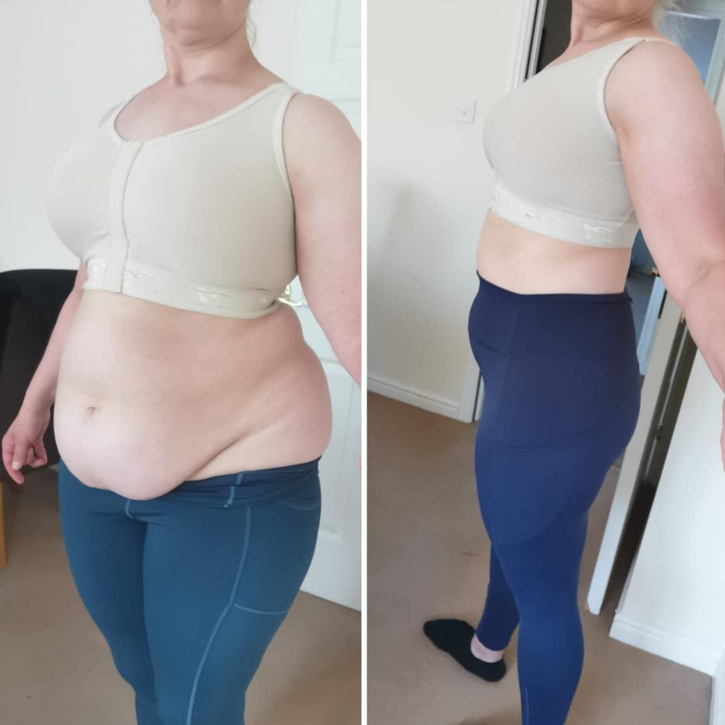
Incredible Transformations From
Our WLA Community

Slide 64
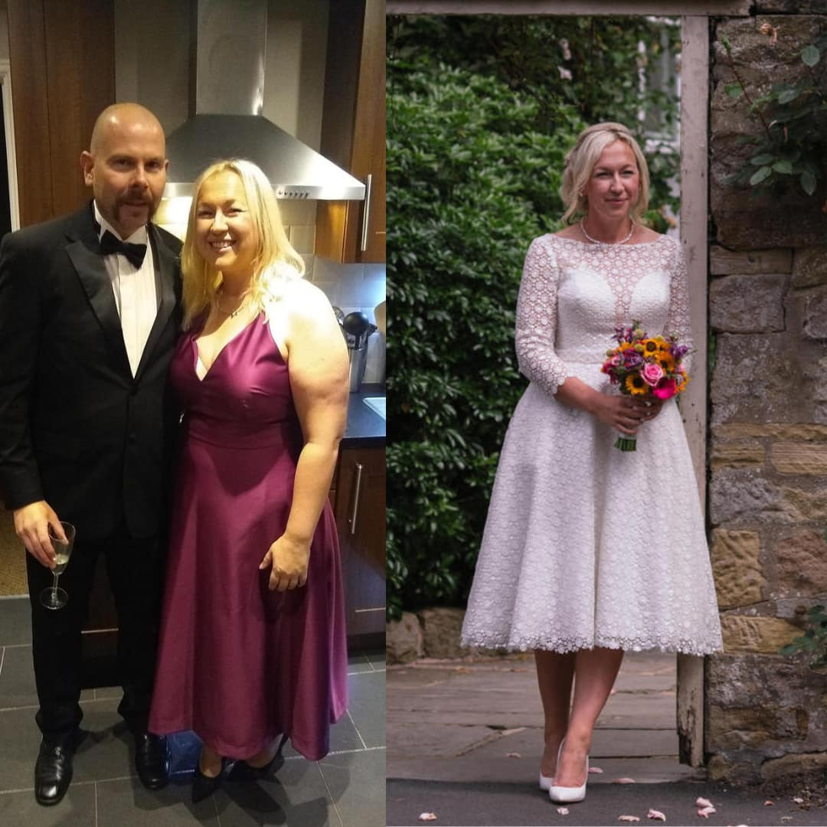

Real Women, Real Transformations

Slide 65

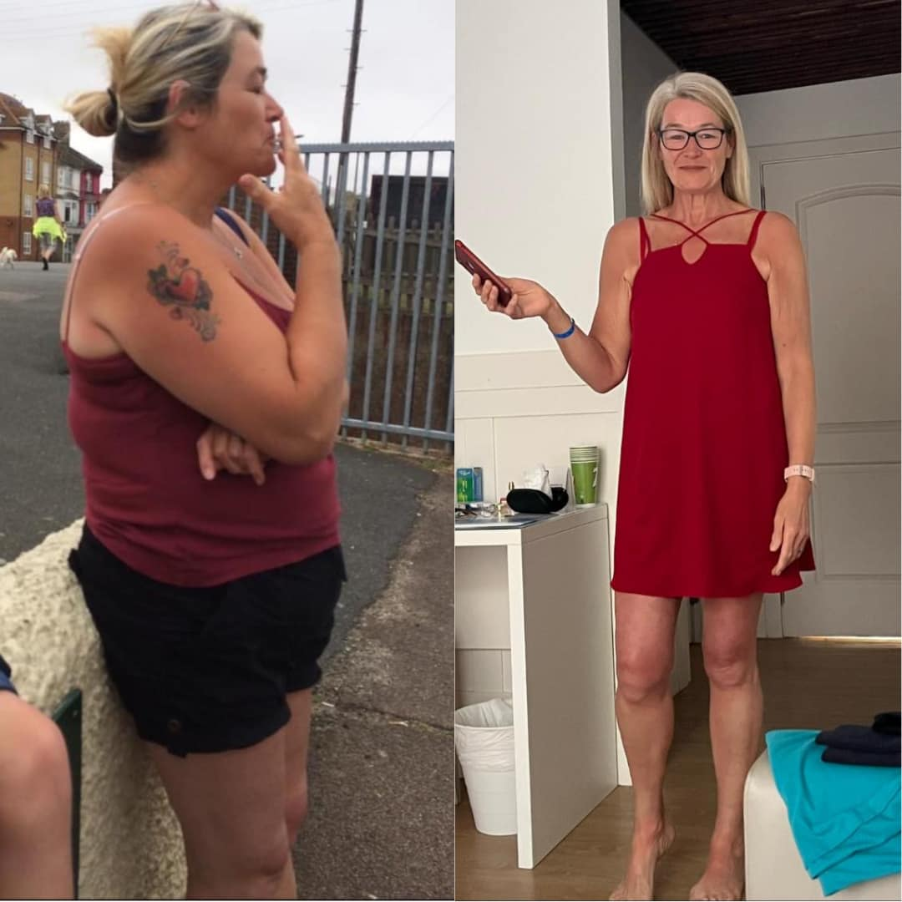
Real Women, Real Transformations

Slide 66
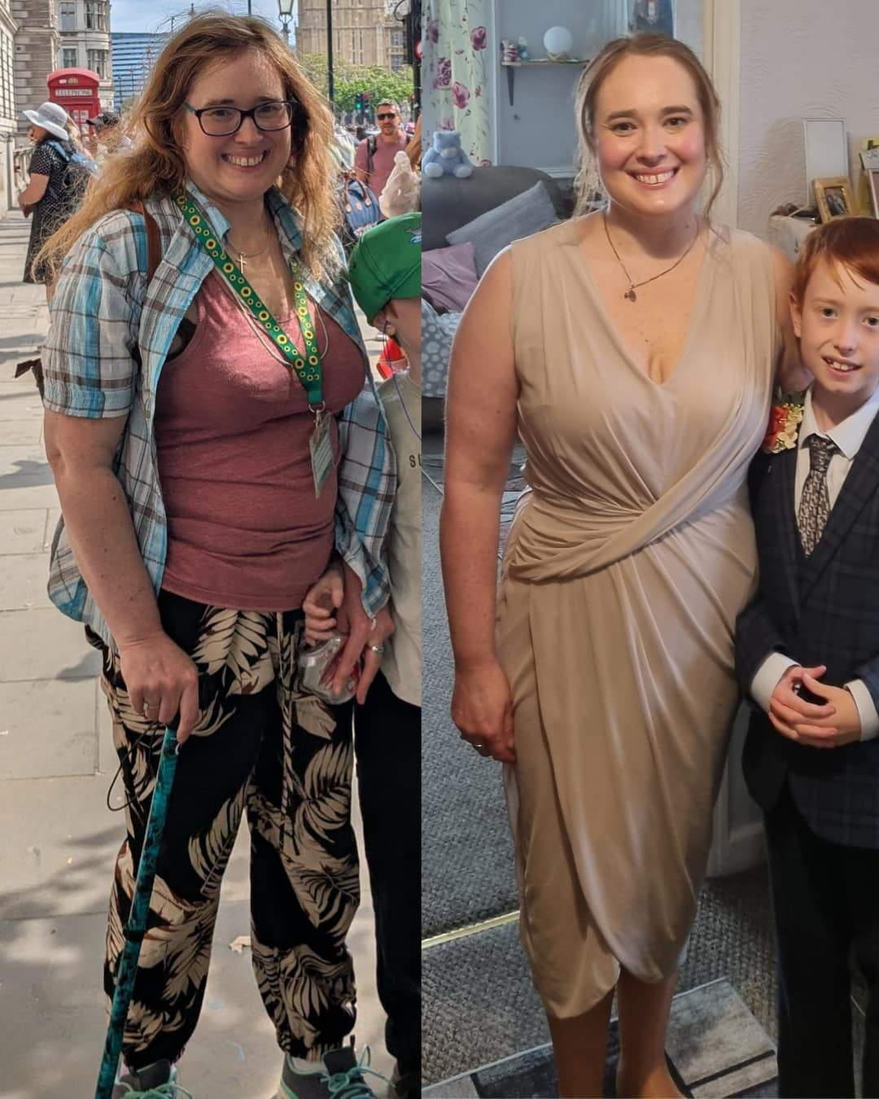
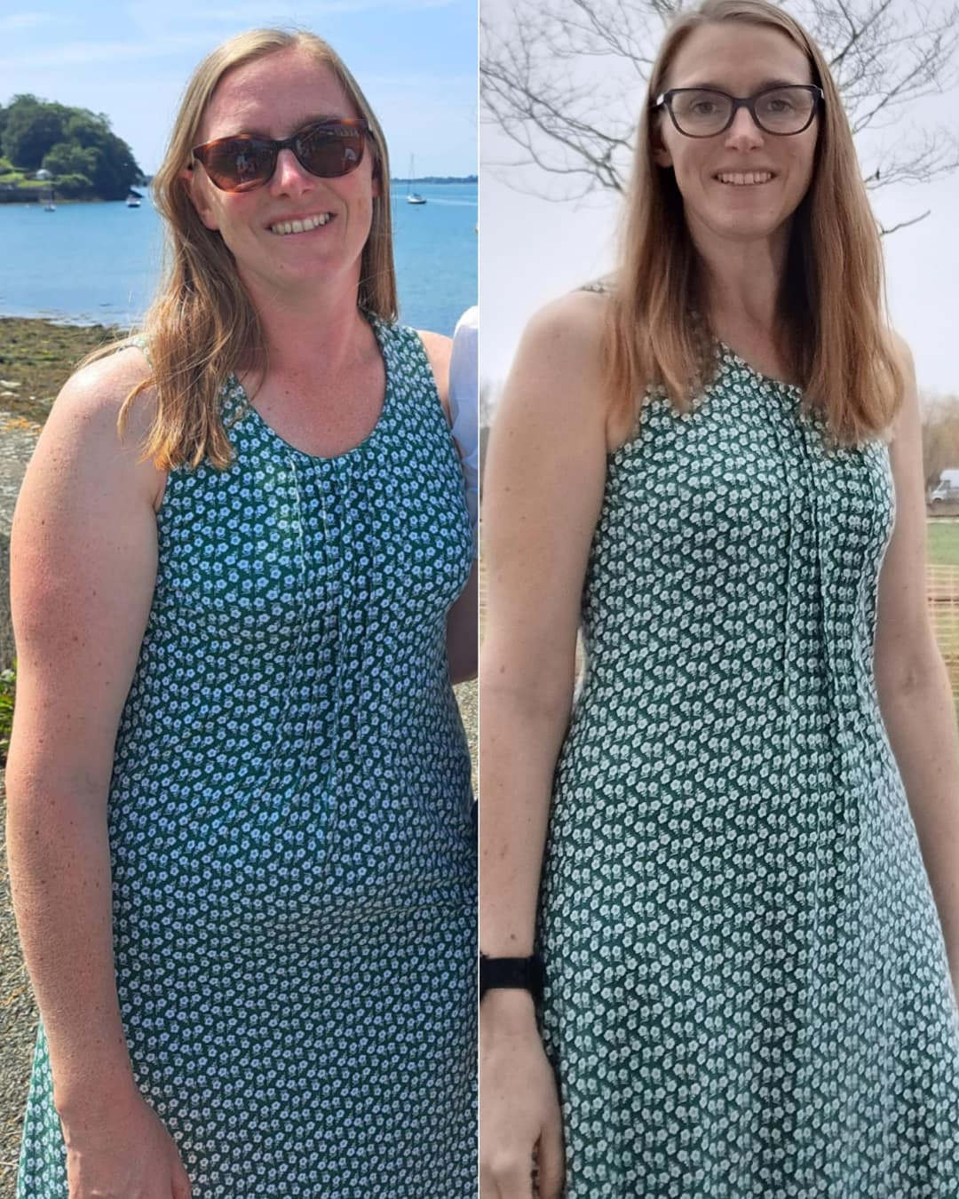
Real Women, Real Transformations

Slide 67
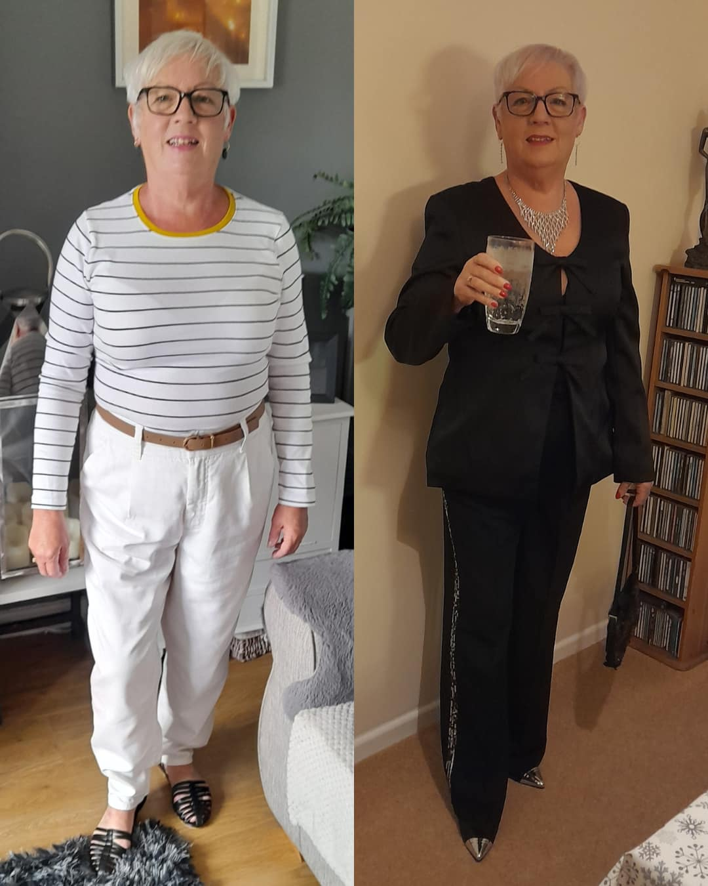
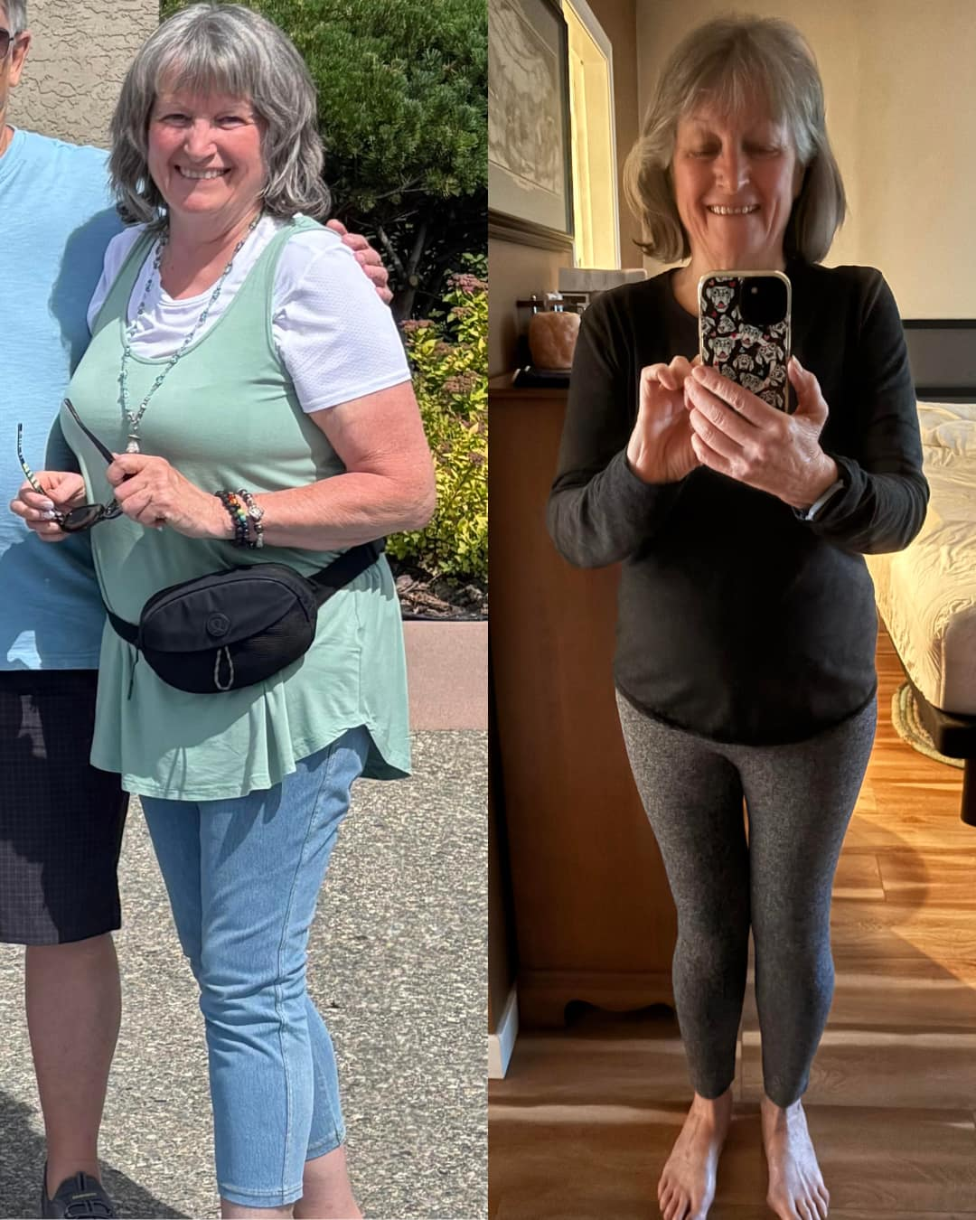
Real Women, Real Transformations

Slide 68
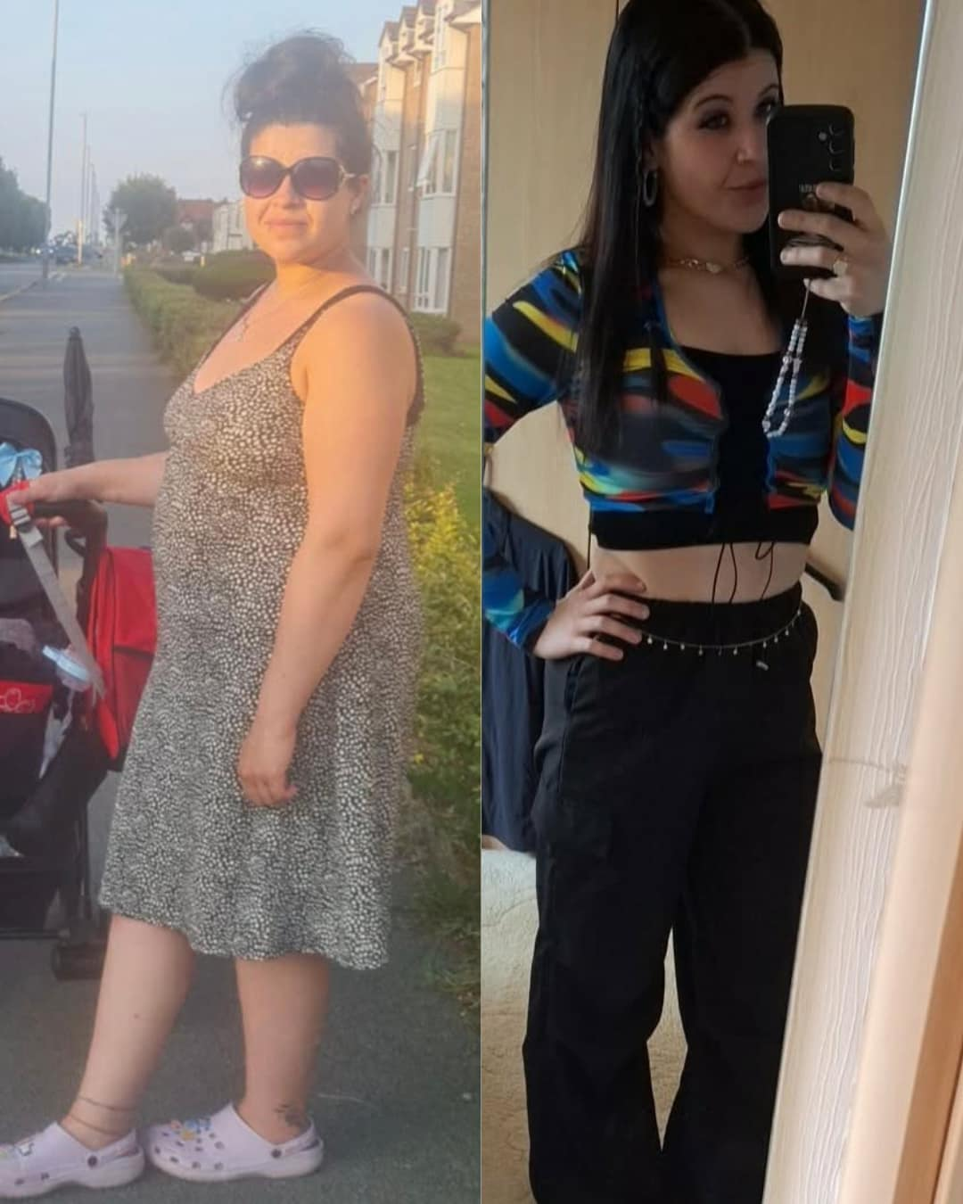

Real Women, Real Transformations

Slide 69
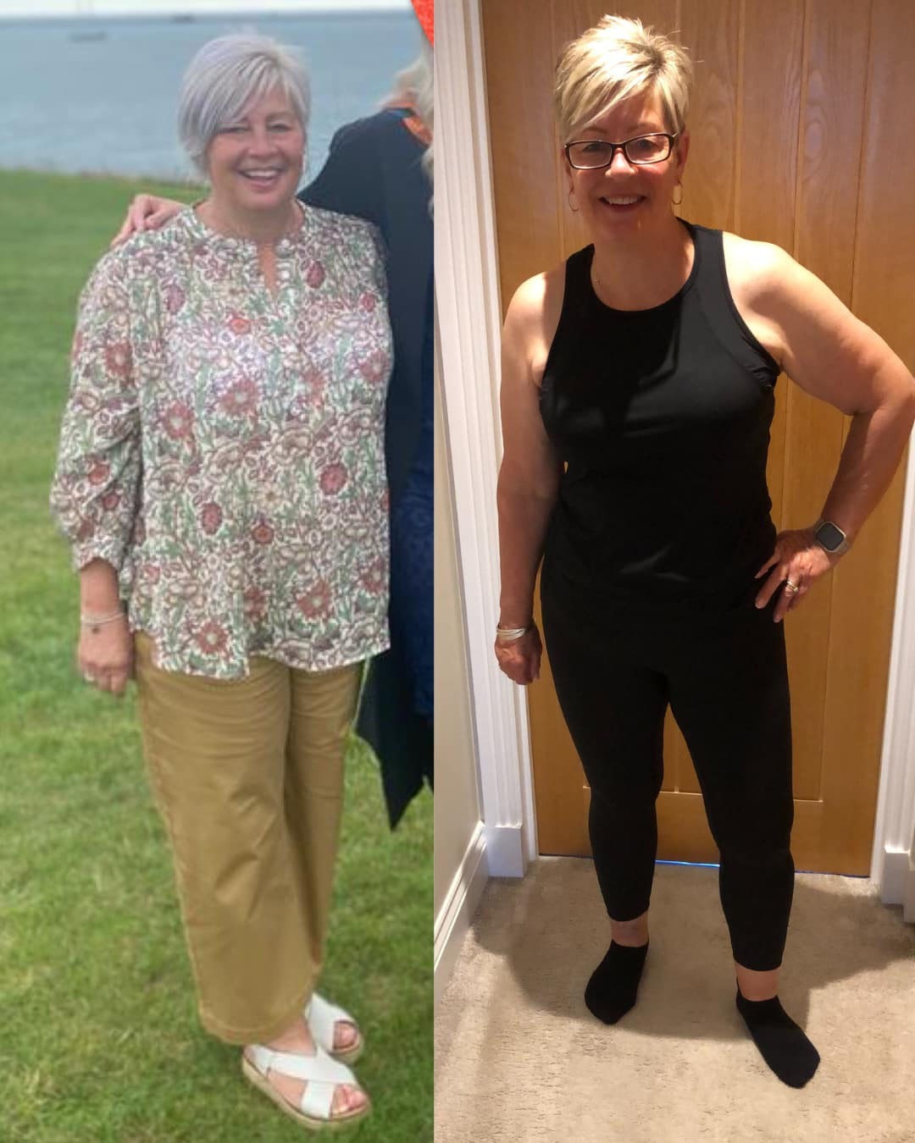
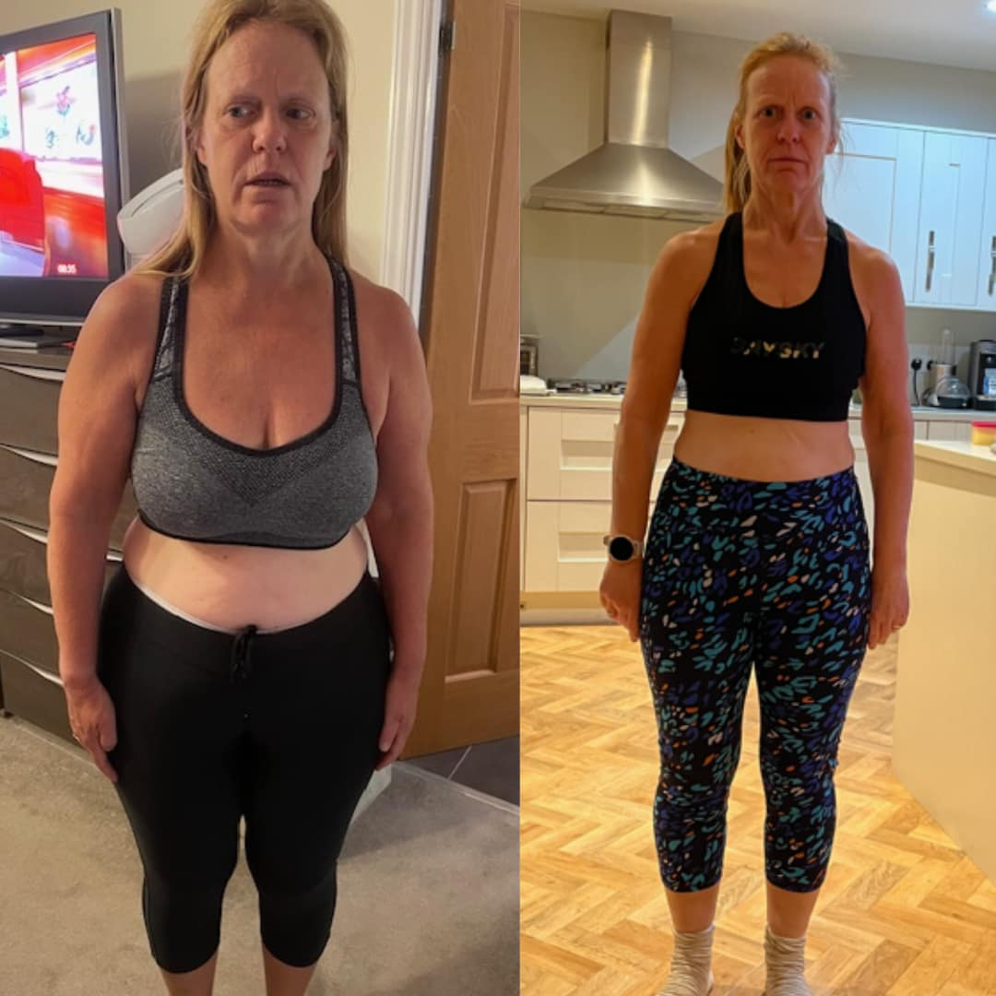
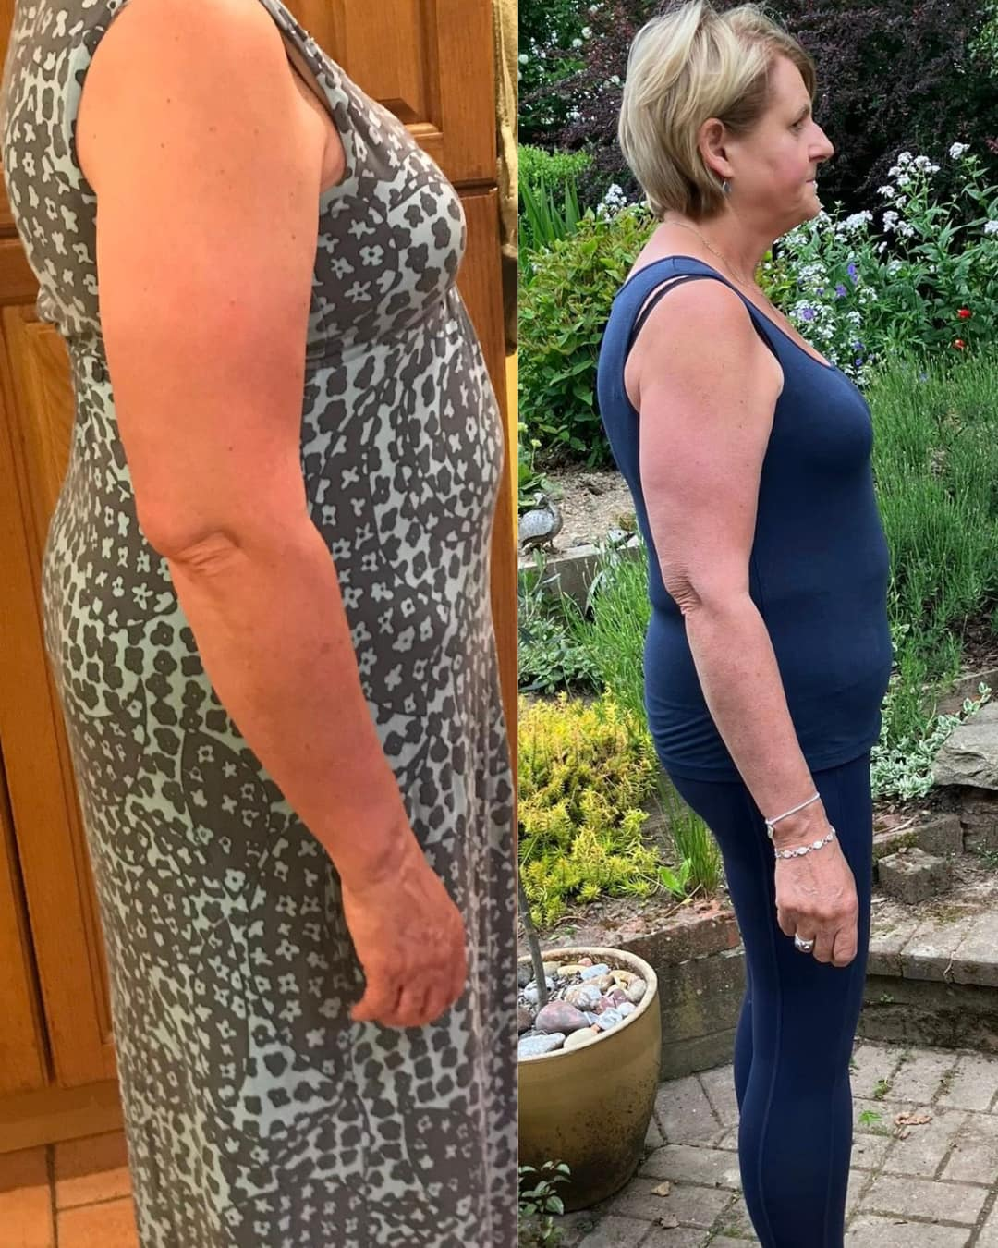
Real Women, Real Transformations

Slide 70
How Is This Challenge Different From The Original 12 Week Academy?
Our Academy program remains unchanged, it's just not open to new clients anymore.
Due to overwhelming demand,
we've introduced new options to provide a more personalised experience.
The truth is, delivering high-level accountability and tailored support is challenging in large groups.
Regular Academy Program: Ideal for those who are self-motivated and need tools to succeed on their own.
12 Week Challenge: Designed for individuals who crave closer support, detailed accountability, and personalised guidance.
It's about taking consistent action, not just having the right tools.

Slide 71
Why Is This Challenge Different From Other Diets?
The WLA summer challenge goal is to support clients who start their weight loss journey but quit after 5 days, lose weight, gain it back and just cannot be consistent. Our ethos is centered around our proven flexible nutrition formula, behavioural change strategies and expert coaching. Most program don’t include these tools or support.
For people who struggle with consistency, they need accountability, challenges, incentives and coaching to continuously take action.
They cannot hold themselves accountable. They need that external motivation and focus.
That's where I come in with our 12 week challenge.
This is a high-energy group coaching program where the goal is action.
Action creates results.

Slide 72
Why Would I Do This?
If you are currently not at your goal, it's probably not because you don't have the right tools it's that you are not implementing them.
You need to take action more than anything else and that's our primary goal for the program. And give you all the tools, so implementing becomes easy

Slide 73
EVERYTHING YOU NEED TO KNOW
Frequently Asked Questions
When does it start?
Monday 8th June, when you register, you will get access to our members area and group straight away
How long is the program?
It is 12 weeks. But with this special Summer offer you get 1 full year of access in total, for just £97.
Do you have a refund policy?
I'm so confident this can help you reach your goals that we have a rock-solid 7-day try-it-out option. If you implement (yes, you have to do the work) and decide it's not for you, get your fee back, no questions asked.
Will I get results?
With high accountability, challenges and incentives for taking action, this is the place to be if you just can't stay consistent on your own. We're going to get to work, but you'll love it, you'll get incredible results and feel better than you have in a long time.

Slide 74
EVERYTHING YOU NEED TO KNOW
Frequently Asked Questions
Are the meal guides new?
Yes. Every week we share a new fat-loss meal guide into our members area, plus new resources, videos and tools monthly to help you stay focused and motivated.
Is it time consuming?
Not at all. Double, triple or quadruple the recipes to save time, energy and money. Use the meal guides as they are with plenty of variety, or simplify them by repeating recipes as much as you like.
Concerned about cost?
We've got you covered with our budgeting tips. Planning your meals actually decreases the cost of your groceries, you'll already have most of the staples in your cupboard; it's just regular food. If any ingredient feels too costly, leave it out or swap it.

Slide 75
EVERYTHING YOU NEED TO KNOW
Frequently Asked Questions
I can't do a lot of exercise…
Not a problem. Your fat-loss results mostly come down to what you're eating, around 80% nutrition. If you have an existing exercise routine, keep it going alongside the program. If you're not currently exercising, let's just focus on your nutrition for maximum results.
I'm a fussy eater…
Every single recipe in the can be adjusted. If you love flavour, keep the recipes pimped up. If you prefer food that's more bland, leave out spices, flavours and herbs. Total flexibility.
I need to feed my family…
Use the meal guides with your family, just increase portion sizes and we can support you in our coaching group. The recipes are family-friendly. Any recipes you don't like, leave out and swap with others.
Will I get Anna's hands-on support?
Yes. This is the only coaching program where you get direct, live coaching from Anna herself. You'll have the chance to ask questions, get personalised feedback, and stay on track every step. Anna's proven strategies, accountability and encouragement will keep you focused and moving toward your goals.

Slide 76
Whether you believe you can or you can't, you are usually right!
Click link in comments if you are ready to become our next success story!
I want to celebrate you in 12 weeks and I will guide you to the best of my ability.

Slide 77

Summer Challenge Winners

Slide 78
Thank you for joining me today and for the 5 day free reset!
Let's take your goals to the next level!
You are capable of your goals and we would be honoured
to help you achieve them!
P.S Today is our final day of reset coaching. If you join the summer challenge you will get access to the members area and group straight away, the party continues over there

