Slide 1

New VIP 1-2-1 PERSONAL Weight Loss
Coaching Group

Slide 2
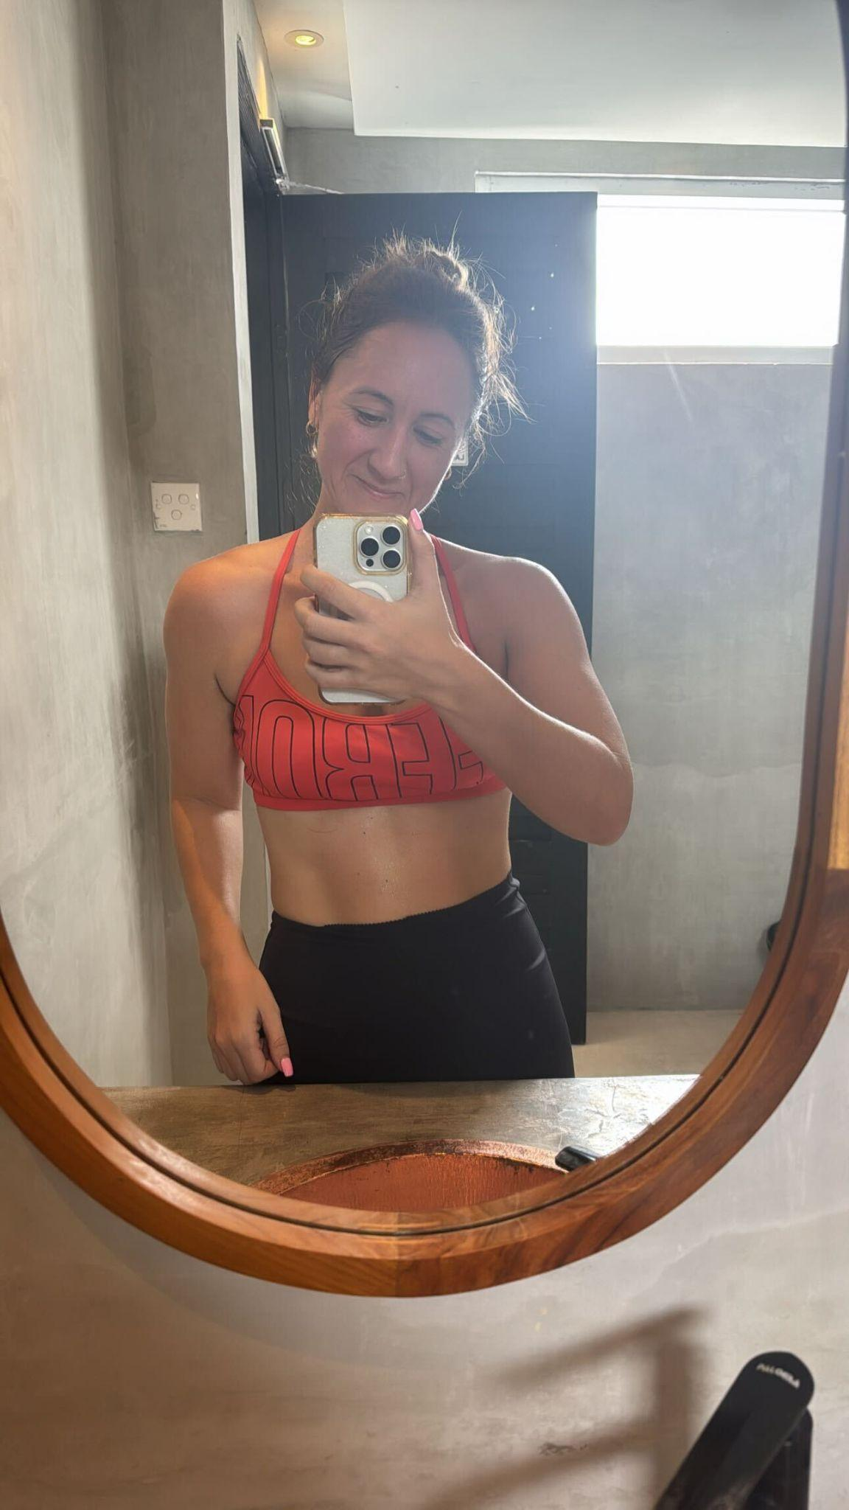
Brand New Round
VIP is back by popular demand. This month we are looking for 30 ladies to coach. I'm looking to create as many success case studies for my 1-2-1 VIP coaching program as possible
**Risk Free**
Guaranteed Results

Slide 3
VIP has been closed for over a year, but the question I’ve been asked most since is
When is it coming back?
So we are bringing it back and opening a brand new round of VIP 1-2-1 coaching

Slide 4

VIP will allow you to:
Lose up to 1 - 3 stone
Build your confidence
Slay your sugar cravings
Skyrocket your energy
Just in time for summer
Without
extreme diets or
exhausting workouts.

Slide 5
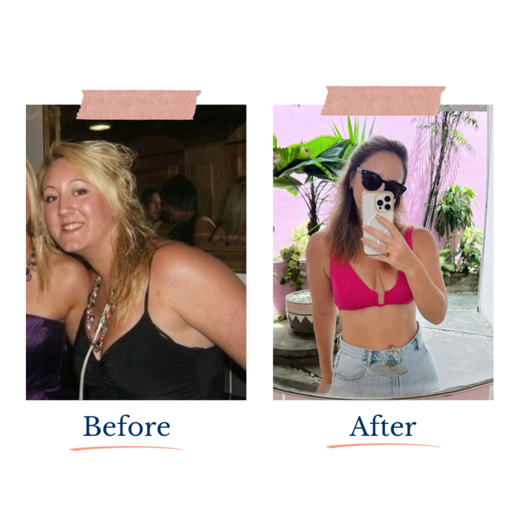
VIP 1-2-1 Coaching
We’ll guide you through the exact same simple, easy-to-follow nutrition formula I used to lose over 2 stone and keep it off…
And in my experience as a degree-qualified Registered Associate Nutritionist, with over 11 years’ experience and having supported 50,000+ clients, nothing transforms results quite like 1-2-1 coaching

Slide 6
Step 1: Personalised Nutrition Strategy For Maximum Results
Sick of not knowing what works for you, frustrated with your lack of results? We build a simple nutrition strategy tailored to you, your lifestyle, goals, time that you have, routine and preferences. No guesswork. No extremes. No starting again every Monday. Just a clear structure that’s easy to follow, reduces cravings, and gets your body responding quickly so you start seeing results sooner.

Slide 7
Step 2: High Accountability, Support + Personal Check in’s
This is the part most women are missing. When you’re doing it alone, it’s easy to make excuses, lose focus and give up. When you’re accountable to someone else, you show up, follow through and take your goals more seriously. It’s not about knowing what to do… it’s about doing it consistently.
With regular check-ins, coaching sessions and daily support, you stay on track, even on the days you don’t feel like it. And that’s what turns good intentions into real results.

Slide 8
Step 3: Results Tracking
You’ll submit your results each month so we can track your progress clearly and keep you moving forward. This adds another powerful layer of accountability, so you don’t drift or stall.
We review everything and make the right adjustments along the way, ensuring you stay on track and your results keep progressing

Slide 9
These 3 steps are what makes 1-2-1 coaching and VIP different to group coaching and digital tools.
When you combine personalised strategy, high accountability and results tracking its a game changer for results

Slide 10
I have had clients that love our WLA ethos but they need more than group coaching. Group coaching works for many but there’s a select few people that need that 1-2-1 support, they don’t engage in groups. For many clients VIP was the game changer!

Slide 11
🔬 Human 1–2–1 coaching outperforms digital-only or self-guided approaches
A study from Stanford University found:
People with access to human coaches (1–2–1 support) lost significantly more weight than those using digital tools alone
👉 Even when the information is the same. Key takeaway: It’s not the plan, it’s the support, accountability and feedback.

Slide 12
The WLA VIP
Personal Coaching Transformation
The next intake is open, we kick off soon
Only have 30 spots available
(10 are already gone)

Slide 13
Lose That Stubborn Last Stone or Lose Up To 3 Stone, Transform Your Body, Relationship With Food, Burn Fat Consistently With a Personalised Nutrition Approach, High Accountability and Daily Support So You Finally Reach Your Goals in 3 or 6 Months With The WLA VIP 1-2-1 Coaching

Slide 14
When I look at why people FAIL at weight loss it’s usually down to lack of accountability, not having time, needing personalisation etc. So VIP is a programme where we bring this all together, we take the WLA ethos and we take it to the next level with accountability that makes you take action every day and support so you know exactly what to do. You need to be self sufficient in group coaching and many are not!

Slide 15
Why Most Women Stay Stuck
Most women already know what to do.
But they’re stuck in the cycle of starting… stopping… and never fully following through.
They’ll have a good week… then life gets busy, motivation drops… and they’re back to square one.
Not because they don’t care but because they’re trying to do it alone. And this is exactly why VIP works…
Because we don’t just give you a plan, we give you the support, structure and accountability to actually follow through

Slide 16
Imagine If This Was You By Summer…
Putting on your favourite clothes and loving how you look in them again
Feeling lighter, energised and comfortable in your body from the moment you wake up
No longer battling constant cravings or evening snacking that undo your progress
Looking in the mirror and finally feeling proud of the woman looking back at you
Enjoying holidays, BBQs and summer events without worrying about your weight
Knowing exactly how to eat in a way that helps you lose weight and keep it off for good

Slide 17
Are You Struggling With…?
Time | No time to figure out your nutrition? Want us to provide you with a personalised nutrition strategy so you get results easily?
Lack of results | Sick of not seeing results and want to see results like Jill every month?
Consistency | Need a coach so that you actually stay consistent and take action, rather than quitting every few weeks?
Energy | Need a nutrition setup that gives you energy? Time to stop depending on sugar and caffeine that keep you in the sugar cycle
Snacking | Require support and accountability so you stop the evening snacking that’s just habit?
Weekends | Get weekend handholding so you don’t ruin all your weekly hard work

Slide 18
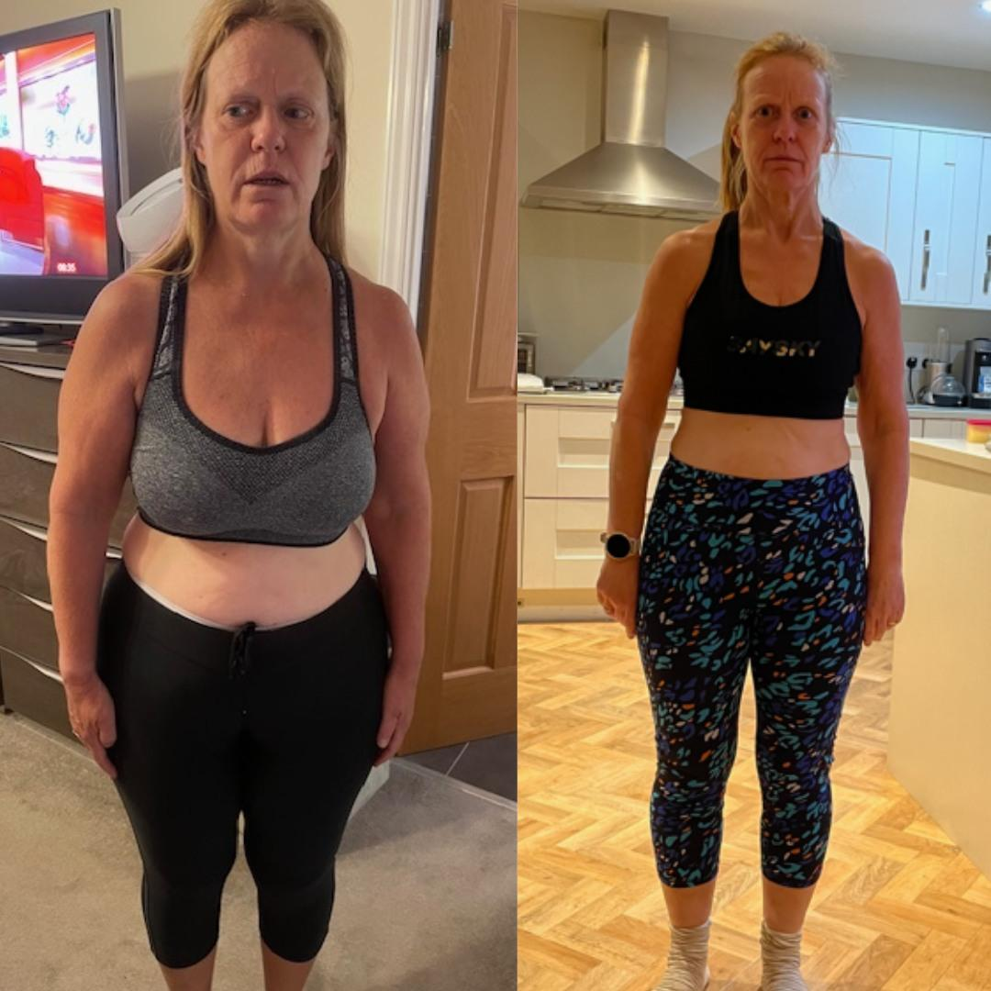
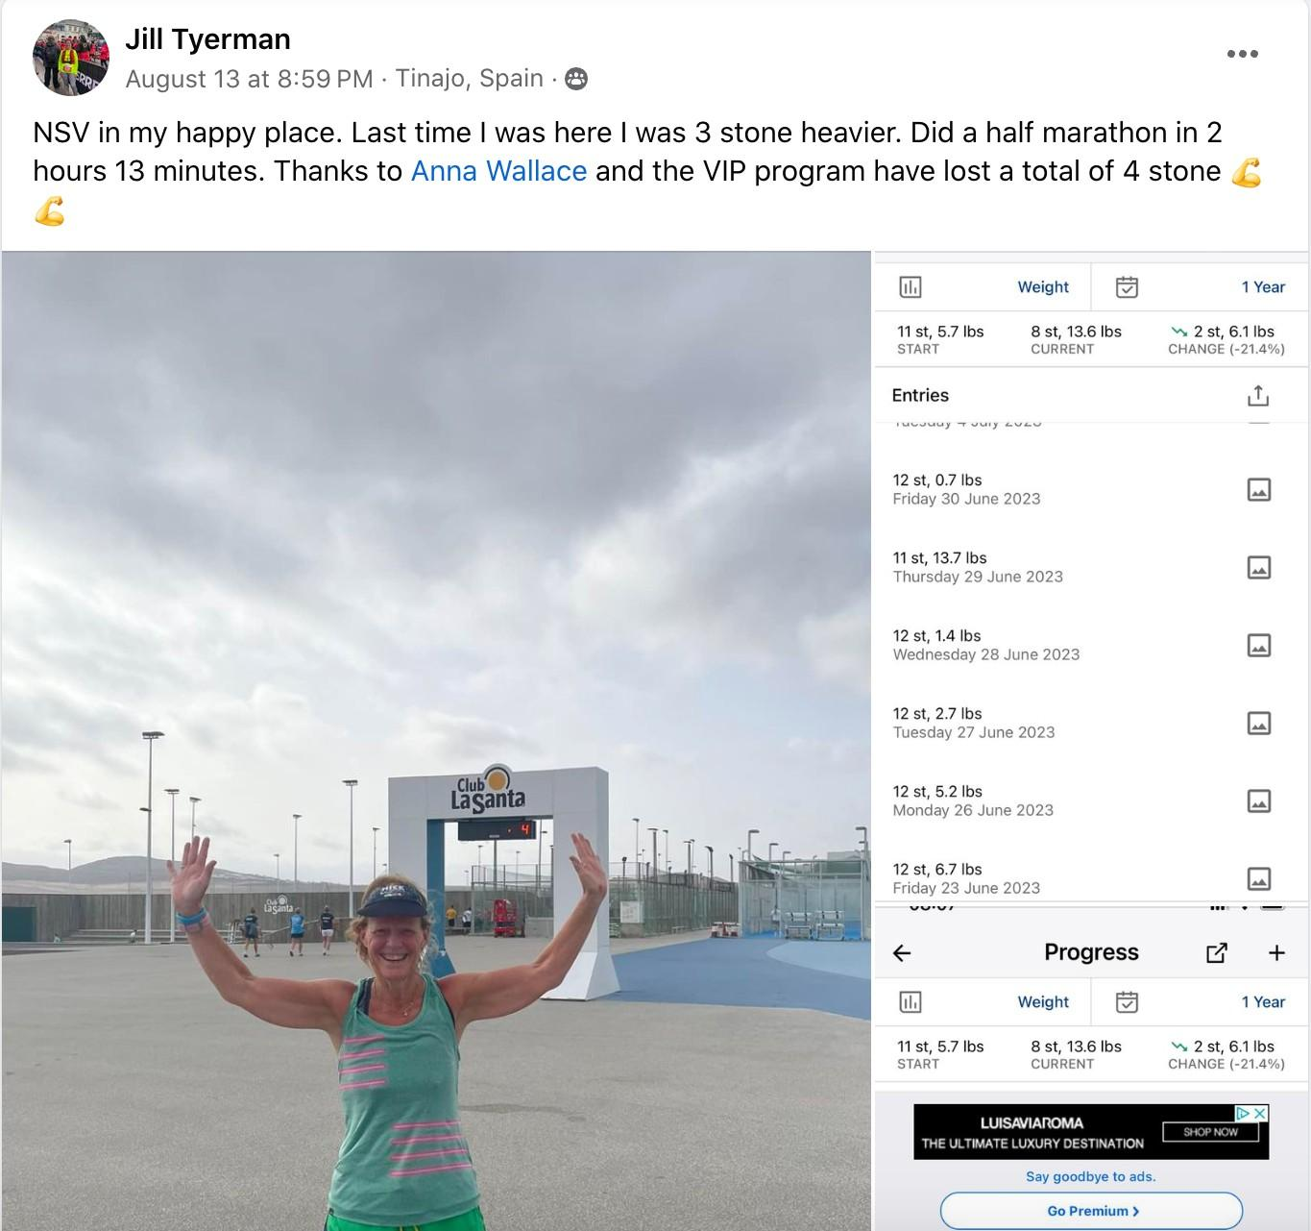
Jill Lost 4 Stone in 6 months in VIP

Slide 19
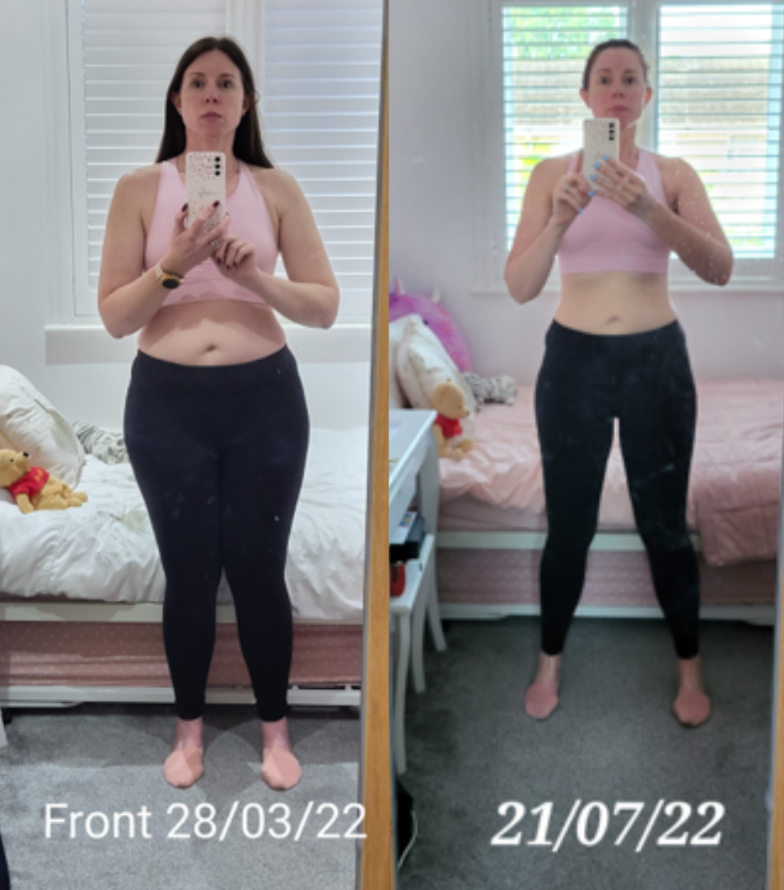
Carly Lost One Stone In Her First Month of VIP Coaching

Slide 20
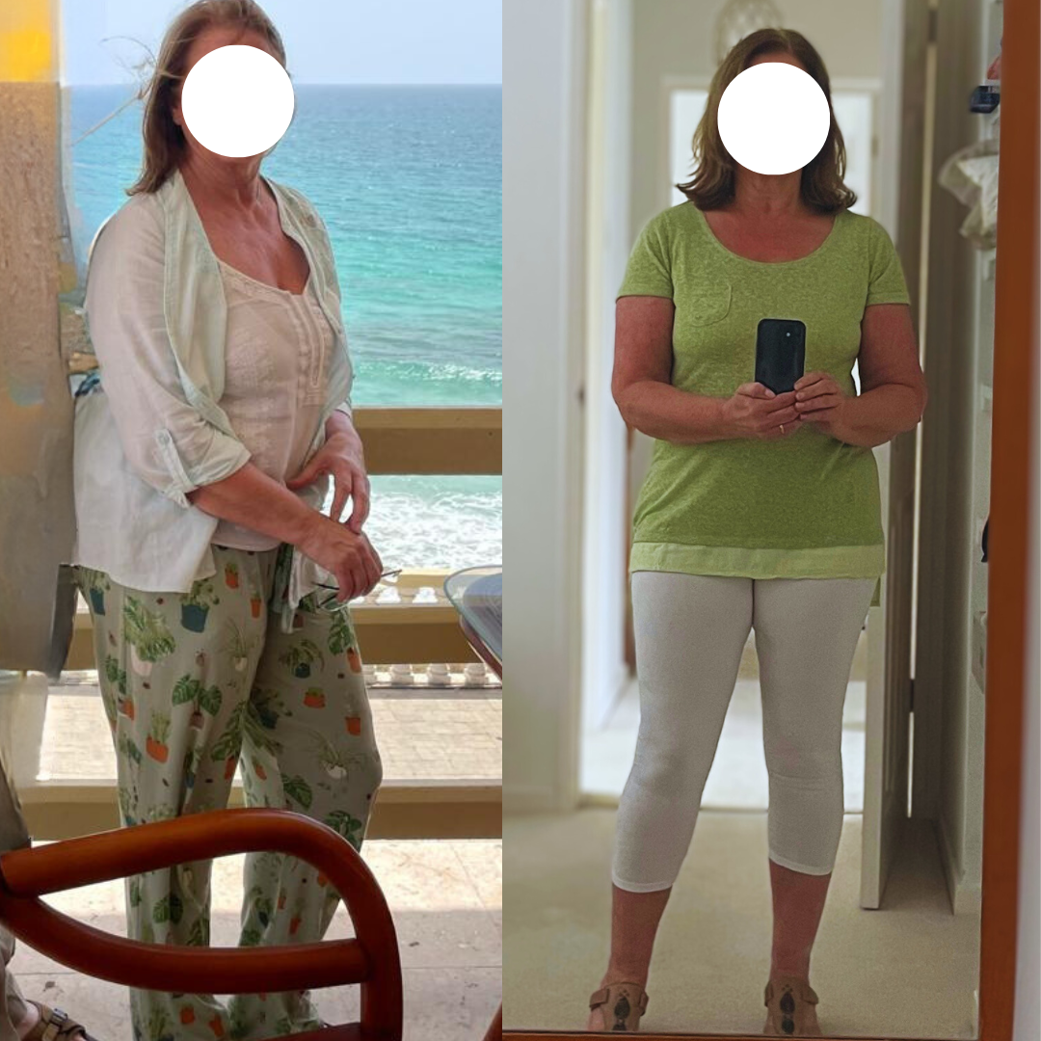
Moira Achieves a Stunning Drop from Size 14 to 10 in Just 5 Months!

Slide 21
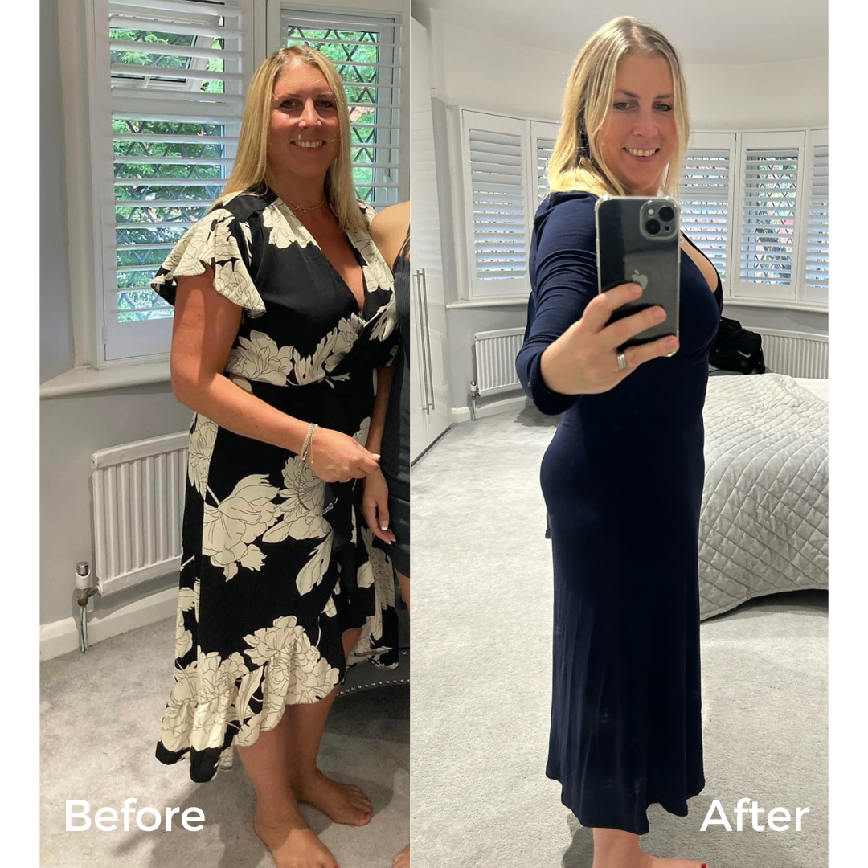
Denise Got To Her Happy Place, Losing a Stone in the VIP

Slide 22
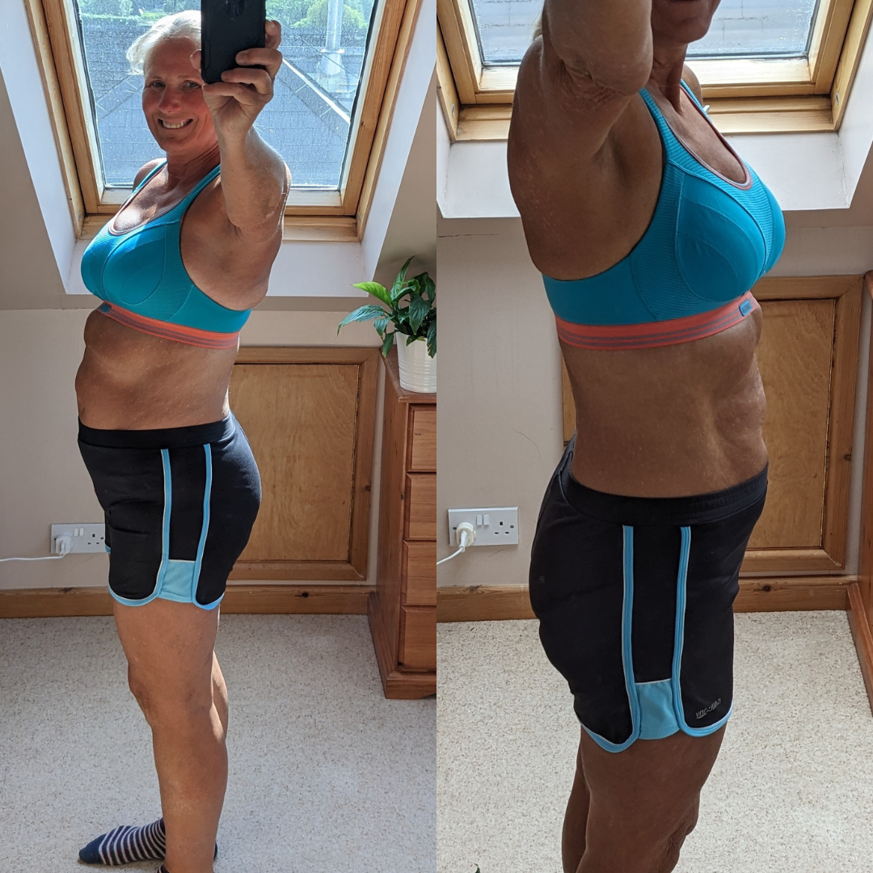
Sally Lost A Stone In 2 Months In VIP

Slide 23
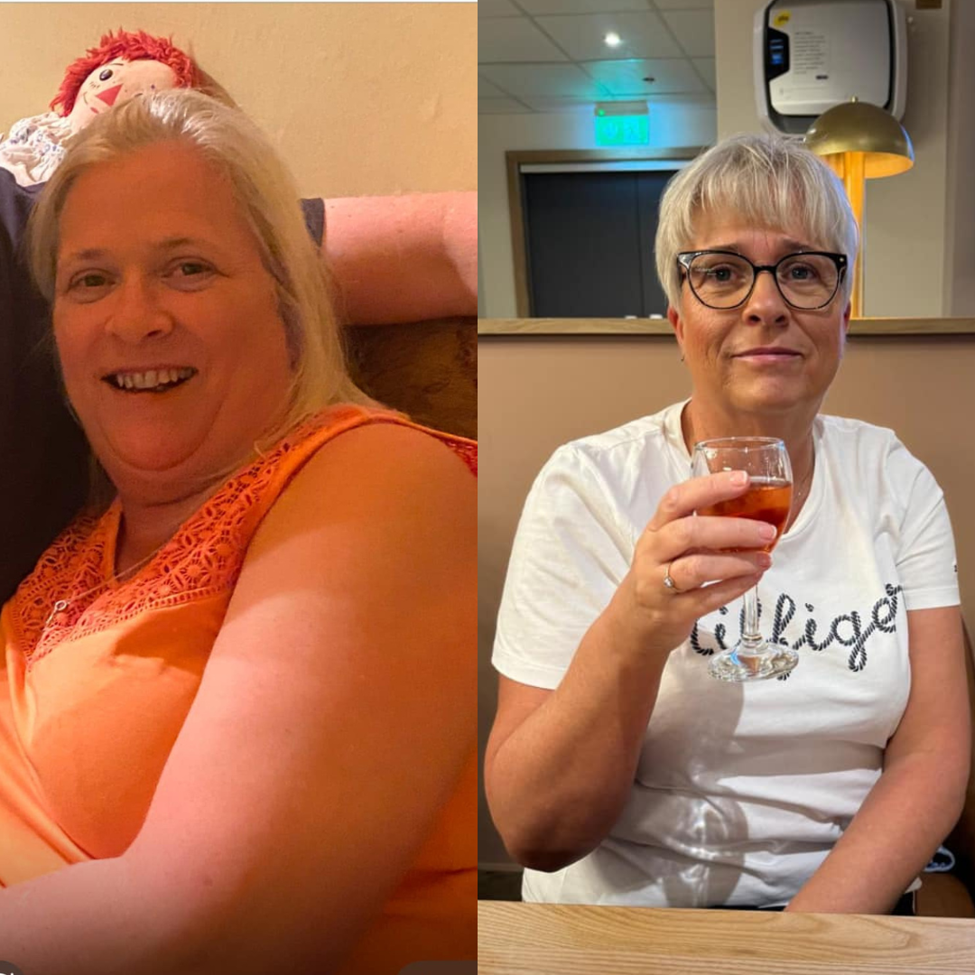
Sam Completely Transformed in VIP

Slide 24
What’s Included
🌟 Monthly 1-2-1 Coaching Sessions: a dedicated session each month to review your progress, solve challenges, and refine your strategy so you continue moving towards your weight loss goal.
🌟 Daily support via WhatsApp / Messenger: stay consistent with daily access to your coach for guidance, encouragement and support so you don’t lose motivation or fall back into old habits.
🌟 Weekly Food Diary Review: Your coach reviews your nutrition each week to identify what’s working, where progress can improve, and how to keep your results moving forward.
🌟 Weekly Nutrition Strategy: Your plan evolves with you. We adjust your nutrition approach based on your progress, lifestyle and goals to keep results sustainable.

Slide 25
What’s Included
🌟 Laser-Focused Weekly Action Steps: Clear, simple priorities each week so you always know exactly what to focus on instead of feeling overwhelmed.
🌟 Monthly Progress Tracker: A structured monthly check-in you complete to track your progress, habits and challenges. This keeps you accountable and allows your coach to review and guide your progress each month.
🌟 Monthly Progress Review: Your coach reviews your progress data with you to celebrate wins, troubleshoot challenges and optimise your strategy.
🌟 Access to Shift & Sustain Members Area: Full access to the WLA coaching framework including meal guides, recipes, resources and behavioural strategies designed to help you lose weight and keep it off long-term.

Slide 26
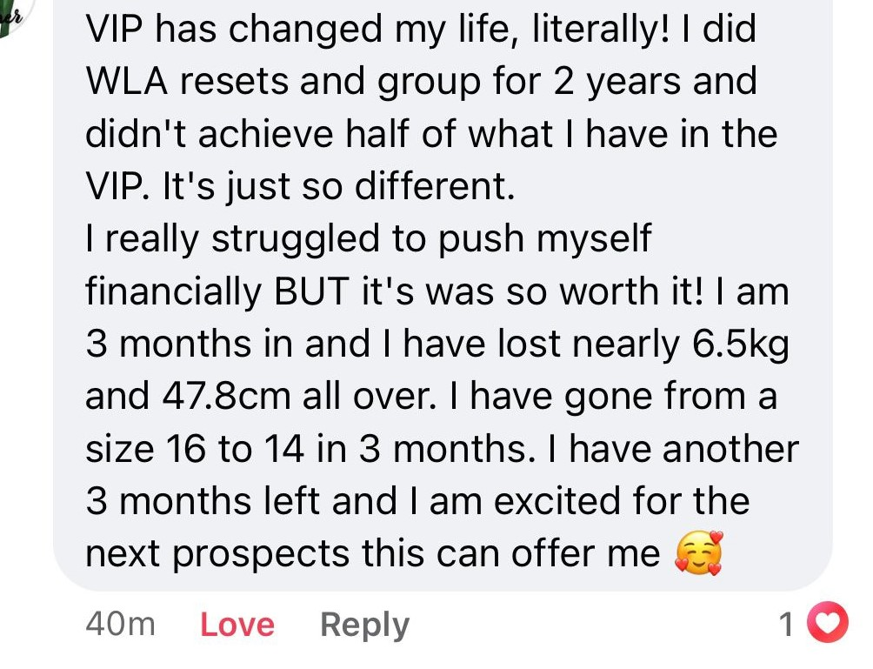

Slide 27
Investment vs Reality
✅ Most degree qualified Registered Associate Nutritionists charge anywhere from £300 - £700 for consultations and ongoing monthly support with them and their team
For one to one coaching this level of support would typically cost £2,000–£5,000+. Take a look around Harley Street in London.
Especially with daily support, weekly reviews and personalised strategy.
But for this round, we’ve made it far more accessible

Slide 28
Don’t Miss This VIP Coaching Round
👥 Limited to just 30 clients (10 places already gone — high interest, limited capacity)
🔓 Previous VIP rounds have sold out well before the start date.
👥 Over 150 women have already requested this info.
🚨 Spaces are limited and filling fast
👉 Once the 30 spots are gone, they’re gone
👉 Secure your spot before they fill

Slide 29
VIP 3 Months 1-2-1 Coaching ⭐️ Only £597 ⭐️
Monthly payment plans start at £199 with PayPal, Klarna and Clearpay

Slide 30
Optional Upgrade Need longer support?
Upgrade to 6 months of coaching for the best long-term results. ⭐️ 6 Months VIP - £1197 ⭐️

Slide 31
Most of the testimonials I have showed are from women in VIP that have gone for the 6-month option because it gives them the time and support to not just lose the weight… but actually keep it off. Your choice!

Slide 32
At this point, you have two options…
You can keep trying to do this on your own and still be in the same place in 3–6 months
Or…
You can get the support, accountability and structure you need to finally follow through and get results

Slide 33
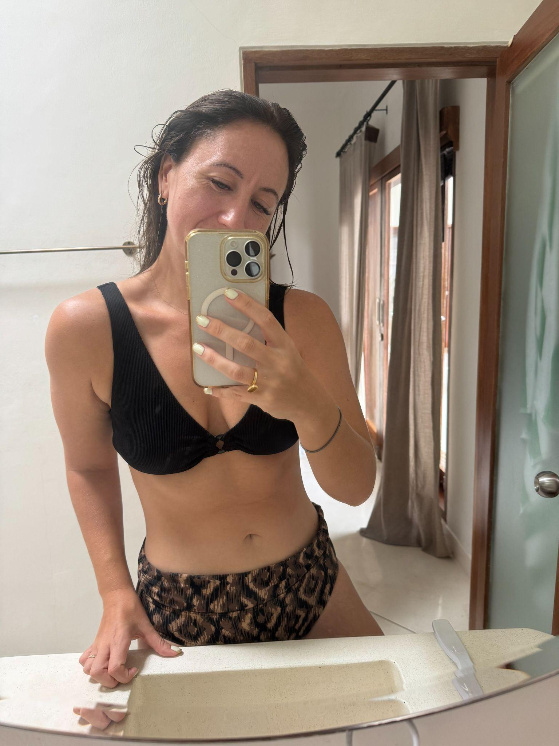
IF YOU’RE IN, JUST REPLY TO MY MESSAGE AND SAY
“IM READY FOR VIP”
I will let you know if there’s spaces left. Spaces are limited, so don’t wait — once they’re gone, they’re gone. Email me: annasnutrition@gmail.com
Anna Wallace - Founder of The Weight Loss Academy, Registered Associate Nutritionist

Slide 34
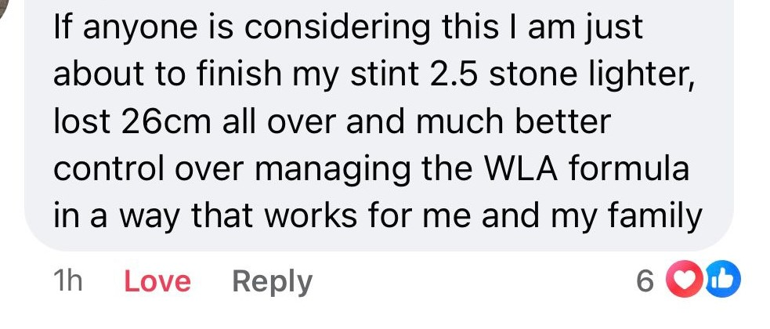

Slide 35
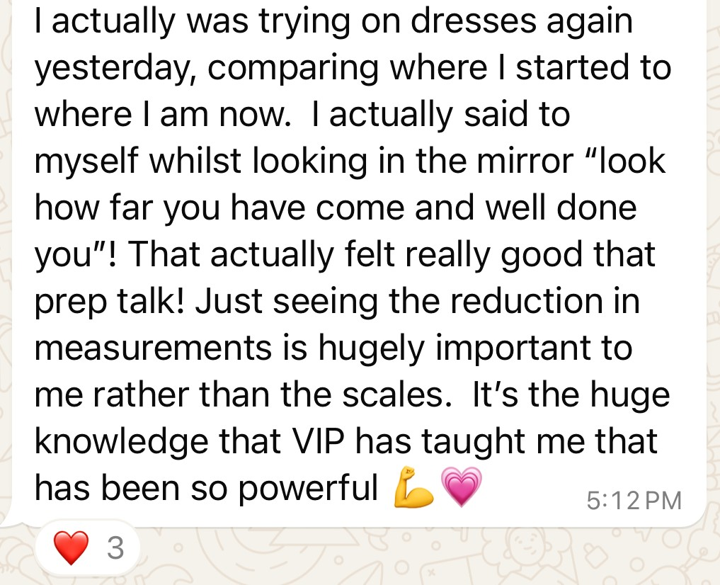

Slide 36
Who is VIP For?
Know they need support and accountability to stay consistent with their weight loss.
Are tired of trying to figure everything out alone and want a clear, personalised strategy.
Know if they are accountable to someone else, they will take action as now they makes excuses.
Want a coach to help them stay on track when motivation drops or life gets busy.
Are ready to take action and finally follow through on their goals.
Want to lose up to 3 stone in a sustainable way and keep the weight off.

Slide 37
Who is VIP Not For?
Are looking for a quick fix or crash diet.
Aren’t ready to take action or follow through with the plan.
Want results without making changes to their habits.
Prefer to do everything on their own without guidance or accountability.
Are not open to learning a sustainable approach to nutrition.
Not ready to commit

Slide 38
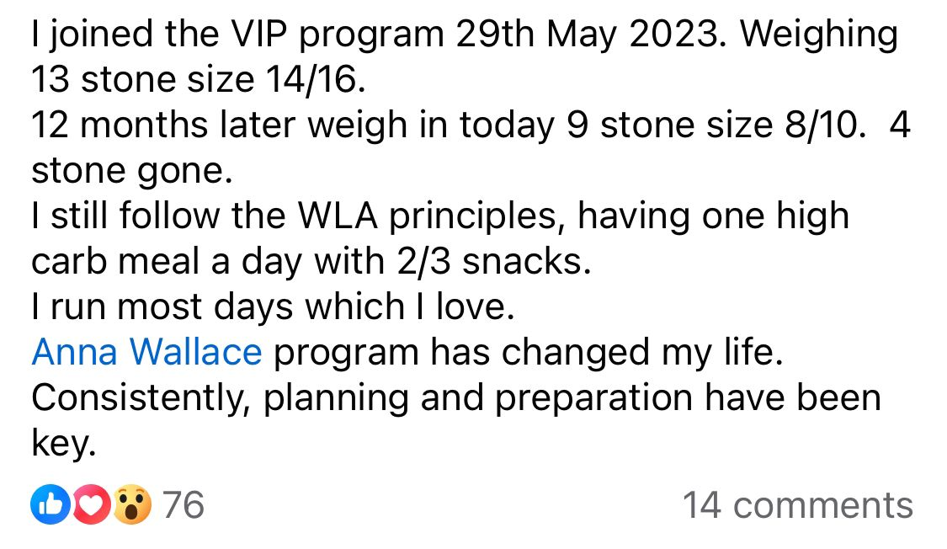

Slide 39
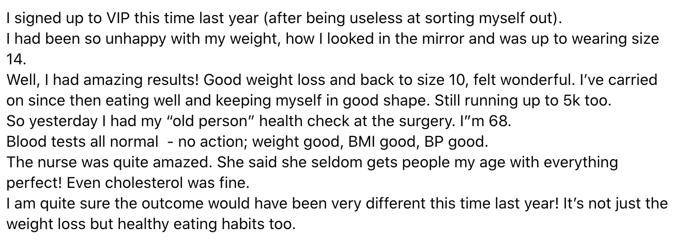

Slide 40
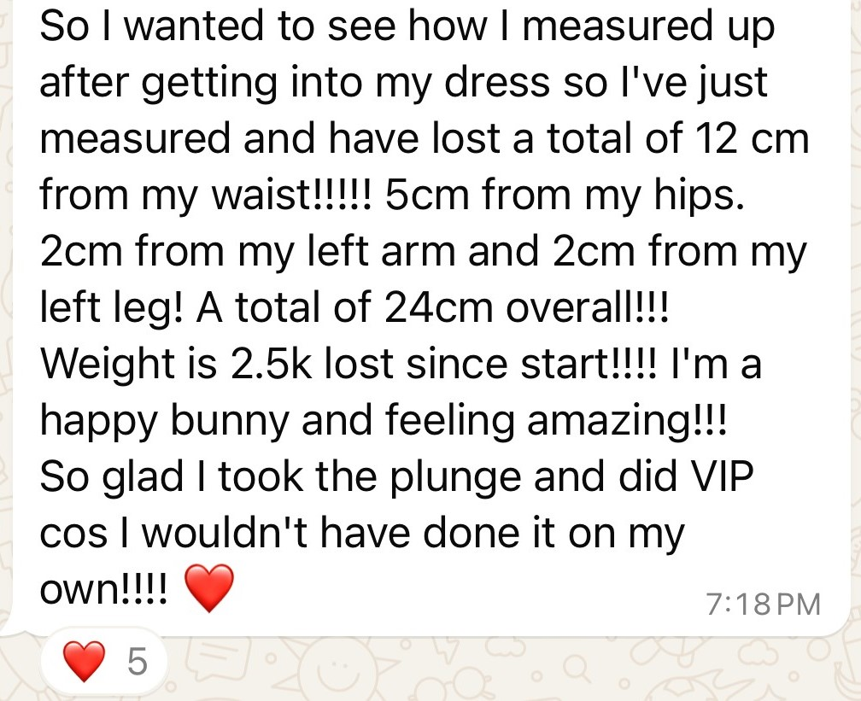

Slide 41
VIP 3 Months 1-2-1 Coaching ⭐️ Special launch price £597 ⭐️
(available until [SIGN-UP DEADLINE]) We start [START DATE] Monthly payment plans start at £199 with PayPal, Klarna and Clearpay

Slide 42
Optional Upgrade Need longer support?
Upgrade to 6 months of coaching for the best long-term results. ⭐️ 6 Months VIP - £1197 ⭐️ Sign-up closes [SIGN-UP DEADLINE]

Slide 43
IF YOU’RE IN, JUST REPLY TO MY MESSAGE AND SAY
“IM READY FOR VIP”
I will let you know if there’s spaces left. Spaces are limited — secure yours before [SIGN-UP DEADLINE]. Email me: annasnutrition@gmail.com
Anna Wallace - Founder of The Weight Loss Academy, Registered Associate Nutritionist

