Slide 1

VIP 1-2-1 COACHING
Personal coaching
that finally gets
you results.
Lose up to 3 stone — without extreme diets or exhausting workouts.
WITH ANNA WALLACE · FOUNDER OF WLA · REGISTERED ASSOCIATE NUTRITIONIST

Slide 2
A FEW VIP SPOTS HAVE OPENED
I only coach a handful of women 1-2-1 at a time — and a few spots have just opened.
If you’ve been thinking about going all-in with personal coaching, this is your moment to grab one.
My full attention, daily support, and a plan built entirely around you.

Slide 3
WHY VIP WORKS
The difference isn’t the plan.
It’s having me in your corner — every single day.
Personalised strategy. Daily support. Real accountability.

Slide 4
WHAT VIP HELPS YOU DO
Lose the weight — and feel like you again.
Lose up to 1–3 stone
Build real, lasting confidence
Calm your sugar cravings
Skyrocket your energy
Look and feel amazing by summer
No extreme diets. No exhausting workouts.

Slide 5
WHY 1-2-1 CHANGES EVERYTHING
Nothing transforms results like 1-2-1 coaching.
I’ll guide you through the exact simple nutrition formula I used to lose over 2 stone and keep it off.
As a degree-qualified Registered Associate Nutritionist with 11+ years’ experience and 50,000+ clients supported — nothing comes close to personal 1-2-1 coaching.

Slide 6
THE VIP METHOD
Three things that make VIP different.
01
02
03
Personalised Strategy
High Accountability
Results Tracking

Slide 7
01
STEP 1 OF 3
Personalised Nutrition Strategy
A plan built entirely around you.
We build a simple nutrition strategy tailored to your lifestyle, goals, time and preferences.
No guesswork. No extremes. No starting again every Monday — just a clear structure that reduces cravings and gets results sooner.

Slide 8
02
STEP 2 OF 3
High Accountability & Daily Support
The part most women are missing.
When you’re accountable to someone else, you show up, follow through and take your goals seriously.
With regular check-ins, coaching and daily support, you stay on track — even on the days you don’t feel like it.

Slide 9
03
STEP 3 OF 3
Results Tracking
We measure what matters, every month.
You submit your results each month so we can track progress clearly and keep you moving forward.
We review everything and make the right adjustments along the way, so your results keep progressing.

Slide 10
THE RESEARCH
Human 1-2-1 coaching outperforms digital-only or self-guided approaches.
A Stanford University study found people with access to a human coach lost significantly more weight than those using digital tools alone — even when the information was identical.
It’s not the plan. It’s the support, accountability and feedback.

Slide 11
WHY MOST WOMEN STAY STUCK
You already know what to do. Following through is the hard part.
Most women are stuck in the cycle of starting… stopping… and never quite following through. A good week, then life gets busy, motivation drops, and it’s back to square one.
Not because they don’t care — because they’re trying to do it alone. That’s exactly why VIP works.

Slide 12
IMAGINE, BY SUMMER
Picture this version of you…
Putting on your favourite clothes and loving how you look
Waking up lighter, energised and comfortable
No more constant cravings or evening snacking
Feeling proud of the woman in the mirror
Enjoying holidays and BBQs without worrying about your weight
Knowing exactly how to eat to lose weight and keep it off

Slide 13
SOUND FAMILIAR?
Are you struggling with…?
TIME
RESULTS
CONSISTENCY
No time to figure out your nutrition? Get a personalised strategy done for you.
Sick of not seeing results and want monthly progress you can feel?
Need a coach so you actually stay consistent instead of quitting?
ENERGY
SNACKING
WEEKENDS
Want a setup that gives you energy — off the sugar-and-caffeine cycle?
Need support to stop the evening snacking that’s just habit?
Want weekend handholding so you don’t undo your hard work?

Slide 14
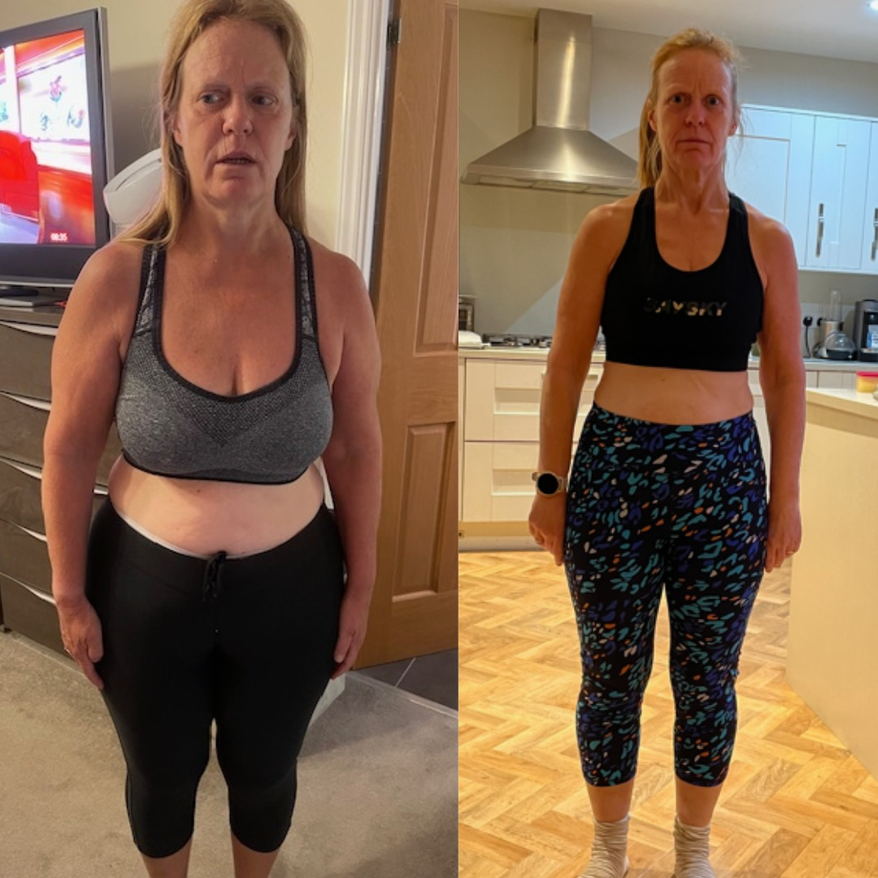
VIP SUCCESS STORY
Jill lost 4 stone
In 6 months of 1-2-1 VIP coaching.

Slide 15
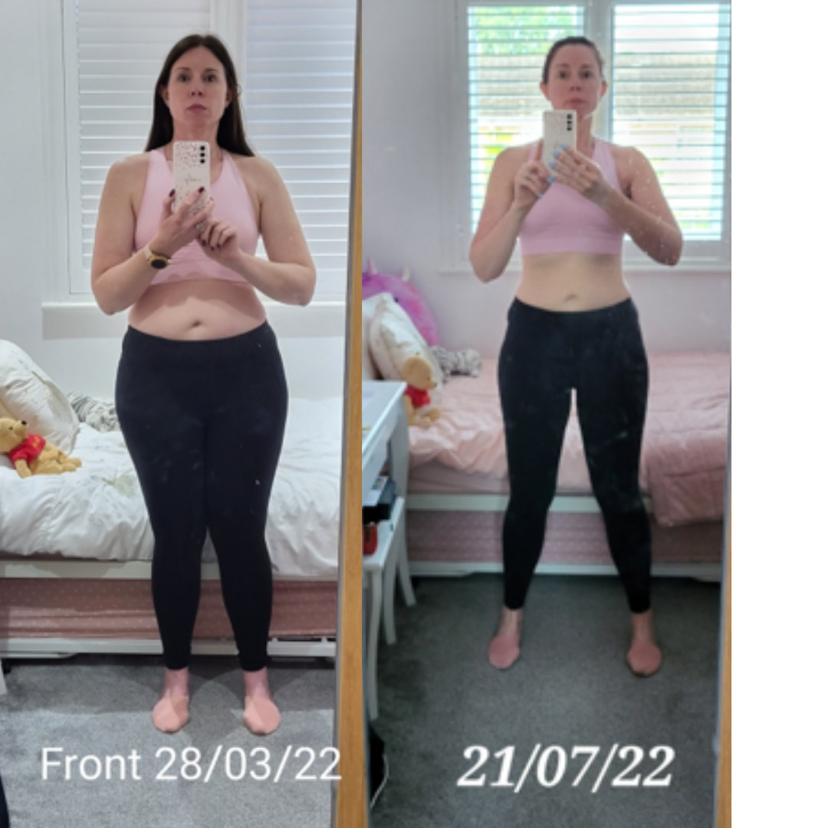
VIP SUCCESS STORY
Carly lost one stone
In her very first month of VIP.

Slide 16
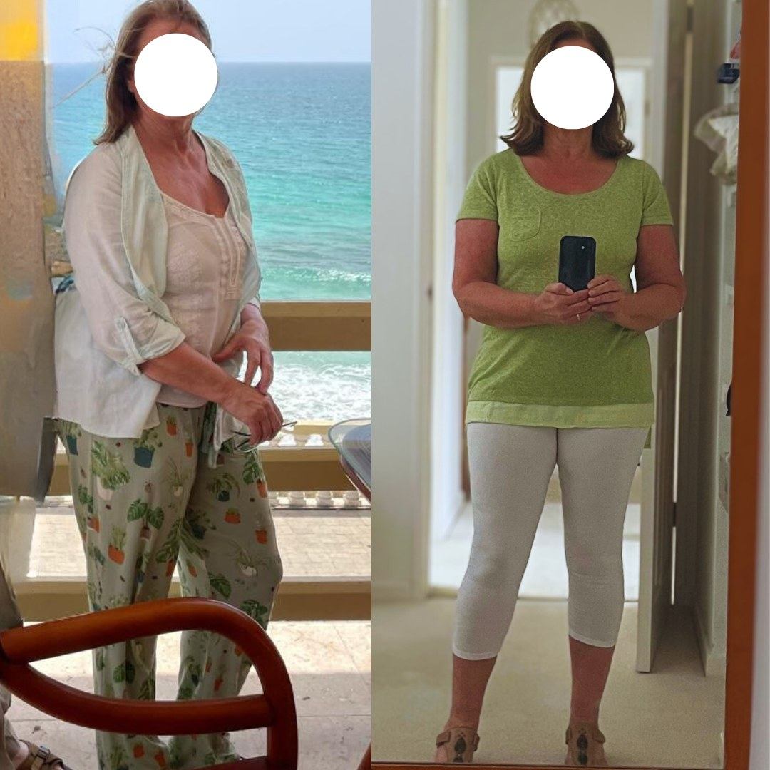
VIP SUCCESS STORY
Moira: size 14 to a 10
A stunning drop in just 5 months.

Slide 17
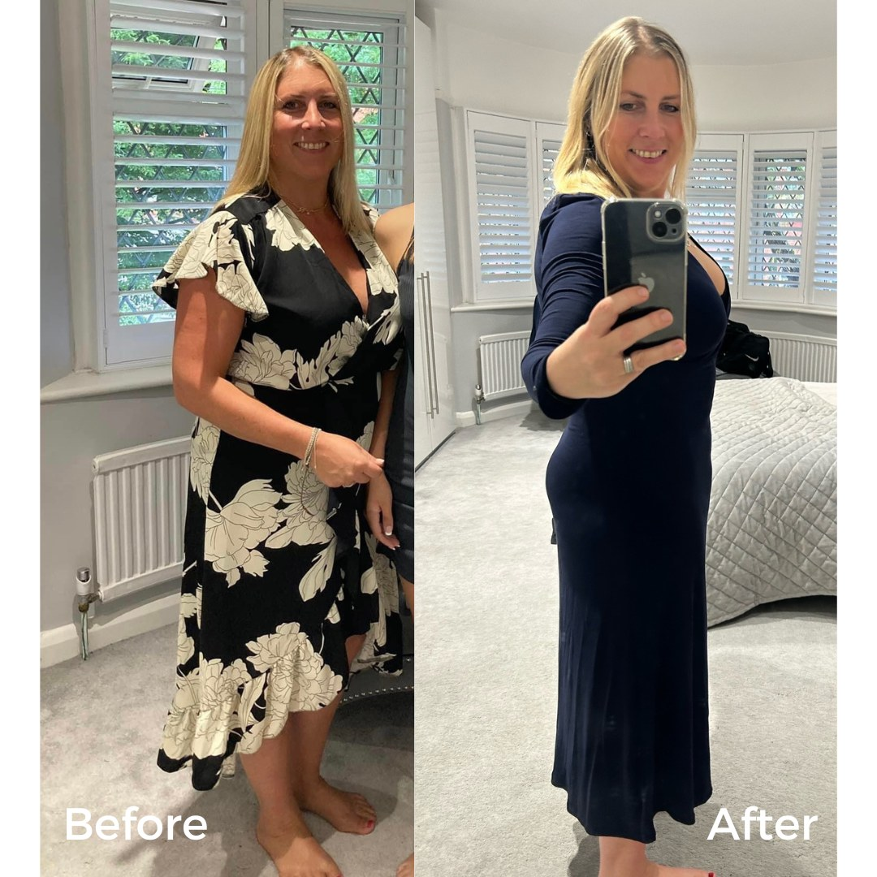
VIP SUCCESS STORY
Denise lost a stone
And reached her happy place in VIP.

Slide 18
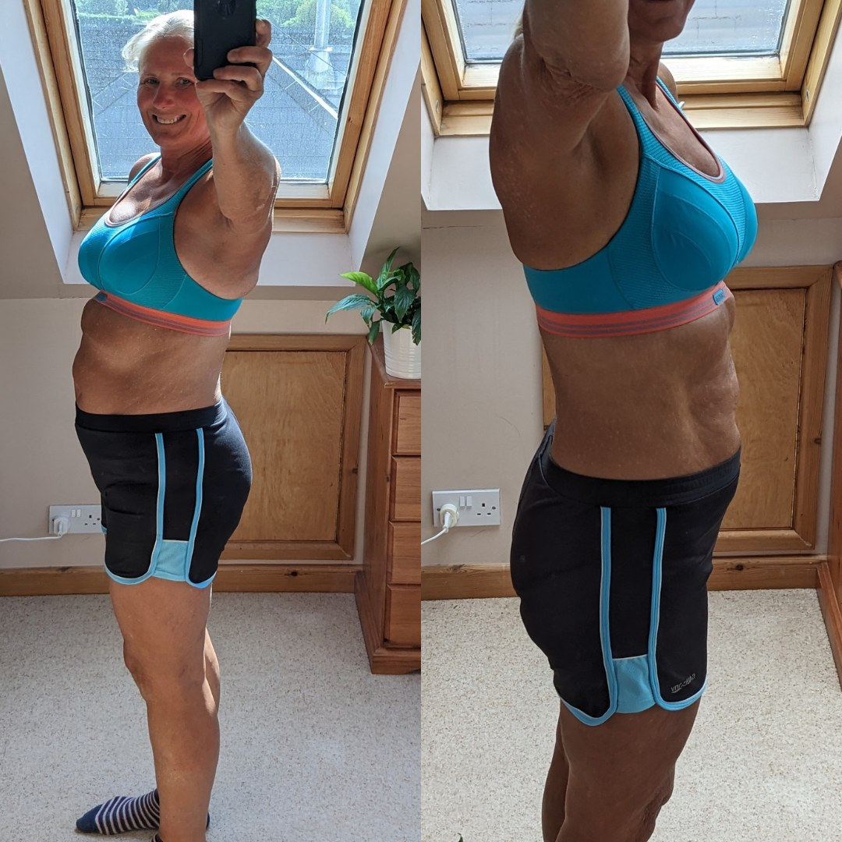
VIP SUCCESS STORY
Sally lost a stone
In just 2 months of VIP coaching.

Slide 19
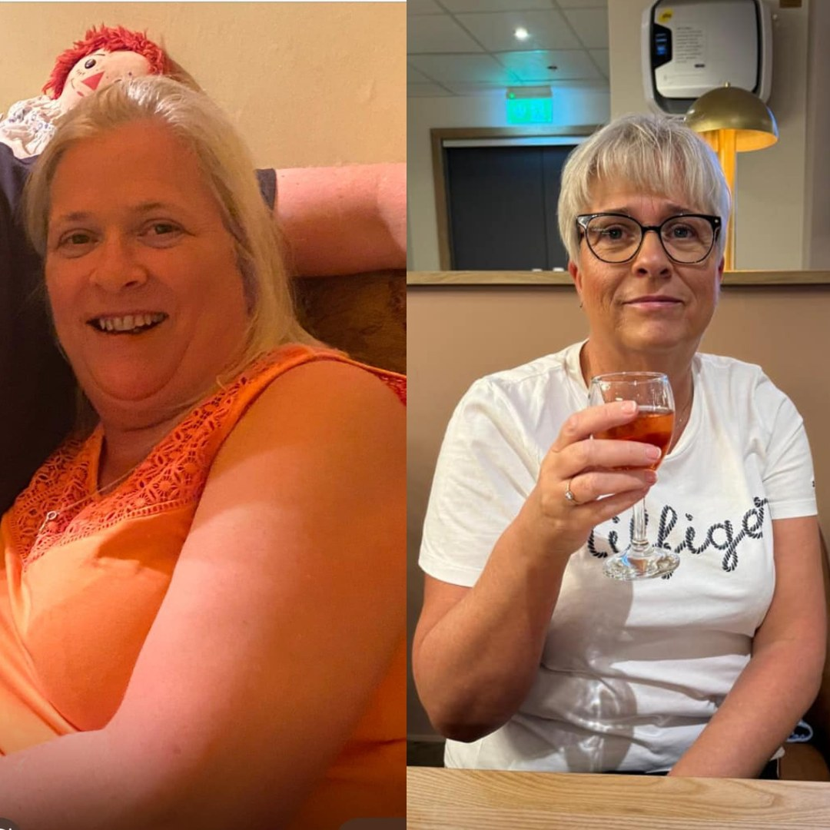
VIP SUCCESS STORY
Sam completely transformed
A total transformation inside VIP.

Slide 20
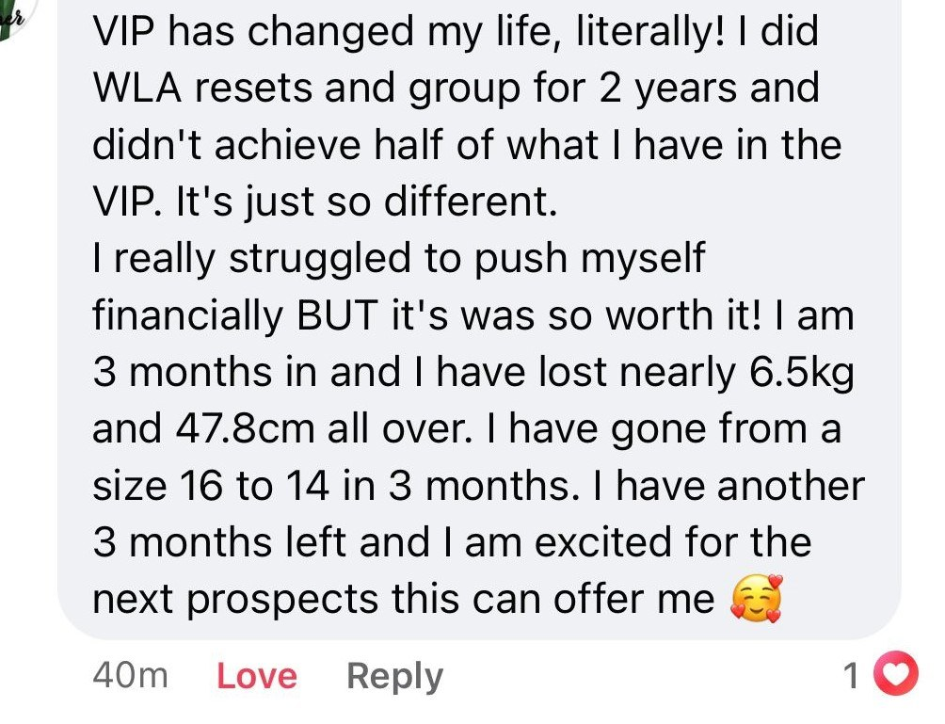
IN THEIR WORDS
VIP is just different.
She'd done resets and group coaching for two years. In her first 3 months of VIP, she dropped from a size 16 to a 14.

Slide 21
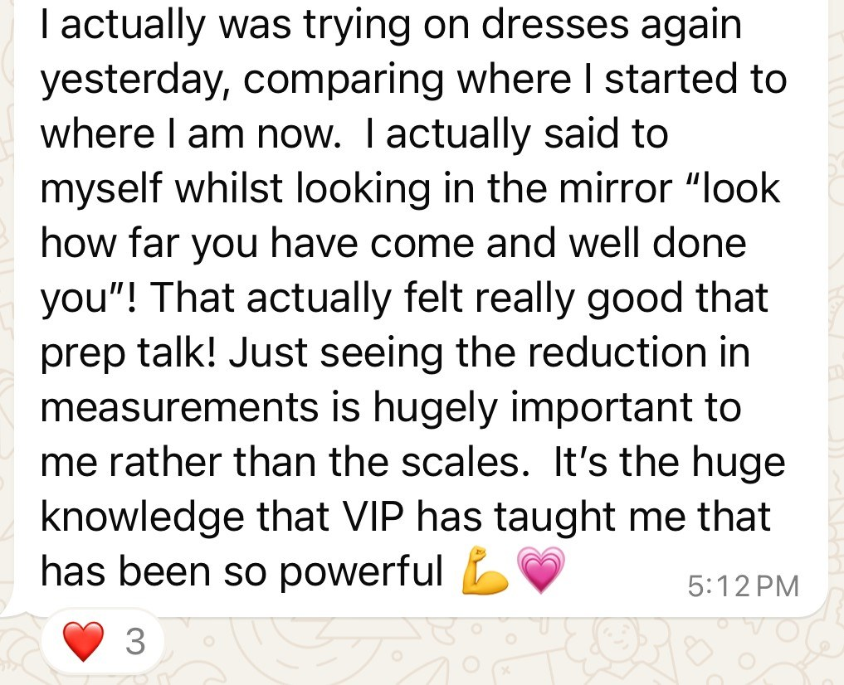
IN THEIR WORDS
Trying on dresses with confidence.
It's the knowledge VIP has taught her, not just the number on the scales, that she values most.

Slide 22
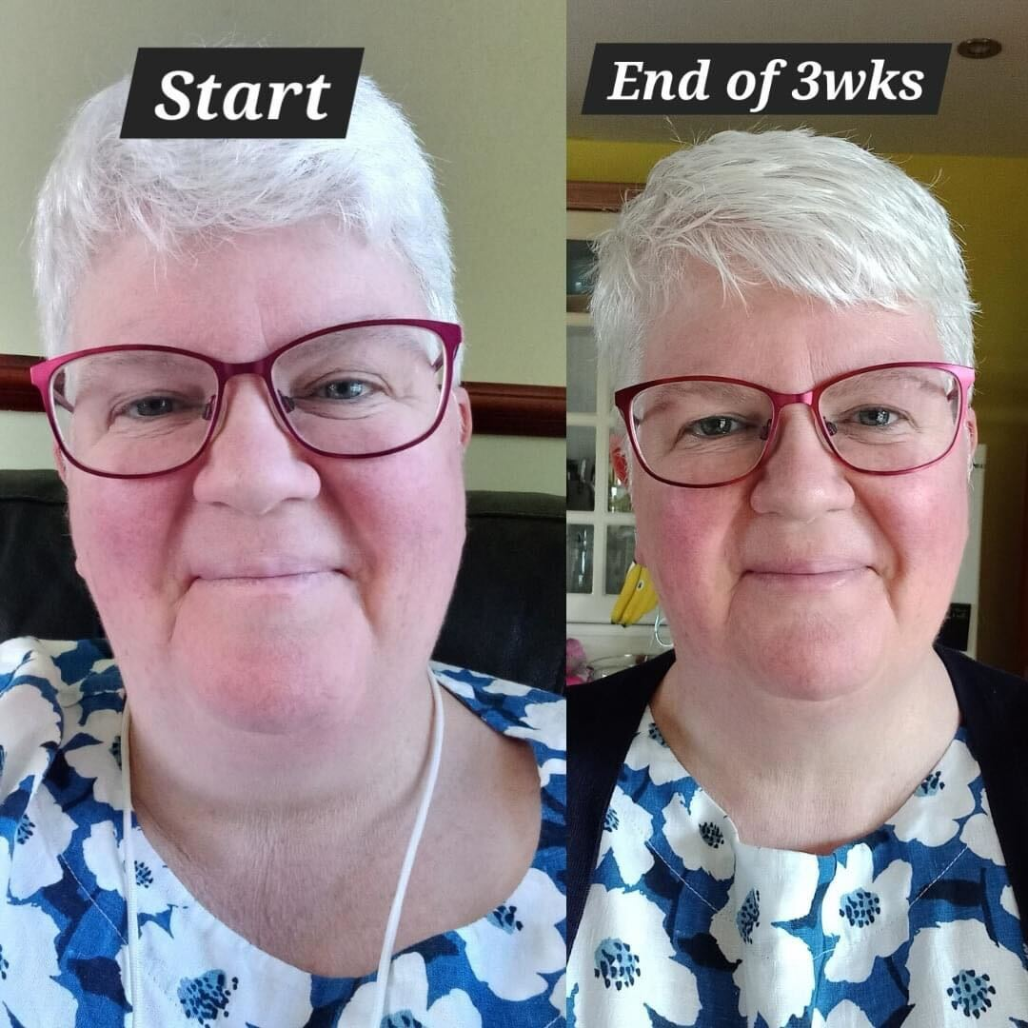
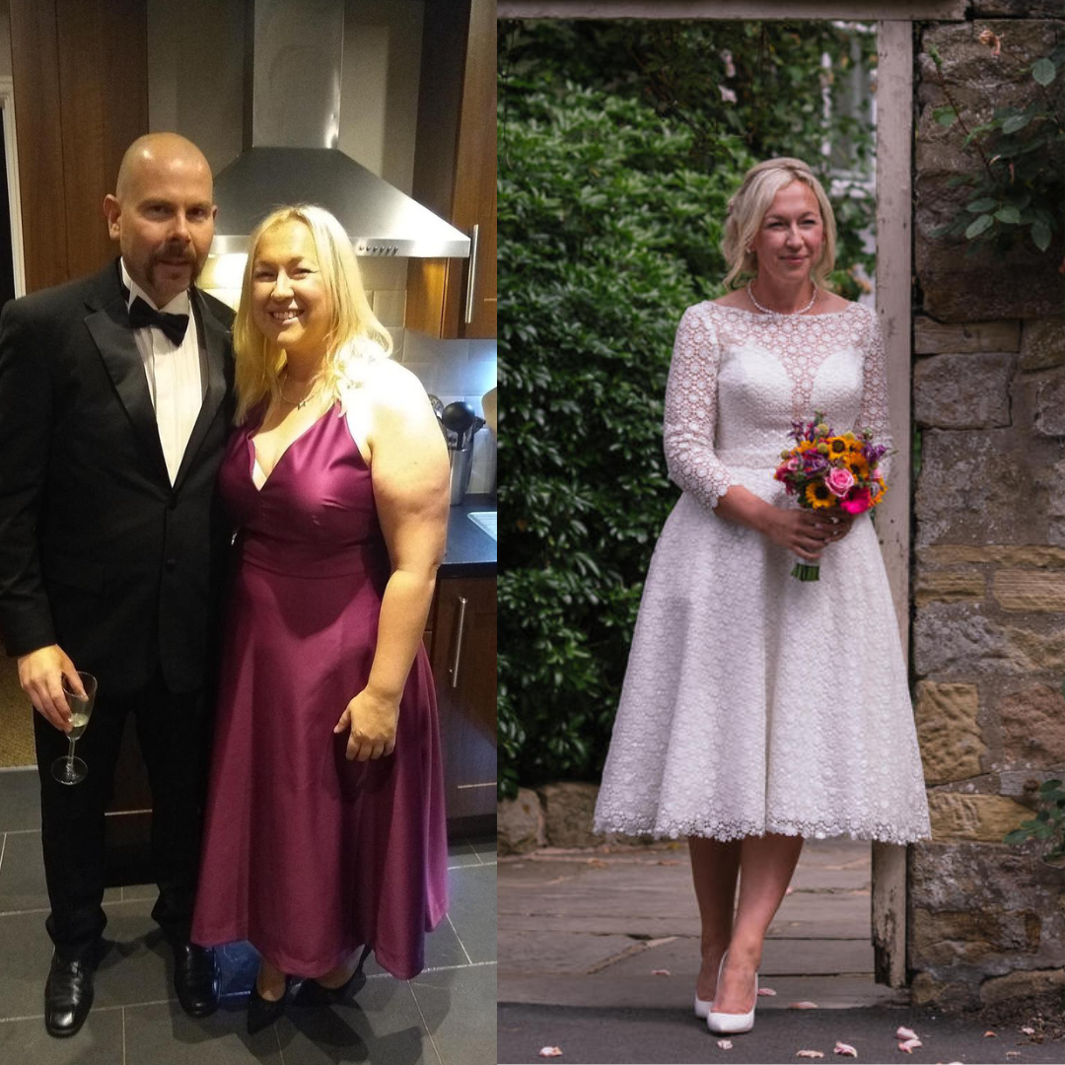
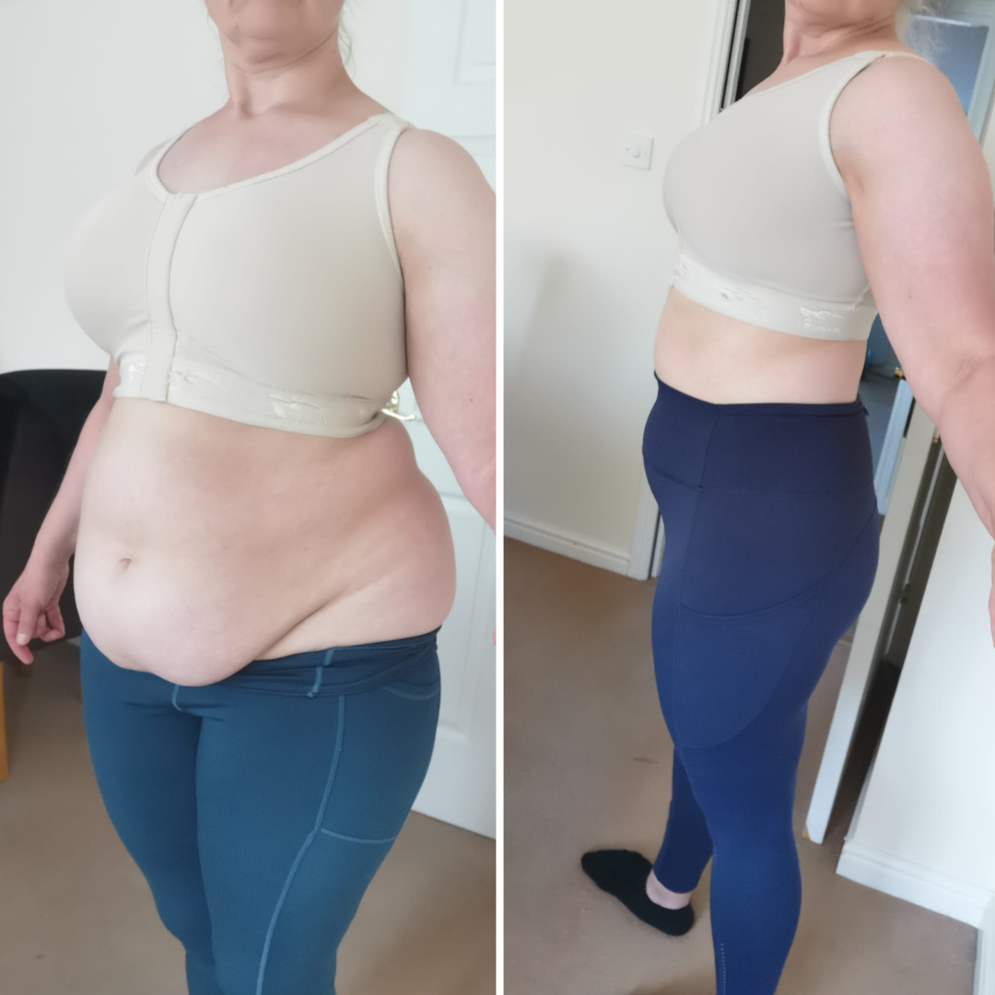
REAL WOMEN, REAL RESULTS
The transformations speak for themselves.
From 1 to 4 stone down — in 1-2-1 VIP coaching with Anna.

Slide 23
EVERYTHING YOU GET
What’s included
✓
Monthly 1-2-1 Coaching Sessions
A dedicated session each month to review progress and refine your plan.
✓
Daily WhatsApp / Messenger Support
Your coach in your pocket for guidance and encouragement every day.
✓
Weekly Food Diary Review
We review your nutrition each week and adjust what’s working.
✓
Weekly Nutrition Strategy
Your plan evolves with your progress, lifestyle and goals.
✓
Laser-Focused Weekly Actions
Clear priorities each week so you always know your next step.
✓
Monthly Progress Tracking & Review
Structured check-ins to keep you accountable and moving forward.
✓
Shift & Sustain Members Area
Full access to meal guides, recipes and the WLA framework.
✓
A Strategy Built Around You
No guesswork, no extremes — just a clear plan that fits your life.

Slide 24
INVESTMENT VS REALITY
This level of support usually costs thousands.
Most degree-qualified Registered Associate Nutritionists charge £300–£700 for consultations and ongoing monthly support.
True 1-2-1 coaching — daily support, weekly reviews, a personalised strategy — typically runs £2,000–£5,000+ (take a look around Harley Street).
For this round, I’ve made it far more accessible.

Slide 25
CHOOSE YOUR VIP JOURNEY
Personal 1-2-1 coaching, built around you.
BEST VALUE
VIP · 3 MONTHS
VIP · 6 MONTHS
£597
£1197
3 months of personalised 1-2-1 coaching
The time to lose it AND keep it off for good
Monthly plans from £199
Most of my biggest transformations
Pay with PayPal, Klarna or Clearpay · Limited to 30 women · Doors open [START DATE]

Slide 26
IS THIS YOU?
Who VIP is for
You know you need support and accountability to stay consistent
You’re tired of figuring it all out alone
You take action when someone’s holding you to it
You want a coach for when motivation dips or life gets busy
You’re ready to follow through on your goals
You want to lose up to 3 stone — sustainably, for good

Slide 27
HONESTY FIRST
Who VIP is not for
You’re looking for a quick fix or crash diet
You’re not ready to take action or follow through
You want results without changing any habits
You’d rather do everything alone, without guidance
You’re not open to a sustainable approach to nutrition
You’re not ready to commit right now

Slide 28
TWO OPTIONS
You can keep doing this alone — and be in the same place in 3–6 months.
Or get the support, structure and accountability to finally follow through.

Slide 29
READY?
Reply and say “I’m ready for VIP.”
I’ll let you know if there are spaces left. Spaces are limited to 30 women — and previous VIP rounds have always filled.
Email me: annasnutrition@gmail.com
Anna Wallace · Founder of The Weight Loss Academy, Registered Associate Nutritionist

