Slide 1
HAUptic Paddle
Avinash Baskaran
Chad G. Rose

Slide 2
Hardware: Commercial Components

Slide 3
Hardware: 3D Printing

Slide 4
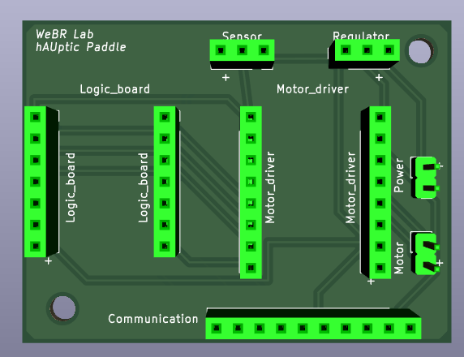
Electronics: PCB

Slide 5
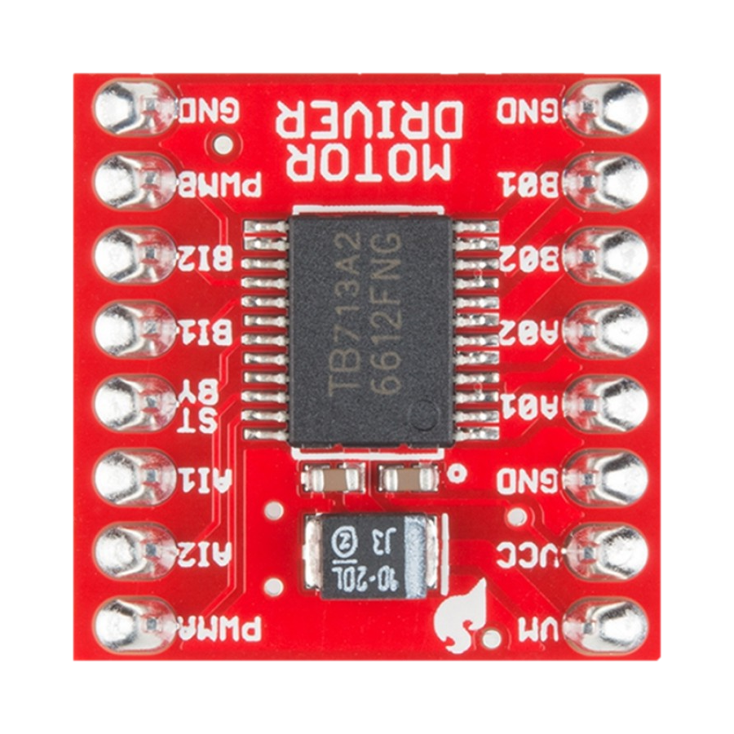
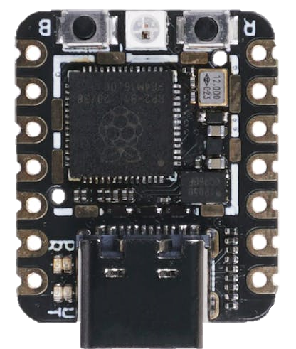
Electronics: PCB internal connections
GND
DNC
DNC
DNC
HIGH
Dir (1/0)
Dir (1/0)
PWM
GND
Motor (+)
Motor (-)
DNC
DNC
GND
Supply (5v) +
Supply (12v) +
DNC
….
…

Slide 6
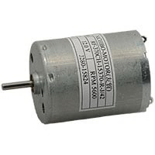
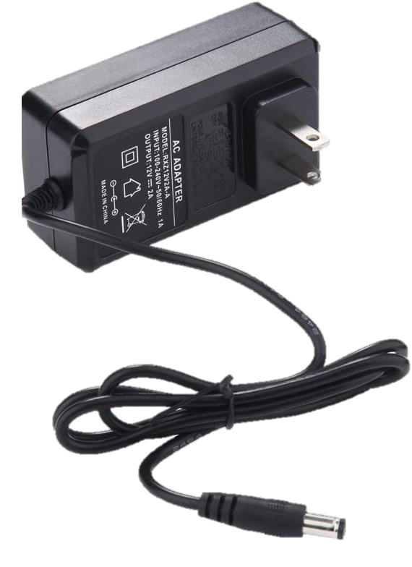
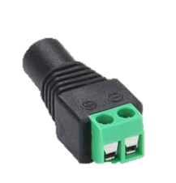
Electronics: PCB external connections
DNC

Slide 7
Electronics: PCB external connections
DNC

Slide 8
Software: Interfacing

Slide 9
Assembly

