Slide 1
Internet of Things Twin Digital Bridge
Arezou Ranjbarpour Maralani
&
Lorenzo Tibaldi

Slide 2
Goal of the project
Designing a prototype for realtime infrastructure maintenance.
A bridge will be equipped with sensor units that will communicate with the main machine of the system.
By exchanging informations with a database it will be possible to trigger alerts when needed.
Through a dashboard it will also be possible to visualize these sensor readings and introduce new alerts.

Slide 3
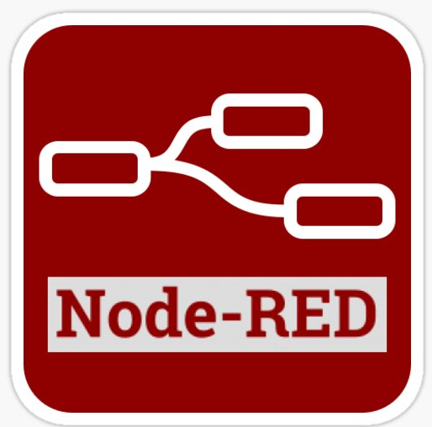

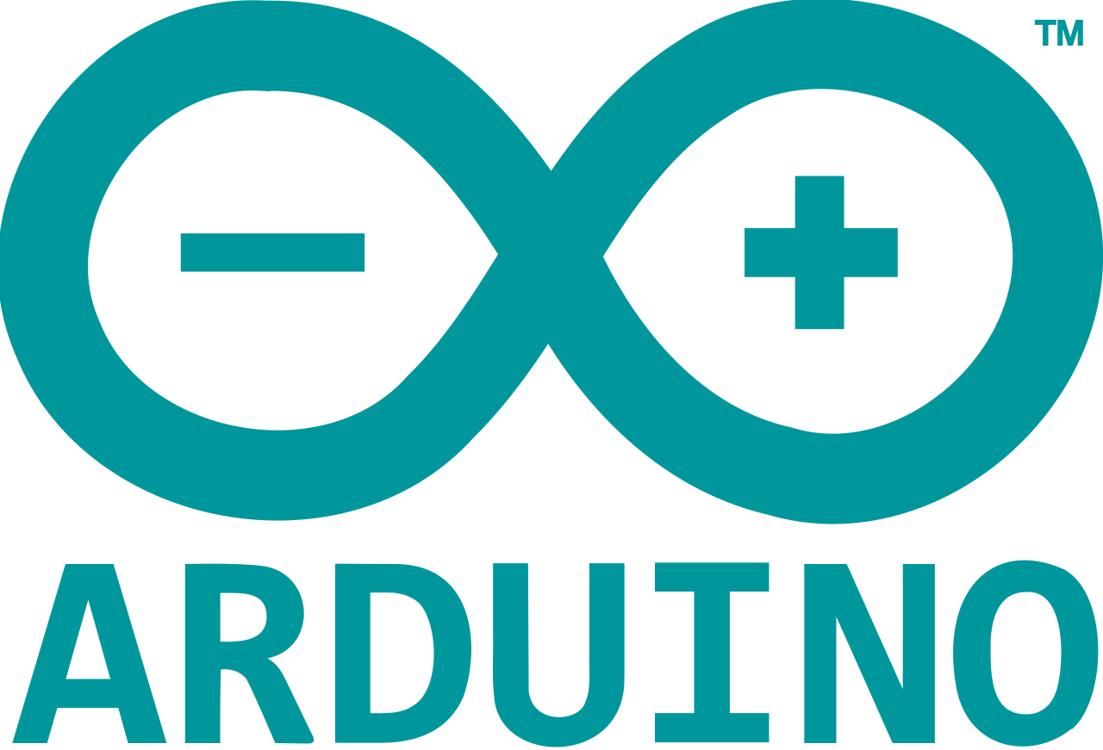




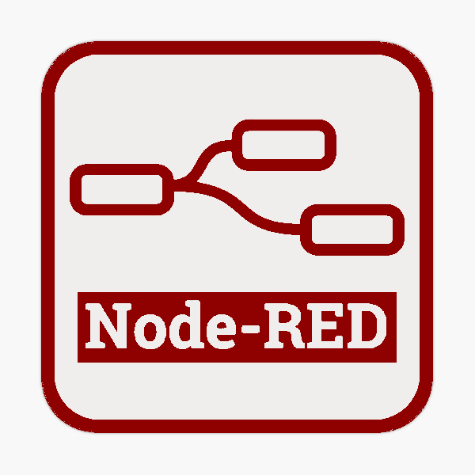


System's Backbone
Sensors' Design
Communications
Dashboard and Visualization
Persistent Database

Slide 4

1
2
3
4

Slide 5
The Sensors
Designed in Tinkercad Circuits
Not all Hardware was available
The code, written in Arduino code, could not be tested
Operations
Obtain the readings from the physical sensors
Only store the values temporarily
Create a JSON file following the template
Send the file through MQTT publishes on the topic: TDB/Readings

Slide 6
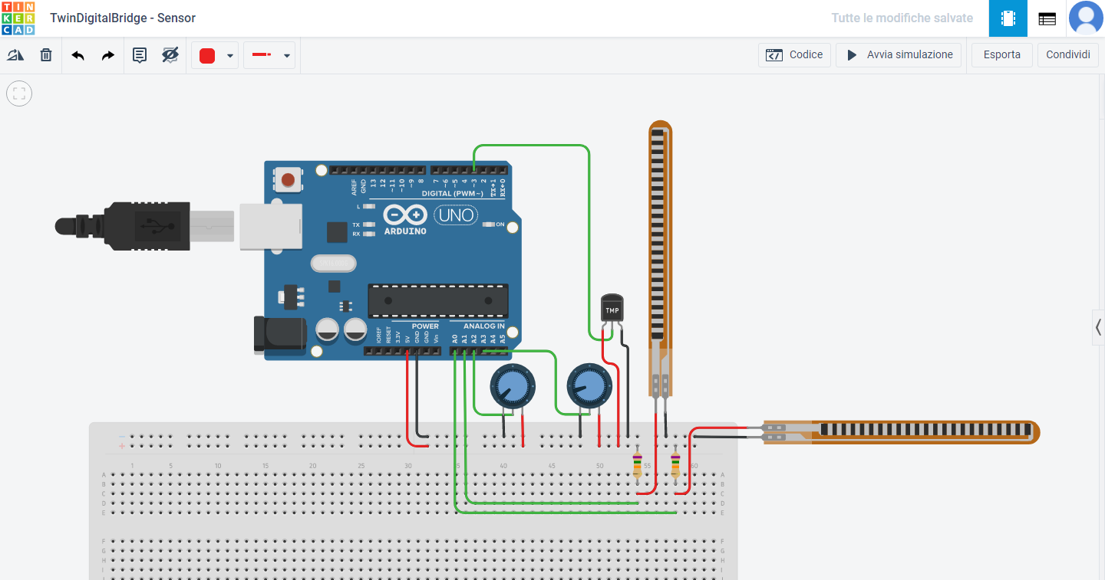
The Sensors

Slide 7
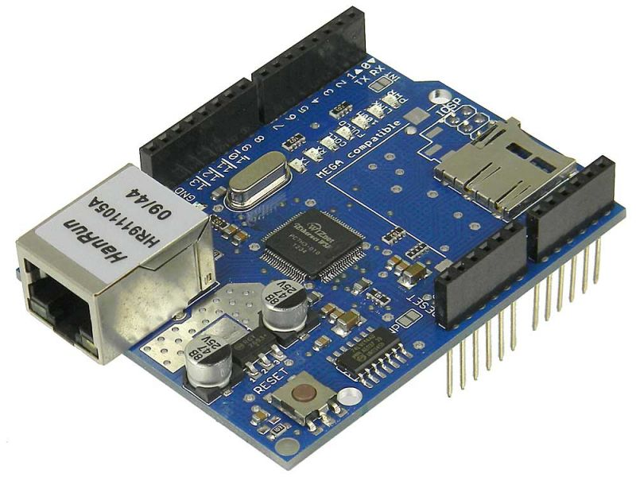
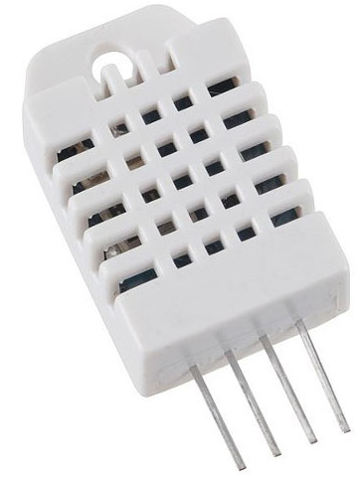
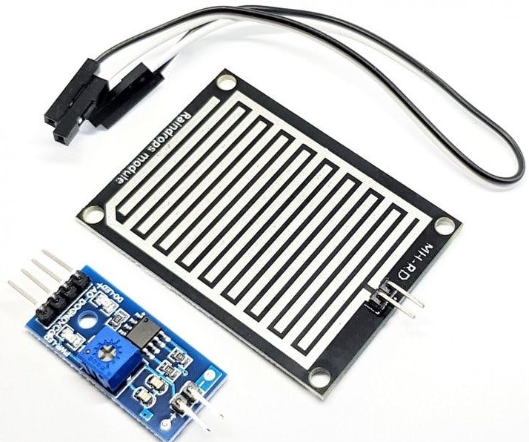
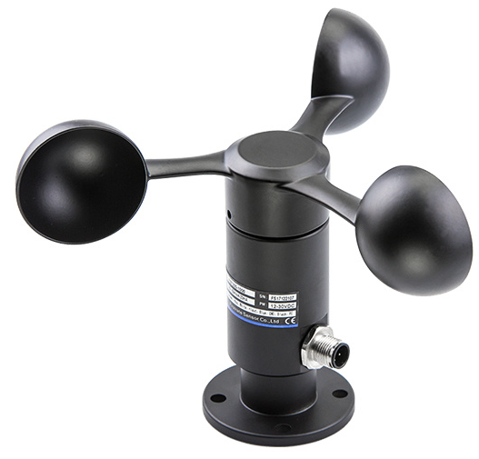
The Sensors
An Ethernet Shield is necessary to be able to use the MQTT protocol with an Arduino Uno
A DHT22 sensor for temperature and humidity must replace the placeholder temperature sensor
A water sensor for the rain amount must replace one placeholder potentiometer
An anemometer for wind speed must replace one placeholder potentiometer

Slide 8
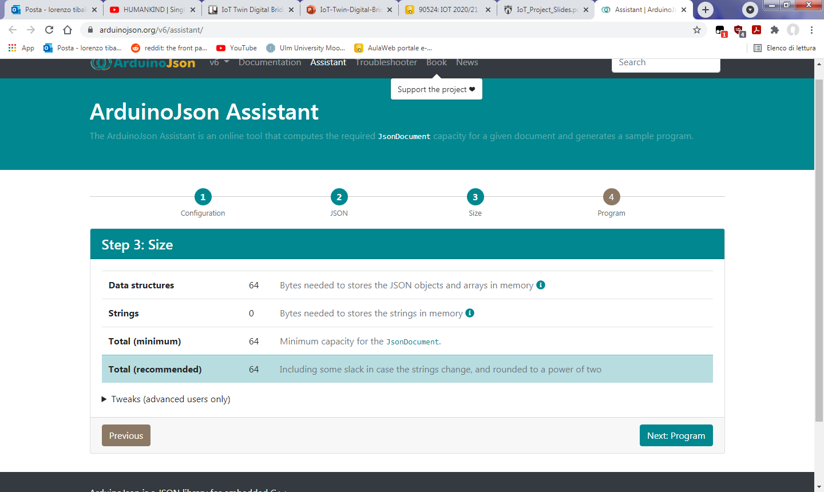
Lightweight!
The only data sent by the sensors is a single JSON file per reading.
By using this tool offered by the ArduinoJson library, we were able to measure the maximum size one of these readings will ever have.
Just 64 Bytes!
The other MQTT connections won't be so light but, on the other hand, they are between the monitoring system and the database.
Those machines aren't as constrained as an Arduino Uno is.

Slide 9
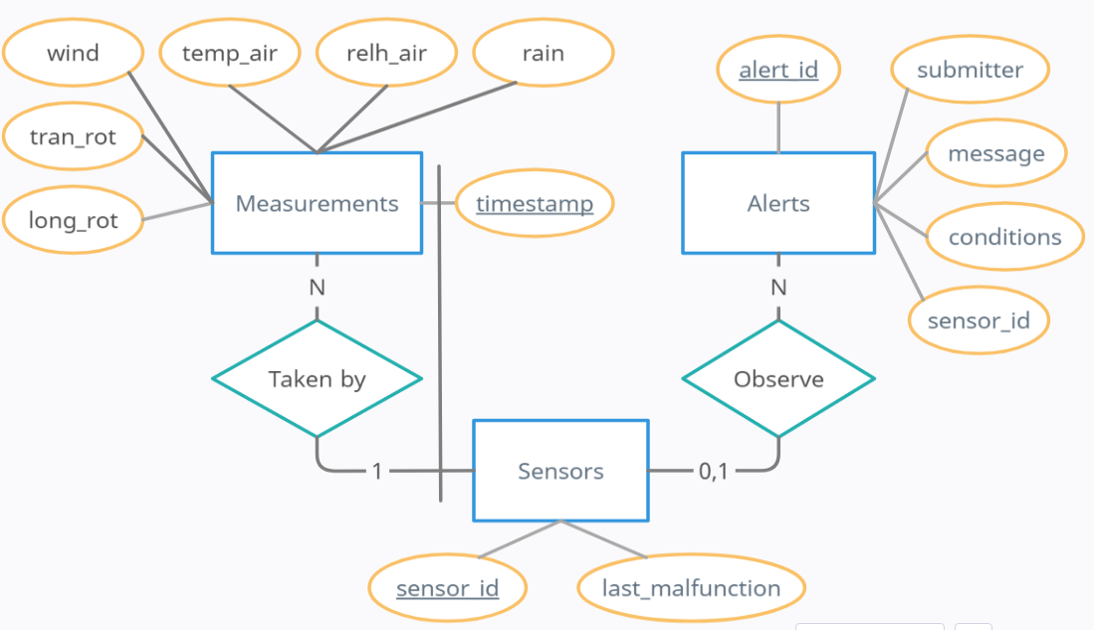
Database Structure

Slide 10
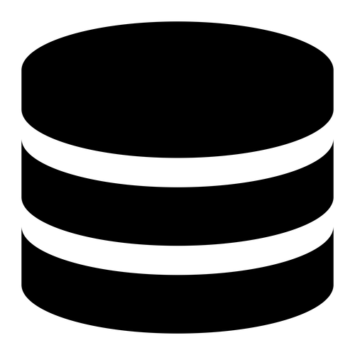
The evolution of the Database
Information stored as
Node-red variables.
The main machine of the system can never be reset, or it will lose the information of the last session.
Information stored in a local SQLite database.
The main machine of the system and the database must be in the same local network.
Information stored in a SQLite database that is queried using the MQTT protocol.
The system is now distributed.

Slide 11
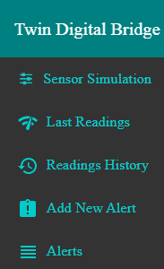
The Dashboard
The only way for the user to interface with the system is through the dashboard that is provided at:
{node-red address}/ui
The view is divided in 5 different tabs:
To simulate the delivery of a sensor measurement. (developer only)
To observe the last readings of any sensor and, optionally, add new sensors.
To visualize all the measurements that are present in the database.
To create new alerts, so that future readings can notify the user.
To visualize all the alerts that are present in the database.

Slide 12
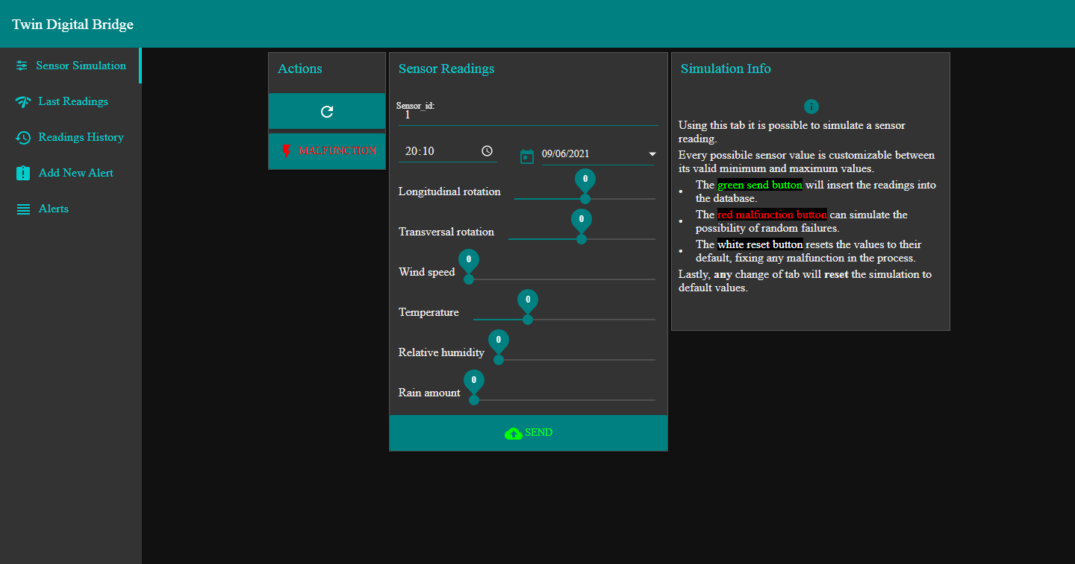

Slide 13
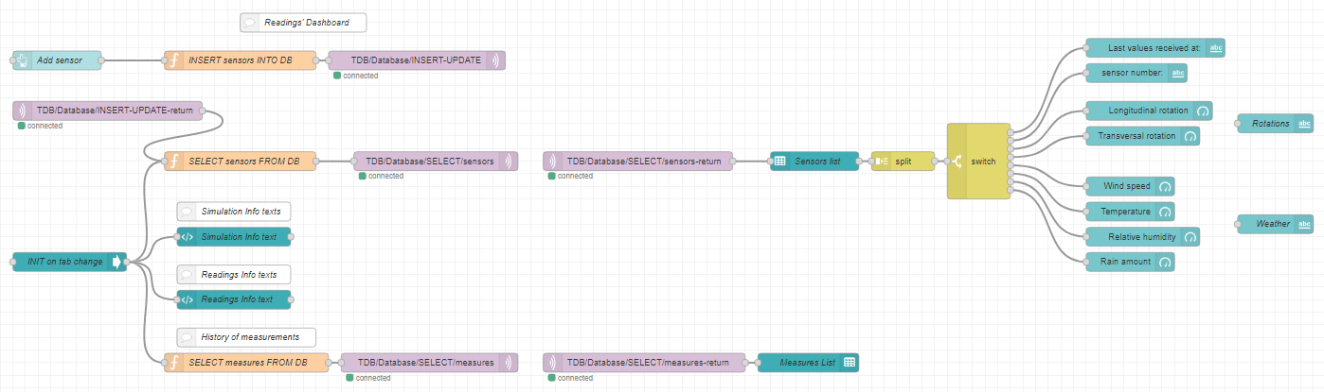
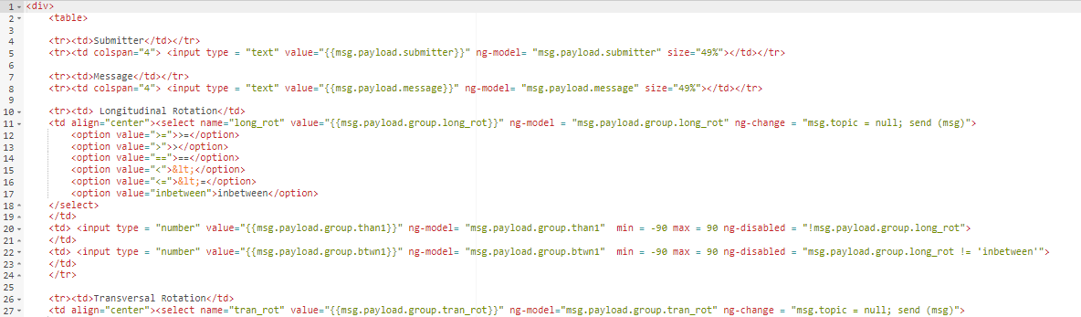
Easy to use Visual Programming with Node-red Dashboard
Flexible for specific use cases with the built-in template node and Angularjs

Slide 14
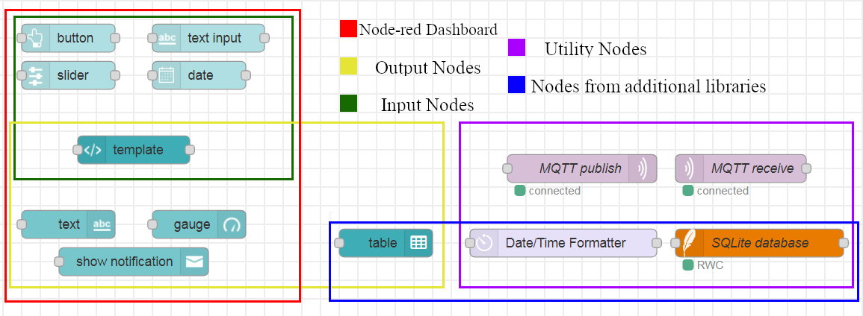
Node-red nodes used
Only Node-red Dashboard and 3 additional nodes were used for the whole dashboard.
The template node could be used in substitution to all the other dashboard nodes by writing the ui elements in Angularjs.

Slide 15
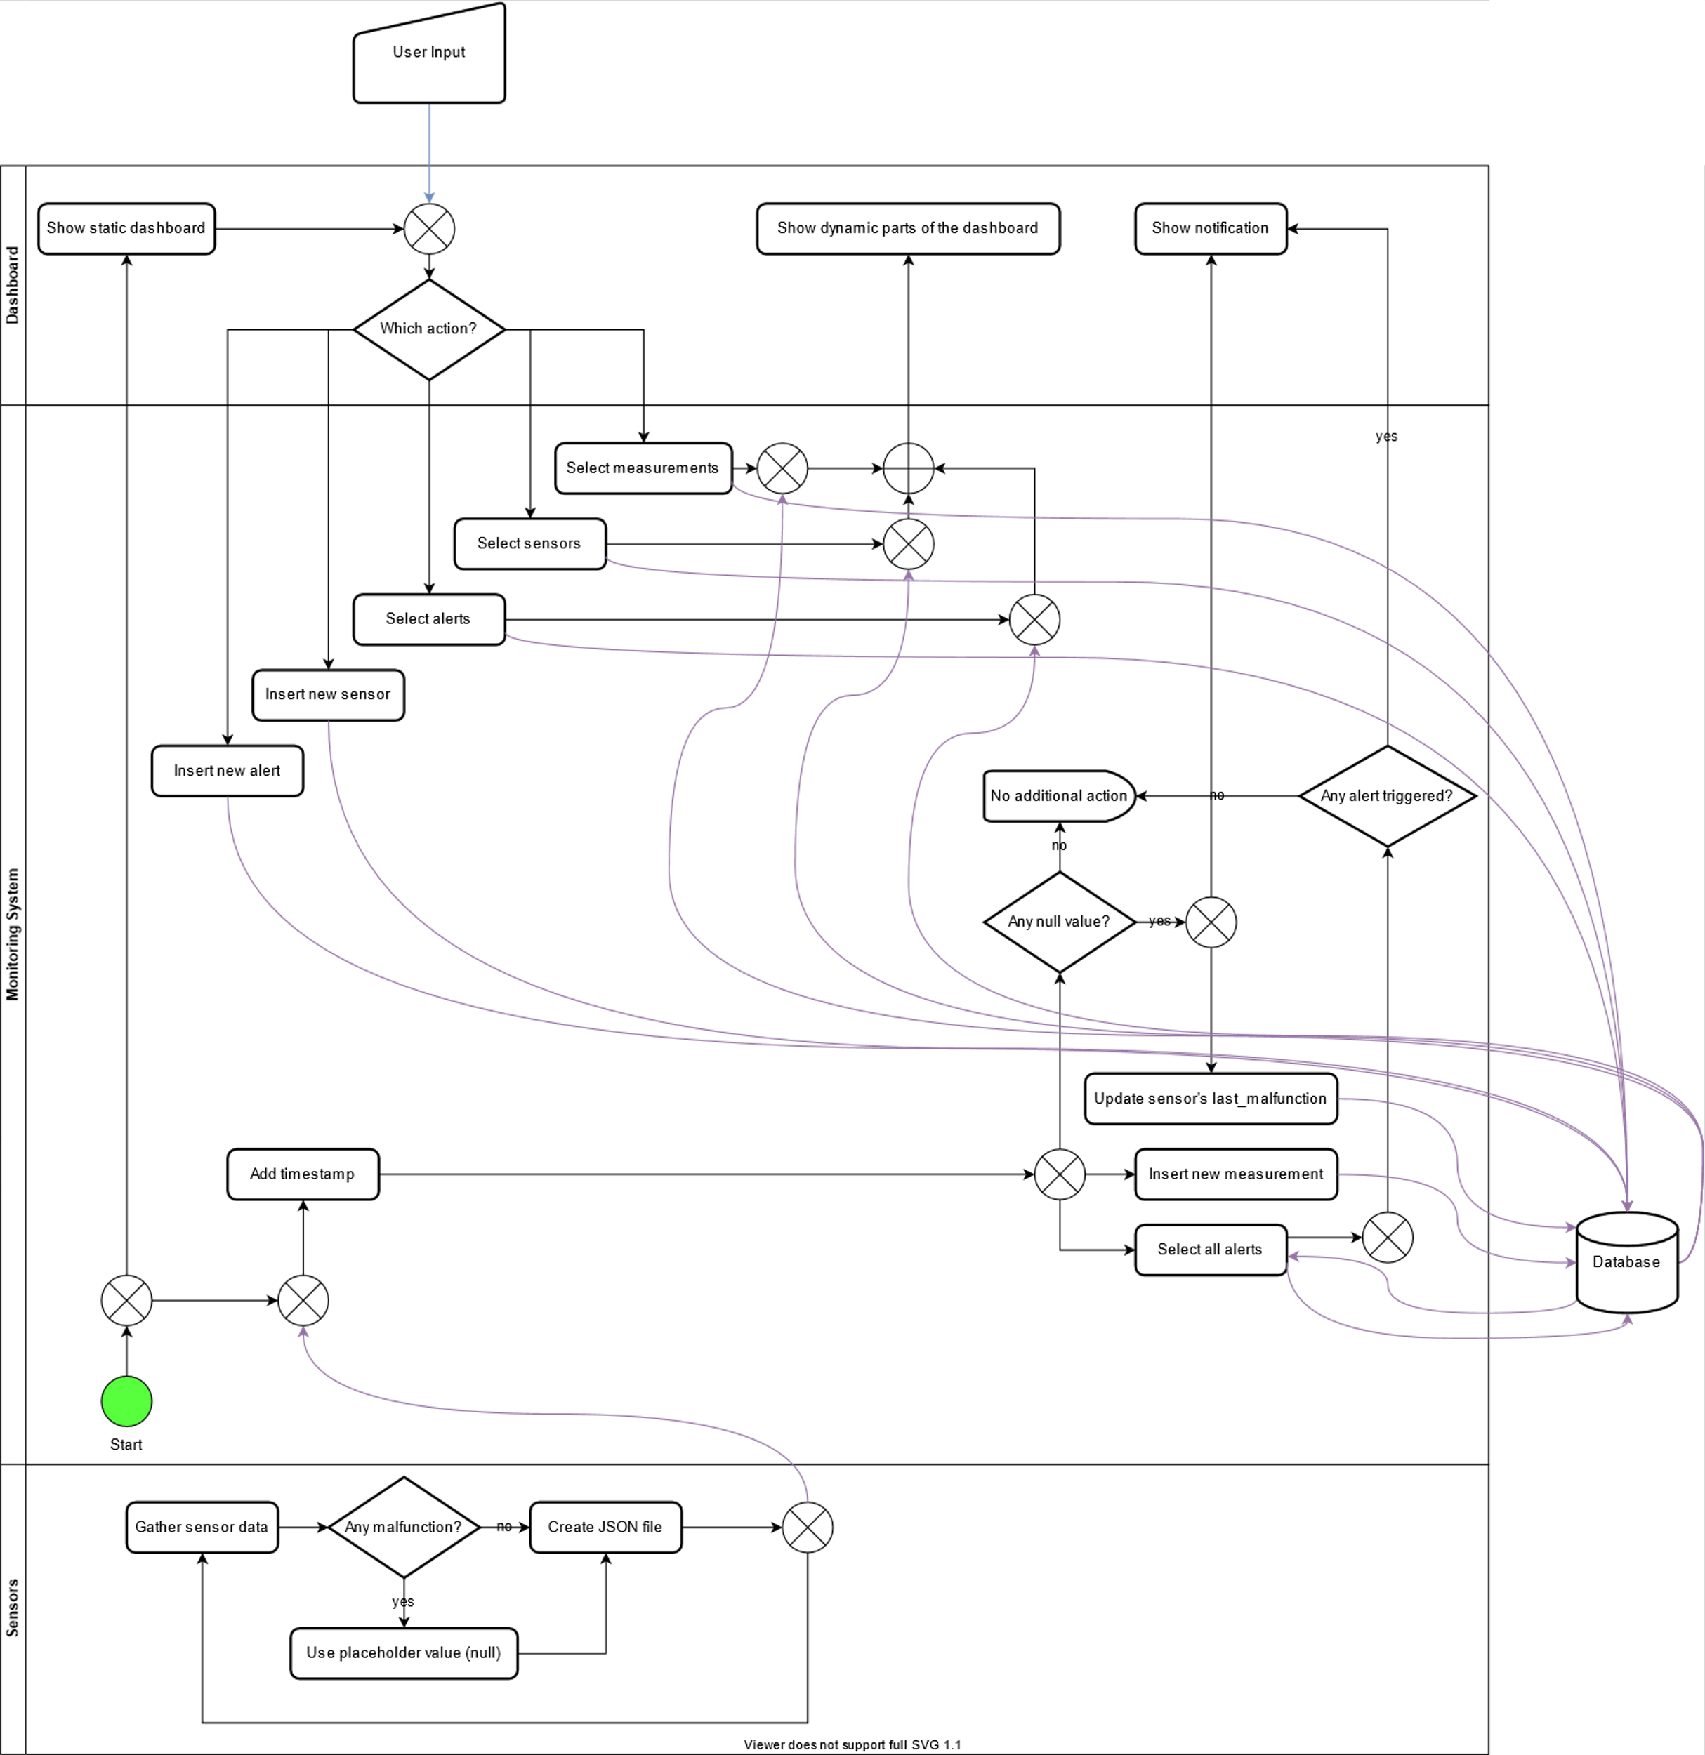

Flowchart of the System
All the curved purple lines represent MQTT connections.
With the exception of having the dashboard in the same machine as the logic (by design) every other component crosses boundaries with MQTT exchanges, making it easy to distribute the system.

Slide 16
Possible improvements
About the system:
Node-red is by default unsecure and token credentials or encrypted keys would be necessary for a real life implementation.
If some consistency policies are setup, it would be possible to separate the main machine from the dashboard. (for example so that many users can add alerts simultaneously)
About the sensors:
The code provided should be compiled and tested for real deployments.
A smart solution to detect sensors' malfunctions would also be very important.
About the dashboard:
Any improvement to the UI, requiring front-end expertise.

Slide 17
Possible improvements
About the database:
An admin account able to manipulate the database, possibly without even needing to reset the system.
Distributing the data in multiple databases and safeguarding it. (for example with redundancy)
Offering the possibility of filtering the data to the user.
About the communications:
Taking precautions against the inherent weaknesses of MQTT. (for example an attacker could listen to the communications of the system just by being subscribed to the correct topic)
Moving away from the Mosquitto public broker and opting instead for a private MQTT broker.

Slide 18
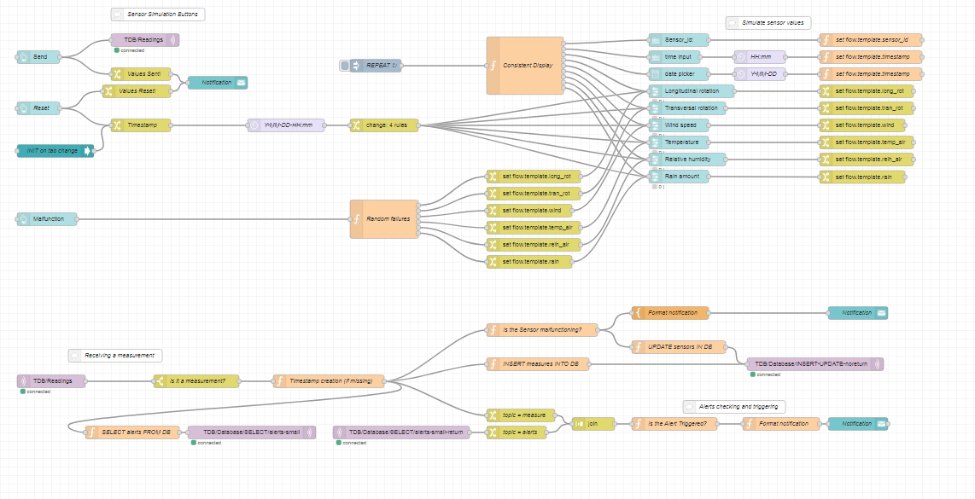
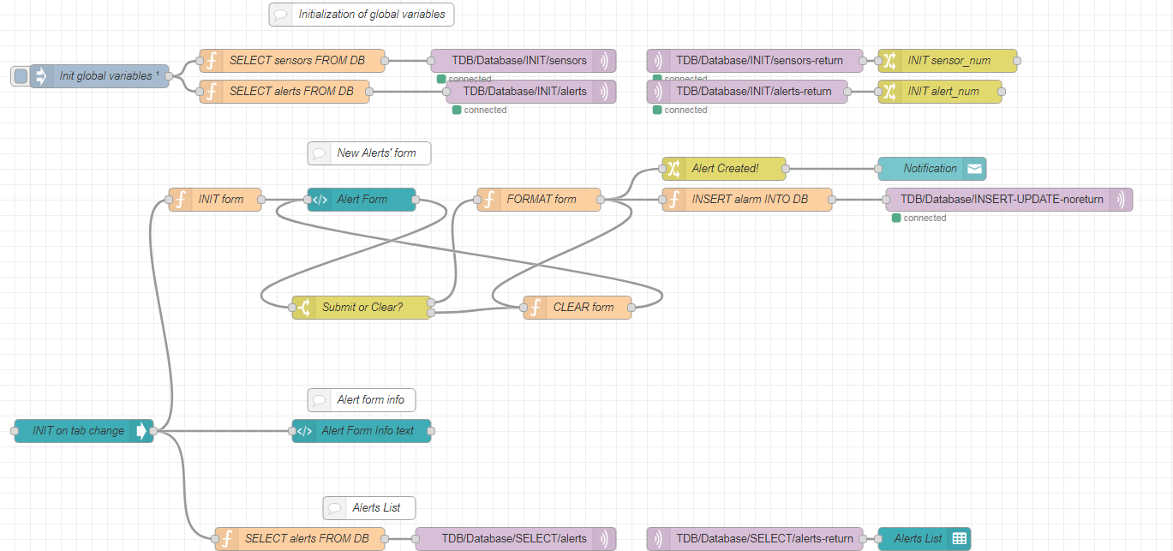
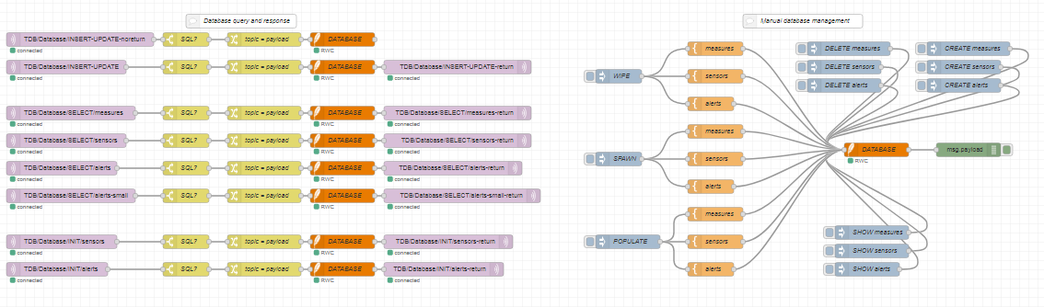
That is all!

