Slide 1

Page replacement and scheduling algorithm
By Cameron Bailey & Bryant Peden

Slide 2
What is First in first out (fifo) & Least recently used?
Page replacement algorithms
Counts page faults
FIFO replaces the page in front of the queue
LRU replaces the page that was least recently used or least used in queue
Inputs:
Array of pages
Size of page frame

Slide 3
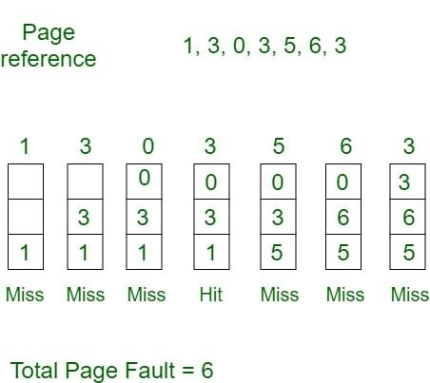
First in first out example
Page array = 7
Page frame = 3

Slide 4
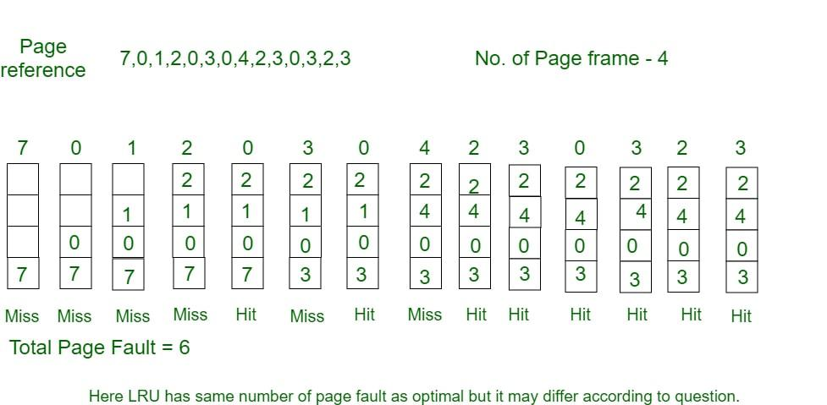
LRU example

Slide 5
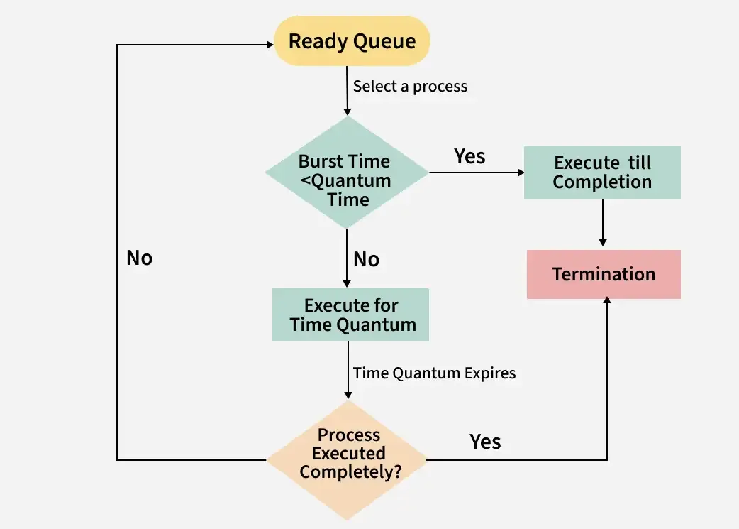
What is round robin?
Measures waiting time & turn around time
Set processes, quantum time, and burst times
Results:
Waiting time
Turnaround time
Averages for both
If burst time is higher than burst time,
then I repeats

Slide 6
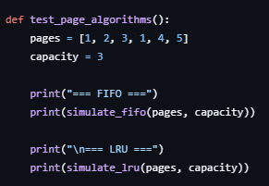
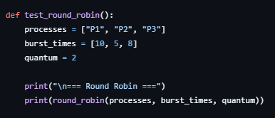
Compare & contrast (Pros)
Easy to alter inputs
Understandable at beginner level
Page algorithm code:
Round Robin algorithm code:

Slide 7
Compare & Contrast (Cons)
Two entirely different outputs (Page vs time)
Can be expensive to implement (tracking, orders)
Needs extra memory (stacking, timestamps)

Slide 8
When to use?
FIFO = any simple systems
LRU = Performance-critical memory systems
Round Robin = multitasking OS

Slide 9
Key parts
LRU > FIFO with memory efficiency.
FIFO is simplest but least effective
Round Robin ensures fairness, not efficiency
They solve different problems

Slide 10
Implementing algorithms to real life
LRU:
Phone Apps running in background
Netflix/YouTube recommendations
Short term memory
FIFO:
Grocery store line
Queue for packages
Round Robin:
Group Talk (Turn-Taking)
Sharing food with friends
Multiplayer Games

Slide 11
Questions?

