Slide 1

LRU & FIFO vs. round robin algorithm
By Cameron Bailey & Stephen Peden

Slide 2
What is First in first out (fifo) & Least recently used?
Page replacement algorithms
Counts page faults
FIFO replaces the page in front of the queue
LRU replaces the page that was least recently used or least used in queue
Inputs:
Array of pages
Size of page frame

Slide 3
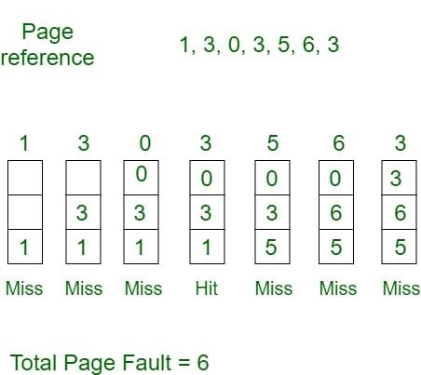
First in first out example
Page array = 7
Page frame = 3

Slide 4
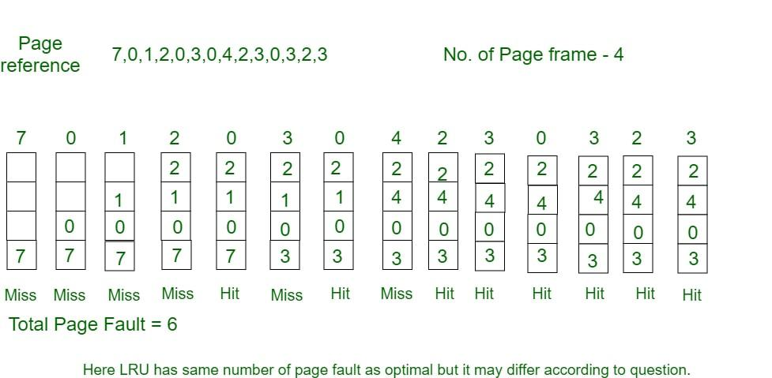
LRU example

Slide 5
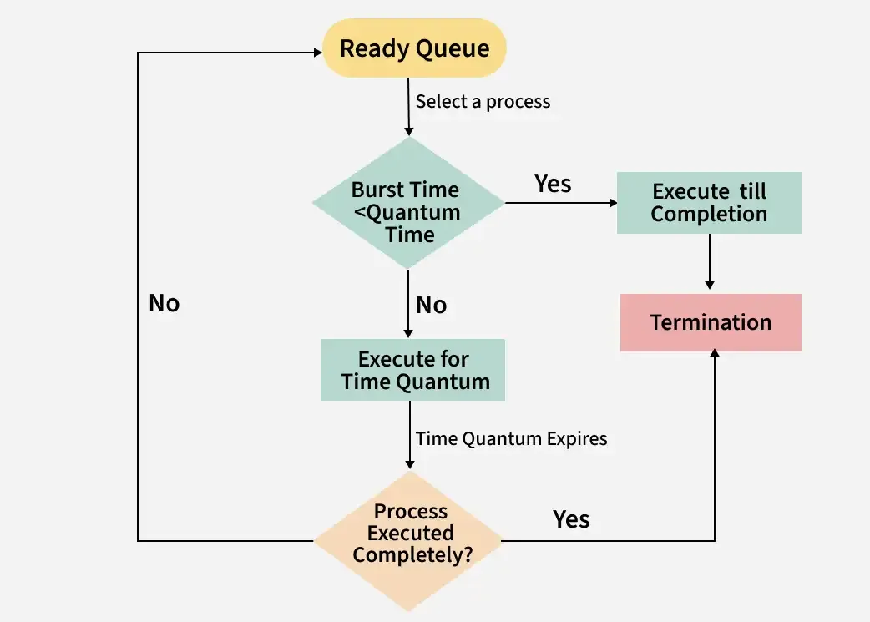
What is round robin?
Measures waiting time & turn around time
Set processes, quantum time, and burst times
Results:
Waiting time
Turnaround time
Averages for both
If burst time is higher than burst time,
then I repeats

