Slide 1
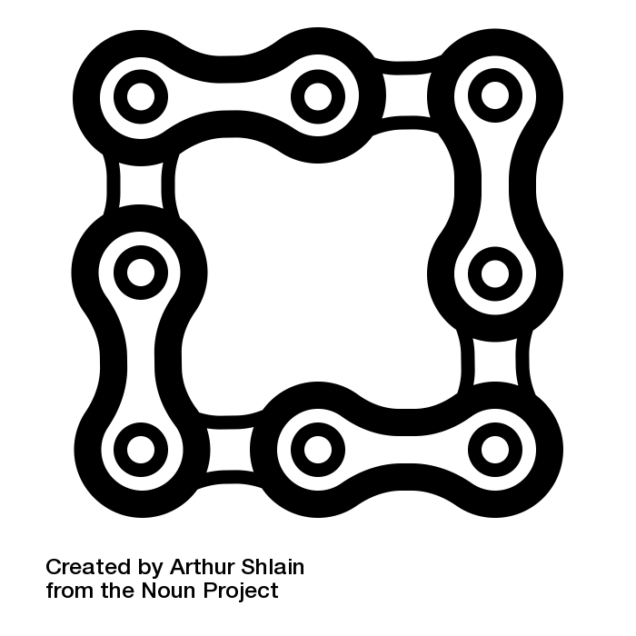

BLOCKCHAIN NOW
search and analytics in the blockchain

Slide 2
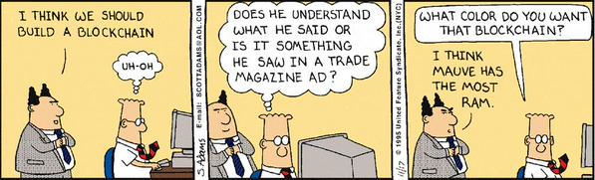
Very special database

Slide 3
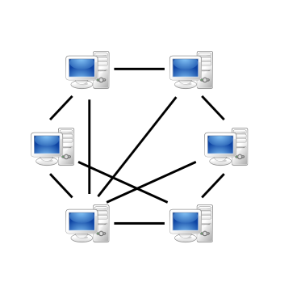
Blockchain Data 1

Slide 4

Blockchain Data 2
Level DB
Level DB
Level DB
Level DB
Level DB
Level DB

Slide 5

Blockchain 3
Level DB
Level DB
Level DB
Level DB
Level DB
Level DB
Data Platform

Slide 6


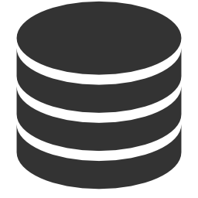

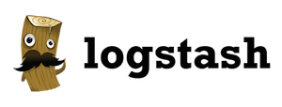



Pipeline Overview
P2P Network
Data Ingestion
Search
Level DB
Processing
UI

Slide 7

Pipeline Overview
Monitoring: Elastic Maven
Docker: Elastic, Meteor
P2P Network
Data Ingestion
Search
Level DB
Docker: BitcoinD
Monitoring: Kafka Manager
Kafkacat
Docker: Kafka, Zoo, Logstash
Processing
UI

Slide 8

Igor Barinov
MS CS Moscow State University
CTO @mobile ads startup
Hobby:
Hackathons
MOOC
Blood Donation
@barinov
http://www.linkedin.com/in/igorbarinov/
https://github.com/igorbarinov/

