Slide 1
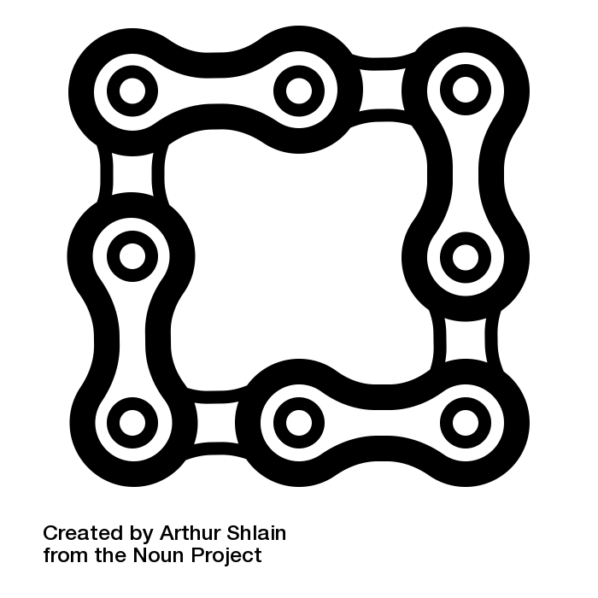

BLOCKCHAIN NOW
search in the bitcoin database

Slide 2
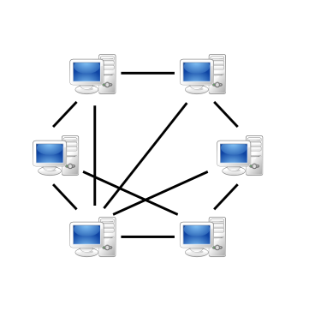
Blockchain Data 1

Slide 3

Blockchain Data 2
Level DB
Level DB
Level DB
Level DB
Level DB
Level DB

Slide 4

Blockchain 3
Level DB
Level DB
Level DB
Level DB
Level DB
Level DB
Pipeline

Slide 5




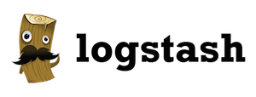



Pipeline Overview
P2P Network
Data Ingestion
Search
Level DB
Processing
UI

Slide 6

Pipeline Overview
Monitoring: Elastic Maven
Docker: Elastic, Meteor
P2P Network
Data Ingestion
Search
Level DB
Docker: BitcoinD
Monitoring: Kafka Manager
Kafkacat
Docker: Kafka, Zoo, Logstash
Processing
UI

Slide 7
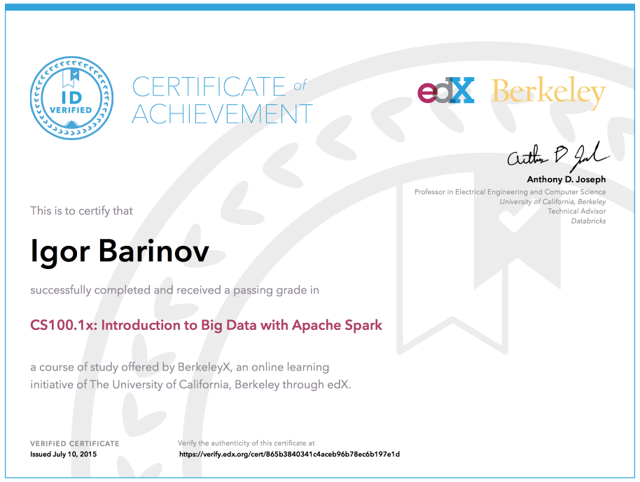
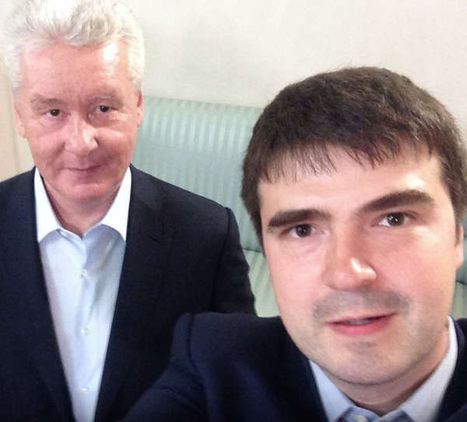
Igor Barinov
MS CS Moscow State University
CTO @mobile ads startup
Hobbies:
Hackathons
Online courses
Blood donation

