Slide 1
Spark after dark

Slide 2
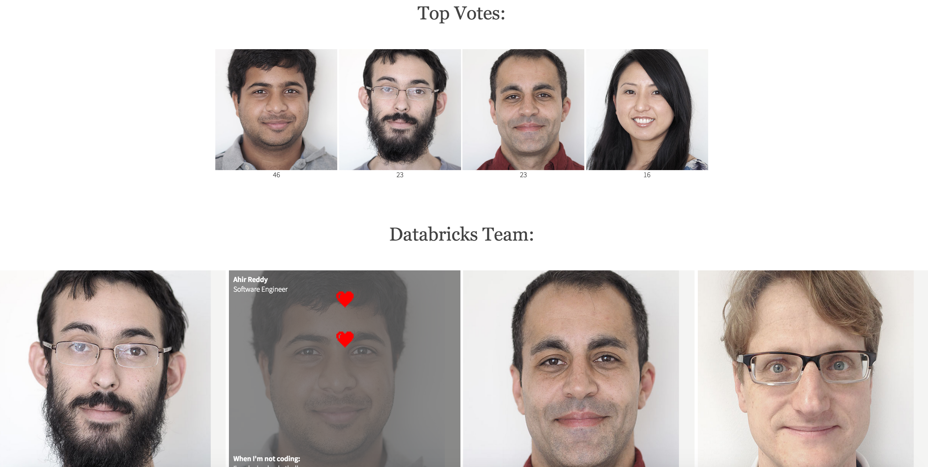
Spark Streaming Demo

Slide 3



Pipeline
AJAX
Kafka + HTTP Proxy

Slide 4


Pipeline
AJAX
Kafka + HTTP Proxy
Persistence
sub to channels
pub
top(4)

