Slide 1

BLOCKCHAIN NOW
end-to-end pipeline for the bitcoin analytics

Slide 2
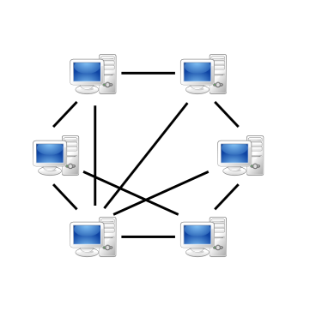
Blockchain in Nutshell 1

Slide 3

Blockchain in Nutshell 2
Level DB
Level DB
Level DB
Level DB
Level DB
Level DB

Slide 4

Blockchain in Nutshell 3
Level DB
Level DB
Level DB
Level DB
Level DB
Level DB
3rd party BitcoinD node

Slide 5
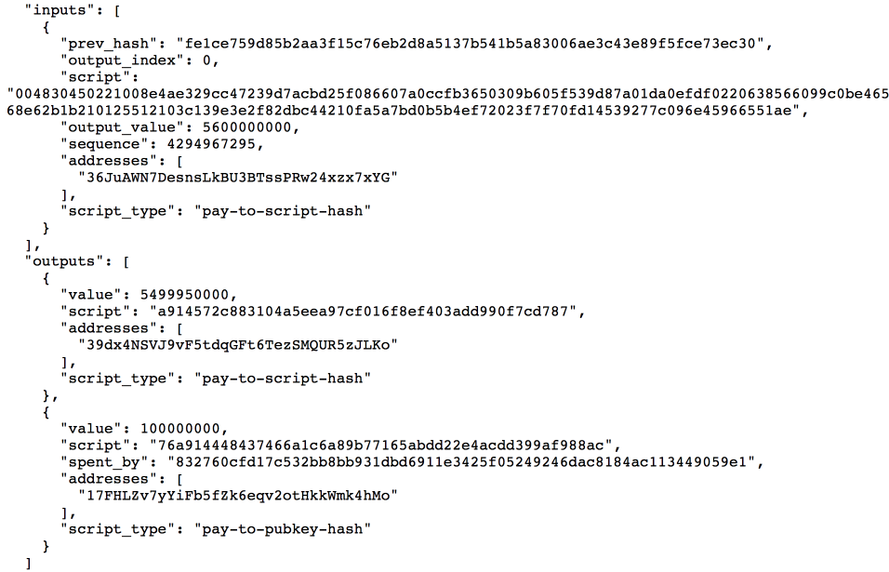
Data Example / JSON

Slide 6








Pipeline Overview
P2P Network
Data Ingestion
Search
Level DB
Processing
Meteor
UI

Slide 7
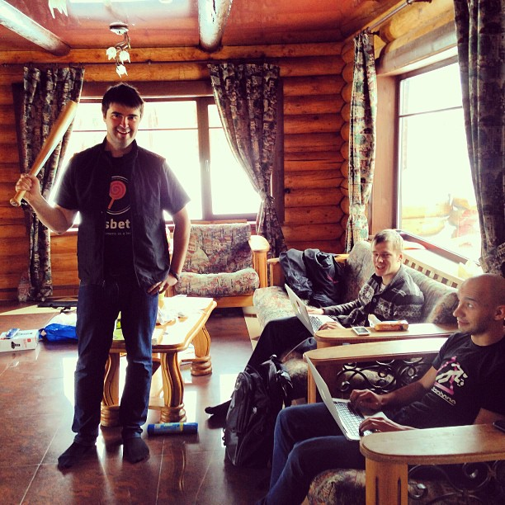
About me
MS CS Moscow State University
Hobby: Hackathons, Reading

