Slide 1
AUTOMATION WITH ALEXA
- Under the guidance of :
Mr. M. Reddy Kedhareswar -

Slide 2
Meet Our Team
K.S. Neelofer
: 163G1A0558.
K.S. Nowreen
: 163G1A0559.
A. Bhanu
: 163G1A0505.
A. Kumar
: 163G1A0521.
M. Ranjith
: 163G1A0548.

Slide 3
Project Summary
Automation
The idea behind the project title is to develop a Automation system which is controlled by the Alexa.
This is a set of useful feature that helps to save time and energy in any task on computer

Slide 4

Automation
Login Process
Automating the Website Login Process Using Selenium.
Backup
Automatic File Backup.
SoapUI
SoapUI is automation tool for test API and services.

Slide 5
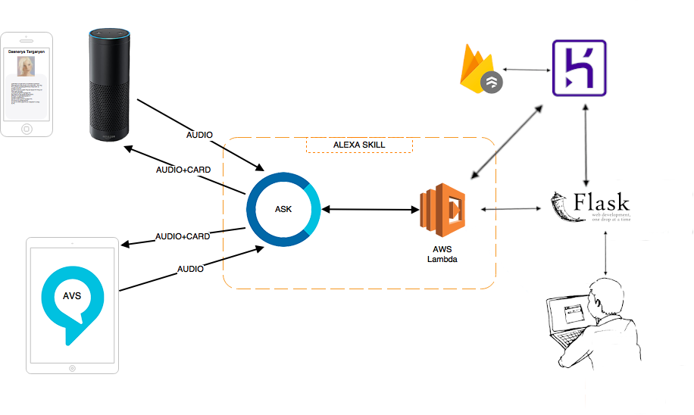
Architecture

Slide 6

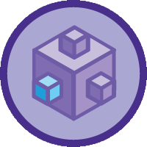
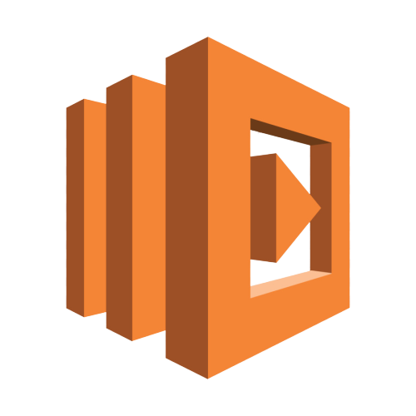
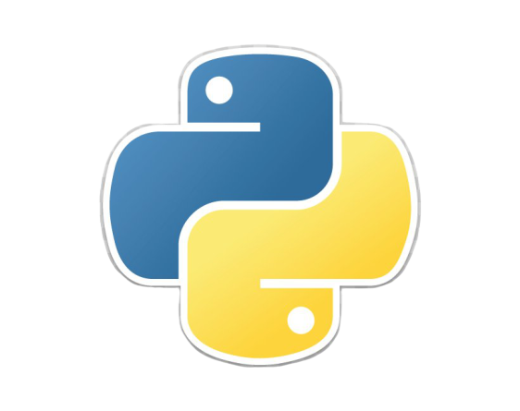
Architecture overview
AWS LAMBDA
Python
AWS Lambda is an event-driven, serverless computing platform provided by Amazon as a part of Amazon Web Services.
Python is an interpreted, high-level, general-purpose programming language.
ALEXA
Heroku
Alexa is Amazon’s cloud-based voice assistant that enables the functioning of the Amazon Echo.
Heroku is a cloud platform as a service supporting several programming languages.

Slide 7
Alexa
What is Alexa?
Alexa is Amazon’s cloud-based voice assistant that enables the functioning of the Amazon Echo.
Alexa Skills
Alexa Skills are the “skills” or the applications that enhance its capacity. Everything that Alexa does is implemented in the Skills. Alexa has specific predefined abilities available in all supported languages, such as the clock, lists, timers, and reminders.
Alexa Voice Service
Amazon allows device manufacturers to integrate Alexa voice capabilities into their own connected products by using the Alexa Voice Service (AVS),

Slide 8
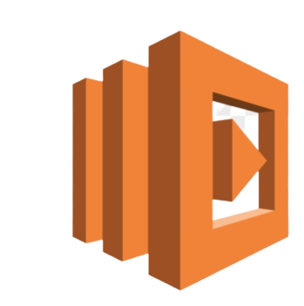
AWS Lambda
What is AWS Lambda?
AWS Lambda is an event-driven, serverless computing platform provided by Amazon as a part of Amazon Web Services.
AWS Lambda is a suitable compute platform for many application scenarios provided that you can write your application code in languages and runtime environments supported by the service.
Lambda is perfect for building APIs, together with API Gateway you can efficiently achieve fast time to market and optimize costs.
There are different ways for using Lambda functions, different serverless design patterns which everyone could follow depending on their needs.

Slide 9
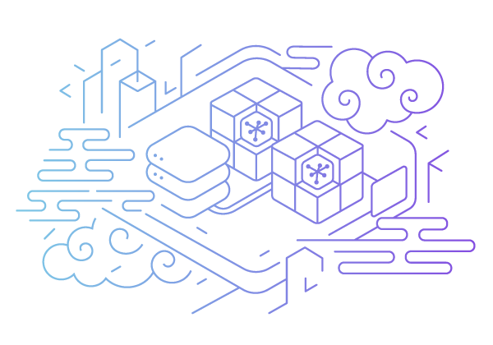
HEROKU
What is HEROKU?
Heroku is a cloud platform as a service (PaaS) supporting several programming languages. One of the first cloud platforms, Heroku has been in development since June 2007,
The Heroku Platform: The Heroku network runs the customer's apps in virtual containers which execute on a reliable runtime environment. Heroku calls these containers "Dynos."
Heroku Elements: Heroku Elements provides users with Add-ons -Tools and services for developing, extending, and operating the app, Build packs -Build packs automate the build processes for the preferred languages and frameworks and Buttons -one-click provision, configure, and deploy third party components, libraries and pattern app.

Slide 10
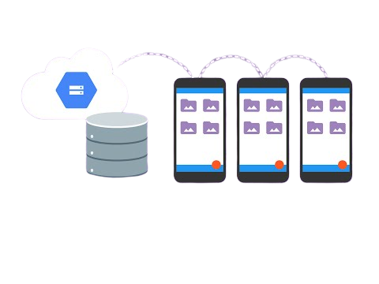
Firebase — Cloud Firestore
What is Cloud Fire store?
Cloud Fire store is the service provided by Firebase specifically for client applications and which is deeply integrated with other firebase products including Google’s cloud functions serverless platform
Documents and Collections :
Cloud Fire store uses “Document and Collection” based structure to store the data and it does not contain any rows and tables.
Data will be stored in documents that are organized into collections. Document supports key-value pairs (field can be any primitive data type ex: int, string etc.), complex and nested objects (called maps).
All documents must be stored in collections and we can create sub-collections in documents depending on your data model

Slide 11
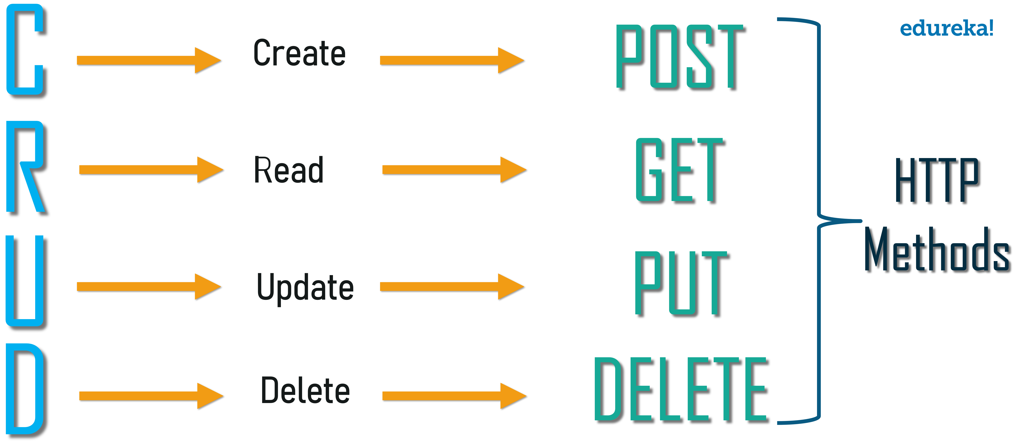
FLASK
What is Flask?
Flask is like snorkeling whereas Django is scuba diving. Flask is light and easy whereas Django is capable of preparing you to enter deeper waters.
What flask do’s?
LOGIC: ‘main.py’ imports the Flask module, creates a web server, creates an instance of the Flask class — your new web application!
DESIGN: The Flask Framework looks for HTML files in a folder called templates.
DATABASE: Flask does not support databases natively, but there are a number of Flask extensions such as Flask-SQL Alchemy.

Slide 12
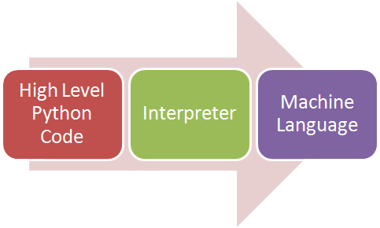
python
What is Python?
Interpreted high-level object-oriented dynamically-typed scripting language.
Why Python?
Python is the most popular language due to the fact that it’s easier to code and understand it.
Python is object oriented programming language and can be used to write functional code too.
It is a suitable language that bridges the gaps between business and developers.
Why Not Python?
Python is slower than C++, C#, Java. This is due to the lack of Just In Time optimizers in Python.

Slide 13
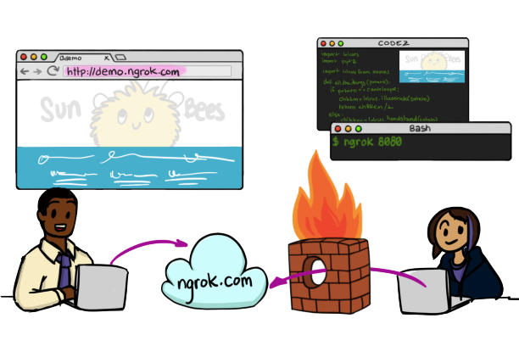
Ngrok
What is Ngrok?
Ngrok” is a useful tool for anybody who is doing server side development. It streamlines the process of debugging server side code on your local machine and also helps to run your sever locally and have access to it from anywhere else.
How it works?
You download and run a program on your machine and provide it the port of a network service, usually a web server.
What it's good for?
Demoing web sites without deploying
Building webhook consumers on your dev machine
Testing mobile apps connected to your locally running backend

Slide 14
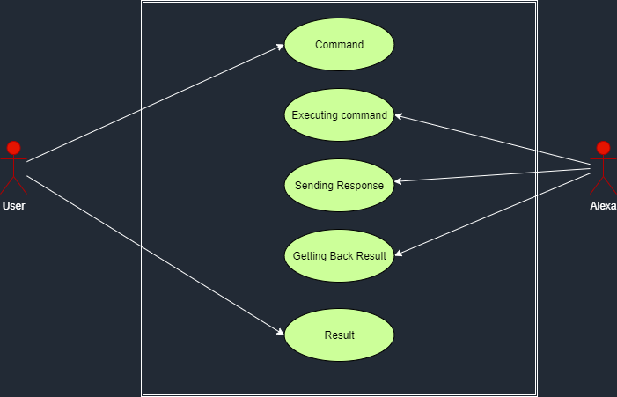

USE CASE
A use case diagram in the Unified Modeling Language (UML) is a type of behavioral diagram defined by and created from a Use-case analysis. Its purpose is to present a graphical overview of the functionality provided by a system in terms of actors, their goals (represented as use cases), and any dependencies between those use cases. The main purpose of a use case diagram is to show what system functions are performed for which actor. Roles of the actors in the system can be depicted.

Slide 15
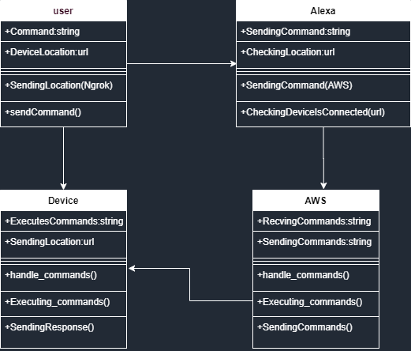
CLASS DIAGRAM
A class diagram in the Unified Modeling Language (UML) is a type of static structure diagram that describes the structure of a system by showing the system's classes, their attributes, operations (or methods), and the relationships among the classes. It explains which class contains information.

Slide 16
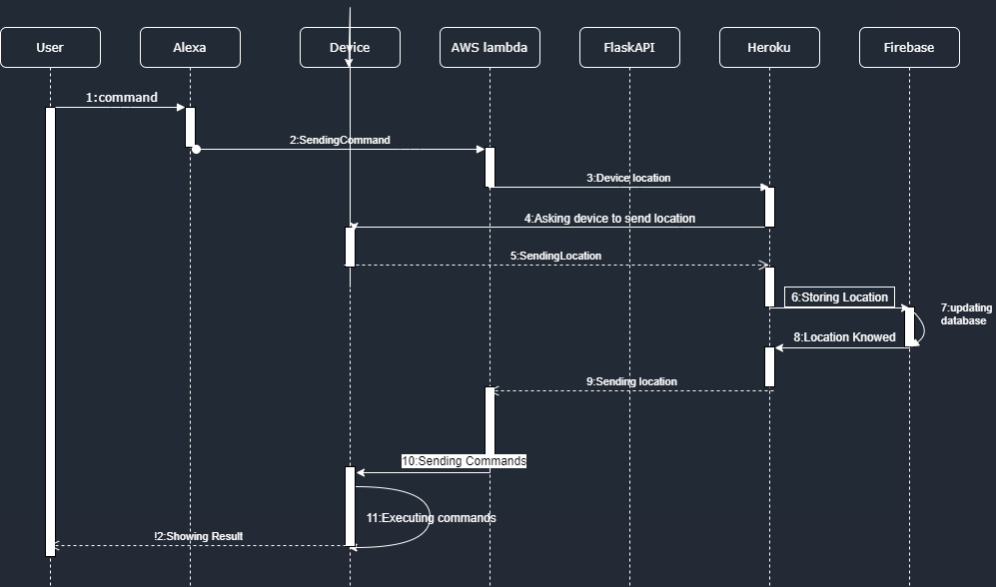
SEQUENCE DIAGRAM
A sequence diagram in Unified Modeling Language (UML) is a kind of interaction diagram that shows how processes operate with one another and in what order. It is a construct of a Message Sequence Chart. Sequence diagrams are sometimes called event diagrams, event scenarios, and timing diagrams.

Slide 17
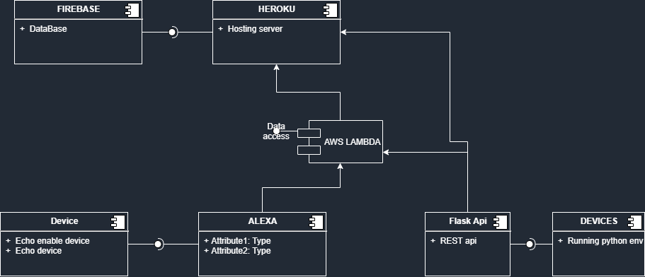
COMPONENT DIAGRAM
Component diagrams are used to describe the physical artifacts of a system. This artifact includes files, executables, libraries etc. So the purpose of this diagram is different, Component diagrams are used during the implementation phase of an application. But it is prepared well in advance to visualize the implementation details.

Slide 18
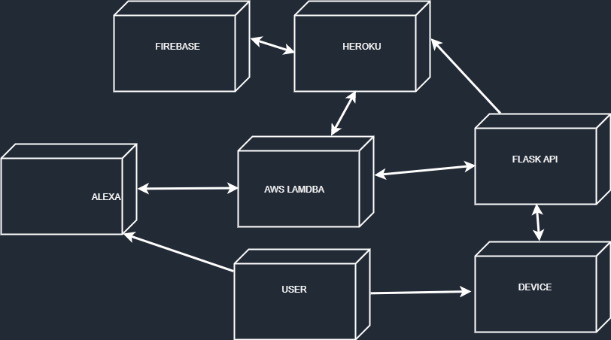
DEPLOYMENT DIAGRAM
Deployment diagram represents the deployment view of a system. It is related to the component diagram. Because the components are deployed using the deployment diagrams. A deployment diagram consists of nodes. Nodes are nothing but physical hardware’s used to deploy the application.

Slide 19
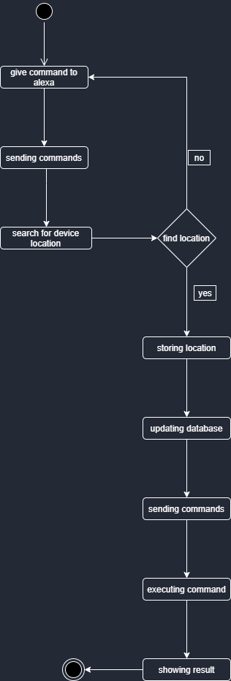
ACTIVITY DIAGRAM
Activity diagrams are graphical representations of workflows of stepwise activities and actions with support for choice, iteration and concurrency. In the Unified Modeling Language, activity diagrams can be used to describe the business and operational step-by-step workflows of components in a system. An activity diagram shows the overall flow of control.

Slide 20
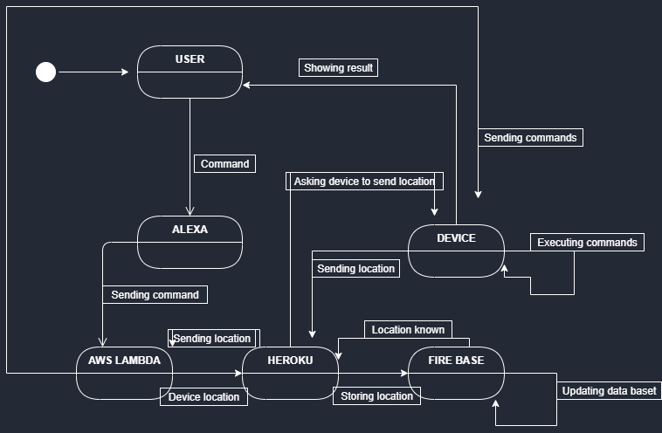
STATE CHART DIAGRAM
A state diagram is a type of diagram used in computer science and related fields to describe the behavior of systems. State diagrams require that the system described is composed of a finite number of states; sometimes, this is indeed the case, while at other times this is a reasonable abstraction

Slide 21
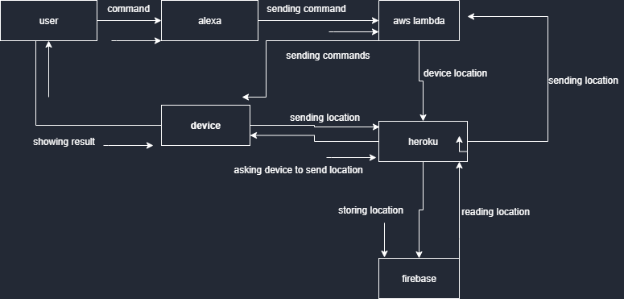
COLLABORATION DIAGRAM
Collaboration diagram the method call sequence is indicated by some numbering technique as shown below. The number indicates how the methods are called one after another. We have taken the same order management system to describe the collaboration diagram. The method calls are similar to that of a sequence diagram. But the difference is that the sequence diagram does not describe the object organization where as the collaboration diagram shows the object organization.

