Slide 1
编译原理期末考试模拟试题-2
张泽宇 2017141463053

Slide 2
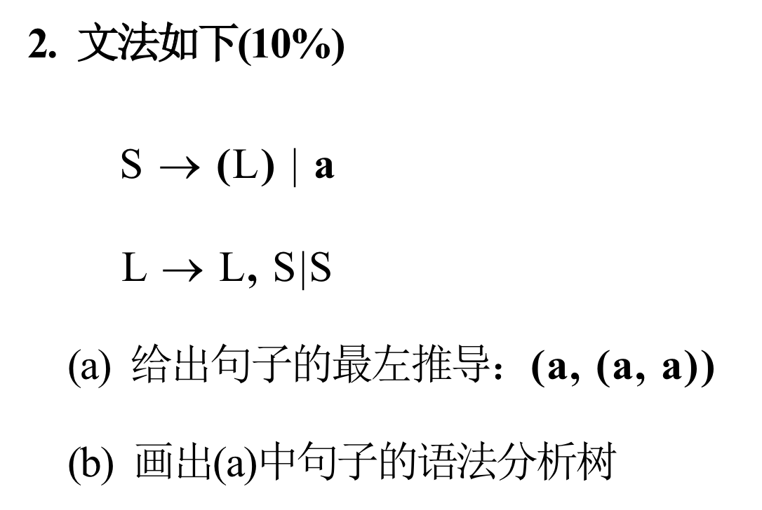
分析：
非终结符：S L
终结符： a ( , )
每一步对最左非终结符进行替换

Slide 3
(a).
S => ( L )
=> ( L , S )
=> ( S , S )
=> ( a , S )
=> ( a , ( L ) )
=> ( a , ( L , S ) )
=> ( a , ( S , S ) )
=> ( a , ( a , S ) )
=> ( a , ( a , a ) )
*最右推导
S => ( L )
=> ( L , S )
=> ( L , ( L ) )
=> ( L , ( L , S ) )
=> ( L , ( L , a ) )
=> ( L , ( S , a ) )
=> ( L , ( a , a ) )
=> ( S , ( a , a ) )
=> ( a , ( a , a ) )

Slide 4
(b).
S
( L )
L , S
S ( L )
a L , S
s a
a

