Slide 1
Part 1:(Chapter 1、2)
Digital Electronic System
Page <number>
26 Feb.-2015
College of Computer Science, Sichuan University
Ying Sancong

Slide 2
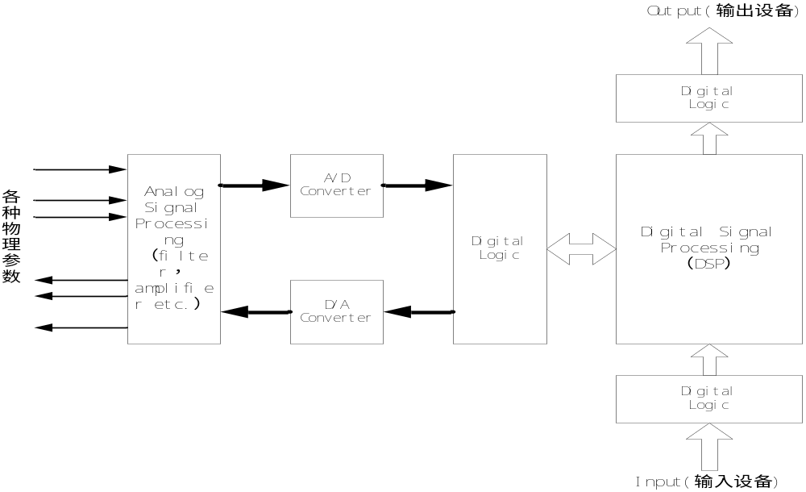
P1 Concepts of Digital Electronic System
1.1 Basic Frame
Sampling-Hold
ADC
quantize
Anti-aliasing
Filter
ReconstructiontFilter
DAC
Page <number>
26 Feb.-2015
College of Computer Science, Sichuan University
Ying Sancong

Slide 3
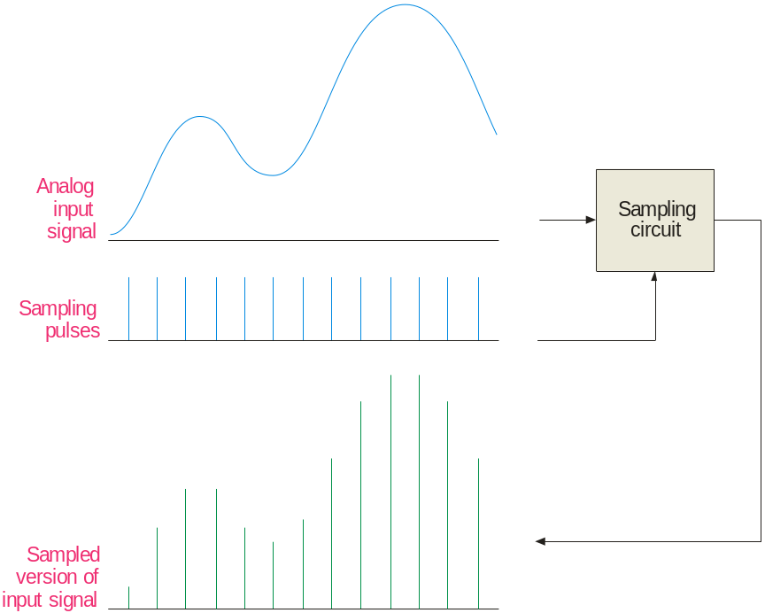
P1 Concepts of Digital Electronic System
1.1 Sampling
Most input signals to an electronic system start out as analog signals. For processing, the signal is normally converted to a digital signal by sampling the input.
Before sampling, the analog input must be filtered with a low-pass anti-aliasing filter. The filter eliminates frequencies that exceed a certain limit that is determined by the sampling rate.
Page <number>
26 Feb.-2015
College of Computer Science, Sichuan University
Ying Sancong

Slide 4
P1 Concepts of Digital Electronic System
1.2 Anti-aliasing Filter（抗混叠滤波器）
To understand the need for an anti-aliasing filter, you need to understand the sampling theorem which essentially states:
In order to recover a signal, the sampling rate must be greater than twice the highest frequency in the signal.
Stated as an equation, f_{sample} > 2f_{a(max)}
where f_{sample} = sampling frequency
f_{a(max)} = highest harmonic in the analog signal
If the signal is sampled less than this, the recovery process will produce frequencies that are entirely different than in the original signal. These “masquerading” signals are called aliases.
Page <number>
26 Feb.-2015
College of Computer Science, Sichuan University
Ying Sancong

Slide 5
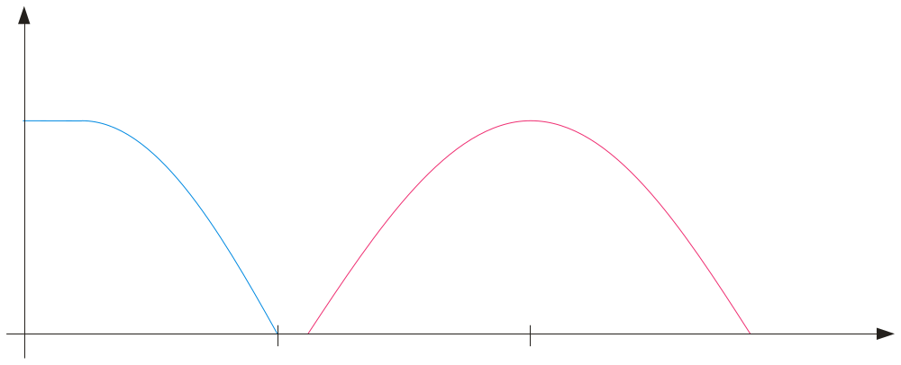
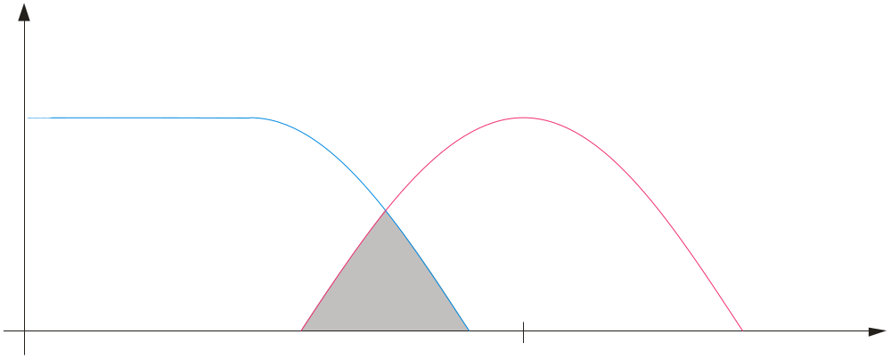
P1 Concepts of Digital Electronic System
1.2 Anti-aliasing Filter
The anti-aliasing filter is a low-pass filter that limits high frequencies in the input signal to only those that meet the requirements of the sampling theorem.
Filtered analog frequency spectrum
Unfiltered analog frequency spectrum
Sampling frequency spectrum
f
f_{c}
f_{sample}
Overlap causes aliasing error
The filter’s cutoff frequency, f_{c}, should be less than ½ f_{sample}.
Page <number>
26 Feb.-2015
College of Computer Science, Sichuan University
Ying Sancong

Slide 6
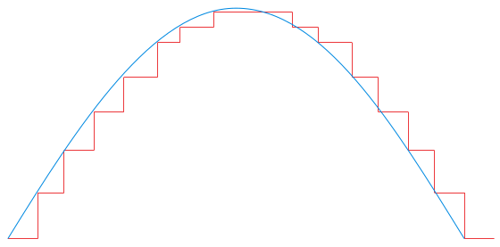
P1 Concepts of Digital Electronic System
1.3 Analog-to-Digital Conversion
To process naturally occurring analog quantities with a digital system, the analog signal is converted to digital form after the anti-aliasing filter.
The first step in converting a signal to digital form is to use a sample-and-hold circuit. This circuit samples the input signal at a rate determined by a clock signal and holds the level on a capacitor until the next clock pulse.
A positive half-wave from 0-10 V is shown in blue. The sample-and-hold circuit produces the staircase representation shown in red.
10 V
0 V
Page <number>
26 Feb.-2015
College of Computer Science, Sichuan University
Ying Sancong

Slide 7
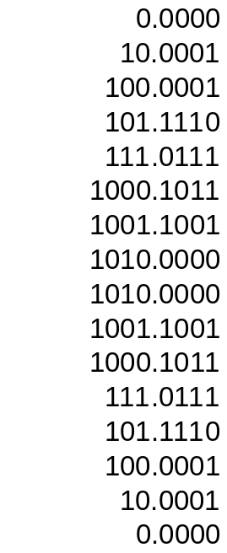

P1 Concepts of Digital Electronic System
1.3 Analog-to-Digital Conversion
The second step is to quantize these staircase levels to binary coded form using an analog-to-digital converter (ADC). The digital values can then be processed by a digital signal processor or computer.
Example
What is the maximum unsigned binary value for the waveform?
Solution
10 V = 10102 V. The table lists the quantized binary values for all of the steps.
Peak = 10 V
10 V
0 V
Page <number>
26 Feb.-2015
College of Computer Science, Sichuan University
Ying Sancong

Slide 8
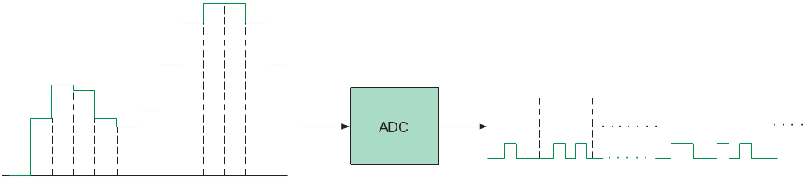
P1 Concepts of Digital Electronic System
1.4 Sample-and-Hold and ADC
Following the anti-aliasing filter, is the sample-and-hold circuit and the analog-to-digital converter. At this point, the original analog signal has been converted to a digital signal.
Samples held for one clock pulse
0 1 0 0 0 1 0 1
1 1 0 0 1 0 1 0
Many ICs can perform both functions on a single chip and include two or more channels. For audio applications, the AD1871 is an example of a stereo audio ADC.
Page <number>
26 Feb.-2015
College of Computer Science, Sichuan University
Ying Sancong

Slide 9
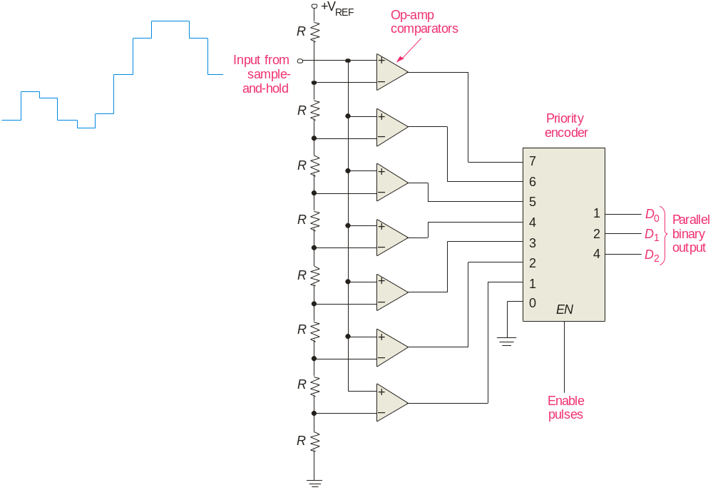
P1 Concepts of Digital Electronic System
1.5 Analog-to-Digital Conversion Methods
The flash ADC（快速）:
The flash ADC uses a series high-speed comparators that compare the input with reference voltages. Flash ADCs are fast but require 2^{n} – 1 comparators to convert an analog input to an n-bit binary number.
Question
How many comparators are needed by a 10-bit flash ADC?
Answer
1023
Page <number>
26 Feb.-2015
College of Computer Science, Sichuan University
Ying Sancong

Slide 10

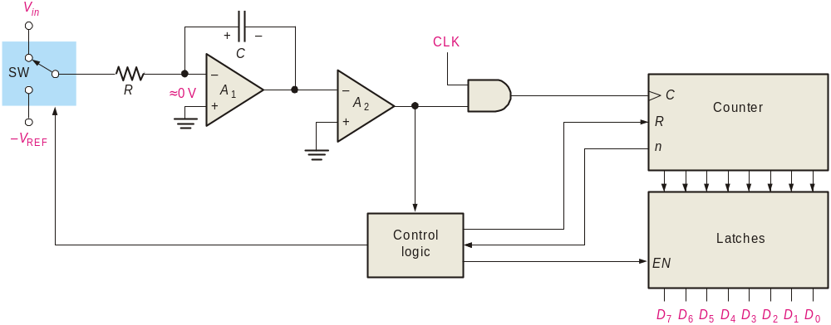

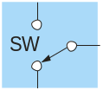
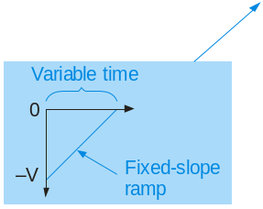
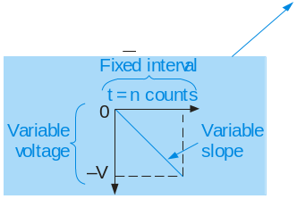
P1 Concepts of Digital Electronic System
1.5 Analog-to-Digital Conversion Methods
The dual-slope ADC（双积分）:
1. The dual-slope ADC integrates the input voltage for a fixed time while the counter counts to n.
2. Control logic switches to the V_{REF} input.
3. A fixed-slope ramp starts from –V as the counter counts. When it reaches 0 V, the counter output is latched.
-V
HIGH
HIGH
Page <number>
26 Feb.-2015
College of Computer Science, Sichuan University
Ying Sancong

Slide 11
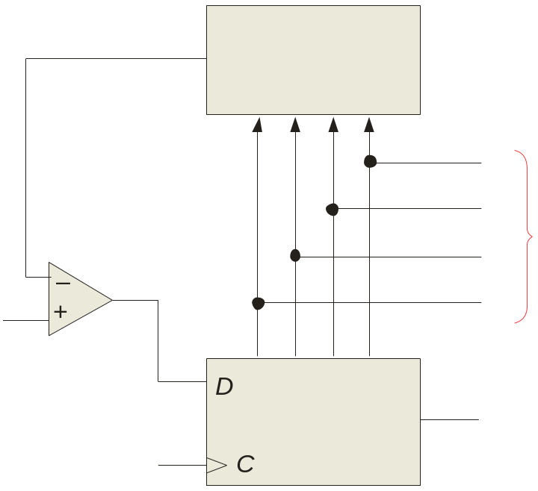

P1 Concepts of Digital Electronic System
1.5 Analog-to-Digital Conversion Methods
The successive approximation ADC（逐次渐进）:
1. Starting with the MSB, each bit in the successive approximation register (SAR) is activated and tested by the digital-to-analog converter (DAC).
V_{out}
2. After each test, the DAC produces an output voltage that represents the bit.
DAC
D₀
D₁
Parallel binary output
3. The comparator compares this voltage with the input signal. If the input is larger, the bit is retained; otherwise it is reset (0).
Comparator
D₂
Input signal
D₃
(MSB)
(LSB)
SAR
Serialbinary output
CLK
The method is fast and has a fixed conversion time for all inputs.
Page <number>
26 Feb.-2015
College of Computer Science, Sichuan University
Ying Sancong

Slide 12
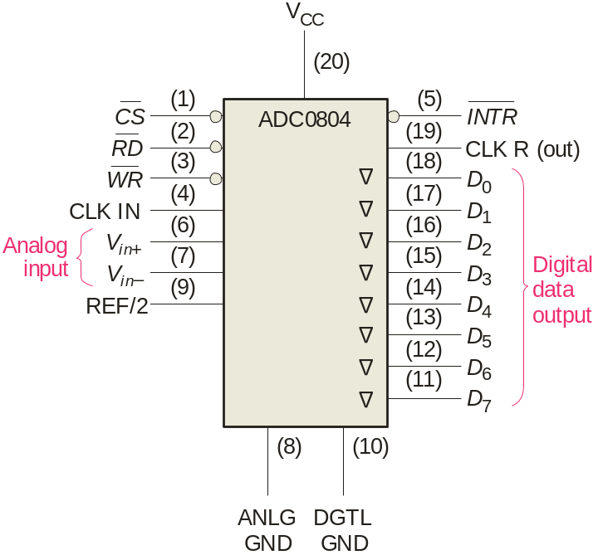
P1 Concepts of Digital Electronic System
1.5 Analog-to-Digital Conversion Methods
An integrated circuit successive approximation ADC is the ADC804. This popular ADC is an 8-bit converter that completes a conversion in 64 clock periods (100 μs).
The completion is signaled by the INTR line going LOW.
Page <number>
26 Feb.-2015
College of Computer Science, Sichuan University
Ying Sancong

Slide 13
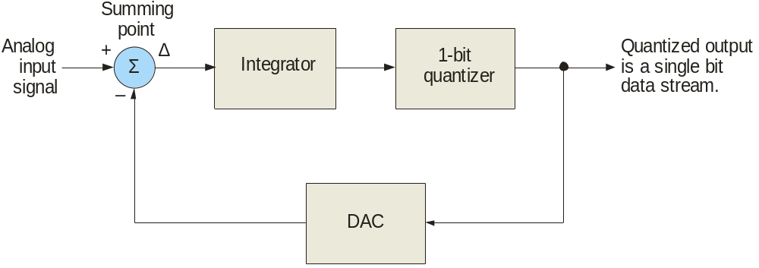
P1 Concepts of Digital Electronic System
1.5 Analog-to-Digital Conversion Methods
The sigma-delta ADC（求和-增量）:
With sigma-delta conversion, the difference between two samples of the analog input signal integrated and quantized. The density of 1s at the output is proportional to the input signal.
Page <number>
26 Feb.-2015
College of Computer Science, Sichuan University
Ying Sancong

Slide 14
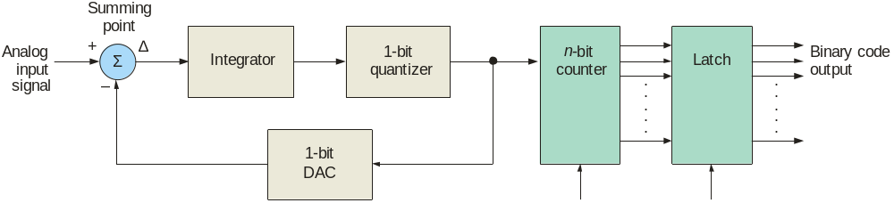
P1 Concepts of Digital Electronic System
1.5 Analog-to-Digital Conversion Methods
One option for the sigma-delta method is to count the one-bit quantized output for a set interval. The output of the counter is latched with the parallel binary code.
Sigma-delta ADCs can have high resolution and have advantages for rejecting noise signals (such as 60 Hz power line interference). They are available in ICs with internal programmable amplifiers. For these reasons, they are widely used in instrumentation applications.
Page <number>
26 Feb.-2015
College of Computer Science, Sichuan University
Ying Sancong

Slide 15
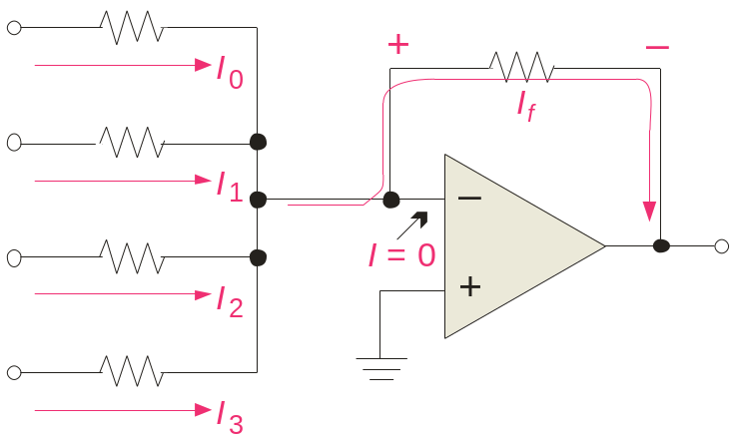
P1 Concepts of Digital Electronic System
1.6 Digital-to-Analog Conversion Methods
Binary-weighted-input DAC（二进制权输入）:
The binary-weighted-input DAC is a basic DAC in which the input current in each resistor is proportional to the column weight in the binary numbering system. It requires very accurate resistors and identical HIGH level voltages for accuracy.
LSB
8R
D₀
R_{f}
The MSB is represented by the largest current, so it has the smallest resistor. To simplify analysis, assume all current goes through R_{f} and none into the op-amp.
4R
D₁
2R
V_{out}
D₂
Analog output
D₃
R
MSB
Page <number>
26 Feb.-2015
College of Computer Science, Sichuan University
Ying Sancong

Slide 16
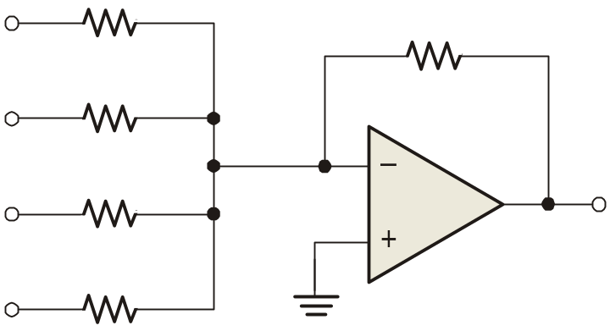
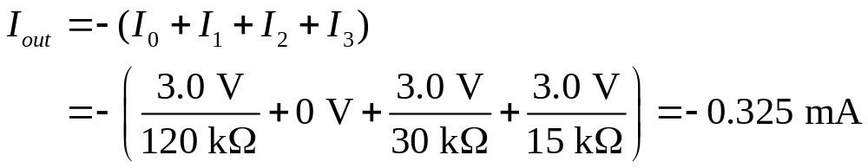
P1 Concepts of Digital Electronic System
1.6 Digital-to-Analog Conversion Methods
Example
A certain binary-weighted-input DAC has a binary input of 1101. If a HIGH = +3.0 V and a LOW = 0 V, what is V_{out}?
120 kΩ
R_{f}
+3.0 V
60 kΩ
10 kΩ
0 V
30 kΩ
V_{out}
+3.0 V
15 kΩ
+3.0 V
Solution
V_{out} = I_{out} R_{f} = (−0.325 mA)(10 kΩ) =
−3.25 V
Page <number>
26 Feb.-2015
College of Computer Science, Sichuan University
Ying Sancong

Slide 17
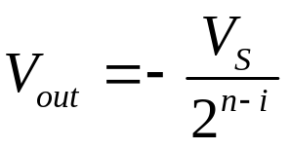
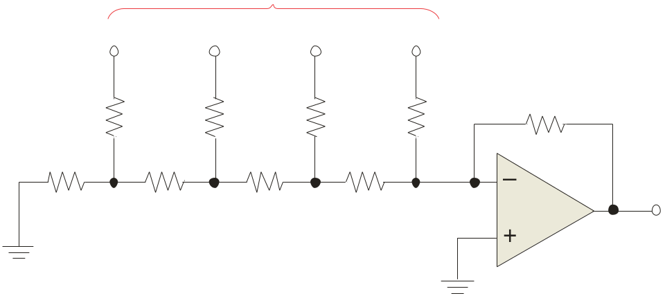
P1 Concepts of Digital Electronic System
1.6 Digital-to-Analog Conversion Methods
R-2R ladder（R/2R阶梯型）:
The R-2R ladder requires only two values of resistors. By calculating a Thevenin equivalent circuit for each input, you can show that the output is proportional to the binary weight of inputs that are HIGH.
Each input that is HIGH contributes to the output:
where V_{S} = input HIGH level voltage
n = number of bits
i = bit number
Inputs
D₀
D₁
D₂
D₃
For accuracy, the resistors must be precise ratios, which is easily done in integrated circuits.
R₁
R₃
R₅
R₇
R_{f} = 2R
2R
2R
2R
2R
R₂
R₄
R₆
R₈
2R
R
R
R
V_{out}
Page <number>
26 Feb.-2015
College of Computer Science, Sichuan University
Ying Sancong

Slide 18
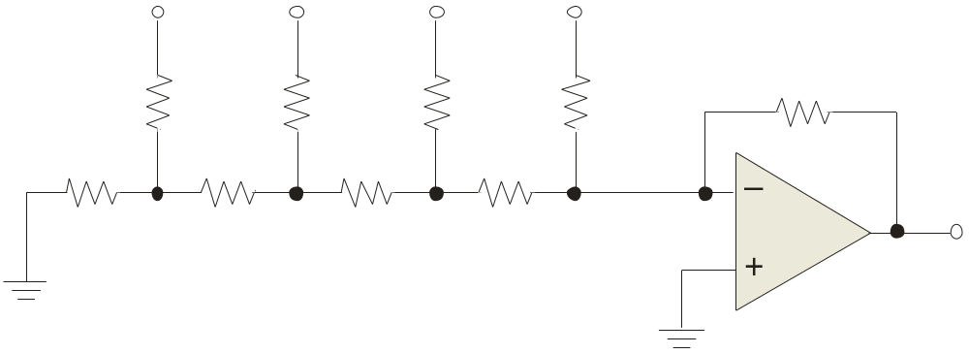

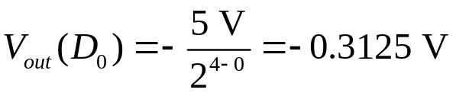
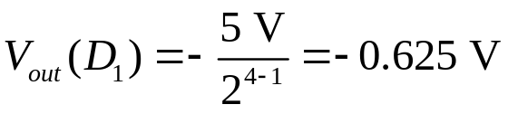
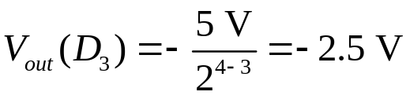
P1 Concepts of Digital Electronic System
1.6 Digital-to-Analog Conversion Methods
Example
An R-2R ladder has a binary input of 1011. If a HIGH = +5.0 V and a LOW = 0 V, what is V_{out}?
D₀
D₁
D₂
D₃
+5.0 V
+5.0 V
0 V
+5.0 V
R₁
R₃
R₅
R₇
R_{f} = 50 kΩ
50 kΩ
50 kΩ
50 kΩ
50 kΩ
R₂
R₄
R₆
R₈
50 kΩ
25 kΩ
25 kΩ
25 kΩ
V_{out}
Solution
Apply to all inputs that are HIGH, then sum the results.
Applying superposition, V_{out} =
−3.43 V
Page <number>
26 Feb.-2015
College of Computer Science, Sichuan University
Ying Sancong

Slide 19

P1 Concepts of Digital Electronic System
1.7 Resolution and Accuracy of DACs
The R-2R ladder is relatively easy to manufacturer and is available in IC packages. DACs based on the R-2R network are available in 8, 10, and 12-bit versions. The resolution is an important specification, defined as the reciprocal of the number of steps in the output.
Question
What is the resolution of the BCN31 R-2R ladder network, which has 8-bits?
Answer
2⁸ – 1 = 255
1/255 = 0.39%
The accuracy is another important specification and is derived from a comparison of the actual output to the expected output. For the BCN31, the accuracy is specified as ±½ LSB = 0.2%.
Page <number>
26 Feb.-2015
College of Computer Science, Sichuan University
Ying Sancong

Slide 20
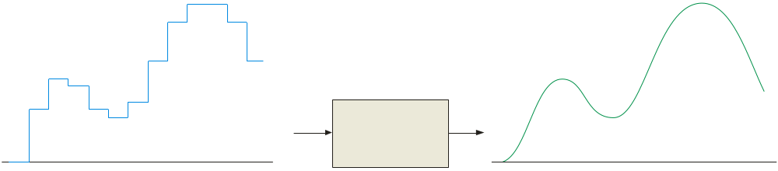
P1 Concepts of Digital Electronic System
1.8 Reconstruction Filter
After converting a digital signal to analog, it is passed through a low-pass “reconstruction filter” to smooth the stair steps in the output. The cutoff frequency of the reconstruction filter is often set to the same limit as the anti-aliasing filter, to block higher harmonics due to the digitizing process.
Reconstruction Filter
Output of the DAC
Final analog output
Page <number>
26 Feb.-2015
College of Computer Science, Sichuan University
Ying Sancong

Slide 21
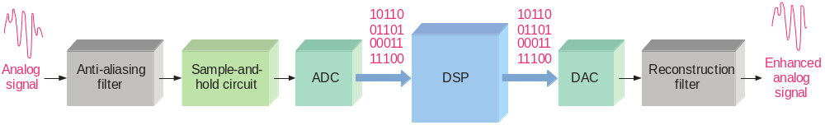
P1 Concepts of Digital Electronic System
1.9 Digital Signal Processing
A digital signal processor (DSP) is optimized for speed and working in real time (as events happen). It is basically a specialized microprocessor with a reduced instruction set.
After filtering and converting the analog signal to digital, the DSP takes over. It may enhance the signal in some predetermined way (reducing noise or echoes, improving images, encrypting the signal, etc.). The signal can then be converted back to analog form if desired.
Page <number>
26 Feb.-2015
College of Computer Science, Sichuan University
Ying Sancong

Slide 22
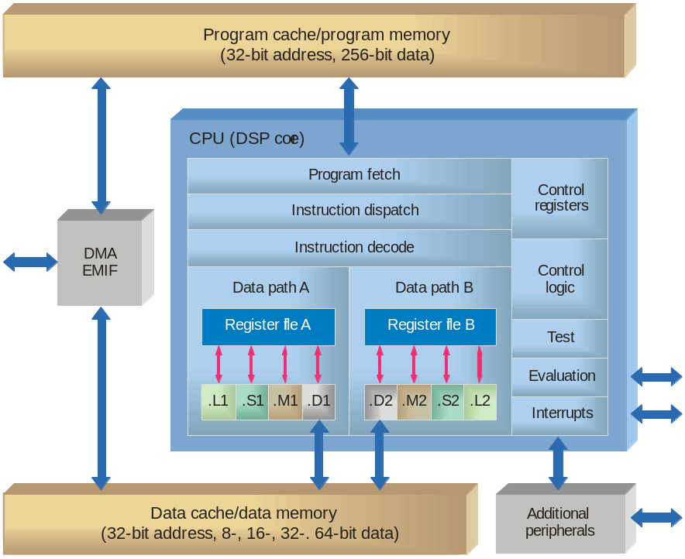
P1 Concepts of Digital Electronic System
1.9 Digital Signal Processing
Because speed is important in DSP applications, assembly language is frequently used because in general it executes faster.
A general block diagram of the TMS320C6000 series DSP
Page <number>
26 Feb.-2015
College of Computer Science, Sichuan University
Ying Sancong

Slide 23

TO BE CONTINUED
Page <number>
01 Sept.-2014
College of Computer Science, Sichuan University
Ying Sancong

