Slide 1
PART 2:(Chapter 3)
Boolean Switching Algebra
(布尔开关代数)
Page <number>
26 Feb.-2015
College of Computer Science, Sichuan University
Ying Sancong

Slide 2
P2.1 Introduction to Boolean algebra
Boolean algebra is a mathematical system that defines a series of logical operations (AND, OR, NOT) performed on sets of variables (a, b, c,.….. ).When stated in this form , the expression is called a Boolean equation or switching equation.
Page <number>
26 Feb.-2015
College of Computer Science, Sichuan University
Ying Sancong

Slide 3
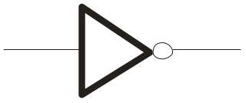
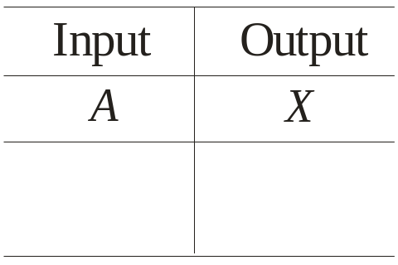
P2.2 Three Primitive Logic Function (cont.)
NOT
A
X
The Inverter
׳
The inverter performs the Boolean NOT operation. When the input is LOW, the output is HIGH; when the input is HIGH, the output is LOW.
LOW (0) HIGH (1)
HIGH (1) LOW(0)
The NOT operation (complement) is shown with an overbar. Thus, the Boolean expression for an inverter is X = A.
Page <number>
26 Feb.-2015
College of Computer Science, Sichuan University
Ying Sancong

Slide 4
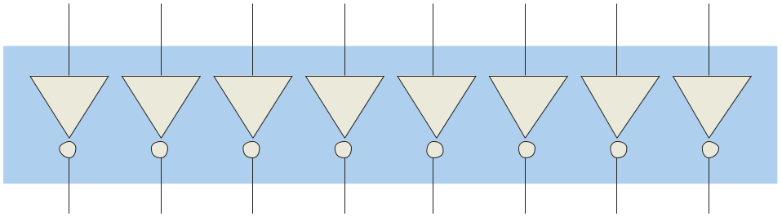
P2.2 Three Primitive Logic Function (cont.)
NOT
A
X
The Inverter
׳
Example waveforms:
A
X
A group of inverters can be used to form the 1’s complement of a binary number:
Binary number
1 0 0 0 1 1 0 1
0 1 1 1 0 0 1 0
1’s complement
Page <number>
26 Feb.-2015
College of Computer Science, Sichuan University
Ying Sancong

Slide 5
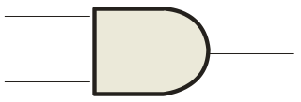
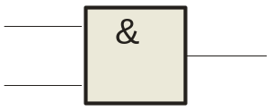
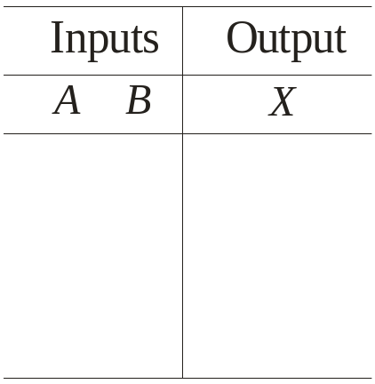
P2.2 Three Primitive Logic Function
AND
A
X
The AND Gate
X
B
B
The AND gate produces a HIGH output when all inputs are HIGH; otherwise, the output is LOW. For a 2-input gate, the truth table is
0 0
0 1
1 0
1 1
0
0
0
1
The AND operation is usually shown with a dot between the variables but it may be implied (no dot). Thus, the AND operation is written as X = A .B or X = AB.
Page <number>
26 Feb.-2015
College of Computer Science, Sichuan University
Ying Sancong

Slide 6
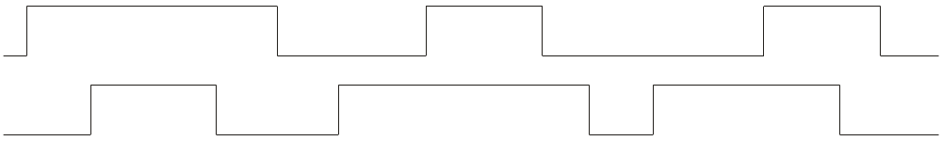

P2.2 Three Primitive Logic Function
AND
A
X
X
The AND Gate
B
B
Example waveforms:
A
B
X
The AND operation is used in computer programming as a selective mask. If you want to retain certain bits of a binary number but reset the other bits to 0, you could set a mask with 1’s in the position of the retained bits.
Example
If the binary number 10100011 is ANDed with the mask 00001111, what is the result?
00000011
Page <number>
26 Feb.-2015
College of Computer Science, Sichuan University
Ying Sancong

Slide 7
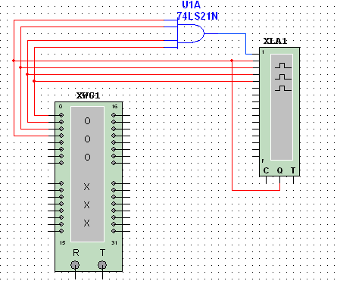
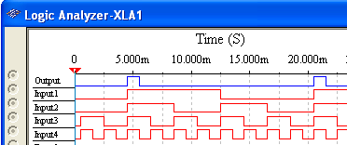
P2.2 Three Primitive Logic Function
AND
A
X
X
The AND Gate
B
B
Example
A Multisim circuit is shown. XWG1 is a word generator set in the count down mode. XLA1 is a logic analyzer with the output of the AND gate connected to first (upper) line of the analyzer. What signal do you expect to on this line?
Solution
The output (line 1) will be HIGH only when all of the inputs are HIGH.
Page <number>
26 Feb.-2015
College of Computer Science, Sichuan University
Ying Sancong

Slide 8

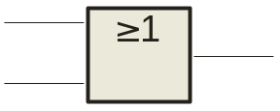
P2.2 Three Primitive Logic Function (cont.)
OR
The OR Gate
A
X
A
X
B
B
The OR gate produces a HIGH output if any input is HIGH; if all inputs are LOW, the output is LOW. For a 2-input gate, the truth table is
0 0
0 1
1 0
1 1
0
1
1
1
The OR operation is shown with a plus sign (+) between the variables. Thus, the OR operation is written as X = A + B.
Page <number>
26 Feb.-2015
College of Computer Science, Sichuan University
Ying Sancong

Slide 9
P2.2 Three Primitive Logic Function (cont.)
OR
The OR Gate
A
X
A
X
B
B
Example waveforms:
A
B
X
The OR operation can be used in computer programming to set certain bits of a binary number to 1.
Example
ASCII letters have a 1 in the bit 5 position for lower case letters and a 0 in this position for capitals. (Bit positions are numbered from right to left starting with 0.) What will be the result if you OR an ASCII letter with the 8-bit mask 00100000?
Solution
The resulting letter will be lower case.
Page <number>
26 Feb.-2015
College of Computer Science, Sichuan University
Ying Sancong

Slide 10
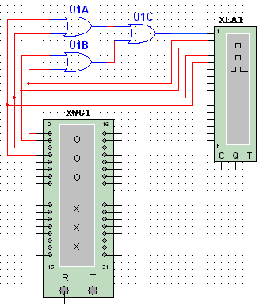
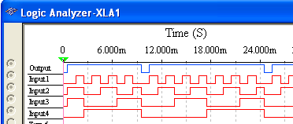
P2.2 Three Primitive Logic Function (cont.)
OR
The OR Gate
A
X
A
X
B
B
A Multisim circuit is shown. XWG1 is a word generator set to count down. XLA1 is a logic analyzer with the output
Example
connected to first (top) line of the analyzer. The three 2-input OR gates act as a single 4-input gate. What signal do you expect on the output line?
Solution
The output (line 1) will be HIGH if any input is HIGH; otherwise it will be LOW.
Page <number>
26 Feb.-2015
College of Computer Science, Sichuan University
Ying Sancong

Slide 11
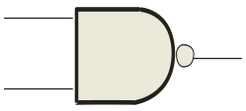
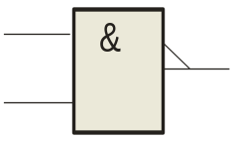
P2.3 Derived logic functions —NAND 、NOR、EX-OR、EX-NOR
NAND (NOT-AND)
A
X
A
X
The NAND Gate
B
B
The NAND gate produces a LOW output when all inputs are HIGH; otherwise, the output is HIGH. For a 2-input gate, the truth table is
0 0
0 1
1 0
1 1
1
1
1
0
The NAND operation is shown with a dot between the variables and an overbar covering them. Thus, the NAND operation is written as X = A .B (Alternatively, X = AB.)
Page <number>
26 Feb.-2015
College of Computer Science, Sichuan University
Ying Sancong

Slide 12
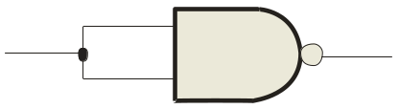
P2.3 Derived logic functions —NAND 、NOR、EX-OR、EX-NOR
NAND (NOT-AND)
A
X
A
X
The NAND Gate
B
B
Example waveforms:
A
B
X
The NAND gate is particularly useful because it is a “universal” gate – all other basic gates can be constructed from NAND gates.
Question
How would you connect a 2-input NAND gate to form a basic inverter?
Page <number>
26 Feb.-2015
College of Computer Science, Sichuan University
Ying Sancong

Slide 13
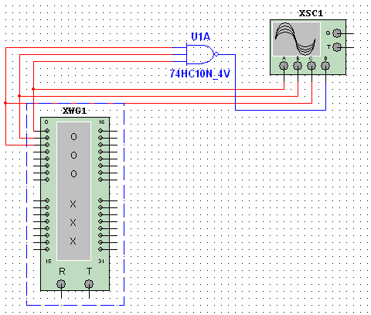
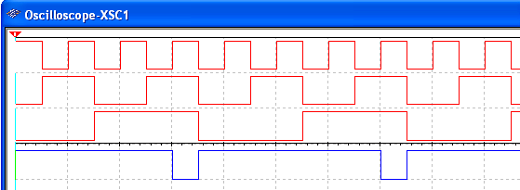
P2.3 Derived logic functions —NAND 、NOR、EX-OR、EX-NOR
NAND (NOT-AND)
A
X
A
X
The NAND Gate
B
B
Example
A Multisim circuit is shown. XWG1 is a word generator set in the count up mode. A four-channel oscilloscope monitors the inputs and output. What output signal do you expect to see?
Solution
The output (channel D) will be LOW only when all of the inputs are HIGH.
Inputs
Page <number>
26 Feb.-2015
College of Computer Science, Sichuan University
Ying Sancong

Slide 14
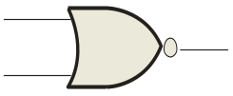
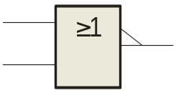
P2.3 Derived logic functions —NAND 、NOR、EX-OR、EX-NOR (cont.)
NOR (NOT-OR)
The NOR Gate
A
X
A
X
B
B
The NOR gate produces a LOW output if any input is HIGH; if all inputs are LOW, the output is HIGH. For a 2-input gate, the truth table is
0 0
0 1
1 0
1 1
1
0
0
0
The NOR operation is shown with a plus sign (+) between the variables and an overbar covering them. Thus, the NOR operation is written as X = A + B.
Page <number>
26 Feb.-2015
College of Computer Science, Sichuan University
Ying Sancong

Slide 15
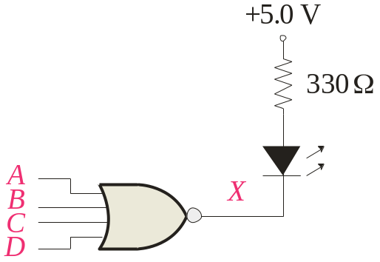
P2.3 Derived logic functions —NAND 、NOR、EX-OR、EX-NOR (cont.)
NOR (NOT-OR)
The NOR Gate
A
X
A
X
B
B
Example waveforms:
A
B
X
The NOR operation will produce a LOW if any input is HIGH.
Example
When is the LED is ON for the circuit shown?
Solution
The LED will be on when any of the four inputs are HIGH.
Page <number>
26 Feb.-2015
College of Computer Science, Sichuan University
Ying Sancong

Slide 16

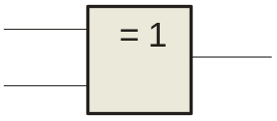
P2.3 Derived logic functions —NAND 、NOR、EX-OR、EX-NOR (cont.)
XOR
A
X
A
X
The XOR Gate
B
B
The XOR gate produces a HIGH output only when both inputs are at opposite logic levels. The truth table is
0 0
0 1
1 0
1 1
0
1
1
0
The XOR operation is written as X = AB + AB. Alternatively, it can be written with a circled plus sign between the variables as X = A + B.
Page <number>
26 Feb.-2015
College of Computer Science, Sichuan University
Ying Sancong

Slide 17
P2.3 Derived logic functions —NAND 、NOR、EX-OR、EX-NOR (cont.)
XOR
A
X
A
X
The XOR Gate
B
B
Example waveforms:
A
B
X
Notice that the XOR gate will produce a HIGH only when exactly one input is HIGH.
Question
If the A and B waveforms are both inverted for the above waveforms, how is the output affected?
There is no change in the output.
Page <number>
26 Feb.-2015
College of Computer Science, Sichuan University
Ying Sancong

Slide 18
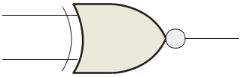
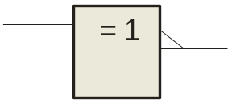
P2.3 Derived logic functions —NAND 、NOR、EX-OR、EX-NOR (cont.)
XNOR
The XNOR Gate
A
X
A
X
B
B
The XNOR gate produces a HIGH output only when both inputs are at the same logic level. The truth table is
0 0
0 1
1 0
1 1
1
0
0
1
The XNOR operation shown as X = AB + AB. Alternatively, the XNOR operation can be shown with a circled dot between the variables. Thus, it can be shown as X = A . B.
Page <number>
26 Feb.-2015
College of Computer Science, Sichuan University
Ying Sancong

Slide 19
P2.3 Derived logic functions —NAND 、NOR、EX-OR、EX-NOR (cont.)
XNOR
The XNOR Gate
A
X
A
X
B
B
Example waveforms:
A
B
X
Notice that the XNOR gate will produce a HIGH when both inputs are the same. This makes it useful for comparison functions.
Question
If the A waveform is inverted but B remains the same, how is the output affected?
The output will be inverted.
Page <number>
26 Feb.-2015
College of Computer Science, Sichuan University
Ying Sancong

Slide 20
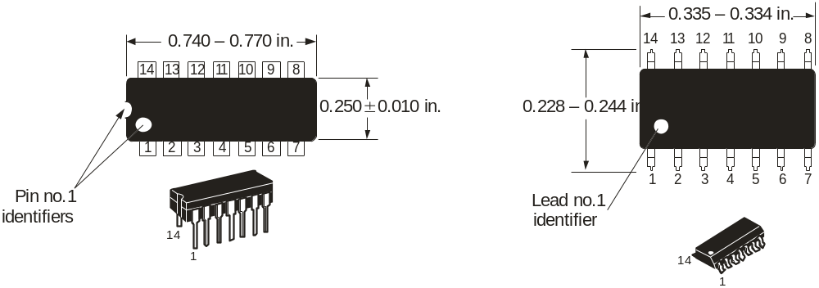
P2.4 Fixed Function Logic
Two major fixed function logic families are TTL and CMOS. A third technology is BiCMOS, which combines the first two. Packaging for fixed function logic is shown.
DIP package SOIC package
Page <number>
26 Feb.-2015
College of Computer Science, Sichuan University
Ying Sancong

Slide 21
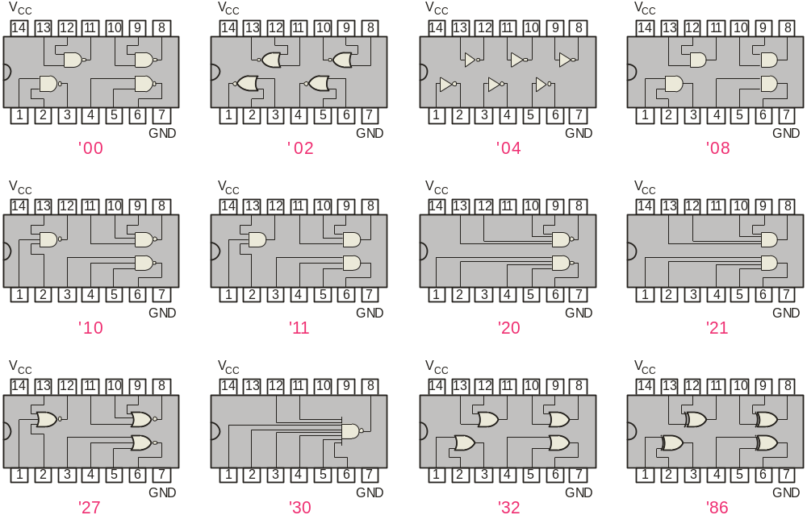
P2.4 Fixed Function Logic
Some common gate configurations are shown.
Page <number>
26 Feb.-2015
College of Computer Science, Sichuan University
Ying Sancong

Slide 22
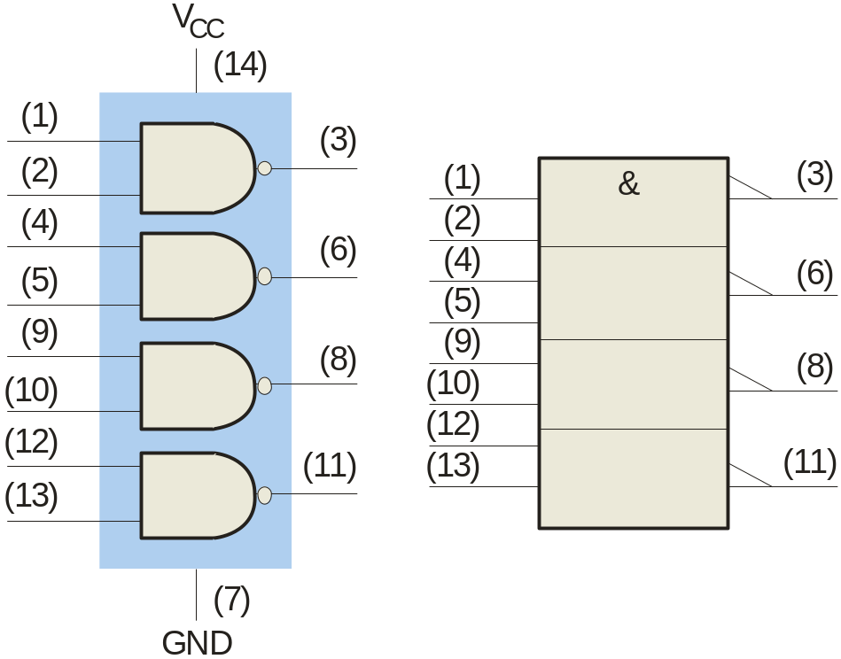
P2.4 Fixed Function Logic
Logic symbols show the gates and associated pin numbers.
Page <number>
26 Feb.-2015
College of Computer Science, Sichuan University
Ying Sancong

Slide 23
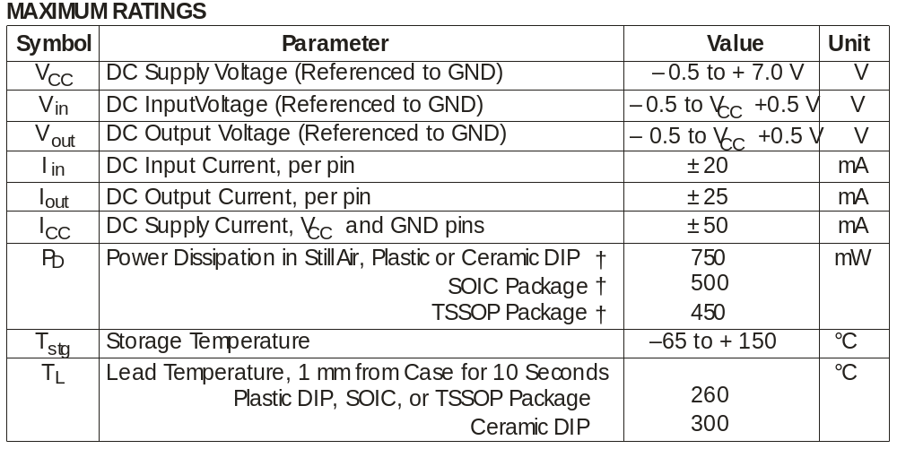
P2.4 Fixed Function Logic
Data sheets include limits and conditions set by the manufacturer as well as DC and AC characteristics. For example, some maximum ratings for a 74HC00A are:
Page <number>
26 Feb.-2015
College of Computer Science, Sichuan University
Ying Sancong

Slide 24
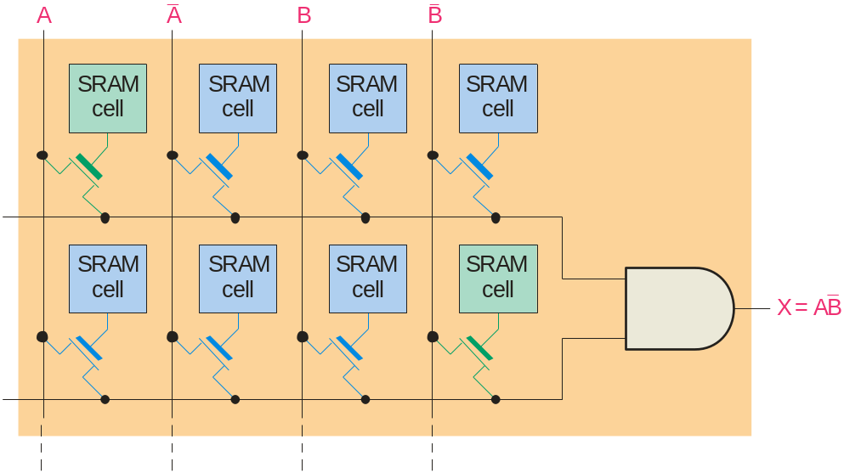
P2.5 Programmable Logic
A Programmable Logic Device (PLD) can be programmed to implement logic. There are various technologies available for PLDs. Many use an internal array of AND gates to form logic terms. Many PLDs can be programmed multiple times.
Page <number>
26 Feb.-2015
College of Computer Science, Sichuan University
Ying Sancong
Notes:
前面给出的不同形状的逻辑符号是逻辑函数的传统表示方式，美国电气与电子工程协会制定了逻辑函数符号标准

Slide 25
P2.5 Programmable Logic
In general, the required logic for a PLD is developed with the aid of a computer. The logic can be entered using a Hardware Description Language (HDL) such as VHDL. Logic can be specified to the HDL as a text file, a schematic diagram, or a state diagram.
Example
A text entry for a programming a PLD in VHDL as a 2-input NAND gate is shown for reference in the following slide. In this case, the inputs and outputs are first specified. Then the signals are described. Although you are probably not familiar with VHDL, you can see that the program is simple to read.
Page <number>
26 Feb.-2015
College of Computer Science, Sichuan University
Ying Sancong

Slide 26
P2.5 Programmable Logic
entity NandGate is
port(A, B: in bit;
LED: out bit);
end entity NandGate;
architecture GateBehavior of NandGate is
signal X: bit;
begin
X <= A nand B;
LED <= X;
end architecture GateBehavior;
Page <number>
26 Feb.-2015
College of Computer Science, Sichuan University
Ying Sancong

Slide 27
Selected Key Terms
OR gate
NAND gate
NOR gate
Exclusive-OR gate
Exclusive-NOR gate
A logic gate that produces a HIGH output when one or more inputs are HIGH.
A logic gate that produces a LOW output only when all of its inputs are HIGH.
A logic gate that produces a LOW output when one or more inputs are HIGH.
A logic gate that produces a HIGH output only when its two inputs are at opposite levels.
A logic gate that produces a LOW output only when its two inputs are at opposite levels.
Page <number>
26 Feb.-2015
College of Computer Science, Sichuan University
Ying Sancong

Slide 28
Quiz
The truth table for a 2-input AND gate is
a.
0 0
0 1
1 0
1 1
0
1
1
0
b.
0 0
0 1
1 0
1 1
1
0
0
0
0 0
0 1
1 0
1 1
0
0
0
1
0 0
0 1
1 0
1 1
0
1
1
1
c.
d.
Page <number>
26 Feb.-2015
College of Computer Science, Sichuan University
Ying Sancong

Slide 29
Quiz
The truth table for a 2-input NOR gate is
a.
0 0
0 1
1 0
1 1
0
1
1
0
b.
0 0
0 1
1 0
1 1
1
0
0
0
0 0
0 1
1 0
1 1
0
0
0
1
0 0
0 1
1 0
1 1
0
1
1
1
c.
d.
Page <number>
26 Feb.-2015
College of Computer Science, Sichuan University
Ying Sancong

Slide 30
Quiz
The truth table for a 2-input XOR gate is
a.
0 0
0 1
1 0
1 1
0
1
1
0
b.
0 0
0 1
1 0
1 1
1
0
0
0
0 0
0 1
1 0
1 1
0
0
0
1
0 0
0 1
1 0
1 1
0
1
1
1
c.
d.
Page <number>
26 Feb.-2015
College of Computer Science, Sichuan University
Ying Sancong

Slide 31
Quiz
A
X
4. The symbol is for a(n)
B
a. OR gate
b. AND gate
c. NOR gate
d. XOR gate
Page <number>
26 Feb.-2015
College of Computer Science, Sichuan University
Ying Sancong

Slide 32
Quiz
A
X
5. The symbol is for a(n)
B
a. OR gate
b. AND gate
c. NOR gate
d. XNOR gate
Page <number>
26 Feb.-2015
College of Computer Science, Sichuan University
Ying Sancong

Slide 33
Quiz
6. A logic gate that produces a HIGH output only when all of its inputs are HIGH is a(n)
a. OR gate
b. AND gate
c. NOR gate
d. NAND gate
Page <number>
26 Feb.-2015
College of Computer Science, Sichuan University
Ying Sancong

Slide 34
Quiz
7. The expression X = A + B means
a. A OR B
b. A AND B
c. A XOR B
d. A XNOR B
Page <number>
26 Feb.-2015
College of Computer Science, Sichuan University
Ying Sancong

Slide 35
Quiz
8. A 2-input gate produces the output shown. (X represents the output.) This is a(n)
a. OR gate
b. AND gate
c. NOR gate
d. NAND gate
A
B
X
Page <number>
26 Feb.-2015
College of Computer Science, Sichuan University
Ying Sancong

Slide 36
Quiz
9. A 2-input gate produces a HIGH output only when the inputs agree. This type of gate is a(n)
a. OR gate
b. AND gate
c. NOR gate
d. XNOR gate
Page <number>
26 Feb.-2015
College of Computer Science, Sichuan University
Ying Sancong

Slide 37
Quiz
10. The required logic for a PLD can be specified in an Hardware Description Language by
a. text entry
b. schematic entry
c. state diagrams
d. all of the above
Page <number>
26 Feb.-2015
College of Computer Science, Sichuan University
Ying Sancong

Slide 38
Quiz
Answers:
1. c
2. b
3. a
4. a
5. d
6. b
7. c
8. d
9. d
10. d
Page <number>
26 Feb.-2015
College of Computer Science, Sichuan University
Ying Sancong

Slide 39

TO BE CONTINUED
Page <number>
01 Sept.-2014
College of Computer Science, Sichuan University
Ying Sancong

