Slide 1
PART 2: (Chapter 4)
Boolean Switching Algebra
(布尔开关代数)
Page <number>
26 Feb.-2015
College of Computer Science, Sichuan University
Ying Sancong

Slide 2

P2.6 Switching Algebra operations
Boolean Addition
In Boolean algebra, a variable is a symbol used to represent an action, a condition, or data. A single variable can only have a value of 1 or 0.
The complement represents the inverse of a variable and is indicated with an overbar. Thus, the complement of A is A.
A literal is a variable or its complement.
Addition is equivalent to the OR operation. The sum term is 1 if one or more if the literals are 1. The sum term is zero only if each literal is 0.
Example
Determine the values of A, B, and C that make the sum term of the expression A + B + C = 0?
Solution
Each literal must = 0; therefore A = 1, B = 0 and C = 1.
Page <number>
26 Feb.-2015
College of Computer Science, Sichuan University
Ying Sancong

Slide 3
P2.6 Switching Algebra operations
Boolean Multiplication
In Boolean algebra, multiplication is equivalent to the AND operation. The product of literals forms a product term. The product term will be 1 only if all of the literals are 1.
Example
What are the values of the A, B and C if the product term of A.B.C = 1?
Solution
Each literal must = 1; therefore A = 1, B = 0 and C = 0.
Page <number>
26 Feb.-2015
College of Computer Science, Sichuan University
Ying Sancong

Slide 4
P2.7 Switching Algebra Laws
Commutative Laws
The commutative laws are applied to addition and multiplication. For addition, the commutative law states
In terms of the result, the order in which variables are ORed makes no difference.
A + B = B + A
For multiplication, the commutative law states
In terms of the result, the order in which variables are ANDed makes no difference.
AB = BA
Page <number>
26 Feb.-2015
College of Computer Science, Sichuan University
Ying Sancong

Slide 5
P2.7 Switching Algebra Laws
Associative Laws
The associative laws are also applied to addition and multiplication. For addition, the associative law states
When ORing more than two variables, the result is the same regardless of the grouping of the variables.
A + (B +C) = (A + B) + C
For multiplication, the associative law states
When ANDing more than two variables, the result is the same regardless of the grouping of the variables.
A(BC) = (AB)C
Page <number>
26 Feb.-2015
College of Computer Science, Sichuan University
Ying Sancong

Slide 6
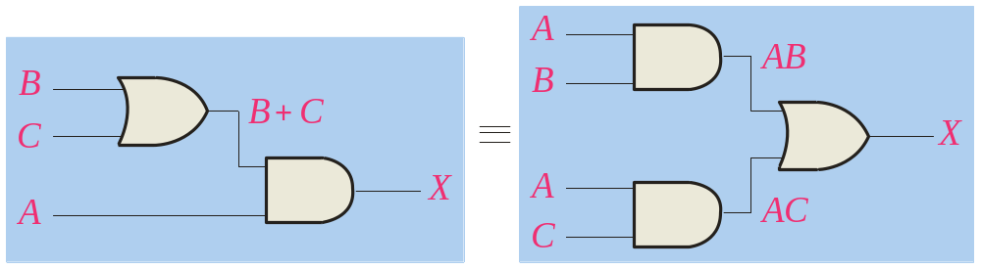
P2.7 Switching Algebra Laws
Distributive Law
The distributive law is the factoring law. A common variable can be factored from an expression just as in ordinary algebra. That is
AB + AC = A(B+ C)
The distributive law can be illustrated with equivalent circuits:
A(B+ C)
AB + AC
Page <number>
26 Feb.-2015
College of Computer Science, Sichuan University
Ying Sancong

Slide 7
P2.8 Switching Algebra Rules
Rules of Boolean Algebra
1. A + 0 = A
7. A . A = A
2. A + 1 = 1
8. A . A = 0
=
3. A . 0 = 0
9. A = A
4. A . 1 = 1
10. A + AB = A
5. A + A = A
11. A + AB = A + B
6. A + A = 1
12. (A + B)(A + C) = A + BC
Page <number>
26 Feb.-2015
College of Computer Science, Sichuan University
Ying Sancong

Slide 8
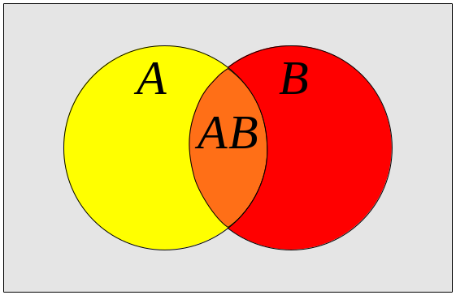
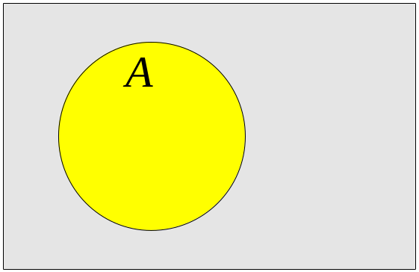
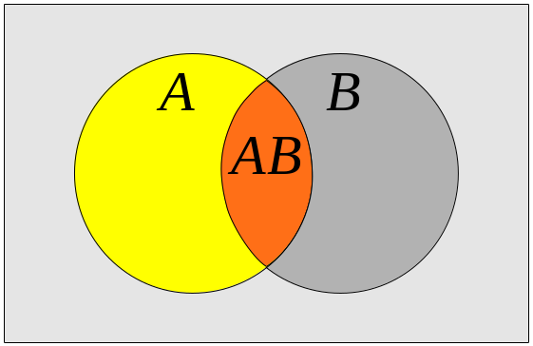
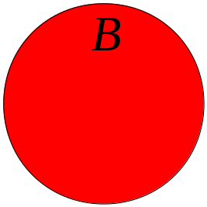
P2.8 Switching Algebra Rules
Rules of Boolean Algebra
Rules of Boolean algebra can be illustrated with Venn diagrams. The variable A is shown as an area.
The rule A + AB = A can be illustrated easily with a diagram. Add an overlapping area to represent the variable B.
The overlap region between A and B represents AB.
=
The diagram visually shows that A + AB = A. Other rules can be illustrated with the diagrams as well.
Page <number>
26 Feb.-2015
College of Computer Science, Sichuan University
Ying Sancong

Slide 9
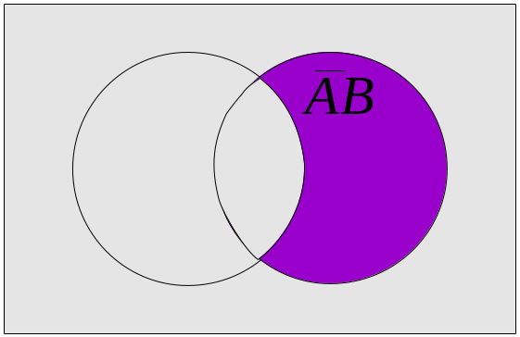
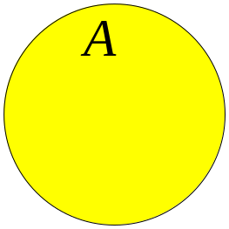
P2.8 Switching Algebra Rules
Rules of Boolean Algebra
Illustrate the rule with a Venn diagram.
Example
A + AB = A + B
Solution
This time, A is represented by the blue area and B again by the red circle.
The intersection represents AB.
Notice that A + AB = A + B
A
Page <number>
26 Feb.-2015
College of Computer Science, Sichuan University
Ying Sancong

Slide 10
P2.8 Switching Algebra Rules
Rules of Boolean Algebra
Rule 12, which states that (A + B)(A + C) = A + BC, can be proven by applying earlier rules as follows:
(A + B)(A + C) = AA + AC + AB + BC
= A + AC + AB + BC
= A(1 + C + B) + BC
= A . 1 + BC
= A + BC
This rule is a little more complicated, but it can also be shown with a Venn diagram, as given on the following slide…
Page <number>
26 Feb.-2015
College of Computer Science, Sichuan University
Ying Sancong

Slide 11
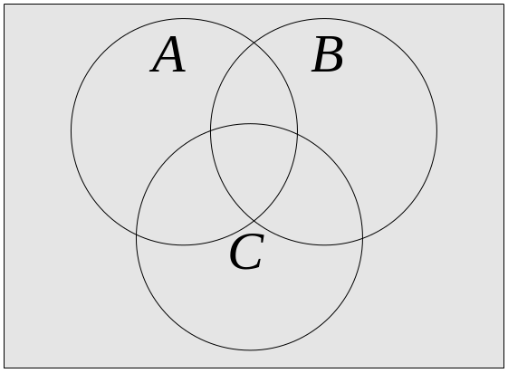
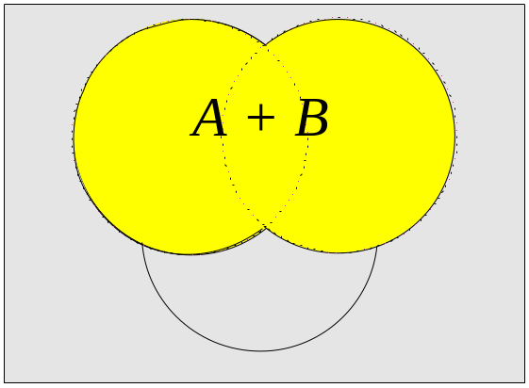
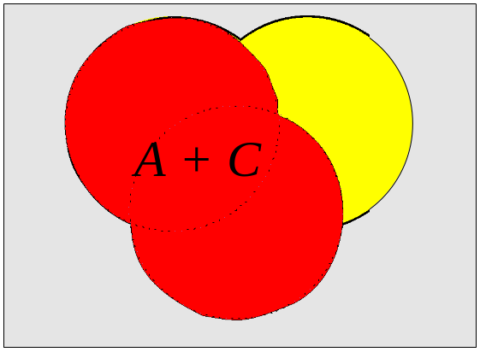
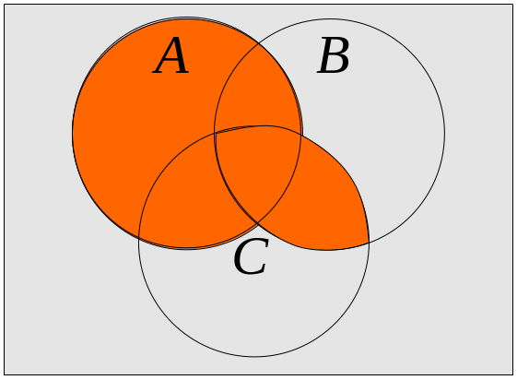
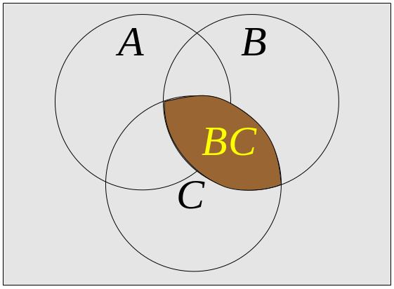
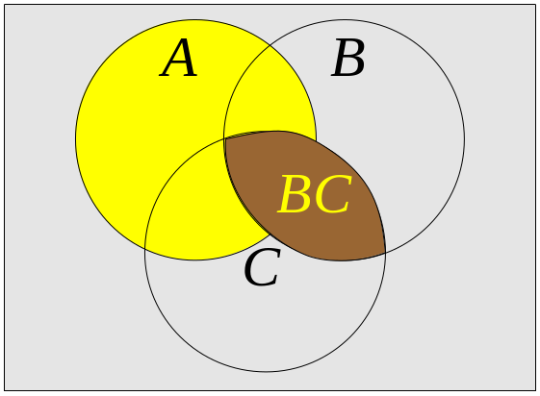
P2.8 Switching Algebra Rules
Three areas represent the variables A, B, and C.
The area representing A + B is shown in yellow.
The area representing A + C is shown in red.
The overlap of red and yellow is shown in orange.
The overlapping area between B and C represents BC.
ORing with A gives the same area as before.
=
(A + B)(A + C)
A + BC
Page <number>
26 Feb.-2015
College of Computer Science, Sichuan University
Ying Sancong

Slide 12
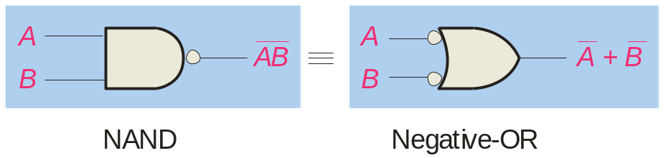
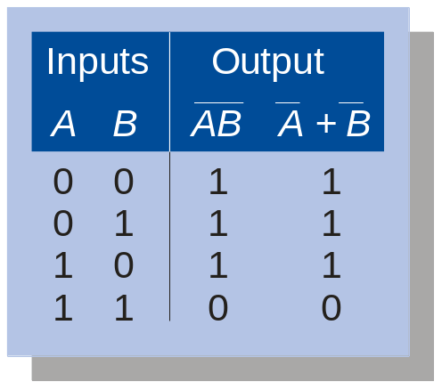
P2.9 Switching Algebra Theorems
DeMorgan’s Theorem
DeMorgan’s 1st Theorem
The complement of a product of variables is equal to the sum of the complemented variables.
AB = A + B
Applying DeMorgan’s first theorem to gates:
Page <number>
26 Feb.-2015
College of Computer Science, Sichuan University
Ying Sancong

Slide 13
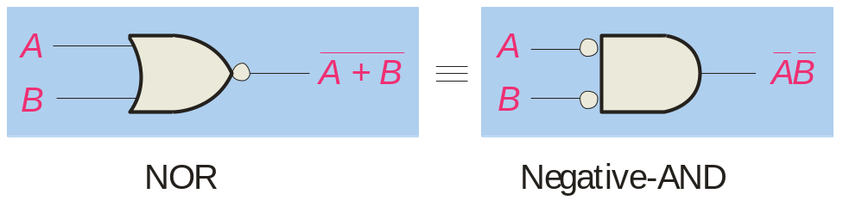
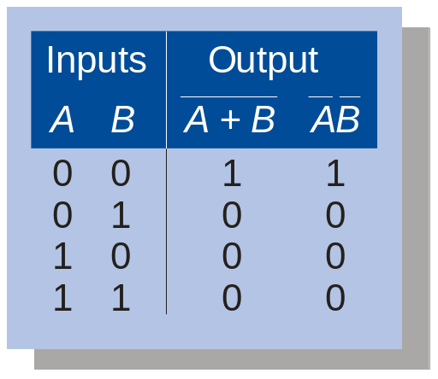
P2.9 Switching Algebra Theorems
DeMorgan’s Theorem
DeMorgan’s 2nd Theorem
The complement of a sum of variables is equal to the product of the complemented variables.
A + B = A . B
Applying DeMorgan’s second theorem to gates:
Page <number>
26 Feb.-2015
College of Computer Science, Sichuan University
Ying Sancong

Slide 14
P2.9 Switching Algebra Theorems
DeMorgan’s Theorem
Example
Apply DeMorgan’s theorem to remove the overbar covering both terms from the
expression X = C + D.
Solution
To apply DeMorgan’s theorem to the expression, you can break the overbar covering both terms and change the sign between the terms. This results in
X = C . D. Deleting the double bar gives X = C . D.
=
Page <number>
26 Feb.-2015
College of Computer Science, Sichuan University
Ying Sancong

Slide 15
P2.9 Switching Algebra Theorems
DeMorgan’s Theorem (General)
x₁x₂x₃…x_{n} = x₁+x₂+x₃+…+x_{n}
x₁+x₂+x₃+…+x_{n} = x₁.x₂.x₃…x_{n}
Page <number>
26 Feb.-2015
College of Computer Science, Sichuan University
Ying Sancong

Slide 16
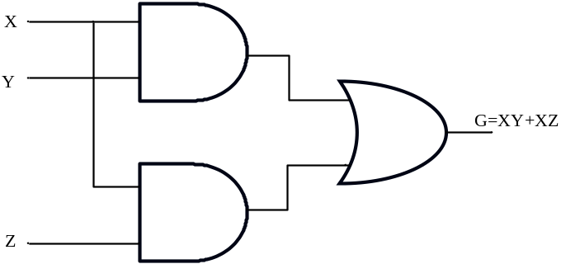
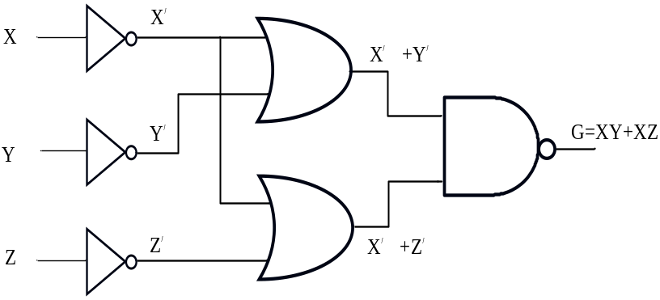
P2.9 Switching Algebra Theorems
DeMorgan’s Theorem Example 1
e.g. 1 Use DeMogan’s Theorem to find an equivalent to G=xy+xz.
Solution 1. Start with the complete function:
a. Let A=xy and B=xz
b. Then G=A+B
c. Complementing step b, G=(A’B’)’
2.Having converted the OR to AND, we can now proceed to convert terms xy and xz
a. Converting, xy=(x’+y’)’
b. converting, xz=(x’+z’)’
c. Therefore,
G=[(x’+y’)(x’+z’)]’
Page <number>
26 Feb.-2015
College of Computer Science, Sichuan University
Ying Sancong
Notes:
由于德摩根定理在我们的数字逻辑设计中会被频繁的使用，下面我们看几个用德摩根定理变形逻辑表达式的例子
例一，求G=xy+xz的等价式分两步走，“或”函数连接了xy,xz两项，所以在求或函数的对偶式时，必须保持这两项的完整性

Slide 17
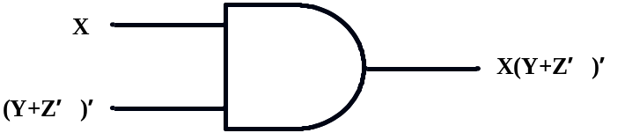
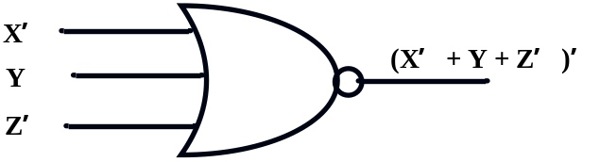
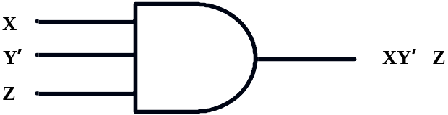
P2.9 Switching Algebra Theorems
DeMorgan’s Theorem Example 2
e.g. 2 Find the DeMogan equivalent to equation F=x (y+ z’)’.
Solution
1. By treating (y+z’)’ as a unit the conversion yields
F=[x’+ (y+ z’)’’)]’=(x’+y+z’)’
2. By applying DeMorgan’s theorm once more, a single three-input AND gate equivalent can also be found
F=(x’+y+z’)’=xy’z
Page <number>
26 Feb.-2015
College of Computer Science, Sichuan University
Ying Sancong

Slide 18
P2.10 Functionally Complete Operation Sets
(完备运算集)
Functionally Complete Operation Sets is a set of logic functions from which any combinational(组合) logic expression can be realized.
  FC1 = {AND,OR,NOT}
  FC2 = {NOR}
  FC3 = {NAND}
  FC4 = {EXOR,AND}
Universal Gates
Page <number>
26 Feb.-2015
College of Computer Science, Sichuan University
Ying Sancong

Slide 19
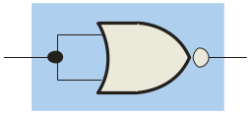
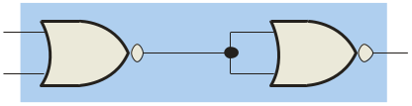
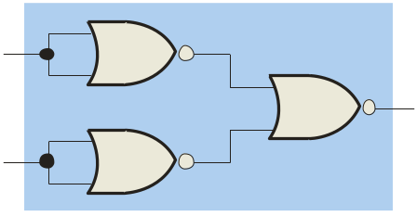
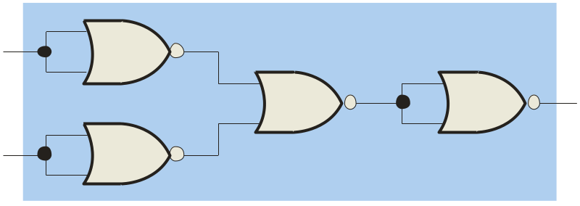
P2.10 Functionally Complete Operation Sets
(完备运算集) (cont.)
Proof: FC2 = {NOR}
xy = (x’+y’)’ = ((x+x)’+(y+y)’)’ ;
x+y = ((x+y)’)’ = ((x+y)’+(x+y)’)’ ;
x’ = (x+0)’ .
NOR gates are also universal gates and can form all of the basic gates.
A
A
A
A + B
B
Inverter
OR gate
A
A
AB
AB
B
B
AND gate
NAND gate
Page <number>
26 Feb.-2015
College of Computer Science, Sichuan University
Ying Sancong

Slide 20
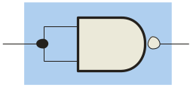
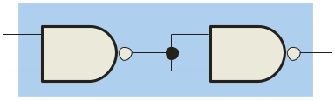
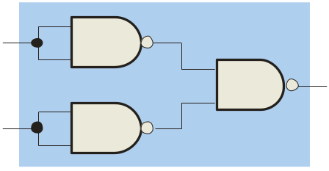
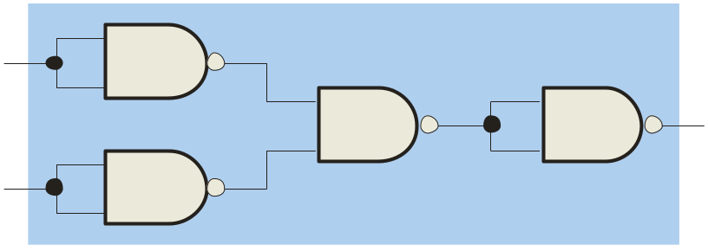
P2.10 Functionally Complete Operation Sets
(完备运算集) (cont.)
Proof: FC3 = {NAND}
xy = ((xy)’)’ = ((xy)’·(xy)’)’ ;
x+y = (x’y’)’ = ((xx)’(yy)’)’ ;
x’ = (xx)’ .
NAND gates are sometimes called universal gates because they can be used to produce the other basic Boolean functions.
A
A
A
AB
B
Inverter
AND gate
A
A
A + B
A + B
B
B
OR gate
NOR gate
Page <number>
26 Feb.-2015
College of Computer Science, Sichuan University
Ying Sancong

Slide 21
P2.10 Functionally Complete Operation Sets
(完备运算集) (cont.)
Proof: FC4 = {EXOR,AND}
x’ = 1⊕x ;
x+y = x⊕y⊕xy
Page <number>
26 Feb.-2015
College of Computer Science, Sichuan University
Ying Sancong

Slide 22
P2.11 Reduction Of Switching Equations
Using Boolean Algebra
Why reduction ?
to reduce cost of the circuit
Switching Equation Expression
  “And-Or” expression (sum of products)
  “Or-And” expression (product of sums)
eg: F(A,B,C) = A’+BC’+AB’C
F(A,B,C,D) = (A+B)(C+D’)(A’+B+C)
Page <number>
26 Feb.-2015
College of Computer Science, Sichuan University
Ying Sancong

Slide 23
P2.11 Reduction Of Switching Equations
Using Boolean Algebra (cont.)
SOP and POS forms
Boolean expressions can be written in the sum-of-products form (SOP) or in the product-of-sums form (POS). These forms can simplify the implementation of combinational logic, particularly with PLDs. In both forms, an overbar cannot extend over more than one variable.
An expression is in SOP form when two or more product terms are summed as in the following examples:
A B C + A B A B C + C D C D + E
An expression is in POS form when two or more sum terms are multiplied as in the following examples:
(A + B)(A + C) (A + B + C)(B + D) (A + B)C
Page <number>
26 Feb.-2015
College of Computer Science, Sichuan University
Ying Sancong

Slide 24
P2.11 Reduction Of Switching Equations
Using Boolean Algebra (cont.)
  “And-Or” expression (sum of products)
e.g. F=AC+ABC+ACD+CD
    Solution:
    F = (AC+ACB)+(ACD+CD)
    = AC(1+B)+CD(1+A)
    = AC+CD
Page <number>
26 Feb.-2015
College of Computer Science, Sichuan University
Ying Sancong

Slide 25
P2.11 Reduction Of Switching Equations
Using Boolean Algebra (cont.)
  “And-Or” expression (sum of products) (cont.)
Exe. 1、 F=A’C’(B’+BD)+A’CD
2、 F=(A⊕B)(AB+A’B’)’+AB
3、F=(A+B+C)(A’+B’+C’)
ANS: 1、 A’B’C’+A’D
2、 A+B
3、 A’C+AB’+BC’
Page <number>
26 Feb.-2015
College of Computer Science, Sichuan University
Ying Sancong

Slide 26
P2.11 Reduction Of Switching Equations
Using Boolean Algebra (cont.)
  “Or-And” expression (product of sums)
e.g. S=A(B’+C)’(BC)’
    Solution:
    S = A(BC’)(B’+C’) // DEMO
    = (ABC’)(B’+C’) // Distribution
    = ABB’C’+ABC’C’ // ..
    = ABC’ // complement, idempotence
Page <number>
26 Feb.-2015
College of Computer Science, Sichuan University
Ying Sancong

Slide 27
P2.11 Reduction Of Switching Equations
Using Boolean Algebra (cont.)
  “Or-And” expression (product of sums) (cont.)
Exe. 1、 F=(A+B)(A+B’)(B+C)(B+C+D)
2、 F=(A+B’)(A’+B)(B+C)(A’+C)
ANS: 1、 A(B+C)
2、 (A+B’)(A’+B)C
Page <number>
26 Feb.-2015
College of Computer Science, Sichuan University
Ying Sancong

Slide 28
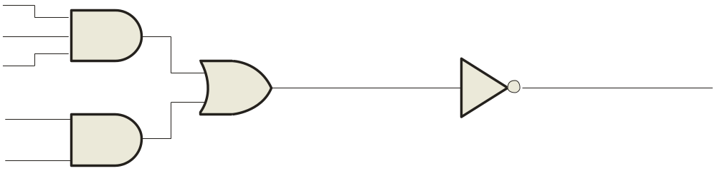
P2.11 Reduction Of Switching Equations
Using Boolean Algebra (cont.)
  “Or-And” expression (product of sums) (cont.)
When the output of a SOP form is inverted, the circuit is called an AND-OR-Invert circuit. The AOI configuration lends itself to product-of-sums (POS) implementation.
An example of an AOI implementation is shown. The output expression can be changed to a POS expression by applying DeMorgan’s theorem twice.
A
B
ABC
C
X = ABC
+ DE
X = ABC
+ DE
AOI
D
X = (ABC)(DE)
DeMorgan
E
DE
X = (A + B + C)(D + E)
POS
Page <number>
26 Feb.-2015
College of Computer Science, Sichuan University
Ying Sancong

Slide 29
Quiz
1. The associative law for addition is normally written as
a. A + B = B + A
b. (A + B) + C = A + (B + C)
c. AB = BA
d. A + AB = A
Page <number>
26 Feb.-2015
College of Computer Science, Sichuan University
Ying Sancong

Slide 30
Quiz
2. The Boolean equation AB + AC = A(B+ C) illustrates
a. the distribution law
b. the commutative law
c. the associative law
d. DeMorgan’s theorem
Page <number>
26 Feb.-2015
College of Computer Science, Sichuan University
Ying Sancong

Slide 31
Quiz
3. The Boolean expression A . 1 is equal to
a. A
b. B
c. 0
d. 1
Page <number>
26 Feb.-2015
College of Computer Science, Sichuan University
Ying Sancong

Slide 32
Quiz
4. The Boolean expression A + 1 is equal to
a. A
b. B
c. 0
d. 1
Page <number>
26 Feb.-2015
College of Computer Science, Sichuan University
Ying Sancong

Slide 33
Quiz
5. Assume an AOI expression is AB + CD. The equivalent POS expression is
a. (A + B)(C + D)
b. (A + B)(C + D)
c. (A + B)(C + D)
d. none of the above
Page <number>
26 Feb.-2015
College of Computer Science, Sichuan University
Ying Sancong

Slide 34
Quiz
6. The two types of gates which are called universal gates are
a. AND/OR
b. NAND/NOR
c. AND/NAND
d. OR/NOR
Page <number>
26 Feb.-2015
College of Computer Science, Sichuan University
Ying Sancong

Slide 35
Quiz
7. The circuit shown is equivalent to an
a. AND gate
b. XOR gate
c. OR gate
d. none of the above
A
B
Page <number>
26 Feb.-2015
College of Computer Science, Sichuan University
Ying Sancong

Slide 36
Quiz
8. The circuit shown is equivalent to
a. an AND gate
b. an XOR gate
c. an OR gate
d. none of the above
A
B
Page <number>
26 Feb.-2015
College of Computer Science, Sichuan University
Ying Sancong

Slide 37
Quiz
Answers:
1. b
2. a
3. a
d
b
6. b
7. d
d
Page <number>
26 Feb.-2015
College of Computer Science, Sichuan University
Ying Sancong

Slide 38

TO BE CONTINUED
Page <number>
01 Sept.-2014
College of Computer Science, Sichuan University
Ying Sancong

