Slide 1
PART 3:
PRINCIPLES OF COMBINATIONAL LOGIC
Page <number>
26 Feb.-2015
College of Computer Science, Sichuan University
Ying Sancong

Slide 2
P3.5 Don't Care Conditions
There may be a combination of input values which
  will never occur
  if they do occur, the output is of no concern.
The function value for such combinations is called a don't care.
They are denoted with x or –. Each x may be arbitrarily assigned the value 0 or 1 in an implementation.
Don’t cares can be used to further simplify a function
Page <number>
26 Feb.-2015
College of Computer Science, Sichuan University
Ying Sancong

Slide 3
P3.5 Don't Care Conditions (cont.)
Minimization using Don’t Cares
Treat don't cares as if they are 1s to generate PIs.
Delete PI's that cover only don't care minterms.
Treat the covering of remaining don't care minterms as optional in the selection process (i.e. they may be, but need not be, covered).
Page <number>
26 Feb.-2015
College of Computer Science, Sichuan University
Ying Sancong

Slide 4
P3.5 Don't Care Conditions (cont.)
Minimization using Don’t Cares : Example1
cd
Simplify the function f(a,b,c,d)
whose K-map is shown at the right.
f = a’c’d+ab’+cd’+a’bc’
or
f = a’c’d+ab’+cd’+a’bd’
The middle two terms are EPIs, while the first and last terms are selected to cover the minterms m₁, m₄, and m₅.
ab
00
01
11
10
00
0
1
0
1
01
1
1
0
1
11
0
0
d
d
0
1
0
1
10
1
1
d
d
1
1
0
1
0
0
d
d
1
1
d
d
0
1
0
1
1
1
0
1
0
0
d
d
1
1
d
d
Page <number>
26 Feb.-2015
College of Computer Science, Sichuan University
Ying Sancong

Slide 5
P3.5 Don't Care Conditions (cont.)
Minimization using Don’t Cares : Example2
cd
Simplify the function g(a,b,c,d) whose K-map is shown at right.
g = a’c’+ ab
or
g = a’c’+b’d
ab
d
1
0
0
1
d
0
d
d
1
0
0
1
d
d
1
1
d
0
d
0
d
d
0
1
d
d
1
0
d
d
0
d
1
0
0
1
d
0
d
1
d
d
1
0
d
d
0
Page <number>
26 Feb.-2015
College of Computer Science, Sichuan University
Ying Sancong

Slide 6
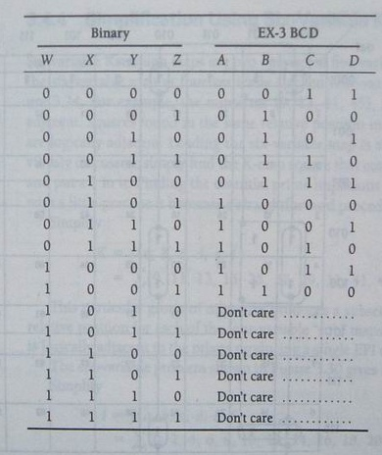
P3.5 Don't Care Conditions (cont.)
Applicaton: EX-3 BCD Encoder
A=f(w,x,y,z)=∑(5,6,7,8,9) +
∑d(10,11,12,13,14,15)
B=f(w,x,y,z)=∑(1.2.3.4.9) +
∑d(10,11,12,13,14,15)
C=f(w,x,y,z)=∑(0,3,4,7,8) +
∑d(10,11,12,13,14,15)
D=f(w,x,y,z)=∑(0,2,4,6,8) +
∑d(10,11,12,13,14,15)
Page <number>
26 Feb.-2015
College of Computer Science, Sichuan University
Ying Sancong

Slide 7
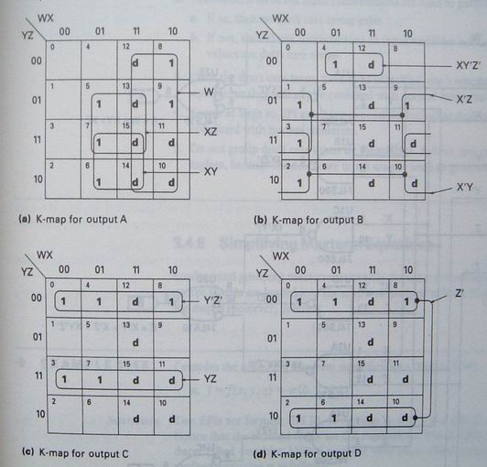
P3.5 Don't Care Conditions (cont.)
Applicaton: EX-3 BCD Encoder (cont.)
Page <number>
26 Feb.-2015
College of Computer Science, Sichuan University
Ying Sancong

Slide 8
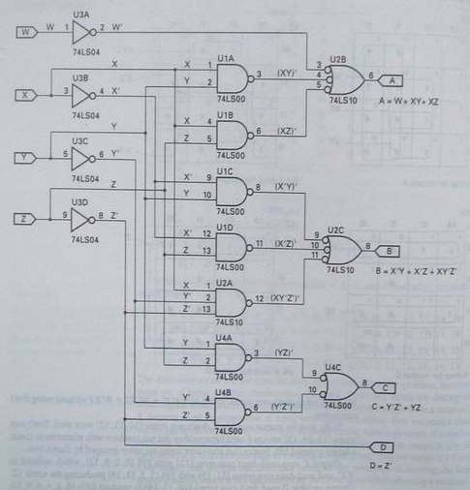
P3.5 Don't Care Conditions (cont.)
Applicaton: EX-3 BCD Encoder (cont.)
A=w+xz+xy
B=x’y+x’z+xyz’
C=y’z’+yz
D=z’
Page <number>
26 Feb.-2015
College of Computer Science, Sichuan University
Ying Sancong

Slide 9
P3.6 Product of Sums Simplification
Use sum-of-products simplification on the zeros of the function in the K-map to get F’.
Find the complement of F’, i.e. (F’)’ = F
using DeMorgan’s Theorem.
Page <number>
26 Feb.-2015
College of Computer Science, Sichuan University
Ying Sancong

Slide 10
P3.6 Product of Sums Simplification (cont.)
POS Example
cd
ab
1
1
1
1
1
1
1
0
0
0
1
1
0
0
0
0
F’(a,b,c,d) = ab’ + ac’ + a’bcd’
F = (a’+b)(a’+c)(a+b’+c’+d)
Page <number>
26 Feb.-2015
College of Computer Science, Sichuan University
Ying Sancong

Slide 11
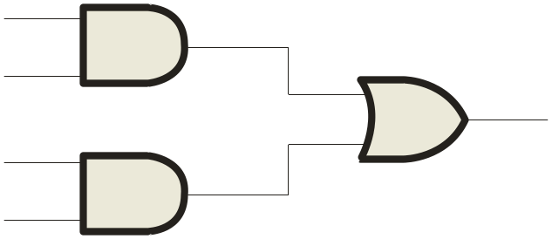
P3.7 NAND and NOR Combinational Circuits
NAND Logic
Recall from DeMorgan’s theorem that AB = A + B. By using equivalent symbols, it is simpler to read the logic of SOP forms. The earlier example shows the idea:
A
C
X =
A
C
+
A
B
A
B
The logic is easy to read if you (mentally) cancel the two connected bubbles on a line.
Page <number>
26 Feb.-2015
College of Computer Science, Sichuan University
Ying Sancong

Slide 12
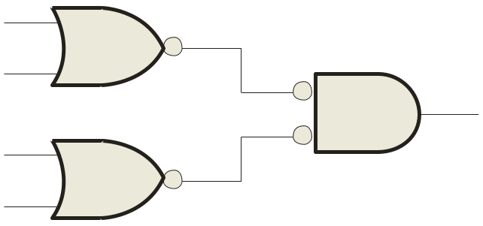
P3.7 NAND and NOR Combinational Circuits
NOR Logic
Alternatively, DeMorgan’s theorem can be written as A + B = A B. By using equivalent symbols, it is simpler to read the logic of POS forms. For example,
A
B
X =
(A + B)(A + C)
A
C
Again, the logic is easy to read if you cancel the two connected bubbles on a line.
Page <number>
26 Feb.-2015
College of Computer Science, Sichuan University
Ying Sancong

Slide 13
P3.7 NAND and NOR Combinational Circuits
Bubble Logic
match/mismatch connecting in logic diagram.
  What is mismatch logic?
    Active Low output connected to Active High input;
    Active High output connected to Active Low input.
Page <number>
26 Feb.-2015
College of Computer Science, Sichuan University
Ying Sancong

Slide 14
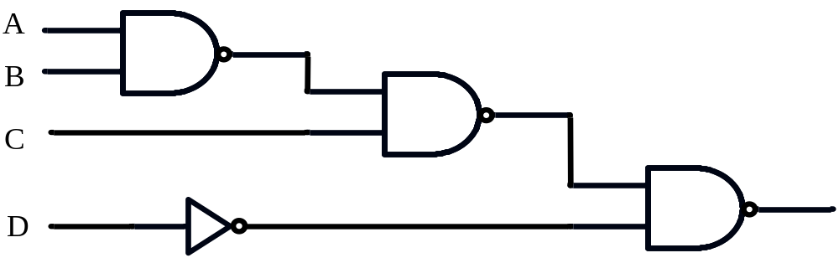
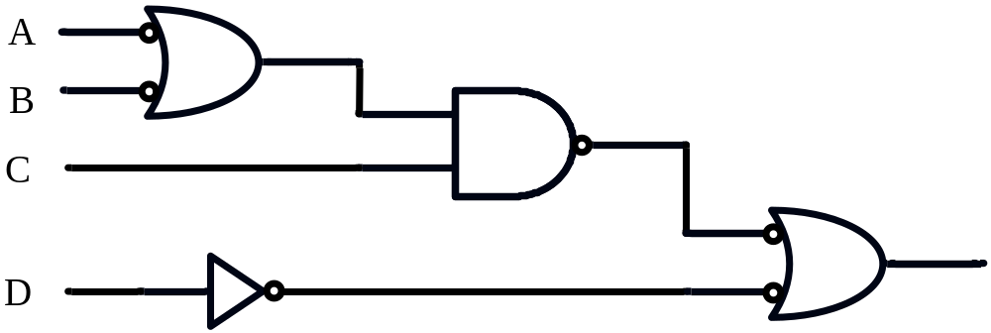
P3.7 NAND and NOR Combinational Circuits
Exe. Write the switching expressions for the following logic circuit.
H=D+C(A’+B’)
Page <number>
26 Feb.-2015
College of Computer Science, Sichuan University
Ying Sancong

Slide 15

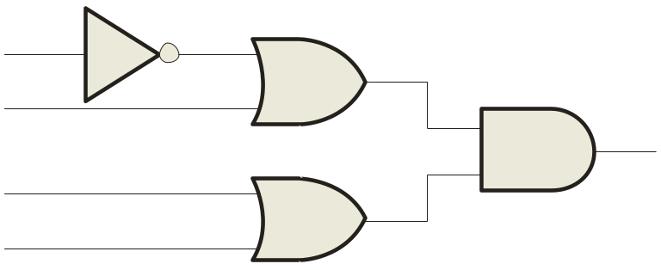
P3.8 Combinational Circuits with pulsed waveform
Pulsed Waveforms
For combinational circuits with pulsed inputs, the output can be predicted by developing intermediate outputs and combining the result. For example, the circuit shown can be analyzed at the outputs of the OR gates:
A
A
G₁
B
B
G₃
C
C
D
G₂
D
G₁
G₂
G₃
Page <number>
26 Feb.-2015
College of Computer Science, Sichuan University
Ying Sancong

Slide 16

P3.8 Combinational Circuits with pulsed waveform
Pulsed Waveforms
Inputs
Output
Alternatively, you can develop the truth table for the circuit and enter 0’s and 1’s on the waveforms. Then read the output from the table.
A B C D
X
0 0 0 0
0
0 0 0 1
1
A
0 0 1 0
1
G₁
0 0 1 1
1
B
0 1 0 0
0
G₃
C
0 1 0 1
1
G₂
0 1 1 0
1
D
0 1 1 1
1
1 0 0 0
0
A
0 1 0 1 0 1 0 1 0 1
1 0 0 1
0
0 1 1 0 0 1 1 0 0 0
1 0 1 0
0
B
1 0 1 1
0
C
0 0 0 1 1 1 1 0 0 0
1 1 0 0
0
1 1 0 1
1
D
0 0 0 0 0 0 0 1 1 0
1 1 1 0
1
G₃
0 0 0 0 1 1 1 0 1 0
1 1 1 1
1
Page <number>
26 Feb.-2015
College of Computer Science, Sichuan University
Ying Sancong

Slide 17
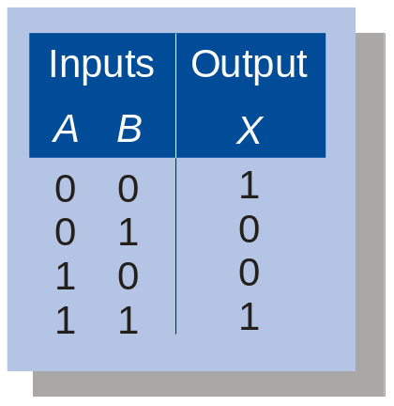
Quiz
1. The truth table shown is for
a. a NAND gate
b. a NOR gate
c. an exclusive-OR gate
d. an exclusive-NOR gate
Page <number>
26 Feb.-2015
College of Computer Science, Sichuan University
Ying Sancong

Slide 18
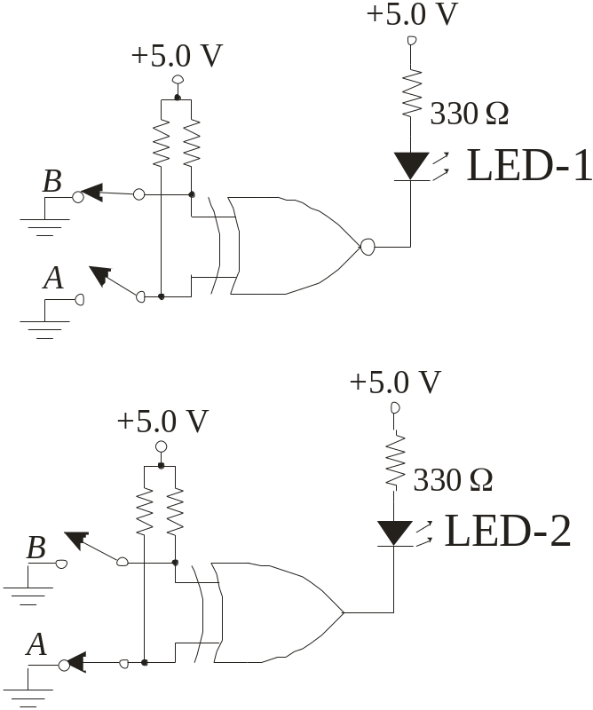
Quiz
2. An LED that should be ON is
a. LED-1
b. LED-2
c. neither
d. both
Page <number>
26 Feb.-2015
College of Computer Science, Sichuan University
Ying Sancong

Slide 19

Quiz
3. During the first three intervals for the pulsed circuit shown, the output of
a. G₁ is LOW and G₂ is LOW
b. G₁ is LOW and G₂ is HIGH
c. G₁ is HIGH and G₂ is LOW
d. G₁ is HIGH and G₂ is HIGH
A
A
G₁
B
B
G₃
C
C
D
G₂
D
Page <number>
26 Feb.-2015
College of Computer Science, Sichuan University
Ying Sancong

Slide 20
Quiz
Answers:
1. d
2. a
3. c
Page <number>
26 Feb.-2015
College of Computer Science, Sichuan University
Ying Sancong

Slide 21
HomeWork
Page 155（第十版）：
2；6. (a),(d),(e)；15.(b),(c)；18. (c),(d)；20.(b),(c),(e)；22；24；26；32；35；41；44.(a),(c),(e)；46；47
Page <number>
26 Feb.-2015
College of Computer Science, Sichuan University
Ying Sancong

Slide 22

TO BE CONTINUED
Page <number>
01 Sept.-2014
College of Computer Science, Sichuan University
Ying Sancong

