Slide 1
PART4: (Chapter 5)
Analysis and Design of Combinational Logic
Page <number>
26 Feb.-2015
College of Computer Science, Sichuan University
Ying Sancong

Slide 2
P4.1 INTRODUCTION TO COMBINATIONAL LOGIC
A combinational circuit consists of logic gates whose outputs, at any time, are determined by combining the values of the inputs.
For n input variables, there are 2^{n} possible binary input combinations.
For each binary combination of the input variables, there is one possible binary value on each output.
Page <number>
26 Feb.-2015
College of Computer Science, Sichuan University
Ying Sancong

Slide 3
P4.1 INTRODUCTION TO COMBINATIONAL LOGIC
(cont.)
Hence, a combinational circuit can be described by:
x₁
Combinational
Circuit
y₁
x₂
.
.
y₂
.
.
y₃
x_{n}
y_{m}
Y₁=f₁(x₁,x₂,…,x_{n})
Y₂=f₂(x₁,x₂,…,x_{n})
Y_{m}=f_{m}(x₁,x₂,…,x_{n})
.
.
.
Page <number>
26 Feb.-2015
College of Computer Science, Sichuan University
Ying Sancong

Slide 4
P4.1 INTRODUCTION TO COMBINATIONAL LOGIC
(cont.)
Combinational vs. Sequential Circuits
n-inputs
Combinational
Circuit
m-outputs
(Depend only on inputs)
Combinational Circuit
m-outputs
n-inputs
Combinational
Circuit
Next state
Storage
Elements
Present state
Sequential Circuit
Page <number>
26 Feb.-2015
College of Computer Science, Sichuan University
Ying Sancong

Slide 5
P4.2 Analysis of Combinational Logic
Procedure
Deriving Switching Equations
Simplifying the switching equations
Giving ruth table
Logic function conclussion
Page <number>
26 Feb.-2015
College of Computer Science, Sichuan University
Ying Sancong

Slide 6
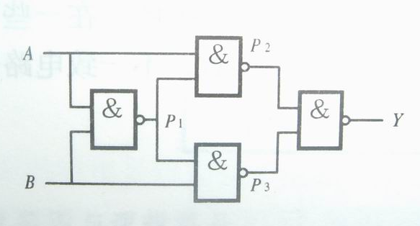
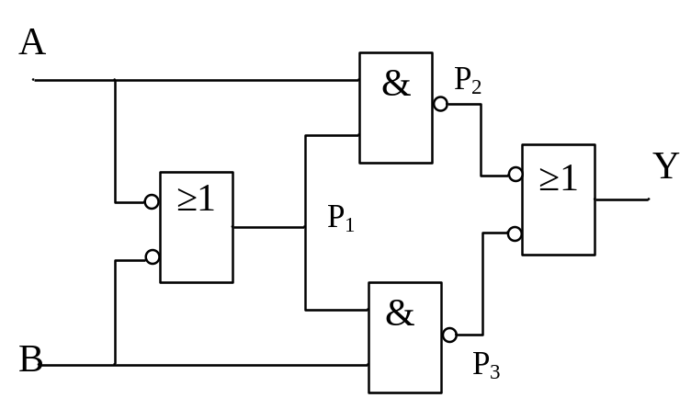
P4.2 Analysis of Combinational Logic (cont.)
E.g. Analysis the functionality of the following circuit
Y=(A’+B’)A+(A’+B’)B
=A’B+AB’
Y=A⊕B
Page <number>
26 Feb.-2015
College of Computer Science, Sichuan University
Ying Sancong

Slide 7
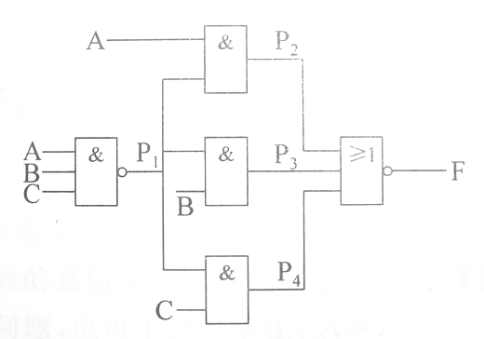
P4.2 Analysis of Combinational Logic (cont.)
E.g. Analysis the functionality of the following circuit
❶
P₁=(ABC)’
P₂=A·P₁=A·(ABC)’
P₃=B·P₁=B·(ABC)’
P₄=C·P₁=C·(ABC)’
❷
F=(P2+P3+P4)’
=(A·(ABC)’+B·(ABC)’+C·(ABC)’)’
=((ABC)’(A+B+C))’
=ABC+A’B’C’
Page <number>
26 Feb.-2015
College of Computer Science, Sichuan University
Ying Sancong

Slide 8
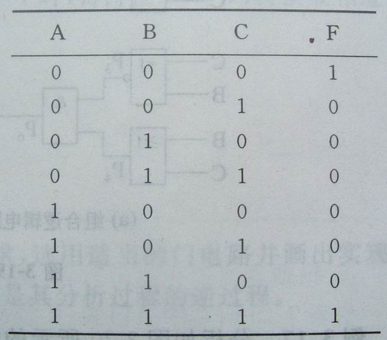
P4.2 Analysis of Combinational Logic (cont.)
❸ Giving truth table
❹ Logic function conclussion
Output logic 1 when three input variables are same value, otherwise, output logic 0.
Page <number>
26 Feb.-2015
College of Computer Science, Sichuan University
Ying Sancong

Slide 9
P4.3 Combinational Circuit Design
Design of a combinational circuit is the development of a circuit from a description of its function.
Starts with a problem specification and produces a logic diagram or set of boolean equations that represent the circuit.
Page <number>
26 Feb.-2015
College of Computer Science, Sichuan University
Ying Sancong

Slide 10
P4.3 Combinational Circuit Design (cont.)
Procedure
Determine the required number of inputs and outputs and assign variables to them.
Derive the truth table that defines the required relationship between inputs and outputs.
Obtain and simplify the Boolean function (K-maps, algebraic manipulation, CAD tools, …). Consider any design constraints (area, delay, power, available libraries, etc).
Draw the logic diagram.
Verify the correctness of the design.
Page <number>
26 Feb.-2015
College of Computer Science, Sichuan University
Ying Sancong

Slide 11
P4.3 Combinational Circuit Design (cont.)
Examples
E.g1. Design a combinational circuit that will multiply two two-bit binary values
Solution:
1. input variables(A₁,A₀,B₁,B₀)
output variables(P₃,P₂,P₁,P₀)
Page <number>
26 Feb.-2015
College of Computer Science, Sichuan University
Ying Sancong

Slide 12
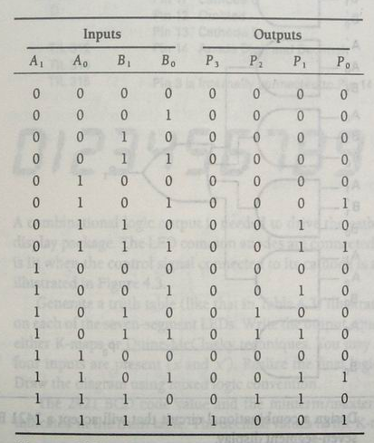
P4.3 Combinational Circuit Design (cont.)
Examples
E.g1. Design a combinational circuit that will multiply two two-bit binary values
Solution:
2. Construct a truth table
The output SOP equations are:
P₃=f(A₁,A₀,B₁,B₀)=∑(15)
P₂=f(A₁,A₀,B₁,B₀)=∑(10,11,14)
P₁=f(A₁,A₀,B₁,B₀)=∑(6,7,9,11,13,14)
P₀=f(A₁,A₀,B₁,B₀)=∑(5,7,13,15)
Page <number>
26 Feb.-2015
College of Computer Science, Sichuan University
Ying Sancong

Slide 13
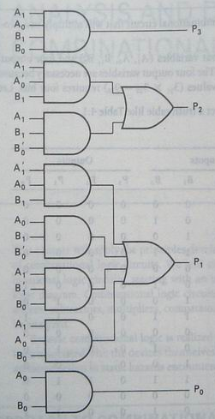
P4.3 Combinational Circuit Design (cont.)
Examples
E.g1. Design a combinational circuit that will multiply two two-bit binary values
Solution:
3. The individually simplified equations are
P₃=A₁A₀B₁B₀
P₂=A₁A₀’B₁+A₁B₁B₀’
P₁=A₁’A₀B₁+A₀B₁B₀’+A₁B₁’B₀+A₁A₀’B₀
P₀=A₀B₀
Page <number>
26 Feb.-2015
College of Computer Science, Sichuan University
Ying Sancong

Slide 14
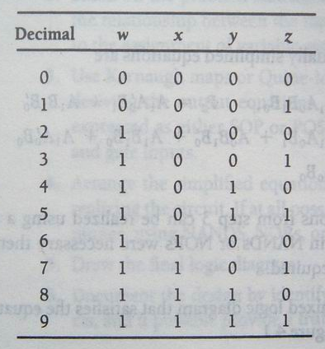
P4.3 Combinational Circuit Design (cont.)
Examples
E.g2. Design a combinational circuit that will accept a 2421BCD code and drive a TIL-312 seven-segment display
Solution:
(1). 2421BCD code
Page <number>
26 Feb.-2015
College of Computer Science, Sichuan University
Ying Sancong

Slide 15
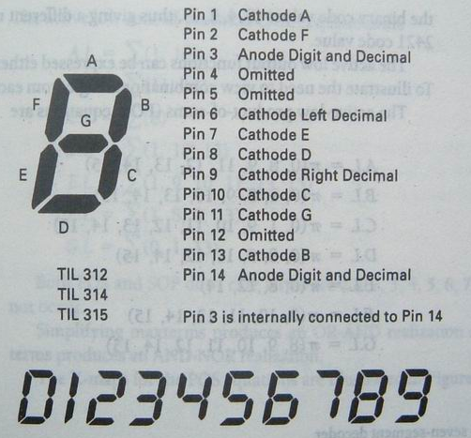
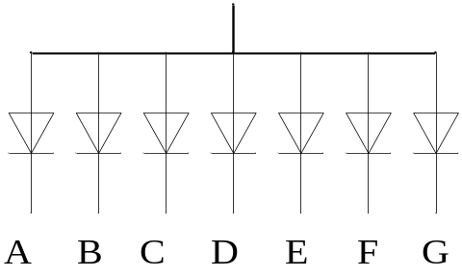
P4.3 Combinational Circuit Design (cont.)
Examples
E.g2. Design a combinational circuit that will accept a 2421BCD code and drive a TIL-312 seven-segment display
Solution:
(2). TIL-312 seven-segment display
Page <number>
26 Feb.-2015
College of Computer Science, Sichuan University
Ying Sancong

Slide 16
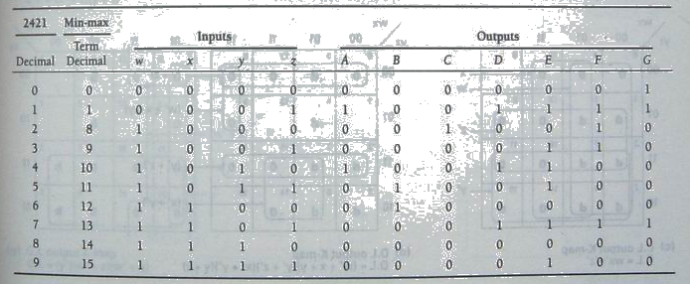
P4.3 Combinational Circuit Design (cont.)
Examples
E.g2. Design a combinational circuit that will accept a 2421BCD code and drive a TIL-312 seven-segment display
Solution:
(3). Input variables ,Output variables and Truth Table
Page <number>
26 Feb.-2015
College of Computer Science, Sichuan University
Ying Sancong

Slide 17
P4.3 Combinational Circuit Design (cont.)
Examples
E.g2. Design a combinational circuit that will accept a 2421BCD code and drive a TIL-312 seven-segment display
Solution:
(4). All output variables equations from truth table and Simplified.
A=∑(1,10)
B=∑(11,12)
C=∑(8)
D=∑(1,10,13)
E=∑(1,9,10,11,13,15)
F=∑(1,8,9,13)
G=∑(0,1,13)
A=w’z+x’yz’
B=xy’z’+x’yz
C=wx’y’z’
D=xy’z+x’yz’+w’z
E=x’y+z
F=wx’y’+y’z
G=w’+xy’z
A=[(w’z)’(x’yz’)]’
B=[(xy’z’)’(x’yz)’]
C=(wx’y’z’)’
D=[(xy’z)’(x’yz’)’(w’z)’]’
E=[(x’y)’(z)’]’
F=[(wx’y’)’(y’z)’]’
G=[(w)(xy’z)’]’
Simplified
used K map
Demorgan
Page <number>
26 Feb.-2015
College of Computer Science, Sichuan University
Ying Sancong

Slide 18
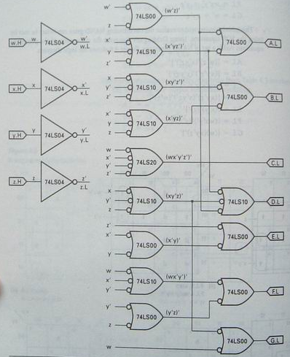
P4.3 Combinational Circuit Design (cont.)
Examples
E.g2. Design a combinational circuit that will accept a 2421BCD code and drive a TIL-312 seven-segment display
Solution:
(5). Draw the logic diagram.
A=[(w’z)’(x’yz’)]’
B=[(xy’z’)’(x’yz)’]
C=(wx’y’z’)’
D=[(xy’z)’(x’yz’)’(w’z)’]’
E=[(x’y)’(z)’]’
F=[(wx’y’)’(y’z)’]’
G=[(w)(xy’z)’]’
Page <number>
26 Feb.-2015
College of Computer Science, Sichuan University
Ying Sancong

Slide 19
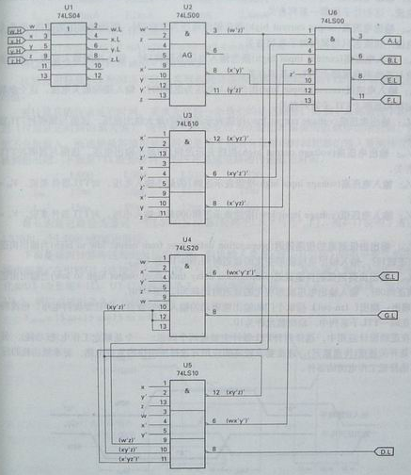
P4.3 Combinational Circuit Design (cont.)
Examples
E.g2. Design a combinational circuit that will accept a 2421BCD code and drive a TIL-312 seven-segment display
Solution:
(6). Draw the circuit diagram.
Page <number>
26 Feb.-2015
College of Computer Science, Sichuan University
Ying Sancong

Slide 20
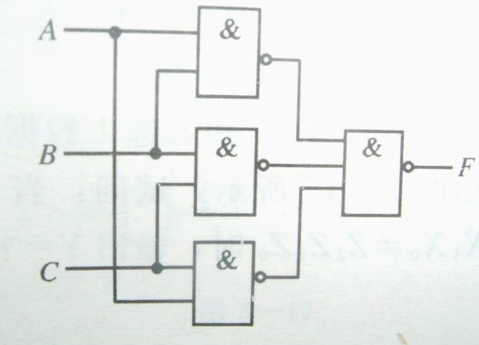
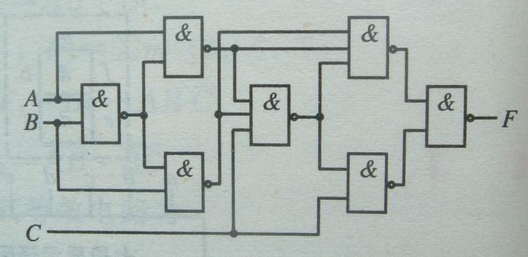
Exe
❶
❷
Page <number>
26 Feb.-2015
College of Computer Science, Sichuan University
Ying Sancong

Slide 21

TO BE CONTINUED
Page <number>
01 Sept.-2014
College of Computer Science, Sichuan University
Ying Sancong

