Slide 1
PART 4: (Chapter 6)
Combinational Logic Design –
Design Procedure, Encoders/Decoders
Page <number>
26 Feb.-2015
College of Computer Science, Sichuan University
Ying Sancong

Slide 2
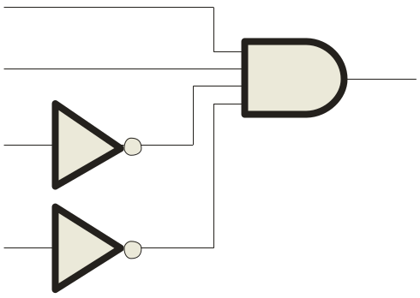

P4.4 Decoders
A decoder is a logic circuit that detects the presence of a specific combination of bits at its input. Two simple decoders that detect the presence of the binary code 0011 are shown. The first has an active HIGH output; the second has an active LOW output.
A₀
A₀
A₁
X
A₁
X
A₂
A₂
A₃
A₃
Active HIGH decoder for 0011
Active LOW decoder for 0011
Page <number>
26 Feb.-2015
College of Computer Science, Sichuan University
Ying Sancong

Slide 3
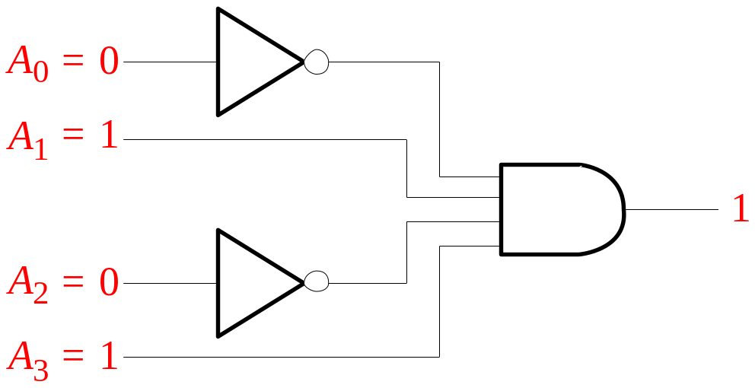

P4.4 Decoders (cont.)
Question
Assume the output of the decoder shown is a logic 1. What are the inputs to the decoder?
Page <number>
26 Feb.-2015
College of Computer Science, Sichuan University
Ying Sancong

Slide 4
P4.4 Decoders (cont.)
A combinational circuit that converts binary information from n coded inputs to a maximum 2^{n} coded outputs
→ n-to- 2^{n} decoder
n-to-m decoder, m ≤ 2^{n}
Examples: BCD-to-7-segment decoder, where n=4 and m= 7
Page <number>
26 Feb.-2015
College of Computer Science, Sichuan University
Ying Sancong

Slide 5
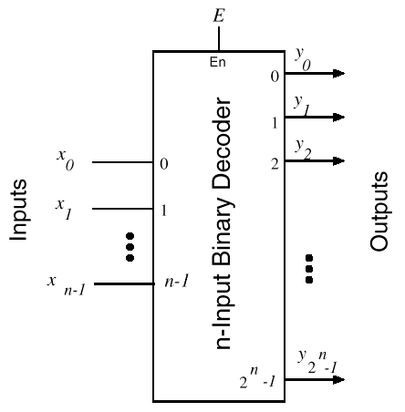
P4.4 Decoders (cont.)
Page <number>
26 Feb.-2015
College of Computer Science, Sichuan University
Ying Sancong

Slide 6
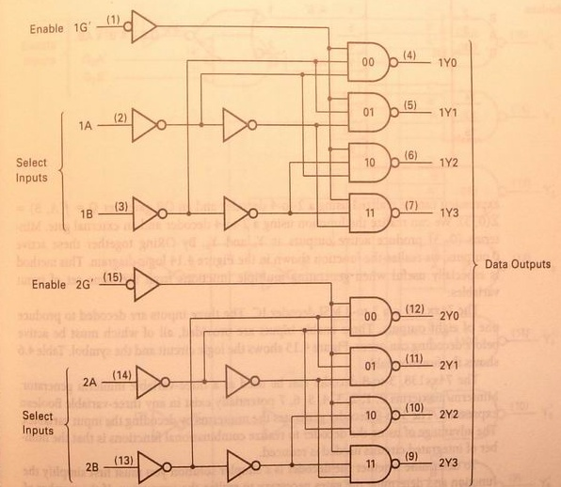
P4.4 Decoders : 2 to 4
Y0=(G’B’A’)’=G+B+A
Y1=(G’B’A)’=G+B+A’
Y2=(G’BA’)’=G+B’+A
Y3=(G’BA)’=G+B’+A’
74XX139 decoder
Page <number>
26 Feb.-2015
College of Computer Science, Sichuan University
Ying Sancong

Slide 7
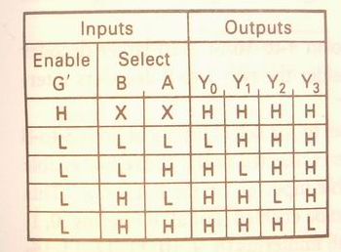
P4.4 Decoders : 2 to 4 (cont.)
Y0=(G’B’A’)’=G+B+A
Y1=(G’B’A)’=G+B+A’
Y2=(G’BA’)’=G+B’+A
Y3=(G’BA)’=G+B’+A’
Page <number>
26 Feb.-2015
College of Computer Science, Sichuan University
Ying Sancong

Slide 8
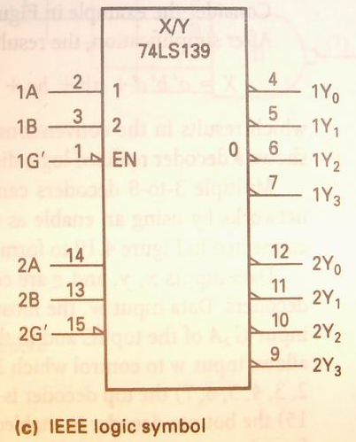
P4.4 Decoders : 2 to 4 (cont.)
Page <number>
26 Feb.-2015
College of Computer Science, Sichuan University
Ying Sancong

Slide 9
P4.4 Decoders : 3 to 8
Three inputs, A₀, A₁, A₂, are decoded into eight outputs, Y₀ through Y₇
Each output Y_{i} represents one of the minterms of the 3 input variables.
Y_{i} = 0 when the binary number A₂A₁A₀ = i
Shorthand: Y_{i} = m_{i}’
The output variables are mutually exclusive; exactly one output has the value 0 at any time, and the other seven are 1.
Page <number>
26 Feb.-2015
College of Computer Science, Sichuan University
Ying Sancong

Slide 10
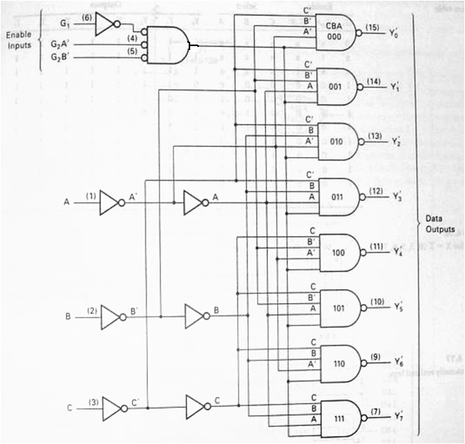
P4.4 Decoders : 3 to 8 (cont.)
Y0’=
Y1’=
Y2’=
Y3’=
Y4’=
Y5’=
Y6’=
Y7’=
Page <number>
26 Feb.-2015
College of Computer Science, Sichuan University
Ying Sancong
Notes:
Yi’等效表示为Yi.L，表示一个低有效的信号。同样G2A’，G2B’也是一个意思。

Slide 11
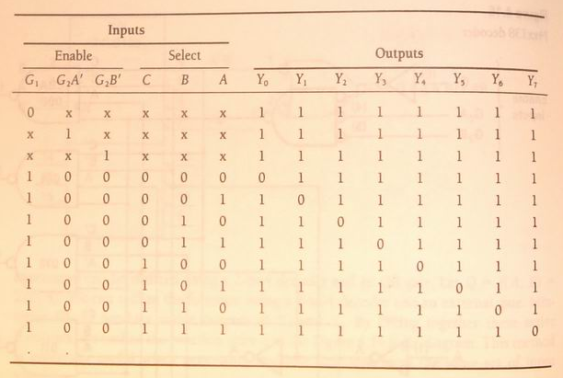
P4.4 Decoders : 3 to 8 (cont.)
Page <number>
26 Feb.-2015
College of Computer Science, Sichuan University
Ying Sancong

Slide 12
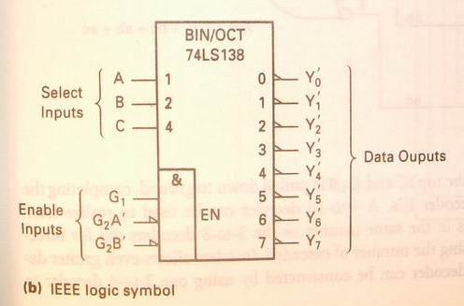
P4.4 Decoders : 3 to 8 (cont.)
Page <number>
26 Feb.-2015
College of Computer Science, Sichuan University
Ying Sancong

Slide 13
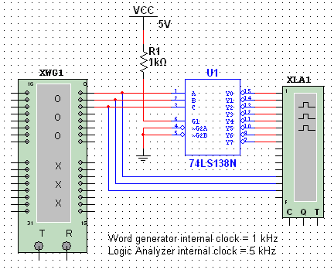
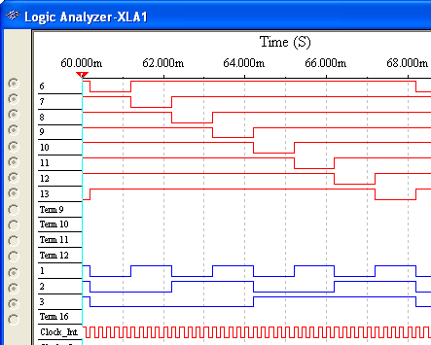
P4.4 Decoders (cont.)
The 74LS138 is a 3-to-8 decoder with three chip select inputs (two active LOW, one active HIGH). In this Multisim circuit, the word generator (XWG1) is set up as an up counter. The logic analyzer (XLA1) compares the input and outputs of the decoder.
Inputs are blue, outputs are red.
Page <number>
26 Feb.-2015
College of Computer Science, Sichuan University
Ying Sancong

Slide 14
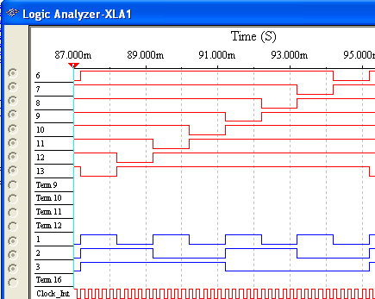
P4.4 Decoders (cont.)
Question
How will the waveforms change if the word generator is configured as a down counter instead of an up counter?
Inputs are blue, outputs are red.
Page <number>
26 Feb.-2015
College of Computer Science, Sichuan University
Ying Sancong

Slide 15
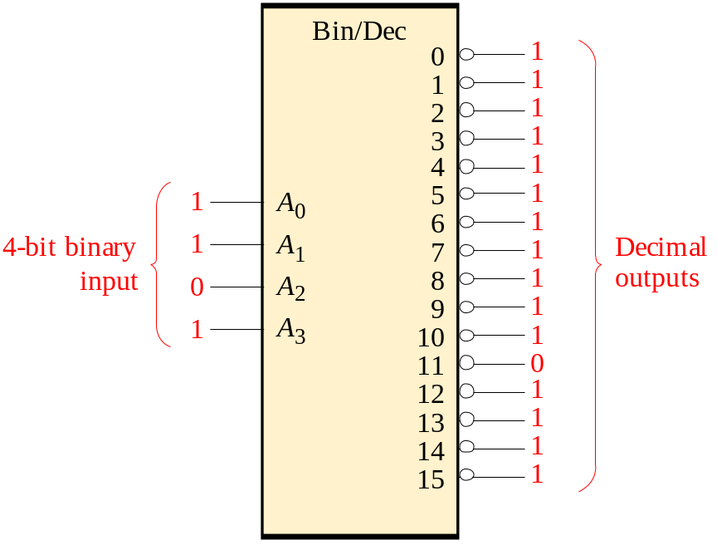
P4.4 Decoders (cont.)
IC decoders have multiple outputs to decode any combination of inputs. For example the binary-to-decimal decoder shown here has 16 outputs – one for each combination of binary inputs.
Question
For the input shown, what is the output?
Page <number>
26 Feb.-2015
College of Computer Science, Sichuan University
Ying Sancong

Slide 16
P4.4 Decoders (cont.)
Implementing Boolean functions using decoders
Y₀’=Y_{0.}L=(C’B’A’)’=m₀’
Y₁’= Y_{1.}L=(C’B’A)’=m₁’
Y₂’=Y_{2.}L= (C’BA’)’=m₂’
Y₃’=Y_{3.}L= (C’BA)’=m₃’
Y₄’=Y_{4.}L= (CB’A’)’=m₄’
Y₅’=Y_{5.}L= (CB’A)’=m₅’
Y₆’=Y_{6.}L= (CBA’)’=m₆’
Y₇’=Y_{7.}L= (CBA)’=m₇’
Page <number>
26 Feb.-2015
College of Computer Science, Sichuan University
Ying Sancong
Notes:
一个N变量的二进制译码的输出包含了n个变量的所有最小项，例如，3线/8线译码器的8个输出包含了3个变量的最小项，如图所示，当使能端有效时，译码器处于译码状态，各输出端表达式为：{mi’}
因此，应用n变量译码器实现逻辑函数时，可以首先将逻辑函数变换成最小项之和的标准形式，并在译码器输出端连接适当的与非门作输出级，就能获得任何形式的输入变量不大于n的组合逻辑函数

Slide 17
P4.4 Decoders (cont.)
Implementing Boolean functions using decoders
E.g. use 74XX138,3-to-8 decoder to implement boolean functions
F₁=A’B’+AC+A’C’
F₂=A’C+AC’
F₃=B’C+BC’
Page <number>
26 Feb.-2015
College of Computer Science, Sichuan University
Ying Sancong

Slide 18
P4.4 Decoders (cont.)
Implementing Boolean functions using decoders
E.g. use 74XX138,3-to-8 decoder to implement boolean functions
Solution1:
F₁=A’B’+AC+A’C’
=m₀+m₁+m₂+m₅+m₇ = (m₀’m₁’m₂’m₅’m₇’)’
F₂=A’C+AC’
= m₁+m₃+m₄+m₆ = (m₁’m₃’m₄’m₆’)’
F₃=B’C+BC’
=m₁+m₂+m₅+m₆ = (m₁’m₂’m₅’m₆’)’
Page <number>
26 Feb.-2015
College of Computer Science, Sichuan University
Ying Sancong

Slide 19
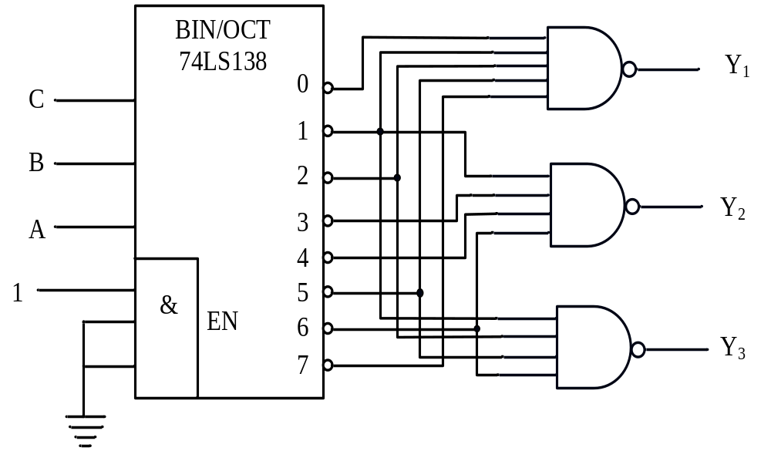
P4.4 Decoders (cont.)
Implementing Boolean functions using decoders
E.g. use 74XX138,3-to-8 decoder to implement boolean functions
Solution1:
F₁= (m₀’m₁’m₂’m₅’m₇’)’
= (Y₀Y₁Y₂Y₅Y₇)’
F₂= (m₁’m₃’m₄’m₆’)’
= (Y₁Y₃Y₄Y₆)’
F₃ = (m₁’m₂’m₅’m₆’)’
= (Y₁Y₂Y₅Y₆)’
Page <number>
26 Feb.-2015
College of Computer Science, Sichuan University
Ying Sancong

Slide 20
P4.4 Decoders (cont.)
Implementing Boolean functions using decoders
E.g. use 74XX138,3-to-8 decoder to implement boolean functions
Solution2:
F₁=A’B’+AC+A’C’=m₀+m₁+m₂+m₅+m₇
=∑(0,1,2,5,7)=∏(3,4,6)
=M₃M₄M₆=m₃’m₄’m₆’
F₂ =A’C+AC’= m₁+m₃+m₄+m₆ =∑(1,3,4,6)
=∏(0,2,5,7)=M₀M₂M₅M₇ =m₀’m₂’m₅’m₇’
F₃ =B’C+BC’=m₁+m₂+m₅+m₆ =∑(1,2,5,6)
=∏(0,3,4,7)=M₀M₃M₄M₇ =m₀’m₃’m₄’m₇’
Page <number>
26 Feb.-2015
College of Computer Science, Sichuan University
Ying Sancong

Slide 21
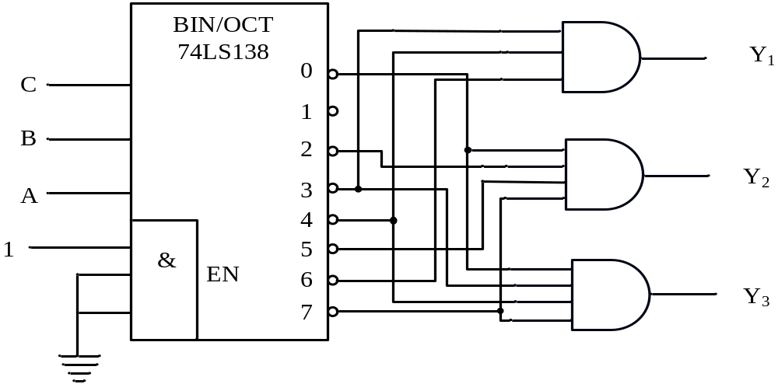
P4.4 Decoders (cont.)
Implementing Boolean functions using decoders
E.g. use 74XX138,3-to-8 decoder to implement boolean functions
Solution2:
F₁=m₃’m₄’m₆’
= Y₃Y₄Y₆
F₂=m₀’m₂’m₅’m₇’
= Y₀Y₂Y₅Y₇
F₃=m₀’m₃’m₄’m₇’
= Y₀Y₃Y₄Y₇
Page <number>
26 Feb.-2015
College of Computer Science, Sichuan University
Ying Sancong

Slide 22
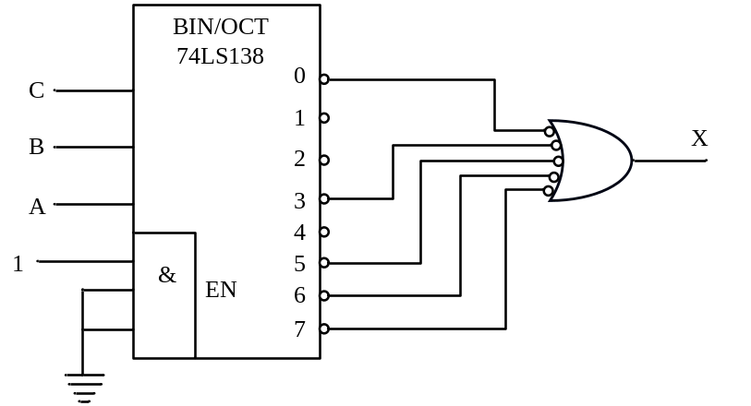
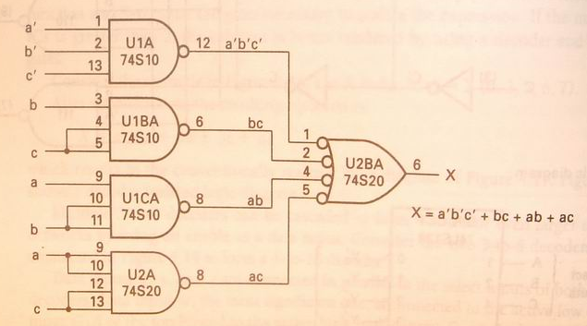
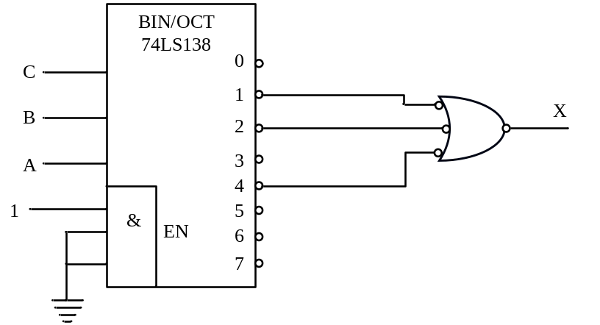
P4.4 Decoders (cont.)
Implementing Boolean functions using decoders
e.g. X=f(a,b,c)=∑(0,3,5,6,7)
=a’b’c’+ab+bc+ac
Page <number>
26 Feb.-2015
College of Computer Science, Sichuan University
Ying Sancong

Slide 23
P4.4 Decoders (cont.)
Implementing Boolean functions using decoders
Here is another example:
Recall full adder equations, and let X, Y, and Z be the inputs:
  S(X,Y,Z) = Σm(1,2,4,7)
  C (X,Y,Z) = Σm(3, 5, 6, 7).
Since there are 3 inputs and a total of 8 minterms, we need a 3-to-8 decoder.
Page <number>
26 Feb.-2015
College of Computer Science, Sichuan University
Ying Sancong

Slide 24
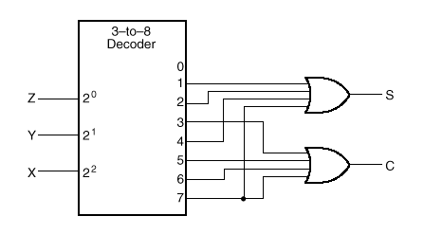
P4.4 Decoders (cont.)
Implementing a Binary Adder using decoders
S(X,Y,Z) = Σm(1,2,4,7)
C(X,Y,Z) = Σm(3,5,6,7)
Page <number>
26 Feb.-2015
College of Computer Science, Sichuan University
Ying Sancong

Slide 25
P4.4 Decoders (cont.)
Implementing Boolean functions using decoders
Exe. Using decoders realize functions
A=f(x,y,z)=∏(0,1,3,5)
G=f(x,y,z)=∑(0,1,2,4,5,6,7)
Page <number>
26 Feb.-2015
College of Computer Science, Sichuan University
Ying Sancong

Slide 26
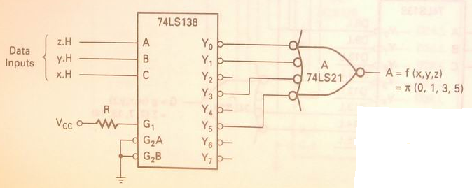
P4.4 Decoders (cont.)
Implementing Boolean functions using decoders
A=f(x,y,z)=∏(0,1,3,5) = M₀M₁M₃M₅
= m₀’m₁’m₃’m₅’ = Y₀Y₁Y₃Y₅ = (Y₀’+Y₁’+Y₃’+Y₅’) ’
Page <number>
26 Feb.-2015
College of Computer Science, Sichuan University
Ying Sancong

Slide 27
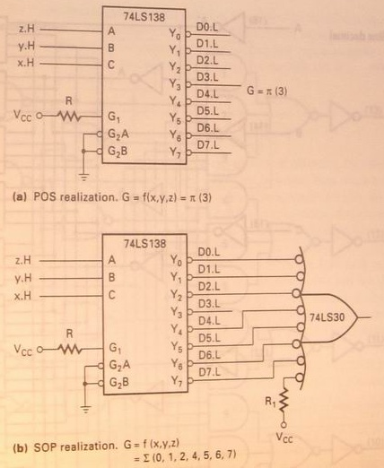
P4.4 Decoders (cont.)
Implementing Boolean functions using decoders
G=f(x,y,z)=∑(0,1,2,4,5,6,7)
=∏(3) = M₃
= m₃’ = Y₃
Page <number>
26 Feb.-2015
College of Computer Science, Sichuan University
Ying Sancong

Slide 28
P4.4 Decoders (cont.)
Decoder Expansions
Larger decoders can be constructed using a number of smaller ones.
HIERARCHICAL design!
Example:
A 6-to-64 decoder can be designed using four 4-to-16 and one 2-to-4 decoders. How? (Hint: Use the 2-to-4 decoder to generate the enable signals to the four 4-to-16 decoders).
Page <number>
26 Feb.-2015
College of Computer Science, Sichuan University
Ying Sancong

Slide 29
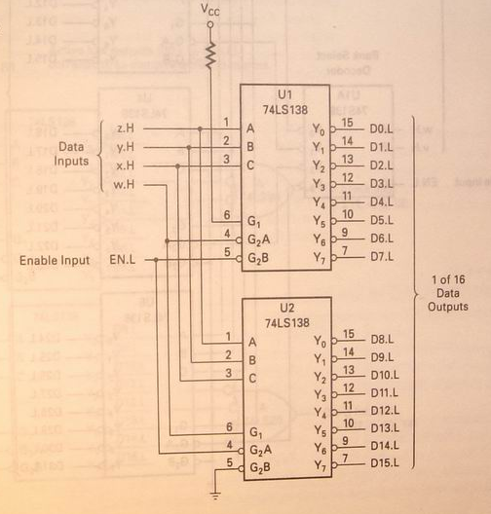
P4.4 Decoders (cont.)
Decoder Expansions
Two 74XX138 decoders forming a single 4-to-16 decoder(P177)
Page <number>
26 Feb.-2015
College of Computer Science, Sichuan University
Ying Sancong

Slide 30
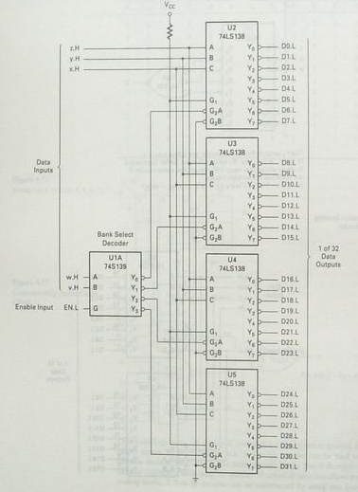
P4.4 Decoders (cont.)
Decoder Expansions
A 5-to-32 decoder using one 2-to-4 and four 3-to-8 decoder ICs(P178)
Page <number>
26 Feb.-2015
College of Computer Science, Sichuan University
Ying Sancong

Slide 31
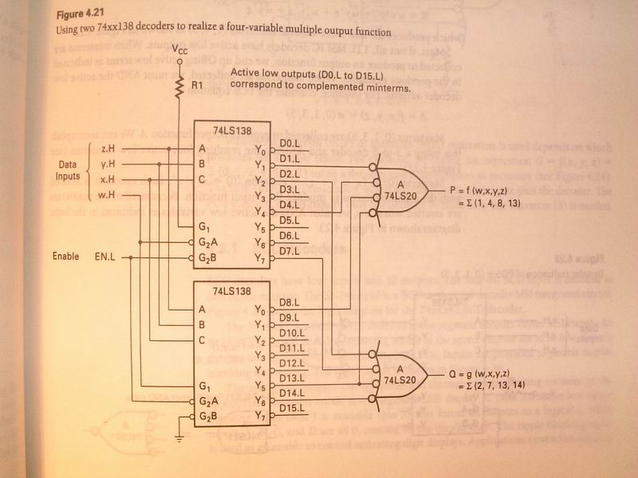
P4.4 Decoders (cont.)
Decoder Expansions
E.g. Using two 74XX138 decoders to realize a four-variable multiple output function(P179)
P=f(w,x,y,z)=∑(1,4,8,13)
Q=f(w,x,y,z)=∑(2,7,13,14)
Page <number>
26 Feb.-2015
College of Computer Science, Sichuan University
Ying Sancong

Slide 32
P4.5 Encoders
An encoder is a digital circuit that performs the inverse operation of a decoder. An encoder has 2^{n} input lines and n output lines.
The output lines generate the binary equivalent of the input line whose value is 1.
Page <number>
26 Feb.-2015
College of Computer Science, Sichuan University
Ying Sancong

Slide 33
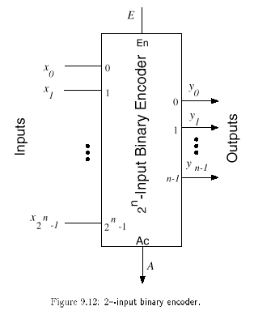
P4.5 Encoders (cont.)
Page <number>
26 Feb.-2015
College of Computer Science, Sichuan University
Ying Sancong

Slide 34
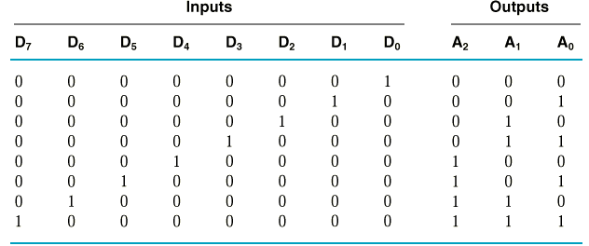
P4.5 Encoders (cont.)
Example: 8-to-3 binary encoder (octal-to-binary)
A₀ = D₁ + D₃ + D₅ + D₇
A₁ = D₂ + D₃ + D₆ + D₇
A₂ = D₄ + D₅ + D₆ + D₇
Page <number>
26 Feb.-2015
College of Computer Science, Sichuan University
Ying Sancong

Slide 35
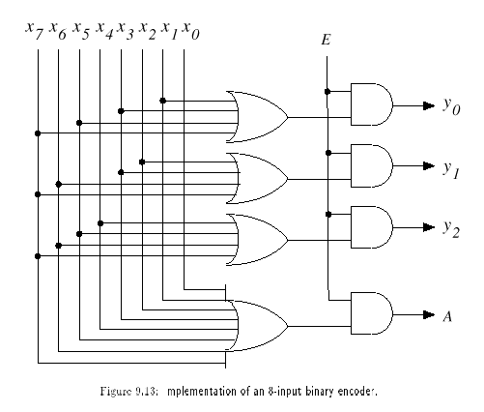
P4.5 Encoders (cont.)
Page <number>
26 Feb.-2015
College of Computer Science, Sichuan University
Ying Sancong

Slide 36
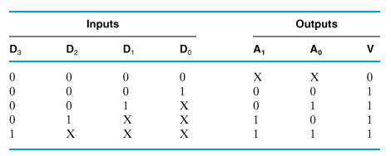
P4.5 Encoders (cont.)
Priority Encoders
Multiple asserted inputs are allowed; one has priority over all others.
Example: 4-to-2 Priority Encoder
Truth Table
Page <number>
26 Feb.-2015
College of Computer Science, Sichuan University
Ying Sancong

Slide 37
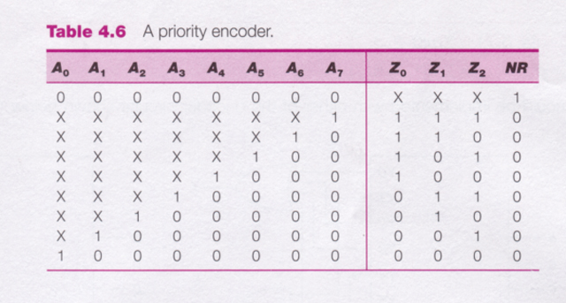
P4.5 Encoders (cont.)
Priority Encoders
Example: 8-to-3 Priority Encoder
Truth Table
Page <number>
26 Feb.-2015
College of Computer Science, Sichuan University
Ying Sancong

Slide 38
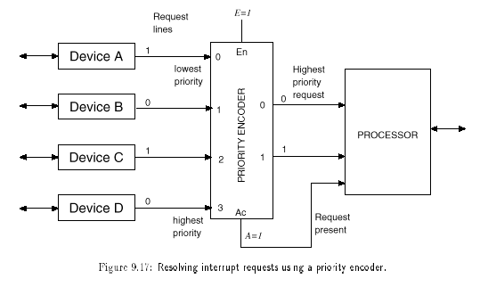
P4.5 Encoders (cont.)
Application of priority encoders
Page <number>
26 Feb.-2015
College of Computer Science, Sichuan University
Ying Sancong

Slide 39
HomeWork
1.Using 3-8 decoders to implement following expressions
(a) Z = f(A,B,C) = A'B+BC'+BC+AB'C'
(b) Z = f(A,B,C) =A'•B' •C'+A'•B+A•B•C'+A•C
Page <number>
26 Feb.-2015
College of Computer Science, Sichuan University
Ying Sancong

Slide 40

TO BE CONTINUED
Page <number>
01 Sept.-2014
College of Computer Science, Sichuan University
Ying Sancong

