Slide 1
PART4: (Chapter 6)
Combinational Logic Design –
Multiplexers
Page <number>
26 Feb.-2015
College of Computer Science, Sichuan University
Ying Sancong

Slide 2
P4.6 Multiplexer
“Selects” binary information from one of many input lines and directs it to a single output line.
Also know as the “selector” circuit.
Selection is controlled by a particular set of inputs lines whose output depends on the combination of the data input lines.
For a 2^{n}-to-1 multiplexer, there are 2^{n} data input lines and n selection lines whose bit combination determines which input is selected.
Page <number>
26 Feb.-2015
College of Computer Science, Sichuan University
Ying Sancong

Slide 3
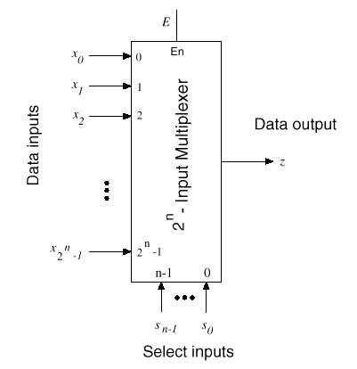
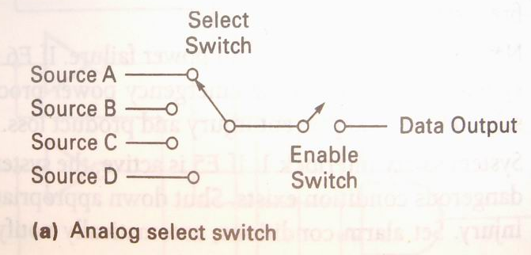
P4.6 Multiplexer (cont.)
Page <number>
26 Feb.-2015
College of Computer Science, Sichuan University
Ying Sancong

Slide 4
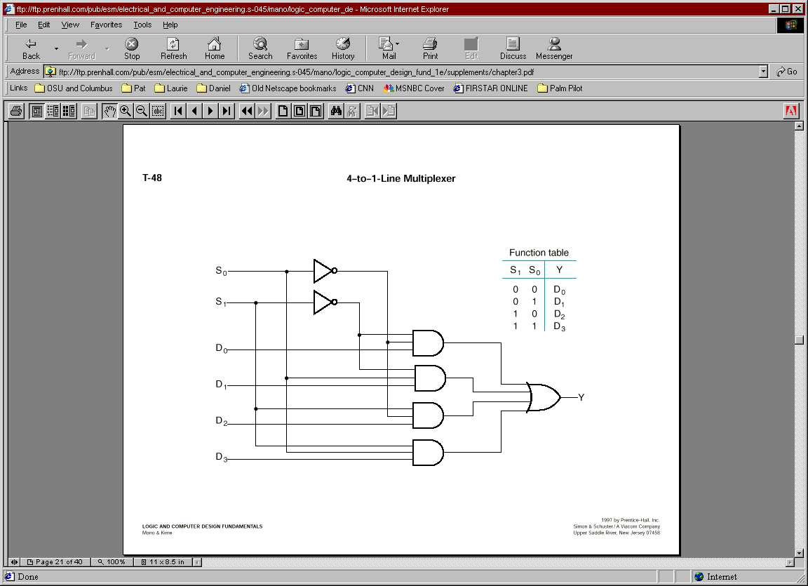
P4.6 Multiplexer : 4 to 1
Y=A’B’D₀+A’BD₁+AB’D₂+ABD₃
=∑m_{i}D_{i}
Page <number>
26 Feb.-2015
College of Computer Science, Sichuan University
Ying Sancong

Slide 5
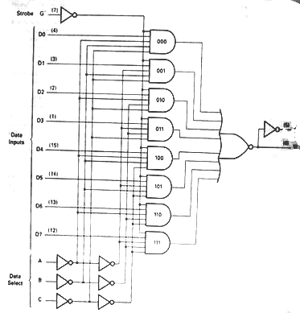
P4.6 Multiplexer : 8 to 1
Y
w
74LS155
Page <number>
26 Feb.-2015
College of Computer Science, Sichuan University
Ying Sancong

Slide 6
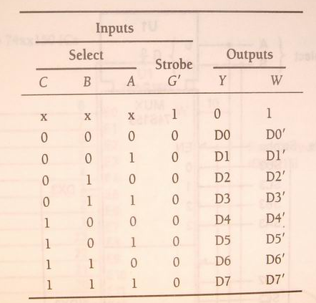
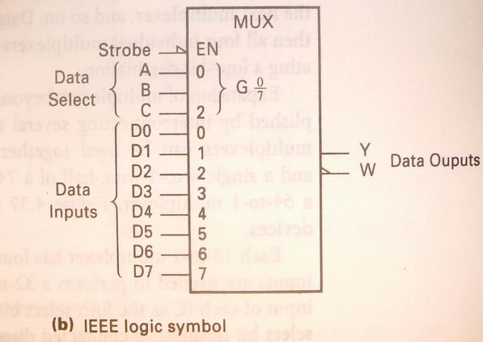
P4.6 Multiplexer : 8 to 1 (cont.)
Y= C’B’A’D₀+ C’B’AD₁+ C’BA’D₂+C’BAD₃+ CB’A’D₄+ CB’AD₅+ CBA’D₆+ CBAD₇
=∑m_{i}D_{i}
Page <number>
26 Feb.-2015
College of Computer Science, Sichuan University
Ying Sancong

Slide 7
P4.6 Multiplexer (cont.)
Multiplexer Expansions
Until now, we have examined single-bit data selected by a MUX. What if we want to select m-bit data/words?
  Combine MUX blocks in parallel with common select and enable signals.
Example: Construct a logic circuit that selects between 2 sets of 4-bit inputs (see next slide for solution).
Page <number>
26 Feb.-2015
College of Computer Science, Sichuan University
Ying Sancong

Slide 8
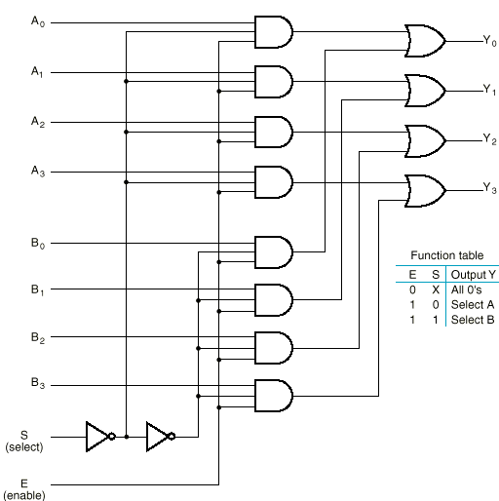
P4.6 Multiplexer (cont.)
Multiplexer Expansions
Example: Quad 2-to-1 MUX
Uses four 2-to-1 MUXs with common select (S) and enable (E).
Select line chooses between A_{i}’s and B_{i}’s. The selected four-wire digital signal is sent to the Y_{i}’s
Enable line turns MUX on and off (E=1 is on).
Page <number>
26 Feb.-2015
College of Computer Science, Sichuan University
Ying Sancong

Slide 9
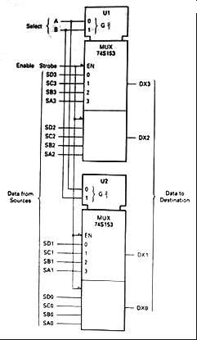
P4.6 Multiplexer (cont.)
Multiplexer Expansions
Example: Quad 4-to-1 MUX
74LS153
Page <number>
26 Feb.-2015
College of Computer Science, Sichuan University
Ying Sancong

Slide 10
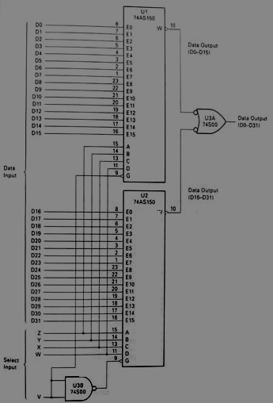
P4.6 Multiplexer (cont.)
Multiplexer Expansions
Input lines Expansion
A32-to-1multiplexer using two 74xx150ICs
Page <number>
26 Feb.-2015
College of Computer Science, Sichuan University
Ying Sancong

Slide 11
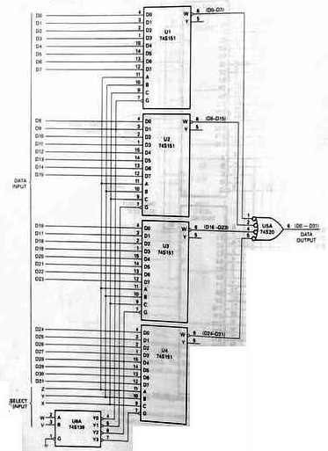
P4.6 Multiplexer (cont.)
Multiplexer Expansions
Input lines Expansion
A 32-to-1 multiplexer using four 8-to-1 multiplexers and a 2-to-4 decoder
Page <number>
26 Feb.-2015
College of Computer Science, Sichuan University
Ying Sancong

Slide 12
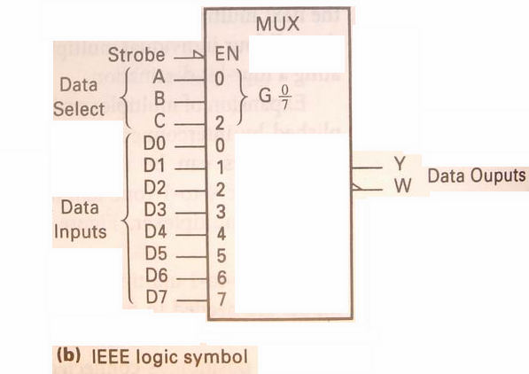
P4.6 Multiplexer (cont.)
Implementing Boolean functions with Multiplexers
E.g. Using an 8-to-1 multiplexer to realize the Boolean function F=f(x,y,z)=∑(1,2,4,5,7)
Y= C’B’A’D₀+ C’B’AD₁+ C’BA’D₂+C’BAD₃+ CB’A’D₄+ CB’AD₅+ CBA’D₆+ CBAD₇
=∑m_{i}D_{i}
F=f(x,y,z)=∑(1,2,4,5,7)
=x’y’z+x’yz’+xy’z’+xy’z+xyz
C=x,B=y,A=z
D₀=D₃=D₆=0
D₁= D₂= D₄= D₅= D₇=1
Page <number>
26 Feb.-2015
College of Computer Science, Sichuan University
Ying Sancong
Notes:
一

Slide 13
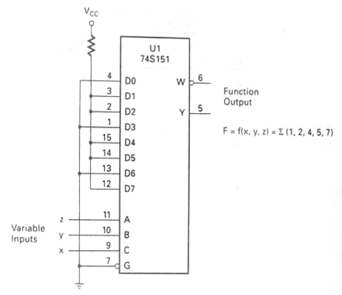
P4.6 Multiplexer (cont.)
Implementing Boolean functions with Multiplexers
E.g. Using an 8-to-1 multiplexer to realize the Boolean function F=f(x,y,z)=∑(1,2,4,5,7)
C=x,B=y,A=z
D₀=D₃=D₆=0
D₁= D₂= D₄= D₅= D₇=1
Page <number>
26 Feb.-2015
College of Computer Science, Sichuan University
Ying Sancong

Slide 14
P4.6 Multiplexer (cont.)
Implementing Boolean functions with Multiplexers
E.g. Using an 4-to-1 multiplexer to realize the Boolean function F=f(x,y,z)=∑(1,2,4,5,7)
Analysis:
F=f(x,y,z)=∑(1,2,4,5,7): Three input variables
4-to-1 multiplexer: Only two selection input lines
So, directively connecting Di to 0/1 don’t resolve the example.
Page <number>
26 Feb.-2015
College of Computer Science, Sichuan University
Ying Sancong

Slide 15
P4.6 Multiplexer (cont.)
Implementing Boolean functions with Multiplexers
F=f(x,y,z)=∑(1,2,4,5,7)=x’y’z+x’yz’+xy’z’+xy’z+xyz
XY
Z
00
01
11
10
Z
Z’
1
Z
Y
Y’
Y
1
X
X’
1
X
D₀
D₁
4-1
MUX
0
1
1
D₂
F
D₃
B
A
1
1
1
1
D₀=X
D₁=X’
D₂=1
D₃=X
D₀=Y
D₁=Y’
D₂=Y
D₃=1
D₀=Z
D₁=Z’
D₂=1
D₃=Z
X
Z
Z
Y
X
Y
F=X’Y’D₀+X’YD₁+XY’D₂+XYD₃
Page <number>
26 Feb.-2015
College of Computer Science, Sichuan University
Ying Sancong

Slide 16
P4.6 Multiplexer (cont.)
Implementing Boolean functions with Multiplexers
Exe. implement function using a 4-to-1 MUX
F(X,Y,Z) = Σm(1,2,6,7)
F(A,B,C) = ∑m(1,3,5,6).
Page <number>
26 Feb.-2015
College of Computer Science, Sichuan University
Ying Sancong

Slide 17
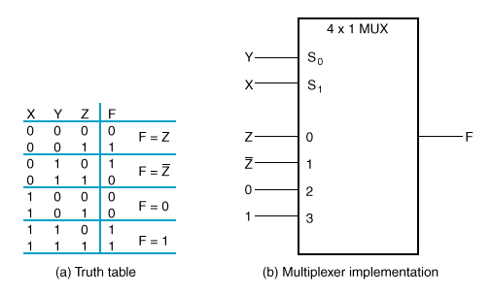
P4.6 Multiplexer (cont.)
Implementing Boolean functions with Multiplexers
F(X,Y,Z) = X’Y’Z + X’YZ’ + XYZ’ + XYZ = Σm(1,2,6,7)
There are n=3 inputs, thus we need a 2²-to-1 MUX
The first n-1 (=2) inputs serve as the selection lines
Page <number>
26 Feb.-2015
College of Computer Science, Sichuan University
Ying Sancong

Slide 18
P4.6 Multiplexer (cont.)
Implementing Boolean functions with Multiplexers
F(A,B,C) = ∑m(1,3,5,6).
AB
C
00
01
11
10
D₀
D₁
4-1
MUX
D₂
F
0
1
D₃
B
A
1
1
1
1
A
B
When A=B=0, F=D₀=C
When A=0, B=1, F=D₁=C
When A=1, B=0, F=D₂=C
When A=B=1, F=D₃=C’
Page <number>
26 Feb.-2015
College of Computer Science, Sichuan University
Ying Sancong

Slide 19
P4.6 Multiplexer (cont.)
Implementing Boolean functions with Multiplexers
A
B
C
F
When A=B=0, F=C
0
0
0
0
0
0
1
1
When A=0, B=1, F=C
0
1
0
0
0
1
1
1
When A=1, B=0, F=C
1
0
0
0
1
0
1
1
When A=B=1, F=C’
1
1
0
1
1
1
1
0
Page <number>
26 Feb.-2015
College of Computer Science, Sichuan University
Ying Sancong

Slide 20
P4.6 Multiplexer (cont.)
Implementing Boolean functions with Multiplexers
MUX implementation of F(A,B,C) = ∑m(1,3,5,6)
A
B
C
C
F
C
C’
Page <number>
26 Feb.-2015
College of Computer Science, Sichuan University
Ying Sancong

Slide 21
P4.6 Multiplexer (cont.)
Implementing Boolean functions with Multiplexers
E.g. Consider the following Boolean expression given in sum-of-product form:
F(x1,x2,x3)=x₁’x₂’+x₁x₂’+x₁x₃
Derive a circuit for using only 2-to-1 multiplexers.
Page <number>
26 Feb.-2015
College of Computer Science, Sichuan University
Ying Sancong

Slide 22
P4.6 Multiplexer (cont.)
Implementing Boolean functions with Multiplexers
F(x1,x2,x3)=x₁’x₂’+x₁x₂’+x₁x₃
= x₁’x₂’ x₃ ’ + x₁’x₂’ x₃ + x₁x₂’ x₃ ’ + x₁x₂’ x₃ + x₁x₂x₃
=∑(0,1,4,5,7)
X₁X₂
X₃
00
01
11
10
0
1
1
D₀=X₂’
D1=X₂’+X₃
1
1
1
1
How to derive it only from function?
Page <number>
26 Feb.-2015
College of Computer Science, Sichuan University
Ying Sancong

Slide 23
P4.6 Multiplexer (cont.)
Implementing Boolean functions with Multiplexers
X₂’
D₀
2-1
MUX
X₃
≥1
D₁
F
D₀=X₂’
D1=X₂’+X₃
A
X₁
Page <number>
26 Feb.-2015
College of Computer Science, Sichuan University
Ying Sancong

Slide 24
P4.6 Multiplexer (cont.)
Implementing Boolean functions with Multiplexers
Exe. F(A,B,C,D)=∑m(1,2,4,9,10,11,12,14,15)
Derive a circuit for using 4-to-1 multiplexers.
Page <number>
26 Feb.-2015
College of Computer Science, Sichuan University
Ying Sancong

Slide 25
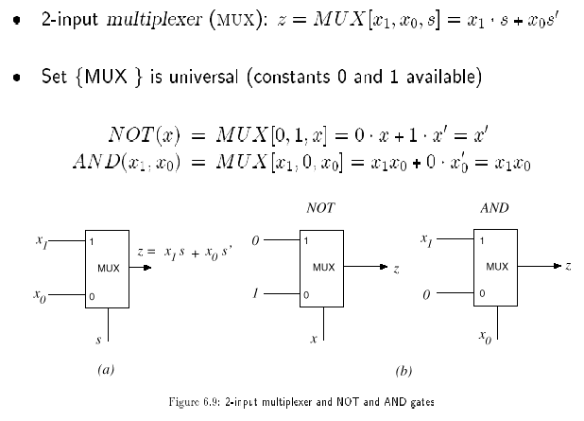
P4.6 Multiplexer (cont.)
Implementing Boolean functions with Multiplexers
MUX as a Universal Gate
We can construct OR, AND, and NOT gates using 2-to-1 MUXs. Thus, 2-to-1 MUX is a universal gate.
z = x₁+ x₁’x₀
= x₁x₀’ + x₁x₀ + x₁’x₀ = x₁ + x₀
z = 0x + 1x’ = x’
z = x₁x₀ + 0x₀’ = x₁x₀
Page <number>
26 Feb.-2015
College of Computer Science, Sichuan University
Ying Sancong

Slide 26
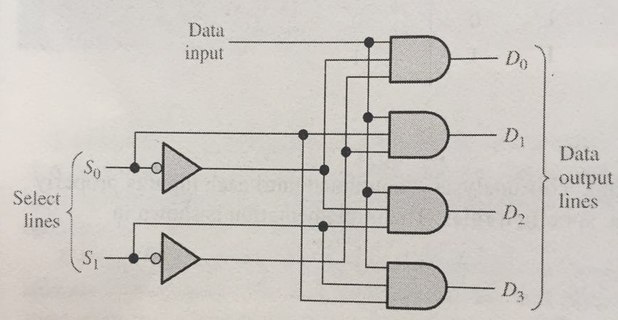
P4.7 Demultiplexer
Demultiplexers
A demultiplexer (DEMUX) performs the opposite function from a MUX. It switches data from one input line to two or more data lines depending on the select inputs.
Page <number>
26 Feb.-2015
College of Computer Science, Sichuan University
Ying Sancong

Slide 27

P4.8 Parity Generators/Checkers
Parity Generators/Checkers
Parity is an error detection method that uses an extra bit appended to a group of bits to force them to be either odd or even. In even parity, the total number of ones is even; in odd parity the total number of ones is odd.
Example
The ASCII letter S is 1010011. Show the parity bit for the letter S with odd and even parity.
Solution
S with odd parity =
11010011
S with even parity =
01010011
Page <number>
26 Feb.-2015
College of Computer Science, Sichuan University
Ying Sancong

Slide 28
HomeWork
1. Using 4-1 Multiplexer to implement following expressions
(a). Z = f(A,B,C) = A'B+BC'+BC+AB'C'
(b). Z = f(A,B,C) =A’•B’ •C’+A’•B+A•B•C’+A•C
Page <number>
26 Feb.-2015
College of Computer Science, Sichuan University
Ying Sancong

Slide 29

TO BE CONTINUED
Page <number>
01 Sept.-2014
College of Computer Science, Sichuan University
Ying Sancong

