Slide 1
PART 4: (Chapter 6)
Combinational Logic Design-
Arithmetic Operation
Page <number>
26 Feb.-2015
College of Computer Science, Sichuan University
Ying Sancong

Slide 2
P4.7 Adder
Overview
Binary Addition
  Half Adder
  Full Adder
  Ripple Carry Adder(并行加法器)
  Carry Look ahead Adder(超前进位加法器)
Decimal Addition
Binary Comparators (Section 6.4)
Page <number>
26 Feb.-2015
College of Computer Science, Sichuan University
Ying Sancong

Slide 3
P4.7 Adder (cont.)
1-bit Adder
Performs the addition of two binary bits.
Four possible operations:
  0+0=0
  0+1=1
  1+0=1
  1+1=10
Circuit implementation requires 2 outputs; one to indicate the sum and another to indicate the carry.
Page <number>
26 Feb.-2015
College of Computer Science, Sichuan University
Ying Sancong

Slide 4
P4.7 Adder (cont.)
Half Adder
Performs 1-bit addition.
Inputs: A₀, B₀
Outputs: S₀, C₁
Index indicates significance,
0 is for LSB and 1 is for the
next higher significant bit.
Boolean equations:
  S₀ = A₀B₀’+A₀’B₀ = A₀ ⊕ B₀
  C₁ = A₀B₀
Truth Table
A₀
B₀
S₀
C₁
0
0
0
0
0
1
1
0
1
0
1
0
1
1
0
1
Page <number>
26 Feb.-2015
College of Computer Science, Sichuan University
Ying Sancong

Slide 5
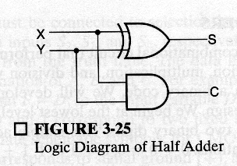
P4.7 Adder (cont.)
Half Adder
S₀ = A₀B₀’+A₀’B₀ = A₀⊕ B₀
C₁ = A₀B₀
Block Diagram
Logic Diagram
A₀
B₀
A₀
S₀
1 bit
half adder
B₀
C₁
C₁
S₀
Page <number>
26 Feb.-2015
College of Computer Science, Sichuan University
Ying Sancong

Slide 6
P4.7 Adder (cont.) n-bit Addition
Design an n-bit binary adder which performs the addition of two n-bit binary numbers and generates a n-bit sum and a carry out.
Example: Let n=4
C_{out} C₃ C₂ C₁ C₀ 1 1 0 1 0
A₃ A₂ A₁ A₀ 1 1 0 1
+ B₃ B₂ B₁ B₀ +1 1 0 1
--------------------- ----------
S₃ S₂ S₁ S₀ 1 0 1 0
Page <number>
26 Feb.-2015
College of Computer Science, Sichuan University
Ying Sancong

Slide 7
P4.7 Adder (cont.)
Full Adder
Full adder (for higher-order bit addition)
Combinational circuit that performs the additions of 3 bits (two bits and a carry-in bit)
A_{i}
B_{i}
1 bit
full adder
C_{i+1}
C_{i}
S_{i}
Page <number>
26 Feb.-2015
College of Computer Science, Sichuan University
Ying Sancong

Slide 8
P4.7 Adder (cont.)
Full Adder
The K-maps for
  C_{i+1}:
  S_{i}:
A_{i}
B_{i}
C_{i}
S_{i}
C_{i+1}
B_{i}C_{i}
0
0
0
0
0
A_{i}
0
0
1
1
0
0
0
1
0
0
1
0
1
0
0
1
1
1
0
1
1
0
1
1
0
0
1
0
B_{i}C_{i}
1
0
1
0
1
A_{i}
1
1
0
0
1
0
1
0
1
1
1
1
1
1
1
0
1
0
Page <number>
26 Feb.-2015
College of Computer Science, Sichuan University
Ying Sancong

Slide 9
P4.7 Adder (cont.)
Full Adder
Boolean equations:
  C_{i+1} = A_{i}B_{i} + A_{i}C_{i} + B_{i}C_{i}
  S_{i} = A_{i}B_{i}’ C_{i}’ + A_{i}’B_{i}’C_{i} + A_{i}’B_{i}C_{i}’ + A_{i}B_{i}C_{i}
  = A_{i} ⊕ B_{i} ⊕ C_{i}
You can design full adder circuit directly from the above equations (requires 3 ANDs and 2 ORs for C_{i+1} and 2 XORs for S_{i})
Page <number>
26 Feb.-2015
College of Computer Science, Sichuan University
Ying Sancong

Slide 10
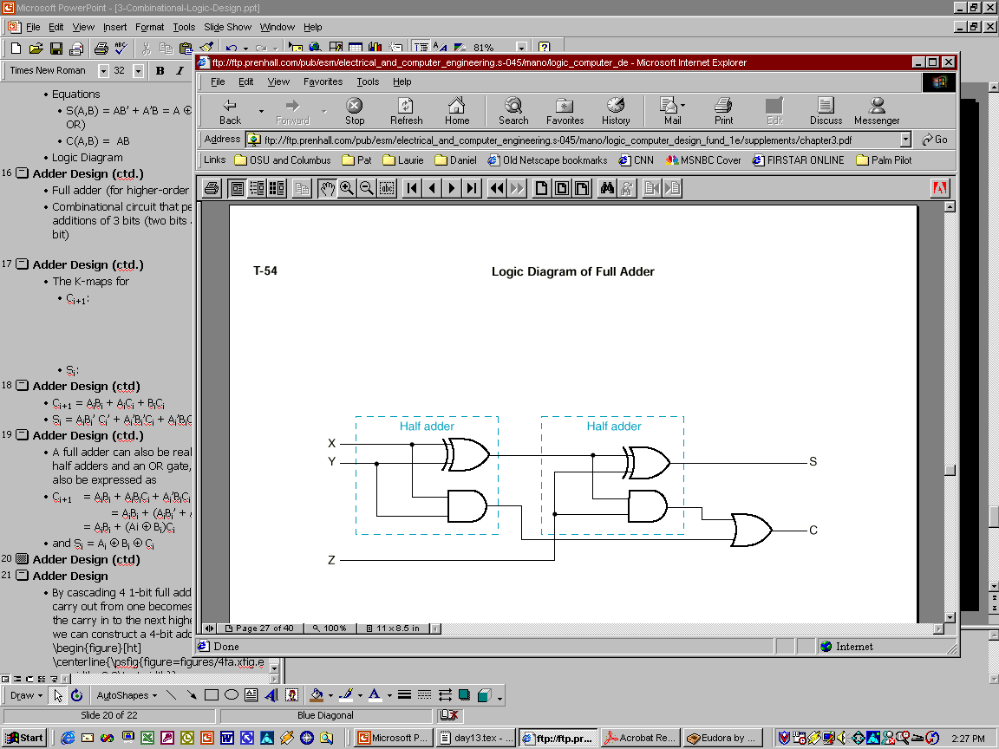
P4.7 Adder (cont.)
Full Adder using 2 Half Adders
A full adder can also be realized with two half adders and an OR gate, since C_{i+1} can also be expressed as:
C_{i+1} = A_{i}B_{i} + A_{i}B_{i}’C_{i} + A_{i}’B_{i}C_{i}
= A_{i}B_{i} + (A_{i}B_{i}’ + A_{i}’B_{i})C_{i}
= A_{i}B_{i} + (Ai ⊕ B_{i})C_{i}
and S_{i} = A_{i} ⊕ B_{i} ⊕ C_{i}
Page <number>
26 Feb.-2015
College of Computer Science, Sichuan University
Ying Sancong
Notes:
体现了多数出变量时，共用部分相同电路，达到优化设计。

Slide 11
P4.7 Adder (cont.) n-bit Combinational Adders
Perform parallel multi-bit addition
Ripple Carry Adder
  Simple design
  Time consuming. Why? (you’ll see in a bit!)
Carry Look ahead Adder
  More complex than ripple-carry adder
  Reduces circuit delay
Page <number>
26 Feb.-2015
College of Computer Science, Sichuan University
Ying Sancong

Slide 12
P4.7 Adder (cont.) n-bit Ripple Carry Adder
Constructed using n 1-bit full adder blocks in parallel.
Cascade the full adders so that the carry out from one becomes the carry in to the next higher bit position.
Page <number>
26 Feb.-2015
College of Computer Science, Sichuan University
Ying Sancong

Slide 13
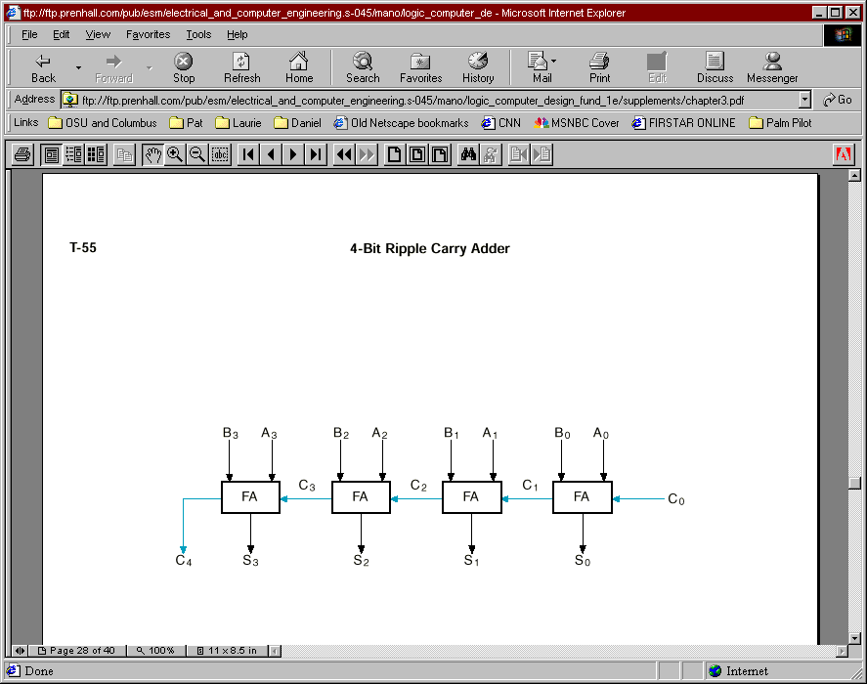
P4.7 Adder (cont.) n-bit Ripple Carry Adder
Example: 4-bit Ripple Carry Adder
C₄ C3 C2 C1 C0
A3 A2 A1 A0
+B3 B2 B1 B0
--------------
S3 S2 S1 S0
Page <number>
26 Feb.-2015
College of Computer Science, Sichuan University
Ying Sancong

Slide 14
P4.7 Adder (cont.) n-bit Ripple Carry Adder
Ripple Carry Adder Delay
Circuit delay in an n-bit ripple carry adder is determined by the delay on the carry path from the LSB (C₀) to the MSB (C_{n}).
Let the delay in a 1-bit FA be Δ. Then, the delay of an n-bit ripple carry adder is nΔ.
Page <number>
26 Feb.-2015
College of Computer Science, Sichuan University
Ying Sancong

Slide 15
P4.7 Adder (cont.)
Carry Look ahead Adder
Alternative design for a combinational n-bit adder.
Practical design with reduced delay at the expense of more complex hardware.
Derived from a transformation of the ripple carry adder design.
Page <number>
26 Feb.-2015
College of Computer Science, Sichuan University
Ying Sancong

Slide 16
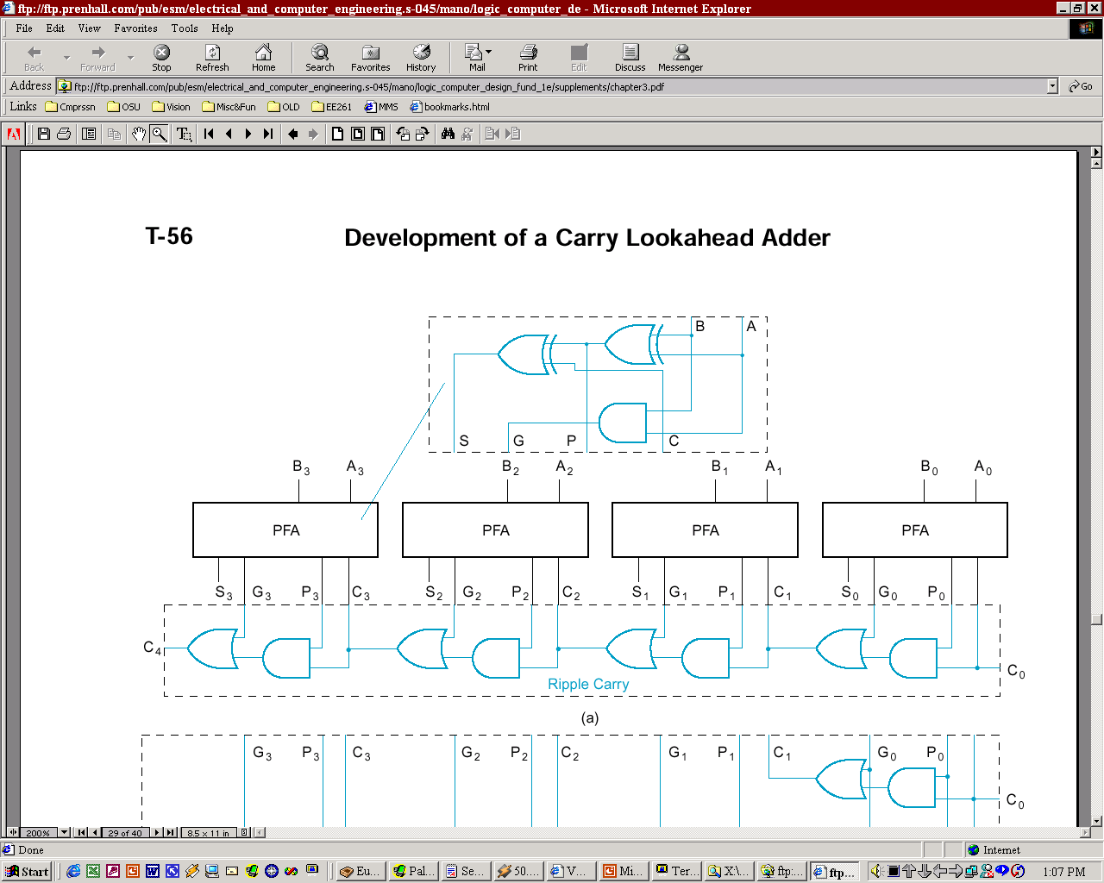
P4.7 Adder (cont.)
Carry Look ahead Adder
Carry Lookahead Adder Design
From a FA, separate between carry generation (a new carry signal is generated, i.e. C_{out}=1) and carry propagation (an existing C_{in} is propagated to C_{out}).
Generate: G_{i} = A_{i}B_{i}: if 1, C_{i+1}=1
Propagate: P_{i} = A_{i} ⊕ B_{i}: if 1, C_{i+1} = C_{i}
Full Adder (FA)
Partial Full Adder (PFA)
B_{i}
A_{i}
A_{i}
B_{i}
S_{i}
C_{i+1}
C_{i}
S_{i}
G_{i}
P_{i}
C_{i}
Page <number>
26 Feb.-2015
College of Computer Science, Sichuan University
Ying Sancong
Notes:
这样，Gi和Pi都只由当前i位的两个加数（Ai，Bi）确定。

Slide 17
P4.7 Adder (cont.)
Carry Look ahead Adder
Carry Lookahead Adder Design (cont.)
C_{i+1} = G_{i} + P_{i}C_{i}
PFA design breaks S functionality apart from G/P functionality
Page <number>
26 Feb.-2015
College of Computer Science, Sichuan University
Ying Sancong

Slide 18
P4.7 Adder (cont.)
Carry Look ahead Adder
Carry Lookahead Adder Design (cont.)
Does this (design in previous slide) solve the long delay problem?
No, carry out still “ripples” !
Idea: use two levels of logic to generate carry out of any block C_{i} in terms of carry in C₀ and addend bits A_{i} and B_{i}
Page <number>
26 Feb.-2015
College of Computer Science, Sichuan University
Ying Sancong

Slide 19
P4.7 Adder (cont.)
Carry Look ahead Adder
Block CLA
Implement:
  C₁ = G₀+P₀ C₀
  C₂ = G₁+P₁C₁ = G₁+P₁(G₀+P₀C₀) = G₁+P₁G₀+P₁P₀C₀
  C₃ = G₂ + P₂C₂ = G₂+P₂G₁+P₂P₁G₀+P₂P₁P₀C₀
  C₄ = G₃+P₃G₂+P₃P₂G₁+P₃P₂P₁G₀ + P₃P₂P₁P₀ C₀
  = G₀₋₃ + P₀₋₃C₀
Group carry generate
Group carry propagate
Page <number>
26 Feb.-2015
College of Computer Science, Sichuan University
Ying Sancong

Slide 20
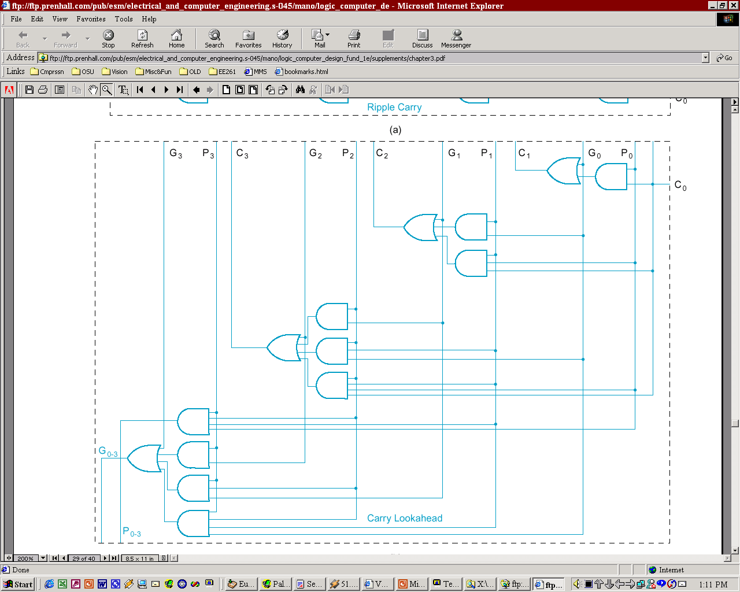
P4.7 Adder (cont.)
Carry Look ahead Adder
Generate/Propagate logic of a 4-bit CLA
-- C₀ … C_{n-1} have a
2-gates delay
-- C₄ = G₀₋₃+P₀₋₃C₀
has a 3-gates delay
  C₁ = G₀+P₀ C₀
  C₂ = G₁+P₁G₀+P₁P₀C₀
  C₃ =G₂+P₂G₁+P₂P₁G₀+P₂P₁P₀C₀
  C₄ = G₃+P₃G₂+P₃P₂G₁+P₃P₂P₁G₀ + P₃P₂P₁P₀ C₀
Page <number>
26 Feb.-2015
College of Computer Science, Sichuan University
Ying Sancong

Slide 21
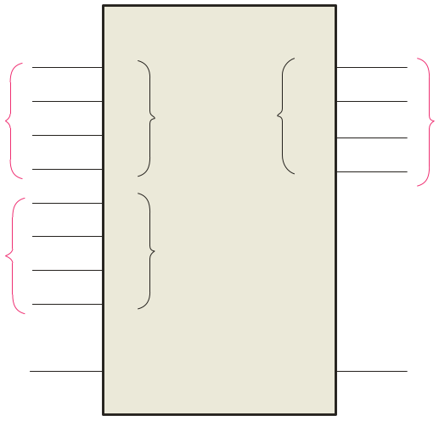
P4.7 Adder (cont.)
Adder Applications
Using MSI Adders as Subtractors
  74LS283 : 4Bits carry look ahead adder device
    The logic symbol for a 4-bit parallel adder is shown. This 4-bit adder includes a carry in (labeled (C₀) and a Carry out (labeled C₄).
    The 74LS283 is an example. It features look-ahead carry, which adds logic to minimize the output carry delay. For the 74LS283, the maximum delay to the output carry is 17 ns.
Σ
1
2
3
4
1
2
3
4
Binary number A
4-bit sum
1
2
3
4
Binary number B
Input carry
C₀
C₄
Output carry
Page <number>
26 Feb.-2015
College of Computer Science, Sichuan University
Ying Sancong

Slide 22
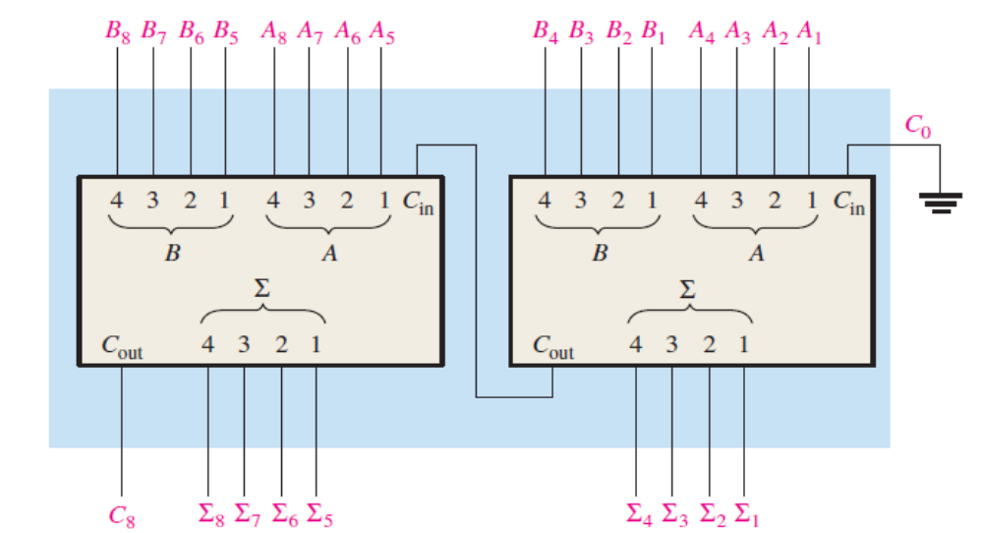
P4.7 Adder (cont.)
Adder Applications
Using MSI Adders as Subtractors
  Cascading four 74LS283 two-bit adders to form 1 8bit adder (Fig. 6-12)
Subtractor
  Using 2s complement to realize subtraction
Page <number>
26 Feb.-2015
College of Computer Science, Sichuan University
Ying Sancong

Slide 23
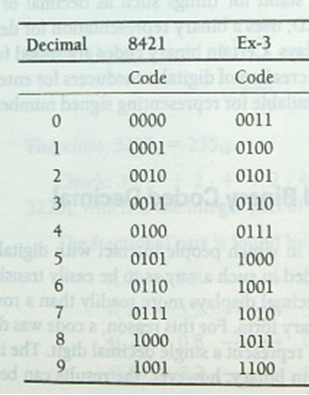
P4.7 Adder (cont.)
Adder Applications
Using an MSI Adders as BCD to Excess-3 code converter
Page <number>
26 Feb.-2015
College of Computer Science, Sichuan University
Ying Sancong

Slide 24
P4.7 Adder (cont.)
Adder Applications
BCD Adder
BCD Decimal Adder:
  Requires 8 inputs (4 bits per decimal number).
  5 outputs indicate the decimal sum and the carry.
  Remember BCD addition rules: Add 0110 to the sum if it is greater than 1010 to correct the carry bit .
Page <number>
26 Feb.-2015
College of Computer Science, Sichuan University
Ying Sancong

Slide 25
P4.7 Adder (cont.)
Adder Applications
BCD Adder (cont.)
Addend
Addend
C = K + z3z2 + z3z1
K
4-bit binary adder
z3 z2 z1 z0
C
0
4-bit binary adder
S3 S2 S1 S0
BCD sum
Page <number>
26 Feb.-2015
College of Computer Science, Sichuan University
Ying Sancong

Slide 26
P4.8 Binary Comparators
Single bit comparator
  A EQ B = A’B’ + AB
  A > B = AB’
  A< B = A’B
Two-bit comparator
Page <number>
26 Feb.-2015
College of Computer Science, Sichuan University
Ying Sancong

Slide 27
P4.9 Arithmetic Logic Unit (ALU)
Combining all possible combinational logic functions (Addition, Subtraction, AND, OR, etc.) into a single IC.
Select bits are used to select one of the functions to be implemented.
Page <number>
26 Feb.-2015
College of Computer Science, Sichuan University
Ying Sancong

Slide 28
Tri-state buffers
logic 0
logic 1
高阻态
Combinational Logic Hazards
  Static ‘1’ hazard
  Static ‘0’ hazard
  Ex. P = xy’ + yz
Page <number>
26 Feb.-2015
College of Computer Science, Sichuan University
Ying Sancong

Slide 29
HomeWork
Page 248:
6.
Page <number>
26 Feb.-2015
College of Computer Science, Sichuan University
Ying Sancong

Slide 30

TO BE CONTINUED
Page <number>
01 Sept.-2014
College of Computer Science, Sichuan University
Ying Sancong

