Slide 1
PART 6:
Sequential Circuits’ Analysis & Design
Page <number>
26 Feb.-2015
College of Computer Science, Sichuan University
Ying Sancong

Slide 2
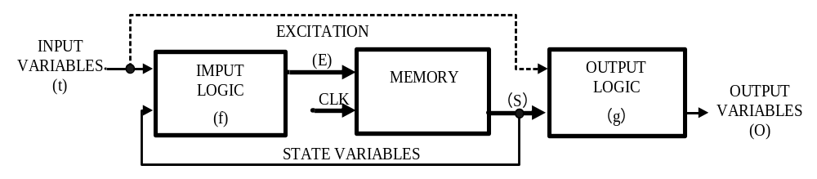
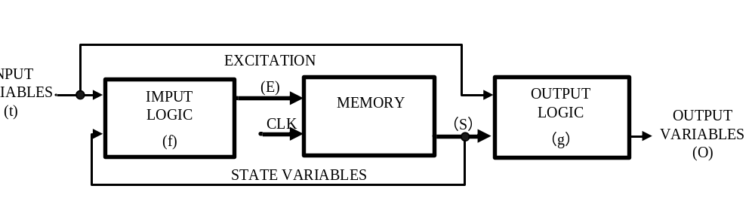
P6.1 State Machines of Sequential Circuit
Mealy Vs Moore machines
Moore sequential circuit model
E=f(I,S_{t})
S_{t+1}=f(S_{t},E)
O=g(S_{t})
Mealy sequential circuit model
E=f(I,S_{t})
S_{t+1}=f(S_{t},E)
O=g(I,S_{t})
Page <number>
26 Feb.-2015
College of Computer Science, Sichuan University
Ying Sancong

Slide 3
P6.1 State Machines of Sequential Circuit
Mealy Vs Moore machines (cont.)
Mealy model:
  Both outputs and next state depend both on primary inputs AND present state.
Moore model:
  Only next state depends directly on primary inputs AND present state. Outputs depend only on present state.
Page <number>
26 Feb.-2015
College of Computer Science, Sichuan University
Ying Sancong

Slide 4
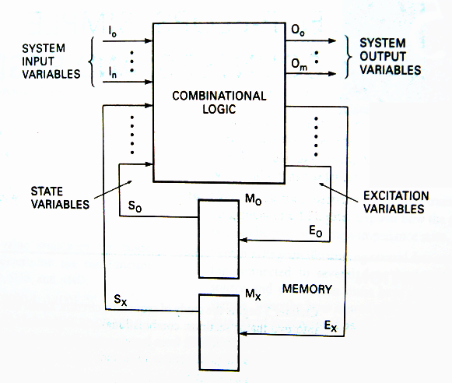
P6.1 State Machines of Sequential Circuit
State Machine Notation
Impute variable
Output variable
State variable
Excitation variable
State
State variables and states are related by the expression:
2^{x}=y
State variables
states
Page <number>
26 Feb.-2015
College of Computer Science, Sichuan University
Ying Sancong
Notes:
输入变量：源于时序机(状态机)外部的所有变量皆被认为是输入变量；
输出变量：离开时序机(状态机)的所有变量皆被认为是输出变量；
状态变量：存储元件（触发器）的输出定义了时序机(状态机)的状态。即触发器的输出就是状态变量。
激励变量：是指对存储元件（触发器）的输入。该激励变量刺激存储元件，使其状态发生改变。
状态：状态变量的确定组合对应一种状态。

Slide 5
P6.1 State Machines of Sequential Circuit
State Node and transition
Graphical representation of a state table.
Graph node with label s denotes state s
Graph edge with label X denotes transition between two states when input X is applied
S
X
S1
S2
Page <number>
26 Feb.-2015
College of Computer Science, Sichuan University
Ying Sancong
Notes:
理解现态和次态的概念及区别。

Slide 6
P6.1 State Machines of Sequential Circuit
State Diagram of Mealy model
0/0
1/0
00
01
I/O
0/1
S1
S2
0/1
0/1
1/0
Reads as:
When at state s1 and apply
input I, we get output O
and proceed to state s2.
10
1/0
11
1/0
Page <number>
26 Feb.-2015
College of Computer Science, Sichuan University
Ying Sancong

Slide 7
P6.1 State Machines of Sequential Circuit
State Diagram of Moore model
I
00,11
S1/O1
S2/O2
01,10
0/0
1/1
Reads as:
When at state s1 with output
O1 and apply input I,
we proceed to state s2 with
Output O2.
01,10
00,11
Page <number>
26 Feb.-2015
College of Computer Science, Sichuan University
Ying Sancong

Slide 8
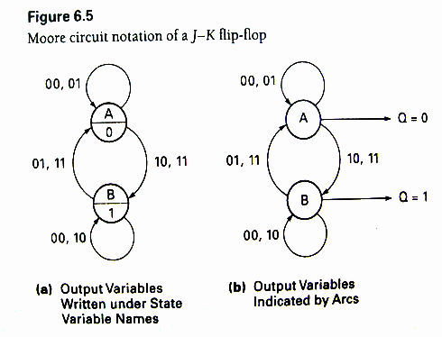
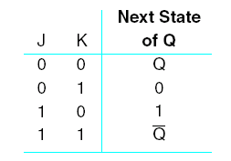
P6.1 State Machines of Sequential Circuit
State Diagram
JK Flip-Flop:
Page <number>
26 Feb.-2015
College of Computer Science, Sichuan University
Ying Sancong

Slide 9
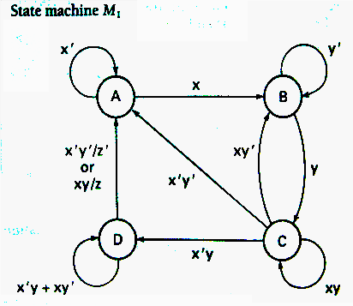
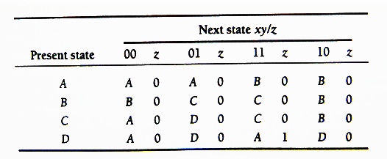
P6.2 Design the Sequential Circuit from State Machines State Table
Enumerates the relationship between inputs, outputs, and states of the sequential circuit.
State Table
Page <number>
26 Feb.-2015
College of Computer Science, Sichuan University
Ying Sancong

Slide 10
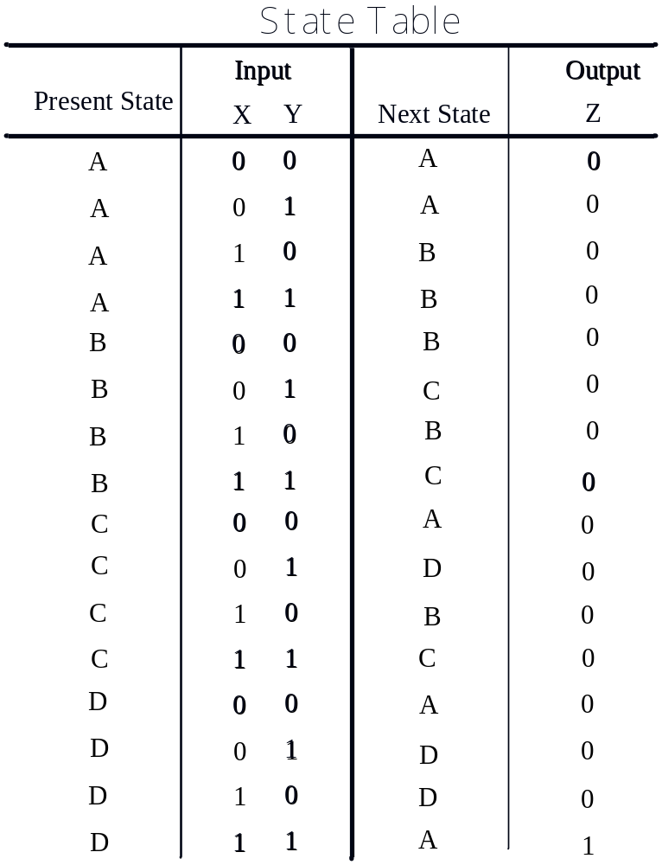
P6.2 Design the Sequential Circuit from State Machines State Table
State Table
Page <number>
26 Feb.-2015
College of Computer Science, Sichuan University
Ying Sancong

Slide 11
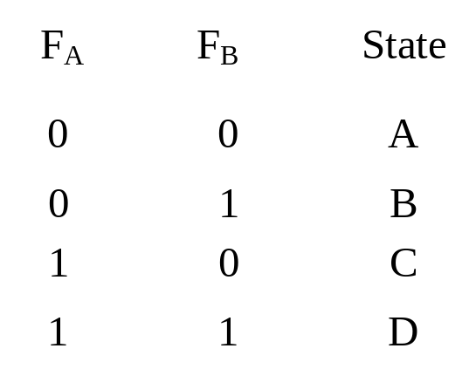
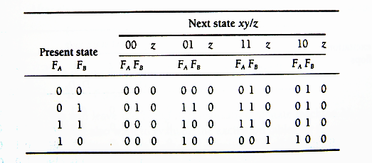
P6.2 Design the Sequential Circuit from State Machines
Transition Table
Each state is assigned a unique code.
Transition Table for state machine M₁
Page <number>
26 Feb.-2015
College of Computer Science, Sichuan University
Ying Sancong

Slide 12
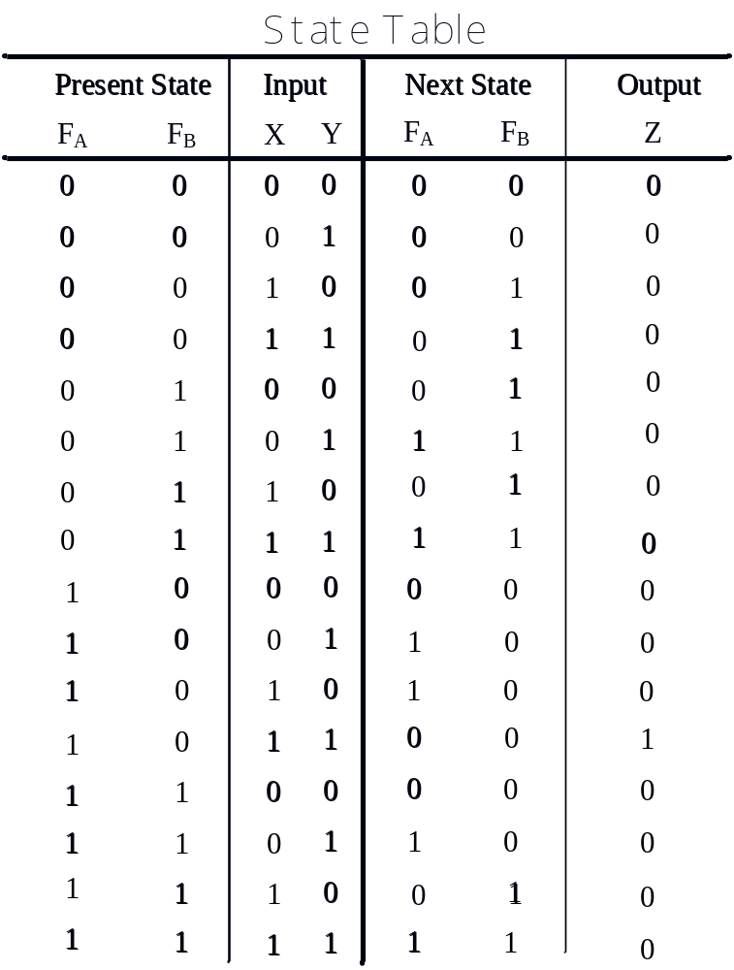
P6.2 Design the Sequential Circuit from State Machines
Transition Table with unique code
Transition Table for state machine M₁
Transition Table for state machine M₁
Page <number>
26 Feb.-2015
College of Computer Science, Sichuan University
Ying Sancong

Slide 13
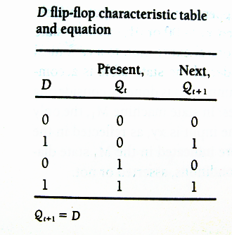
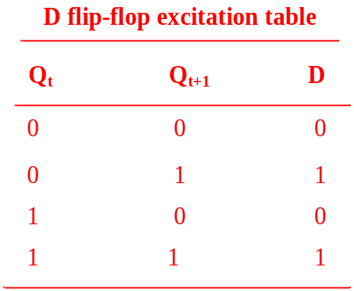
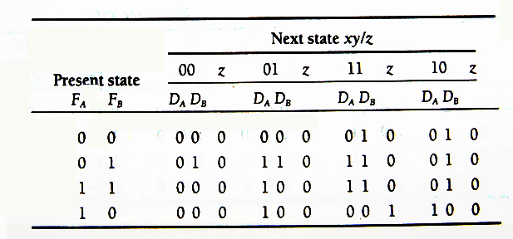
P6.2 Design the Sequential Circuit from State Machines
Excitation Table and Equations
D flip-flop used to realize circuit
Transition Table for state machine M₁
state machine M₁ excitation table using D flip-flops
Page <number>
26 Feb.-2015
College of Computer Science, Sichuan University
Ying Sancong

Slide 14
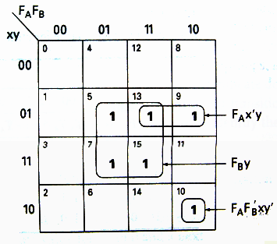
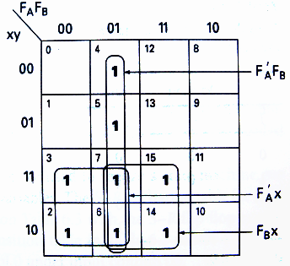
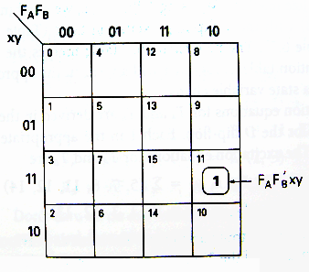
P6.2 Design the Sequential Circuit from State Machines
Excitation Table and Equations
D flip-flop used to realize circuit (cont.)
D_{A} K-Map
D_{B} K-Map
Z K-Map
D_{A} = f(F_{A},F_{B},x,y)=Σ(5,7,10,13,15)=F_{A}F_{B}’xy’+F_{A}x’y+F_{B}y
D_{B} = f(F_{A},F_{B},x,y)=Σ(2,3,4,5,6,7,14,15)=F_{A}’F_{B}+F_{A}’x+F_{B}x
Z = f(F_{A},F_{B},x,y)=Σ(11)=F_{A}F_{B}’xy
Page <number>
26 Feb.-2015
College of Computer Science, Sichuan University
Ying Sancong

Slide 15
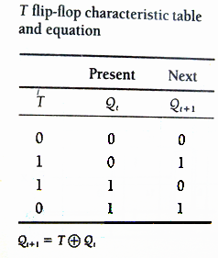
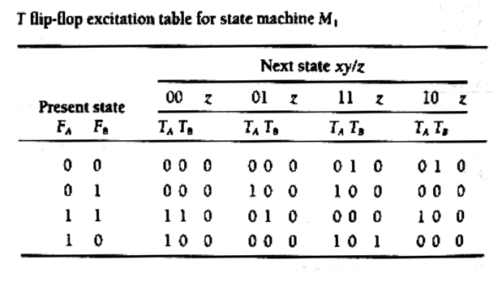
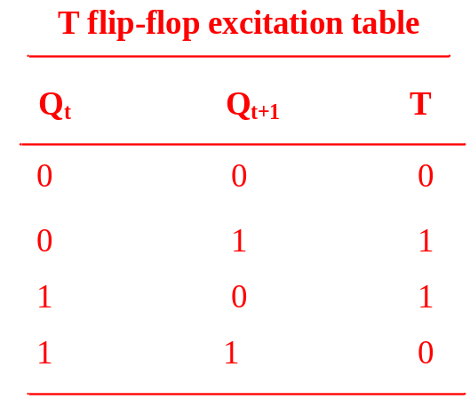
P6.2 Design the Sequential Circuit from State Machines
Excitation Table and Equations
T flip-flop used to realize circuit
Transition Table for state machine M₁
state machine M₁ excitation table using T flip-flops
Page <number>
26 Feb.-2015
College of Computer Science, Sichuan University
Ying Sancong

Slide 16
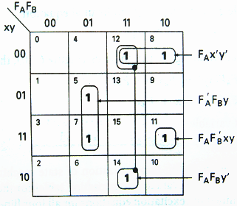
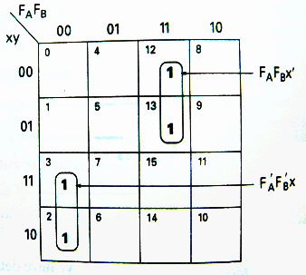
P6.2 Design the Sequential Circuit from State Machines
Excitation Table and Equations
T flip-flop used to realize circuit (cont.)
T_{A} K-Map
T_{B} K-Map
Z K-Map
T_{A}=f(F_{A},F_{B},x,y)=Σ(5,7,8,11,12,14)=F_{A}F_{B}’xy+F_{A}x’y’+F_{A}F_{B}y’+F_{A}’F_{B}y
T_{B}=f(F_{A},F_{B},x,y)=Σ(2,3,12,13)=F_{A}’F_{B}’x+F_{A}F_{B}x’
Z = f(F_{A},F_{B},x,y)=Σ(11)=F_{A}F_{B}’xy
Page <number>
26 Feb.-2015
College of Computer Science, Sichuan University
Ying Sancong

Slide 17
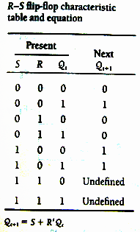
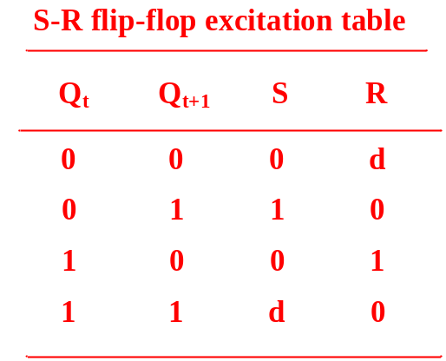
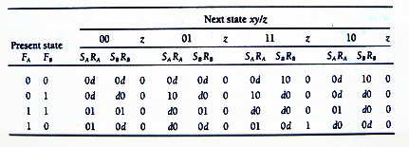
P6.2 Design the Sequential Circuit from State Machines
Excitation Table and Equations
S-R flip-flop used to realize circuit
Transition Table for state machine M₁
state machine M₁ excitation table using S-R flip-flops
Page <number>
26 Feb.-2015
College of Computer Science, Sichuan University
Ying Sancong

Slide 18
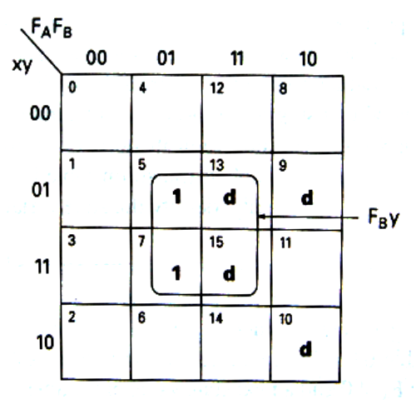
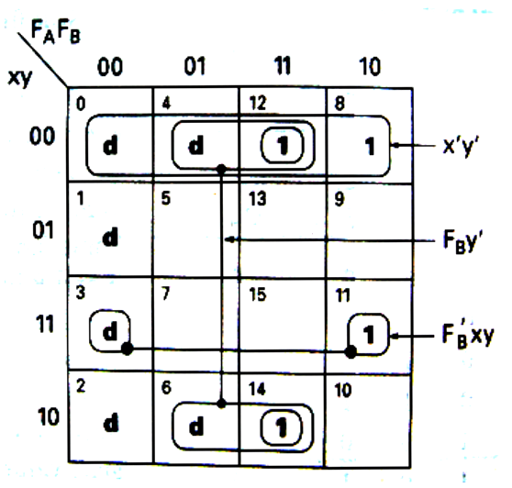
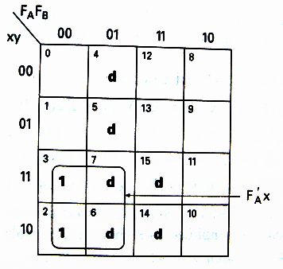
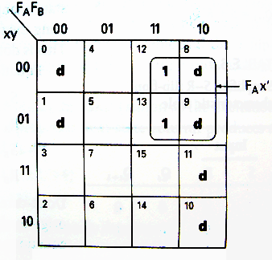
P6.2 Design the Sequential Circuit from State Machines
Excitation Table and Equations
S-R flip-flop used to realize circuit (cont.)
S_{A} K-Map
R_{A} K-Map
S_{B} K-Map
R_{B} K-Map
S_{A}=f(F_{A},F_{B},x,y)=Σ(5,7) +Σd(9,10,13,15) = F_{B}y
R_{A}=f(F_{A},F_{B},x,y)=Σ(8,11,12,14) +Σd(0,1,2,3,4,6) = F_{B}’xy+x’y’+F_{B}y’
S_{B}=f(F_{A},F_{B},x,y)=Σ(2,3) +Σd(4,5,6,7,14,15) = F_{A}’x
R_{B}=f(F_{A},F_{B},x,y)=Σ(12,13) +Σd(0,1,8,9,10,11) = F_{A}x’
Page <number>
26 Feb.-2015
College of Computer Science, Sichuan University
Ying Sancong

Slide 19
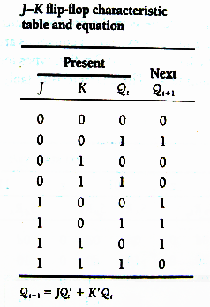
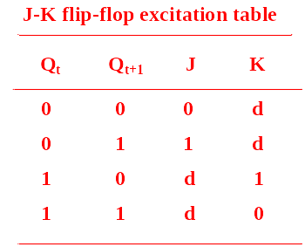
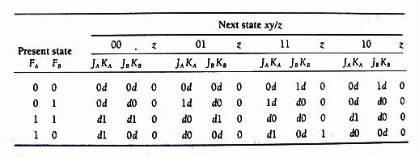
P6.2 Design the Sequential Circuit from State Machines
Excitation Table and Equations
J-K flip-flop used to realize circuit
Transition Table for state machine M₁
state machine M₁ excitation table using J-K flip-flops
Page <number>
26 Feb.-2015
College of Computer Science, Sichuan University
Ying Sancong

Slide 20
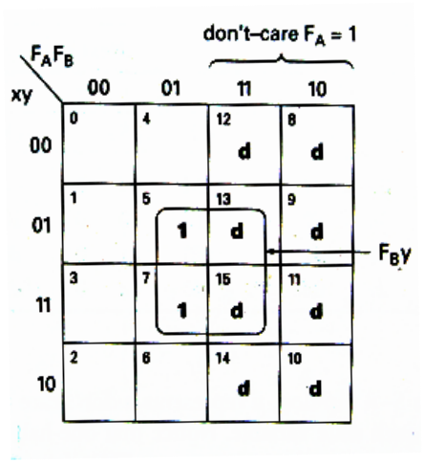
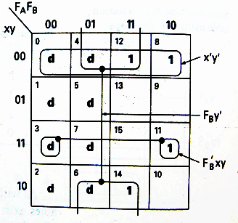
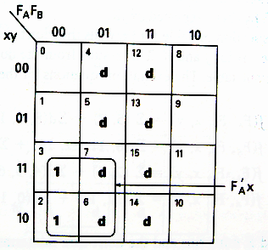
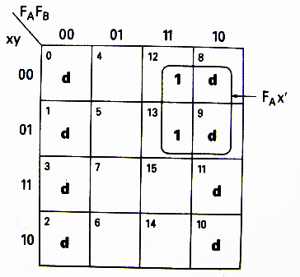
P6.2 Design the Sequential Circuit from State Machines
Excitation Table and Equations
S-R flip-flop used to realize circuit (cont.)
J_{A} K-Map
K_{A} K-Map
J_{B} K-Map
K_{B} K-Map
J_{A}=f(F_{A},F_{B},x,y)=Σ(5,7) +Σd(8,9,10,11,12,13,14,15) = F_{B}y
K_{A}=f(F_{A},F_{B},x,y)=Σ(8,11,12,14) +Σd(0,1,2,3,4,6,7) = F_{B}’xy+x’y’+F_{B}y’
J_{B}=f(F_{A},F_{B},x,y)=Σ(2,3) +Σd(4,5,6,7,12,13,14,15) = F_{A}’x
K_{B}=f(F_{A},F_{B},x,y)=Σ(12,13) +Σd(0,1,2,3,8,9,10,11) = F_{A}x’
Page <number>
26 Feb.-2015
College of Computer Science, Sichuan University
Ying Sancong

Slide 21
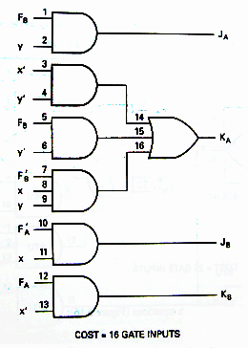
P6.2 Design the Sequential Circuit from State Machines
Excitation Realization Cost
J-K flip-flop used to realize circuit
J_{A}=F_{B}y
K_{A}=F_{B}’xy+x’y’+F_{B}y’
J_{B}=F_{A}’x
K_{B}=F_{A}x’
Page <number>
26 Feb.-2015
College of Computer Science, Sichuan University
Ying Sancong

Slide 22
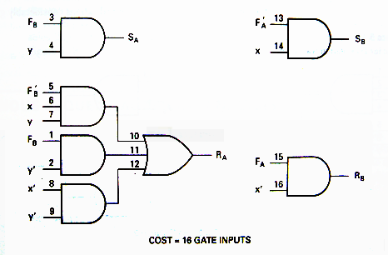
P6.2 Design the Sequential Circuit from State Machines
Excitation Realization Cost
S-R flip-flop used to realize circuit
S_{A}=F_{B}y
R_{A}=F_{B}’xy+x’y’+F_{B}y’
S_{B}=F_{A}’x
R_{B}=F_{A}x’
Page <number>
26 Feb.-2015
College of Computer Science, Sichuan University
Ying Sancong

Slide 23
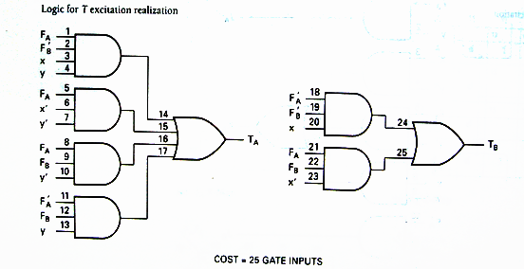
P6.2 Design the Sequential Circuit from State Machines
Excitation Realization Cost
T flip-flop used to realize circuit
T_{A}=F_{A}F_{B}’xy+F_{A}x’y’+F_{A}F_{B}y’+F_{A}’F_{B}y
T_{B}=F_{A}’F_{B}’x+F_{A}F_{B}x’
Page <number>
26 Feb.-2015
College of Computer Science, Sichuan University
Ying Sancong

Slide 24
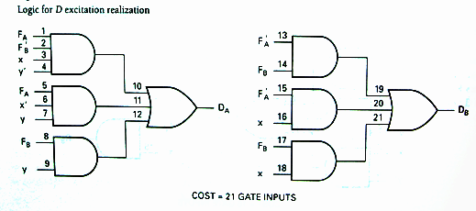
P6.2 Design the Sequential Circuit from State Machines
Excitation Realization Cost
D flip-flop used to realize circuit
D_{A}=F_{A}F_{B}’xy’+F_{A}x’y+F_{B}y
D_{B}=F_{A}’F_{B}+F_{A}’x+F_{B}x
Page <number>
26 Feb.-2015
College of Computer Science, Sichuan University
Ying Sancong

Slide 25
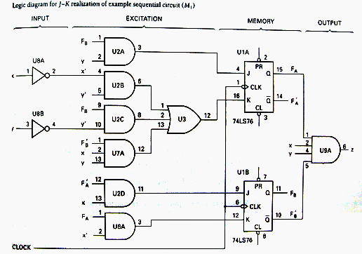
P6.2 Design the Sequential Circuit from State Machines
Circuit Realization of the State Machine M1
Z = F_{A}F_{B}’xy
Page <number>
26 Feb.-2015
College of Computer Science, Sichuan University
Ying Sancong

Slide 26

P6.3 Construction of State Diagrams
Up-Down Decade Counter
Example 1
Create the state diagram for a synchronous decade counter. The counter is to count up or down, in binary, depending on the value of a mode control input signal. When the mode control input M = 0, the counter is to count up; when M = 1, the counter I to count down. The counter is to repeat or cycle; that is, to count from 0 to 9 and then start over if M = 0 or count down from 9 to 0 if M = 1. The counter output y is to be a 1 if counting up and the terminal count is reached. Another output z is to be a 1 at the terminal count if counting down.
Should the mode control value change during a count sequence, outputs y and z will be asserted when the terminal count is reached.
Page <number>
26 Feb.-2015
College of Computer Science, Sichuan University
Ying Sancong

Slide 27
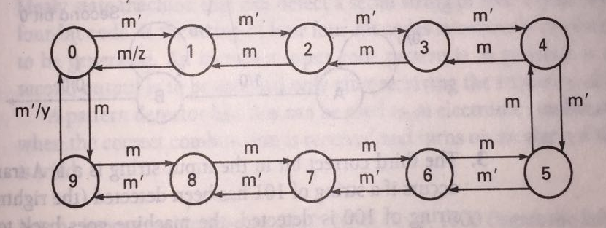

P6.3 Construction of State Diagrams
Up-Down Decade Counter
Solution1
Page <number>
26 Feb.-2015
College of Computer Science, Sichuan University
Ying Sancong

Slide 28
P6.3 Construction of State Diagrams
Sequence Detectors
Example 2
Construct a Mealy state diagram that will detect the serial input sequence of 10110. The detection of the required bit pattern can occur in a longer data string and the correct pattern can overlap with another pattern. When the input pattern has been detected, cause an output z to be asserted high.
For example, let the input string be
x = 1 0 1 1 0 1 1 0 1 1 0
the output: z = 0 0 0 0 1 0 0 1 0 0 1
Page <number>
26 Feb.-2015
College of Computer Science, Sichuan University
Ying Sancong

Slide 29
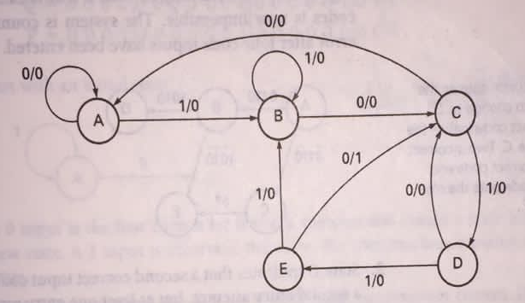
P6.3 Construction of State Diagrams
Sequence Detectors
Solution2
Page <number>
26 Feb.-2015
College of Computer Science, Sichuan University
Ying Sancong

Slide 30
P6.3 Construction of State Diagrams
Sequence Detectors
Example 3
Design a Mealy serial bit-pattern detector that will detect the input sequence 01010 in a longer bit string. If the pattern is detected, then cause output Q to be active-high. If an 011 bit pattern occurs within the same serial data string, cause output P to be active-high. If the 011 pattern occurs, cause the state machine to initialize and start over looking for the 01010 pattern. Overlapping 01010 patterns can occur.
For example, if
x = 0 0 1 1 0 1 0 1 0 1 1 1 0 1 0 1 0 1 0 1, then outputs
Q = 0 0 0 0 0 0 0 0 1 0 0 0 0 0 0 0 1 0 1 0
P = 0 0 0 1 0 0 0 0 0 0 1 0 0 0 0 0 0 0 0 0
Page <number>
26 Feb.-2015
College of Computer Science, Sichuan University
Ying Sancong

Slide 31
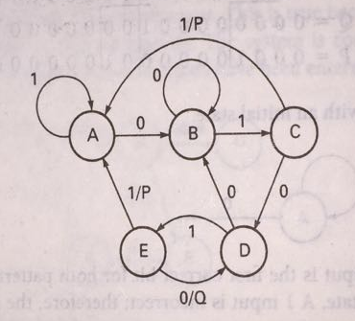
P6.3 Construction of State Diagrams
Sequence Detectors
Solution3
Page <number>
26 Feb.-2015
College of Computer Science, Sichuan University
Ying Sancong

Slide 32

TO BE CONTINUED
Page <number>
01 Sept.-2014
College of Computer Science, Sichuan University
Ying Sancong

