Slide 1
PART 6:
Sequential Circuits’ Analysis & Design
Page <number>
26 Feb.-2015
College of Computer Science, Sichuan University
Ying Sancong

Slide 2
P6.4 Synchronous Sequential Circuit Analysis
Analysis Pinciples
Analysis Pinciples
  1. Determine the system variables: input, state, and output.
  2. Determine the flip-flop type. Write the characteristic equations.
  3. write the excitation equations.
  4. write the next state equations.
  5. Write the output variable equations.
  6. Construct a transition table.
  7. Assign symbols to the states and construct a state table or state diagram.
  8. When possible, construct a timing diagram.
  9. Functionality analysis
Page <number>
26 Feb.-2015
College of Computer Science, Sichuan University
Ying Sancong

Slide 3
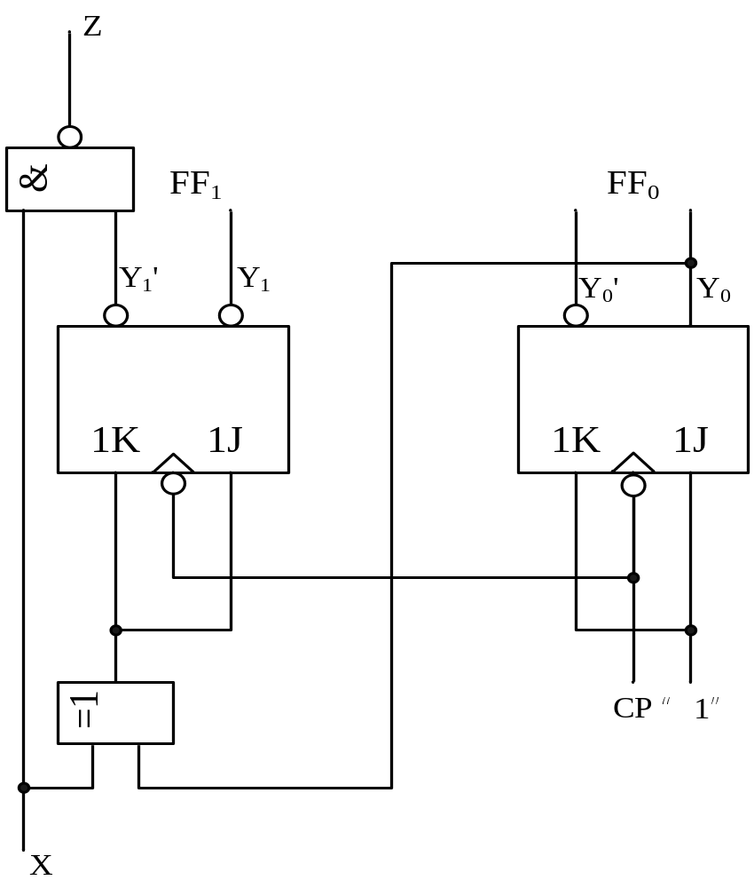
P6.4 Synchronous Sequential Circuit Analysis
Analysis Examples
E.g.1: Analysis the following synchronous sequential circuit, suppose the present state is 00, the input sequence is 0000011111, give the timing diagram.
Page <number>
26 Feb.-2015
College of Computer Science, Sichuan University
Ying Sancong

Slide 4
P6.4 Synchronous Sequential Circuit Analysis
Analysis Examples
  1. Determine the system variables: input, state, and output.
  input=x
  output=Z
  state variables=y₁ and y₀
  2. Determine the flip-flop type. Write the characteristic equations.
  y^{n+1}=Jy^{n}’+k’y^{n}
  3. write the excitation equations.
  K₀=J₀=1
  K₁=J₁=x⊕y₀
Page <number>
26 Feb.-2015
College of Computer Science, Sichuan University
Ying Sancong

Slide 5
P6.4 Synchronous Sequential Circuit Analysis
Analysis Examples
  4. write the next state equations.
  y₁^{n+1}=J₁y₁’+k’y₁ y₁^{n+1}=x’y₁’y₀ +x’y₁y₀’+xy₁’y₀’+xy₁y₀
  y₀^{n+1}=J₀y₀’+k₀’y₀ y₀^{n+1}=y₀’
  5. Write the output variable equations.
  Z=(xy₁’)’=x’+y₁
  6. Construct a transition table.
Page <number>
26 Feb.-2015
College of Computer Science, Sichuan University
Ying Sancong

Slide 6
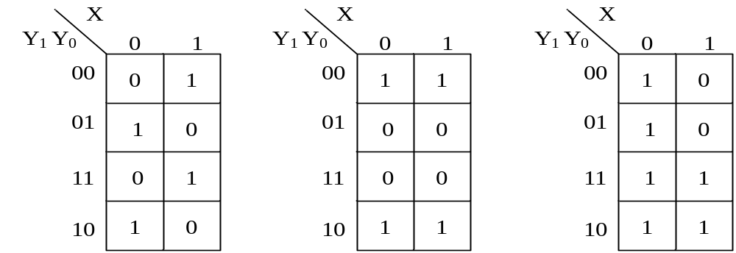
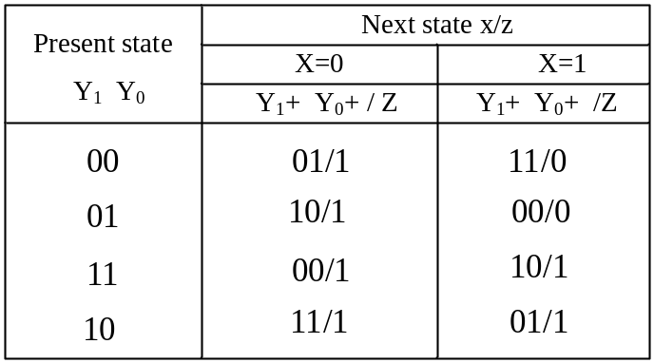
P6.4 Synchronous Sequential Circuit Analysis
Analysis Examples
  y₁^{n+1}= x’y₁’y₀ +x’y₁y₀’ +xy₁’y₀’+xy₁y₀
  y₀^{n+1}=y₀’
  Z=(xy₁’)’=x’+y₁
Y₁^{n+1} K-Map
Y₀^{n+1} K-Map
Z K-Map
Page <number>
26 Feb.-2015
College of Computer Science, Sichuan University
transition table
Ying Sancong

Slide 7
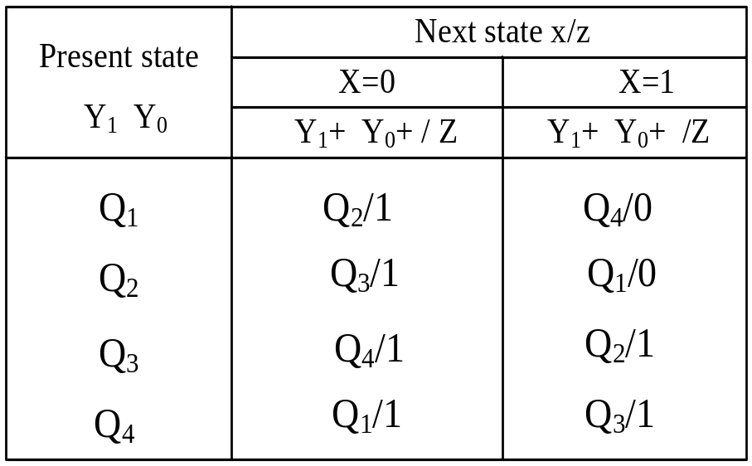
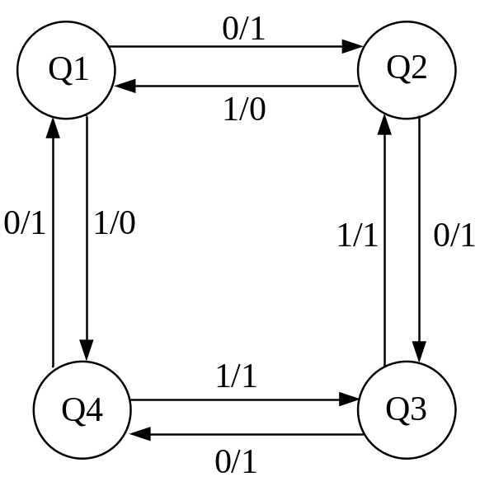
P6.4 Synchronous Sequential Circuit Analysis
Analysis Examples
  7. Assign symbols to the states and construct a table or state diagram.
Q1:Y1Y0=00 Q2:Y1Y0=01 Q3:Y1Y0=10 Q4:Y1Y0=11
Page <number>
26 Feb.-2015
College of Computer Science, Sichuan University
Ying Sancong

Slide 8
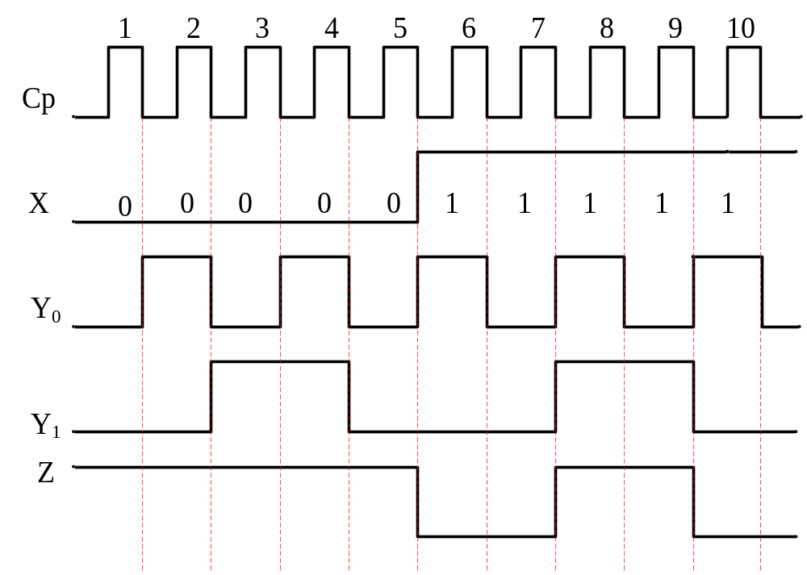
P6.4 Synchronous Sequential Circuit Analysis
Analysis Examples
  8. construct a timing diagram.
Page <number>
26 Feb.-2015
College of Computer Science, Sichuan University
Ying Sancong

Slide 9
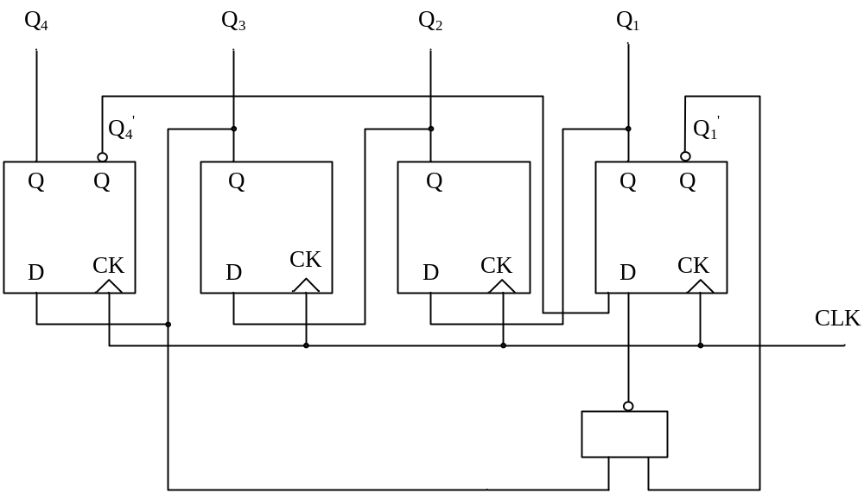
P6.4 Synchronous Sequential Circuit Analysis
Analysis Examples
E.g.2: Analysis the following circuit
Page <number>
26 Feb.-2015
College of Computer Science, Sichuan University
Ying Sancong

Slide 10
P6.4 Synchronous Sequential Circuit Analysis
Analysis Examples
  1. Determine the system variables: input, state, and output.
  state variables: Q₁,Q₂,Q₃, and Q₄
  2. Determine the flip-flop type. Write the characteristic equations.
  Q^{n+1}=D
  3. excitation equations.
  D₄=Q₃
  D₃=Q₂
  D₂=Q₁
  D₁=Q₄’(Q₃Q₁’)’=Q₄’Q₃’+Q₄’Q₁
Page <number>
26 Feb.-2015
College of Computer Science, Sichuan University
Ying Sancong

Slide 11
P6.4 Synchronous Sequential Circuit Analysis
Analysis Examples
  4. the next state equations.
  Q₄^{n+1}=Q₃
  Q₃^{n+1}=Q₂
  Q₂^{n+1}=Q₁
  Q₁^{n+1}=Q₄’Q₃’+Q₄’Q₁
Page <number>
26 Feb.-2015
College of Computer Science, Sichuan University
Ying Sancong

Slide 12
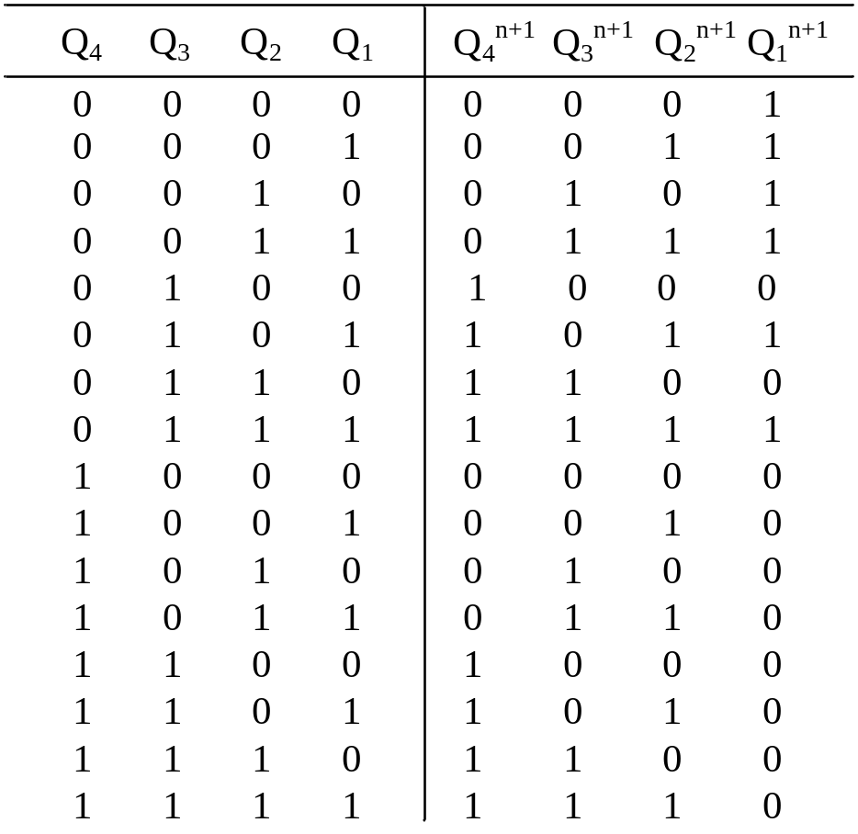
P6.4 Synchronous Sequential Circuit Analysis
Analysis Examples
  5. Construct a transition table.
Page <number>
26 Feb.-2015
College of Computer Science, Sichuan University
Ying Sancong

Slide 13
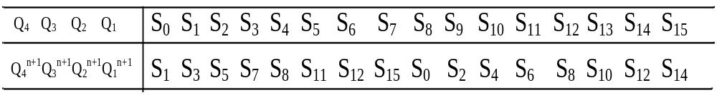
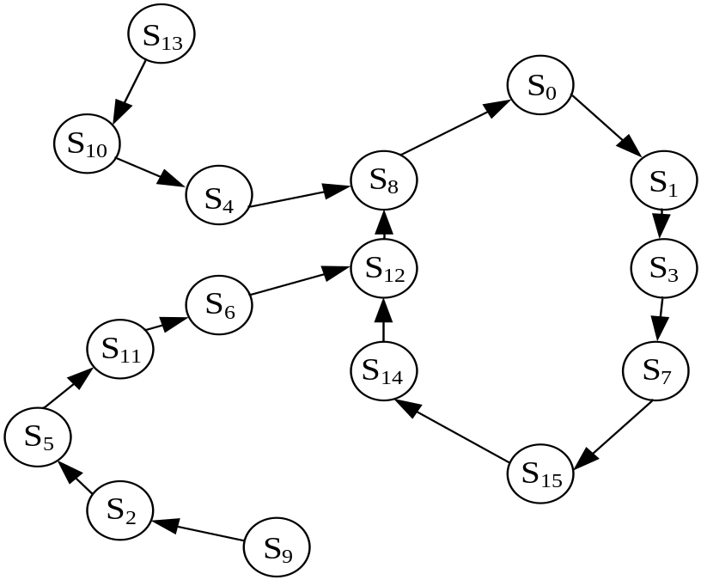
P6.4 Synchronous Sequential Circuit Analysis
Analysis Examples
  6. Assign symbols to the states and construct a table or state diagram.
Page <number>
26 Feb.-2015
College of Computer Science, Sichuan University
Ying Sancong

Slide 14
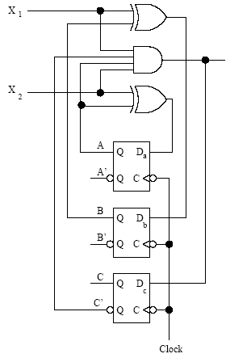
P6.4 Synchronous Sequential Circuit Analysis
Analysis Examples
E.g.3: Find the transition table and the state table for the Mealy sequential circuit below.
Page <number>
26 Feb.-2015
College of Computer Science, Sichuan University
Ying Sancong

Slide 15
P6.4 Synchronous Sequential Circuit Analysis
Analysis Examples
  1. Determine the system variables: input, state, and output.
  input: x₁,x₂
  output: Z
  state variable: Q_{a} , Q_{b} , Q_{c}
  2. Determine the flip-flop type. Write the characteristic equations.
  Q_{n+1}=D
  3. Excitation equations and output equations.
  D_{a}=Q_{a}⊕X₂
  D_{b}=Q_{b}⊕X₁
  D_{c}=X₁X₂Q_{c}’Q_{a}
  Z=X₁X₂Q_{c}’Q_{a}
Page <number>
26 Feb.-2015
College of Computer Science, Sichuan University
Ying Sancong

Slide 16
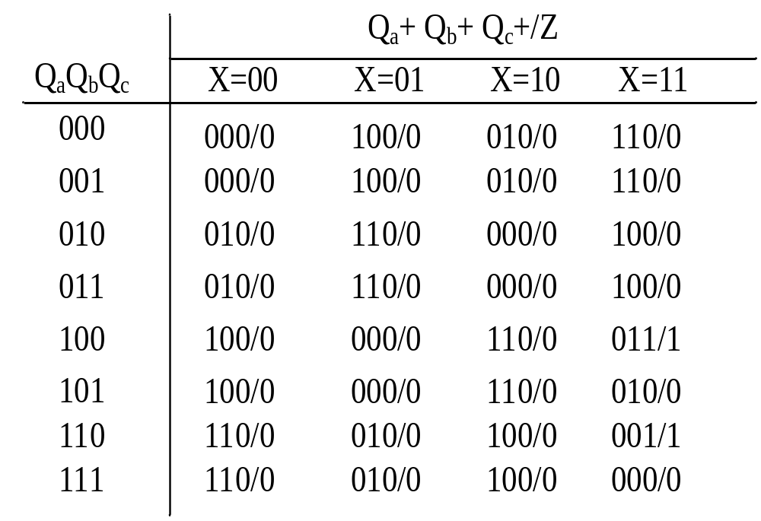
P6.4 Synchronous Sequential Circuit Analysis
Analysis Examples
  4. write the next state equations.
  Q_{a}^{n+1}=Q_{a}X₂’+Q_{a}’X₂
  Q_{b}^{n+1}=Q_{b}X₁’+Q_{b}’X₁
  Q_{c}^{n+1}=X₁X₂Q_{c}’Q_{a}
  5. Construct a transition table.
Page <number>
26 Feb.-2015
College of Computer Science, Sichuan University
Ying Sancong

Slide 17
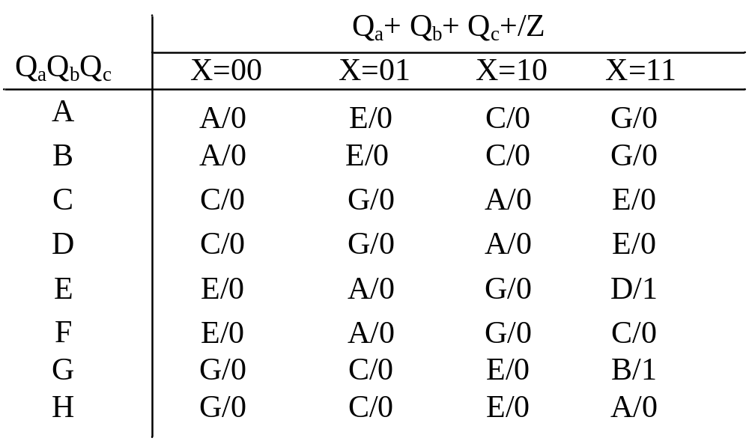
P6.4 Synchronous Sequential Circuit Analysis
Analysis Examples
  6. Assign symbols to the states and construct a state table
QaQbQc
A: 0 0 0
B: 0 0 1
C: 0 1 0
D: 0 1 1
E: 1 0 0
F: 1 0 1
G: 1 1 0
H: 1 1 1
Page <number>
26 Feb.-2015
College of Computer Science, Sichuan University
Ying Sancong

Slide 18
P6.5 Registers and Counters
A n-bit register is a set of n flip-flops that is capable of storing n bits of binary information.
With added combinational gates, the register can perform data-processing tasks.
A counter is a register that goes through a predetermined sequence of states upon the application of clock pulses.
Page <number>
26 Feb.-2015
College of Computer Science, Sichuan University
Ying Sancong

Slide 19
P6.5 Registers and Counters
Registers Overview
Parallel Load Register
Shift Registers
  Serial Load
  Serial Addition
Shift Register with Parallel Load
Bidirectional Shift Register
Page <number>
26 Feb.-2015
College of Computer Science, Sichuan University
Ying Sancong

Slide 20
P6.5 Registers and Counters
Registers
Example (next slide) generic 4-bit register.
The common Clock input triggers all flip-flops on the rising edge of each pulse, and the binary data available at the four D inputs are transferred into the 4-bit register.
Page <number>
26 Feb.-2015
College of Computer Science, Sichuan University
Ying Sancong

Slide 21
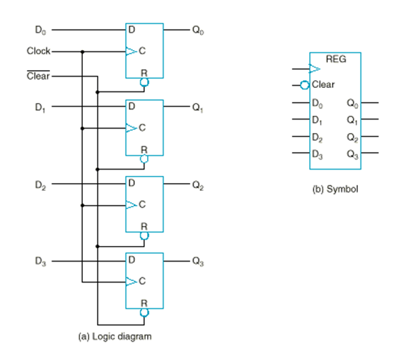
P6.5 Registers and Counters
Registers
Page <number>
26 Feb.-2015
College of Computer Science, Sichuan University
Ying Sancong

Slide 22
P6.5 Registers and Counters
Registers with parallel load
Next page shows a 4-bit register with a control input Load that is directed through gates into the D inputs of the flip-flops.
When Load is 1, the data on the four inputs is transferred into the register with the next positive transition of a clock pulse.
When Load is 0, the data inputs are blocked, and the D inputs of the flip-flops are connected to their outputs.
Page <number>
26 Feb.-2015
College of Computer Science, Sichuan University
Ying Sancong

Slide 23
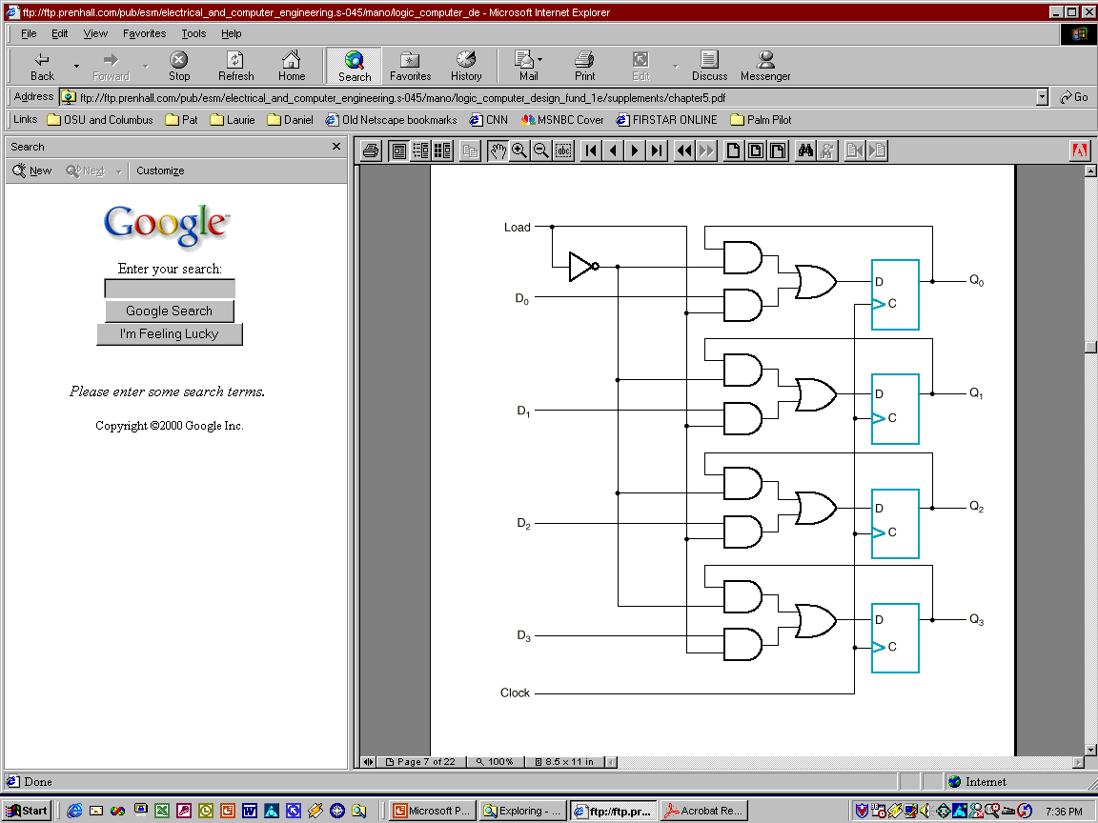
P6.5 Registers and Counters
Registers with parallel load
Page <number>
26 Feb.-2015
College of Computer Science, Sichuan University
Ying Sancong

Slide 24
P6.5 Registers and Counters
Shift registers
A register capable of shifting its stored bits laterally in one or both directions is called a shift register.
The logical configuration of a shift register consists of a chain of flip-flops in cascade, with the output of one flip-flop connected to the input of the next FF.
Page <number>
26 Feb.-2015
College of Computer Science, Sichuan University
Ying Sancong

Slide 25
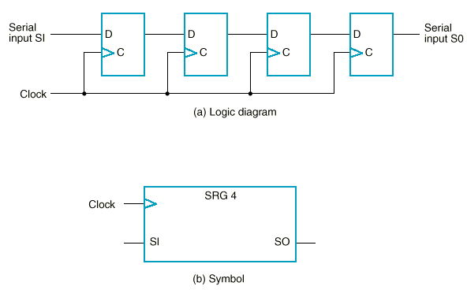
P6.5 Registers and Counters
Shift registers
Page <number>
26 Feb.-2015
College of Computer Science, Sichuan University
Ying Sancong

Slide 26
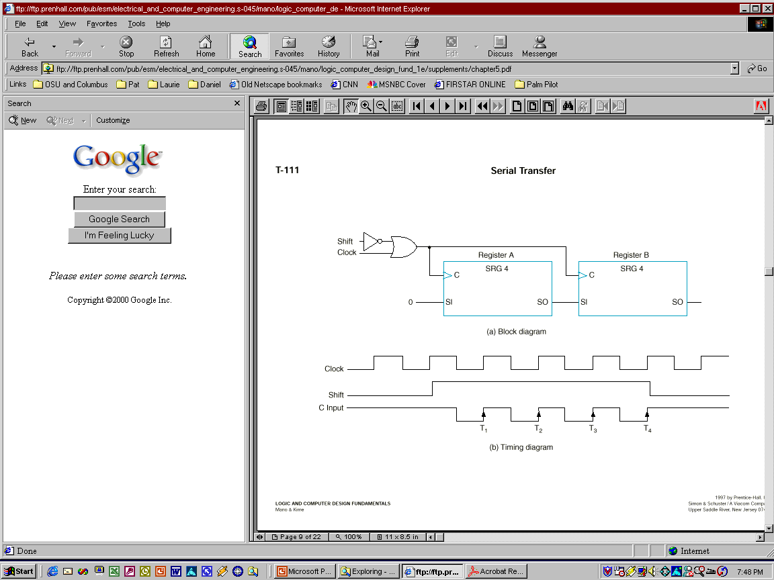
P6.5 Registers and Counters
Shift registers
The next figure shows how the serial transfer of information from register A to register B can be done. One clock cycle per bit of data is required.
Page <number>
26 Feb.-2015
College of Computer Science, Sichuan University
Ying Sancong

Slide 27
P6.5 Registers and Counters
Serial addition using shift registers
The two binary numbers to be added serially are stored in two shift registers.
Bits are added one pair at a time through a single full-adder (FA) circuit.
The carry out of the full adder is transferred into a D flip-flop. The output of the carry FF is then used as the carry input for the next pair of bits.
The sum bit on the S output of the full adder is transferred into the result shift register A.
Page <number>
26 Feb.-2015
College of Computer Science, Sichuan University
Ying Sancong

Slide 28
P6.5 Registers and Counters
Serial vs. parallel addition
The parallel adder is a combinational circuit, whereas the serial adder is a sequential circuit.
The parallel adder has n full adders for n-bit operands, whereas the serial adder requires only one full adder.
The serial circuit takes n clock cycles to complete an addition.
In summary, the parallel adder in space is n times larger than the serial adder, but it is n times faster.
The serial adder, although it is n times slower, is n times smaller in space.(It’s a trade-off!)
Page <number>
26 Feb.-2015
College of Computer Science, Sichuan University
Ying Sancong

Slide 29
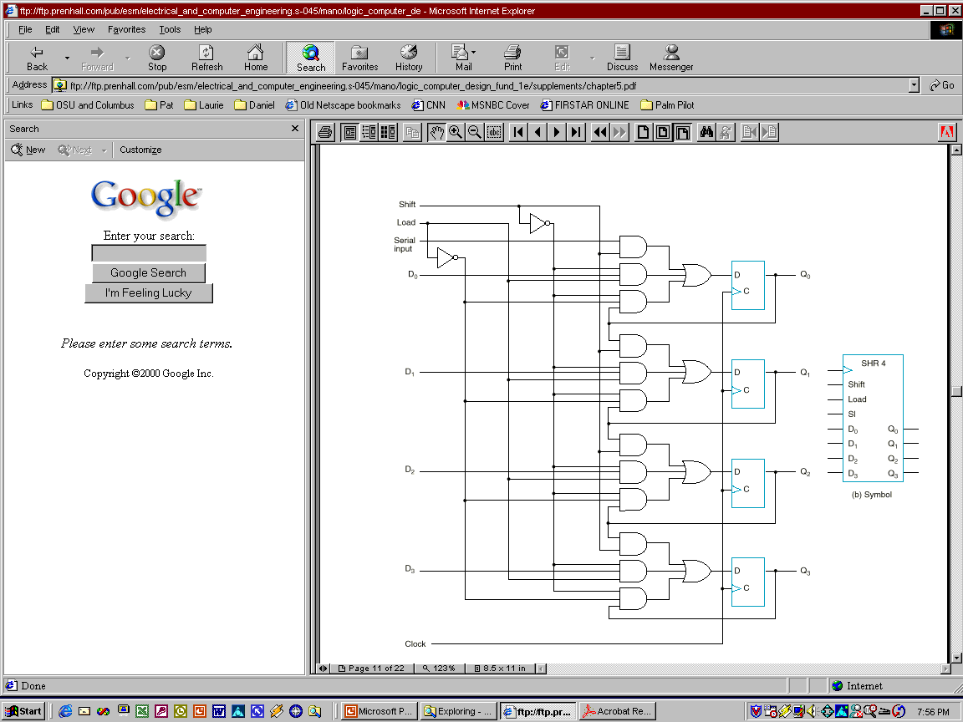
P6.5 Registers and Counters
Shift register with parallel load
Shift | Load | Operation
0 | 0 | Nothing
0 | 1 | Load parallel
1 | X | Shift
Page <number>
26 Feb.-2015
College of Computer Science, Sichuan University
Ying Sancong

Slide 30
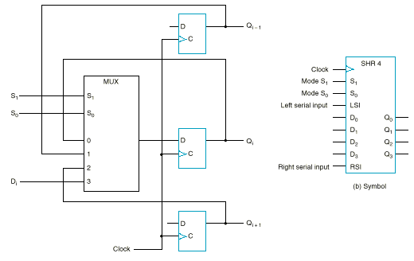
P6.5 Registers and Counters
Bidirectional Shift Register
S₁S₀ | Action
00 | Nothing
01 | Shift down
10 | Shift up
11 | Parallel load
Page <number>
26 Feb.-2015
College of Computer Science, Sichuan University
Ying Sancong

Slide 31

TO BE CONTINUED
Page <number>
01 Sept.-2014
College of Computer Science, Sichuan University
Ying Sancong

