Slide 1
PART 6:(Chapter 8、9)
Sequential Circuits’ Analysis & Design
Page <number>
26 Feb.-2015
College of Computer Science, Sichuan University
Ying Sancong

Slide 2
P6.5 Registers and Counters
Counters Overview
Ripple Counter
Synchronous Binary Counters
  Design with D Flip-Flops
  Design with J-K Flip-Flops
Serial Vs. Parallel Counters
Up-down Binary Counter
Binary Counter with Parallel Load
BCD Counter, Arbitrary sequence Counters
Page <number>
26 Feb.-2015
College of Computer Science, Sichuan University
Ying Sancong

Slide 3
P6.5 Registers and Counters
Counters
A counter is a register that goes through a predetermined sequence of states upon the application of clock pulses.
Counters are categorized as:
  Ripple Counters:
  The FF output transition serves as a source for triggering other FFs. No common clock.
  Synchronous Counter:
  All FFs receive the common clock pulse, and the change of state is determined from the present state.
Page <number>
26 Feb.-2015
College of Computer Science, Sichuan University
Ying Sancong

Slide 4
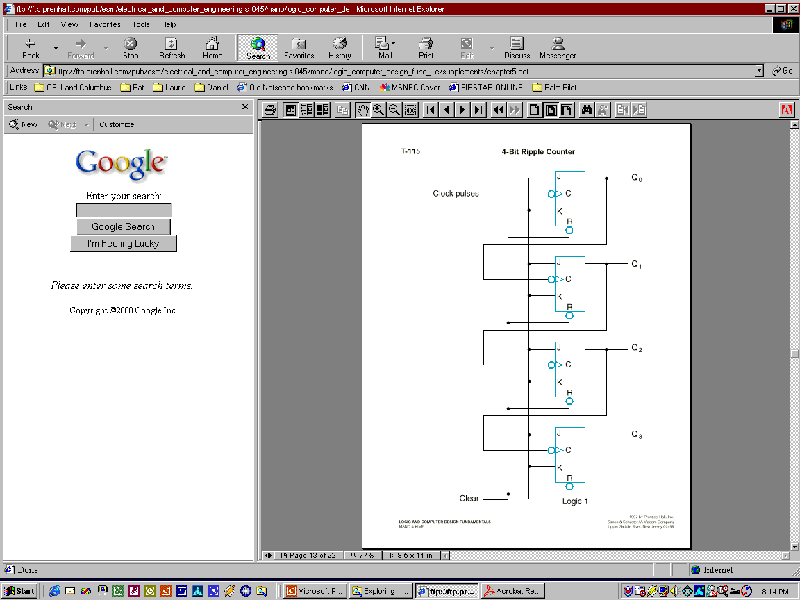
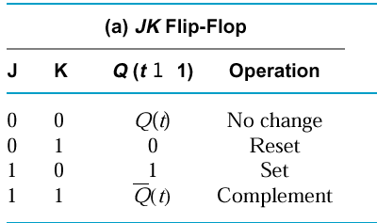
P6.5 Registers and Counters
Example: A 4-bit Upward Counting Ripple Counter
Less Significant
Bit output is Clock
for Next Significant Bit!
(Clock is active low)
Page <number>
26 Feb.-2015
College of Computer Science, Sichuan University
Ying Sancong

Slide 5
P6.5 Registers and Counters
Example: A 4-bit Upward Counting Ripple Counter
  The output of each FF is connected to the C input of the next FF in sequence.
  The FF holding the least significant bit receives the incoming clock pulses.
  The J and K inputs of all FFs are connected to a permanent logic 1.
  The bubble next to the C label indicates that the FFs respond to the negative-going transition of the input.
Page <number>
26 Feb.-2015
College of Computer Science, Sichuan University
Ying Sancong

Slide 6
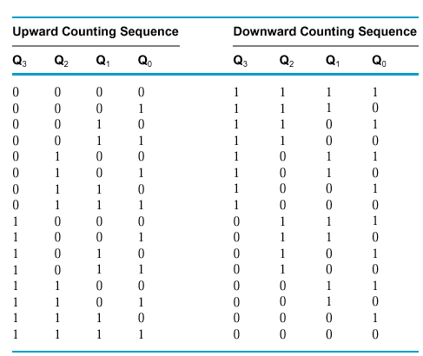
P6.5 Registers and Counters
Example: A 4-bit Upward Counting Ripple Counter
Operation:
The least significant bit (Q₀) is complemented with each negative-edge clock pulse input.
Every time that Q₀ goes from 1 to 0, Q₁ is complemented.
Every time that Q₁ goes from 1 to 0, Q₂ is complemented.
Every time that Q₂ goes from 1 to 0, Q₃ is complemented, and so on.
Page <number>
26 Feb.-2015
College of Computer Science, Sichuan University
Ying Sancong

Slide 7
P6.5 Registers and Counters
Synchronous Binary Counters
The design procedure for a binary counter is the same as any other synchronous sequential circuit.
The primary inputs of the circuit are the CLK and any control signals (EN, Load, etc).
The primary outputs are the FF outputs (present state).
Most efficient implementations usually use T-FFs or JK-FFs. We will examine JK and D flip-flop designs.
Page <number>
26 Feb.-2015
College of Computer Science, Sichuan University
Ying Sancong

Slide 8
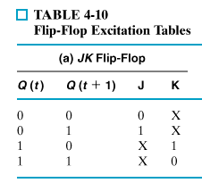
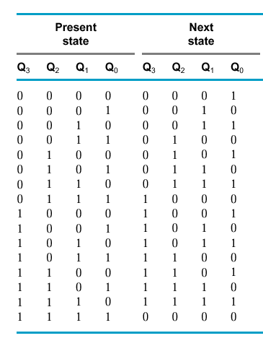
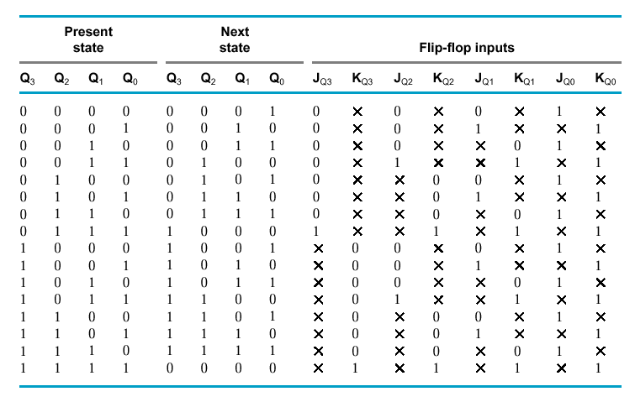
P6.5 Registers and Counters
Synchronous Binary Counters
J-K Flip Flop Design of a 4-bit Binary Up Counter
Page <number>
26 Feb.-2015
College of Computer Science, Sichuan University
Ying Sancong

Slide 9
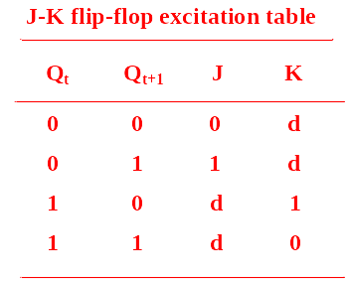
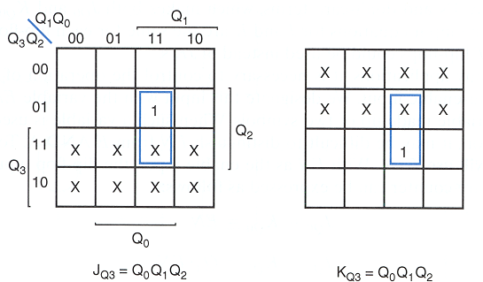
P6.5 Registers and Counters
Synchronous Binary Counters
J-K Flip Flop Design of a 4-bit Binary Up Counter (cont.)
JK-FF3
Page <number>
26 Feb.-2015
College of Computer Science, Sichuan University
Ying Sancong

Slide 10
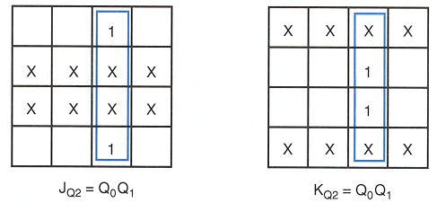
P6.5 Registers and Counters
Synchronous Binary Counters
J-K Flip Flop Design of a 4-bit Binary Up Counter (cont.)
JK-FF2
Page <number>
26 Feb.-2015
College of Computer Science, Sichuan University
Ying Sancong

Slide 11
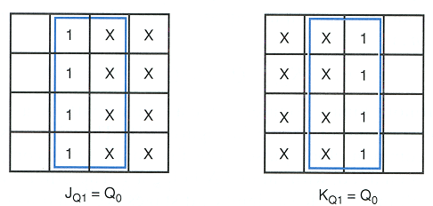
P6.5 Registers and Counters
Synchronous Binary Counters
J-K Flip Flop Design of a 4-bit Binary Up Counter (cont.)
JK-FF1
Page <number>
26 Feb.-2015
College of Computer Science, Sichuan University
Ying Sancong

Slide 12
P6.5 Registers and Counters
Synchronous Binary Counters
J-K Flip Flop Design of a 4-bit Binary Up Counter (cont.)
J_{Q0} = 1
K_{Q0} = 1
J_{Q1} = Q₀
K_{Q1} = Q₀
J_{Q2} = Q₀ Q₁
K_{Q2} = Q₀ Q₁
J_{Q3} = Q₀ Q₁ Q₂
K_{Q3} = Q₀ Q₁ Q₂
logic 1
Q₀
J
C
K
J
Q₁
C
K
J
Q₂
C
K
J
Q₃
C
K
CLK
Page <number>
26 Feb.-2015
College of Computer Science, Sichuan University
Ying Sancong

Slide 13
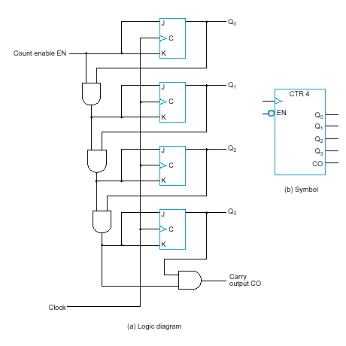
P6.5 Registers and Counters
Synchronous Binary Counters
J-K Flip Flop Design of a Binary Up Counter with EN and CO
EN = enable control signal, when 0 counter remains in the same state, when 1 it counts
CO = carry output signal, used to extend the counter to more stages
J_{Q0} = 1 · EN
K_{Q0} = 1 · EN
J_{Q1} = Q₀ · EN
K_{Q1} = Q₀ · EN
J_{Q2} = Q₀ Q₁ · EN
K_{Q2} = Q₀ Q₁ · EN
J_{Q3} = Q₀ Q₁ Q₂ · EN
K_{Q3} = Q₀ Q₁ Q₂ · EN
C0 = Q₀ Q₁ Q₂ Q₃ · EN
Page <number>
26 Feb.-2015
College of Computer Science, Sichuan University
Ying Sancong

Slide 14
P6.5 Registers and Counters
Synchronous Binary Counters
D Flip Flop Design of a Binary Up Counter with EN and CO
D_{Q0} = Q₀ ⊗ EN
D_{Q1} = Q₁ ⊗ ( Q₀ · EN)
D_{Q2} = Q₂ ⊗ ( Q₀ Q₁ · EN )
D_{Q3} = Q₃ ⊗ ( Q₀ Q₁ Q₂ · EN )
C0 = Q₀ Q₁ Q₂ Q₃ · EN
JK-based design calls for 4 AND gates
D-based design calls for 4 AND and 4 XOR gates
JK-FF equations
Page <number>
26 Feb.-2015
College of Computer Science, Sichuan University
Ying Sancong

Slide 15
P6.5 Registers and Counters
Up-Down Binary Counter
n-bit
Up-Down
Counter
clock
Q₀
Q₁
Q_{n-1}
UD
•
•
•
UD = 0: count up
UD = 1: count down
Page <number>
26 Feb.-2015
College of Computer Science, Sichuan University
Ying Sancong

Slide 16
P6.5 Registers and Counters
Up-Down Binary Counter
UD Q2 Q1 Q0 Q2.D Q1.D Q0.D
UD Q2 Q1 Q0 Q2.D Q1.D Q0.D
0 0 0 0 0 0 1
0 0 0 1 0 1 0
0 0 1 0 0 1 1
0 0 1 1 1 0 0
0 1 0 0 1 0 1
0 1 0 1 1 1 0
0 1 1 0 1 1 1
0 1 1 1 0 0 0
1 0 0 0 1 1 1
1 0 0 1 0 0 0
1 0 1 0 0 0 1
1 0 1 1 0 1 0
1 1 0 0 0 1 1
1 1 0 1 1 0 0
1 1 1 0 1 0 1
1 1 1 1 1 1 0
Up-Counter
Down-Counter
Finish the design in class
Page <number>
26 Feb.-2015
College of Computer Science, Sichuan University
Ying Sancong

Slide 17
P6.5 Registers and Counters
Binary Counter with Parallel Load
(Next slide) gives the logic diagram and symbol of a 4-bit synchronous binary counter with parallel load capability. The function table for this binary counter is
Load
Count
Operation
0
0
Nothing
0
1
Count
1
x
Load
Page <number>
26 Feb.-2015
College of Computer Science, Sichuan University
Ying Sancong

Slide 18
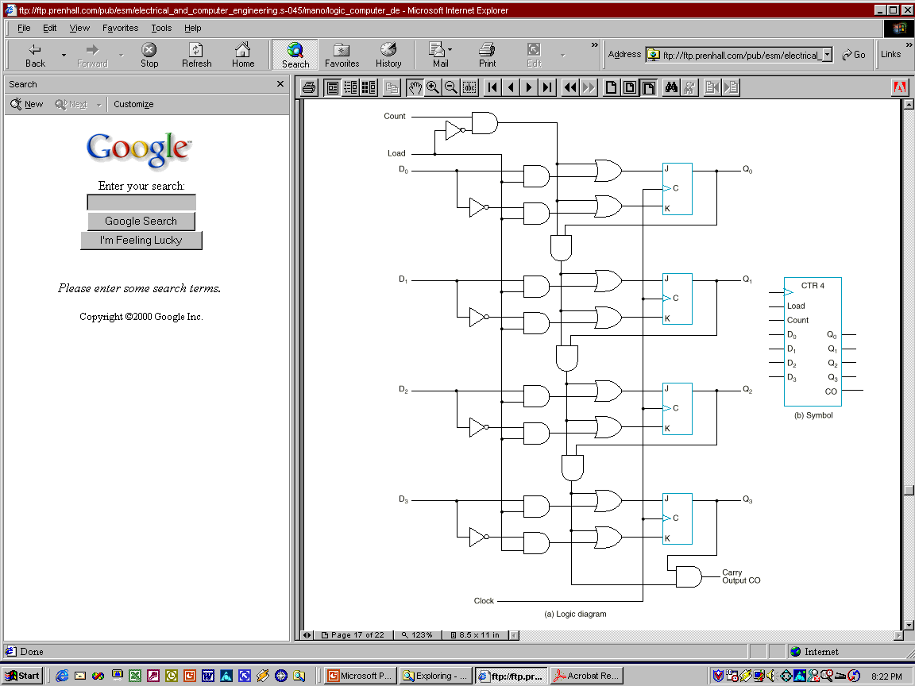
P6.5 Registers and Counters
Binary Counter with Parallel Load
Page <number>
26 Feb.-2015
College of Computer Science, Sichuan University
Ying Sancong

Slide 19
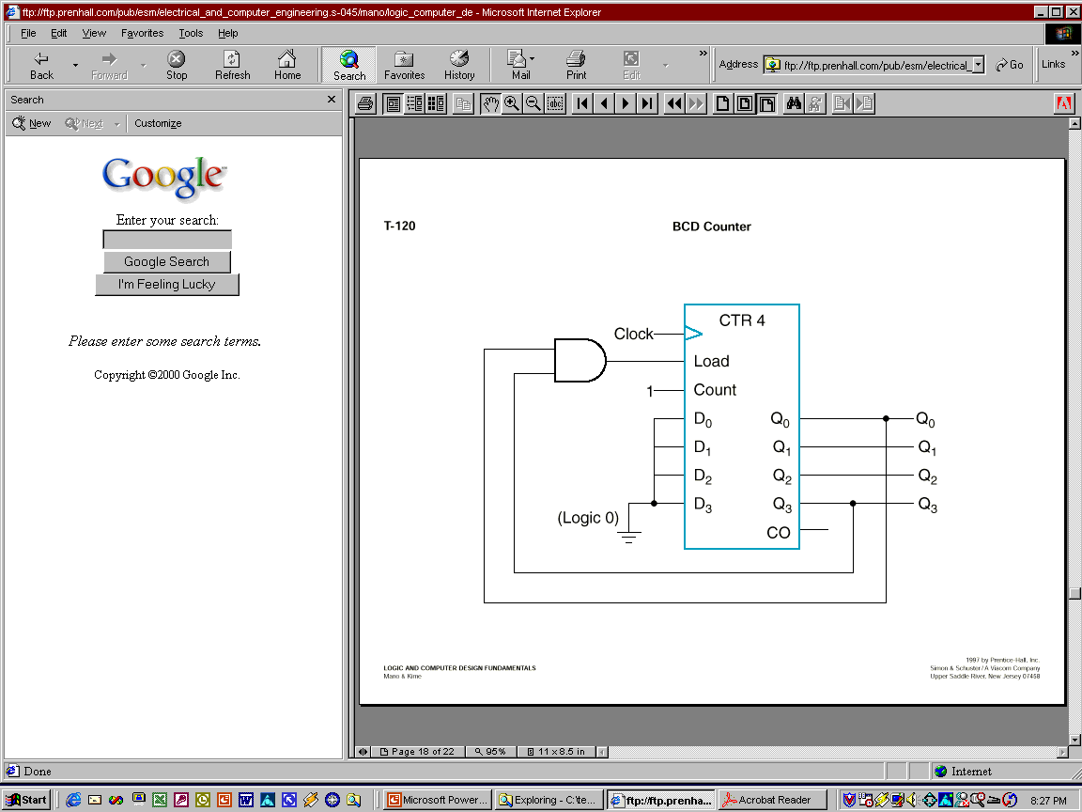
P6.5 Registers and Counters
BCD counter
The binary counter with parallel load can be converted into a synchronous BCD counter by connecting an external AND gate to it.
Load
Count
Operation
0
0
Nothing
0
1
Count
1
x
Load
Page <number>
26 Feb.-2015
College of Computer Science, Sichuan University
Ying Sancong

Slide 20
P6.5 Registers and Counters
BCD counter
The counter starts with an all-zero output.
As long as the output of the AND gate is 0, each positive clock pulse transition increments the counter by one.
When the output reaches the count of 1001, both Q₀ and Q₃ become 1, making the output of the AND gate equal to 1. This condition makes Load active, so on the next clock transition, the counter does not count, but is loaded from its four inputs.
The value loaded then is 0000.
Page <number>
26 Feb.-2015
College of Computer Science, Sichuan University
Ying Sancong

Slide 21
P6.5 Registers and Counters
Arbitrary Sequence Counter
Given an arbitrary sequence, design a counter that will generate this sequence.
Procedure:
  Derive state table/diagram based on give sequence
  Simplify (using K-maps, etc)
  Draw logic diagram
Example: Use D-FFs to draw the logic diagram for sequence generator (counter) for: 0 → 7 → 6 → 1 → 0 (000 → 111 → 110 → 001 → 000)
Page <number>
26 Feb.-2015
College of Computer Science, Sichuan University
Ying Sancong

Slide 22
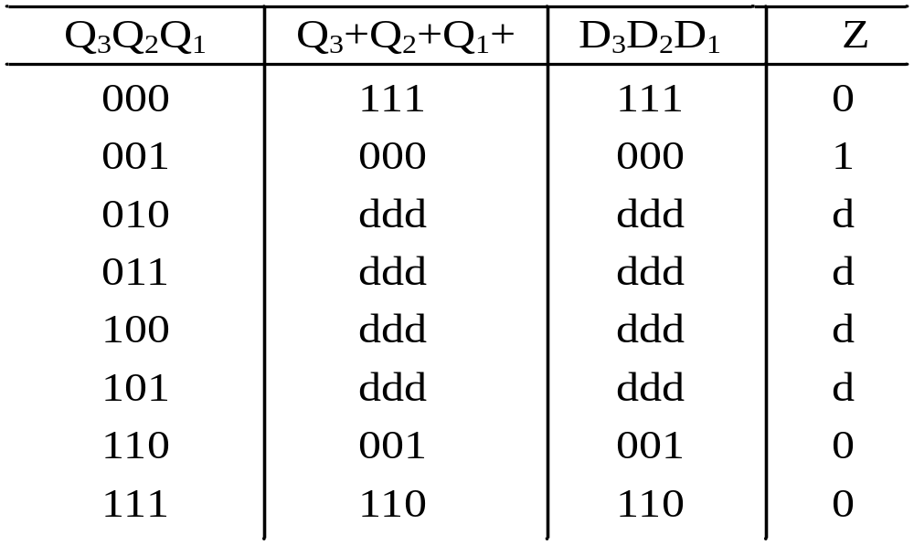
P6.5 Registers and Counters
Arbitrary Sequence Counter
Example:
Use D-FFs to draw the logic diagram for sequence generator (counter) for: 0 → 7 → 6 → 1 → 0 (000 → 111 → 110 → 001 → 000)
Page <number>
26 Feb.-2015
College of Computer Science, Sichuan University
Ying Sancong

Slide 23
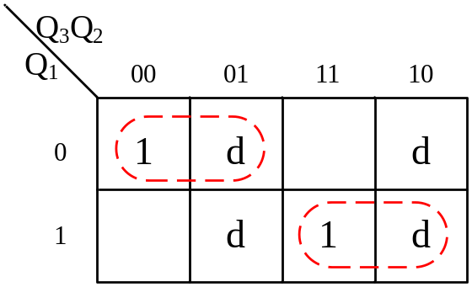

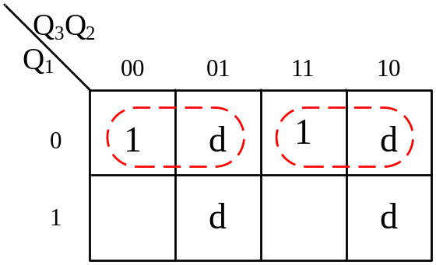
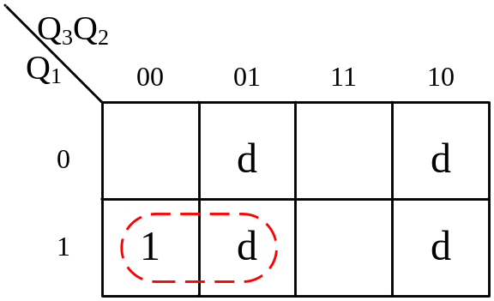
P6.5 Registers and Counters
Arbitrary Sequence Counter
Example:
D₃ K-Map
D₂ K-Map
D₁ K-Map
D₃=Q₃’Q₁’+Q₃Q₁
D₂=Q₃’Q₁’+Q₃Q₁
D₁=Q₁’
Z= Q₃’Q₁
Z K-Map
Page <number>
26 Feb.-2015
College of Computer Science, Sichuan University
Ying Sancong

Slide 24
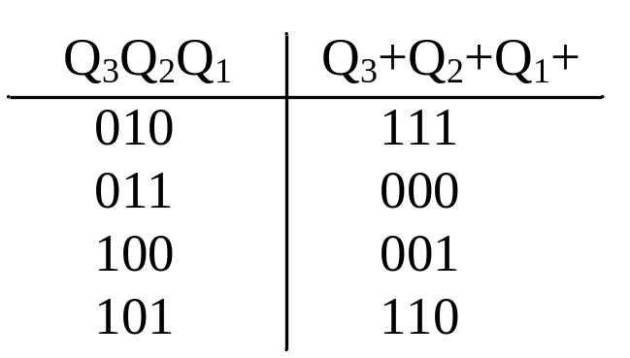
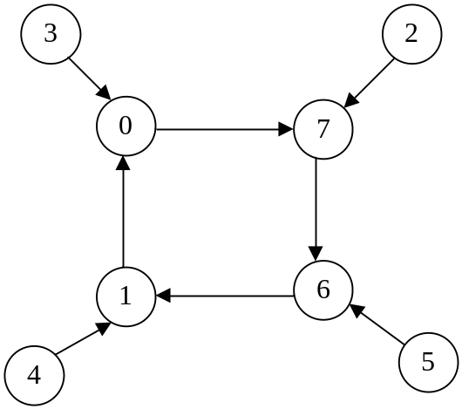
P6.5 Registers and Counters
Arbitrary Sequence Counter
Example:
D₃=Q₃’Q₁’+Q₃Q₁
D₂=Q₃’Q₁’+Q₃Q₁
D₁=Q₁’
Z= Q₃’Q₁
Page <number>
26 Feb.-2015
College of Computer Science, Sichuan University
Ying Sancong

Slide 25
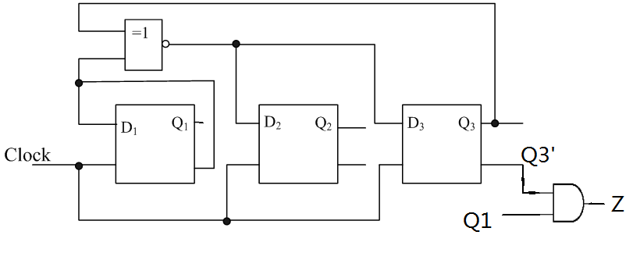
P6.5 Registers and Counters
Arbitrary Sequence Counter
Example:
Page <number>
26 Feb.-2015
College of Computer Science, Sichuan University
Ying Sancong

Slide 26
HomeWork
Page 357:
16, 18.
Page <number>
26 Feb.-2015
College of Computer Science, Sichuan University
Ying Sancong

Slide 27

TO BE CONTINUED
Page <number>
01 Sept.-2014
College of Computer Science, Sichuan University
Ying Sancong

