Slide 1
PART 7:(Chapter 10)
Memory and PLDs
Page <number>
26 Feb.-2015
College of Computer Science, Sichuan University
Ying Sancong

Slide 2

P7.1 Memory
Memory Units
Memories store data in units from one to eight bits. The most common unit is the byte, which by definition is 8 bits.
Computer memories are organized into multiples of bytes called words. Generally, a word is defined as the number of bits handled as one entity by a computer. By this definition, a word is equal to the internal register size (usually 16, 32, or 64 bits).
For historical reasons, assembly language defines a word as exactly two bytes. In assembly language, a 32 bit entity is called a double-word and 64 bits is defined as a quad-word.
Page <number>
26 Feb.-2015
College of Computer Science, Sichuan University
Ying Sancong

Slide 3
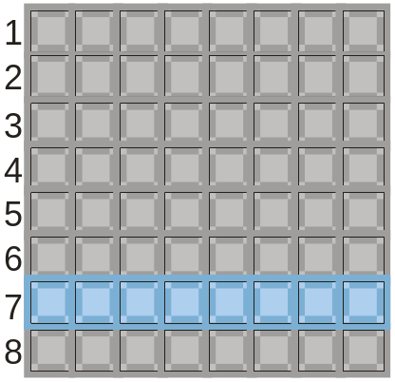
P7.1 Memory
Memory Units
The location of a unit of data in a memory is called the address. In PCs, a byte is the smallest unit of data that can be accessed.
In a 2-dimensional array, a byte is accessed by supplying a row number. For example the blue byte is located in row 7.
Page <number>
26 Feb.-2015
College of Computer Science, Sichuan University
Ying Sancong

Slide 4
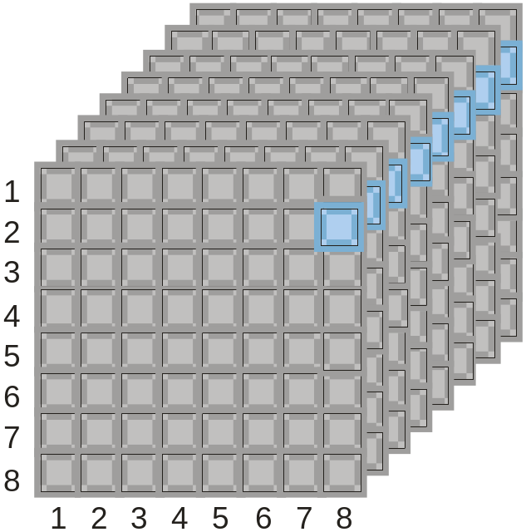


P7.1 Memory
Memory Addressing
A 3-dimensional array is arranged as rows and columns. Each byte has a unique row and column address.
Question
How many bytes are shown?
What is the location of the blue byte?
Answers
a) 64 B
b) Row 2, column 8
This example is (of course) only for illustration. Typical computer memories have 256 MB or more of capacity.
Page <number>
26 Feb.-2015
College of Computer Science, Sichuan University
Ying Sancong

Slide 5
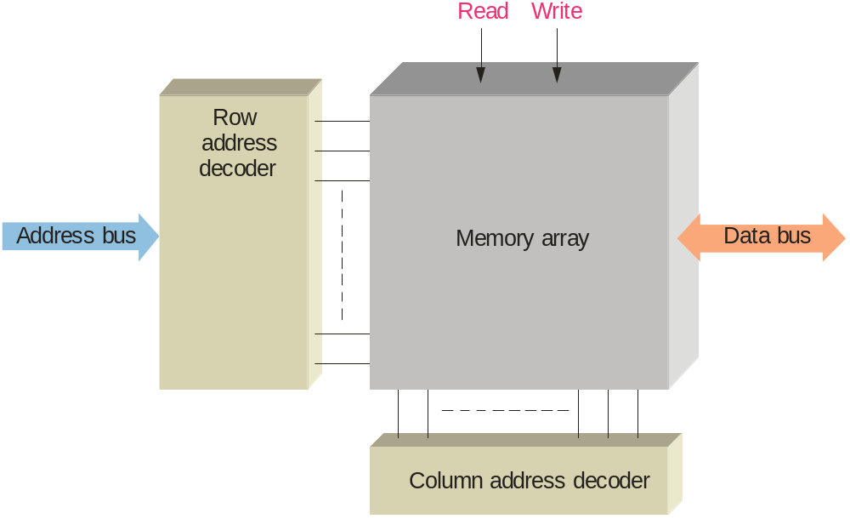
P7.1 Memory
Memory Addressing
In order to read or write to a specific memory location, a binary code is placed on the address bus. Internal decoders decode the address to determine the specific location. Data is then moved to or from the data bus.
The address bus is a group of conductors with a common function. Its size determines the number of locations that can be accessed. A 32 bit address bus can access 2³² locations, which is approximately 4G.
Page <number>
26 Feb.-2015
College of Computer Science, Sichuan University
Ying Sancong

Slide 6
P7.1 Memory
Memory Addressing
In addition to the address bus and data bus, semiconductor memories have read and write control signals and chip select signals. Depending on the type of memory, other signals may be required.
Read Enable (RE) and Write Enable (WE) signals are sent from the CPU to memory to control data transfer to or from memory.
Chip Select (CS) or Chip Enable (CE) is used as part of address decoding. All other inputs are ignored if the Chip Select is not active.
Output Enable (OE) is active during a read operation, otherwise it is inactive. It connects the memory to the data bus.
Page <number>
26 Feb.-2015
College of Computer Science, Sichuan University
Ying Sancong

Slide 7
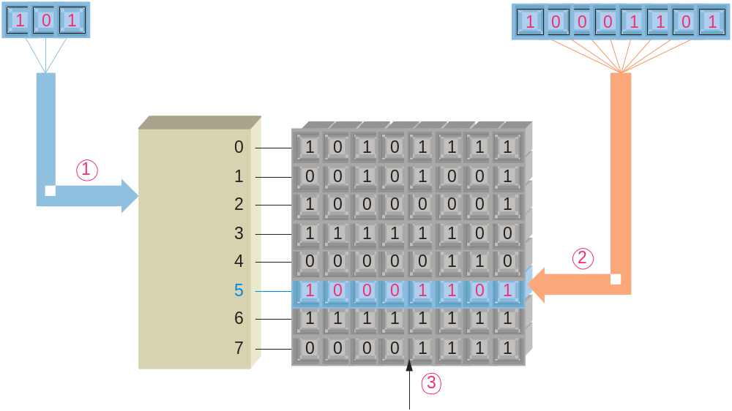
P7.1 Memory
Read and Write Operations
The two main memory operations are called read and write. A simplified write operation is shown in which new data overwrites the original data. Data moves to the memory.
Address register
Data register
Address decoder
Byte organized memory array
Address bus
The address is placed on the address bus.
Data is placed on the data bus.
A write command is issued.
Data bus
Write
Page <number>
26 Feb.-2015
College of Computer Science, Sichuan University
Ying Sancong

Slide 8
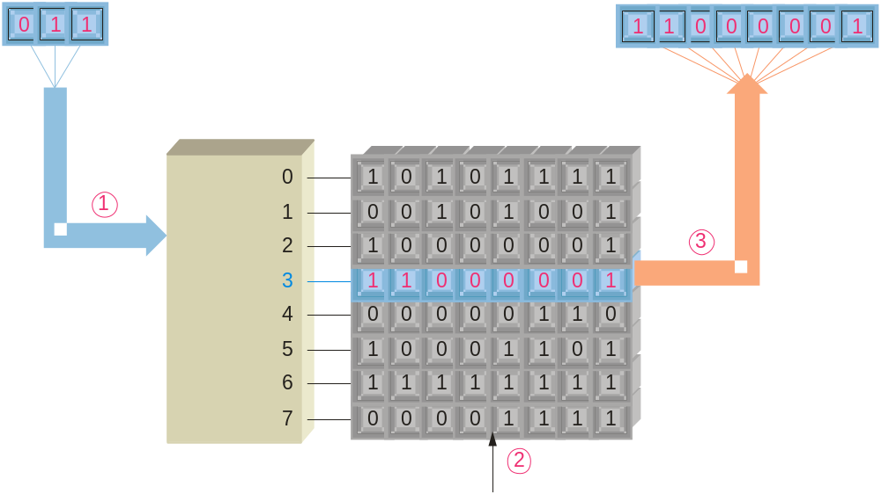
P7.1 Memory
Read and Write Operations
The read operation is actually a “copy” operation, as the original data is not changed. The data bus is a “two-way” path; data moves from the memory during a read operation.
Address register
Data register
Address decoder
Byte organized memory array
Address bus
The address is placed on the address bus.
A read command is issued.
A copy of the data is placed in the data bus and shifted into the data register.
Data bus
Read
Page <number>
26 Feb.-2015
College of Computer Science, Sichuan University
Ying Sancong

Slide 9
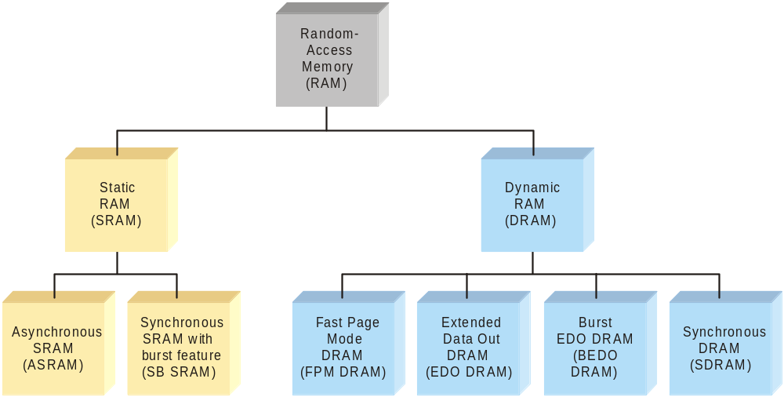
P7.1 Memory
Random Access Memory
RAM is for temporary data storage. It is read/write memory and can store data only when power is applied, hence it is volatile. Two categories are static RAM (SRAM) and dynamic RAM (DRAM).
Bits stored in a semiconductor latch or flip-flop
Bits stored as charge on a capacitor
Page <number>
26 Feb.-2015
College of Computer Science, Sichuan University
Ying Sancong

Slide 10
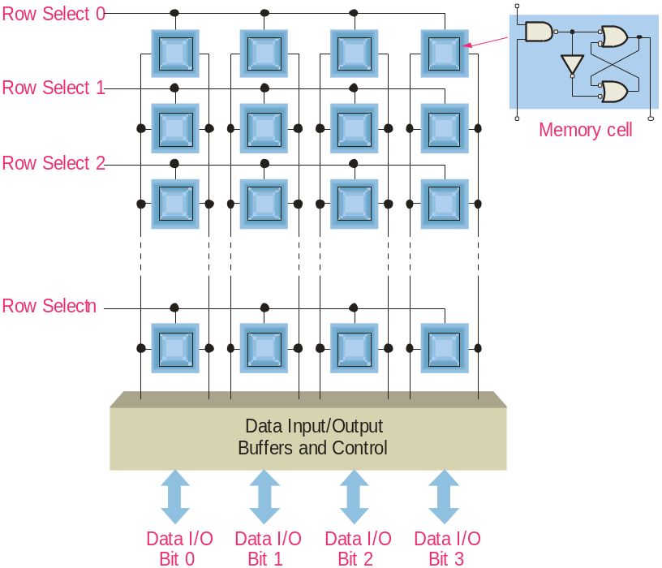
P7.1 Memory
Static RAM
SRAM uses semiconductor latch memory cells. The cells are organized into an array of rows and columns.
SRAM is faster than DRAM but is more complex, takes up more space, and is more expensive. SRAMs are available in many configurations – a typical large SRAM is organized as 512 k X 8 bits.
Page <number>
26 Feb.-2015
College of Computer Science, Sichuan University
Ying Sancong

Slide 11
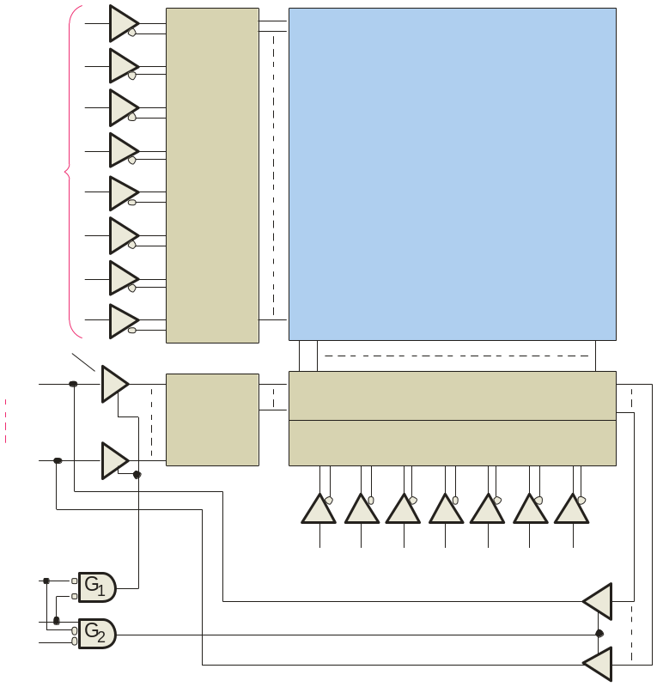
P7.1 Memory
Asynchronous Static RAM
The basic organization of an asynchronous SRAM is shown.
Read cycle sequence:
A valid address is put on the address bus
Chip select is LOW
Output enable is LOW
Data is placed on the data bus
Memory array
Address lines
Row
decoder
256 rows x
128 columns x
8 bits
Write cycle sequence:
A valid address is put on the address bus
Chip select is LOW
Write enable is LOW
Data is placed on the data bus
Eight
input buffers
Output data
I/O₀
Input data control
Column I/O
I/O₇
Column decoder
CS
Address lines
WE
OE
Page <number>
26 Feb.-2015
College of Computer Science, Sichuan University
Ying Sancong

Slide 12
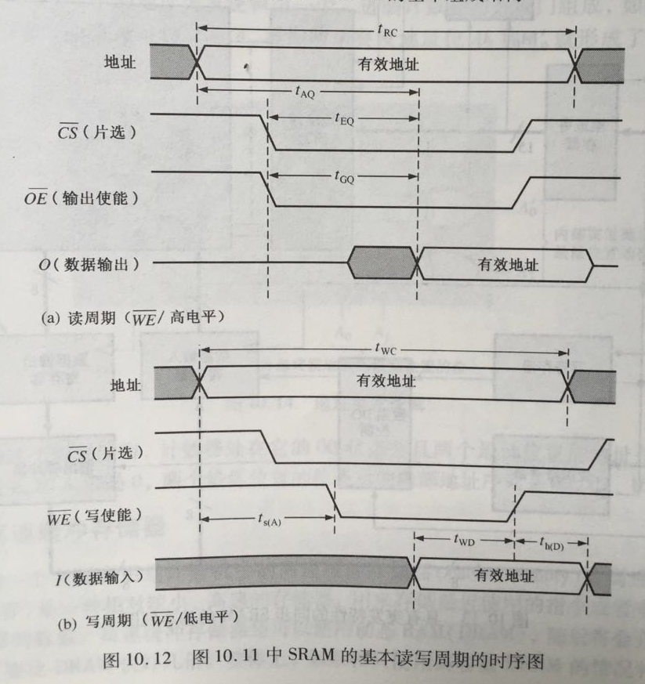
P7.1 Memory
Page <number>
26 Feb.-2015
College of Computer Science, Sichuan University
Ying Sancong

Slide 13
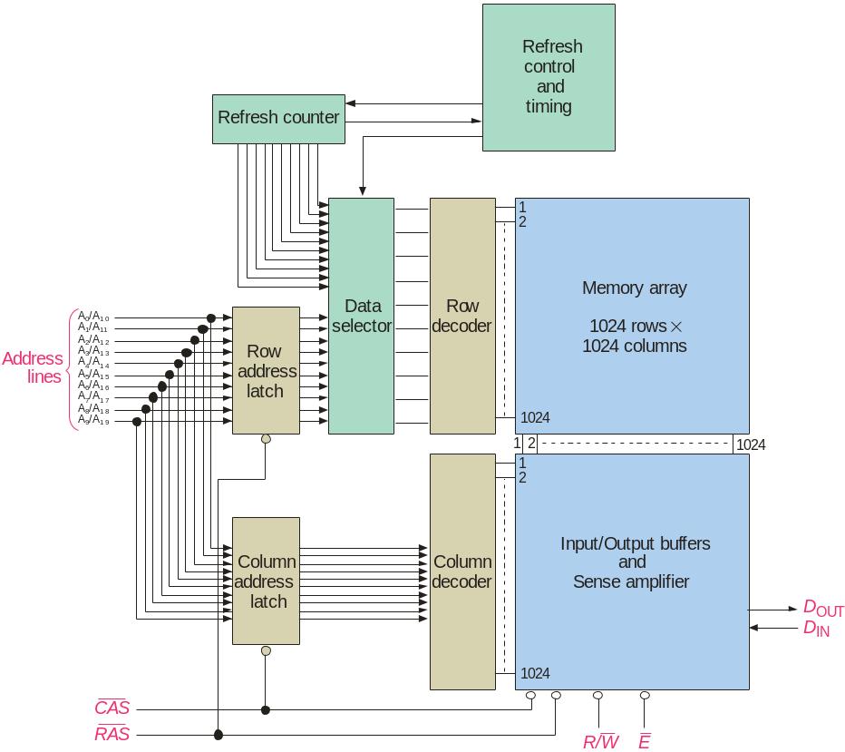
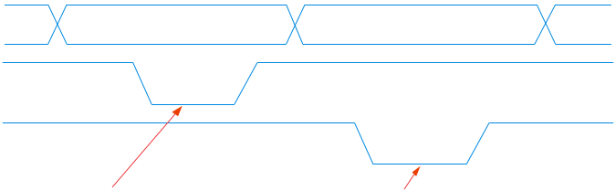
P7.1 Memory
Dynamic RAM (DRAM)
Dynamic RAMs (DRAMs) store data bits as a charge on a capacitor.
DRAMs are simple and cost effective, but require refresh circuitry to prevent losing data. The address lines are multiplexed to reduce the number of address lines.
Multiplexed address lines:
Addresses
RAS
CAS
Row address is latched when RAS is LOW
Column address is latched when CAS is LOW
Page <number>
26 Feb.-2015
College of Computer Science, Sichuan University
Ying Sancong

Slide 14
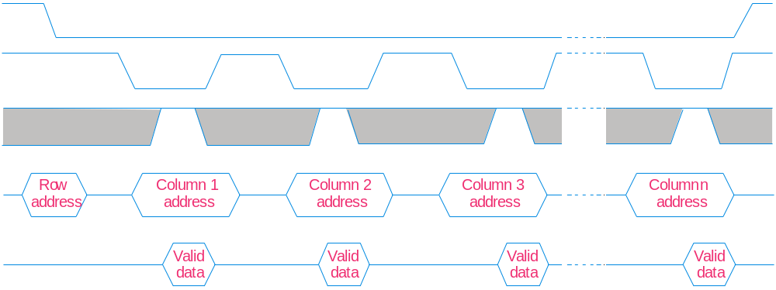
P7.1 Memory
Dynamic RAM (DRAM)
A feature with some DRAMs is fast page mode. Fast page mode allows successive read or write operations from a series of columns address that are all on the same row.
RAS
CAS
R/W
Addresses
D_{OUT}
Other types of DRAMs have been developed to speed access and make the processor more efficient. These include EDO DRAMs, BEDO DRAMs and SDRAMs etc.
Page <number>
26 Feb.-2015
College of Computer Science, Sichuan University
Ying Sancong

Slide 15
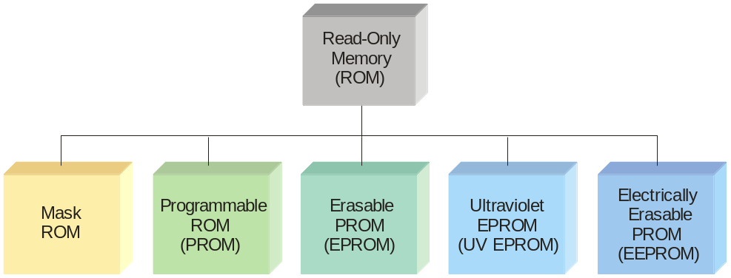
P7.1 Memory
Read-Only Memory (ROM)
The ROM family is all considered non-volatile, because it retains data with power removed. It includes various members that can be either permanent memory or erasable.
ROMs are used to store data that is never (or rarely) changed such as system initialization files. ROMs are non-volatile, meaning they retain the data when power is removed, although some ROMs can be reprogrammed using specialized equipment.
Page <number>
26 Feb.-2015
College of Computer Science, Sichuan University
Ying Sancong

Slide 16
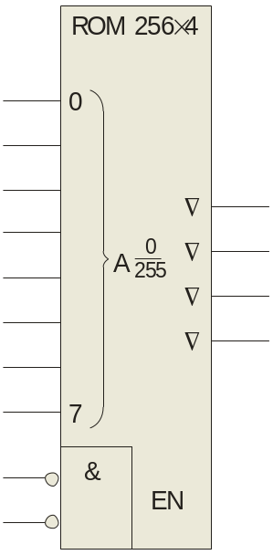
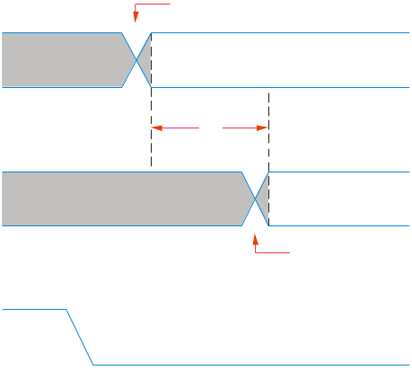
P7.1 Memory
Read-Only Memory (ROM)
A ROM symbol is shown with typical inputs and outputs. The triangles on the outputs indicate it is a tri-stated device.
To read a value from the ROM, an address is placed on the address bus, the chip is enabled, and a short time later (called the access time), data appears on the data bus.
Address input lines
A₀
Data output lines
A₁
A₂
O₀
Address transition
A₃
Address input lines
A₄
O₁
Valid address on input lines
O₂
A₅
O₃
t_{a}
A₆
Data outputs
Valid data on output lines
A₇
Data output transition
E₀
E₁
Chip select
Page <number>
26 Feb.-2015
College of Computer Science, Sichuan University
Ying Sancong

Slide 17
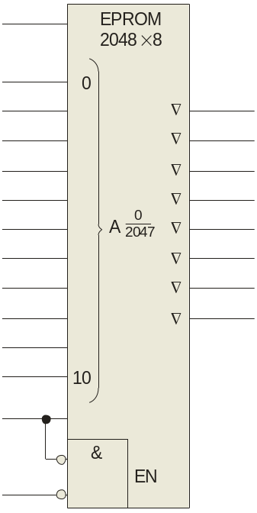
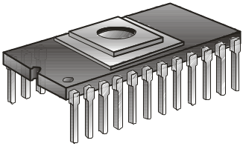
P7.1 Memory
PROMs, EPROMs and EEPROMs
PROMs are programmable ROM, in which a fused link is burned open during the programming process. Once the PROM is programmed, it cannot be reversed.
An EPROM is an erasable PROM and can be erased by exposure to UV light through a window. To program it, a high voltage is applied to V_{PP} and OE is brought LOW.
V_{PP}
A₀
A₁
O₀
A₂
O₁
A₃
O₂
A₄
O₃
A₅
O₄
A₆
O₅
A₇
O₆
A₈
O₇
A₉
A₁₀
Another type of erasable PROM is the EEPROM, which can be erased and programmed with electrical pulses.
CE/PGM
OE
Page <number>
26 Feb.-2015
College of Computer Science, Sichuan University
Ying Sancong

Slide 18
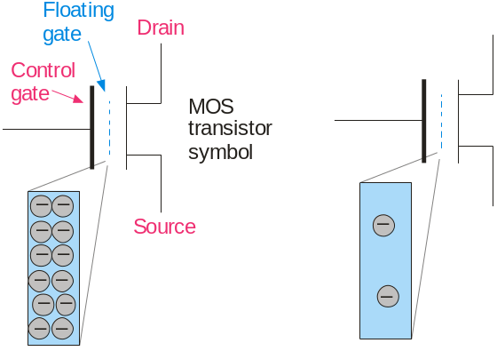
P7.1 Memory
Flash Memory
Flash memories are high density read/write memories that are nonvolatile. They have the ability to retain charge for years with no applied power.
Flash memory uses a MOS transistor with a floating gate as the basic storage cell. The floating gate can store charge (logic 0) when a positive voltage is applied to the control gate. With little or no charge, the cell stores a logic 1.
logic 0 is stored
logic 1 is stored
The flash memory cell can be read by applying a positive voltage to the control gate. If the cell is storing a 1, the positive voltage is sufficient to turn on the transistor; if it is storing a 0, the transistor is off.
Page <number>
26 Feb.-2015
College of Computer Science, Sichuan University
Ying Sancong

Slide 19
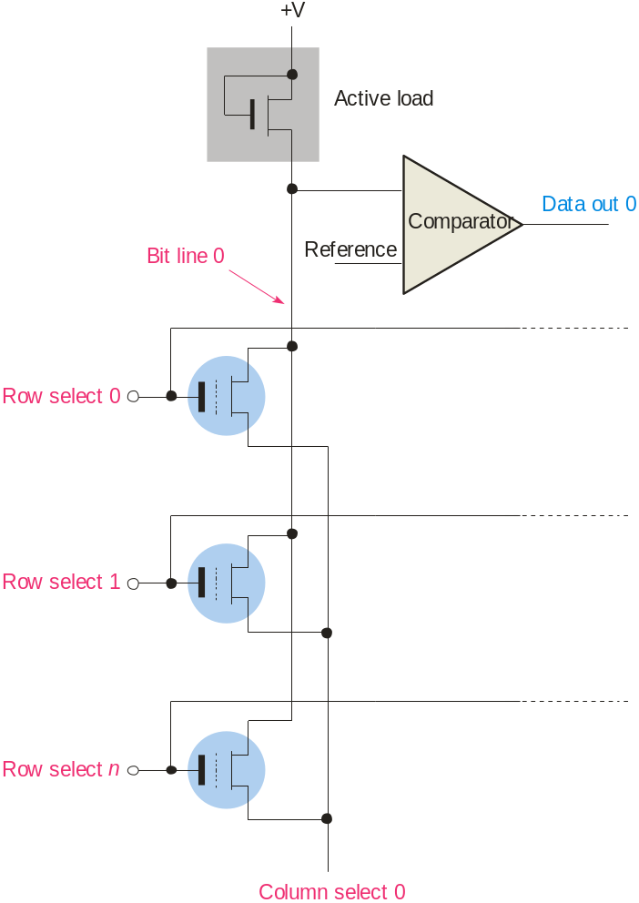
P7.1 Memory
Flash Memory
Flash memories arranged in arrays with an active load. For simplicity, only one column is shown. When a specific row and column is selected during a read operation, the active load has current.
One drawback to flash memory is that once a bit has been set to 0, it can be reset to a 1 only by erasing an entire block of memory. Another limitation is that flash memory has a large but finite number of read/write cycles.
Page <number>
26 Feb.-2015
College of Computer Science, Sichuan University
Ying Sancong

Slide 20
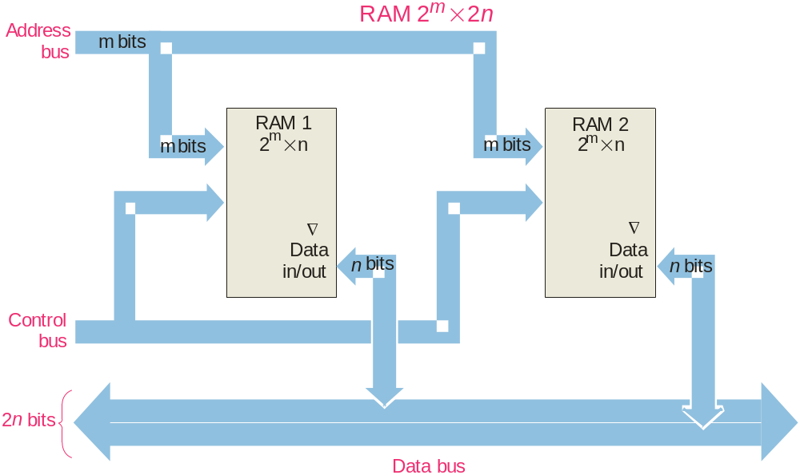
P7.1 Memory
Memory Expansion
Memory can be expanded in either word size or word capacity or both.
To expand word size:
Notice that the data bus size is larger, but the number of address is the same.
Page <number>
26 Feb.-2015
College of Computer Science, Sichuan University
Ying Sancong

Slide 21
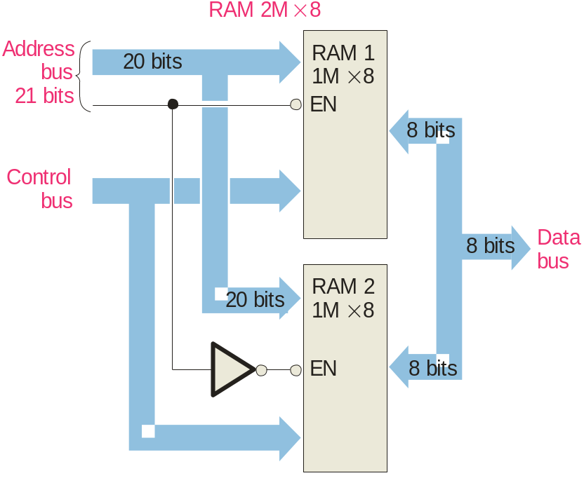
P7.1 Memory
Memory Expansion
To expand word capacity, you need to add an address line as shown in this example
Notice that the data bus size does not change.
Question
What is the purpose of the inverter?
Answer
Only one of the ICs is enabled at any time depending on the logic on the added address line.
Page <number>
26 Feb.-2015
College of Computer Science, Sichuan University
Ying Sancong

Slide 22
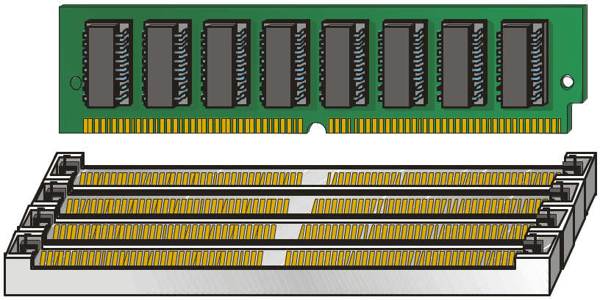
P7.1 Memory
SIMMs and DIMMs
SIMMs (single in-line memory modules) and DIMMs (dual in-line memory modules) are plug-in circuit boards containing the ICs and I/O brought out on edge connectors. SIMMs have a 32-bit data path with I/O on only one side whereas DIMMs have a 64-bit data path with I/O on both sides of the board.
SIMM or DIMM
Socket on system board
Page <number>
26 Feb.-2015
College of Computer Science, Sichuan University
Ying Sancong

Slide 23
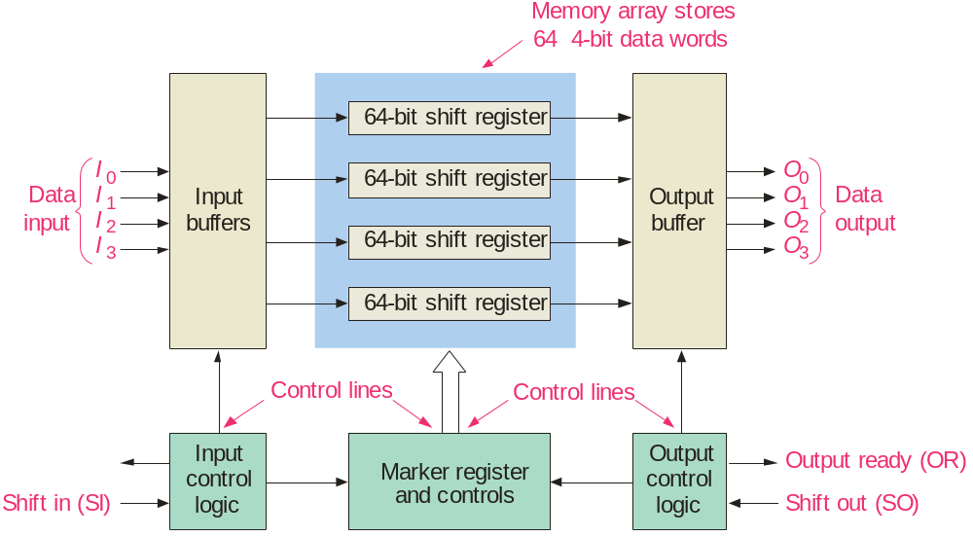
P7.1 Memory
FIFO Memory
FIFO means first in-first out. This type of memory is basically an arrangement of shift registers. It is used in applications where two systems communicate at different rates.
Page <number>
26 Feb.-2015
College of Computer Science, Sichuan University
Ying Sancong

Slide 24
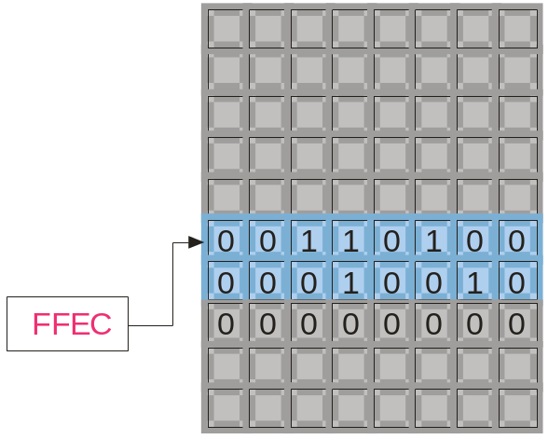
P7.1 Memory
LIFO Memory
LIFO means last in-first out. In microprocessors, a portion of RAM is devoted to this type of memory, which is called the stack. Stacks are very useful for temporary storage of internal registers, so that the processor can be interrupted but can easily return to a given task.
A special register, called the stack pointer, keeps track of the location that data was last stored on the stack. This will be the next data to be taken from the stack when needed.
Top-of-stack
Stack pointer
Page <number>
26 Feb.-2015
College of Computer Science, Sichuan University
Ying Sancong

Slide 25
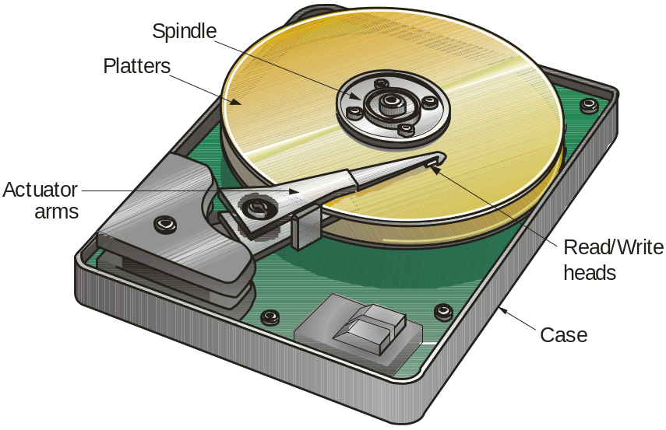
P7.1 Memory
Magnetic Hard Drive
The magnetic hard drive is the backbone of computer mass storage and is applied to other devices such as digital video recorders. Capacities of hard drives have increased exponentially, with 1 TB (1 trillion bytes!) drives available today.
Platters are arranged in tracks (circular shapes) and sectors (pie shaped). Files are listed in a File Allocation Table, (FAT) that keeps track of file names, locations, size, and more.
Hard drive with cover removed
Page <number>
26 Feb.-2015
College of Computer Science, Sichuan University
Ying Sancong

Slide 26

P7.1 Memory
Optical Storage
The compact disk (CD) uses a laser to burn tiny pits into the media. Surrounding the pits are flat areas called lands. The CD can be read using a low-power IR laser that detects the difference between pits and lands.
Binary data is encoded with a special method called negative non-return to zero encoding. A change from a pit to a land or a land to a pit represents a binary one, whereas no change represents a zero. A standard 120 mm CD can hold approximately 700 MB of data.
Page <number>
26 Feb.-2015
College of Computer Science, Sichuan University
Ying Sancong

Slide 27
P7.2 PLDs
Programmable Logic
Programmable Logic Devices (PLDs) are ICs with a large number of gates and flip flops that can be configured with basic software to perform a specific logic function or perform the logic for a complex circuit. Major types of PLDs are:
SPLD: (Simple PLDs) are the earliest type of array logic used for fixed functions and smaller circuits with a limited number of gates. (The PAL and GAL are both SPLDs).
CPLD: (Complex PLDs) are multiple SPLDs arrays and inter-connection arrays on a single chip.
FPGA: (Field Programmable Gate Array) are a more flexible arrangement than CPLDs, with much larger capacity.
Page <number>
26 Feb.-2015
College of Computer Science, Sichuan University
Ying Sancong

Slide 28
P7.2 PLDs
Programmable Logic
Advantages to PLDs include
Reduced complexity of circuit boards
  Lower power requirements
  Less board space
  Simpler testing procedures
Higher reliability
Design flexibility
Page <number>
26 Feb.-2015
College of Computer Science, Sichuan University
Ying Sancong

Slide 29
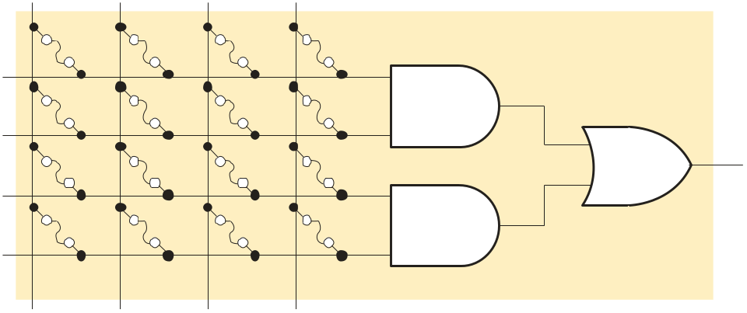
P7.2 PLDs
PALs and GALs
All PLDs contain arrays. Two important SPLDs are PALs (Programmable Array Logic) and GALs (Generic Array Logic). A typical array consists of a matrix of conductors connected in rows and columns to AND gates.
PALs have a one time programmable (OTP) array, in which fuses are permanently blown, creating the product terms in an AND array.
A A B B
X
Simplified AND-OR array
Page <number>
26 Feb.-2015
College of Computer Science, Sichuan University
Ying Sancong

Slide 30
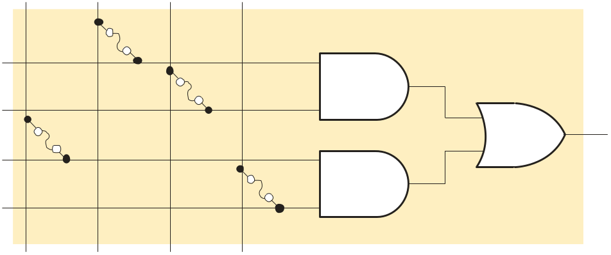
P7.2 PLDs
PALs and GALs
PALs are programmed with a specialized programmer that blows selected internal fuse links. After blowing the fuses, the array represents the Boolean logic expression for the desired circuit.
A A B B
Example
What function is represented by the array?
X
Solution
X = AB + AB
The function represents an XOR gate.
Page <number>
26 Feb.-2015
College of Computer Science, Sichuan University
Ying Sancong

Slide 31
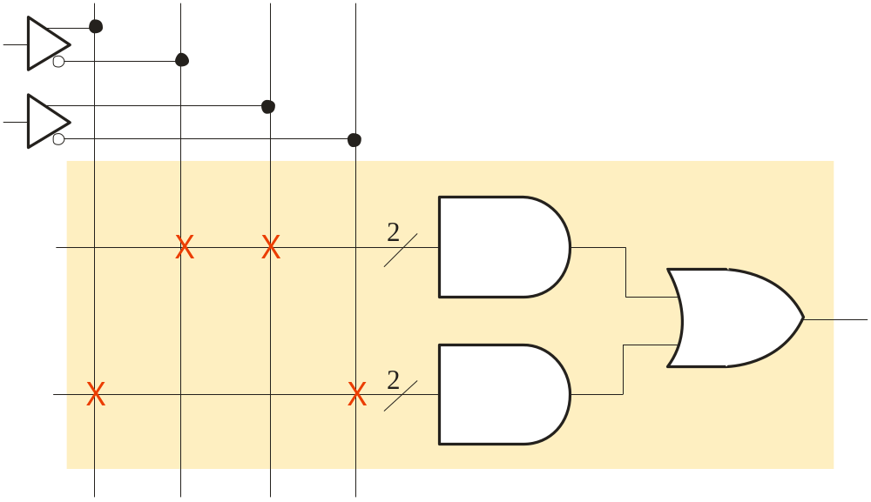
P7.2 PLDs
PALs and GALs
PALs and GALs can be represented with a simplified diagram. A single line can represent multiple gate inputs. The logic shown is for the XOR gate, given previously.
Input buffer
A A B B
Single line with slash indicating multiple AND gate inputs
Fuse blown
AB
Fuse intact
AB + AB
AB
Page <number>
26 Feb.-2015
College of Computer Science, Sichuan University
Ying Sancong

Slide 32
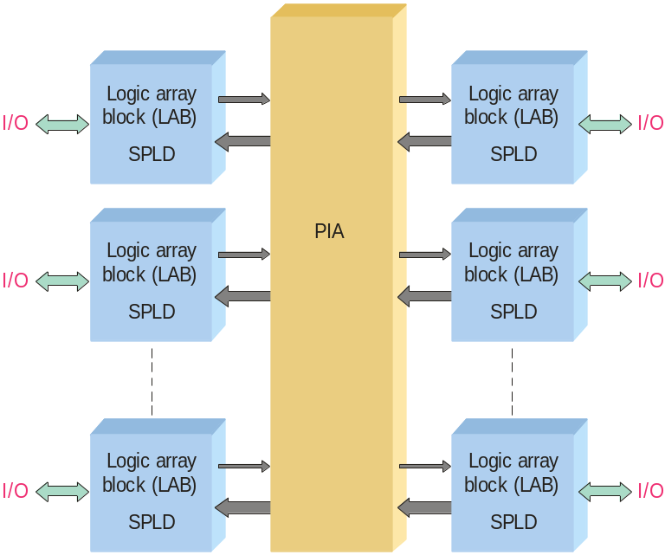
P7.2 PLDs
CPLDs
A complex programmable logic device (CPLD) has multiple logic array blocks (LABs) that are actually SPLDs on a single IC. LABs are connected via a programmable interconnect array (PIA). Various CPLDs have different structures for these elements.
The PIA is the interconnection between the LABs. Logic is fitted to the CPLD and routing is determined by a high-level programming language called a hardware description language (HDL).
Page <number>
26 Feb.-2015
College of Computer Science, Sichuan University
Ying Sancong

Slide 33
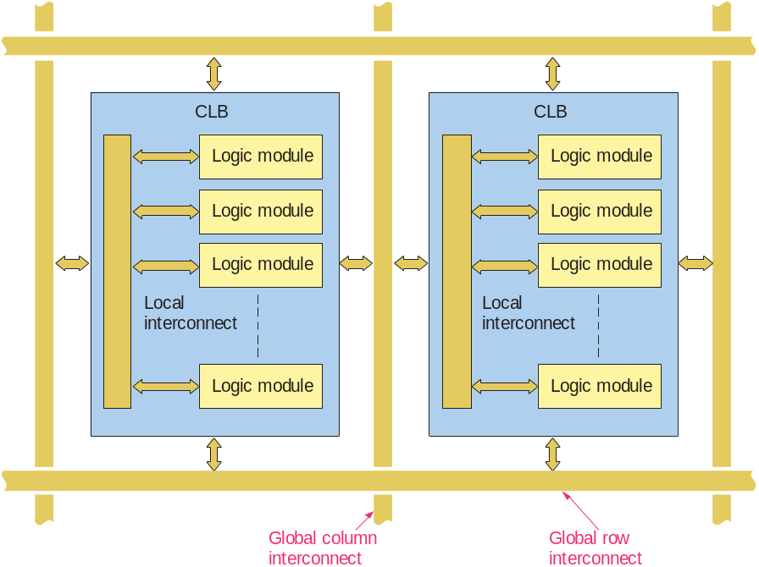
P7.2 PLDs
FPGAs
A field programmable gate array (FPGA) uses a different architecture than a CPLD. The configurable logic block (CLB) is the basic element which is replicated many times.
CLBs are arranged in a row and column structure. Within the CLBs are logic modules joined by local interconnects. Generally, the logic modules are composed of a look-up table (LUT), a flip-flop, and a MUX that can be used to bypass the flip-flop for strictly combinational logic.
Page <number>
26 Feb.-2015
College of Computer Science, Sichuan University
Ying Sancong

Slide 34
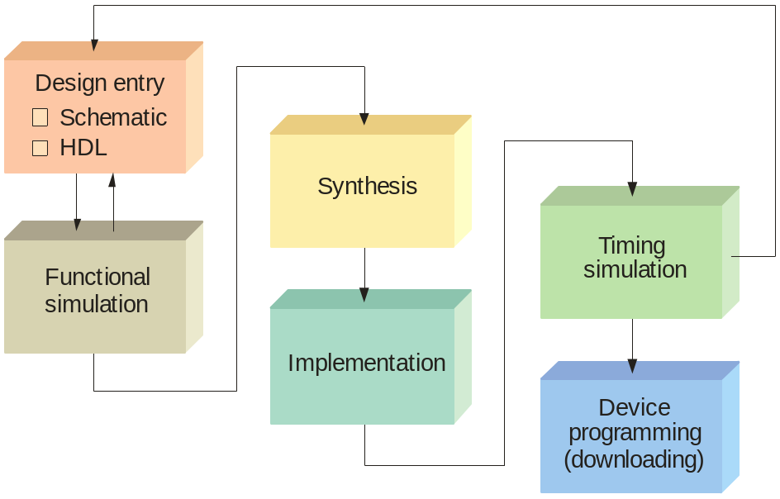
P7.2 PLDs
Programmable Logic Software
All manufacturers of programmable logic provide software to support their products. The process is illustrated in the flowchart.
The first step is to enter the logic design into a computer. It is done in one of two ways:
1) Schematic entry
2) Hardware description language (HDL).
Page <number>
26 Feb.-2015
College of Computer Science, Sichuan University
Ying Sancong

Slide 35
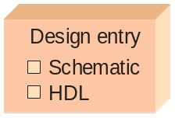
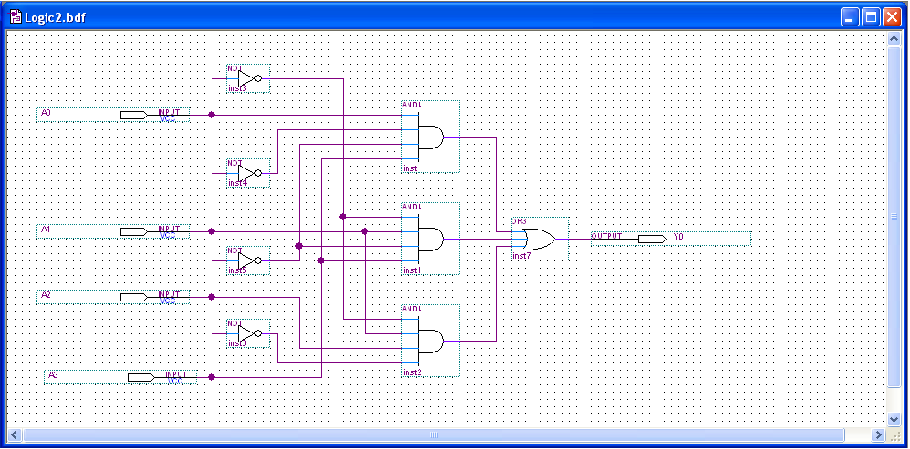
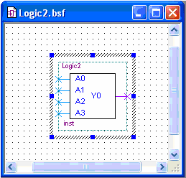
P7.2 PLDs
Programmable Logic Software
In schematic entry, the design is drawn on a computer screen by placing components and connecting then with simulated wires. You do not need to know the details of an HDL. After drawing the schematic, it can be reduced to a single block symbol:
Page <number>
26 Feb.-2015
College of Computer Science, Sichuan University
Ying Sancong

Slide 36
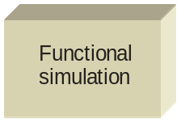
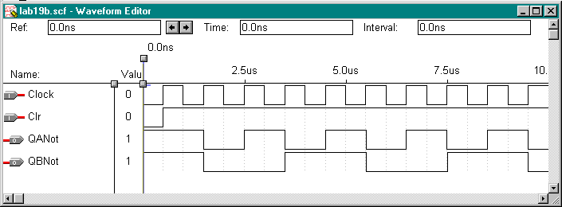
P7.2 PLDs
Functional Simulation
After entering the circuit into an HDL (such as VHDL), the circuit is tested in a functional simulation. The functional simulation is part of the HDL. You can test the circuit with waveforms to verify the operation.
Example
The following shows the functional test of a counter using a waveform editor:
Page <number>
26 Feb.-2015
College of Computer Science, Sichuan University
Ying Sancong

Slide 37
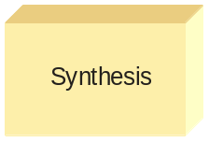
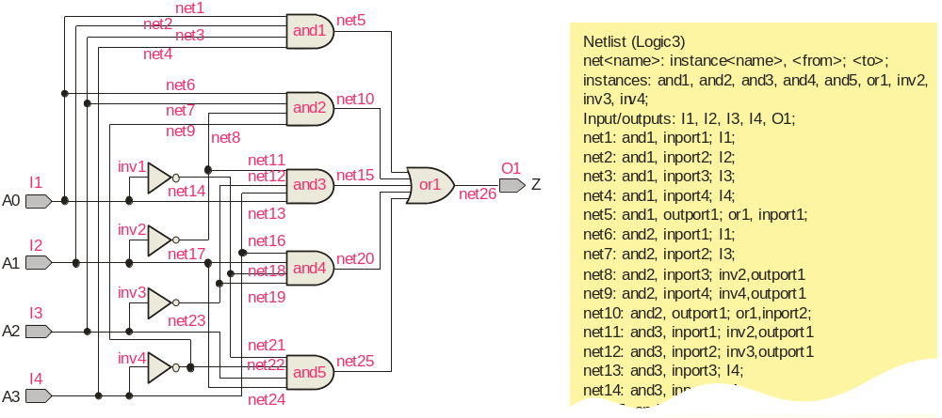
P7.2 PLDs
Synthesis
After the simulation, the computer program optimizes the logic by eliminating redundant terms and generating a netlist, (a connection list) that is a complete description of the circuit.
Netlist
Page <number>
26 Feb.-2015
College of Computer Science, Sichuan University
Ying Sancong

Slide 38
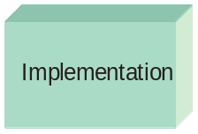

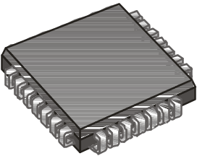
P7.2 PLDs
Implementation
The computer next “maps” the design from the netlist to fit it to a target device. Data for all potential target devices are in a software library. The computer must account for the I/O pins and fit the logic to the target device.
Page <number>
26 Feb.-2015
College of Computer Science, Sichuan University
Ying Sancong

Slide 39
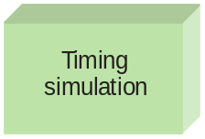
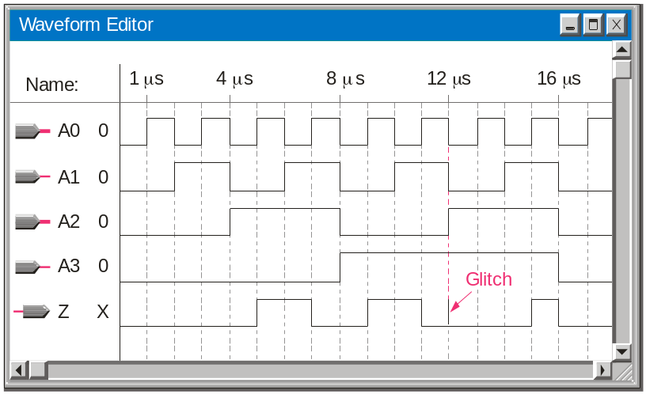
P7.2 PLDs
Timing Simulation
After implementation, a timing simulation is done that takes into account the specific delays in the target device and verifies that there no problems with the timing. As in the case of the functional simulation, the waveform editor can be used to review final timing.
If a problem is revealed, it is not too late to correct it before downloading the file.
Page <number>
26 Feb.-2015
College of Computer Science, Sichuan University
Ying Sancong

Slide 40
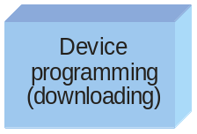
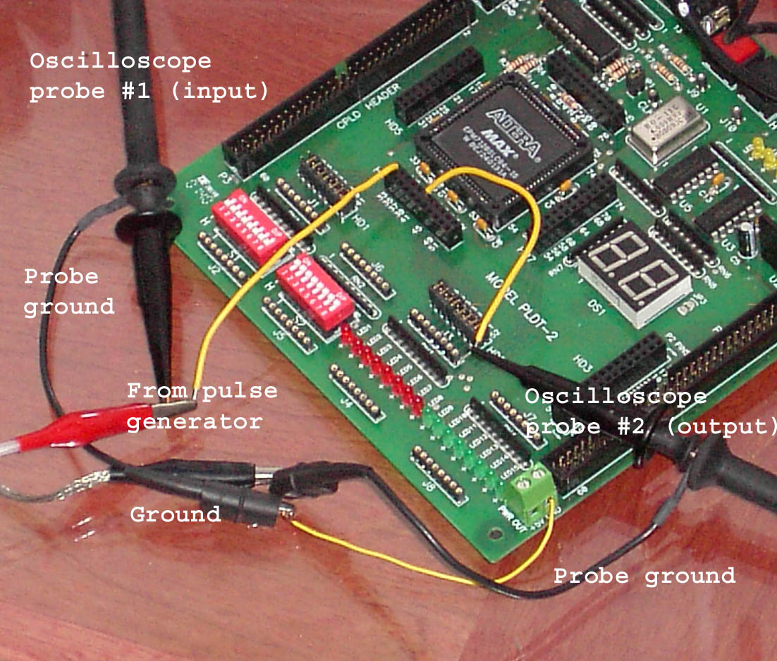
P7.2 PLDs
Device Programming
The final step is to send the programming file from the computer to the target device and test the implementation.
A PLDT-2 prototyping board that has an Altera PLD as the target device is shown. Connections are added to the board from a pulse generator and oscilloscope to test the actual circuit in a laboratory environment. The prototyping board has built-in power supplies, interfacing, I/O, and more.
Page <number>
26 Feb.-2015
College of Computer Science, Sichuan University
Ying Sancong

Slide 41

Page <number>
01 Sept.-2014
College of Computer Science, Sichuan University
Ying Sancong

