Slide 1

Chapter 3 Process Description and Control
陈瑜 yuchen@scu.edu.cn

Slide 2
Agenda
3.1 What is a Process
3.2 Process States
3.3 Process Description
3.4 Process Control
3.5 Execution of the Operating System

Slide 3
Process 进程
A program in execution
An instance of a program running on a computer
The entity that can be assigned to and executed on a processor
A unit of activity 一组活动单元 characterized by：
  the execution of a sequence of instructions
  a current state
  an associated set of system resources

Slide 4
Process Control Block,PCB 进程控制块
Contains the process elements
Created and manage by the operating system
Allows support for multiple processes

Slide 5
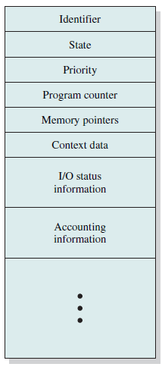

Process Elements
Identifier：A unique identifier associated with this process, to distinguish it from all other processes.
State：If the process is currently executing, it is in the running state.
Priority
Program counter: The address of the next instruction in the program to be executed.
Memory pointers: Include pointers to the program code and data associated with this process, plus any memory blocks shared with other processes.
Context data（进程执行时 处理器中寄存器中的数据）
I/O status information:Includes outstanding I/O requests, I/O devices assigned to this process
Accounting information记账信息include the amount of processor time and clock time used, time limits, account numbers

Slide 6
Agenda
3.1 What is a Process
3.2 Process States
3.3 Process Description
3.4 Process Control
3.5 Execution of the Operating System

Slide 7
3.2 Process States
3.2.1 Trace of the Process
3.2.2 A Two-State Process Model
3.2.3 The Creation and Termination of Processes
3.2.4 A Five-State Model
3.2.5 Suspended Process

Slide 8
Trace of Process 进程轨迹
Sequence of instruction that execute for a process 进程执行的指令序列--进程轨迹
Dispatcher 调度器 switches the processor from one process to another

Slide 9
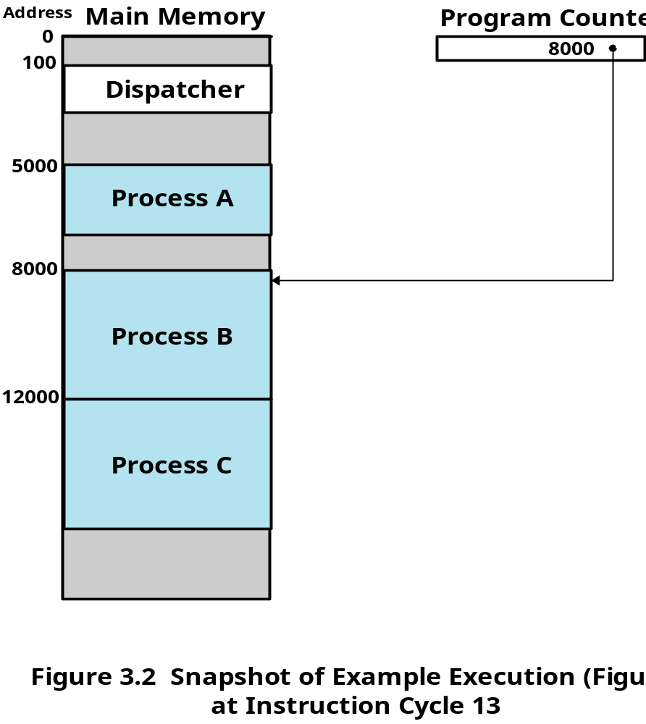
Example Execution

Slide 10
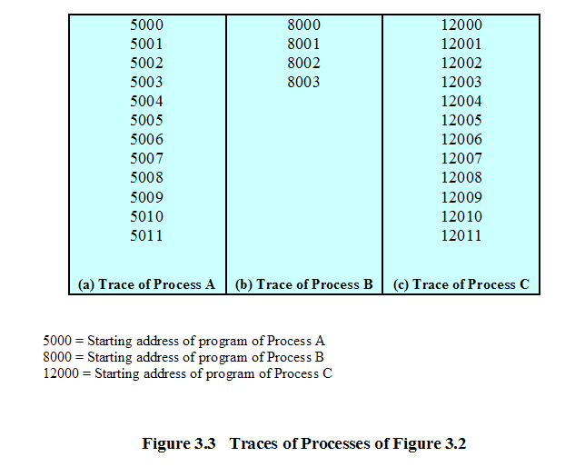
Trace of Processes

Slide 11
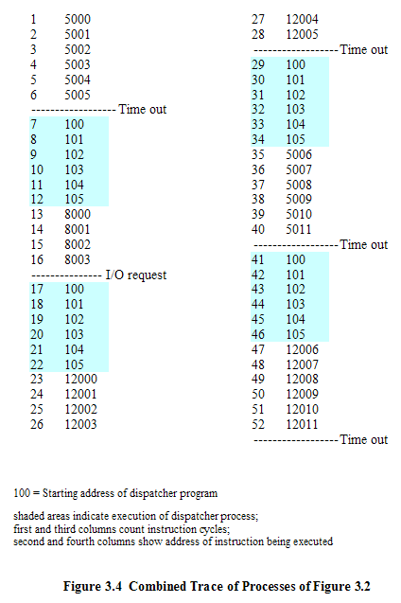
Trace of Processes
备注：
1.阴影部分代表由分配器执行的代码，100是分派器程序的起始地址；
2.假定：每一个进程最多可连续执行6个指令周期，超过被中断；进程B中第4条指令调用了进程必须等待的I/O操作。
（In Pages：110-111）

Slide 12
3.2 Process States
3.2.1 Trace of the Process
3.2.2 A Two-State Process Model
3.2.3 The Creation and Termination of Processes
3.2.4 A Five-State Model
3.2.5 Suspended Process

Slide 13
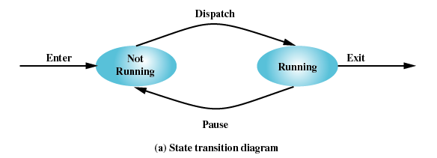
Two-State Process Model
Process may be in one of two states
  Running 运行态
  Not-running非运行态

Slide 14
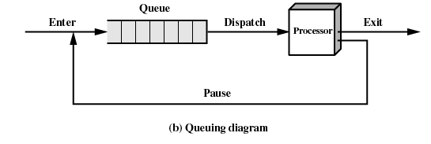
Not-Running Process in a Queue

Slide 15
3.2 Process States
3.2.1 Trace of the Process
3.2.2 A Two-State Process Model
3.2.3 The Creation and Termination of Processes
3.2.4 A Five-State Model
3.2.5 Suspended Process

Slide 16
Process Creation(1/2)
Process Creation进程创建
When a new process is to be added to those currently being managed, the OS builds the data structures(details in 3.3) that are used to manage the process and allocates address space in main memory to the process.

Slide 17
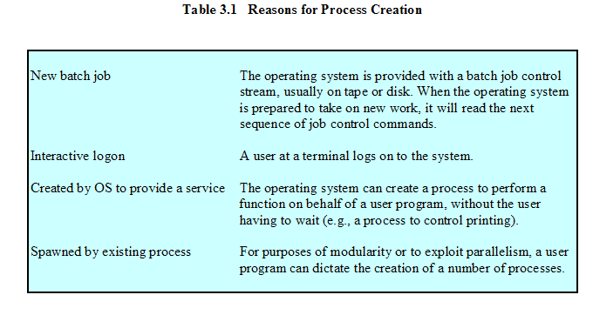
Process Creation(2/2)
交互登录
由现有进程派生

Slide 18
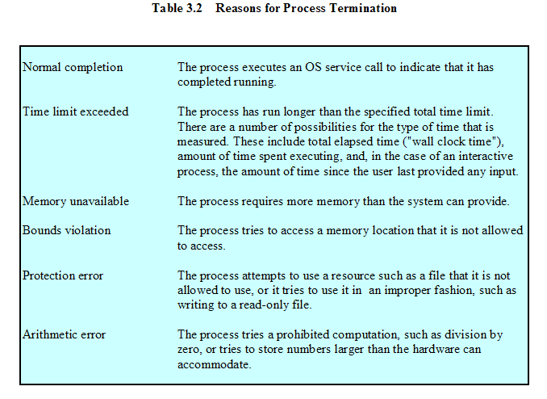
Process Termination（1/2）
超出范围/越界

Slide 19
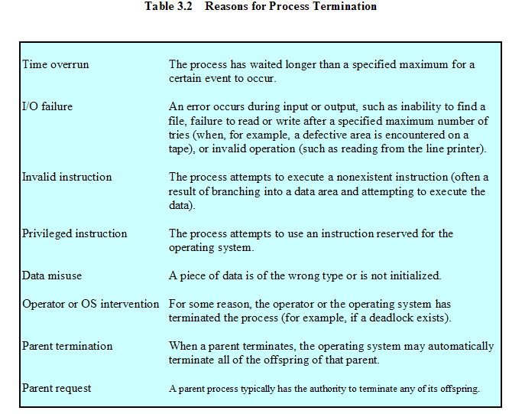
Process Termination （2/2）(cont.)

Slide 20
3.2 Process States
3.2.1 Trace of the Process
3.2.2 A Two-State Process Model
3.2.3 The Creation and Termination of Processes
3.2.4 A Five-State Model
3.2.5 Suspended Process

Slide 21
Limit of Two-State Process Model
Not-running
  ready to execute
  waiting for I/O (blocked)
Dispatcher cannot just select the process that has been in the queue the longest because it may be blocked

Slide 22
A Five-State Model
Running 运行态 The process that is currently being executed. For this chapter, we will assume a computer with a single processor, so at most one process at a time can be in this state.
Ready 就绪态 A process that is prepared to execute when given the opportunity
Blocked/Waiting 阻塞态 A process that cannot execute until some event occurs, such as the completion of an I/O operation
New 新建态 A process that has just been created but has not yet been admitted to the pool of executable processes by the OS. Typically, a new process has not yet been loaded into main memory, although its process control block has been created.
Exit 退出态 A process that has been released from the pool of executable processes by the OS, either because it halted or because it aborted for some reason.

Slide 23
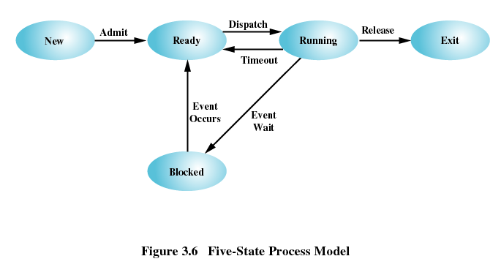
Five-State Process Model

Slide 24
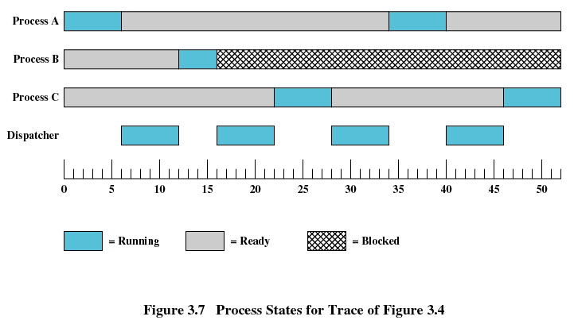

Process States
Figure 3.4

Slide 25
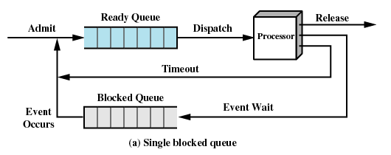
Using Two Queues: 单阻塞队列

Slide 26
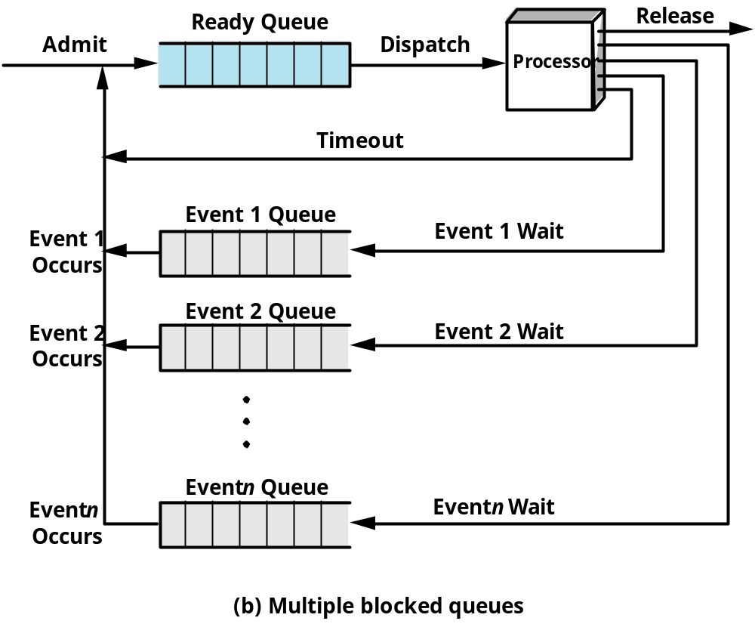
Multiple Blocked Queues多阻塞队列

Slide 27
3.2 Process States
3.2.1 Trace of the Process
3.2.2 A Two-State Process Model
3.2.3 The Creation and Termination of Processes
3.2.4 A Five-State Model
3.2.5 Suspended Process

Slide 28
Suspended Processes 被挂起的进程
Processor is faster than I/O， so all processes could be waiting for I/O
Swap these processes to disk to free up more memory
Blocked state becomes suspend state when swapped to disk
Two new states：
  Blocked/Suspend 阻塞挂起态：进程已在外存并等待一个事件
  Ready/Suspend就绪/挂起态：进程已在外存，只要载入就可运行

Slide 29
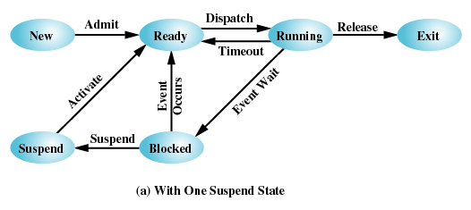
With One Suspend State

Slide 30
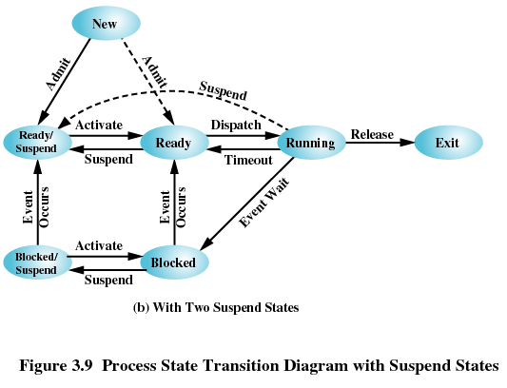
With Two Suspend States

Slide 31
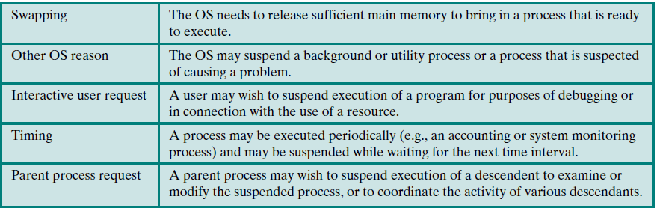
Table 3.3 Reasons for Process Suspension

Slide 32
Agenda
3.1 What is a Process
3.2 Process States
3.3 Process Description
3.4 Process Control
3.5 Execution of the Operating System

Slide 33
3.3 Process Description
3.3.1 Processes and Resources
3.3.2 Operating System Control Structures
3.3.3 Process Control Structures

Slide 34
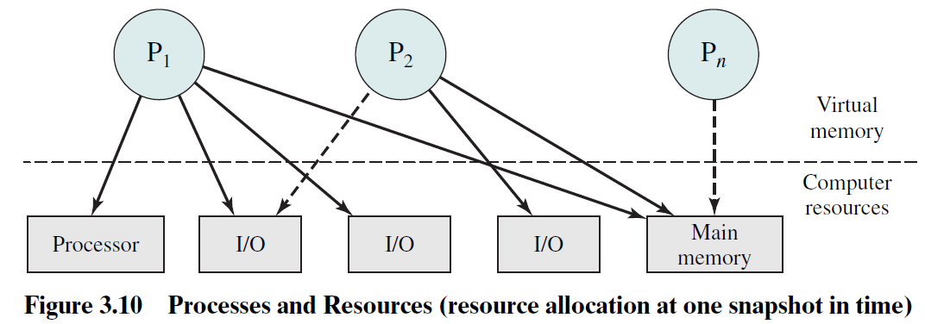
Processes and Resources
Note：
Process P1 is running; at least part of the process is in main memory, and it has control of two I/O devices.
Process P2 is also in main memory but is blocked waiting for an I/O device allocated to P1.
Process Pn has been swapped out and is therefore suspended.

Slide 35
3.3 Process Description
3.3.1 Processes and Resources
3.3.2 Operating System Control Structures
3.3.3 Process Control Structures

Slide 36
Operating System Control Structures
OS need: Information about the current status of each process and resource 每个进程和资源的当前状态
Tables are constructed for each entity the operating system manages 操作系统构造并维护他所管理的所有实体的信息表

Slide 37
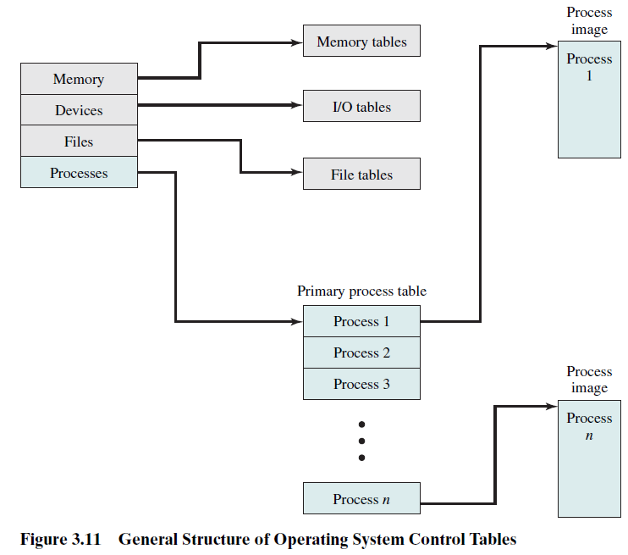
Structure of OS Control Tables

Slide 38
Memory Tables：
Allocation of main memory to processes 分配给进程的主存
Allocation of secondary memory to processes 分配给进程的辅存
Any protection attributes of blocks of main or virtual memory, such as which processes may access certain shared memory regions共享内存区域的保护属性
Information needed to manage virtual memory 虚拟内存的管理信息
(more details in Part 3...)

Slide 39
I/O Tables：
I/O Tables are used by the OS to manage the I/O devices and channels通道 of the computer system.
At any given time, an I/O device may be available or assigned to a particular process. If an I/O operation is in progress, the OS needs to know the status of the I/O operation and the location in main memory being used as the source or destination of the I/O transfer.
(more details in Chapter 11...)

Slide 40
File Tables：
Provide information about the existence of files,
and their location on secondary memory,
and their current status,
and other attributes...
(more details in Chapter 12...)

Slide 41
Process Table：
Every entry每一个表项 is a description of a process image进程映像

Slide 42
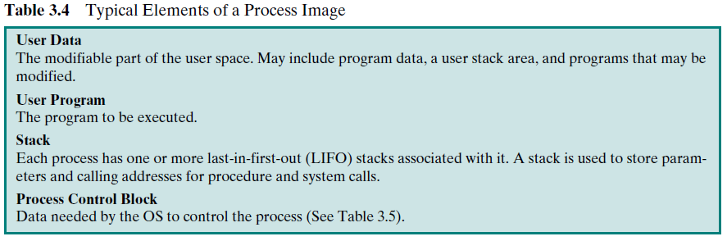
Process Image：
Process Image
  Collection of program, data, stack, attributes

Slide 43
3.3 Process Description
3.3.1 Processes and Resources
3.3.2 Operating System Control Structures
3.3.3 Process Control Structures

Slide 44
Process Control Block （PCB）
The PCB information can be grouped into three general categories:
Process Identification 进程标识信息
Processor State Information 进程状态信息
  User-Visible Registers
  Control and Status Registers
  Stack Pointers 栈指针
Process Control information 进程控制信息
  Scheduling and State Information
  Data Structuring (link information)
  Interprocess Communication进程间通信
  Process Privileges进程特权
  Memory Management
  Resource Ownership and Utilization 资源所有权和使用情况
  (More details in Table 3.5)

Slide 45
Agenda
3.1 What is a Process
3.2 Process States
3.3 Process Description
3.4 Process Control
3.5 Execution of the Operating System

Slide 46
3.4 Process Control
3.4.1 Modes of Execution
3.4.2 Process Creation
3.4.3 Process Switching

Slide 47
Modes of Execution
Two Modes：
（1） User mode
  Less-privileged mode
  User programs typically execute in this mode
（2）System mode, control mode, or kernel mode
  More-privileged mode
  Kernel of the operating system
  the software has complete control of the processor and all its instructions, registers, and memory.
Translation between the two model (please see details in Textbook p134)
  Processor status register (PSR) and current privileged level (CPL)
  User mode->System mode
  System mode->User mode

Slide 48
Modes of Execution
Two Modes：
（1） User mode
  Less-privileged mode
  User programs typically execute in this mode
（2）System mode, control mode, or kernel mode
  More-privileged mode
  Kernel of the operating system
  the software has complete control of the processor and all its instructions, registers, and memory.
Translation between the two model (please see details in Textbook p134)
  Processor status register (PSR) and current privileged level (CPL)
  User mode->System mode
  System mode->User mode
课外思考题：
How？What happen?

Slide 49
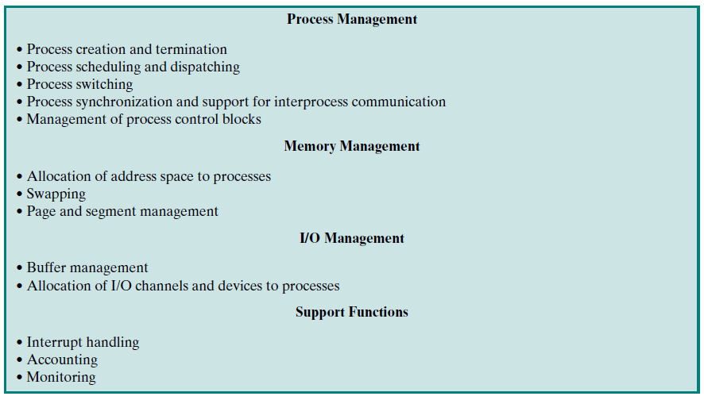
Table 3.7 Typical Functions of an Operating System Kernel

Slide 50
3.4 Process Control
3.4.1 Modes of Execution
3.4.2 Process Creation
3.4.3 Process Switching

Slide 51
Process Creation
Once the OS decides, for whatever reason (Table 3.1), to create a new process, it can proceed as follows:
Assign a unique process identifier to the new process
Allocate space for the process
Initialize process control block
Set up appropriate linkages设置正确的链接
  Ex: add new process to linked list used for scheduling queue
Create of expand other data structures
  Ex: maintain an accounting file 维护记账文件

Slide 52
3.4 Process Control
3.4.1 Modes of Execution
3.4.2 Process Creation
3.4.3 Process Switching 进程切换

Slide 53
When to Switch a Process
A process switch may occur any time that the OS has gained control from the currently running process. The possible events that may give control to the OS include:
Interrupt
  Clock interrupt
    process has executed for the maximum allowable time slice
  I/O interrupt
  Memory fault 内存失效
    Referenced virtual address is not in main memory, so it must be brought in.

Slide 54
When to Switch a Process
Trap 陷阱
  error or exception occurred
  may cause process to be moved to Exit state
Supervisor call (System Call) 系统调用
  such as file open

Slide 55
Process Switching 进程切换步骤
Save context of processor including program counter and other registers
Update the process control block of the process and change the process’s state that is currently in the Running state
Move process control block to appropriate queue – ready; blocked; ready/suspend
Select another process for execution
Update the process control block of the process selected and change it state
Update memory-management data structures
Restore context of the selected process

Slide 56
Agenda
3.1 What is a Process
3.2 Process States
3.3 Process Description
3.4 Process Control
3.5 Execution of the Operating System操作系统的执行

Slide 57
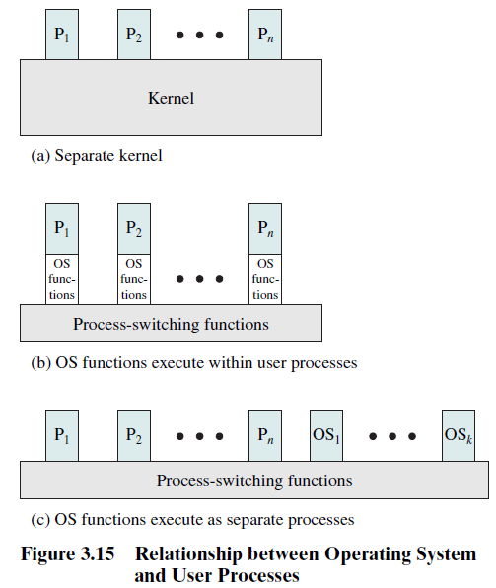
Execution of the Operating System
Figure 3.15 illustrates a range of approaches that are found in various contemporary operating systems.

Slide 58
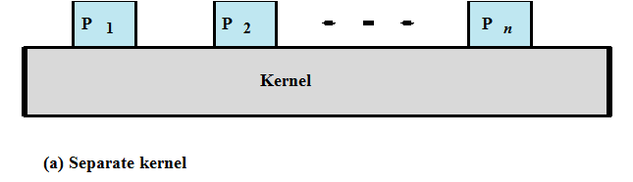
Execution of the Operating System
Non-process Kernel 无进程内核:在进程外部执行OS内核
  Execute kernel outside of any process
  Operating system code is executed as a separate entity that operates in privileged mode

Slide 59
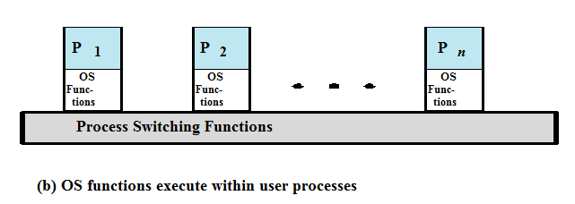
Execution of the Operating System
Execution Within User Processes 在用户进程内执行
  Execute all OS software in the context of a user process
  Process executes in privileged mode when executing operating system code

Slide 60
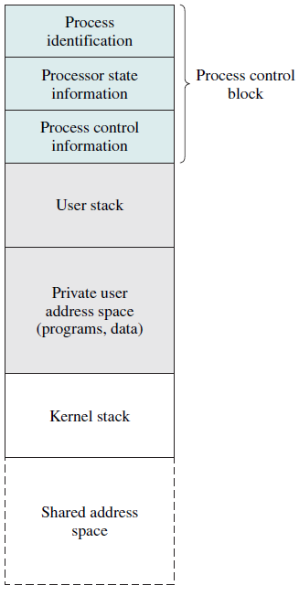

Figure 3.16 suggests a typical process image structure for this strategy.
A separate kernel stack is used to manage calls/returns while the process is in kernel mode.
Operating system code and data are in the shared address space and are shared by all user processes.

Slide 61
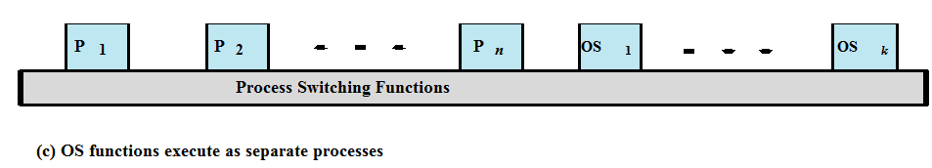
Execution of the Operating System
Process-Based Operating System 基于进程的OS
  Implement operating system as a collection of system processes
  Useful in multi-processor or multi-computer environment

Slide 62
Skip Section 3.6

Slide 63
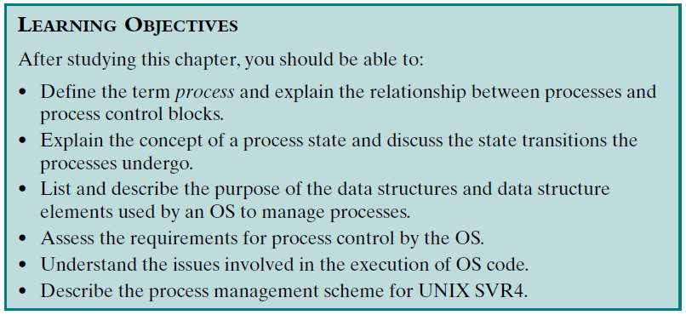
Review：
Assigned Readings: textbooks,p105-151; preview Chapter 4.

