Slide 1

Chapter 4 Threads
陈瑜
yuchen@scu.edu.cn

Slide 2
Agenda
4.1 Processes and Threads
4.2 Types of Threads

Slide 3
4.1 Processes and Threads
4.1.0 Introduction
4.1.1 Multithreading
4.1.2 Thread Functionality

Slide 4
Introduction
The discussion so far has presented the concept of a process as embodying two characteristics:
-Resource ownership 资源所有权
A process includes a virtual address space to hold the process image
-Scheduling/execution 调度/执行
The execution of a process follows an execution trace that may be interleaved交替 with other processes
Above two characteristics are treated independently by the operating system

Slide 5
Introduction
In contemporary OS，to distinguish the two characteristics, the unit of Dispatching/Scheduling is usually referred to as a thread or lightweight process
将调度的单位称为线程或轻量进程
The unit of resource ownership is usually referred to as a process or task
资源所有权的单位称为进程或者任务

Slide 6
4.1 Processes and Threads
4.1.0 Introduction
4.1.1 Multithreading
4.1.2 Thread Functionality

Slide 7
Single-Thread 单线程
Single-threaded approach refers to the traditional approach of a single thread of execution per process, in which the concept of a thread is not recognized
单线程：指一个进程中只有一个线程在执行的传统方法，线程的概念并不明确
e.g.:
  MS-DOS supports a single thread 单进程、单线程
  Some UNIX supports multiple user processes but only supports one thread per process 多进程，每个进程单线程

Slide 8
Multithreading多线程
Multithreading refers to the ability of an OS to support multiple threads of execution within a single process
多线程：指操作系统支持在一个进程中执行多个线程的能力
  Windows, Solaris, Linux, Mach, and OS/2 support multiple threads

Slide 9
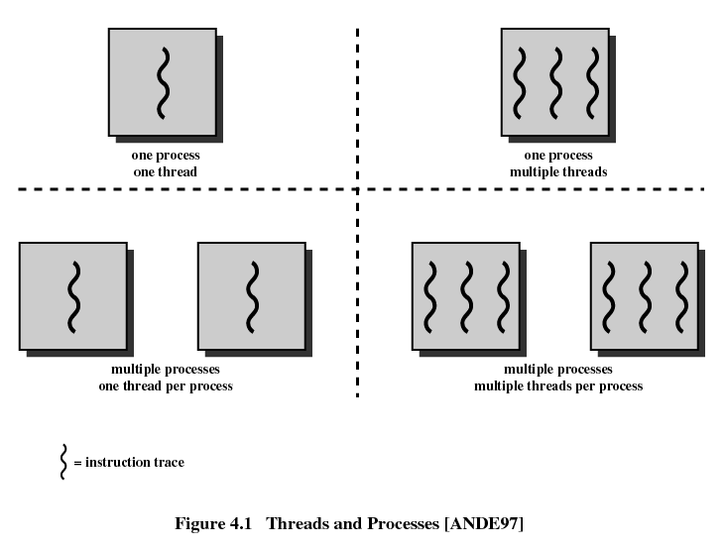
Of interest in this section is the use of multiple processes, each of which supports multiple threads.

Slide 10
DOS
Java
Some Unix
Windows
Of interest in this section is the use of multiple processes, each of which supports multiple threads.

Slide 11
Process--Unit of Resource allocation and Unit of Protection 资源分配单元和保护的单元
Have a virtual address space which holds the process image( code, data, stack and PCB)
有容纳进程镜像的虚拟地址空间
Protected access受保护的访问 to processors, memory, other processes 与其他进程通信 , files, and I/O resources
Contains one or more threads

Slide 12
Thread--Unit of Scheduling/Execution调度执行的单位
Each thread has:
  An execution state (running, ready, etc.)
  A saved thread context when not running; one way to view a thread is as an independent program counter operating within a process
  Has an execution stack有一个执行栈
  Some per-thread static storage for local variables
  Access to the memory and resources of its process,shared with all other threads in that process

Slide 13
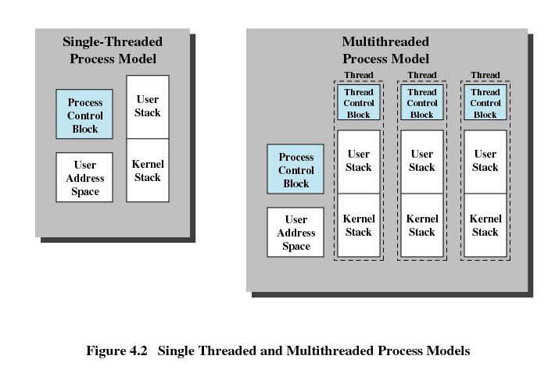
Distinction Between Threads and Processes From the Point of View of Process Management 从进程管理的角度看线程和进程
无明确的线程概念

Slide 14
Distinction Between Threads and Processes From the Point of View of Process Management 从进程管理的角度看线程和进程
Stacks: manage the call/return behavior
of the execution of the process
When the process is running,
it controls the processor registers.
When the process is not running,
the contents of these registers are saved.

Slide 15
Distinction Between Threads and Processes From the Point of View of Process Management 从进程管理的角度看线程和进程
There are separate stacks and control block for each thread;
Control block containing register values, priority,
and other thread-related state information.
All of the threads of a process share the state and resources of that process.
They reside in the same address space and have access to the same data.

Slide 16
Benefits 优点 of Threads
1. It takes far less time to create a new thread in an existing process than to create a brand-new process.创建快
2. It takes less time to terminate a thread than a process 结束快
3. It takes less time to switch between two threads within the same process than to switch between processes切换快
4. Since threads within the same process share memory and files, they can communicate with each other without invoking the kernel 通信快

Slide 17
Threads are Affected by Many Process Action
Suspending a process involves suspending all threads of the process since all threads share the same address space 挂起进程会挂起该进程的所有线程
Termination of a process, terminates all threads within the process 终止进程会终止该进程的所有线程

Slide 18
4.1 Processes and Threads
4.1.0 Introduction
4.1.1 Multithreading
4.1.2 Thread Functionality 线程的功能

Slide 19
Thread States
As with processes, the key states for a thread are：
-Running 运行态
-Ready 就绪态
-Blocked 阻塞态
Generally, it does not make sense to associate suspend states with
threads because such states are process-level concepts.
In particular, if a process is swapped out, all of its threads are necessarily swapped out because they all share the address space of the process.

Slide 20
Thread States
Four basic thread operations associated with a change in thread state：
  Spawn 派生： Typically, when a new process is spawned, a thread for that process is also spawned. Subsequently, a thread within a process may spawn another thread within the same process
  Block 阻塞：When a thread needs to wait for an event, it will block (saving its user registers, program counter, and stack pointers). The processor may now turn to the execution of another ready thread in the same or a different process.
  Unblock 解除阻塞：When the event for which a thread is blocked occurs, the thread is moved to the Ready queue.
  Finish 结束：When a thread completes, its register context and stacks are deallocated 释放

Slide 21
Thread States
Suspending a process involves suspending all threads of the process
Question：Blocking a thread involves blocking the process，right？

Slide 22
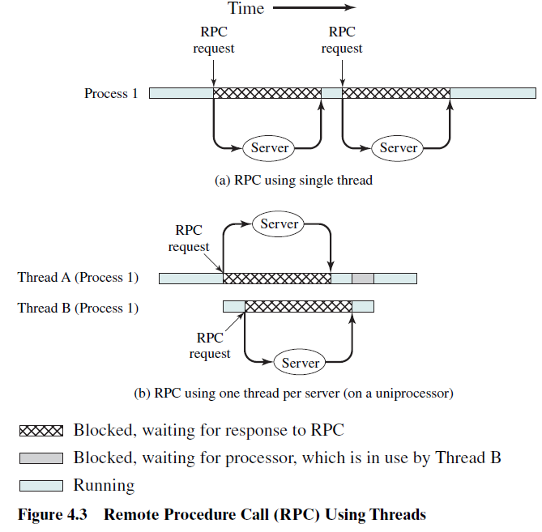
Example：Remote Procedure Call（RPC）Using Single Thread
results in a
substantial
speedup

Slide 23
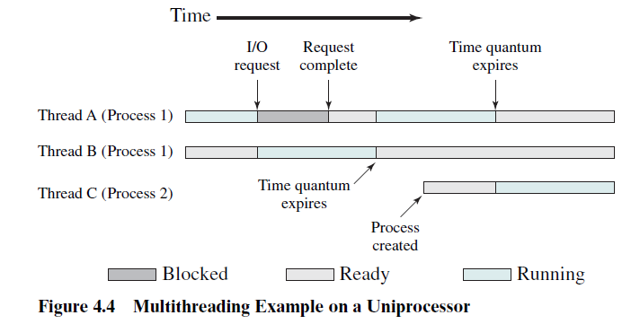
On a uniprocessor, multiprogramming enables the interleaving交替 of multiple threads within multiple processes.
In the example of Figure 4.4, three threads in two processes are interleaved on the processor. Execution passes from one thread to another either when the currently running thread is blocked or when its time slice is exhausted

Slide 24
Agenda
4.1 Processes and Threads
4.2 Types of Threads 线程分类

Slide 25
4.2 Types of Threads
4.2.1 User-Level and Kernel-Level Thread
4.2.2 Other Arrangements

Slide 26
Types of Threads
There are two categories of thread :
-user-level threads (ULTs) 用户级线程
-kernel-level threads (KLTs) 内核级线程
--also name as kernel-supported threads内核支持线程
or lightweight processes 轻量级进程

Slide 27


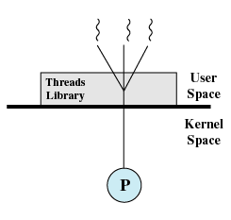
User-Level Threads (ULT，用户级线程)
Multithread implemented by a threads library
All thread management is done by the application
The kernel is not aware of the existence of threads & scheduling is done on a process basis
e.g.: Linux
图4.5(a)纯用户级线程

Slide 28
User-Level Threads (ULT，用户级线程)
Multithread implemented by a threads library
All thread management is done by the application
The kernel is not aware of the existence of threads & scheduling is done on a process basis
e.g.: Linux
The threads library contains code
for creating and destroying threads,
for passing messages and data between threads,
for scheduling thread execution,
for saving and restoring thread contexts.
图4.5(a)纯用户级线程

Slide 29
User-Level Threads (ULT，用户级线程)
Multithread implemented by a threads library
All thread management is done by the application
The kernel is not aware of the existence of threads & scheduling is done on a process basis
e.g.: Linux
图4.5(a)纯用户级线程

Slide 30
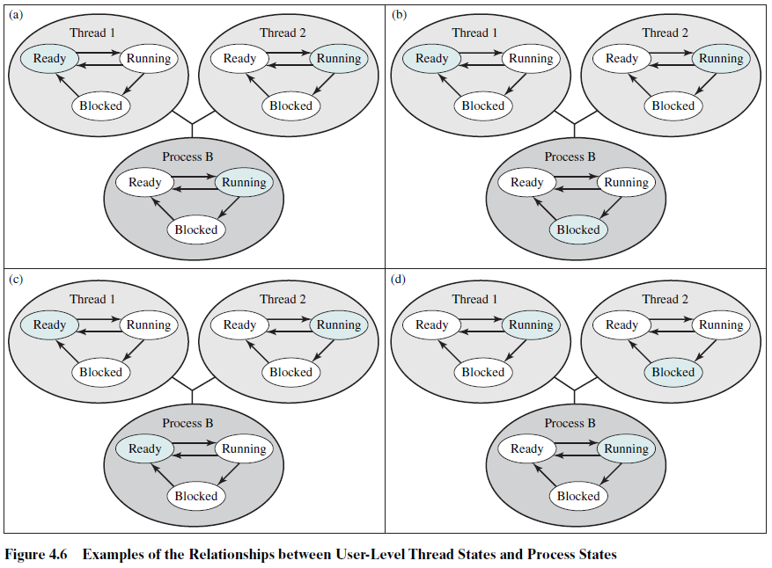
线程2发起一个I/O系统调用
进程B超时
线程2需要线程1的某操作

Slide 31
Kernel-Level Threads( KLT，内核级线程)
In a pure KLT facility 纯内核软件中,
- all of the work of thread management is done by the
kernel
-There is no thread management code in the application
level, simply an application programming interface (API)
to the kernel thread facility只用一个到内核线程设施的API接口
-Windows is an example of this approach.

Slide 32
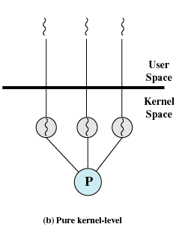
Kernel-Level Threads( KLT，内核级线程)
Kernel maintains context information for the process and the threads
Scheduling is done on a thread basis
e.g.: Windows
图4.5(b)纯内核级线程

Slide 33
Advantages of ULT to KLT
Less overhead of thread switches(mode switches do not required)
Scheduling can be application specific
ULTs can run on any operating system

Slide 34
Disadvantages of ULT to KLT
One thread is blocked, all other threads of the process are blocked
A multithreaded application cannot take advantage of multiprocessing
Ways to tackle these drawbacks:
  Multiple processes
  Jacketing“套管(马甲）”技术
注：jacketing的目标是把一个产生阻塞的系统调用转化成一个非阻塞的系统调用。
例如，不是直接调用一个系统I/O例程，而是让线程调用一个应用级的I/O jacket例程，这个jacket例程中的代码用来检查并确定I/O设备是否忙。如果忙，该线程进入阻塞状态并将控制传送给另一个线程。当这个线程后来又重新获得控制时，jacketing例程会再次检查I/O设备。

Slide 35
Advantages of KLT to ULT
Overcomes the two principal drawbacks of the ULT：
  Multiple threads in one process can simultaneously run on multiple processors
  One threads blocked cannot make the other threads blocked within the same process
  Kernel routines themselves can be multithreaded内核例程自身也可多线程化

Slide 36
Disadvantages of KLT to ULT
  The principal disadvantage is that transfer of control from one thread to another thread within the same process requires a mode switch to the kernel内核状态切换需求

Slide 37
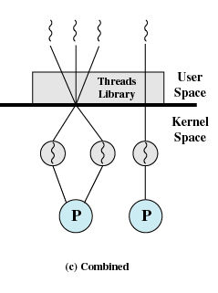
Combined Approaches
Example is in Solaris OS：
Thread creation done in the user space
The multiple ULTs from a single application are mapped onto some (smaller or equal) number of KLTs
Bulk of scheduling and synchronization of threads within application
图4.5(c)混合模式

Slide 38
4.2 Types of Threads
4.2.1 User-Level and Kernel-Level Thread
4.2.2 Other Arrangements 其他方案

Slide 39
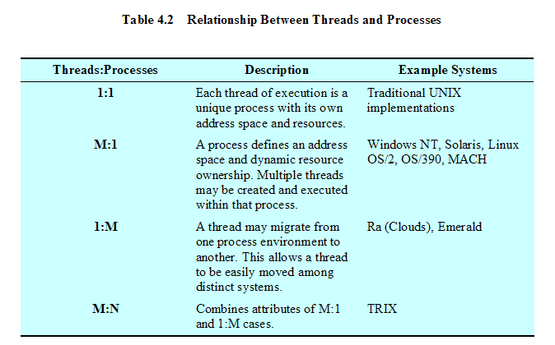
Relationship Between Threads and Processes

Slide 40
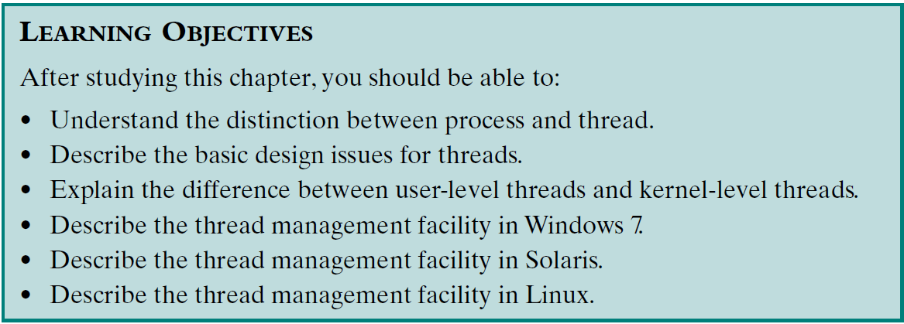
Review：
Assigned Readings: textbooks,p152-198; preview Chapter 5.

