Slide 1

Chapter 5 CONCURRENCY并发：
--Mutual Exclusion 互斥 and Synchronization 同步
陈瑜
yuchen@scu.edu.cn

Slide 2
Agenda
5.1 Principles of Concurrency 并发的原理
5.2 Mutual Exclusion: Hardware Support
5.3 Semaphores
5.4 Monitors
5.5 Message Passing
5.6 Readers/Writers Problem

Slide 3
Concurrency
The central themes of operating system design are all concerned with the management of processes and threads:
- Multiprogramming: The management of multiple processes
within a uniprocessor system 多道程序设计技术
- Multiprocessing: The management of multiple processes within
a multiprocessor 多处理器技术
- Distributed processing: The management of multiple processes
executing on multiple, distributed computer systems 分布式处理
器技术
Fundamental to all of these areas, and fundamental to OS design, is concurrency并发

Slide 4
Concurrency
Concurrency
  并发 VS 并行
  Interleave (one Processor) VS Overlap (more than one processor)
并发
并行

Slide 5
Concurrency
Concurrency arises in three different contexts:
  - Multiple applications 多应用程序
  Multiprogramming was invented to allow processing time to be dynamically shared among a number of active applications
  多道程序技术允许多个活动应用程序间共享处理器时间
  - Structured application 结构化应用程序
    Some application can be designed as a set of concurrent processes应用程序可被设计成一组并发进程
  - Operating-system structure 操作系统结构
    Operating system is a set of processes or threads
    操作系统自身作为一组进程或线程实现

Slide 6
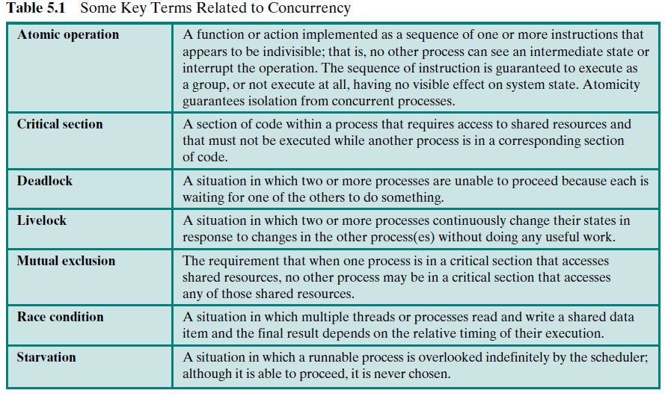
Concurrency
原子操作
临界区
死锁
活锁
互斥
竞争条件
饥饿

Slide 7
Concurrency
原子操作
Atomic operation 原语操作：
A function or action implemented as a sequence of one or more instructions that appears to be indivisible 对外不可见
No other process can see an intermediate state内部状态 or interrupt the operation.
The sequence of instruction is guaranteed to execute as a group, or not execute at all, having no visible effect on system state.
Atomicity guarantees isolation from concurrent processes
原子性保证了并发进程的隔离
临界区
死锁
活锁
互斥
竞争条件
饥饿

Slide 8
Concurrency
原子操作
临界区
Critical section 临界区：
A section of code within a process；In this section, the process prepare to access the shared resources 进入临界区代码段，进程将访问共享资源
it must not be executed while another process is in a corresponding section of code 当有其它进程在此代码段执行时，进程不能在此段执行
死锁
活锁
互斥
竞争条件
饥饿

Slide 9
Concurrency
原子操作
临界区
死锁
Deadlock 死锁：
A situation in which two or more processes are unable to proceed because each is waiting for one of the others to do something
活锁
互斥
竞争条件
饥饿

Slide 10
Concurrency
Livelock 活锁：
A situation in which two or more processes continuously change their states in response to changes in the other process(es) without doing any useful work.
原子操作
临界区
死锁
活锁
互斥
竞争条件
饥饿

Slide 11
Concurrency
Mutual exclusion 互斥：
The requirement that when one process is in a critical section that accesses shared resources, no other process may be in a critical section that accesses any of those shared resources一个进程在临界区访问共享资源时，其它进程不能进入该临界区并访问共享资源
原子操作
临界区
死锁
活锁
互斥
竞争条件
饥饿

Slide 12
Concurrency
Race condition 竞争条件：
A situation in which multiple threads or processes read and write a shared data item and the final result depends on the relative timing（相对时间）of their execution.
原子操作
临界区
死锁
活锁
互斥
竞争条件
饥饿

Slide 13
Concurrency
Starvation 饥饿：
A situation in which a runnable process is overlooked indefinitely by the scheduler; although it is able to proceed, it is never chosen.
一个可运行的进程尽管可继续执行，但被调度程序无限期的忽视而不能被调
度执行的情形
原子操作
临界区
死锁
活锁
互斥
竞争条件
饥饿

Slide 14
5.1 Principles of Concurrency
5.1.1 A Simple Example
5.1.2 Race Condition
5.1.3 Operating System Concerns
5.1.4 Process Interaction
5.1.5 Requirements for Mutual Exclusion

Slide 15
Difficulties of Concurrency
Sharing of global resources is fraught with peril
全局资源共享充满危险
It is difficult for the OS to manage the allocation of resources optimally
资源的最优化分配很难实现
Difficult to locate programming errors
程序错误很难定位

Slide 16
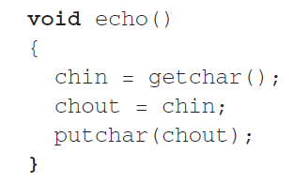
A Simple Example:
Example：

Slide 17
A Simple Example:
Example:
P1
P2
chin
chout
void echo()
{
chin = getchar();
chout = chin;
putchar(chout);
}
void echo()
{
chin = getchar();
chout = chin;
putchar(chout);
}

Slide 18
A Simple Example：(Uniprocessor 单处理器情况下)
Process P1 Process P2
. .
chin = getchar(); .
chout = chin; .
chin = getchar();
chout = chin;
putchar(chout);
putchar(chout); .
  Term： Race
Process P1 Process P2
. .
chin = getchar(); .
chout = chin; .
putchar(chout); .
chin = getchar();
chout = chin;
putchar(chout);

Slide 19
A Simple Example(Multiprocessor多处理器情况下)
Process P1 Process P2
. .
chin = getchar(); .
. chin = getchar();
chout = chin; chout = chin;
putchar(chout); .
. putchar(chout);
. .

Slide 20
A Simple Example(Multiprocessor多处理器情况下)
Process P1 Process P2
. .
chin = getchar(); .
. chin = getchar();
chout = chin; chout = chin;
putchar(chout); .
. putchar(chout);
. .
Why?
How?

Slide 21
A Simple Example(Multiprocessor多处理器情况下)
Process P1 Process P2
. .
chin = getchar(); .
. chin = getchar();
chout = chin; chout = chin;
putchar(chout); .
. putchar(chout);
. .
Why?
-In the case of a uniprocessor system, the reason we have a problem is that an interrupt can stop instruction execution anywhere in a process.
-In the case of a multiprocessor system, we have that same condition and, in addition, a problem can be caused because two processes may be executing simultaneously and both trying to
access the same global variable.

Slide 22
A Simple Example(Multiprocessor多处理器情况下)
Process P1 Process P2
. .
chin = getchar(); .
. chin = getchar();
chout = chin; chout = chin;
putchar(chout); .
. putchar(chout);
. .
How?

Slide 23
5.1 Principles of Concurrency
5.1.1 A Simple Example
5.1.2 Race Condition 竞争条件
5.1.3 Operating System Concerns
5.1.4 Process Interaction
5.1.5 Requirements for Mutual Exclusion

Slide 24
5.1.2 Race Condition 竞争条件
A race condition occurs when multiple processes or threads read and write data items so that the final result depends on the order of execution of instructions in the multiple processes or thread.
竞争条件发生在当多个进程或者线程在读写数据时，其最终结果依赖于多个进程或者线程的指令执行顺序
(Please read Appendix A after class)

Slide 25
5.1 Principles of Concurrency
5.1.1 A Simple Example
5.1.2 Race Condition
5.1.3 Operating System Concerns 操作系统关注的问题
5.1.4 Process Interaction
5.1.5 Requirements for Mutual Exclusion

Slide 26
Operating System Concerns：
What design and management issues are raised by the existence of concurrency? It can list the following concerns:
The OS must be able to keep track of the various processes (through PCB)
The OS must allocate and deallocate various resources for each active process 为每个活动进程分配和释放各种资源
  Processor time
  Memory
  Files
  I/O devices
The OS must protect the data and physical resources of each process against unintended interference by other processes避免其他进程的干扰
Output of process must be independent of the speed of execution of other concurrent processes进程的功能和输出结果必须与执行速度无关

Slide 27
Operating System Concerns：
What design and management issues are raised by the existence of concurrency? It can list the following concerns:
The OS must be able to keep track of the various processes (through PCB)
The OS must allocate and deallocate various resources for each active process 为每个活动进程分配和释放各种资源
  Processor time
  Memory
  Files
  I/O devices
The OS must protect the data and physical resources of each process against unintended interference by other processes避免其他进程的干扰
Output of process must be independent of the speed of execution of other concurrent processes进程的功能和输出结果必须与执行速度无关
How to tackle the issue of speed independence?
We need to look at the ways in which processes can interact进程如何交互

Slide 28
5.1 Principles of Concurrency
5.1.1 A Simple Example
5.1.2 Race Condition
5.1.3 Operating System Concerns
5.1.4 Process Interaction进程的交互
5.1.5 Requirements for Mutual Exclusion

Slide 29
Process Interaction 进程交互
We can classify the ways in which processes interact on the basis of the degree to which they are aware of each other’s existence
There are three possible degrees of awareness plus the consequences of each:
Processes unaware of each other 进程间相互不知道
Processes indirectly aware of each other间接知道
Process directly aware of each other进程间直接知道

Slide 30
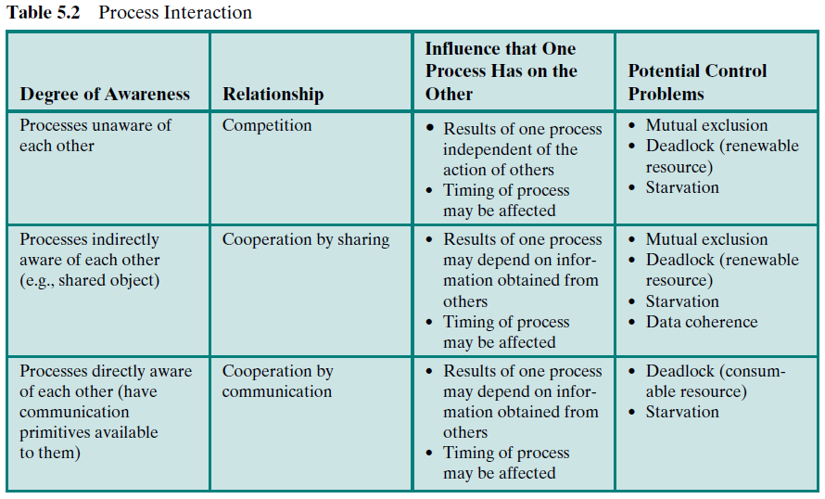

Slide 31
一个进程的结果与另一个进程的活动无关
进程的执行时间可能会受到影响
潜在问题：
互斥、死锁（可复用资源）
、饥饿

Slide 32
共享合作关系
一个进程的结果可能取决于另一个进程的结果
进程的执行时间可能会受到影响
潜在问题：
互斥、死锁（可复用资源）
、饥饿、数据一致性问题
间接知道对方存在（共享对象）

Slide 33
直接知道对方存在
（之间有可用的通信原语）
一个进程的结果可能取决于另一个进程的结果
进程的执行时间可能会受到影响
通过通信合作关系
潜在问题：
死锁（可消耗资源）
、饥饿

Slide 34
Competition Among Processes for Resources 进程间的资源竞争
Concurrent processes come into conflict with each other when they are competing for the use of the same resource.
In the case of competing processes three control problems must be faced：
(1)Mutual Exclusion 互斥
  Critical sections 临界区
    Only one program at a time is allowed in its critical section
    Example： only one process at a time is allowed to send command to the printer
(2)Deadlock 死锁
(3)Starvation 饥饿

Slide 35
Competition Among Processes for Resources 进程间的资源竞争
Concurrent processes come into conflict with each other when they are competing for the use of the same resource.
In the case of competing processes three control problems must be faced：
(1)Mutual Exclusion 互斥
  Critical sections 临界区
    Only one program at a time is allowed in its critical section
    Example： only one process at a time is allowed to send command to the printer
(2)Deadlock 死锁
(3)Starvation 饥饿
For example: consider two processes, P1 and P2, and two resources, R1 and R2. Suppose that each process needs access to both resources to perform part of its function.
Then it is possible to have the following situation:
the OS assigns R1 to P2, and R2 to P1. Each process is waiting for one of the two resources. Neither will release the resource that it already owns until it has acquired the other resource and performed the function requiring both resources.

Slide 36
Competition Among Processes for Resources 进程间的资源竞争
Concurrent processes come into conflict with each other when they are competing for the use of the same resource.
In the case of competing processes three control problems must be faced：
(1)Mutual Exclusion 互斥
  Critical sections 临界区
    Only one program at a time is allowed in its critical section
    Example： only one process at a time is allowed to send command to the printer
(2)Deadlock 死锁
(3)Starvation 饥饿
For example: Suppose: three processes (P1, P2, P3) each require periodic access to resource R. Consider: P1 is in possession of the resource, and both P2 and P3 are delayed, waiting for that resource. When P1 exits its critical section, either P2 or P3 should be allowed access to R. Assume: the OS grants R to P3 and that P1 again requires access before P3 completes its critical section. If the OS grants access to P1 after P3 has finished, and subsequently alternately grants access to P1 and P3, then P2 may indefinitely be denied access to the resource, even though there is no deadlock situation.（P1和P3不停申请， OS把P2“忽略”了）

Slide 37
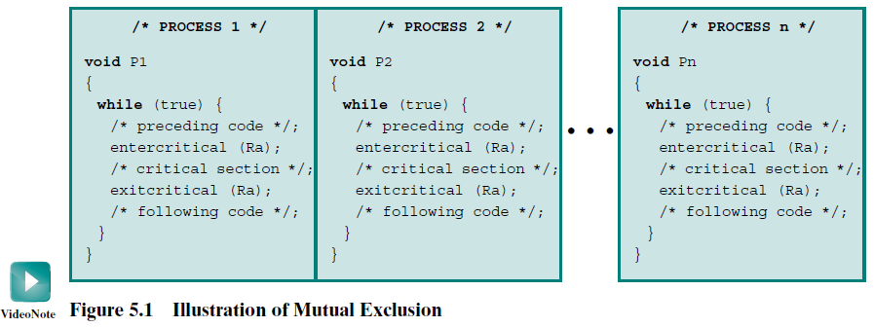
Illustration of Mutual Exclusion by critical section 互斥机制示例
.entercritical：进入临界区 .exitcritical：退出临界区
please see Example in next page

Slide 38
Example of Concurrency
Critical section/临界区
  互斥进入:
P1
P2
chin
chout
void echo()
{
chin = getchar();
chout = chin;
putchar(chout);
}
void echo()
{
chin = getchar();
chout = chin;
putchar(chout);
}

Slide 39
Example of Concurrency
Critical section/临界区
  互斥进入:
P1
P2
chin
chout
EnterCritical( )
EnterCritical( )
void echo()
{
chin = getchar();
chout = chin;
putchar(chout);
}
void echo()
{
chin = getchar();
chout = chin;
putchar(chout);
}
ExitCritical( )
ExitCritical( )

Slide 40
Example of Concurrency
Critical section/临界区
  互斥进入:
    How to use and how to implementation？
    EnterCritical: what happen there? (Especially when can’t enter)
P1
P2
chin
chout
EnterCritical( )
EnterCritical( )
void echo()
{
chin = getchar();
chout = chin;
putchar(chout);
}
void echo()
{
chin = getchar();
chout = chin;
putchar(chout);
}
ExitCritical( )
ExitCritical( )

Slide 41
Example of Concurrency
Critical section/临界区
  互斥进入:
    逻辑上的原子性
  （Details in next class）
  Lock：Busy Waiting
  Semaphores：Block
P1
P2
chin
chout
LOCK( )
LOCK( )
void echo()
{
chin = getchar();
chout = chin;
putchar(chout);
}
void echo()
{
chin = getchar();
chout = chin;
putchar(chout);
}
UNLOCK( )
UNLOCK( )

Slide 42
5.2 Example of Concurrency(16/16)
Critical section/临界区
  互斥进入:
    Q：How to implementation? （next class）
P1
P2
chin
chout
EnterCritical( )
EnterCritical( )
void echo()
{
chin = getchar();
chout = chin;
putchar(chout);
}
void echo()
{
chin = getchar();
chout = chin;
putchar(chout);
}
ExitCritical( )
ExitCritical( )

Slide 43
5.1 Principles of Concurrency
5.1.1 A Simple Example
5.1.2 Race Condition
5.1.3 Operating System Concerns
5.1.4 Process Interaction
5.1.5 Requirements for Mutual Exclusion互斥的要求

Slide 44
Requirements for Mutual Exclusion互斥的要求
To provide support for mutual exclusion互斥 should meet the following requirements:
Only one process at a time is allowed in the critical section for a resource 一次只允许一个进程进入临界区，忙则等待
A process that halts in its noncritical section must do so without interfering with other processes 阻塞于临界区外的进程不能干涉其它进程
No deadlock or starvation不会发生饥饿和死锁，有限等待
A process must not be delayed access to a critical section when there is no other process using it 闲则让进
No assumptions are made about relative process speeds or number of processes对相关进程的执行速度和处理器数目没有要求
A process remains inside its critical section for a finite time only有限占用

Slide 45
Pause
阅读相关章节内容，并预习后边内容。

Slide 46
Agenda
5.1 Principles of Concurrency
5.2 Mutual Exclusion: Hardware Support
5.3 Semaphores
5.4 Monitors
5.5 Message Passing
5.6 Readers/Writers Problem

Slide 47
5.2 Mutual Exclusion: Hardware Support
5.2.1 Interrupt Disabling 中断禁用
5.2.2 Special Machine Instructions 专用机器指令

Slide 48
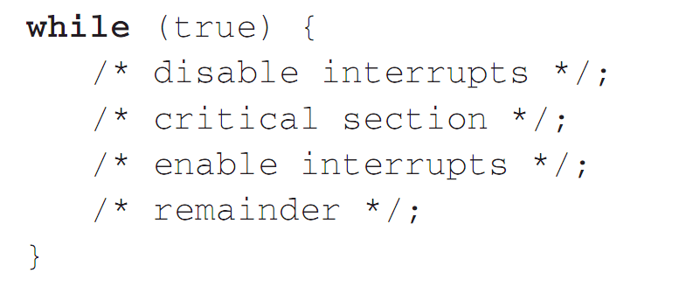
Hardware Support: Interrupt Disabling

Slide 49
Hardware Support: Interrupt Disabling
A process runs until it invokes an operating system service or until it is interrupted
Disabling interrupts guarantees mutual exclusion on uniprocessor system
Disadvantage:
  Processor is limited in its ability to interleave programs
  disabling interrupts on one processor will not guarantee mutual exclusion in multi-processors environment.

Slide 50
5.2 Mutual Exclusion: Hardware Support
5.2.1 Interrupt Disabling
5.2.2 Special Machine Instructions专用机器指令

Slide 51
Hardware Support: Special Machine Instructions
Performed in a single instruction cycle
  Access to the memory location is blocked for any other instructions

Slide 52
Hardware Support: Special Machine Instructions
Test and Set Instruction (text edition 5)
boolean testset (int i) {
if (i == 0) {
i = 1;
return true;
}
else {
return false;
}
}

Slide 53
Hardware Support: Special Machine Instructions
Compare and swap
int compare_and_swap(int *word,
int testval, int newval)
{
int oldval;
oldval = *word;
if ( oldval == testval) *word = newval;
return oldval;
}

Slide 54
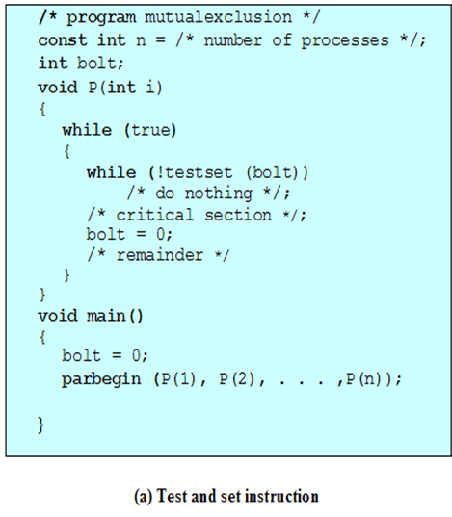
Hardware Support for Mutual Exclusion

Slide 55
Hardware Support: Special Machine Instructions
Exchange Instruction
void exchange(int register, int memory) {
int temp;
temp = memory;
memory = register;
register = temp;
}

Slide 56
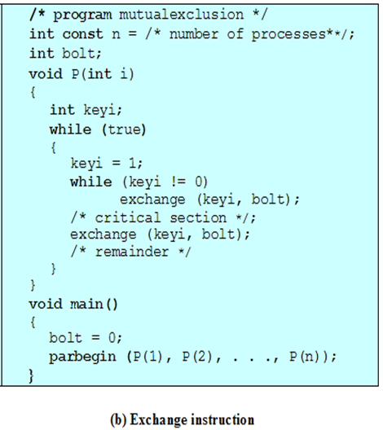
Hardware Support for Mutual Exclusion
注意：第5版教材错误

Slide 57
Hardware Support: Special Machine Instructions
Advantages
  By sharing main memory，it is applicable to any number of processes
    single processor
    multiple processors
  It is simple and therefore easy to verify
  It can be used to support multiple critical sections

Slide 58
Hardware Support: Special Machine Instructions
Disadvantages
  Busy-waiting 忙等待 consumes processor time
  Starvation 饥饿 is possible when a process leaves a critical section and more than one process is waiting.
  Deadlock 死锁 is possible
    If a low priority process has the critical region and a higher priority process needs, the higher priority process will obtain the processor to wait for the critical region

Slide 59
Agenda
5.1 Principles of Concurrency
5.2 Mutual Exclusion: Hardware Support
5.3 Semaphores 信号量
5.4 Monitors
5.5 Message Passing
5.6 Readers/Writers Problem

Slide 60
5.3 Semaphores 信号量
5.3.0 Overview
5.3.1 Mutual Exclusion
5.3.2 The Producer/Consumer Problem
5.3.3 Implement of Semaphores

Slide 61
Semaphores 信号量
Fundamental principle基本原理:
Two or more processes can cooperate by means of simple signals, such that a process can be forced to stop at a specified place until it has received a specific signal
两个或者多个进程可以通过简单的信号进行合作；一个进程可以被迫在一个位置停止，直到它收到一个特定的信号
For signaling, special variables called semaphores are used
一种称为信号量的特殊变量用来传递信号
If a process is waiting for a signal, it is suspended until that signal is sent
如果一个进程在等待一个信号，它会被挂起，直到它等待的信号被发出

Slide 62
Semaphores
Semaphore is a variable that has an integer value 整数值
  Initialize：May be initialized to a nonnegative number 非负数
  semWait (P)：Wait operation decrements the semaphore value，If the value becomes negative, then the process executing the semWait is blocked.
  semSignal (V)：Signal operation increments semaphore value，If the resulting value is less than or equal to zero, then a process blocked by a semWait operation, if any, is unblocked.

Slide 63
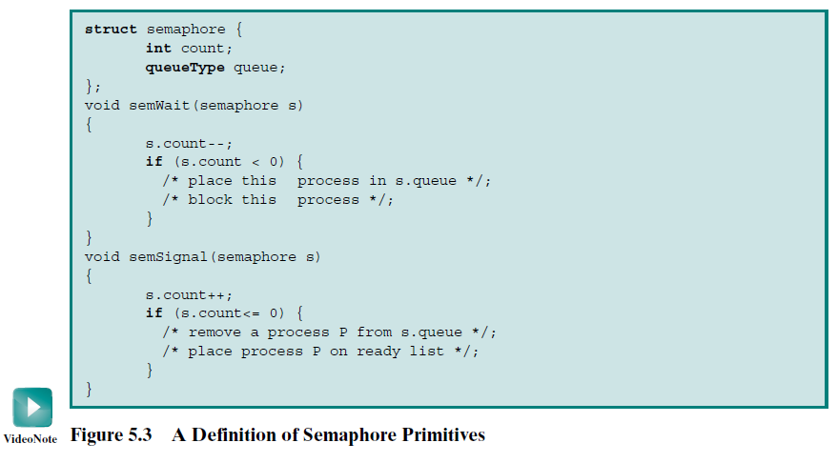
Semaphore Primitives信号量原语的定义

Slide 64
Binary Semaphore 二元信号量
Binary Semaphore is a variable that has an integer value
  May be initialized to 0 or 1.
  semWaitB：checks the semaphore value. If the value is zero, then the process executing the semWaitB is blocked. If the value is one, then the value is changed to zero and the process continues execution.
  semSignalB：checks to see if any processes are blocked on this semaphore. If so, then a process blocked by a semWaitB operation is unblocked. If no processes are blocked, then the value of the semaphore is set to one.

Slide 65
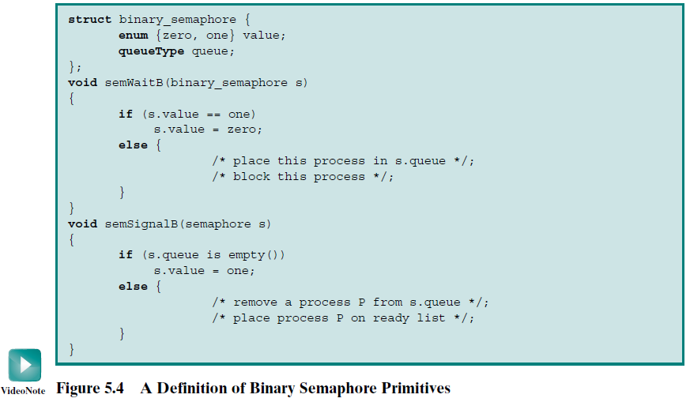
A Definition of Binary Semaphore Primitives 二元信号量原语的定义

Slide 66
Semaphore terms 信号量术语
Binary Semaphore 二元信号量
Mutex 互斥信号量/互斥锁
Counting Semaphore 计数信号量
General Semaphore 一般信号量
Weak Semaphore 弱信号量
Strong Semaphore 强信号量

Slide 67
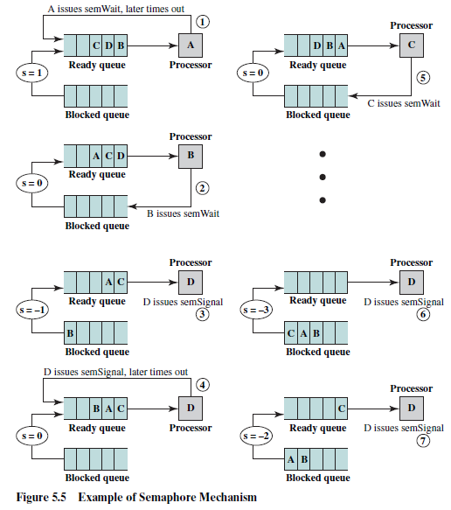
An example of the operation of a strong semaphore 强信号量操作示例

Slide 68
5.3 Semaphores
5.3.0 Overview
5.3.1 Mutual Exclusion 互斥
5.3.2 The Producer/Consumer Problem
5.3.3 Implement of Semaphores

Slide 69
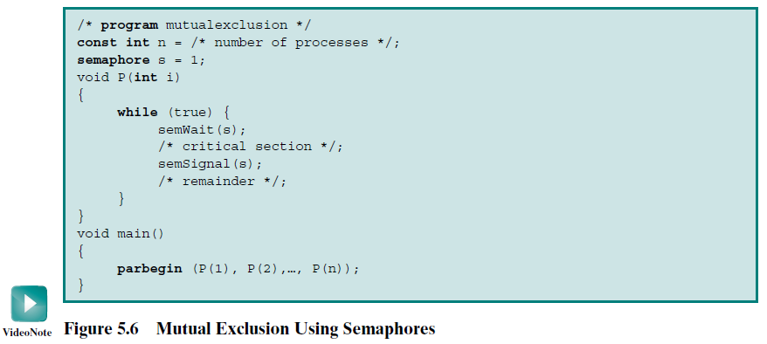
Mutual Exclusion Using Semaphores
用信号量s解决互斥问题的方法示例

Slide 70
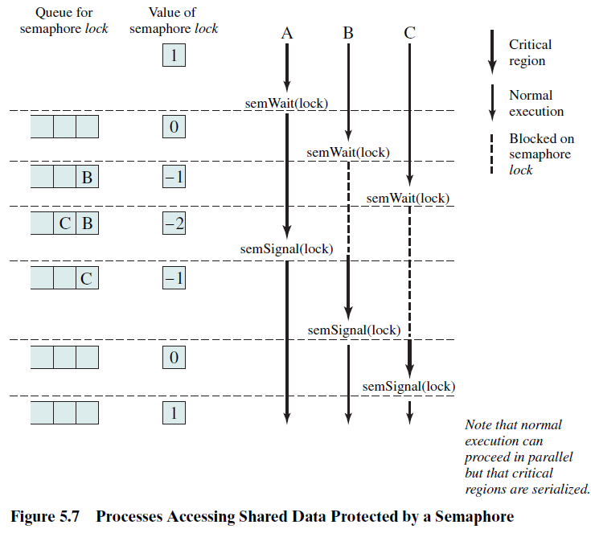
Mutual Exclusion Using Semaphores
用信号量s解决互斥问题的方法示例 (cont.)

Slide 71
More than one process in its critical section at a time 多个进程同时在临界区内的情形
Initialize the semaphore to the specified value
s.count >= 0: s.count is the number of processes that can execute semWait(s) without suspension
s.count < 0: The magnitude of s.count is the number of processes suspended in s.queue.

Slide 72
5.3 Semaphores
5.3.1 Overview
5.3.2 Mutual Exclusion
5.3.3 The Producer/Consumer Problem
5.3.4 Implement of Semaphores

Slide 73
Producer/Consumer Problem 生产者/消费者问题
One or more producers are generating data and placing these in a buffer
A single consumer is taking items out of the buffer one at time
Only one producer or consumer may access the buffer at any one time

Slide 74
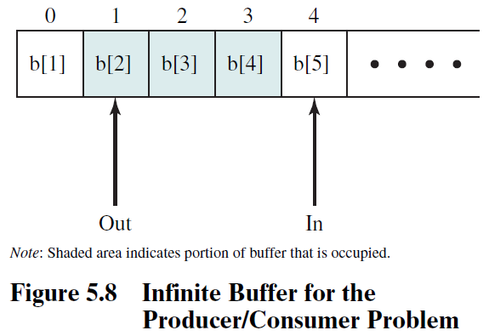
Producer/Consumer Problem with Infinite Buffer 无限缓冲区

Slide 75
Producer with Infinite Buffer
producer:
while (true) {
/* produce item v */
b[in] = v;
in++;
}

Slide 76
Consumer with Infinite Buffer
consumer:
while (true) {
while (in <= out)
/*do nothing */;
w = b[out];
out++;
/* consume item w */
}

Slide 77
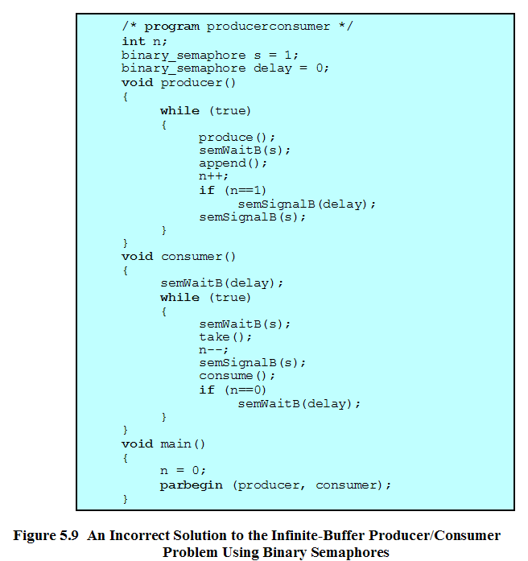
缓冲区中的项数
控制进入临界区
避免“超前”消费

Slide 78
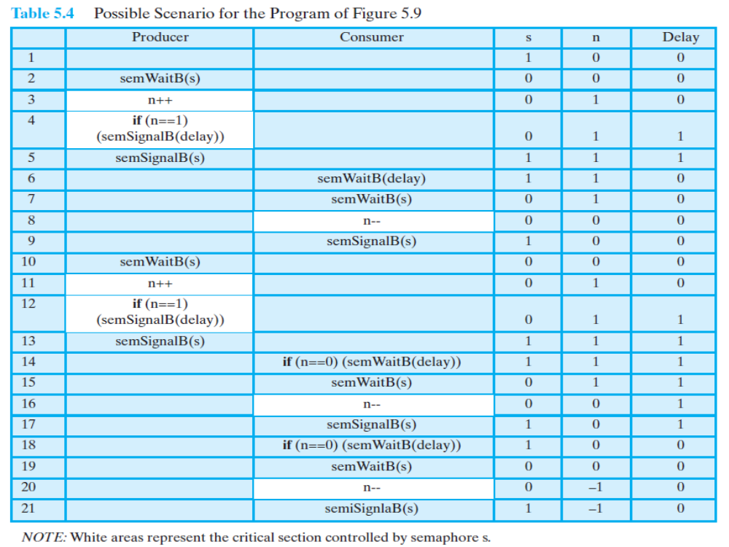

Slide 79
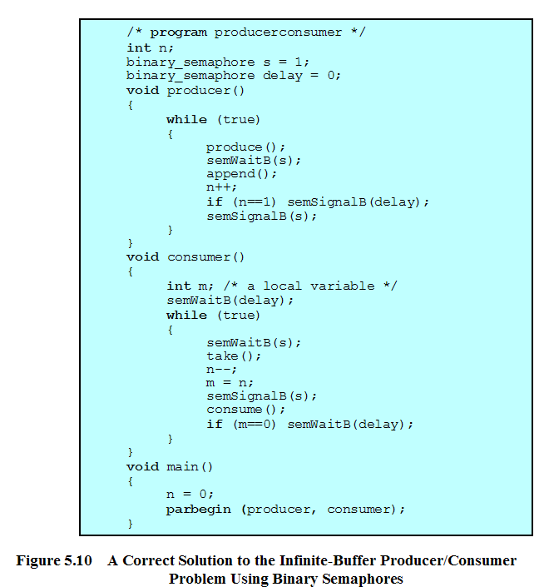

Slide 80
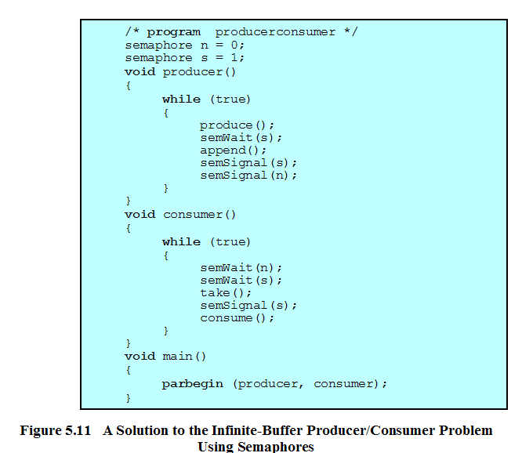
控制“超前消费”
控制进入临界区

Slide 81
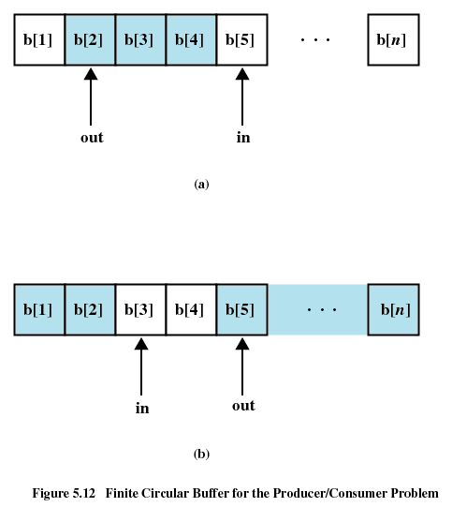
Producer/Consumer Problem with Finite Buffer 有限缓冲区

Slide 82
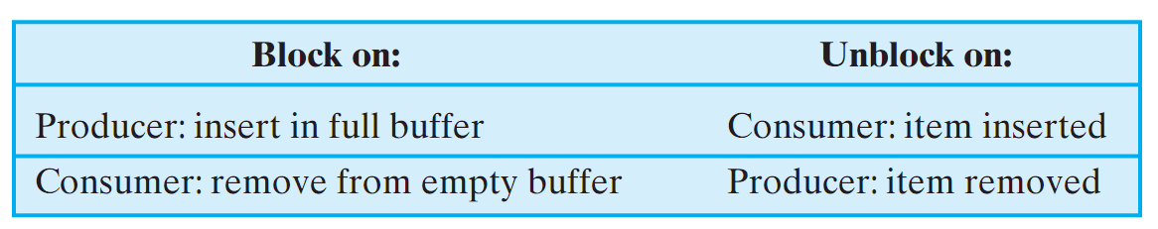
Producer/Consumer Problem with Finite Buffer 有限缓冲区
The buffer is treated as a circular storage, and pointer values must be expressed modulo the size of the buffer.
The following relationships hold:

Slide 83
Producer with Circular Buffer
producer:
while (true) {
/* produce item v */
while ((in + 1) % n == out) /* do nothing */;
b[in] = v;
in = (in + 1) % n
}

Slide 84
Consumer with Circular Buffer
consumer:
while (true) {
while (in == out)
/* do nothing */;
w = b[out];
out = (out + 1) % n;
/* consume item w */
}

Slide 85
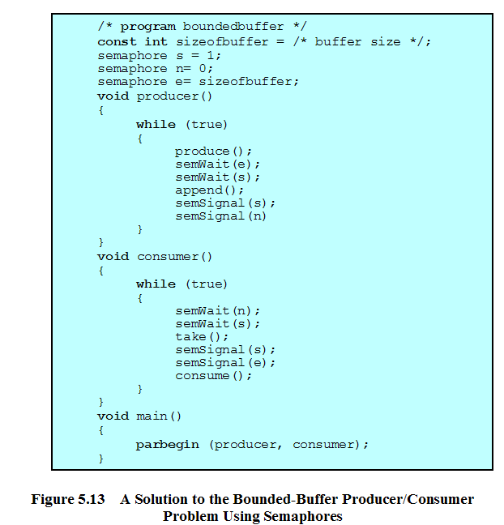
控制进入临界区
控制“超前”消费
控制生产“过剩”

Slide 86
5.3 Semaphores
5.3.1 Overview
5.3.2 Mutual Exclusion
5.3.3 The Producer/Consumer Problem
5.3.4 Implement of Semaphores 信号量的实现

Slide 87
5.3.4 Implement of Semaphores
Implement in hardware or firmware 用硬件或固件实现
Implement in software, e.g. Dekker or Peterson
Implement by inhibit interrupts 中断禁止for a single-processor system

Slide 88
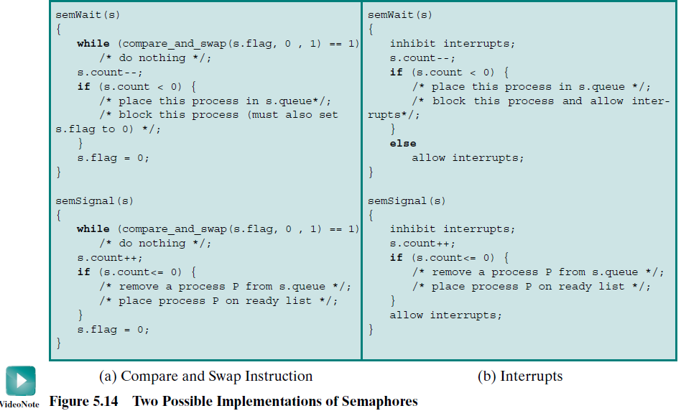
5.3.4 Implement of Semaphores

Slide 89
Agenda
5.1 Principles of Concurrency
5.2 Mutual Exclusion: Hardware Support
5.3 Semaphores
5.4 Monitors 管程
5.5 Message Passing
5.6 Readers/Writers Problem

Slide 90
Monitors 管程
Monitor is a software module consisting of one ore more procedures, an initialization sequence, and local data 管程由一个或者多个例程、一段初始化代码和局部数据组成.
And the chief characteristics are the following:
  Local data variables are accessible only by the monitor
  Process enters monitor by invoking one of its procedures
  Only one process may be executing in the monitor at a time

Slide 91
Monitors Operations管程操作
A monitor supports synchronization by the use of condition variables管程通过条件变量实现同步
cwait(c): Suspend execution of the calling process on condition c. The monitor is now available for use by another process.
csignal(c): Resume execution of some process blocked after a cwait on the same condition. If there are several such processes, choose one of them; if there is no such process, do nothing.
Note that monitor wait and signal operations are different from those for the semaphore. If a process in a monitor signals and no task is waiting on the condition variable, the signal is lost.

Slide 92
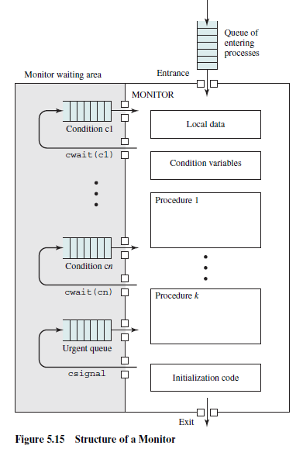

Slide 93
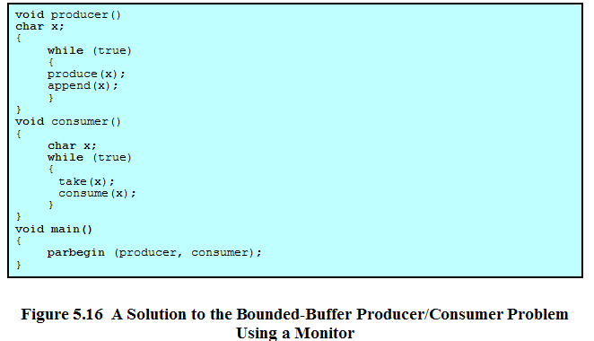
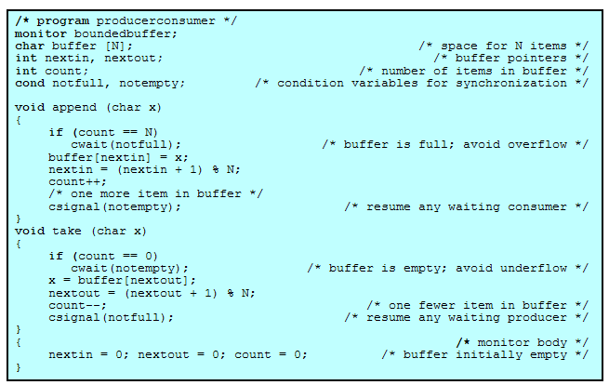
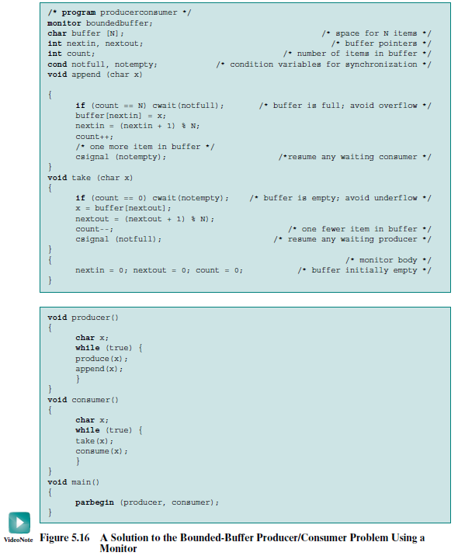

Slide 94
Agenda
5.1 Principles of Concurrency
5.2 Mutual Exclusion: Hardware Support
5.3 Semaphores
5.4 Monitors
5.5 Message Passing 消息传递
5.6 Readers/Writers Problem

Slide 95
Message Passing
Enforce mutual exclusion
Exchange information
The actual function of message passing is normally provided in the form of a pair of primitives:
- send (destination, message)
- receive (source, message)

Slide 96
Synchronization 同步
Sender and Receiver may or may not be blocking
Blocking send, blocking receive
  Both sender and receiver are blocked until message is delivered

Slide 97
Synchronization 同步
Nonblocking send, blocking receive
  Sender continues on
  Receiver is blocked until the requested message arrives
Nonblocking send, nonblocking receive
  Neither party is required to wait

Slide 98
Addressing 寻址
Direct addressing 直接寻址
  Send primitive includes a specific identifier of the destination process
  Receive primitive could know ahead of time which process a message is expected or receive primitive could use source parameter to return a value when the receive operation has been performed

Slide 99
Addressing
Indirect addressing 间接寻址
  Messages are sent to a shared data structure consisting of queues
  Queues are called mailboxes
  One process sends a message to the mailbox and the other process picks up the message from the mailbox

Slide 100
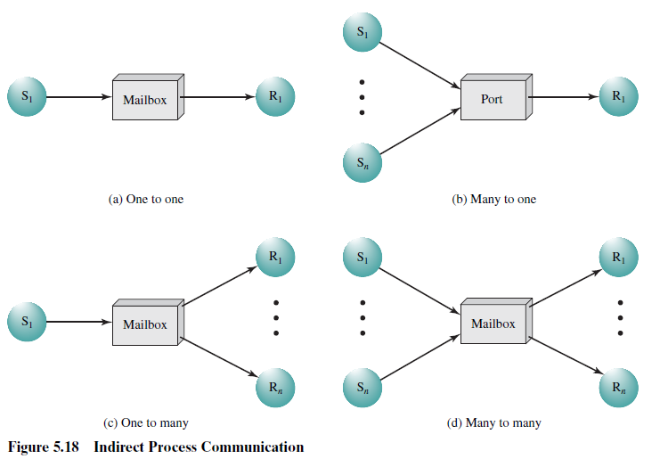
Indirect Process Communication 间接的进程通信

Slide 101
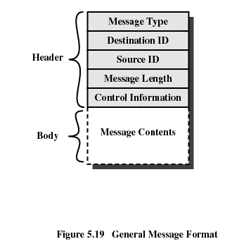
Message Format 消息格式

Slide 102
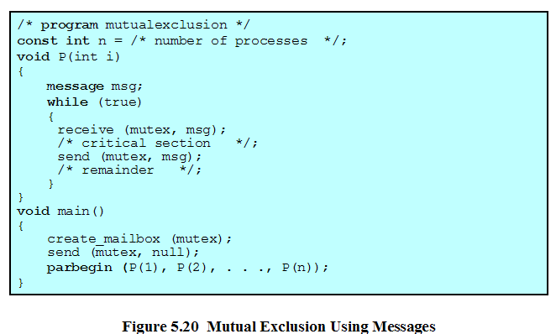

Slide 103
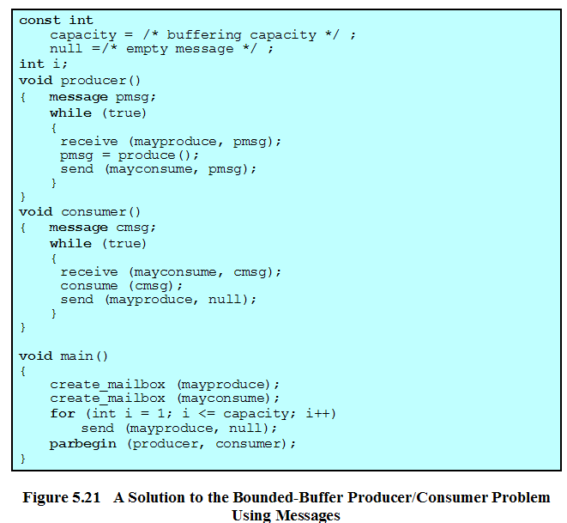

Slide 104
Agenda
5.1 Principles of Concurrency
5.2 Mutual Exclusion: Hardware Support
5.3 Semaphores
5.4 Monitors
5.5 Message Passing
5.6 Readers/Writers Problem
5.7 Summary

Slide 105
Readers/Writers Problem
Any number of readers may simultaneously read the file
Only one writer at a time may write to the file
If a writer is writing to the file, no reader may read it

Slide 106
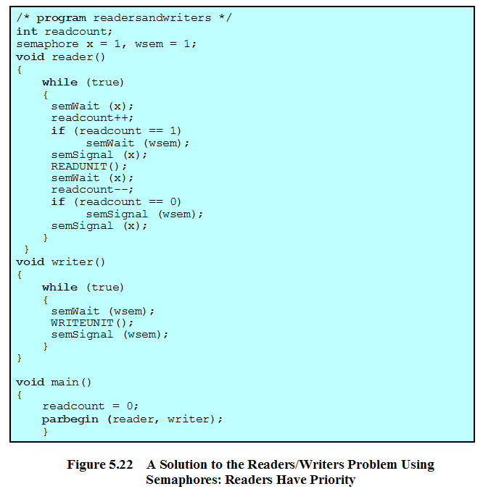
Readers/Writers Problem
正在读的进程数
用于读写/写写互斥保护
用于readcount修改保护

Slide 107
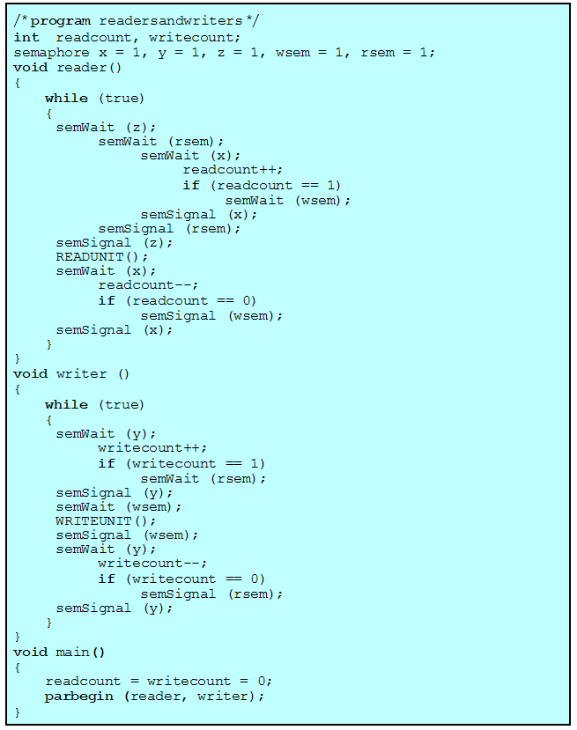

Readers/Writers Problem
readcount:正在读的进程数
rsem：当至少有一个写请求时，对新的读请求进行阻塞
wsem：用于读写互斥保护
writecount:正在和将要进行写的进程数
y：控制writecount的修改
x：控制readcount的修改
z: 只允许一个读进程在rsem上排队，其他读进程在z上排队

Slide 108
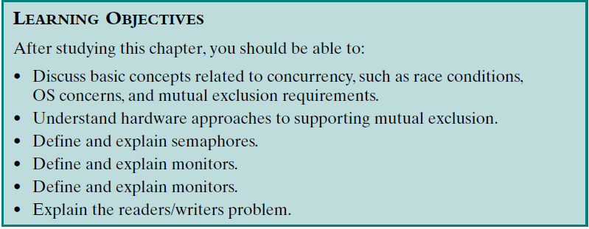
Review：
Assigned Readings: textbooks,p199-258; preview Chapter 6.

