Slide 1

Chapter 6 Concurrency: Deadlock 死锁and Starvation 饥饿
陈瑜
yuchen@scu.edu.cn

Slide 2
6.1 Principles of Deadlock
6.1 Principles of Deadlock
6.2 Deadlock Prevention
6.3 Deadlock Avoidance
6.4 Deadlock Detection
6.5 An Integrated Deadlock Strategy
6.6 Dining Philosophers Problem

Slide 3
Deadlock:
Deadlock: Permanent blocking of a set of processes that either compete for system resources or communicate with each other
No efficient solution in the general case
All deadlock involve conflicting needs for resources by two or more processes 死锁源于两个或者多个进程的资源需求冲突
  A common example is the traffic deadlock交通死锁

Slide 4
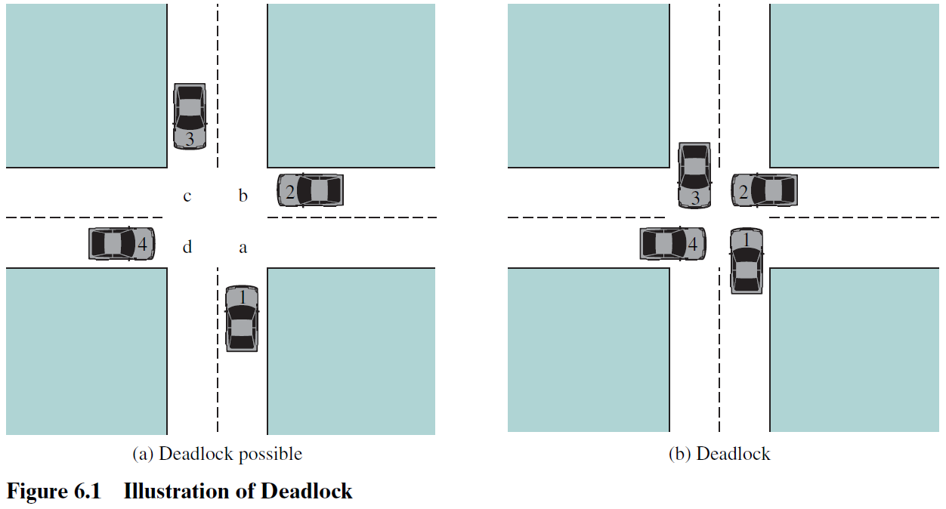

Slide 5
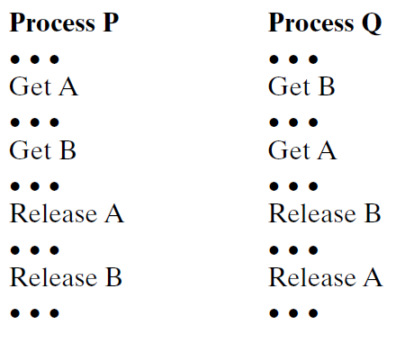
Let us now look at a depiction of deadlock involving processes and computer resources.
Fig.6.2, which we refer to as a joint progress diagram联合进程图, illustrates the progress of two processes competing for two resources.Each process needs exclusive use of both resources for a certain period of time. Two processes, P and Q, have the following general form:

Slide 6
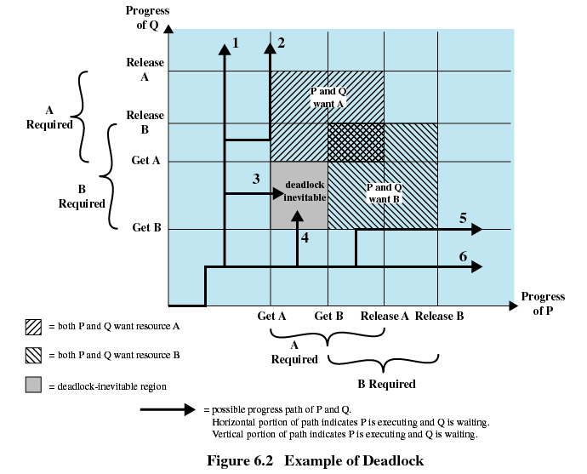

Slide 7
fatal region敏感区域
（死锁无法避免）

Slide 8
How to avoid?

Slide 9
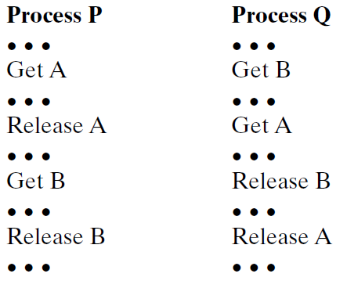
Whether or not deadlock occurs depends on both the dynamics of the execution and on the details of the application.
For example, suppose that P does not need both resources at the same time so that the two processes have the following form:

Slide 10
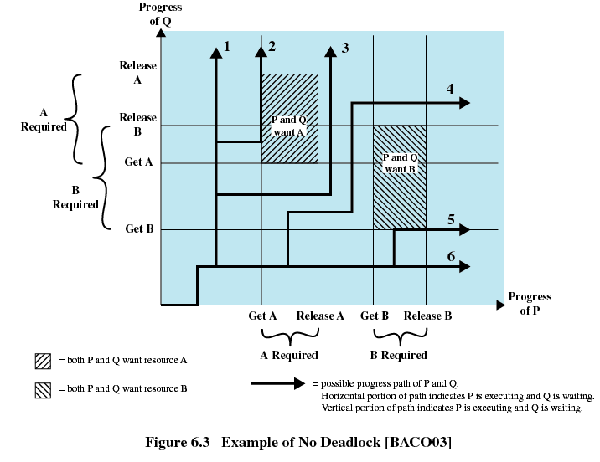

Slide 11
Resources Categories 资源的分类
Reusable Resources 可重用资源
Consumable Resources 可消耗资源

Slide 12
6.1 Principles of Deadlock
6.1.1 Reusable Resources
6.1.2 Consumable Resources
6.1.3 Resource Allocation Graphs
6.1.4 The Conditions for Deadlock

Slide 13
Reusable Resources 可重用资源
Used by only one process at a time and not depleted耗尽by that use
Processes obtain resources that they later release for reuse by other processes
Examples include： processors, I/O channels, main and secondary memory, devices, and data structures such as files, databases

Slide 14
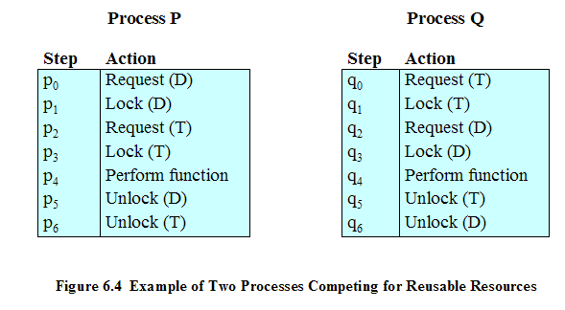
Deadlock Example of Reusable Resources
Consider two processes that compete for exclusive access to a disk file D and a tape drive T. The programs engage in the operations depicted in Figure 6.4 ：Interleaves the execution: p0 p1 q0 q1 p2 q2...

Slide 15
Deadlock Example of Reusable Resources
Consider two processes that compete for exclusive access to a disk file D and a tape drive T. The programs engage in the operations depicted in Figure 6.4 ：Interleaves the execution: p0 p1 q0 q1 p2 q2...
One strategy for dealing with such a deadlock is to impose system design constraints concerning the order in which resources can be requested. How?

Slide 16
Another Deadlock Example of Reusable Resources
Space is available for allocation of 200Kbytes, and the following sequence of events occur
Deadlock occurs if both processes progress to their second request
P1
P2
. . .
. . .
Request 80 Kbytes;
Request 70 Kbytes;
. . .
. . .
Request 60 Kbytes;
Request 80 Kbytes;

Slide 17
Another Deadlock Example of Reusable Resources
Space is available for allocation of 200Kbytes, and the following sequence of events occur
Deadlock occurs if both processes progress to their second request
P1
P2
. . .
. . .
Request 80 Kbytes;
Request 70 Kbytes;
If the amount of memory to be requested is not known ahead of time, it is difficult to deal with this type of deadlock by means of system design constraints.
The best way to deal with this particular problem is, in effect, to eliminate the possibility by using virtual memory, which is discussed in Chapter 8.
. . .
. . .
Request 60 Kbytes;
Request 80 Kbytes;

Slide 18
6.1 Principles of Deadlock
6.1.1 Reusable Resources
6.1.2 Consumable Resources 可消耗资源
6.1.3 Resource Allocation Graphs
6.1.4 The Conditions for Deadlock

Slide 19
Consumable Resources 可消耗资源
May be created (produced) and destroyed (consumed) by processes
Typically, there is no limit on the number of consumable resources of a particular type. An unblocked producing process may create any number of such resources.
When a resource is acquired by a consuming process, the resource ceases to exist.
Examples include interrupts, signals, messages, and information in I/O buffers

Slide 20
Deadlock Example of Consumable Resources
Deadlock occurs if receive is blocking：
（Suppose: blocking receive mode）
P1
P2
. . .
. . .
Receive(P2);
Receive(P1);
. . .
. . .
Send(P2, M1);
Send(P1, M2);

Slide 21
Deadlock Example of Consumable Resources
Deadlock occurs if receive is blocking：
（Suppose: blocking receive mode）
P1
P2
Once again, a design error is the cause of the deadlock. Such errors may be quite subtle and difficult to detect.
Furthermore, it may take a rare 罕见 combination of events to cause the deadlock; thus a program could be in use for a considerable period of time, even years, before the deadlock actually occurs.
. . .
. . .
Receive(P2);
Receive(P1);
. . .
. . .
Send(P2, M1);
Send(P1, M2);

Slide 22
There is no single effective strategy that can deal with all types of deadlock.

Slide 23
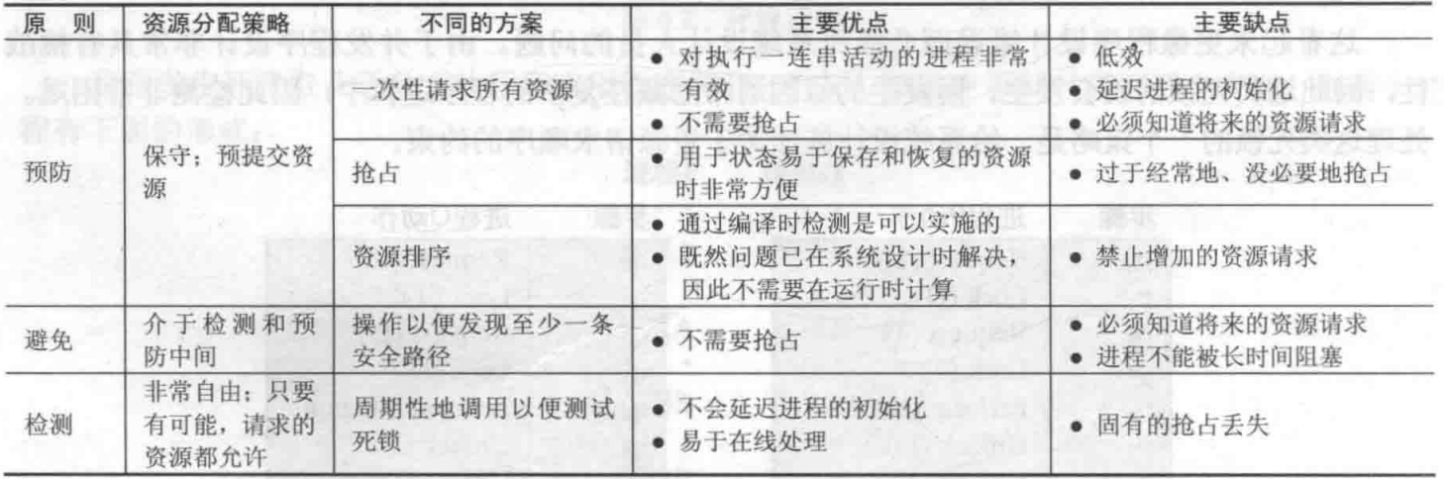
Table 6.1 summarizes the key elements of the most important approaches that have been developed: prevention, avoidance, and detection.

Slide 24
6.1 Principles of Deadlock
6.1.1 Reusable Resources
6.1.2 Consumable Resources
6.1.3 Resource Allocation Graphs
6.1.4 The Conditions for Deadlock

Slide 25
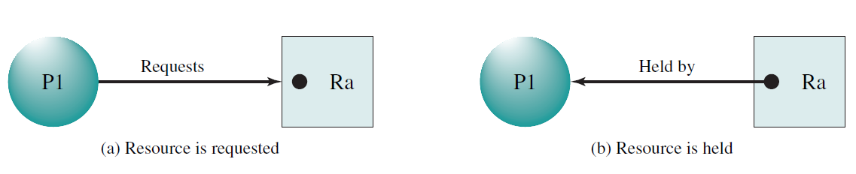
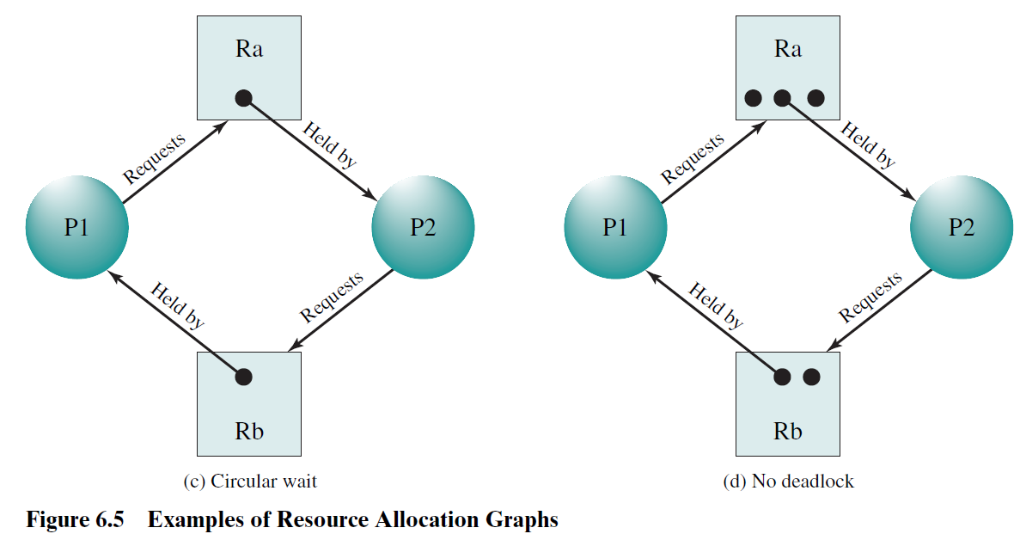
Resource Allocation Graphs资源分配图
A useful tool in characterizing the allocation of resources to processes is the resource allocation graph, introduced by Holt.
Directed graph that depicts a state of the system of resources and processes

Slide 26
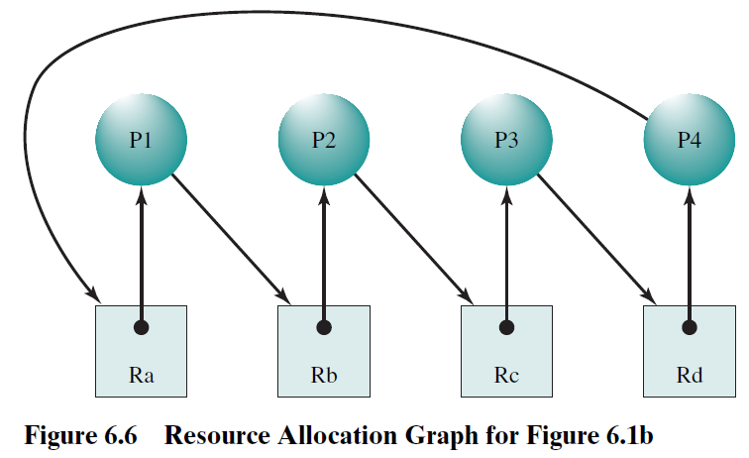
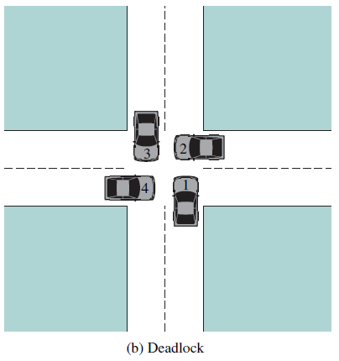
Resource Allocation Graphs资源分配图
The resource allocation graph of Figure 6.6 corresponds to the deadlock situation in Figure 6.1b.
Fig.6.1b

Slide 27
6.1 Principles of Deadlock
6.1.1 Reusable Resources
6.1.2 Consumable Resources
6.1.3 Resource Allocation Graphs
6.1.4 The Conditions for Deadlock

Slide 28
Conditions for Deadlock：
Mutual exclusion 互斥
  A resource may used only by one process at a time
Hold-and-wait 占有且等待
  A process may hold allocated resources while awaiting assignment 分配 of other resources.
No preemption 不可抢占
  No resource can be forcibly 强制 removed form a process holding it
以上只是三个必要条件但非充分条件，还有另一个条件(next page)

Slide 29
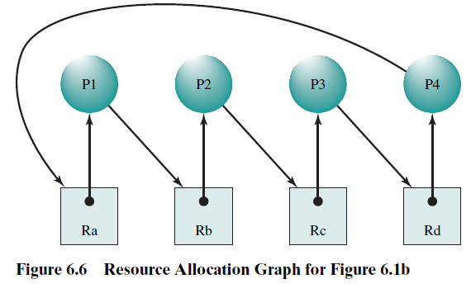
Conditions for Deadlock：
Circular wait循环等待
  A closed chain of processes exists, such that each process holds at least one resource needed by the next process in the chain
Fig.6.1b
以上四个条件一起构成了死锁的充分必要条件！

Slide 30
Possibility of Deadlock： 死锁的可能性
(1) Mutual Exclusion 互斥
(2) Hold and wait 占有且等待
(3) No preemption 不可抢占
Existence of Deadlock: 死锁的存在性
(1) Mutual Exclusion
(2) Hold and wait
(3) No preemption
(4) Circular wait 循环等待

Slide 31
Three general approaches exist for dealing with deadlock：
First, one can prevent预防 deadlock by adopting a policy that eliminates消除 one of the conditions (conditions 1- 4).
Second, one can avoid deadlock by making the appropriate dynamic choices based on the current state of resource allocation.
Third, one can attempt to detect the presence of deadlock (conditions 1 - 4 hold) and take action to recover.

Slide 32
Agenda
6.1 Principles of Deadlock
6.2 Deadlock Prevention 死锁预防
6.3 Deadlock Avoidance
6.4 Deadlock Detection
6.5 An Integrated Deadlock Strategy
6.6 Dining Philosophers Problem

Slide 33
Deadlock Prevention 死锁预防
The strategy of deadlock prevention is to design a system in such a way that the possibility of deadlock is excluded排除.
We can view deadlock prevention methods as falling into two classes：
An indirect method of deadlock prevention is to prevent the occurrence of one of the three necessary conditions listed previously (items 1 - 3).
A direct method of deadlock prevention is to prevent the occurrence of a circular wait (item 4).

Slide 34
Deadlock Prevention 死锁预防
Mutual Exclusion 互斥
  Must be supported by the operating system
  Some resources, such as files, may allow multiple accesses for reads but only exclusive access for writes. Even in this case, deadlock can occur if more than one process requires write permission.
Hold and Wait 占有且等待
  Require a process request all of its required resources at one time
  No Preemption 不可抢占
  Process must release resource and request again
  Operating system may preempt a process to require it releases its resources
  Circular Wait 循环等待
  Define a linear ordering of resource types

Slide 35
Deadlock Prevention 死锁预防
Mutual Exclusion 互斥
Hold and Wait 占有且等待
  Require a process request all of its required resources at one time
  No Preemption 不可抢占
  Process must release resource and request again
  Operating system may preempt a process to require it releases its resources
  Circular Wait 循环等待
  Define a linear ordering of resource types
The hold-and-wait condition can be prevented by requiring that a process request all of its required resources at one time and blocking the process until all requests can be granted simultaneously.

Slide 36
Deadlock Prevention 死锁预防
Mutual Exclusion 互斥
Hold and Wait 占有且等待
  Require a process request all of its required resources at one time
  No Preemption 不可抢占
  Process must release resource and request again
  Operating system may preempt a process to require it releases its resources
  Circular Wait 循环等待
  Define a linear ordering of resource types
This approach is inefficient in two ways:
First, a process may be held up for a long time waiting for all of its resource requests to be filled, when in fact it could have proceeded with only some of the resources.
Second, resources allocated to a process may remain unused for a considerable period, during which time they are denied to other processes. Another problem is that a process may not know in advance all of the resources that it will require.

Slide 37
Deadlock Prevention 死锁预防
Mutual Exclusion 互斥
Hold and Wait 占有且等待
  Require a process request all of its required resources at one time
  No Preemption 不可抢占
  Process must release resource and request again
  Operating system may preempt a process to require it releases its resources
  Circular Wait 循环等待
  Define a linear ordering of resource types
There is also the practical problem created by the use of modular programming or a multithreaded structure for an application. An application would need to be aware of all resources that will be requested at all levels or in all modules to make the simultaneous request.

Slide 38
Deadlock Prevention 死锁预防
Mutual Exclusion 互斥
Hold and Wait 占有且等待
  No Preemption 不可抢占
  Process must release resource and request again
  Operating system may preempt抢占 a process to require it releases its resources
  This approach is practical only when applied to resources whose state can be easily saved and restored later, as is the case with a processor.
  Circular Wait 循环等待

Slide 39
Deadlock Prevention 死锁预防
Mutual Exclusion 互斥
Hold and Wait 占有且等待
  No Preemption 不可抢占
  Circular Wait 循环等待
  The circular-wait condition can be prevented by defining a linear ordering of resource types. If a process has been allocated resources of type R, then it may subsequently request only those resources of types following R in the ordering.
  As with hold-and-wait prevention, circular-wait prevention may be inefficient, slowing down processes and denying resource access unnecessarily.

Slide 40
Agenda
6.1 Principles of Deadlock
6.2 Deadlock Prevention
6.3 Deadlock Avoidance 死锁避免
6.4 Deadlock Detection
6.5 An Integrated Deadlock Strategy
6.6 Dining Philosophers Problem

Slide 41
Deadlock Avoidance 死锁避免
An approach to solving the deadlock problem that differs subtly差异很小 from deadlock prevention is deadlock avoidance.
In deadlock prevention, we constrain resource requests to prevent at least one of the four conditions of deadlock. This is either done indirectly, by preventing one of the three necessary conditions (mutual exclusion, hold and wait, no preemption), or directly, by preventing circular wait. This leads to inefficient use of resources and inefficient execution of processes.
Deadlock avoidance, allows the three necessary conditions but makes judicious明智 choices to assure that the deadlock point is never reached.

Slide 42
Deadlock Avoidance 死锁避免
An approach to solving the deadlock problem that differs subtly差异很小 from deadlock prevention is deadlock avoidance.
In deadlock prevention, we constrain resource requests to prevent at least one of the four conditions of deadlock. This is either done indirectly, by preventing one of the three necessary conditions (mutual exclusion, hold and wait, no preemption), or directly, by preventing circular wait. This leads to inefficient use of resources and inefficient execution of processes.
Deadlock avoidance, allows the three necessary conditions but makes judicious明智 choices to assure that the deadlock point is never reached.
Deadlock avoidance allows more concurrency than deadlock prevention.
Deadlock avoidance requires knowledge of future process resource requests.

Slide 43
Two Approaches to Deadlock Avoidance:
Process Initiation Denial 进程启动拒绝
  Do not start a process if its demands might lead to deadlock
Resource Allocation Denial资源分配拒绝
  Do not grant an incremental resource request to a process if this allocation might lead to deadlock
  如果一个进程增加资源的请求会导致死锁，则不允许此分配

Slide 44
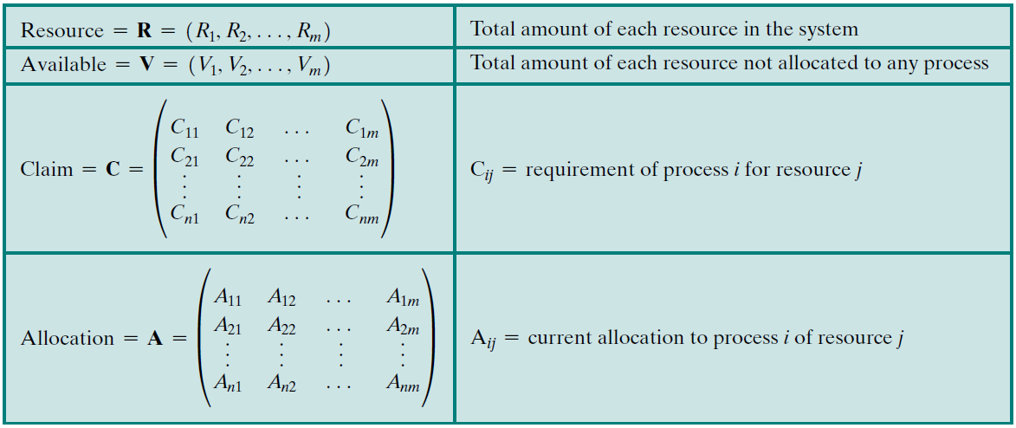
Process Initiation Denial 进程启动拒绝:
Consider a system of n processes and m different types of resources. Let us define the following vectors and matrices:

Slide 45
Process Initiation Denial 进程启动拒绝:
The matrix Claim gives the maximum requirement of each process for each resource,
with one row dedicated to each process.
This information must be declared in advance by a process for deadlock avoidance
to work.
Consider a system of n processes and m different types of resources. Let us define the following vectors and matrices:

Slide 46
Process Initiation Denial 进程启动拒绝:
The matrix Allocation gives the current allocation to each process.
Consider a system of n processes and m different types of resources. Let us define the following vectors and matrices:

Slide 47
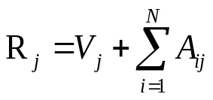
Process Initiation Denial 进程启动拒绝:
Consider a system of n processes and m different types of resources. Let us define the following vectors and matrices:
The following relationships hold:
（1） for all j ：
All resources are either available or allocated. 所有资源要么可用要么已被分配

Slide 48
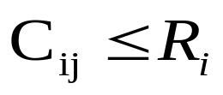
Process Initiation Denial 进程启动拒绝:
Consider a system of n processes and m different types of resources. Let us define the following vectors and matrices:
The following relationships hold:
（2） for all i and j ：
No process can claim more than the total amount of resources in the system. 任何进程不可超量申请资源

Slide 49
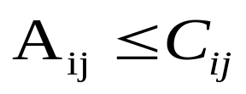
Process Initiation Denial 进程启动拒绝:
Consider a system of n processes and m different types of resources. Let us define the following vectors and matrices:
The following relationships hold:
（3） for all i and j ：
No process is allocated more resources of any type than the process originally claimed to need. 分配给任何进程的任何资源均不可超过其当初声明的此资源的最大请求量

Slide 50

Process Initiation Denial 进程启动拒绝:
Consider a system of n processes and m different types of resources. Let us define the following vectors and matrices:
With these quantities defined, we can define a deadlock avoidance policy that refuses to start a new process if its resource requirements might lead to deadlock.
Start a new process P_{n+1} only if ：
即：只有满足所有当前进程的最大请求量及新的进程的请求时才会启动该进程

Slide 51
Process Initiation Denial 进程启动拒绝:
Consider a system of n processes and m different types of resources. Let us define the following vectors and matrices:
However，
This strategy is hardly optimal并非最优, because it assumes the worst: that all processes will make their maximum claims together.

Slide 52
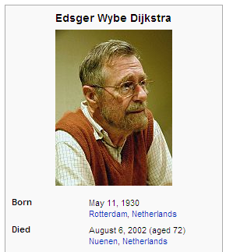
Resource Allocation Denial资源分配拒绝
一些概念：
Referred to as the banker’s algorithm
-by Dijkstra
Consider a system with a fixed number of processes and a fixed number of resources. At any time a process may have zero or more resources allocated to it:
State of the system系统状态: is the current allocation of resources to process
Safe state安全状态: is where there is at least one sequence that does not result in deadlock
Unsafe state不安全状态: is a state that is not safe

Slide 53
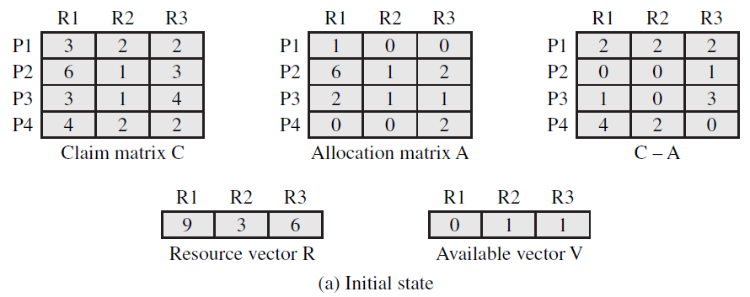
Fig.6.7 Determination of a Safe State安全状态的确定
(a)Initial State：

Slide 54
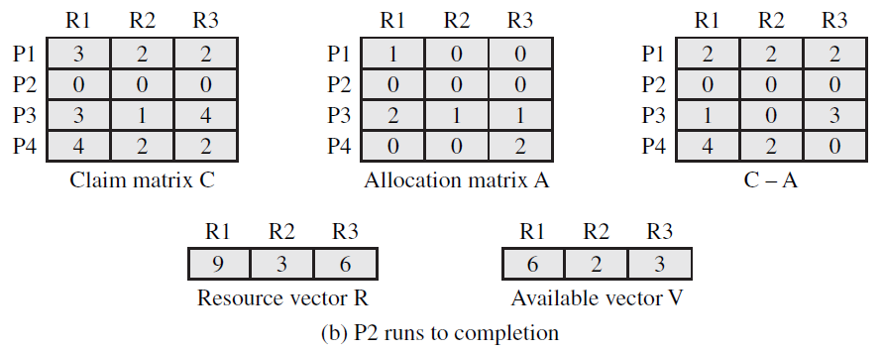
Fig.6.7 Determination of a Safe State
(b)P2 Runs to Completion：

Slide 55
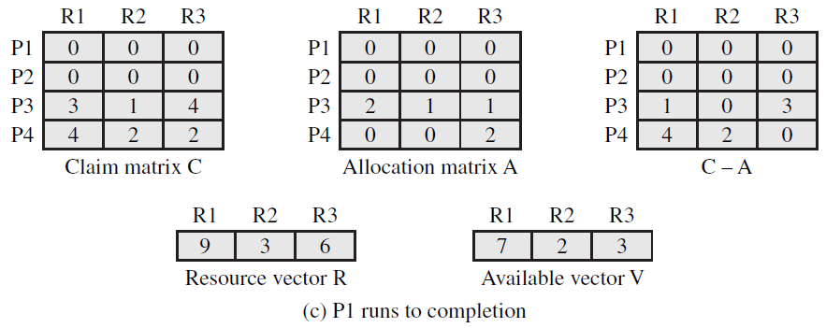
Fig.6.7 Determination of a Safe State
(c)P1 Runs to Completion：

Slide 56
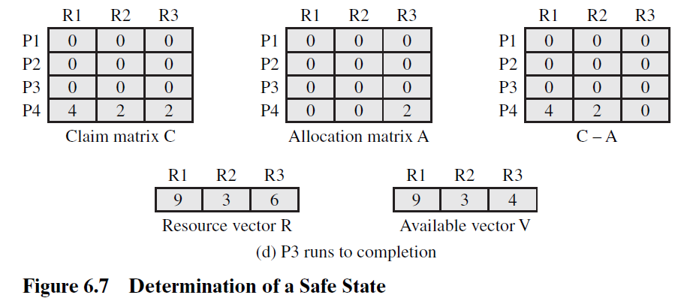
Fig.6.7 Determination of a Safe State
(d)P3 Runs to Completion：

Slide 57
Fig.6.7 Determination of a Safe State
(d)P3 Runs to Completion：
These concepts suggest the following deadlock avoidance strategy, which ensures that the system of processes and resources is always in a safe state.
When a process makes a request for a set of resources, assume that the request is granted, update the system state accordingly, and then determine whether the result is a safe state.
If so, grant the request and,
if not, block the process until it is safe to grant the request.

Slide 58
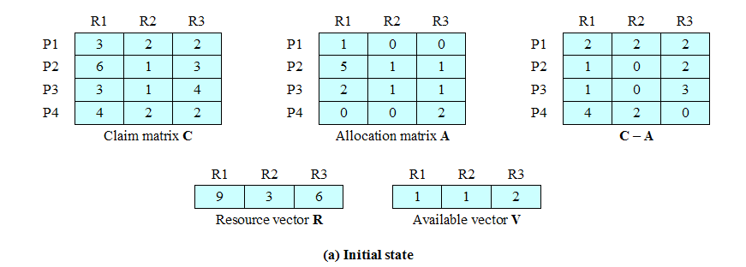
Fig.6.8 Determination of an Unsafe State
if P1 request for one additional unit each of R1 and R3

Slide 59
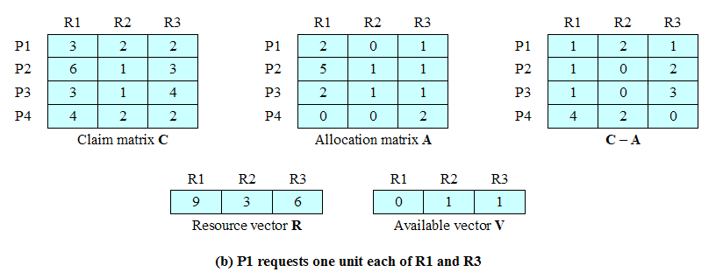


Fig.6.8 Determination of an Unsafe State

Slide 60
Fig.6.8 Determination of an Unsafe State
It is important to point out that Figure 6.8b is not a deadlocked state. It merely has the potential for deadlock.
It is possible, for example, that if P1 were run from this state it would subsequently release one unit of R1 and one unit of R3 prior to needing these resources again.
If that happened, the system would return to a safe state.
Thus, the deadlock avoidance strategy does not predict deadlock with certainty; it merely anticipates 预料 the possibility of deadlock and assures that there is never such a possibility.

Slide 61
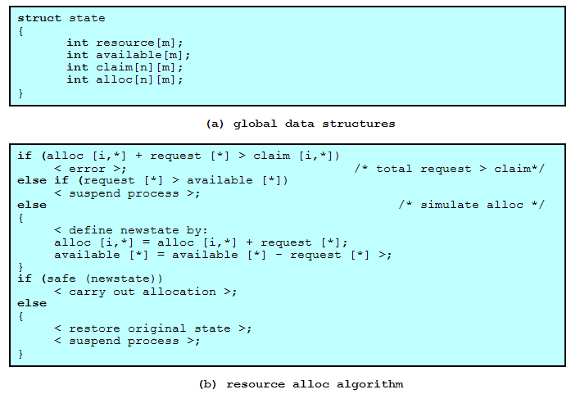
Deadlock Avoidance Logic 死锁避免逻辑

Slide 62
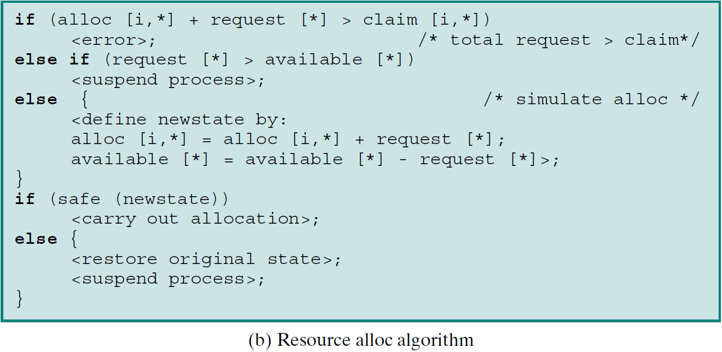
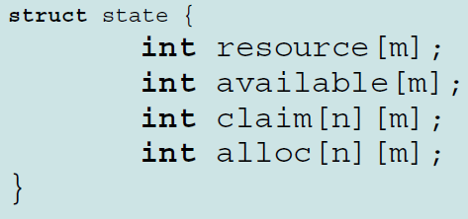
Deadlock Avoidance Logic 死锁避免逻辑

Slide 63
Deadlock Avoidance Logic 死锁避免逻辑
First, a check is made to assure that the request does not exceed the
original claim of the process.

Slide 64
Deadlock Avoidance Logic 死锁避免逻辑

Slide 65
Deadlock Avoidance Logic 死锁避免逻辑

Slide 66
Deadlock Avoidance Logic 死锁避免逻辑

Slide 67
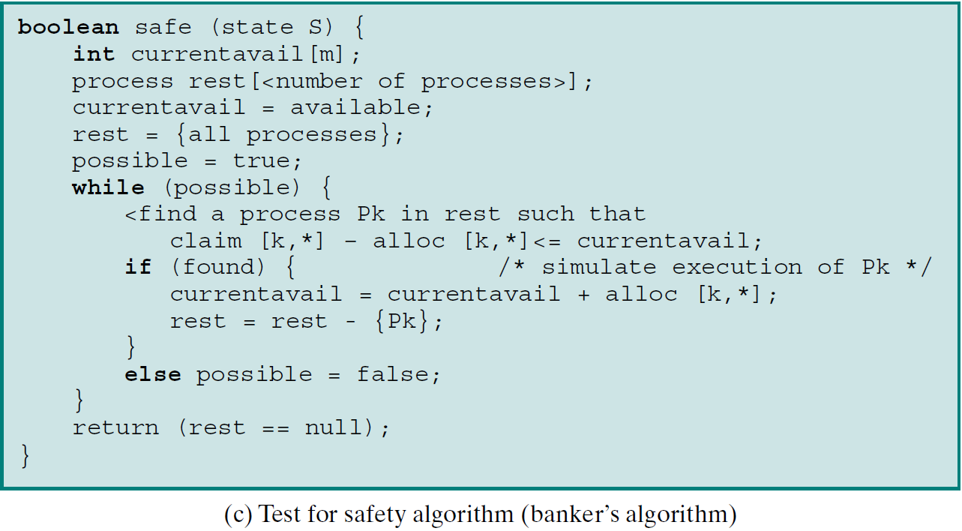
Deadlock Avoidance Logic (cont.)
算法逻辑参考
Fig.6.7 & Fig. 6.8

Slide 68
Advantage of Deadlock Avoidance:
It is not necessary to preempt 抢占 and rollback 回滚processes, as in deadlock detection, and is less restrictive than deadlock prevention.
However, it does have a number of restrictions (next page)

Slide 69
Restrictions of Deadlock Avoidance:
Maximum resource requirement must be stated in advance 事先必须声明
Processes under consideration must be independent; no synchronization requirements
There must be a fixed number of resources to allocate
No process may exit while holding resources

Slide 70
Agenda
6.1 Principles of Deadlock
6.2 Deadlock Prevention
6.3 Deadlock Avoidance
6.4 Deadlock Detection
6.5 An Integrated Deadlock Strategy
6.6 Dining Philosophers Problem

Slide 71
Deadlock Detection
Deadlock prevention strategies are very conservative保守; they solve the problem of deadlock by limiting access to resources and by imposing 加强 restrictions 约束 on processes.
At the opposite extreme, deadlock detection strategies do not limit resource access or restrict process actions.
With deadlock detection, requested resources are granted to processes whenever possible. Periodically, the OS performs an algorithm that allows it to detect the circular wait condition described earlier in condition (4) and illustrated in Figure 6.6.

Slide 72
Deadlock Detection
A check for deadlock can be made as frequently as each resource request or, less frequently, depending on how likely it is for a deadlock to occur.
Checking at each resource request has two advantages: It leads to early detection, and the algorithm is relatively simple because it is based on incremental changes to the state of the system.
However, such frequent checks consume considerable processor time.

Slide 73
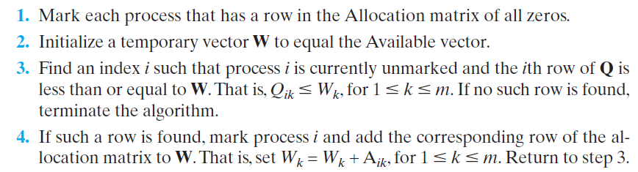
Deadlock Detection
Deadlock Detection algorithm(A common algorithm for deadlock detection is one described in [COFF71]),
  The algorithm proceeds by marking processes that are not deadlocked.
    Initially, all processes are unmarked.
    Then the following steps are performed:

Slide 74
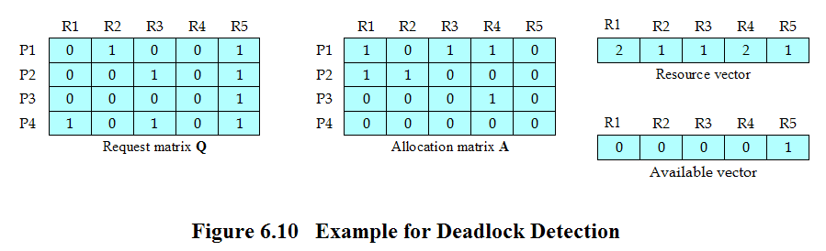
Deadlock Detection
Reference P.278 of the textbook for deadlock detection algorithm (Fig.6.10)

Slide 75
Deadlock Detection
Step1: Mark P4, because P4 has no allocated resources
Step2: Set W = (0 0 0 0 1).
Reference P.278 of the textbook for deadlock detection algorithm (Fig.6.10)

Slide 76
Deadlock Detection
Step3: The request of process P3 is less than or equal to W, so mark P3 and set
W = W + ( 0 0 0 1 0 ) = ( 0 0 0 0 1 )+ ( 0 0 0 1 0 )=(0 0 0 1 1)
Reference P.278 of the textbook for deadlock detection algorithm (Fig.6.10)

Slide 77
Deadlock Detection
Step4: No other unmarked process has a row in Q that is less than or equal to W ( W=(0 0 0 1 1) ).
Therefore, terminate the algorithm.
Reference P.278 of the textbook for deadlock detection algorithm (Fig.6.10)

Slide 78
Deadlock Detection
A deadlock exists if and only if there are unmarked processes at the end of the algorithm.
The set of unmarked rows corresponds precisely to the set of deadlocked processes.
The strategy in this algorithm is to find a process whose resource requests can be satisfied with the available resources, and then assume that those resources are granted and that the process runs to completion and releases all of its resources. The algorithm then looks for another process to satisfy.
Note that this algorithm does not guarantee to prevent deadlock; that will depend on the order in which future requests are granted. All that it does is determine if deadlock currently exists.
Reference P.278 of the textbook for deadlock detection algorithm (Fig.6.10)

Slide 79
Recovery Strategies Once Deadlock Detected 死锁检测到后的解锁策略
Abort 取消 all deadlocked processes
Back up 回滚 each deadlocked process to some previously defined checkpoint, and restart all process
  Original deadlock may occur again
Successively abort 连续取消 deadlocked processes until deadlock no longer exists
Successively preempt 连续抢占 resources until deadlock no longer exists

Slide 80
Selection Criteria Deadlocked Processes
被剥夺或者取消进程的选择标准
Least amount of processor time consumed so far
目前为止消耗的处理器时间最少
Least number of lines of output produced so far
目前为止产生的输出最少
Most estimated time remaining
预计剩下的时间最长
Least total resources allocated so far
目前为止分配的资源总量最小
Lowest priority 最低的优先级

Slide 81
Agenda
6.1 Principles of Deadlock
6.2 Deadlock Prevention
6.3 Deadlock Avoidance
6.4 Deadlock Detection
6.5 An Integrated Deadlock Strategy 综合的死锁策略
6.6 Dining Philosophers Problem

Slide 82
Strengths and Weaknesses of the Strategies

Slide 83
Strengths and Weaknesses of the Strategies
As Table 6.1 suggests, there are strengths and weaknesses to all of the strategies for dealing with deadlock. Rather than attempting to design an OS facility that employs only one of these strategies, it might be more efficient to use different strategies in different situations.

Slide 84
An Integrated Deadlock Strategy一种综合死锁策略
[HOWA73] suggests one approach:
Group resources into a number of different resource classes 资源分类
Use the linear ordering strategy线性排序策略 defined previously for the prevention of circular wait to prevent deadlocks between resource classes
类与类之间用线性排序策略避免死锁
Within a resource class, use the algorithm that is most appropriate for that class
每个类中使用适合于该类的策略

Slide 85
Agenda
6.1 Principles of Deadlock
6.2 Deadlock Prevention
6.3 Deadlock Avoidance
6.4 Deadlock Detection
6.5 An Integrated Deadlock Strategy
6.6 Dining Philosophers Problem

Slide 86
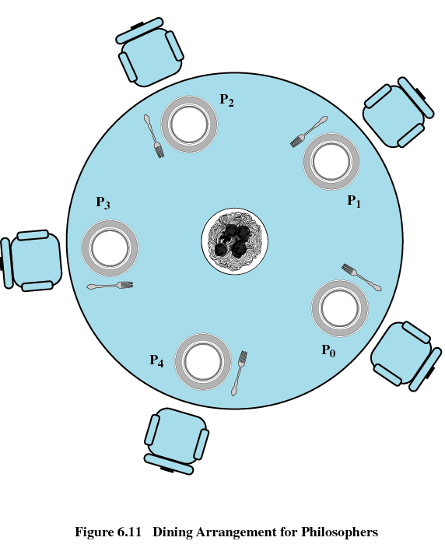
Dining Philosophers Problem哲学家就餐问题

Slide 87
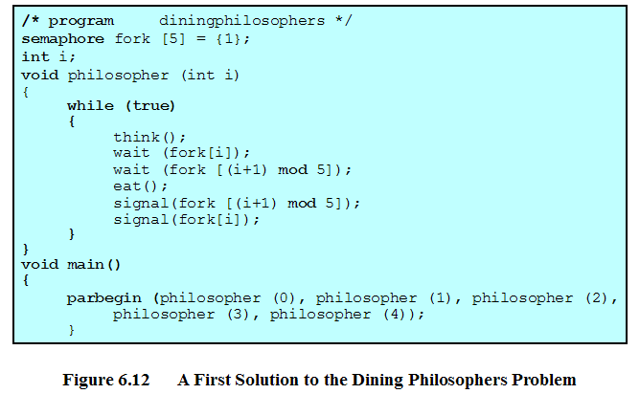
Dining Philosophers Problem (incorrect，Why？)

Slide 88
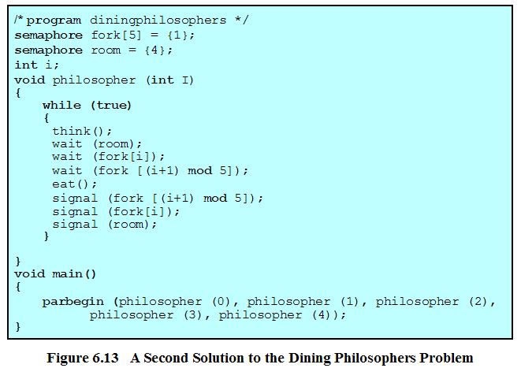
Dining Philosophers Problem

Slide 89
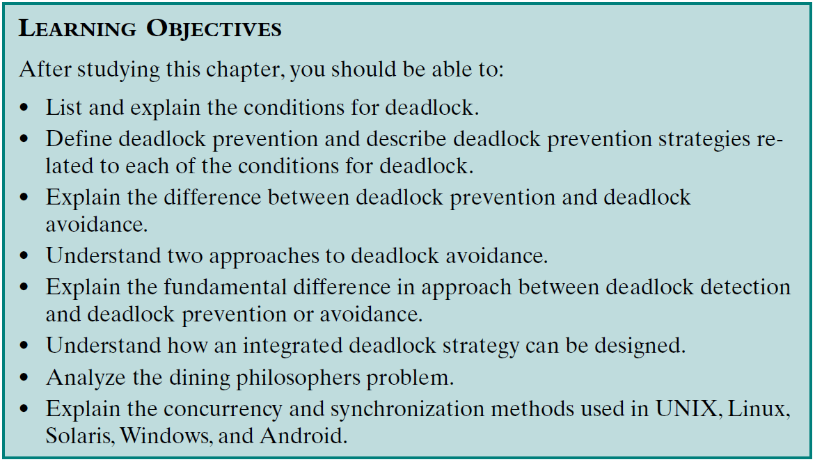
Review：
Assigned Readings: textbooks,p260-307; preview Chapter 7.

