Slide 1
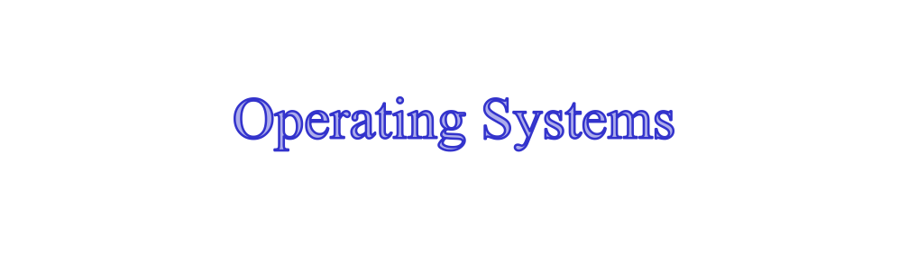
Chapter 7 Memory Management
陈瑜
yuchen@scu.edu.cn

Slide 2
Agenda
7.1 Memory Management Requirements
7.2 Memory Partitioning
7.3 Paging
7.4 Segmentation
7.5 Summary

Slide 3
Memory Management
Subdividing memory to accommodate multiple processes
为支持多道程序将内存进行划分
Memory needs to be allocated to ensure a reasonable supply of ready processes to consume available processor time
内存管理应确保有适当数目的就绪进程使用处理器时间

Slide 4
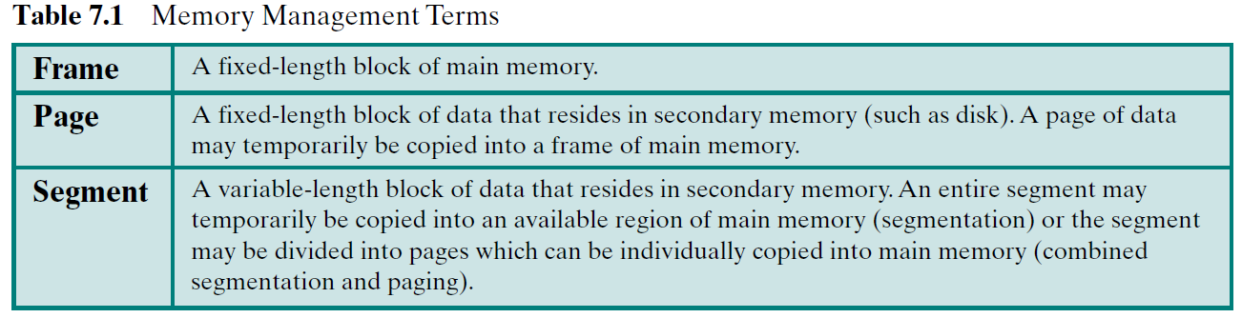
Memory Management
Memory Management Terms:
页框：内存中固定长度的块
固定长度的数据块
变长数据块

Slide 5
7.1 Memory Management Requirements
7.1.1 Relocation 重定位
7.1.2 Protection
7.1.3 Sharing
7.1.4 Logical Organization
7.1.5 Physical Organization

Slide 6
Memory Management Requirements
Relocation 重定位
  Programmer does not know where the program will be placed in memory when it is executed
  While the program is executing, it may be swapped交换to disk and returned to main memory at a different location (relocated重定位)
  Memory references访问must be translated in the code to actual physical memory address物理内存地址

Slide 7
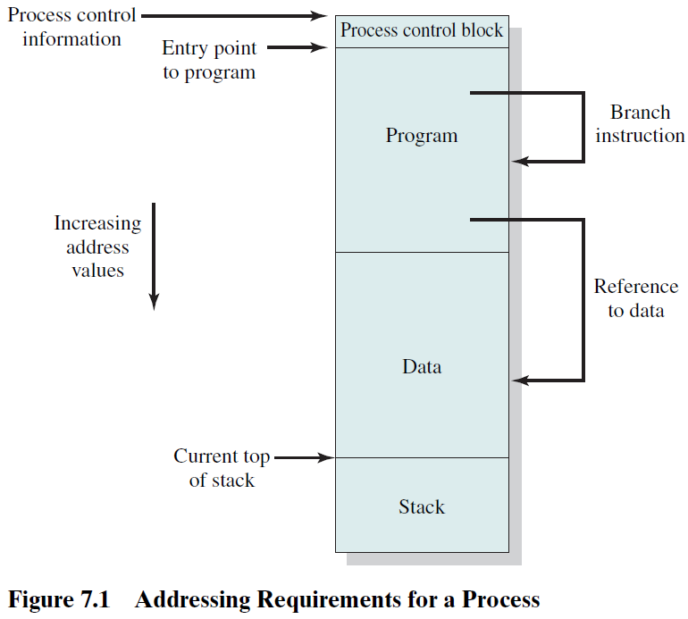
Addressing Requirements for a Process进程的寻址需求

Slide 8
7.1 Memory Management Requirements
7.1.1 Relocation
7.1.2 Protection
7.1.3 Sharing
7.1.4 Logical Organization
7.1.5 Physical Organization

Slide 9
Memory Management Requirements
Protection 存储保护
  Processes should not be able to reference memory locations in another process without permission or jump to instructions area of another process 进程不能在未授权的情况下访问其他进程的数据，不能跳转到其他进程的代码区域执行指令 ----防止地址越界、防止操作越权
  Normally, processes cannot access any portion of the OS, neither program nor data
  Impossible to check absolute addresses at compile time, instead, absolute addresses must be checked at rum time.
  Memory protection requirement must be satisfied by the processor (hardware) rather than the operating system

Slide 10
7.1 Memory Management Requirements
7.1.1 Relocation
7.1.2 Protection
7.1.3 Sharing 存储共享
7.1.4 Logical Organization
7.1.5 Physical Organization

Slide 11
Memory Management Requirements
Sharing 存储共享
  Allow several processes to access the same portion of memory
    Share same copy of the program
    Share data structure to cooperate on some task
  通常，进程之间共享代码的主要目的是为了节约存储空间；共享数据的主要目的是为了实现进程间的相互通信。

Slide 12
7.1 Memory Management Requirements
7.1.1 Relocation
7.1.2 Protection
7.1.3 Sharing
7.1.4 Logical Organization
7.1.5 Physical Organization

Slide 13
Memory Management Requirements
Logical Organization 逻辑组织
  Main memory is organized in a linear address space, consisting of a sequence of bytes or words
  Programs are written in modules, and its advantages:
    Modules can be written and compiled independently
    Different degrees of protection can be given to different modules (read-only, execute-only)
    Share modules among processes
  Segmentation分段技术 is the most easy to satisfies these requirements.

Slide 14
7.1 Memory Management Requirements
7.1.1 Relocation
7.1.2 Protection
7.1.3 Sharing
7.1.4 Logical Organization
7.1.5 Physical Organization

Slide 15
Memory Management Requirements
Physical Organization 物理组织
  Memory is organized into at least two level：main memory and secondary memory
  In this two-level scheme, the organization of the flow of information between main and secondary memory is a major system concern. The responsibility for this flow could be assigned to the individual programmer, but this is impractical and undesirable for two reasons:
  (1)Memory available for a program plus its data may be
  insufficient 供程序和数据使用的内存可能不足
    - Overlaying覆盖allows various modules to be assigned the
    same region of memory
  (2)Programmer does not know how much space will be available
  and where his/her program will be loaded in memory

Slide 16
Memory Management Requirements
Physical Organization 物理组织
  Memory is organized into at least two level：main memory and secondary memory
  In this two-level scheme, the organization of the flow of information between main and secondary memory is a major system concern. The responsibility for this flow could be assigned to the individual programmer, but this is impractical and undesirable for two reasons:
  (1)Memory available for a program plus its data may be
  insufficient 供程序和数据使用的内存可能不足
    - Overlaying覆盖allows various modules to be assigned the
    same region of memory
  (2)Programmer does not know how much space will be available
  and where his/her program will be loaded in memory

Slide 17
Agenda
7.1 Memory Management Requirements
7.2 Memory Partitioning 内存分区
7.3 Paging
7.4 Segmentation
7.5 Summary

Slide 18
7.2 Memory Partitioning内存分区
7.2.1 Fixed Partitioning
7.2.2 Dynamic Partitioning
7.2.3 Buddy System
7.2.4 Relocation

Slide 19
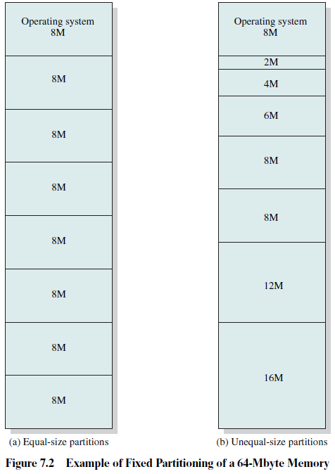
Fixed Partitioning 固定分区
Alternatives for Fixed Partitioning
  Equal-size partitions 大小相等的分区
  Unequal-size partitions 大小不等的分区

Slide 20
Fixed Partitioning
Equal-size partitions: features
  Any process whose size is less than or equal to the partition size can be loaded into an available partition
  If all partitions are full, the operating system can swap a process out of a partition

Slide 21
Fixed Partitioning
Equal-size partitions: difficulties
  A program may not fit in a partition. The programmer must design the program with overlays
  程序太大而放不进一块分区，必须采用覆盖技术
  Main memory use is inefficient. Any program, no matter how small, occupies an entire partition.
    internal fragmentation 内部碎片/内零头

Slide 22
Fixed Partitioning
Unequal-size partitions大小不等的分区
  Both of these problems of equal-size partitions can be lessened缓解, though not solved, by using unequal-size partitions.

Slide 23
Placement Algorithm with Fixed Partitions
固定分区的放置算法
Equal-size partitions
  Because all partitions are of equal size, it does not matter which partition is used
Unequal-size partitions
  Can assign each process to the smallest partition within which it will fit
  Queue for each partition
  Processes are assigned in such a way as to minimize wasted memory within a partition

Slide 24
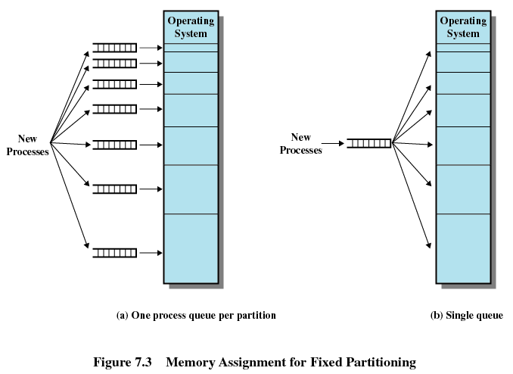

Slide 25
Disadvantages of Fixed Partitions
The number of active processes in the system is limited by the number of partitions
Small jobs will not utilize partition efficiently
The use of fixed partitioning is almost unknown today. One example of a successful operating system that did use this technique was an early IBM mainframe主机 operating system, OS/MFT (Multiprogramming with a Fixed Number of Tasks).

Slide 26
7.2 Memory Partitioning
7.2.1 Fixed Partitioning
7.2.2 Dynamic Partitioning
7.2.3 Buddy System
7.2.4 Relocation

Slide 27
Dynamic Partitioning 动态分区
Partitions are of variable length and number
Process is allocated exactly as much memory as required
Eventually get holes in the memory. This is called external fragmentation 外部碎片/外零头
Must use compaction 压缩 to shift 移动 processes so they are contiguous and all free memory is in one block

Slide 28
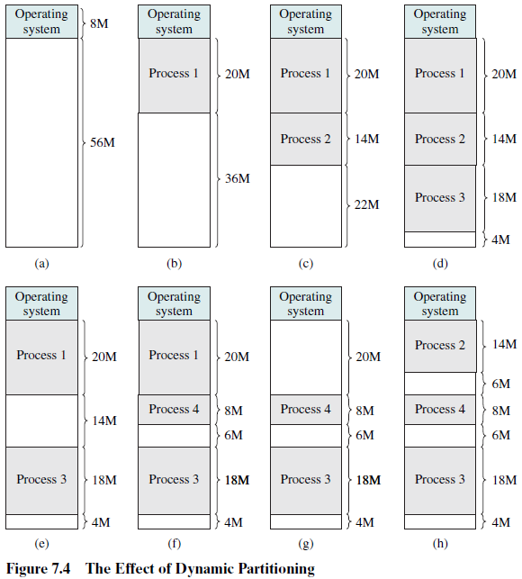

Slide 29
Dynamic Partitioning Placement Algorithm
Three placement algorithms放置算法：
（1）Best-fit algorithm 最佳适配
  Chooses the block that is closest in size to the request
  Worst performer overall
  Since smallest block is found for process, the smallest amount of fragmentation is left
  Memory compaction must be done more often

Slide 30
Dynamic Partitioning Placement Algorithm
（2）First-fit algorithm 首次适配
  Scans memory form the beginning and chooses the first available block that is large enough
  Simplest and usually fastest and best
  May have many process loaded in the front end of memory that must be searched over when trying to find a free block

Slide 31
Dynamic Partitioning Placement Algorithm
（3）Next-fit 下次适配/邻近适配
  Scans memory from the location of the last placement and chooses the next available block that is large enough
  More often allocate a block of memory at the end of memory where the largest block is found
  The largest block of memory is broken up into smaller blocks
  Compaction is required to obtain a large block at the end of memory

Slide 32
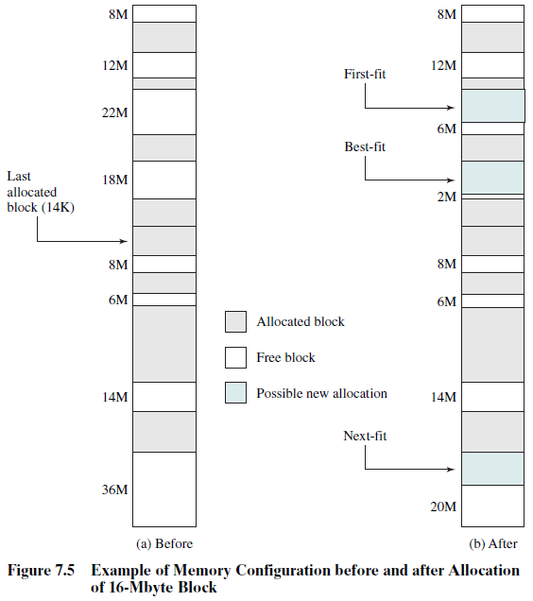

Slide 33
7.2 Memory Partitioning
7.2.1 Fixed Partitioning
7.2.2 Dynamic Partitioning
7.2.3 Buddy System 伙伴系统
7.2.4 Relocation

Slide 34
Buddy System
Entire space available is treated as a single block of 2^{U} (e.g. 1M = 2²⁰ )
If a request of size s such that 2^{U-1} < s <= 2^{U}, entire block is allocated
Otherwise block is split into two equal buddies
Process continues until smallest block greater than or equal to s is generated

Slide 35
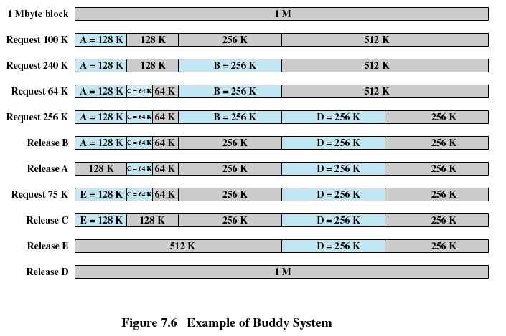

Slide 36
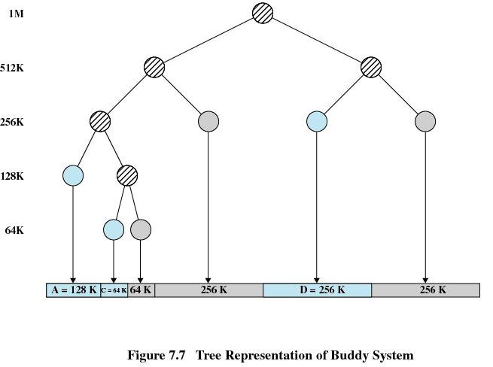

Slide 37
7.2 Memory Partitioning
7.2.1 Fixed Partitioning
7.2.2 Dynamic Partitioning
7.2.3 Buddy System
7.2.4 Relocation 重定位

Slide 38
Relocation 重定位
When program loaded into memory the actual (absolute) memory locations are determined
A process may occupy different partitions which means different absolute memory locations during execution (from swapping 交换)
Compaction 压缩 will also cause a program to occupy a different partition which means different absolute memory locations

Slide 39
Several Types of Addresses：
Logical Address 逻辑地址
  Reference to a memory location independent of the current assignment of data to memory
  与当前数据在内存中的分配无关的访问地址
  Translation must be made to the physical address
Relative Address 相对地址
  Address expressed as a location relative to some known point，usually a value in a processor register.
Physical Address 物理地址
  The absolute address or actual location in main memory

Slide 40
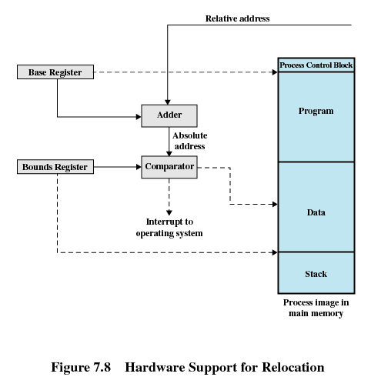
相对地址
基址寄存器
加法器
界限寄存器
绝对地址
比较器
给操作系统的中断
进程映像

Slide 41
Registers Used during Execution：
Base register 基址寄存器
  Starting address for the process
Bounds register界限寄存器
  Ending location of the process
These values are set when the process is loaded or when the process is swapped in 换入

Slide 42
Registers Used during Execution：
The value of the base register is added to a relative address to produce an absolute address
The resulting address is compared with the value in the bounds register
If the address is not within bounds, an interrupt is generated to the operating system

Slide 43
Agenda
7.1 Memory Management Requirements
7.2 Memory Partitioning
7.3 Paging 分页
7.4 Segmentation

Slide 44
Both unequal fixed-size and variable-size partitions are inefficient in the use of memory; the former results in internal fragmentation, the latter in external fragmentation.
How to tackle this problem?

Slide 45
Paging 分页技术：
Partition memory into small equal fixed-size chunks等长固定大小的小块 which are called frames 页框、帧
Divide each process into small equal fixed-size chunks which are called pages页. The size of pages are equal to the size of frames
Operating system maintains a page table页表for each process：
  Contains the frame location帧位置for each page in the process
  Memory address consist of a page number页号and offset偏移量within the page

Slide 46
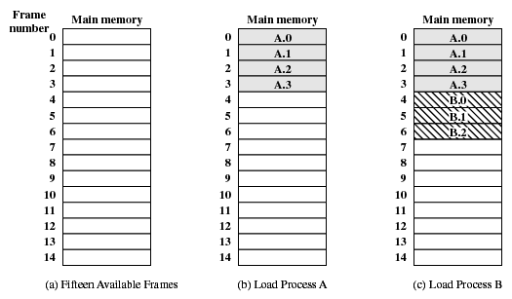
Assignment of Process Pages to Free Frames
Figure 7.9 Assignment of Process to Free Frames

Slide 47
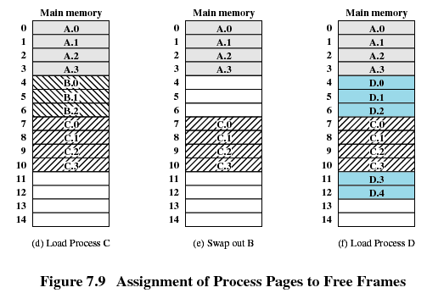
Assignment of Process Pages to Free Frames
B is suspended
and is swapped out

Slide 48
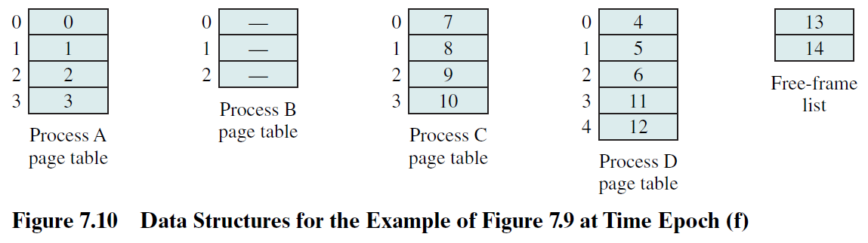
Page Tables for Example in Fig. 7.9
A page table contains one entry for each page of the process, so that the table is easily indexed by the page number (starting at page 0).
Each page table entry contains the number of the frame in main memory that holds the corresponding page.
In addition, the OS maintains a single free-frame list of all the frames in main memory that are currently unoccupied and available for pages.

Slide 49
Page Tables for Example in Fig. 7.9
Thus we see that simple paging, as described here, is similar to fixed partitioning.
The differences are that, with paging, the partitions are rather small; a program may occupy more than one partition; and these partitions need not be contiguous. more advantage?

Slide 50
Page Tables for Example in Fig. 7.9
To make this paging scheme convenient, both the size of frame and page size must be a power of 2. With the use of a page size that is a power of 2, it is easy to demonstrate that the relative address.
The relative address can be expressed as a page number and offset.
An example is shown in Figure 7.11.

Slide 51
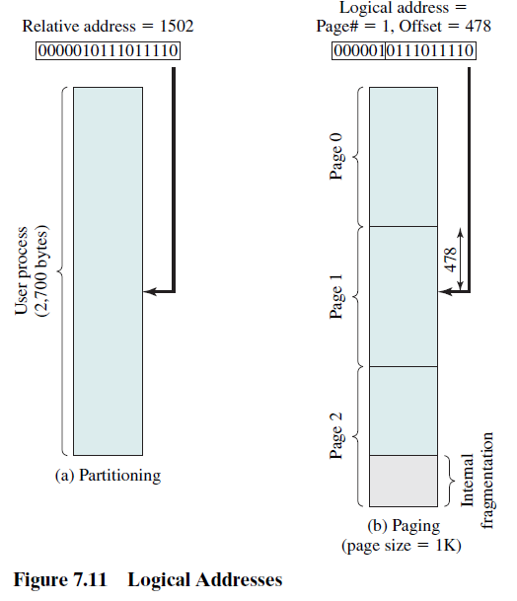
In Fig.7.11:
16-bit addresses are used, the page size is 1K = 1,024 bytes, offset field of 10 bits is needed, leaving 6 bits for the page number. Thus a program can consist of a maximum of 2⁶ = 64 pages of 1K bytes each.
The relative address 1502 in binary form is 0000010111011110.

Slide 52
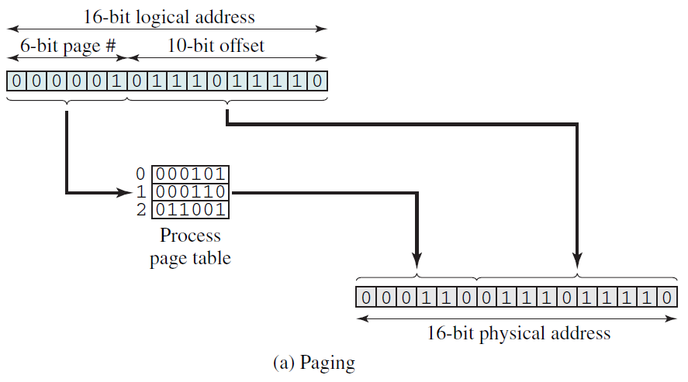

Slide 53
Agenda
7.1 Memory Management Requirements
7.2 Memory Partitioning
7.3 Paging
7.4 Segmentation 分段

Slide 54
Segmentation 分段
Program and its data can be divided into a number of segmentation, all segments of all programs do not have to be of the same length
There is a maximum segment length
Addressing consist of two parts:
  segment number 段号
  offset 偏移量
Since segments are not equal, segmentation is similar to dynamic partitioning 动态分区

Slide 55
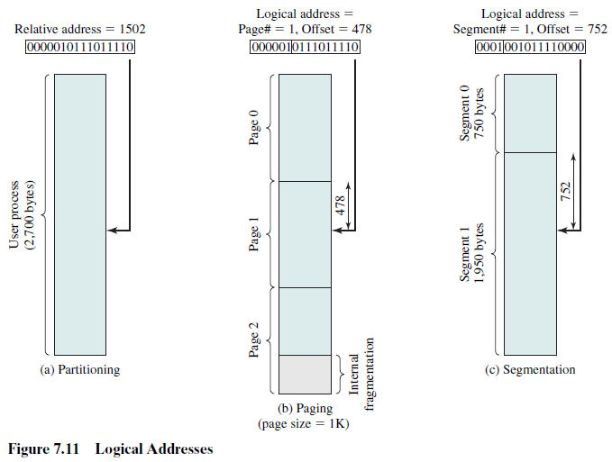

Slide 56
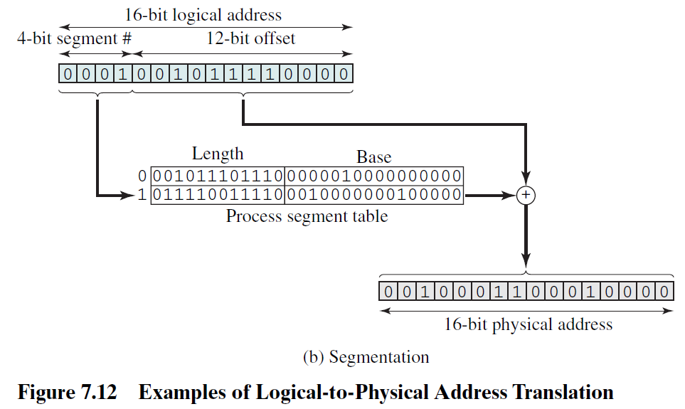

Slide 57
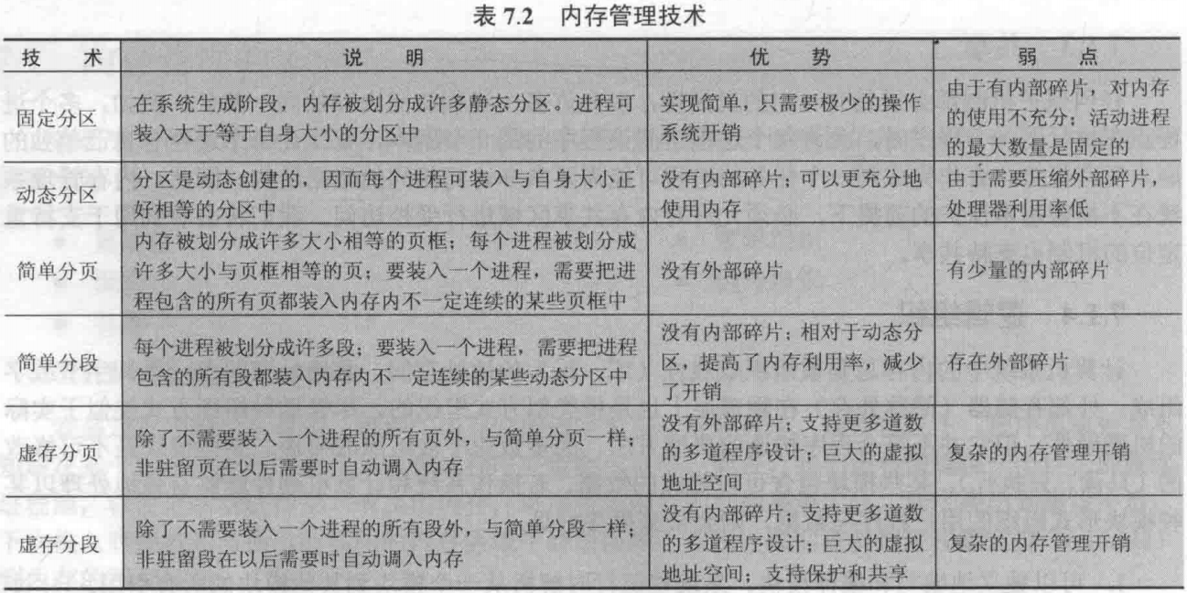
Summary:

Slide 58
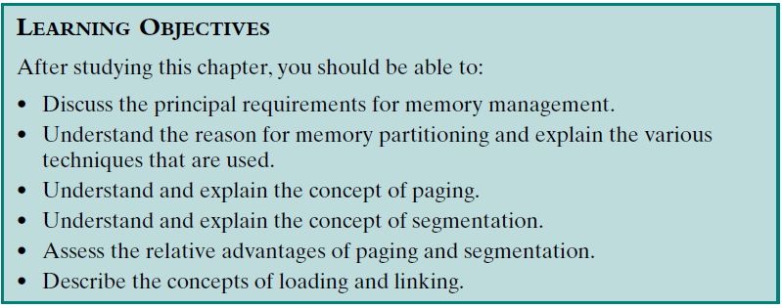
Review：
Assigned Readings: textbooks,p310-339; preview Chapter 8.
Read Appendix 7A !

