Slide 1

Chapter 8 Virtual Memory
陈瑜
yuchen@scu.edu.cn

Slide 2
Agenda
8.1 Hardware and Control Structure
8.2 Operating System Software

Slide 3
8.1 Hardware and Control Structure
8.1.0 Overview
8.1.1 Locality and Virtual Memory
8.1.2 Paging
8.1.3 Segmentation
8.1.4 Combined Paging and Segmentation
8.1.5 Protection and Sharing

Slide 4
Hardware and Control Structures
Review: simple page and segment memory management：
All memory references within a process are logical addresses that are dynamically translated into physical addresses at run time
运行时访问地址动态转换
  A process may be swapped in and out 换入和换出 of main memory such that it occupies different regions
A process may be broken up into pieces(pages or segments) that do not need to located contiguously in main memory 进程分块
  The combination of dynamic run-time address translation and the use of a page or segment table permits this.

Slide 5
Execution of a Program 程序运行
New Idea: All pieces of a process do not need to be loaded in main memory during execution 部分载入
--It is not necessary that all of the pages or all of the
segments of a process be in main memory during
execution.
Operating system brings into main memory a few (a part of) pieces of the program, no all pieces
  Resident set常驻集 - portion of process that is in main memory

Slide 6
Execution of a Program
When an address is needed that is not in main memory:
  1. An interrupt/exception is generated, which is known as page fault interrupt 缺页中断
  2. Operating system gain the control by running ISR(Interrupt service routine)
    Piece of process that contains the logical address is brought into main memory
      Operating system issues a disk I/O Read request
    places the process in a blocking state
      Another process is dispatched to run while the disk I/O takes place
  3. An interrupt is issued when disk I/O complete which causes the operating system to place the affected process in the Ready state

Slide 7
Advantages of Breaking up a Process进程分块的优点
More processes may be maintained in main memory
主存中保留多个进程
  Only load in some of the pieces of each process
  With so many processes in main memory, it is very likely a process will be in the Ready state at any particular time, so CPU will be kept in busy
A process may be larger than all of main memory
支持大于主存的进程

Slide 8
Types of Memory 存储器类型
Real memory 实存
  A process executes only in main memory
  Main memory, the memory provided by computer hardware
Virtual memory 虚存
  The memory to programmer’s view
  Allows for effective multiprogramming
  Relieves the user of tight constraints of main memory 解除了用户与主存之间的紧密约束

Slide 9
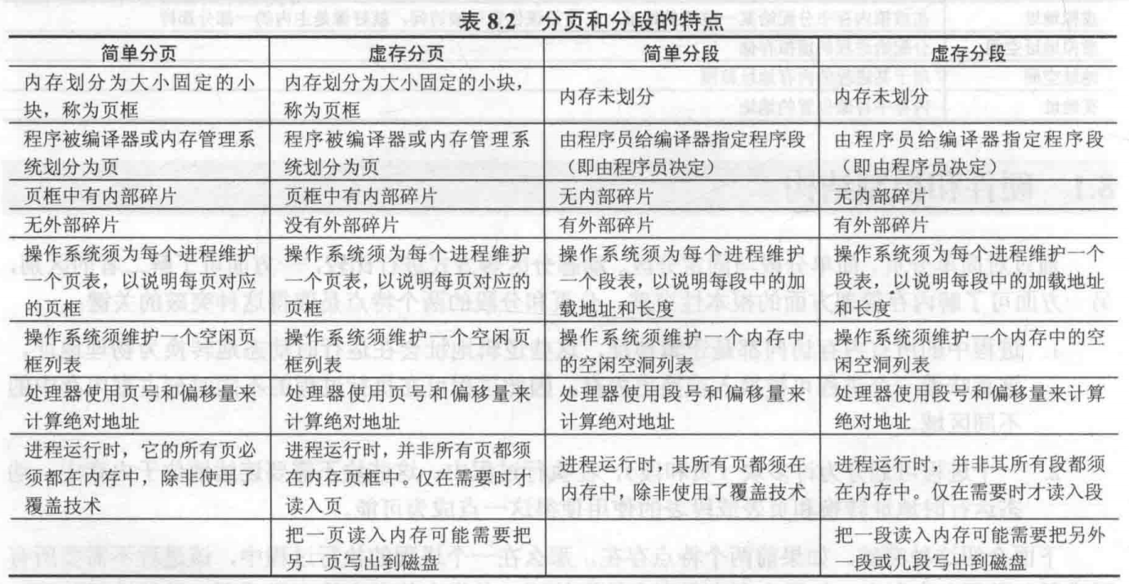
Table 8.2 summarizes characteristics of paging and segmentation with and without the use of virtual memory

Slide 10
Thrashing 系统抖动/系统颠簸
Thrashing
  Swapping out a piece of a process just before that piece is needed，then it will just have to go get that piece again almost immediately.
  Too much of this operations may leads the processor spends most of its time swapping pieces rather than executing user instructions
How to tackle?

Slide 11
Thrashing 系统抖动/系统颠簸
Thrashing
  Swapping out a piece of a process just before that piece is needed，then it will just have to go get that piece again almost immediately.
  Too much of this operations may leads the processor spends most of its time swapping pieces rather than executing user instructions
How to tackle?

Slide 12
Thrashing 系统抖动/系统颠簸
Thrashing
  Swapping out a piece of a process just before that piece is needed，then it will just have to go get that piece again almost immediately.
  Too much of this operations may leads the processor spends most of its time swapping pieces rather than executing user instructions
How to tackle?
The avoidance of thrashing was a major research area in the 1970s and led to a variety of complex but effective algorithms. In essence, the OS tries to guess, based on recent history, which pieces are least likely to be used in the near future----Principle of Locality局部性原理

Slide 13
8.1 Hardware and Control Structure
8.1.0 Overview
8.1.1 Locality and Virtual Memory 局部性与虚拟内存
8.1.2 Paging
8.1.3 Segmentation
8.1.4 Combined Paging and Segmentation
8.1.5 Protection and Sharing

Slide 14
Principle of Locality局部性原理
Program and data references within a process tend to cluster程序和数据访问的集簇倾向（Chapter 1，see Appendix 1A）
Only a few pieces of a process will be needed over a short period of time
  Just like you play games
Possible to make intelligent guesses about which pieces will be needed in the future
  This suggests that virtual memory may work efficiently

Slide 15
Support Needed for Virtual Memory
Cooperation of H/W and S/W
  Hardware must support paging and segmentation
  Operating system must be able to management the movement of pages and/or segments between secondary memory and main memory

Slide 16
8.1 Hardware and Control Structure
8.1.0 Overview
8.1.1 Locality and Virtual Memory
8.1.2 Paging
8.1.3 Segmentation
8.1.4 Combined Paging and Segmentation
8.1.5 Protection and Sharing

Slide 17
Paging 分页
Each process has its own page table页表
Each page table entry(PTE) 页表项 contains：
  the frame number of the corresponding page in main memory页框号
  A bit P is needed to indicate whether the page is in main memory or not 存在位P
  A bit M may be needed to indicate whether the page has been modified or not since it was loaded in main memory 修改位M

Slide 18
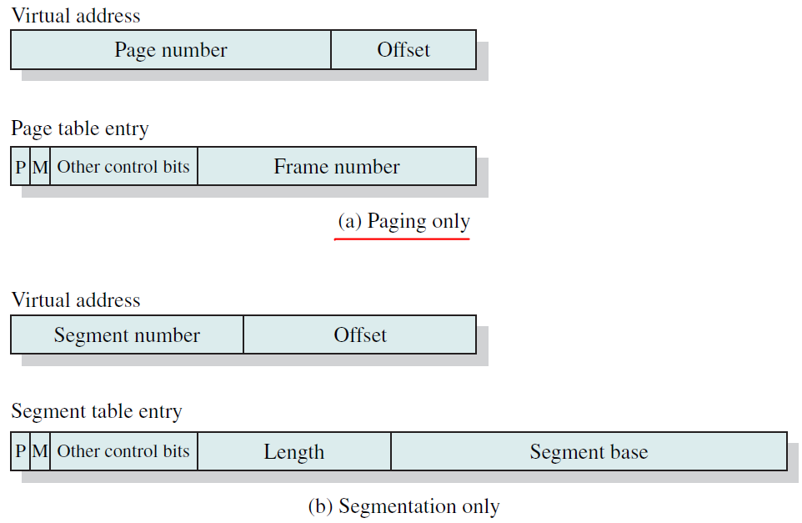
Page Table Structure： Figure 8.1

Slide 19
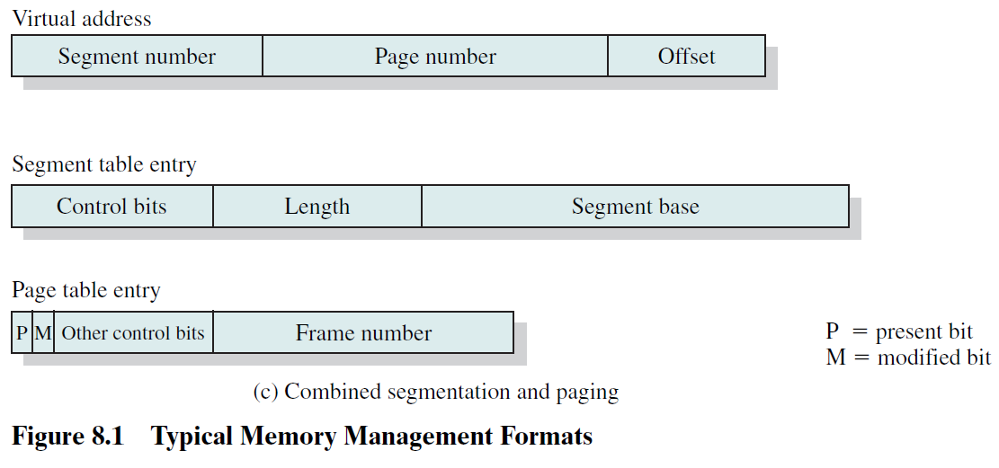
Page Table Structure： Figure 8.1

Slide 20
Modify Bit in Page Table
Modify bit M is needed to indicate if the page has been altered since it was last loaded into main memory
  If no change has been made, the page does not have to be written to the disk when it needs to be swapped out换出

Slide 21
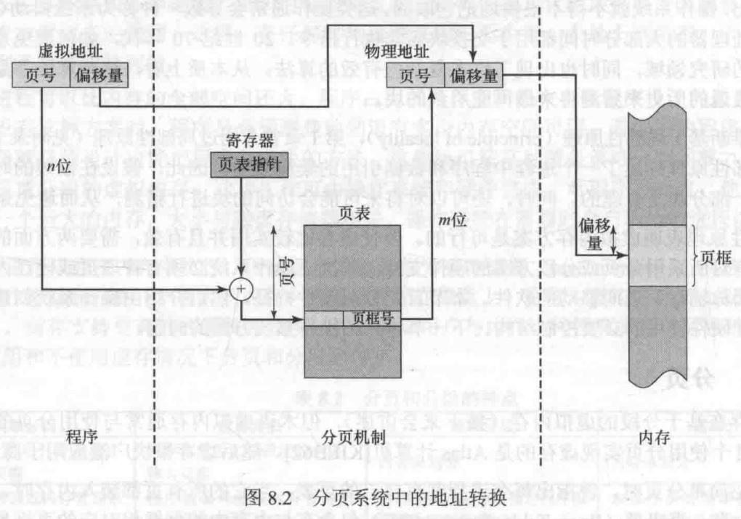
Address Translation in a Paging System

Slide 22
Address Translation in a Paging System
当前进程的页表
的起始位置

Slide 23
Page Tables页表
The entire page table may take up too much main memory
  Page tables are also stored in virtual memory
  The entire page table size is proportional 正比 to that of the virtual address space
Two-Level Scheme
  When a process is running, part of its page table is in main memory

Slide 24
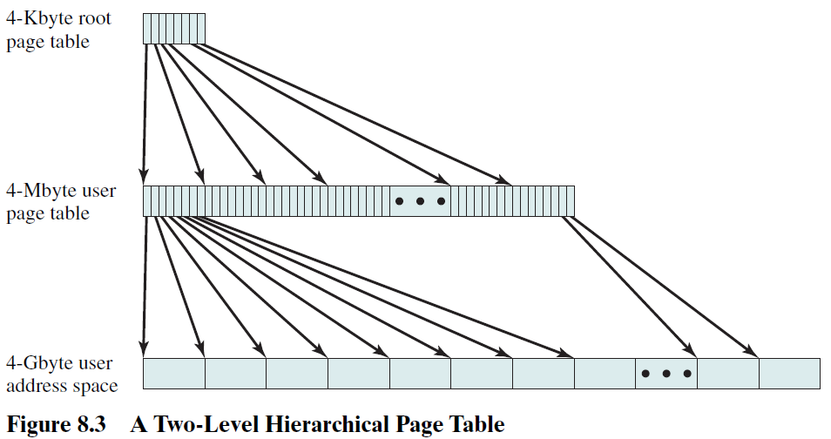
Two-Level Scheme for 32-bit Address
32位地址的两级页表方案
4KB
4KB
4KB
4KB
4GB=2³²=2¹²（=4KB）* 2²⁰（=1MB）
假定一个页表项占4字节，则需要4MB(=2²*2²⁰)大小的页表....

Slide 25
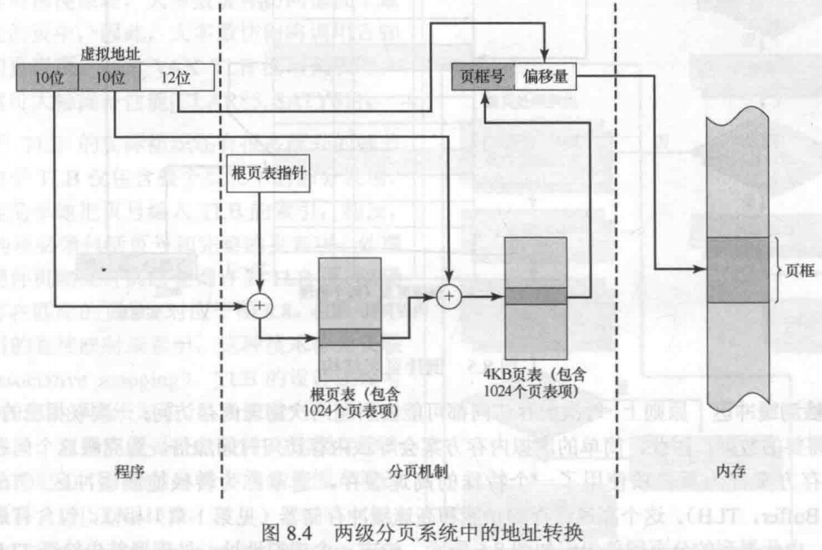
Two-Level Scheme for 32-bit Address
32位地址的两级页表方案

Slide 26
Inverted Page Table 反向页表/倒排页表
A drawback of the type of page tables that we have been discussing is that their size is proportional to that of the virtual address space
页表设计的缺点：页表大小与虚拟地址空间大小成正比
An alternative approach to the use of one or multiple-level page tables is the use of an inverted page table structure
Used on PowerPC, UltraSPARC, and IA-64 architecture

Slide 27
Inverted Page Table 反向页表/倒排页表
In this approach, the page number portion of a virtual address is mapped into a hash value虚拟地址的页号部分使用一个简单的散列函数映射到散列表/哈希表中
The hash value is a pointer to the inverted page table, which contains the page table entries哈希表包含指向倒排表的指针，而倒排表中含有页表项
There is one entry in the inverted page table for each real memory page frame rather than one per virtual page.
Fixed proportion of real memory is required for the tables regardless of the number of processes or virtual pages supported

Slide 28
Inverted Page Table
Each entry in the page table includes the following:
- Page number 页号:This is the page number portion of the
virtual address
- Process identifier 进程标志符:The process that owns this page.
The combination of page number and process identifier
identifies a page within the virtual address space of a
particular process.
- Control bits 控制位:This field includes flags, such as valid,
referenced, and modified; and protection and locking
information.
- Chain pointer 链指针

Slide 29
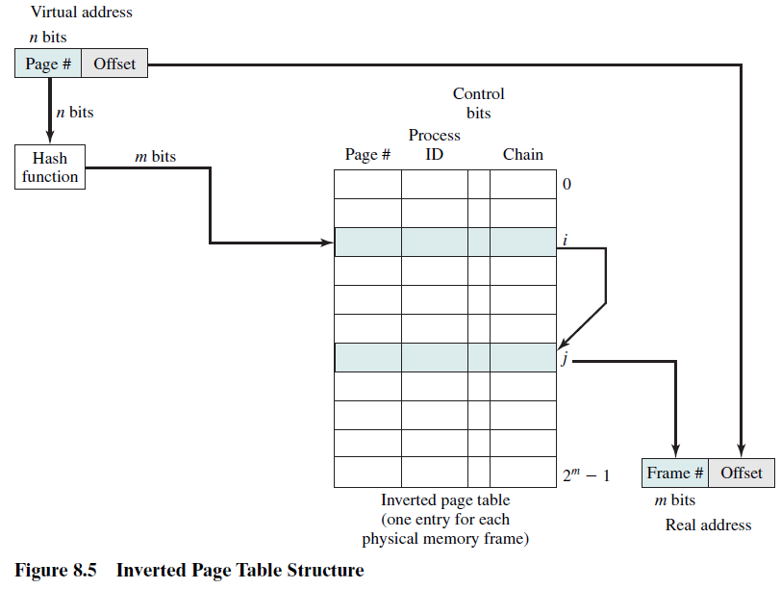
Inverted Page Table Structure

Slide 30
Translation Lookaside Buffer（TLB）
转换检测缓冲区/旁视缓冲器 “快表”
Each virtual memory reference can cause two physical memory accesses
  One to fetch the page table
  One to fetch the data
To overcome this problem a high-speed cache is set up for page table entries
  Called a Translation Lookaside Buffer (TLB)
  Contains page table entries that have been most recently used

Slide 31
Work Flow of Translation Lookaside Buffer
Given a virtual address, processor examines the TLB
If page table entry is present (TLB hit), the frame number is retrieved and the real address is formed
If page table entry is not found in the TLB (TLB miss), the page number is used to index the process page table
First checks if page is already in main memory
  If not in main memory a page fault is issued
The TLB is updated to include the new page entry

Slide 32
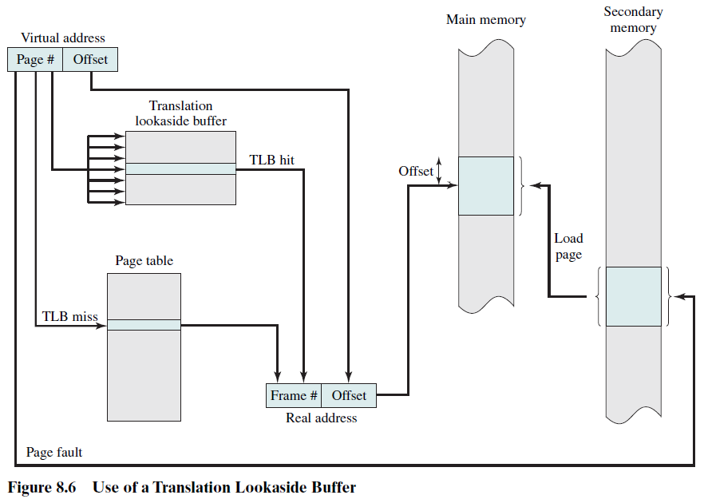
Use of a Translation Lookaside Buffer

Slide 33
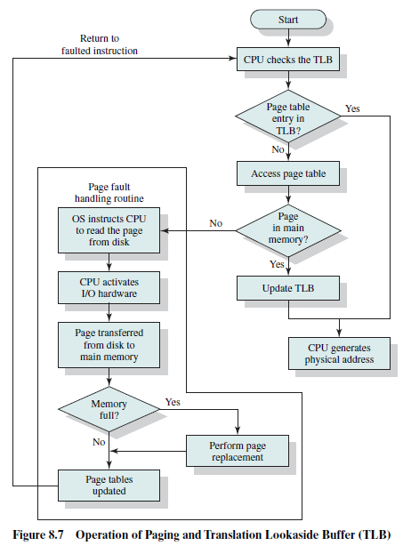

Slide 34
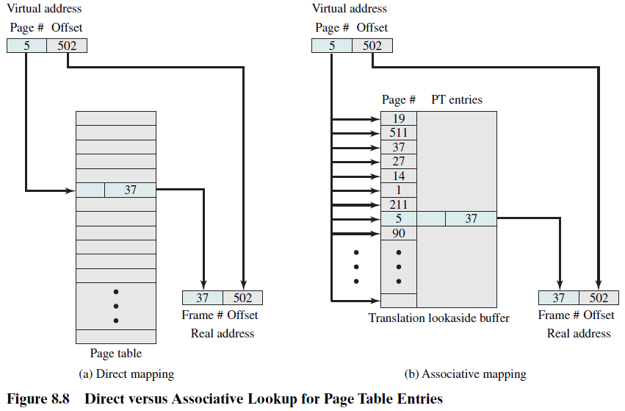
直接映射
关联映射
More details of TLB in literatures (e.g., [STAL13])...

Slide 35
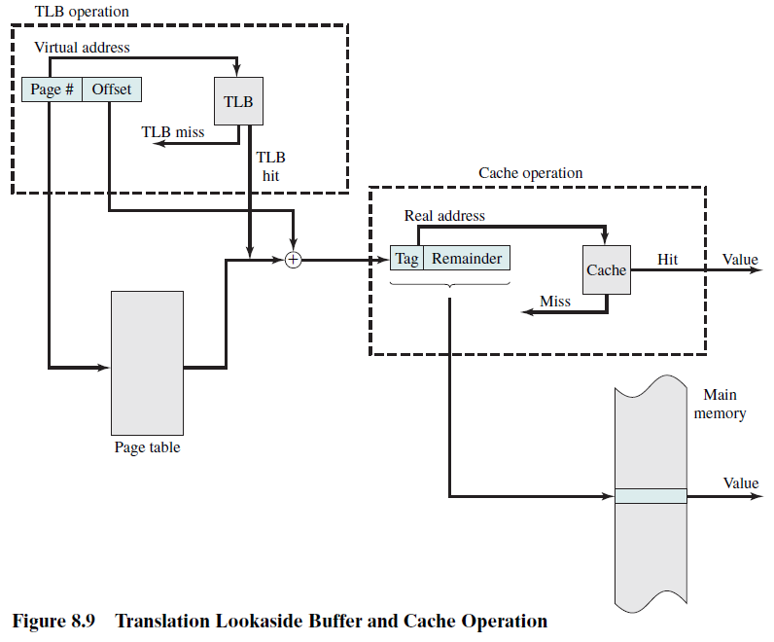
高速缓存的细节
参见[STAL13]

Slide 36
Page Size 页尺寸/页大小
Smaller page size’s advantage
  less amount of internal fragmentation 内部碎片
Smaller page size’s disadvantage
  more pages required per process, more pages per process means larger page tables
  Secondary memory is designed to efficiently transfer large blocks of data, so a large page size is better

Slide 37
Page Size
Small page size, large number of pages will be found in main memory
  As time goes on during execution, the pages in memory will all contain portions of the process near recent references. Page faults low 缺页率低
  Increased page size causes pages to contain locations further from any recent reference. Page faults rise.
However, the page fault rate will begin to fall as the size of page approaches a point.

Slide 38
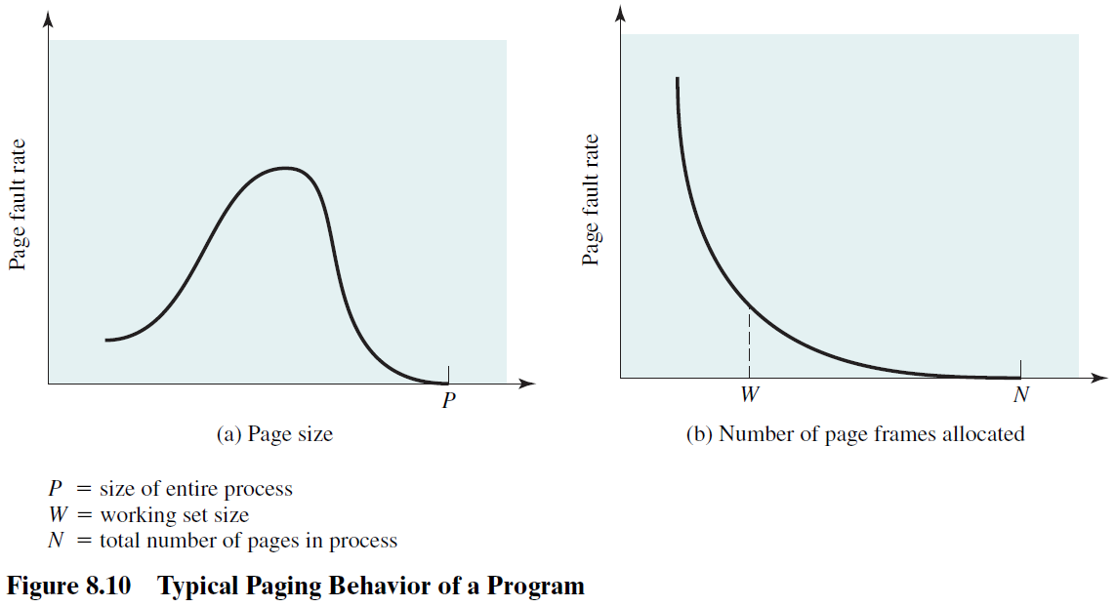

Slide 39
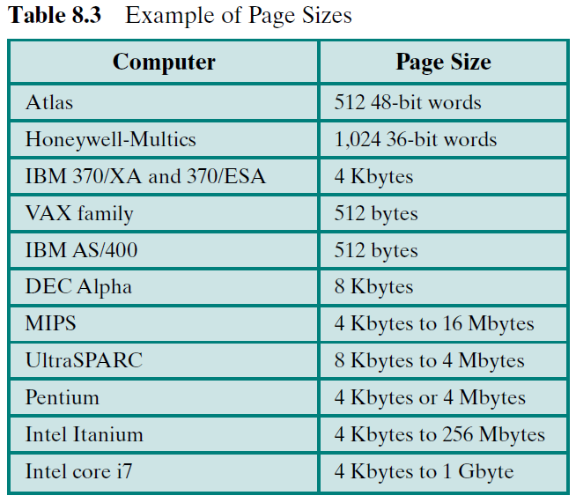
Example Page Sizes

Slide 40
8.1 Hardware and Control Structure
8.1.0 Overview
8.1.1 Locality and Virtual Memory
8.1.2 Paging
8.1.3 Segmentation 分段
8.1.4 Combined Paging and Segmentation
8.1.5 Protection and Sharing

Slide 41
Segmentation分段
Segmentation allows the programmer to view memory as consisting of multiple address spaces or segments. Segments may be of unequal, indeed dynamic, size.
Memory references consist of a (segment number, offset) form of address.
A number of advantages to the programmer over a nonsegmented address space:
  Simplifies handling of growing data structures
  Allows programs to be altered and recompiled independently
  Lends有助于itself to sharing data among processes
  Lends有助于itself to protection

Slide 42
Segmentation分段
Segmentation allows the programmer to view memory as consisting of multiple address spaces or segments. Segments may be of unequal, indeed dynamic, size.
Memory references consist of a (segment number, offset) form of address.
A number of advantages to the programmer over a nonsegmented address space:
  Simplifies handling of growing data structures
  Allows programs to be altered and recompiled independently
  Lends有助于itself to sharing data among processes
  Lends有助于itself to protection

Slide 43
Segment Tables段表
Corresponding segment in main memory内存段
Each entry contains
  the length of the segment段长
  A bit is needed to determine if segment is already in main memory存在位
  Another bit is needed to determine if the segment has been modified since it was loaded in main memory修改位

Slide 44
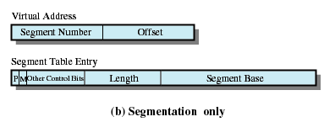
Segment Table Entries
段长
段基址

Slide 45
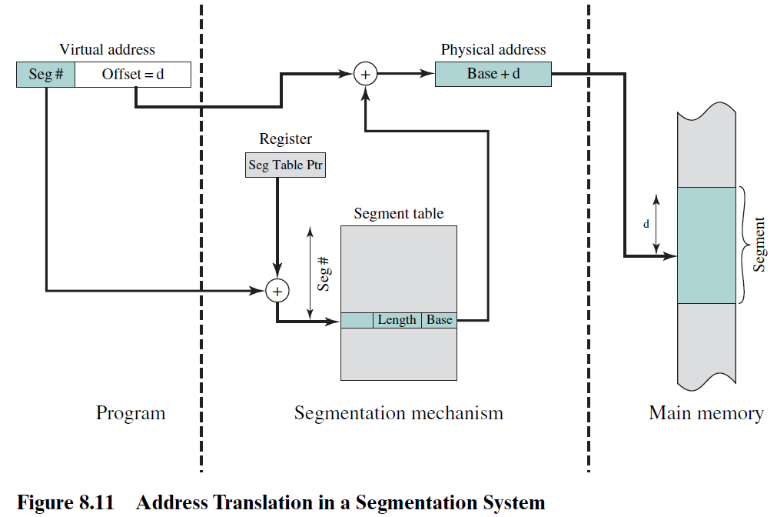

Slide 46
8.1 Hardware and Control Structure
8.1.0 Overview
8.1.1 Locality and Virtual Memory
8.1.2 Paging
8.1.3 Segmentation
8.1.4 Combined Paging and Segmentation
8.1.5 Protection and Sharing

Slide 47
Combined Paging and Segmentation
Paging is transparent to the programmer
Segmentation is visible to the programmer
Each segment is broken into fixed-size pages
Each Process has a segment table and several page tables
  Each segment has a page table

Slide 48
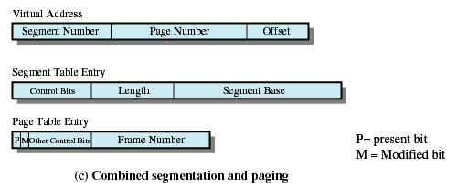
Combined Segmentation and Paging

Slide 49
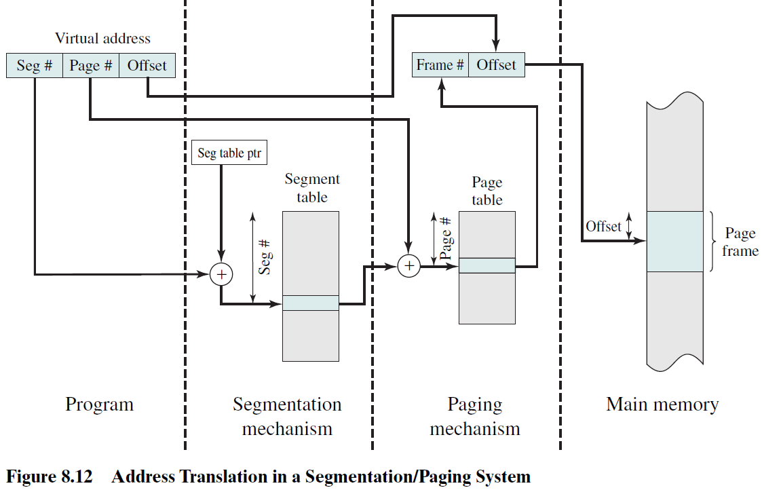

Slide 50
8.1 Hardware and Control Structure
8.1.0 Overview
8.1.1 Locality and Virtual Memory
8.1.2 Paging
8.1.3 Segmentation
8.1.4 Combined Paging and Segmentation
8.1.5 Protection and Sharing

Slide 51
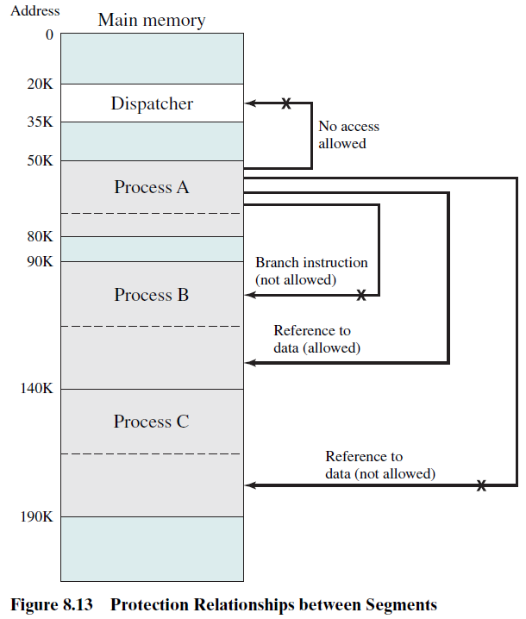

Slide 52
Agenda
8.1 Hardware and Control Structure
8.2 Operating System Software

Slide 53
8.2 Pre(1/2)
The design of the memory management portion of an operating system depends on three fundamental areas of choice:
  Whether or not to use virtual memory techniques
    VM is popular
  The use of paging or segmentation or both
    Paging is more popular
  The algorithms/policies/strategies employed for various aspects of memory management
    Table 8.4 （next）

Slide 54
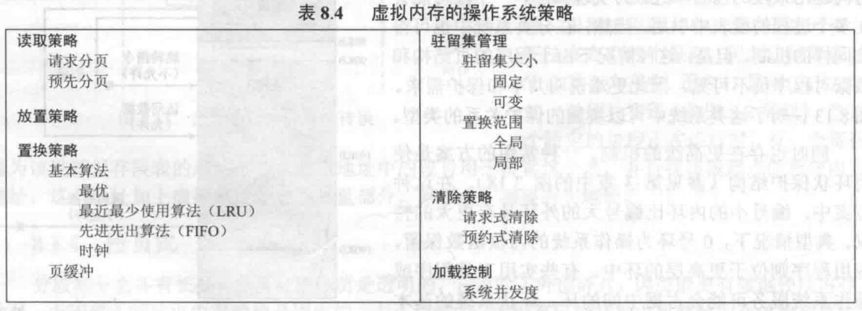
8.2 Pre(2/2)

Slide 55
8.2 Operating System Software
8.2.1 Fetch Policy 读取策略
8.2.2 Placement Policy
8.2.3 Replacement Policy
8.2.4 Resident Set Management
8.2.5 Clearing Policy
8.2.6 Load Control

Slide 56
Fetch Policy读取策略
Fetch Policy
  Determines when a page should be brought into memory
  Demand paging 请求分页式 only brings pages into main memory when a reference is made to a location on the page
    Many page faults when process first started
  Prepaging预约分页式 brings in more pages than needed
    More efficient to bring in pages that reside contiguously on the disk

Slide 57
8.2 Operating System Software
8.2.1 Fetch Policy
8.2.2 Placement Policy 放置策略
8.2.3 Replacement Policy
8.2.4 Resident Set Management
8.2.5 Clearing Policy
8.2.6 Load Control

Slide 58
Placement Policy 放置策略
Placement Policy: Determines where in real memory a process piece is to reside 驻留
  Important in a segmentation system and nonuniform memory access(NUMA, 非一致存储器访问多处理器) system
  放置策略对分段系统和NUMA系统影响大
  In Paging or combined paging with segmentation,it is not important because hardware performs address translation and placement is usually irrelevant
  放置策略对分页和段页式系统影响不大

Slide 59
8.2 Operating System Software
8.2.1 Fetch Policy
8.2.2 Placement Policy
8.2.3 Replacement Policy 置换策略
8.2.4 Resident Set Management
8.2.5 Clearing Policy
8.2.6 Load Control

Slide 60
Replacement Policy 置换策略
Placement Policy: Which page is replaced?
  Page removed should be the page least likely to be referenced in the near future 最近访问可能性最小的页
  Most policies predict the future behavior on the basis of past behavior 基于过去的行为预测未来的行为

Slide 61
Frame Locking帧锁定
Frame Locking
  If frame is locked, it may not be replaced, some examples:
    Kernel of the operating system
    Control structures
    I/O buffers
  Associate a lock bit with each frame

Slide 62
Basic Replacement Algorithms
算法1:
Optimal policy( OPT, 最佳 )
  Selects for replacement that page for which the time to the next reference is the longest
  选择下次访问距当前时间最长的页被置换
  Impossible to have perfect knowledge of future events

Slide 63
Basic Replacement Algorithms
算法2:
Least Recently Used (LRU, 最近最少使用)
  Replaces the page that has not been referenced for the longest time上次访问距当前时间最长的页
  By the principle of locality, this should be the page least likely to be referenced in the near future
  Each page could be tagged with the time of last reference. This would require a great deal of overhead.

Slide 64
Basic Replacement Algorithms
算法3:
First-in, first-out (FIFO)
  Treats page frames allocated to a process as a circular buffer把分配给进程的页帧看做是一个循环缓冲区
  Pages are removed in round-robin 循环 style
  Simplest replacement policy to implement
  Page that has been in memory the longest is replaced
  These pages may be needed again very soon

Slide 65
Basic Replacement Algorithms
算法4:
Clock Policy 时钟策略
  Additional bit called a use bit 使用位
  When a page is first loaded in memory, the use bit is set to 1
  When the page is referenced, the use bit is set to 1
  When it is time to replace a page, the first frame encountered with the use bit set to 0 is replaced
  During the search for replacement, each use bit set to 1 is changed to 0

Slide 66
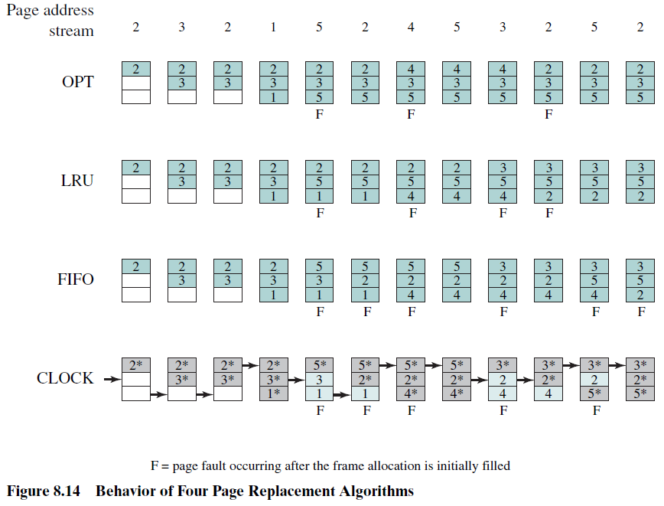

Slide 67
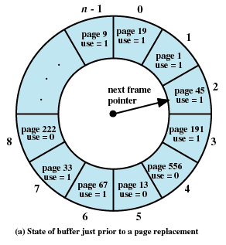
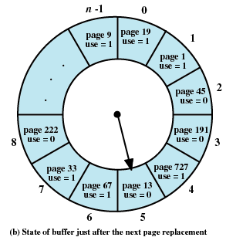

Slide 68
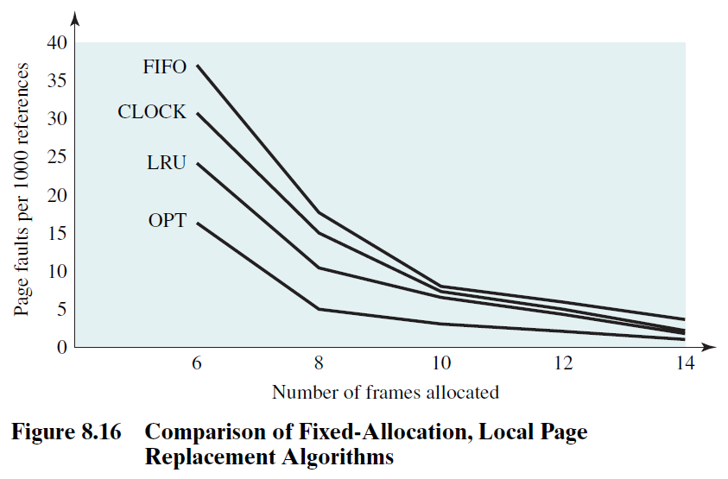
Comparison of Placement Algorithms

Slide 69
Basic Replacement Algorithms
Page Buffering 页缓冲
  Replaced page is added to one of two lists
    Free page list 空闲页表 if page has not been modified
    Modified page list 修改页表
  Read textbook：p367-368

Slide 70
8.2 Operating System Software
8.2.1 Fetch Policy
8.2.2 Placement Policy
8.2.3 Replacement Policy
8.2.4 Resident Set Management驻留集管理
8.2.5 Clearing Policy
8.2.6 Load Control

Slide 71
Resident Set Size驻留集大小(Read Textbook:P368-375)
With paged virtual memory, it is not necessary and indeed may not be possible to bring all of the pages of a process into main memory to prepare it for execution.
Thus, the OS must decide how many pages to bring in, that is, how much main memory to allocate to a particular process.
Several factors come into play:
-The smaller the amount of memory allocated to a process, the more processes that can reside in main memory at any one time. This increases the probability that the OS will find at least one ready process at any given time and hence
reduces the time lost due to swapping.

Slide 72
Resident Set Size驻留集大小
With paged virtual memory, it is not necessary and indeed may not be possible to bring all of the pages of a process into main memory to prepare it for execution.
Thus, the OS must decide how many pages to bring in, that is, how much main memory to allocate to a particular process.
Several factors come into play:
(1)The smaller the amount of memory allocated to a process, the more processes that can reside in main memory at any one time. This increases the probability that the OS will find at least one ready process at any given time and hence reduces the time lost due to swapping.

Slide 73
Resident Set Size驻留集大小
With paged virtual memory, it is not necessary and indeed may not be possible to bring all of the pages of a process into main memory to prepare it for execution.
Thus, the OS must decide how many pages to bring in, that is, how much main memory to allocate to a particular process.
Several factors come into play:
(2)If a relatively small number of pages of a process are in main memory, then, despite the principle of locality, the rate of page faults will be rather high.

Slide 74
Resident Set Size驻留集大小
With paged virtual memory, it is not necessary and indeed may not be possible to bring all of the pages of a process into main memory to prepare it for execution.
Thus, the OS must decide how many pages to bring in, that is, how much main memory to allocate to a particular process.
Several factors come into play:
(3)Beyond a certain size, additional allocation of main memory to a particular process will have no noticeable effect on the page fault rate for that process because of the principle of locality.

Slide 75
Resident Set Size驻留集大小
Fixed-allocation 固定分配
  Gives a process a fixed number of pages within which to execute
  When a page fault occurs, one of the pages of that process must be replaced
Variable-allocation 可变分配
  Number of pages allocated to a process varies over the lifetime of the process

Slide 76
Replace Scope置换范围
The scope of a replacement strategy can be categorized as global or local. Both types of policies are activated by a page fault when there are no free page frames.
Local Replace Policy 局部置换
  Chooses only among the resident pages of the process that generated the page fault in selecting a page to replace
Global Replace Policy 全局置换
  Considers all unlocked pages in main memory as candidates for replacement, regardless of which process owns a particular page

Slide 77
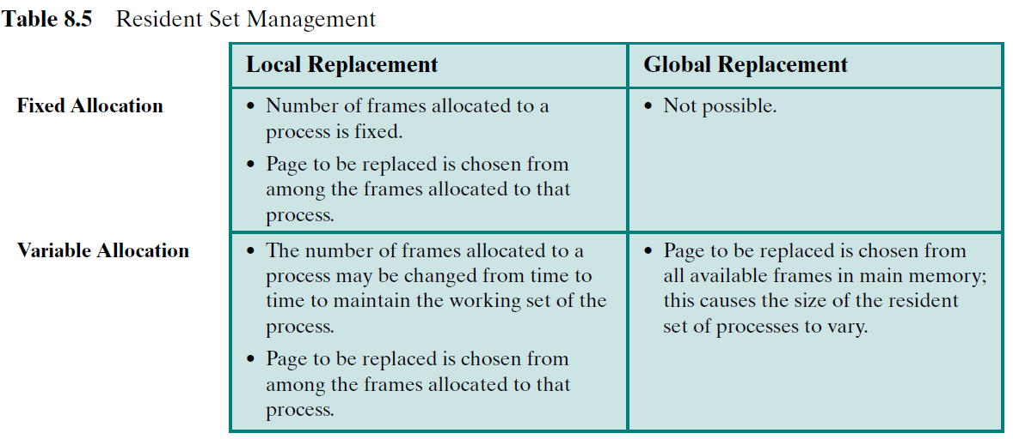

Slide 78
Fixed Allocation, Local Scope固定分配,局部置换
Decide ahead of time the amount of allocation to give a process 事先确定给进程分配多少页
If allocation is too small, there will be a high page fault rate 如果太少，导致高缺页率
If allocation is too large there will be too few programs in main memory 如果分配太多，内存中驻留的程序会过少

Slide 79
Variable Allocation,Global Scope可变分配,全局置换
Easiest to implement
  Adopted by many operating systems
Operating system keeps list of free frames
Free frame is added to resident set of process when a page fault occurs
If no free frame, replaces one from any of the resident processes

Slide 80
Variable Allocation,Local Scope可变分配,局部置换
When new process added, allocate number of page frames based on application type, program request, or other criteria
When page fault occurs, select page from among the resident set of the process that suffers the fault
Reevaluate重新评估allocation of processes from time to time, and increase or decrease allocation to improve overall performance

Slide 81
8.2 Operating System Software
8.2.1 Fetch Policy
8.2.2 Placement Policy
8.2.3 Replacement Policy
8.2.4 Resident Set Management
8.2.5 Clearing Policy 清除策略
8.2.6 Load Control

Slide 82
Cleaning Policy
A cleaning policy is the opposite of a fetch policy; it is concerned with determining when a modified page should be written out to secondary memory.
Two common alternatives are demand cleaning and precleaning.
Demand cleaning 请求式清除
  A page is written out only when it has been selected for replacement
Precleaning 预约式清除
  Pages are written out in batches before they are needed

Slide 83
Cleaning Policy
Best approach uses page buffering
  Replaced pages are placed in two lists
    Modified and unmodified
  Pages in the modified list are periodically written out in batches
  Pages in the unmodified list are either reclaimed 回收if referenced again or lost when its frame is assigned to another page

Slide 84
8.2 Operating System Software
8.2.1 Fetch Policy
8.2.2 Placement Policy
8.2.3 Replacement Policy
8.2.4 Resident Set Management
8.2.5 Clearing Policy
8.2.6 Load Control 加载控制

Slide 85
Load Control
Determines the number of processes that will be resident in main memory
Too few processes, many occasions when all processes will be blocked and much time will be spent in swapping
Too many processes will lead to thrashing

Slide 86
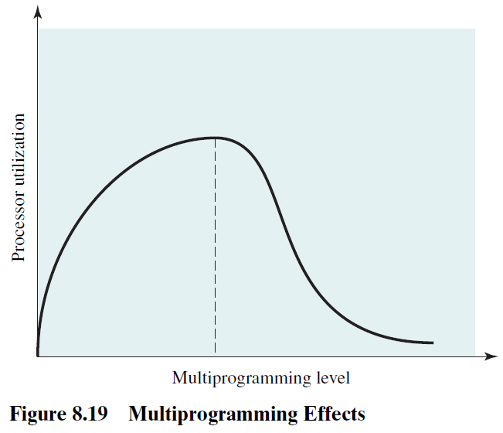
Multiprogramming Level 多道程序设计级

Slide 87
Process Suspension 进程挂起
If the degree of multiprogramming is to be reduced, one or more of the currently resident processes must be suspended (swapped out) 系统并发度减小时，一个或多个当前驻留进程必须被挂起（换出）

Slide 88
Process Suspension 进程挂起
[CARR81] lists six possibilities:
Lowest priority process 最低优先级进程
Faulting process 页错误进程
  This process does not have its working set in main memory so it will be blocked anyway
Last process activated 最后被激活的进程
  This process is least likely to have its working set resident
Process with smallest resident set 驻留集最小的进程
  This process requires the least future effort to reload
Largest process 占用空间最大的进程
  Obtains the most free frames
Process with the largest remaining execution window 具有最大剩余执行窗口的进程

Slide 89
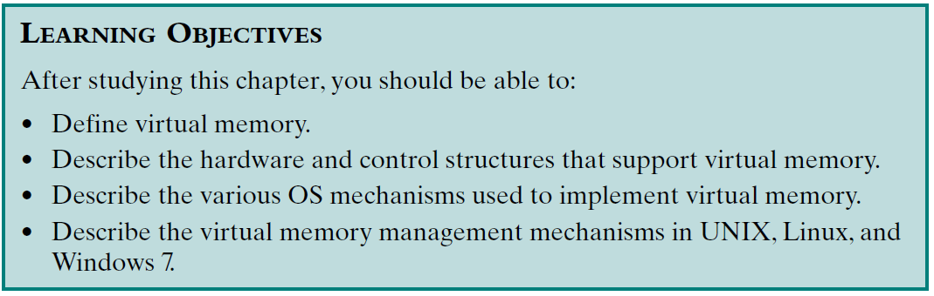
Review：
Assigned Readings: textbooks,p341-395; preview Chapter 9.

