Slide 1

Chapter 9 Uniprocessor Scheduling
陈瑜
yuchen@scu.edu.cn

Slide 2
Agenda
9.1 Type of Processor Scheduling 处理器调度类型
9.2 Scheduling Algorithms

Slide 3
9.1 Type of Processor Scheduling
9.1.0 Overview
9.1.1 Long-term Scheduling
9.1.2 Medium-term Scheduling
9.1.3 Short-term Scheduling

Slide 4
Function and Aim of Scheduling
Function
  广义：Assign resources to processes
  狭义：Assign processor(s) to processes
Aim (These criteria conflict; finding the right balance)
  Response time 响应时间
  Throughput 吞吐率
  Processor efficiency 处理器效率
  Fairness 公平性

Slide 5
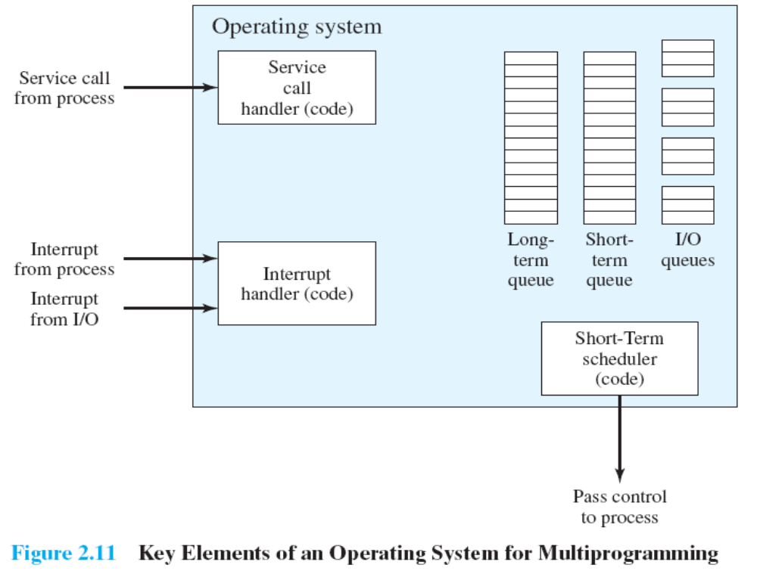

Slide 6
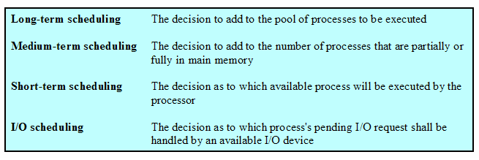
Types of Scheduling

Slide 7
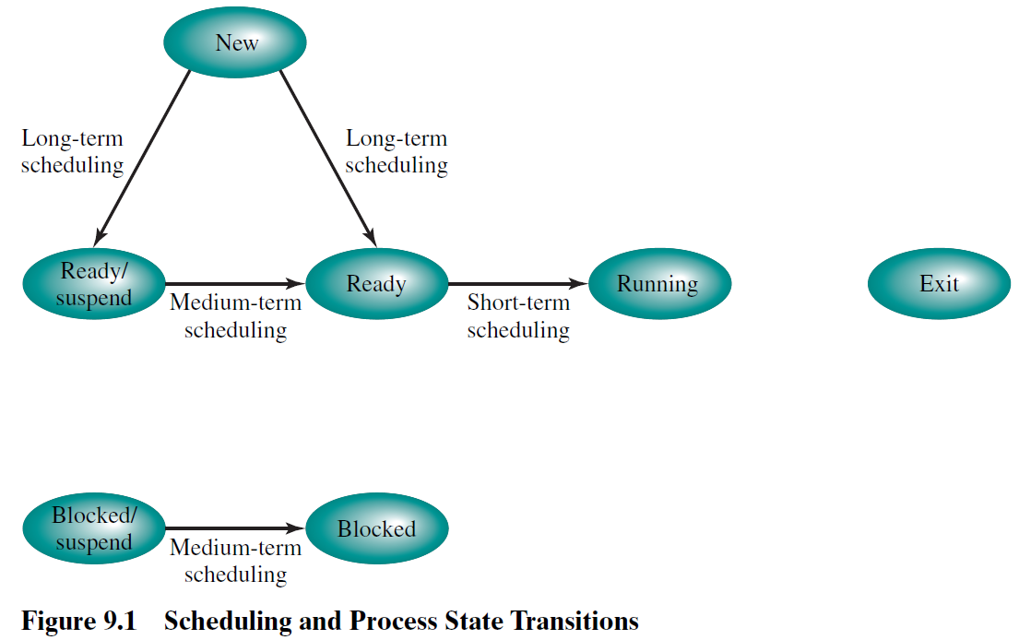
Scheduling and Process State Transitions
调度与进程状态转换

Slide 8
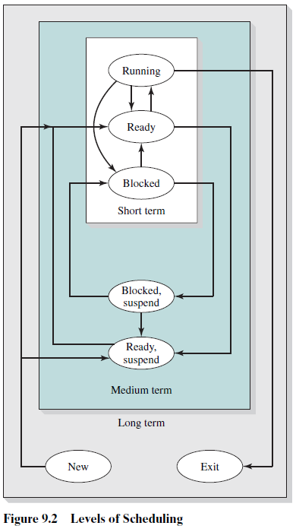
Levels of Scheduling 调度层次

Slide 9
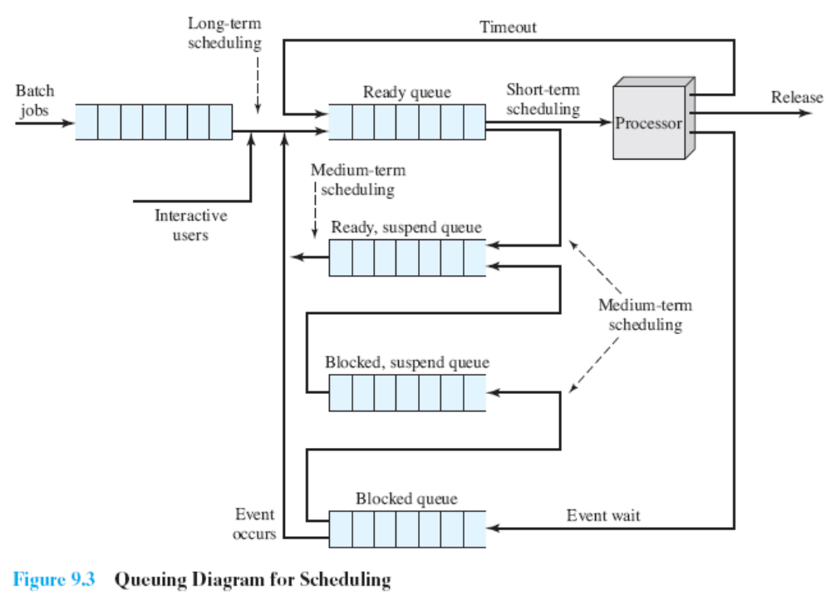

Slide 10
9.1 Type of Processor Scheduling
9.1.0 Overview
9.1.1 Long-term Scheduling 长程调度
9.1.2 Medium-term Scheduling
9.1.3 Short-term Scheduling

Slide 11
Long-Term Scheduling 长程调度
Determines which programs are admitted to the system for processing
  Controls the degree of multiprogramming
  More processes, smaller percentage of time each process is executed

Slide 12
9.1 Type of Processor Scheduling
9.1.0 Overview
9.1.1 Long-term Scheduling
9.1.2 Medium-term Scheduling
9.1.3 Short-term Scheduling

Slide 13
Medium-Term Scheduling 中程调度
Part of the swapping function
  Based on the need to manage the degree of multiprogramming

Slide 14
9.1 Type of Processor Scheduling
9.1.0 Overview
9.1.1 Long-term Scheduling
9.1.2 Medium-term Scheduling
9.1.3 Short-term Scheduling

Slide 15
Short-Term Scheduling 短程调度
Known as the dispatcher 分派器/分派程序
  Executes most frequently
Invoked when an event occurs：
  Clock interrupts 时钟中断
  I/O interrupts I/O中断
  Operating system calls 操作系统调用
  Signals(e.g., semaphores) 信号（信号量）

Slide 16
Agenda
9.1 Type of Processor Scheduling
9.2 Scheduling Algorithms

Slide 17
9.2 Scheduling Algorithms
9.2.1 Short-term Criteria 短程调度规则
9.2.2 The Use of Priorities
9.2.3 Alternative of Scheduling Policies
9.2.4 Performance Comparison
9.2.5 Fair-Share Scheduling

Slide 18
Short-Tem Scheduling Criteria短程调度规则
User-oriented 面向用户
  User oriented criteria relate to the behavior of the system as perceived by the individual user or process.
  用户感知到的系统行为
  E.g.: Response Time 响应时间
    Elapsed time between the submission of a request until there is output.
System-oriented 面向系统
  the focus is on effective and efficient utilization of the processor处理器的使用效率
  E.g.: throughput
    which is the rate at which processes are completed.

Slide 19
Short-Term Scheduling Criteria
Performance-related 性能相关
  Quantitative 定量的
    such as
      response time 响应时间
      throughput 吞吐率
not directly performance related与性能无直接关系
  either qualitative 定性的 in nature or do not lend themselves readily to measurement and analysis.
    such as
      predictability 可预测性

Slide 20
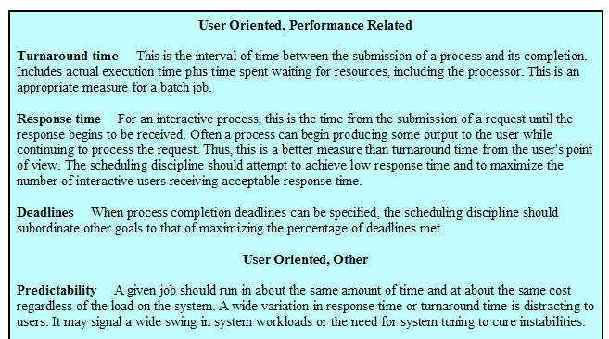
Table 9.2 Scheduling Criteria调度规则（p403）

Slide 21
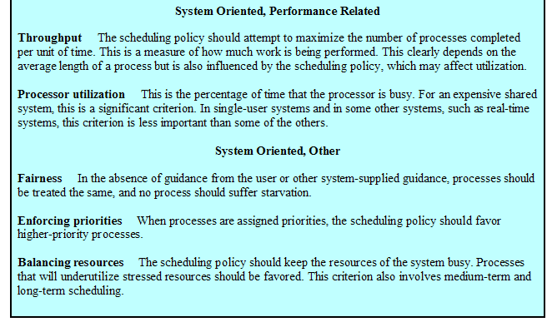
Table 9.2 Scheduling Criteria（cont.）

Slide 22
9.2 Scheduling Algorithms
9.2.1 Short-term Criteria
9.2.2 The Use of Priorities优先级的使用
9.2.3 Alternative of Scheduling Policies
9.2.4 Performance Comparison
9.2.5 Fair-Share Scheduling

Slide 23
Priorities 优先级
Scheduler will always choose a process of higher priority over one of lower priority
Have multiple ready queues to represent each level of priority
Lower-priority may suffer starvation
  Allow a process to change its priority based on its age or execution history

Slide 24
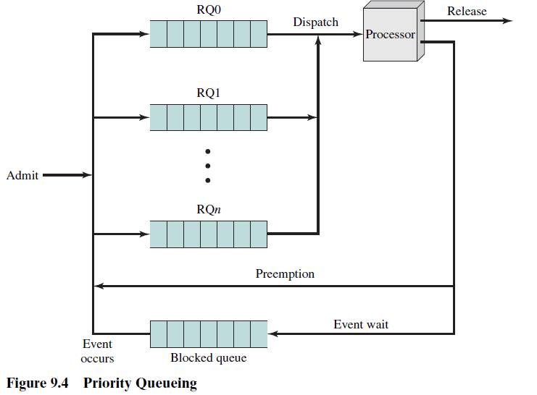
Priorities Queuing

Slide 25
9.2 Scheduling Algorithms
9.2.1 Short-term Criteria
9.2.2 The Use of Priorities
9.2.3 Alternative of Scheduling Policies选择调度策略
9.2.4 Performance Comparison
9.2.5 Fair-Share Scheduling

Slide 26
Terms
Response time 响应时间
Turnaround time 周转时间
Normalized turnaround time 归一化周转事件，周转时间/服务时间
Throughput 吞吐率
Predictability 可预测性
Selection function 选择函数，确定在就绪进程中选择哪一个进程在下一次执行
Decision mode 决策模式，选择函数被执行瞬间的处理方式
  Preemptive 抢占，当前正在执行的进程可能被操作系统中断，并转移到就绪态
  Nonpreemptive 非抢占，一旦处于运行态就不断执行直到终止或者被阻塞

Slide 27
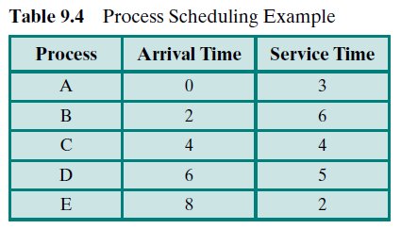
Process Scheduling Example

Slide 28
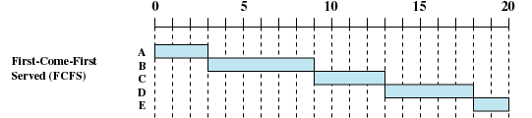
First-Come-First-Served，FCFS
先来先服务 （Figure 9.5）
Decision mode: Nonpreempitive
Dispatch time: the current process ceases 终止 to execute
Method: The oldest process in the Ready queue is selected

Slide 29
First-Come-First-Served (FCFS)
Disadvantageous to short process
  A short process may have to wait a very long time before it can execute
Favors CPU-bound processes偏向于受处理器限制的进程
  I/O processes have to wait until CPU-bound process completes

Slide 30


Round-Robin，RR 轮转 （Figure 9.5）
RR，q＝1
Decision mode: preemption
Dispatch time: period q based on a clock
Method：select next process based on FCFS

Slide 31
Round-Robin
Clock interrupt is generated at periodic intervals
When an interrupt occurs, the currently running process is placed in the read queue
  Next ready job is selected based on FCFS
Known as time slicing 时间片
Disadvantageous to I/O-bound processes

Slide 32
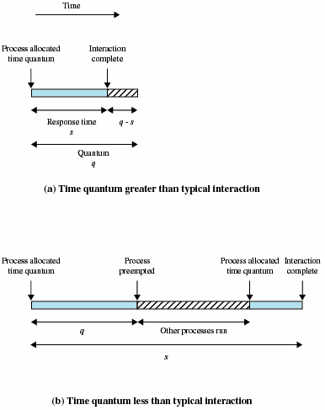
Effect of Size of Preemption Time Quantum 时间片大小的影响 (Figure 9.6)

Slide 33
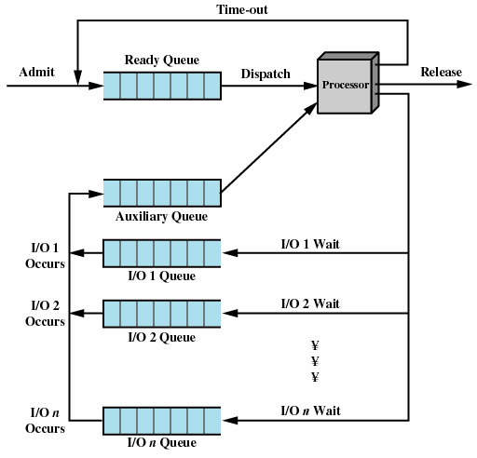
Queuing Diagram for virtual Round-Robin Scheduler，VRR 虚拟轮转法 (Figure 9.7)

Slide 34

Shortest Process Next，SPN 最短进程优先
（Figure 9.5）
Decision mode: Nonpreemptive
Dispatch time: the current process ceases to execute
Method: Process with shortest expected processing time is selected next

Slide 35
Shortest Process Next
Predictability of longer processes is reduced 长进程的可预测性降低了
Possibility of starvation 饥饿 for longer processes

Slide 36

Shortest Remaining Time，SRT 最短剩余时间 (Figure 9.5)
Decision mode: Preemptive version of shortest process next
Dispatch time: decision is made when a new process arrives
Method: Process with shortest remaining time is selected next

Slide 37

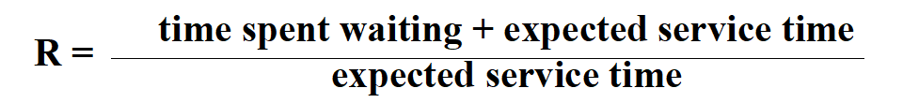
Highest Response Ratio Next，HRRN
最高响应比优先 (Figure 9.5)
Decision mode: Nonpreemptive
Dispatch time: the current process ceases to execute
Method: Choose next process with the greatest response ratio

Slide 38
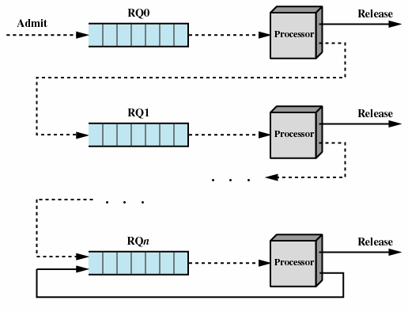
Feedback 反馈法 （Figure 9.10）
SPN/SRT/HRRN need to know process service time
while Feedback doesn’t
Preemptive
Penalize 惩罚 jobs that have been running longer

Slide 39
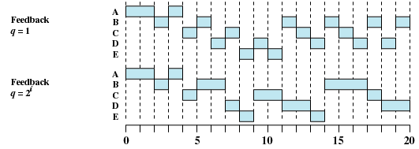
Feedback （Figure 9.5）

Slide 40
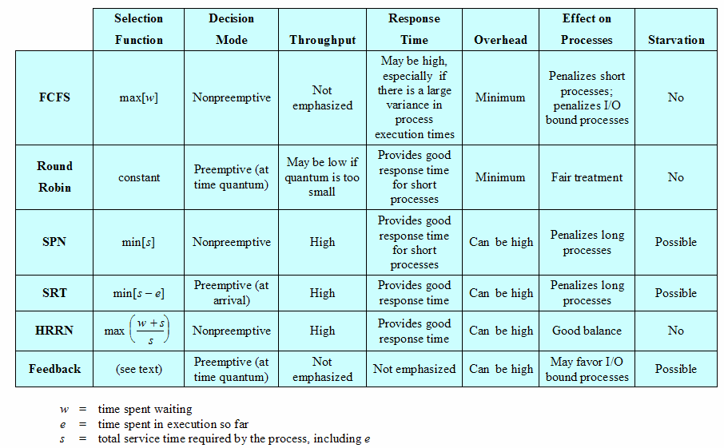
Characteristics of Various Scheduling Policies
（Table 9.3）

Slide 41
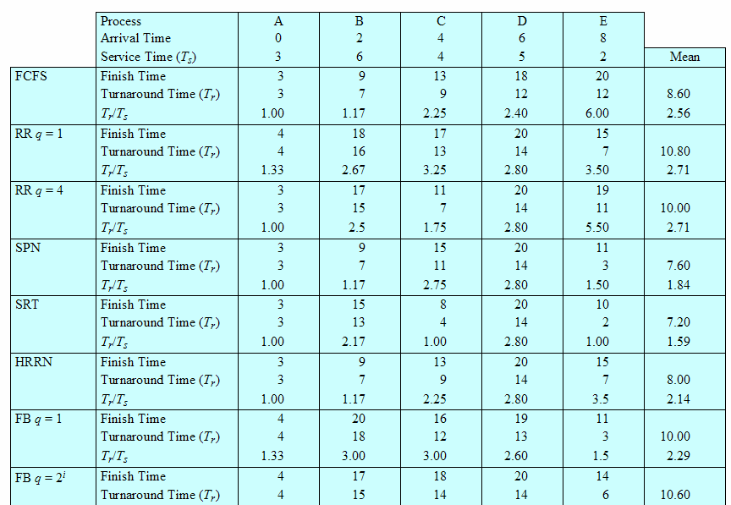
A Comparison of Scheduling policies(Table 9.5)

Slide 42
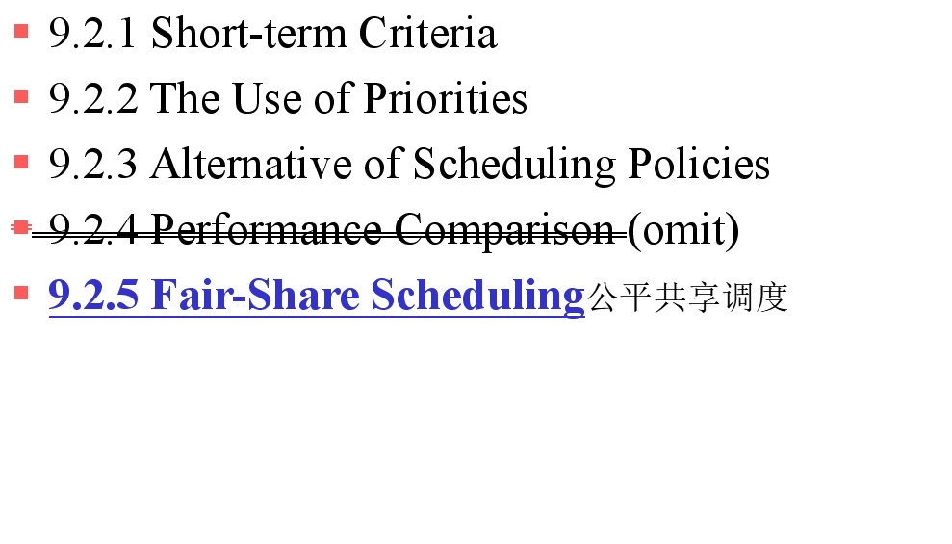
9.2 Scheduling Algorithms

Slide 43
Fair-Share Scheduling 公平共享调度
User’s application runs as a collection of processes (threads)
User is concerned about the performance of the application
Need to make scheduling decisions based on process sets

Slide 44
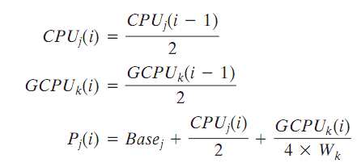
Fair-Share Scheduling 公平共享调度
Scheduling is done on the basis of
  under-lying priority of the process
  recent processor usage of the process
  recent processor usage of the group
The higher the numerical value of the priority, the lower the priority. The following formulas apply for process j in group k:

Slide 45
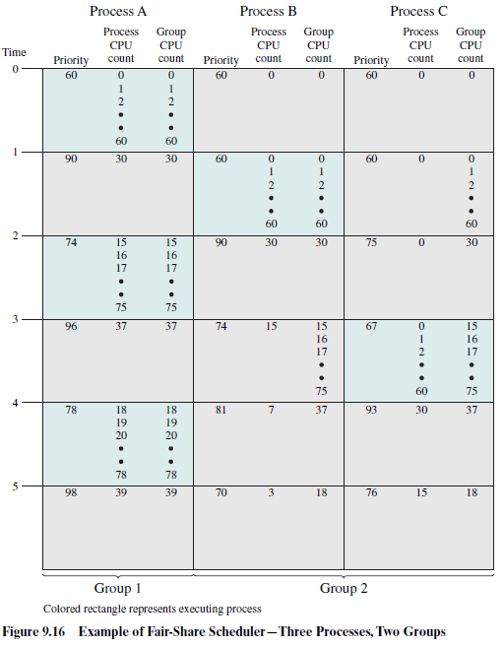
Example of Fair share Scheduler

Slide 46
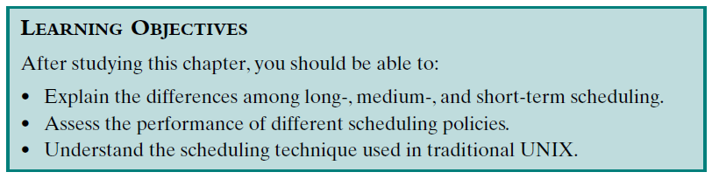
Review：
Assigned Readings: textbooks,p398-431; preview Chapter 11.

