Slide 1

Chapter 11 I/O Management and Disk Scheduling
陈瑜
yuchen@scu.edu.cn

Slide 2
Agenda
11.1 I/O Devices I/O设备
11.2 Organization of the I/O Function
11.3 Operating System Design Issues
11.4 I/O Buffering
11.5 Disk Scheduling
11.6 RAID
11.7 Disk Cache

Slide 3
Categories of I/O Devices
I/O设备分类
Roughly grouped into three categories:
1. Human readable 人可读
  Used to communicate with the user
  Printers
  Video display terminals
    Display
    Keyboard
    Mouse

Slide 4
Categories of I/O Devices
2. Machine readable 机器可读
  Used to communicate with electronic equipment
  Disk and tape drives
  Sensors
  Controllers

Slide 5
Categories of I/O Devices
3. Communication 通信
  Used to communicate with remote devices
  Digital line drivers 数字线路驱动器
  Modems
  Network device

Slide 6
Differences in I/O Devices
1. Data rate数据传输速率
  May be differences of several orders of magnitude数量级 between the data transfer rates

Slide 7
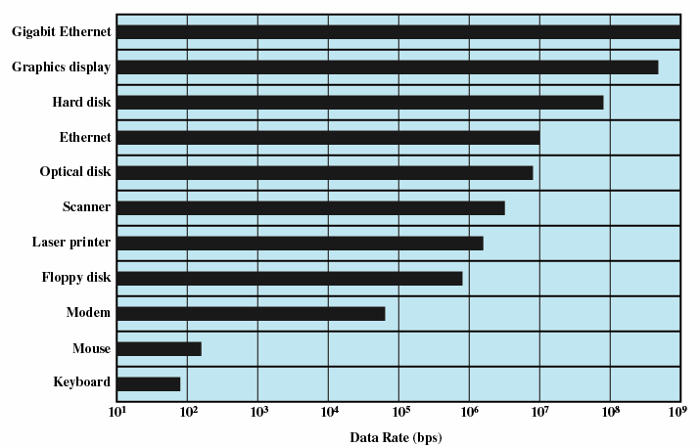
Typical I/O Device Data Rates

Slide 8
Differences in I/O Devices
2. Application：the use to which a device is put has an influence on the software and policies in the OS and supporting utilities. For example:
  Disk used to store files requires file management software
  Disk used to store virtual memory pages needs special hardware and software to support it
  Terminal may be used by an ordinary user or a system administrator. These uses imply different privilege levels and perhaps different priorities in the OS.

Slide 9
Differences in I/O Devices
3. Complexity of control 控制复杂性: For example, a printer requires a relatively simple control interface. A disk is much more complex.
4. Unit of transfer 传送单位
  Data may be transferred as
    a stream of bytes，e.g. terminal
    in larger blocks, e.g. disk
5. Data representation
  Encoding schemes
6. Error conditions
  Devices respond to errors differently

Slide 10
Agenda
11.1 I/O Devices
11.2 Organization of the I/O Function I/O功能的组织
11.3 Operating System Design Issues
11.4 I/O Buffering
11.5 Disk Scheduling
11.6 RAID
11.7 Disk Cache

Slide 11
Three techniques for performing I/O:
1. Programmed I/O 可编程I/O（程序控制I/O）
  The processor issues an I/O command, on behalf of a process, to an I/O module; that process then busy waits for the operation to be completed before proceeding.
  Process is busy-waiting for the operation to complete
2. Interrupt-driven I/O 中断驱动I/O
  The processor issues an I/O command to an I/O module
  Processor continues executing instructions
  I/O module sends an interrupt when done
3. Direct Memory Access，DMA 直接存储器访问
  DMA module controls exchange of data between main memory and the I/O device
  Processor interrupted only after entire block has been transferred
  DMA must be supported by the operating system.

Slide 12
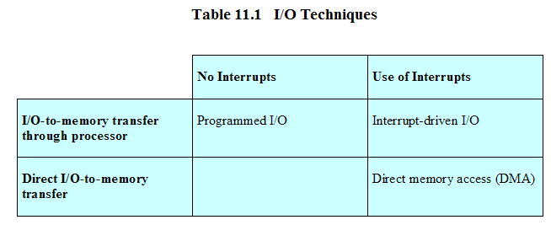
Relationship Among Techniques

Slide 13
Evolution of the I/O Function
I/O功能的发展 （六个阶段）
Processor directly controls a peripheral device外部设备
  Processor has to handle details of external devices
Controller or I/O module is added
  Processor uses programmed I/O without interrupts
  Processor does not need to handle details of external devices
Controller or I/O module with interrupts
  Processor does not spend time waiting for an I/O operation to be performed

Slide 14
Evolution of the I/O Function
I/O功能的发展 （六个阶段）
The I/O module is given direct control of memory via DMA
  Blocks of data are moved into memory without involving the processor
  Processor involved at beginning and end only

Slide 15
Evolution of the I/O Function
I/O功能的发展 （六个阶段）
I/O module (I/O channel， I/O通道) is enhanced to a separate processor.
I/O模块有一个单独的处理器、专门的I/O指令集
  The central processing unit (CPU) directs the I/O processor to execute an I/O program in main memory.
  The I/O processor fetches and executes these instructions without processor intervention介入
I/O processor （I/O处理器）
  I/O module has its own local memory
  Its a computer in its own right

Slide 16
Evolution of the I/O Function
I/O功能的发展 （六个阶段）
I/O module (I/O channel) is enhanced to a separate processor. I/O模块有一个单独的处理器、专门的I/O指令集
  The central processing unit (CPU) directs the I/O processor to execute an I/O program in main memory.
  The I/O processor fetches and executes these instructions without processor intervention介入
I/O processor
  I/O module has its own local memory
  Its a computer in its own right
As one proceeds along this evolutionary path,
more and more of the I/O function is performed without processor involvement.
The central processor is increasingly relieved of I/O-related tasks, improving performance.

Slide 17
Direct Memory Access 直接存储器访问
Processor delegates 委派 I/O operation to the DMA module
DMA module transfers data directly to or form memory
When complete DMA module sends an interrupt signal to the processor

Slide 18
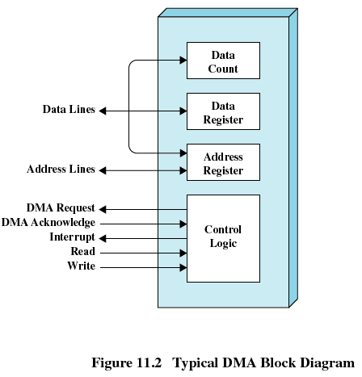
DMA Block diagram 典型的DMA框图

Slide 19
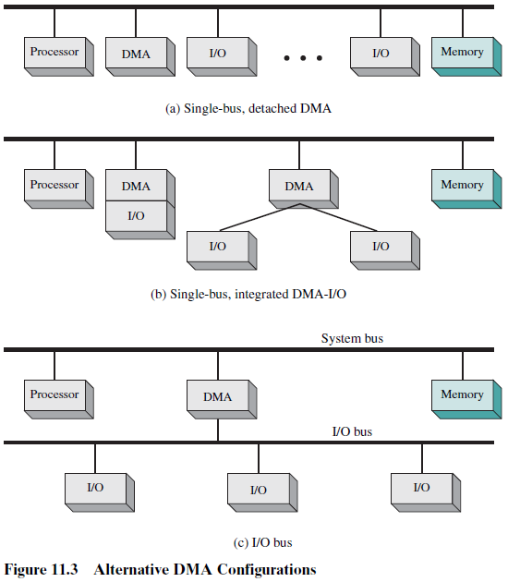
DMA Configurations DMA配置

Slide 20
Agenda
11.1 I/O Devices
11.2 Organization of the I/O Function
11.3 Operating System Design Issues
11.4 I/O Buffering
11.5 Disk Scheduling
11.6 RAID
11.7 Disk Cache

Slide 21
Operating System Design Issues
操作系统设计问题
Efficiency 效率 and generality通用性 are most important objectives in designing the I/O facility
Efficiency 效率
  Most I/O devices extremely slow compared to main memory，I/O cannot keep up with processor speed
  Use of multiprogramming多道程序allows for some processes to be waiting on I/O while another process executes
  Swapping交换 is used to bring in additional Ready processes which is an I/O operation

Slide 22
Operating System Design Issues
Generality通用性
  Desirable to handle all I/O devices in a uniform manner统一模式
  Hide most of the details of device I/O in lower-level routines例程 so that processes and upper levels see devices in general terms such as read, write, open, close, lock, unlock

Slide 23
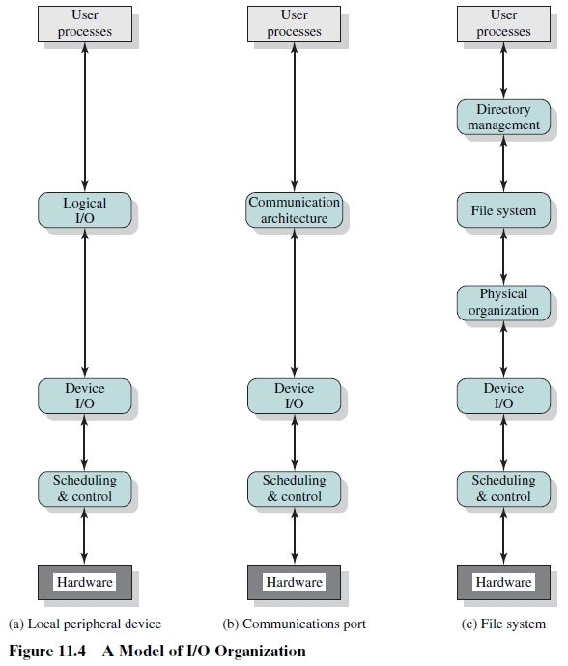

Slide 24
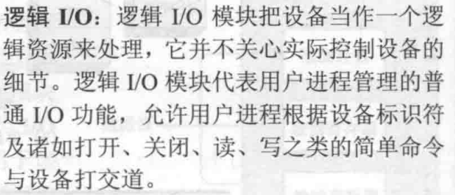

Slide 25
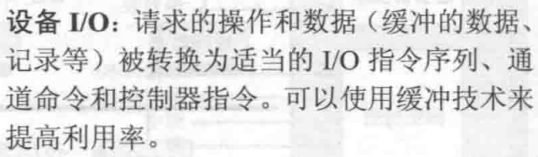

Slide 26
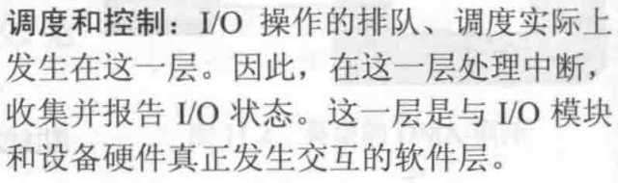

Slide 27
Agenda
11.1 I/O Devices
11.2 Organization of the I/O Function
11.3 Operating System Design Issues
11.4 I/O Buffering
11.5 Disk Scheduling
11.6 RAID
11.7 Disk Cache

Slide 28
I/O Buffering I/O缓冲
Reasons for buffering 缓存原因
  Processes must wait for I/O to complete before proceeding
  Certain pages must remain in main memory during I/O
Define of I/O buffering
  Performs input transfers in advance of requests being made and performs output transfers some time after the request is made 预输入、缓输出

Slide 29
I/O Buffering
Distinction between two types of I/O devices:
1. Block-oriented 面向块
  Information is stored in fixed sized blocks
  Transfers are made a block at a time
  Used for disks and tapes
2. Stream-oriented 面向流
  Transfers information as a stream of bytes
  Used for terminals, printers, communication ports, mouse and other pointing devices, and most other devices that are not secondary storage

Slide 30
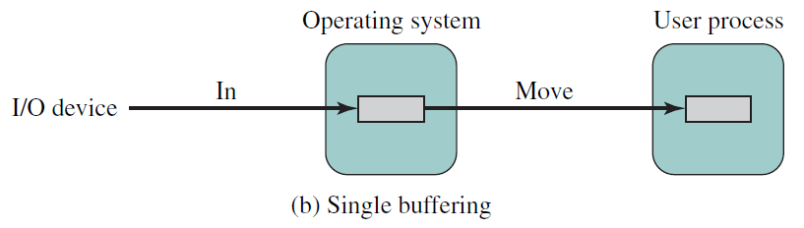
Single Buffer 单缓冲
Operating system assigns分配 one buffer in the system space for an I/O request
Block-oriented single buffering
  Input transfers are made to buffer
  Block is moved to user space when needed
  Another block is requested immediately
    Read ahead 预读 , or anticipated input 预输入

Slide 31
Single Buffer
Advantages of block-oriented single buffer
  User process can process one block of data while next block is read in
  Swapping can occur since input is taking place in system memory, not user memory
Disadvantages of block-oriented single buffer
  Operating system keeps track of assignment of system buffers to user processes
  The swapping logic is affected

Slide 32
Single Buffer
Stream-oriented single buffer
  Line-at-a-time fashion
    Input from or output to a terminal is one line at a time with carriage return signaling the end of the line
  Byte-at-a-time fashion
    Input and Output follow the producer/consumer model

Slide 33
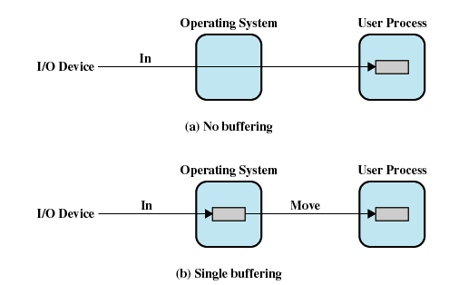
I/O Buffering [KNUT97]
处理时间：T+C
T：输入一个数据块到内存所需要的时间，即传输时间
C：被用户进程加工处理需要的计算时间
M：将数据从系统缓冲区复制到用户内存工作空间所需时间，移动时间
处理时间：max[T, C]+M

Slide 34
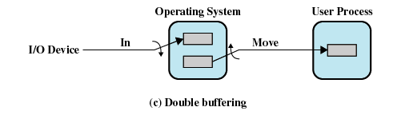
Double Buffer 双缓冲
Use two system buffers instead of one
A process can transfer data to or from one buffer while the operating system empties or fills the other buffer
处理时间：max[T, C]

Slide 35
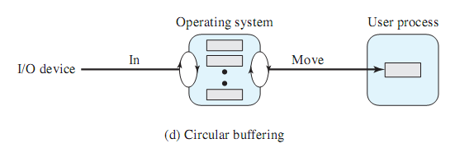
Circular Buffer 循环缓冲
More than two buffers are used
Each individual buffer is one unit in a circular buffer
Used when I/O operation must keep up with process

Slide 36
The Utility of Buffering缓冲的作用
Buffering is a technique that smoothes out peaks in I/O demand.
Buffering is one tool that can increase the efficiency of the OS and the performance of individual processes.

Slide 37
Agenda
11.1 I/O Devices
11.2 Organization of the I/O Function
11.3 Operating System Design Issues
11.4 I/O Buffering
11.5 Disk Scheduling
11.6 RAID
11.7 Disk Cache

Slide 38
Disk Performance Parameters
When the disk drive is operating, the disk is rotating at constant speed. To read or write, the disk head must be positioned at the desired track 磁道 and at the beginning of the desired sector 扇区

Slide 39
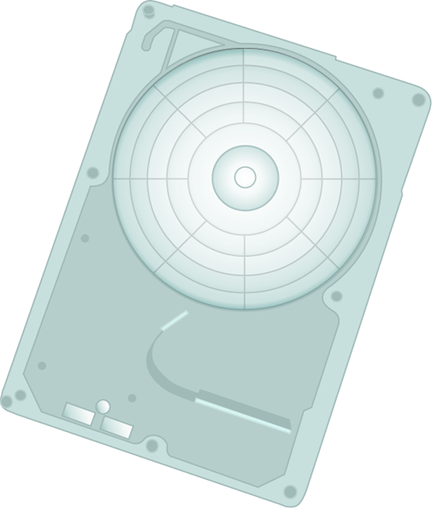


Seek time寻道时间
Time it takes to position the head磁头at the desired track

Slide 40
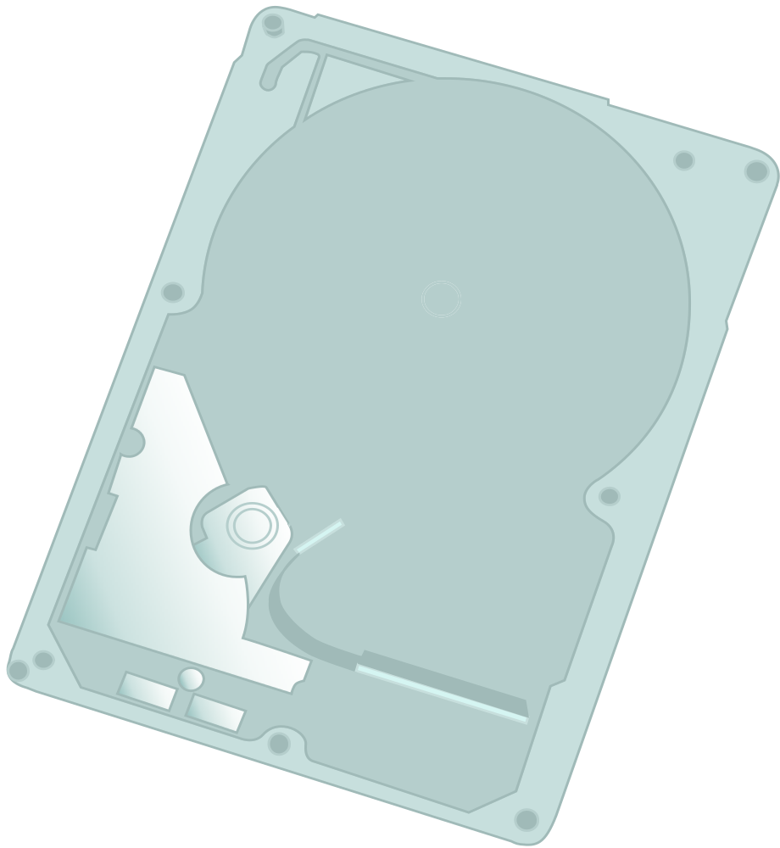
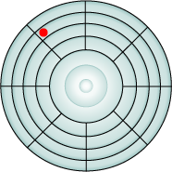

Rotational delay旋转延迟
Time its takes for the beginning of the sector to reach the head

Slide 41
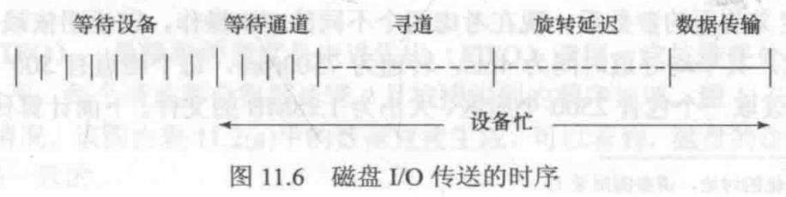
Timing of a Disk I/O Transfer

Slide 42

Disk Performance Parameters磁盘性能参数
Access time 存取时间
  The time it takes to get in position to read or write
  Sum of seek time (T_{s}) and rotational delay (1/2r)
Transfer time 传输时间, b/(rN)
  Data transfer occurs as the sector moves under the head
Thus the total average access time can be expressed as:
Ta：总平均存取时间
Ts：平均寻道时间
r：旋转速度，转/秒
b：要传送字节数
N：一个磁道的字节数

Slide 43
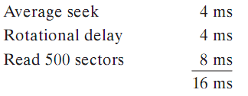
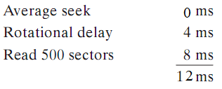
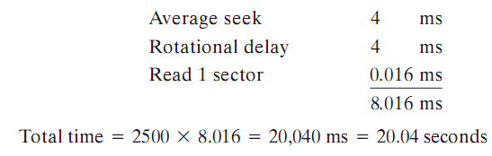
A Timing Comparison 时序比较
Sequential access: 5 adjacent相邻 tracks, 500 sectors/track, total 2500 sectors
First track: Next 4 tracks:
Random access: 2500 sectors

Slide 44
Disk Scheduling Policies
磁盘调度策略
Seek time and rotational delay are the reasons for differences in performance
  The key to increase performance of disk is to minimize seek time
Random scheduling
  For a single disk there will be a number of I/O requests
  If requests are selected randomly (random scheduling, 随机调度), we will poor performance
  used to evaluate other techniques

Slide 45
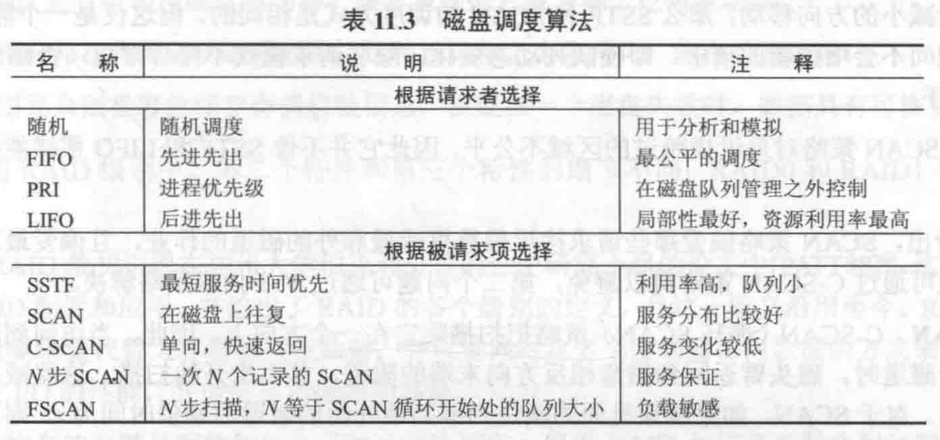
Disk Scheduling Policies
磁盘调度策略

Slide 46
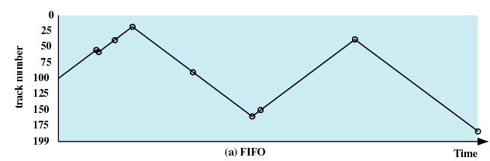
Disk Scheduling Policies
First-in, first-out (FIFO)
  Processes items from the queue in sequential order
  Fair to all processes
  Approximate random scheduling in performance if there are many processes
55、58、39、18、90、160、150、38、184

Slide 47
Disk Scheduling Policies
Priority 优先级
  With a system based on priority (PRI), the control of the scheduling is outside the control of disk management software. Such an approach is not intended to optimize disk utilization but to meet other objectives within the OS.
  Short batch jobs may have higher priority
  Provide good interactive response time

Slide 48
Disk Scheduling Policies
Last-in, first-out (LIFO)
  Good for transaction processing systems
    The device is given to the most recent user so there should be little arm movement
  Possibility of starvation since a job may never regain the head of the line

Slide 49
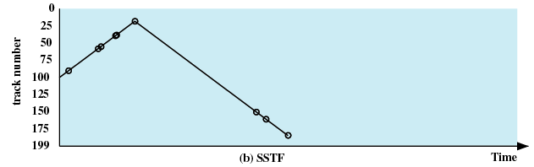
Disk Scheduling Policies
Shortest Service Time First (SSTF)
  Select the disk I/O request that requires the least movement of the disk arm from its current position
  Always choose the minimum Seek time
55、58、39、18、90、160、150、38、184

Slide 50
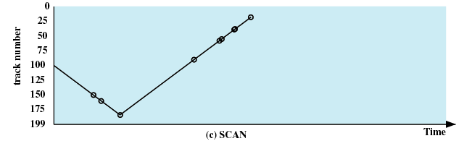
Disk Scheduling Policies
SCAN，also known as the elevator algorithm
  Arm moves in one direction only, satisfying all outstanding requests until it reaches the last track in that direction
  Direction is reversed
55、58、39、18、90、160、150、38、184

Slide 51
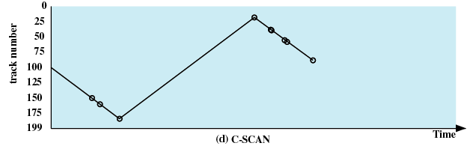
Disk Scheduling Policies
C-SCAN (circular SCAN，循环SCAN)
  Restricts scanning to one direction only
  When the last track has been visited in one direction, the arm is returned to the opposite end of the disk and the scan begins again
55、58、39、18、90、160、150、38、184

Slide 52
Disk Scheduling Policies
N-step-SCAN
  Segments the disk request queue into subqueues of length N
  Subqueues are processed one at a time, using SCAN
  New requests added to other queue when queue is processed
FSCAN
  Two queues
  When a scan begins, all of the requests are in one of the queues, with the other empty.
  During the scan, all new requests are put into the other queue. Thus, service of new requests is deferred 延迟 until all of the old requests have been processed.

Slide 53
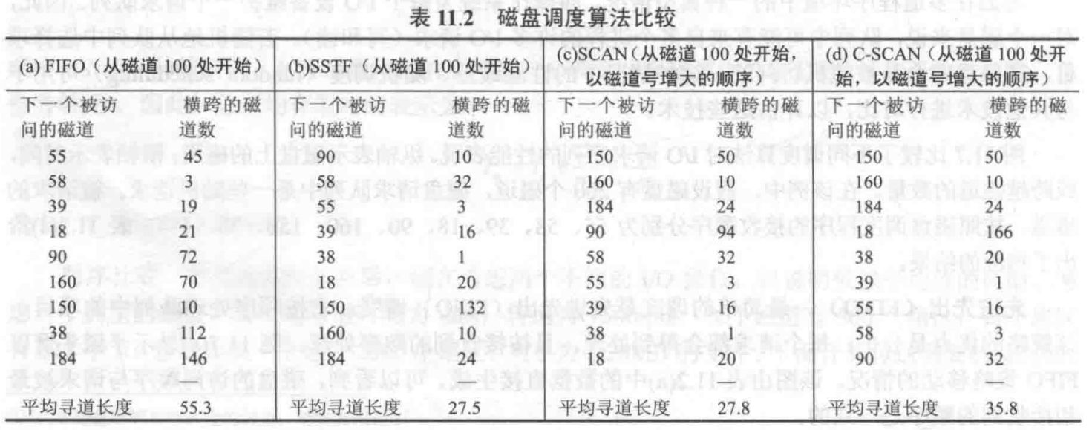
Disk Scheduling Algorithms

Slide 54
Agenda
11.1 I/O Devices
11.2 Organization of the I/O Function
11.3 Operating System Design Issues
11.4 I/O Buffering
11.5 Disk Scheduling
11.6 RAID 独立磁盘冗余阵列
11.7 Disk Cache

Slide 55
RAID
Redundant Array of Independent Disks(RAID) 独立冗余磁盘阵列 or Redundant Array of Inexpensive(RAI) 廉价冗余磁盘整列
Set of physical disk drives viewed by the operating system as a single logical drive
Data are distributed across the physical drives of an array in a scheme known as striping 条带化
Redundant disk capacity is used to store parity information which guarantees data recoverability in case of a disk failure.

Slide 56
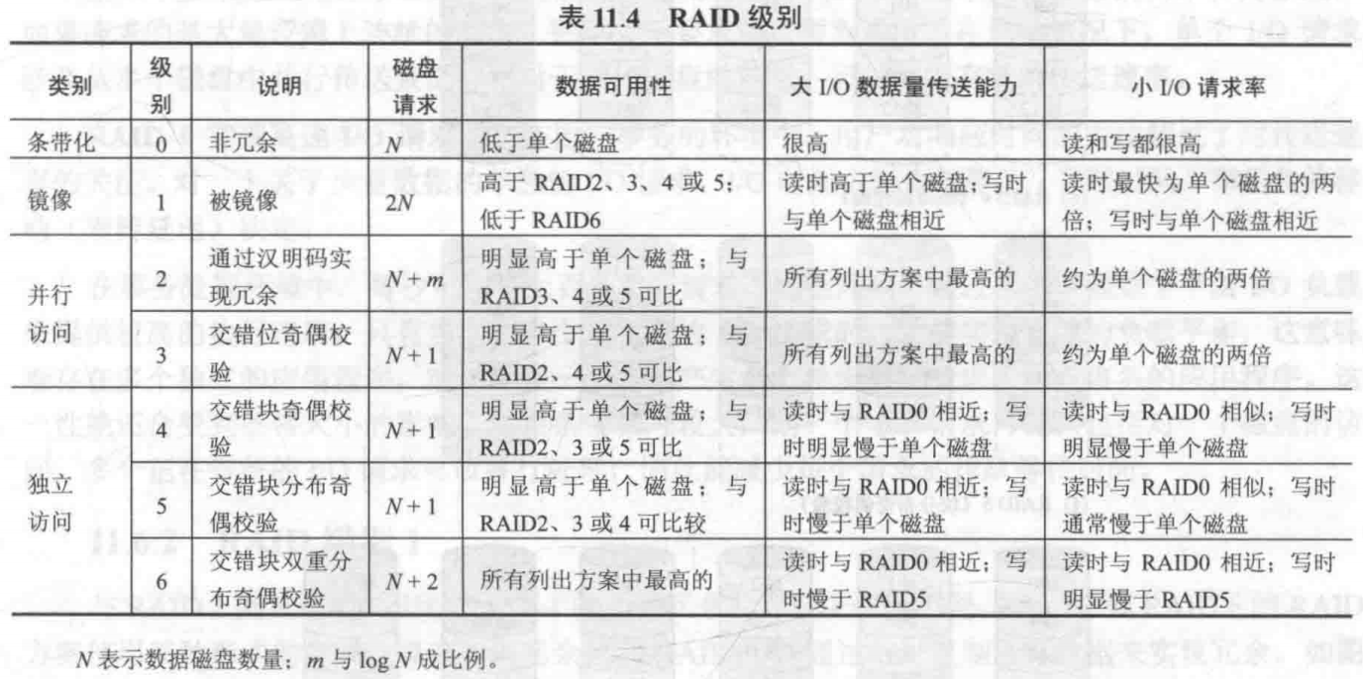
RAID

Slide 57
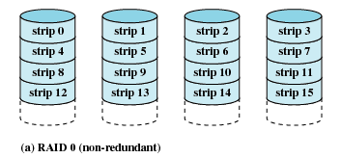
RAID 0 (non-redundant)

Slide 58
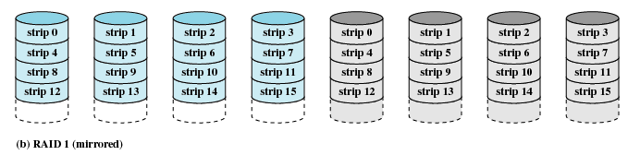
RAID 1 (mirrored)

Slide 59
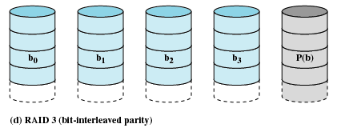
RAID 3 (bit-interleaved parity)交错位奇偶校验

Slide 60
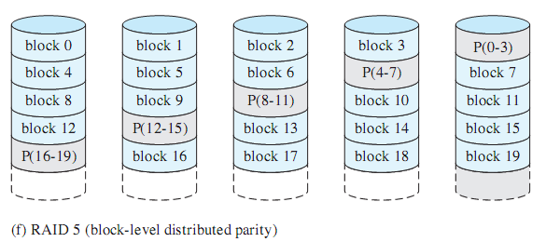
RAID 5 (block-level distributed parity)块分布奇偶校验

Slide 61
Agenda
11.1 I/O Devices
11.2 Organization of the I/O Function
11.3 Operating System Design Issues
11.4 I/O Buffering
11.5 Disk Scheduling
11.6 RAID
11.7 Disk Cache

Slide 62
Disk Cache
Buffer in main memory for disk sectors
Contains a copy of some of the sectors on the disk
Two design issues:
  Method to transfer the block of data from the disk cache to memory assigned to the user process
  缓存数据与用户空间交换
    Data move
    Pointer passing
  The replacement strategy 置换策略 when the disk cache is full for store new data

Slide 63
Replacement Strategy 1: Least Recently Used，LRU 最近最少使用策略置换算法
The block that has been in the cache the longest with no reference to it is replaced
The cache consists of a stack of blocks
Most recently referenced block is on the top of the stack
When a block is referenced or brought into the cache, it is placed on the top of the stack
The block on the bottom of the stack is removed when a new block is brought in
Blocks don’t actually move around in main memory，A stack of pointers is used

Slide 64
Replacement Strategy 2: Least Frequently Used，LFU最不常使用策略置换算法
The block that has experienced the fewest references is replaced
A counter is associated with each block
Counter is incremented each time block accessed
Block with smallest count is selected for replacement
Some blocks may be referenced many times in a short period of time and the reference count is misleading

Slide 65
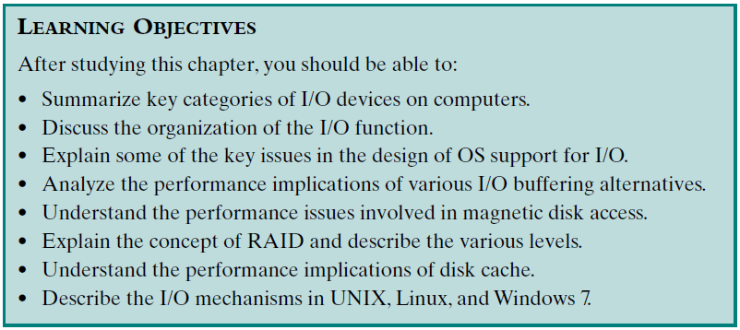
Review：
Assigned Readings: textbooks,p478-521; preview Chapter 12.

