Slide 1
软件需求分析
software Requirements Analysis
王湖南
wanghunan@scu.edu.cn
四川大学软件学院

Slide 2
Course Overview
(Fall 2019)
Software Requirements Analysis
Week 1

Slide 3
General Info -1
Course Instructor: 王湖南
wanghunan@scu.edu.cn
Assistant: TBD
Software Requirements Analysis: overview

Slide 4
General Info-2
Referencing textbooks:
Managing Software Requirements 2/e:A Use Case Approach by D. Leffingwell and D. Widrig
《软件需求》（第3 版），Karl E.Wiegers 著，清华大学出版社，2014－11
《需求工程实践者之路》(第4版)，Christof Ebert 著，机械工业出版社，2013－9
Software Requirements Analysis: overview

Slide 5
General Info -3
grading:
  Peace time(60%)
    Class participation(10%)
    Midterm Exam(20%)
    Assignments(30%)
  Project(40%)
    Project discussion(10%)
    Project presentation(10%)
    SRS Document(20%)
Software Requirements Analysis: overview

Slide 6
General Info -4
Course contents:
  Requirements Fundamentals
  Eliciting Requirements
  Requirements Modeling
  Requirements Specification & Documentation
  Requirements Validation
  Requirements management
  Professional Practice
Software Requirements Analysis: overview

Slide 7
Question
Do you think the phase of software requirements analysis is important?
  According to your experience or practice,
  give your opinion.
Software Requirements Analysis: overview

Slide 8
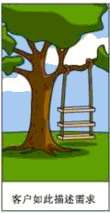






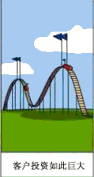

关于需求的漫画（1）
Software Requirements Analysis: overview
Notes:
System Requirements Analysis

Slide 9

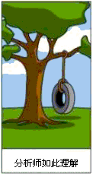

关于需求的漫画（2）
需求开发出现问题
需求管理出现问题
客户无法准确描述需求
改进之路
需求工程之需求开发
需求工程之需求管理
Software Requirements Analysis: overview
Notes:
System Requirements Analysis

Slide 10
为什么要收集需求？
美国Standish Group（2004）的调查结果显示：
  31%的项目被中途取消
  52%的项目超支89%
  大公司91%的项目不能按时按预算完工
  小公司84%的项目不能按时按预算完工

Slide 11
原因分析
问题调查：什么是项目出麻烦的最主要原因（多选）
  需求规格 50%
  管理顾客需求 45%
  软件实现和测试 32%
  项目管理 30%
  编码 7%
统计数字
  需求缺陷修改成本占返工成本总额的70%
  需求缺陷可轻易消耗25%-40%的项目预算
Notes:
注：本页引用了European Software Process Improvement Training Initiative（1995）、Boehm and Papaccio(1998b)的调查结果

Slide 12
软件需求变化趋势
业务分析被认为是一门专业的学科，专业认证和组织已经兴起
基于数据库的需求管理工具和需求辅助开发工具日趋成熟（如原型、建模和仿真）
敏捷开发方法的使用越来越广泛，处理敏捷项目需求的技术也在不断演化
可视化模型越来越广泛地应用于阐述需求知识
Notes:
摘自《软件需求》第三版前言

Slide 13
软件需求的未变化方面
对需求工程不够重视：需求开发和需求管理
未意识到需求收集以及许多软件和系统项目工作中，普遍面临的最大挑战是人与人如何互动
Notes:
摘自《软件需求》第三版前言

Slide 14
Agenda for this Lecture
Engineering Character of Software Development
Requirements Engineering, Requirements Management and Requirements Development
Software Processes
Requirements and the Software Lifecycle
Key Points
Next?
Discussion
Software Requirements Analysis: overview

Slide 15
Software Engineering: Definition
A discipline for the systematic production and maintenance of software developed by a team, which is
  fault-free,
  delivered on time,
  within budget, and
  satisfies the user’s needs
GOAL: to produce a good quality software that is useful for people
Software Requirements Analysis: overview

Slide 16
What is a Good Quality Software?
A software is good if it MEETS CUSTOMERS EXPECTATIONS:
  it is (at least) correct, reliable, maintainable, user-friendly …
  the total cost it incurs over all phases of its life cycle is minimal
Software Requirements Analysis: overview

Slide 17
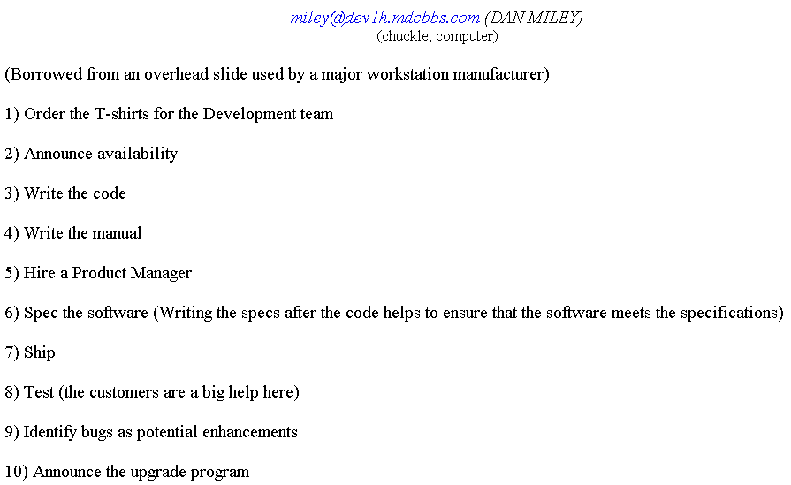
Familiar Problems ….
Software Requirements Analysis: overview
Notes:
System Requirements Analysis

Slide 18
Code Development & Software Engineering
Small and easy problems – haphazard approach:
  Read the problem statement
  Write the code, run the program, examine error messages, fix syntactic errors and change the logic, etc. until the program executes (preferably with correct results)
What about large and complex software problems?
Software Requirements Analysis: overview

Slide 19
Engineering Character of Software Development
Large software development project requires an Engineering approach:
  Life-Cycle
  Teamwork
  Requires an overall plan, organization and communication
Software Requirements Analysis: overview

Slide 20
Software Process: Framework for SE Practice
Process: defines who is doing what, when, and how to reach a certain goal.
Process Framework:
  Framework activities
    Set of software engineering actions
    Each action is a collection of related individual work tasks
  Umbrella activities
    Applied throughout the software process
Software Requirements Analysis: overview
Notes:
System Requirements Analysis

Slide 21
Framework Activities
Communication
Planning
Modeling
  Analysis of requirements
  Design
Construction
  Code generation
  Testing
Deployment
Software Requirements Analysis: overview

Slide 22
Software Process: Framework for SE Practice
  umbrella activities include:
software project management
formal technical reviews
software quality assurance
software configuration management
reusability management
measurement
document preparation and production
risk management
Each of these umbrella activities is defined by a set of tasks that are adapted to the project type and degree of rigor with which software engineering is to be applied.
Software Requirements Analysis: overview
Notes:
System Requirements Analysis

Slide 23
Requirements Engineering, Requirements Development and Requirements Management
Requirements Engineering
Requirements Development
Requirements Management
Relation
Software Requirements Analysis: overview
Notes:
System Requirements Analysis

Slide 24
Requirements Engineering, Requirements Development and Requirements Management
Requirements Engineering
The broad spectrum of tasks and techniques that lead to an understanding of requirements is called requirements engineering. Ref:《软件工程实践者的研究方法》
需求工程是系统性地、规范地进行需求获取、编写、分析、协商、核实和管理，使期望和目标在一个产品中实现。Ref:《需求工程实践者之路》
需求工程是指用工程化的方法、技术和规格来开发和管理软件的需求。Ref:《软件需求工程》
Software Requirements Analysis: overview
Notes:
System Requirements Analysis

Slide 25
Requirements Engineering, Requirements Development and Requirements Management
Requirements Development :
  Elicitation
  Analysis
  Specification
  Validation
  encompass all the activities involved with exploring,evaluating,documenting,and confirming the requirements for a project
Software Requirements Analysis: overview
Notes:
System Requirements Analysis

Slide 26
Requirements Engineering, Requirements Development and Requirements Management
Requirements Management :
  Defining rqmts baseline…
  Evaluating the impact of proposed rqmts changes …
  Keeping project plan current with the rqmts as they evolve
  Negotiating new commitments based on the estimated impact of rqmts changes
Software Requirements Analysis: overview
Notes:
System Requirements Analysis

Slide 27
Requirements Engineering, Requirements Development and Requirements Management
  Defining the relationships and dependencies that exist between rqmts
  Tracing individual rqmts to their corresponding design, source code and tests
  Tracing rqmts status and change activity throughout the project
  Manage changing rqmts to minimize their disruptive impact on the project
Software Requirements Analysis: overview
Notes:
System Requirements Analysis

Slide 28
Requirements Engineering, Requirements Development and Requirements Management
Relation:
Requirements Engineering
Rqmts Development
Rqmts Management
Elicitation
Analysis
Specification
Validation
Software Requirements Analysis: overview
Notes:
System Requirements Analysis

Slide 29
Requirements Engineering, Requirements Development and Requirements Management
Marketing, Customers, Management
Analyze, Document,
Review, Negotiate
Requirements
Development
Baseline Requirements
Requirements
Management
current
baseline
Revised
baseline
Marketing,
Customers,
Management
Requirements
change
process
Project
environment
Rqmts.
changes
project
changes
Software Requirements Analysis: overview
Notes:
System Requirements Analysis

Slide 30
Process Models: General Classification
Waterfall
Incremental
Evolutionary
Specialized
Software Requirements Analysis: overview
Notes:
System Requirements Analysis

Slide 31
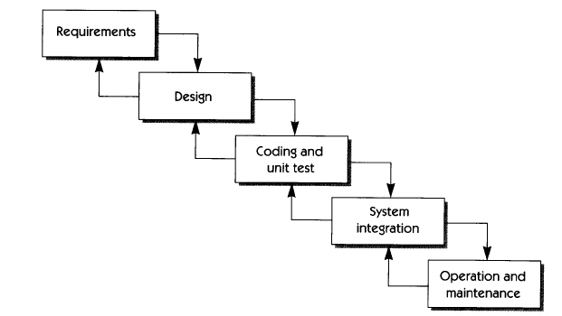
The Linear (Waterfall) Model
old fashioned but reasonable approach when requirements are well understood
Software Requirements Analysis: overview
Notes:
System Requirements Analysis
Modeled after a conventional engineering cycle
Assumes that a complete system will be delivered after the linear sequence is completed
Problems: customer has to sate all requirements explicitly; doesn’t support change; customer can see a working version of the program until code phase.

Slide 32
Waterfall Model: Discussion
Assumes that a complete system will be delivered after the linear sequence is completed
Problems:
  customer has to state all requirements explicitly;
  doesn’t support change;
  customer can see a working version of the program until code phase.
Software Requirements Analysis: overview
Notes:
System Requirements Analysis

Slide 33
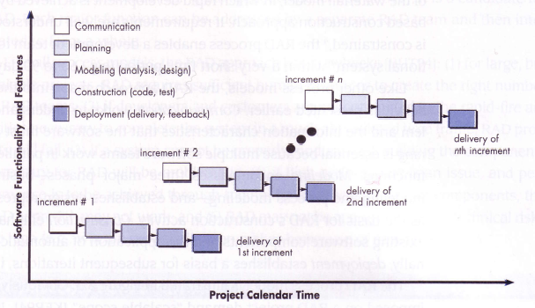
The Incremental Model
delivers software in small but usable pieces, each piece builds on pieces already delivered
Software Requirements Analysis: overview
Notes:
System Requirements Analysis

Slide 34
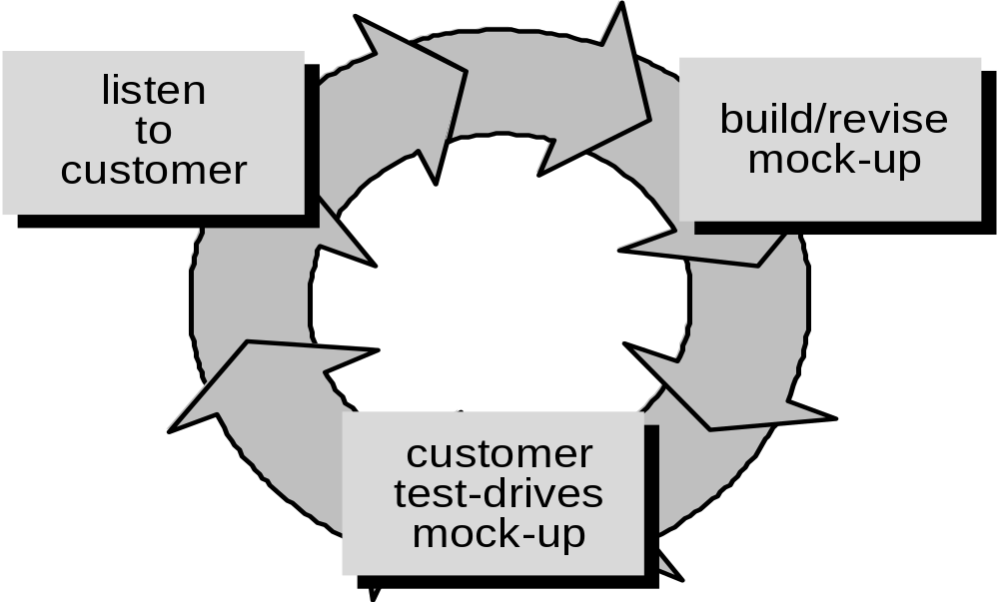
Evolutionary Models: Prototyping
good first step when customer has a legitimate need, but is clueless about the details, developer needs to resist pressure to extend a rough prototype into a production product
Software Requirements Analysis: overview
Notes:
System Requirements Analysis

Slide 35
Prototyping: Discussion
Designed to assist the customer or developer in understanding requirements.
Quick design (focus on representation of software aspects visible to the user)
Prototype is evaluated by the customer, and used to identify and refine requirements
Prototype is discarded (at least in part)
Software Requirements Analysis: overview
Notes:
System Requirements Analysis

Slide 36
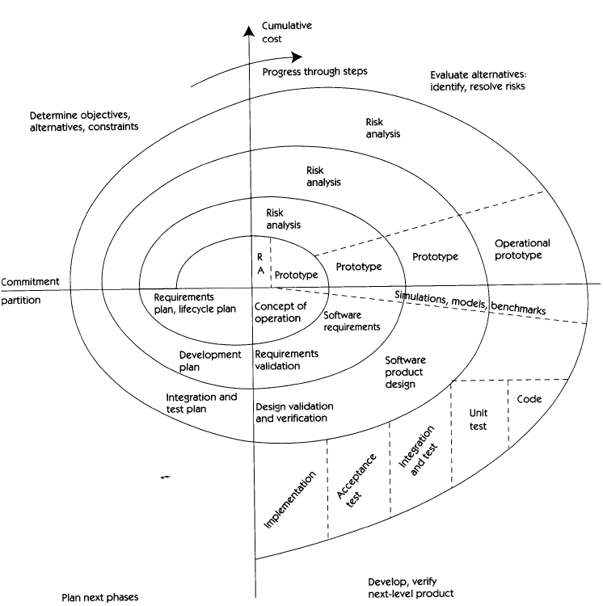
An Evolutionary Spiral Model: Boehm
Software Requirements Analysis: overview
Notes:
System Requirements Analysis

Slide 37
Spiral Model: Discussion
Risk-Driven Process Model
  Demands considerable risk assessment expertise
Large-scale evolving software systems
Enables the developer to apply the prototyping approach at any stage in the evolution of the product
Software Requirements Analysis: overview
Notes:
System Requirements Analysis
Couples the iterative nature of prototyping with the controlled and systematic aspects of the linear model
Enables development of increasingly more complete versions of the software
Demands a direct consideration of technical risks at all stages of the project

Slide 38
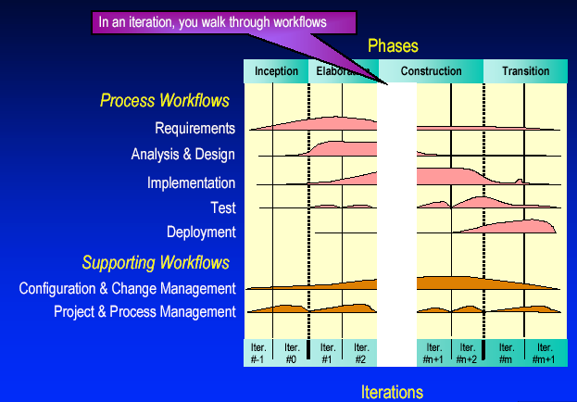
Specialized Process Models:
Rational Unified Process (RUP)
Software Requirements Analysis: overview
Notes:
System Requirements Analysis

Slide 39
Unified Process:
Iterative Life Cycle
Main reason for using the iterative life cycle:
  You do not have all the information you need up front
  Things will change during the development period
Inception: bracket the project’s risks by building a proof of concept
Elaboration:
  Develop a common understanding of the system’s scope and desired behavior
  Address system-wide issues (activities and resources)
Software Requirements Analysis: overview
Notes:
System Requirements Analysis

Slide 40
Unified Process:
Iterative Life Cycle
Construction: build the product
  Risk-Driven iterations
  Continuous integration
Transition: deliver the product to the user’s community
  Facilitate user acceptance
  Measure user satisfaction
Software Requirements Analysis: overview
Notes:
System Requirements Analysis

Slide 41
Iteration Process
Inception
Elaboration
Construction
Transition
Iteration 1
Iteration 2
Iteration 3
“Mini-Waterfall” Process
Iteration Planning
Rqmts Capture
Analysis & Design
Implementation
Test
Prepare Release
Software Requirements Analysis: overview
Notes:
System Requirements Analysis

Slide 42
Selecting Iterations
The first iteration:
  Be modest regarding the amount of functionality that can be achieved in the first iteration
  Teams new to an iterative approach are usually overoptimistic
How many iterations do I need?
  On projects taking 18 months or less, 3 to 6 iterations are typical
Software Requirements Analysis: overview
Notes:
System Requirements Analysis

Slide 43
Iteration Assessment
Assess iteration results (functionality, performance, quality)
Consider external changes that have occurred during this iteration (changes to requirements, changes to user needs, competitor plans)
Determine what rework is required and assign it to the remaining iterations
Software Requirements Analysis: overview
Notes:
System Requirements Analysis

Slide 44
RUP: Discussion
Combination of iterative and incremental development
Defines the function of the system from the user point of view applying scenario-based approach.
Uses Unified Modeling Language (UML): industrial standard notation
Software Requirements Analysis: overview
Notes:
System Requirements Analysis
Unified Software Development Process (UP) is representative of CBD models that are used in industry.

Slide 45
Specialized Process Models:
The Formal Methods Model
Formal methods—the process to apply when a mathematical specification is to be developed
Enable software engineers to specify, develop, and verify a computer-based system by applying a rigorous, mathematical notation.
Offers (the promise of) defect-free software
Time consuming and expensive
Extensive training is required
Applicable to safety-critical software
Software Requirements Analysis: overview
Notes:
System Requirements Analysis
Cleanroom software engineering—emphasizes error detection before testing. Currently applied in industry.

Slide 46
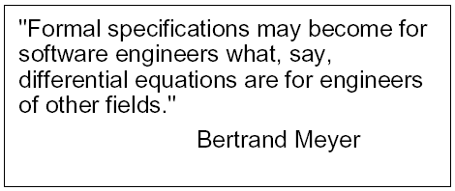
Example:
Safety-Critical Systems
Consequences of failure are extremely high, usually a threat of human life
Use of rigorous techniques for specifications
Software Requirements Analysis: overview

Slide 47
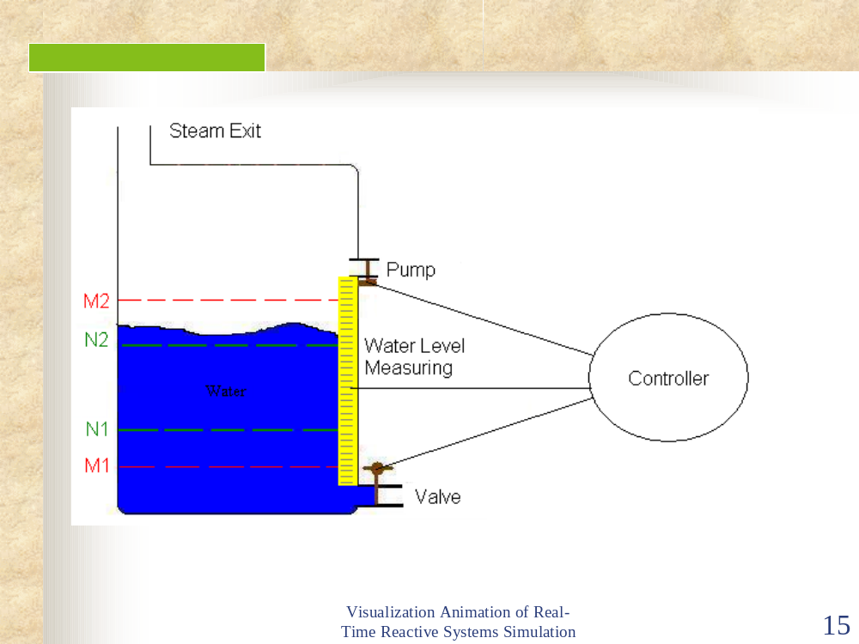
Steam Boiler Controller
Software Requirements Analysis: overview

Slide 48
The Process Model:
Adaptability and Specialization
the framework activities will always be applied on every project ... BUT
the tasks (and degree of rigor) for each activity will vary based on:
  the type of project (an “entry point” to the model)
  characteristics of the project
  common sense judgment; concurrence of the project team
Software Requirements Analysis: overview
Notes:
System Requirements Analysis

Slide 49
Generic Process Framework
Communication:
  Project initiation, Requirements gathering
Planning
  Estimating, Scheduling, Tracking
Modeling
  Analysis & Specification
  Design
Construction
  Code, testing
Deployment
  Delivery, support, maintenance
Course Goals
Software Requirements Analysis: overview
Notes:
System Requirements Analysis

Slide 50
Importance of Requirements
The set of requirements constitute a contract between the client and the software developer
  It should be written such that all stakeholders can understand what the system will do.
  It allows developer to map problem domain concepts to solution domain concepts
Software Requirements Analysis: overview
Notes:
System Requirements Analysis

Slide 51
Requirements Specifications
Definition: “Specifications represent a model of how inputs are related to system reactions and outputs”
Specification is an ABSTRACTION of the Requirements
Needed for: complex, large, or critical problems.
Specifications will increase the technical level of details given in the requirements
Software Requirements Analysis: overview
Notes:
System Requirements Analysis

Slide 52
Requirements Gathering:
Dice Game
Requirements gathering is the Starting Point (WHAT, i.e., problem oriented)
Dice Game:
A player rolls two dice.
If the total is seven, the player wins; otherwise he loses.
Software Requirements Analysis: overview

Slide 53
Modeling:
Bridge between Requirements and Solution
Modeling a system involves:
  identifying the things that are important to your particular view
  Their properties
  consider how specific instances of these things must fit together.
Modeling a system is affected by how you expect to use the system
Software Requirements Analysis: overview
Notes:
System Requirements Analysis
These things are from the vocabulary of the system you are modeling. For example, if you are building a house , things like walls, doors, windows, cabinets, and lights are some of the things that will be important to a home owner. Each of these things can be distinguished from the other. Each of them has a set of properties. Walls have a height and a width and are solid. Doors also have a height and width and are solid, as well, but have the additional behavior that allows them to open in one direction. Windows are similar to doors have slightly different properties. Windows are usually (but not always) designed so that you can get out of them instead of pass through them.
Individual walls, doors, and windows rarely exist in isolation, so you must also consider how specific instances of these things must fit together. The things you identify and the relationships you choose to establish among them will be affected by how you expect to use the various room to room, and the general style and feel you want this arrangement to create.
.
Users will be concerned about different things. For example, the plumbers who help build your house will be interested in things like drains, traps, and vents. You, as a home owner, won’t necessarily care about these things except in so far as they interact with the things in your view, where a drain might be placed in a floor or where a vent might intersect with the roof line.

Slide 54
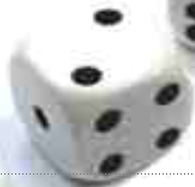
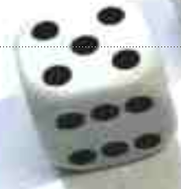
How Do You Expect to Use the Dice Game ?
“Happy end” scenario
Dice Game:
Roll two dice.
System:
CONGRATULATIONS! You won the game.
Software Requirements Analysis: overview

Slide 55

How Do You Expect to Use the Dice Game ?
Not so “happy end” scenario
Dice Game:
Roll two dice.
System:
Looser, try again …
Software Requirements Analysis: overview

Slide 56
Modeling: Dice Game
Modeling Features:
Dice Game:
A player rolls two dice.
If the total is seven, the player wins; otherwise he loses.
Play with one user and two dice
Software Requirements Analysis: overview

Slide 57

Modeling: Dice Game
Modeling Structure
Rolls
Player
name
1
2
Die
FaceValue
1
2
Plays
DiceGame
total
1
1
Includes
Software Requirements Analysis: overview
Notes:
System Requirements Analysis
highly-creative activity. It’s hard to measure a good design objectively

Slide 58
Modeling: Dice Game
Modeling Behavior
: DiceGame
Die1: Die
Die2:Die
Play()
roll()
GetFaceValue()
roll()
GetFaceValue()
Result()
Total()
Software Requirements Analysis: overview
Notes:
System Requirements Analysis
highly-creative activity. It’s hard to measure a good design objectively

Slide 59
Review of today’s lecture
Engineering Approach to Software:
  Framework: … ?
  Role of Documentation: … ?
Role of the Requirements Modeling: … ?
Role of the Requirements Document: … ?
Software Requirements Analysis: overview

Slide 60
Next
Requirements Fundamentals
Software Requirements Analysis: overview

Slide 61
Discussion
About project and team
Software Requirements Analysis: overview

