Slide 1
Building the Use Case Model
Cont.
Week 7
System Requirements Analysis

Slide 2
Agenda
Brief Review of the Previous Lecture
Hierarchy of Use Cases levels
Relationships between use cases
Templates for use cases
Key Points
summary
Next?
Discussion
System Requirements Analysis

Slide 3
Reminder :
UML Diagrams Appropriate for OO Analysis Modeling:
Use-Case Diagram
(This week)
Interaction Diagrams
Class Diagram for Domain Model
Activity Diagram
Statecharts
Domain Model
Use Case Model
(cont.)
System Requirements Analysis

Slide 4
Review:
A Step-By-Step Building of the Use-Case Model
Step 1: Identify and describe the Actors
Step 2: Identify the use Cases and write a Brief Description
Step 3: Identify the Actor and use-Case Relationships
Step 4: Outline the Individual Use Cases
Step 5: Refine the Use Cases
System Requirements Analysis

Slide 5
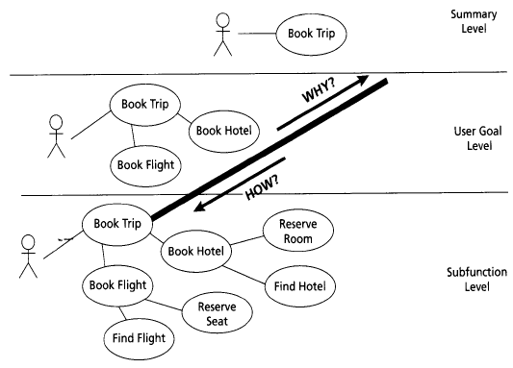
Hierarchy of Use Cases Levels
(Cockburn 2001)
System Requirements Analysis

Slide 6
Summary Use Cases
Summary: simple, one-paragraph story describing the main success scenario for the use case
Role: to define a broad scope of the system
Wings over the World:
System Requirements Analysis

Slide 7
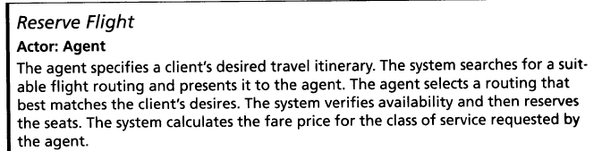
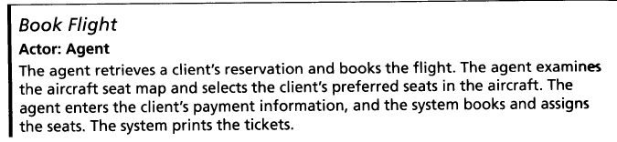
Example of Summary Use Cases
System Requirements Analysis

Slide 8
User-Goal Level Use Cases
Satisfies a particular and immediate goal of value to the primary actor.
Includes Step-by-step descriptions of the main success scenario
Wings Over the World User-Level Use Cases:
  Book Flight
  Book Hotel
System Requirements Analysis

Slide 9
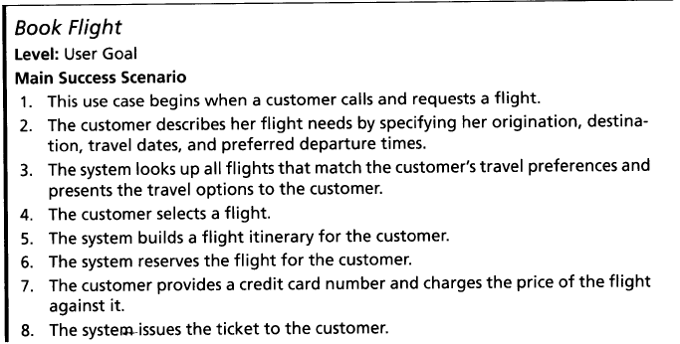
Example of User Goal Level Use Case
System Requirements Analysis

Slide 10
Subfunction Level Use Cases
Used by User-level use cases
  When we need more details, we unfold the story
Subfunction Level satisfies a partial goal of a user-goal use case or of another subfunction
Steps are lower level subfunctions
Wings over the World subfunctions:
  Find Flight, Find Hotel, Reserve Room, Reserve Seat
System Requirements Analysis

Slide 11
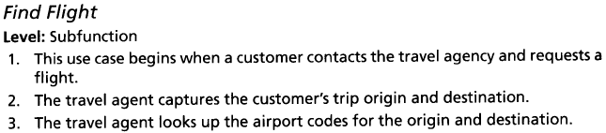
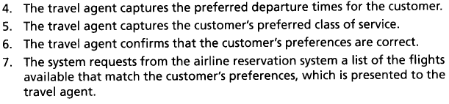
Subfunction Level Use Case Example
System Requirements Analysis

Slide 12
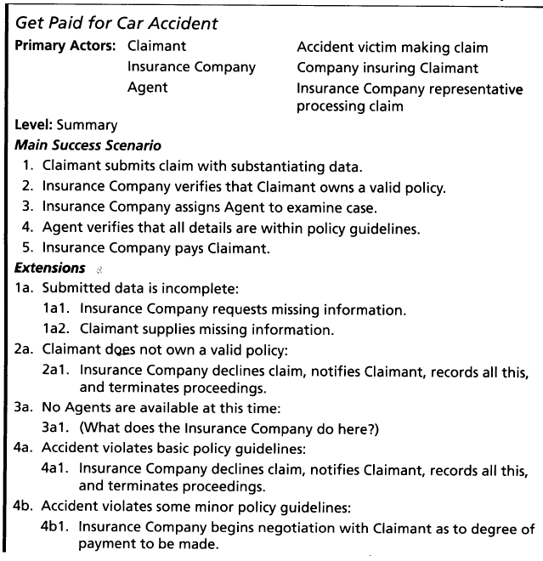
Get Paid for Car Accident Example (from Cockburn 2001)
System Requirements Analysis

Slide 13
More on Scenarios
Some Rules
  Each scenario begins with a triggering action that the system is able to detect
    ATM Withdraw Cash Main Success Scenario
      Customer inserts the card.
      …
  Steps should not be too small
    Stepping up to the sidewalk Main Success scenario
      She lifts her foot from the street to the curb.
      She arcs the foot through the air, and lowers to the pavement
      …
  Keep scenarios to three to nine steps, all at a level of abstraction just below the use case goal
System Requirements Analysis
Notes:
The step’s goal becomes the complete single goal for a lower level use case. Examples: p.154, “Patterns …”

Slide 14
REVIEW: The IT industry now loves use cases, but... how do you write large volumes of them? (from A. Cockburn)
Common agreement that use cases are useful.
  Adopted by every OO methodology
  Recommendation from developers, users
But what are they really?
How do you structure 180 of them?
  what is their format? level of detail?
Jacobson invented “uses” (now include) and “extends” relations:
  when do you use each, how do you type it in?
System Requirements Analysis

Slide 15
Relationships between Use Cases
Reuse existing text describing common behavior
Mechanisms (stereotypes in UML):
  <<Include>> (for common sub-behavior)
  <<Extend>> (a single event interrupts the main success scenario multiple times; or there is an important alternative to emphasize)
  <<Generalization>> (to capture abstraction)
System Requirements Analysis

Slide 16
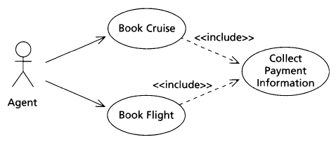
Using Include Relationship
System Requirements Analysis

Slide 17
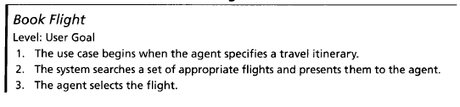

Using Include Relationship (cont.)
Collect Payment Information
Call Collect Payment Information to get payment information.
System Requirements Analysis

Slide 18
Using Include Relationship (cont.)
Collect Payment Information
Collect Payment Information Use Case
The agent requests the credit card information and charges the total to it.
The system request the bank to validate the credit card and the balance.
The bank confirms the charge to the credit card.
System Requirements Analysis

Slide 19
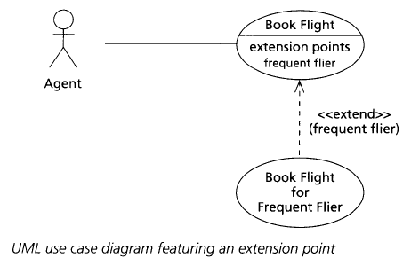
Using Extend Relationship (with extension points)
System Requirements Analysis

Slide 20
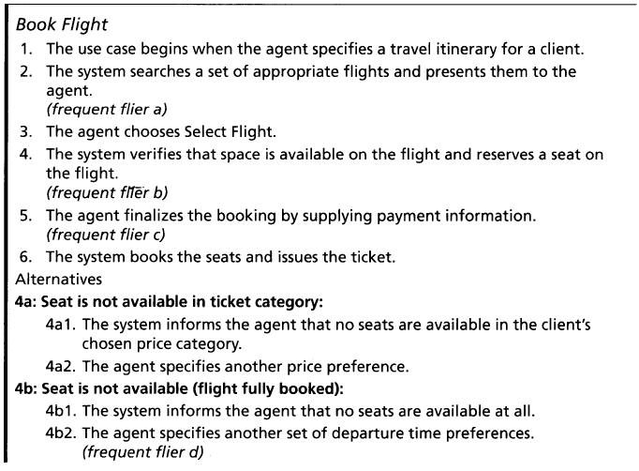
Using Extend Relationship (cont.)
System Requirements Analysis

Slide 21
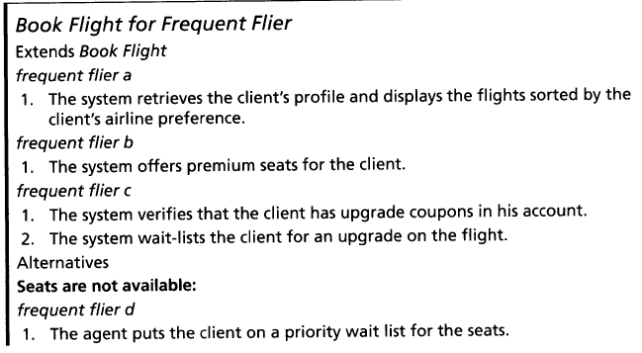
Using Extend Relationship (cont.)
System Requirements Analysis

Slide 22
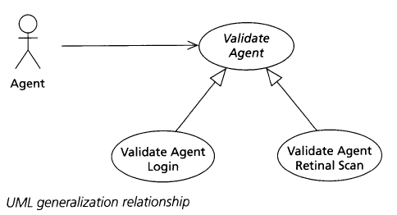
Using Generalization Relationship
System Requirements Analysis

Slide 23
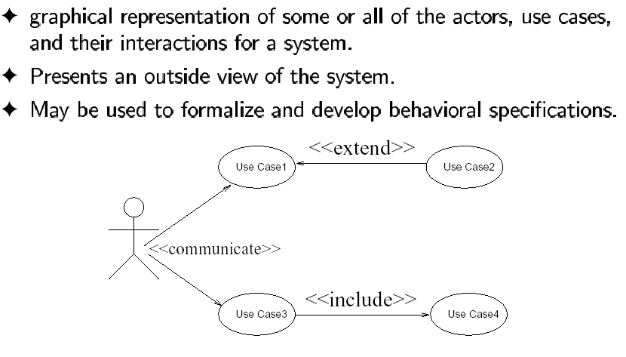
Use Case Diagram
System Requirements Analysis

Slide 24
Well-Written Use Case?
It follows the organization’s writing template and basic style
It is logically correct
It is readable to the end evaluators
It is precise enough for the implementors to use
System Requirements Analysis

Slide 25
When your use-case model is complete?
Ask the following question:
Have you identified and documented all actors and goals?
Has the customer, or someone representing the customer, acknowledged that the use case set is complete, and that each use case is readable and correct?
System Requirements Analysis

Slide 26
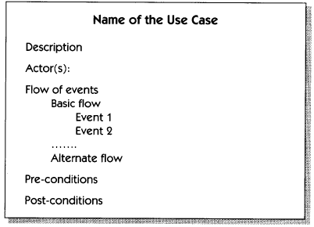
Book’s Template for Use Case
System Requirements Analysis

Slide 27
Use Case v.s. NFRs, Constraints, Business Rules, etc.
Add Special Requirements section after the list of Extensions
List the non-functional requirements, design constraints and business rules in the Special Requirements section
System Requirements Analysis

Slide 28
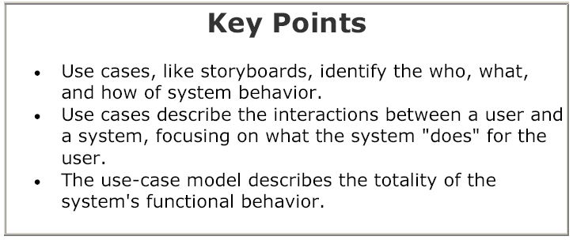
Key Points
System Requirements Analysis

Slide 29
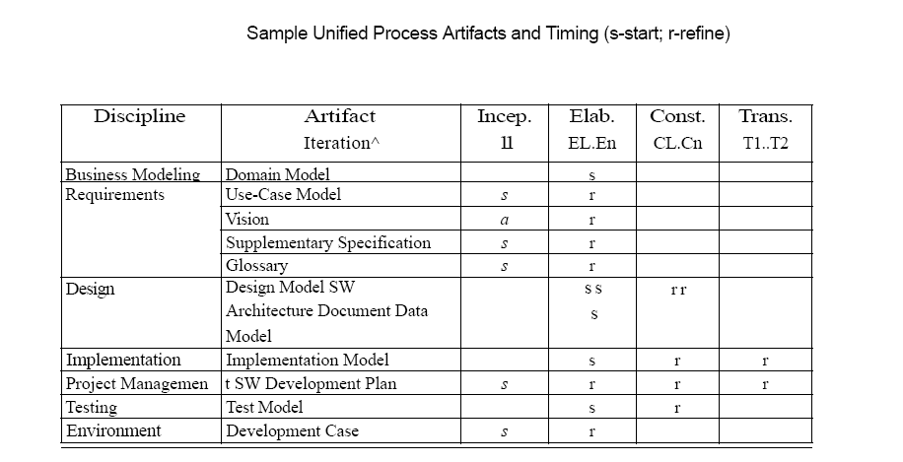
Summary
System Requirements Analysis

Slide 30
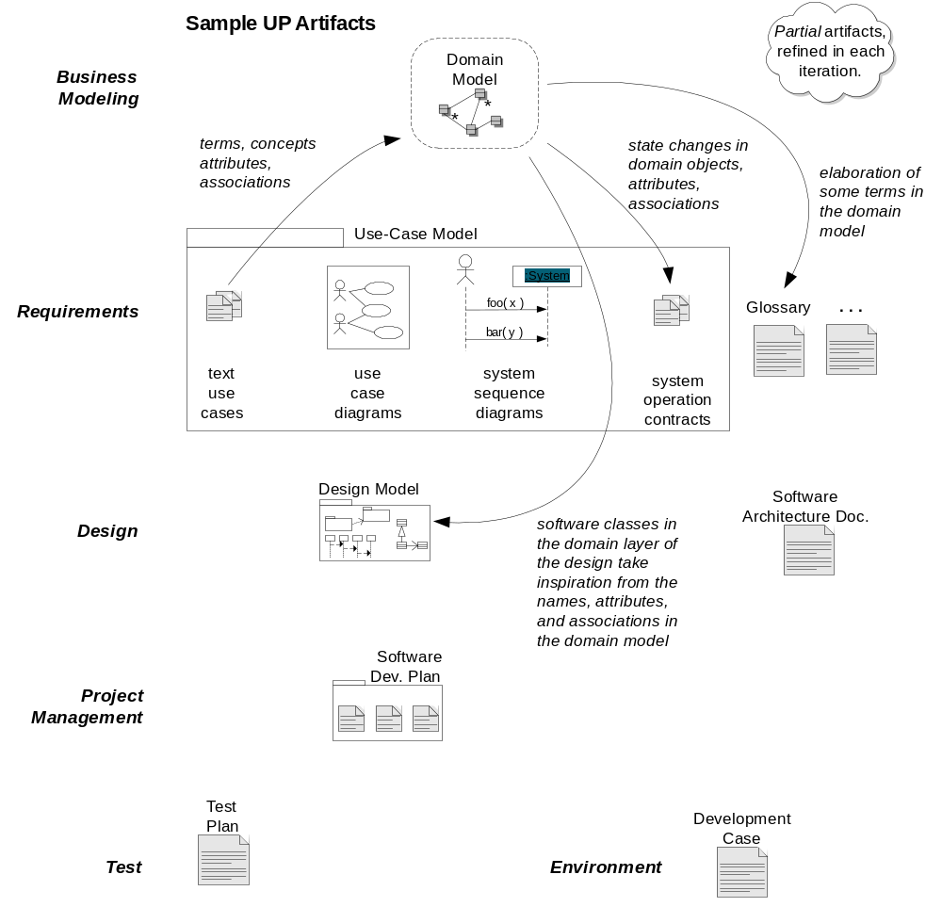
Summary
System Requirements Analysis

Slide 31
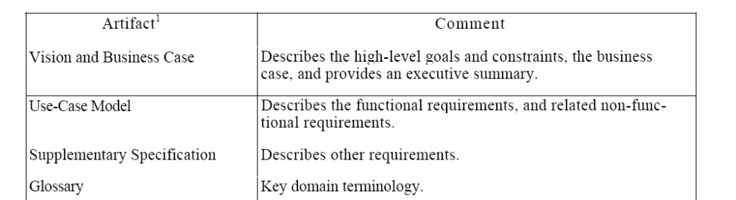
Summary
System Requirements Analysis

Slide 32
NEXT ?
Domain Model
UML diagrams for the Analysis Model
Organizing Requirements
Documentation
System Requirements Analysis

Slide 33
Discussion
Discuss and refine the Use Case Model of your project, using the knowledge studied in today’s class.
System Requirements Analysis

