Slide 1
Technical Methods for Specifying Requirements
Week 9
Software Requirements Analysis

Slide 2
Agenda
Technical Methods for Specifying Requirements
  Pseudocode
  Decision Tables and Decision Trees
  Extended Finite State Machines
  Activity Diagrams
  Entity-Relationship Models
Software Requirements Analysis

Slide 3
Decision Table
Uses a tabular format to map the logic behind a decision-making process
Display a combination of conditions to be met and actions to be taken
Single condition/action:
  If there is smoke (condition)
  then push the fire alarm (action)
multiple conditions and actions?
Software Requirements Analysis
Notes:
It is an extremely powerful device for viewing complex judgments in a tiny format.

Slide 4
Decision Table
If there is smoke (condition 1)
and you have given up smoking (condition 2)
and someone else is not smoking (condition 3)
then push the fire alarm (action 1)
and leave the building (action 2)
but if there is no smoke (condition 1)
then do nothing (action 1)
Software Requirements Analysis
Notes:
When dealing with multiple conditions and actions, the situation becomes more complex

Slide 5
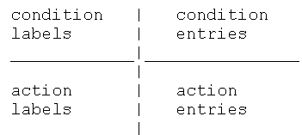
Decision Table Structure
Software Requirements Analysis

Slide 6

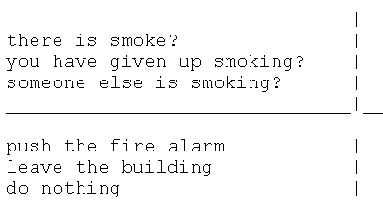

Condition and Action Labels
Conditions:
Actions:
Partial Decision Table:
Software Requirements Analysis

Slide 7
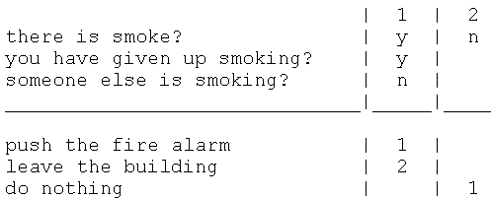
Condition and Action Entries
The entry half of the table shows which conditions are true
The numbers appearing in the action entry section tell you which actions are to be taken and in what order.
the columns in a decision table are actually rules
Final Decision Table:
Software Requirements Analysis
Notes:
We may now fill in the condition and action entries by assigning each action a precedence for execution when certain conditions exist
Notice how concisely the logic of complex decisions can be displayed in this particular format. A decision table, then, is really a logical spreadsheet, and does for reasoning what electronic spreadsheets do for numbers. It provides a feel of instantaneity and immediate visual feedback of your conjectures.

Slide 8
Constructing a Decision Table
List all actions that can be associated with a specific usage of the software system
List all conditions during the usage
Associate specific sets of conditions with specific actions
Define rules by indicating what action(s) occurs for a set of conditions
Software Requirements Analysis

Slide 9
Illustration of the use of a decision table (Pressman)
Three types of customers are defined: a regular, a silver customer, and a gold customer.
A regular customer receives normal print rates ad delivery.
A silver customer gets an 8% discount on all quotes and is placed ahead of all regular customers in the job queue.
A gold customer gets a 15% reduction in quoted prices and is placed ahead of both regular and silver customers in the job queue.
A special discount of x% in addition to other discounts can be applied to any customer’s quote at the discretion of management.
Software Requirements Analysis
Notes:
These types are assigned by the amount of business the customer does with the print shop over a 12-month period

Slide 10
Decision Tables, simple example.
(On any given day.) I only take some leisure time after I have finished my homework; otherwise, I do my homework. For leisure on Fridays, I go out to see a repertoire movie, but only if I have completed my homework before 6pm, otherwise (because it is too late for the movie) I just read a good book at home.
Software Requirements Analysis
Notes:
Original problem description: I only take some leisure time after I have finished my homework. For leisure on Fridays, I go out to see a movie, but only if I have completed my homework ahead of time, otherwise I just read a good book at home.

Slide 11
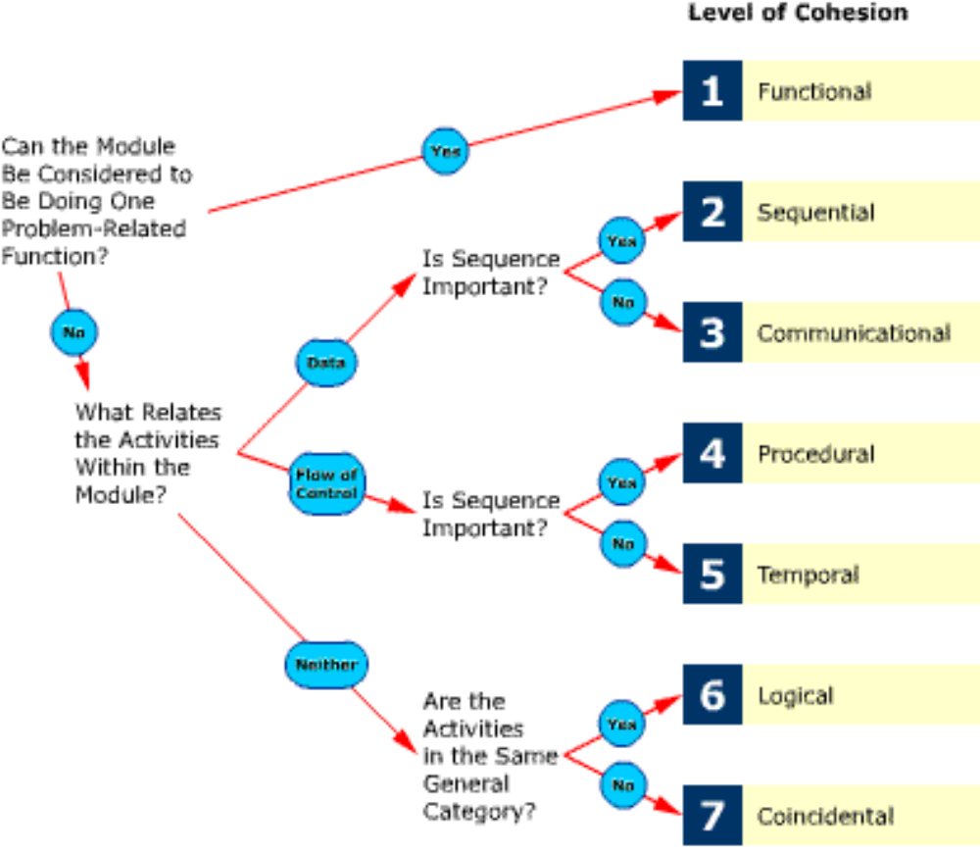
Decision Tree: Example
Software Requirements Analysis

Slide 12
Reminder:
UML Diagrams Appropriate for OO Analysis Modeling:
Use-Case Diagram
Interaction Diagrams
Class Diagram for Domain Model
State Machines (today)
Activity Diagram (today)
Domain Model
Use Case Model
(cont.)
Software Requirements Analysis

Slide 13
Extended Finite State Machines
  State ?
  A condition or situation during the life of a system / object during which it satisfies some condition, performs some activity, or waits for some event.
Software Requirements Analysis

Slide 14
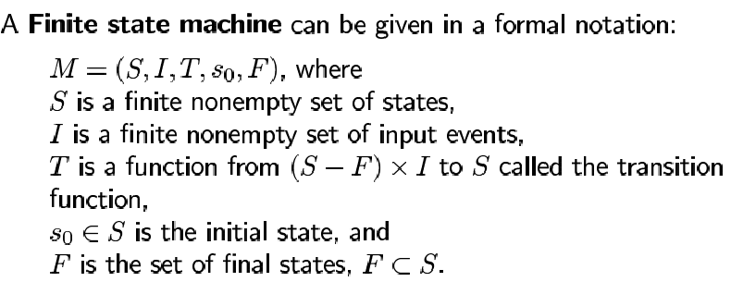
Finite State Machine and Behavior Specification
Software Requirements Analysis

Slide 15
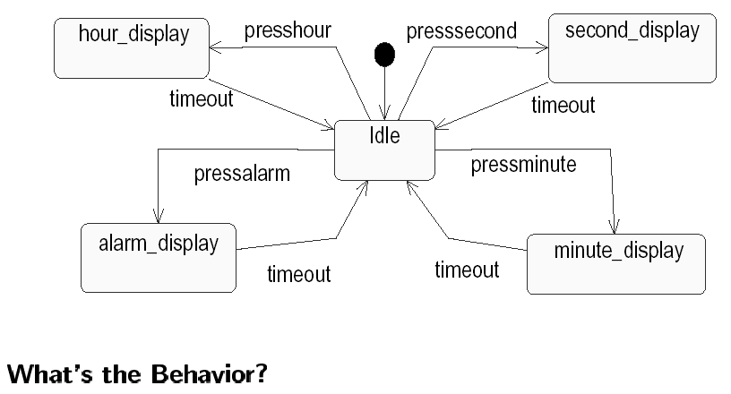
Example: Alarm Clock
Software Requirements Analysis

Slide 16
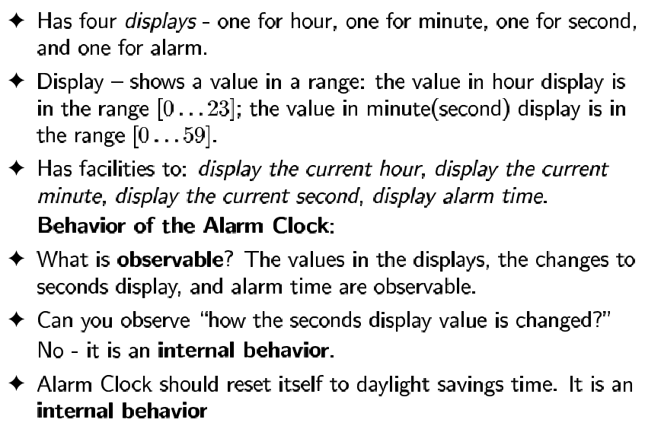
Example: Alarm Clock
Software Requirements Analysis

Slide 17
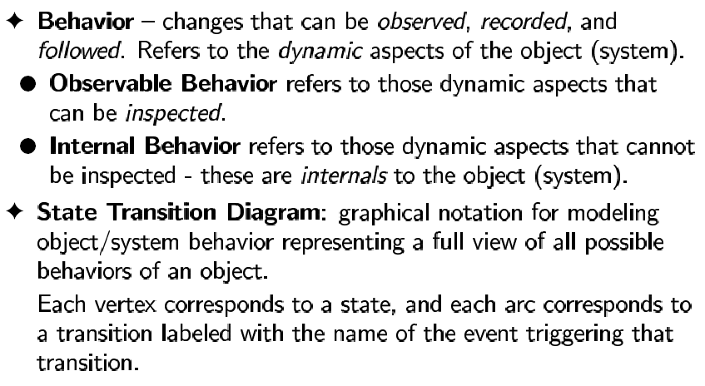
State Machine and Behavior Specification
Software Requirements Analysis

Slide 18
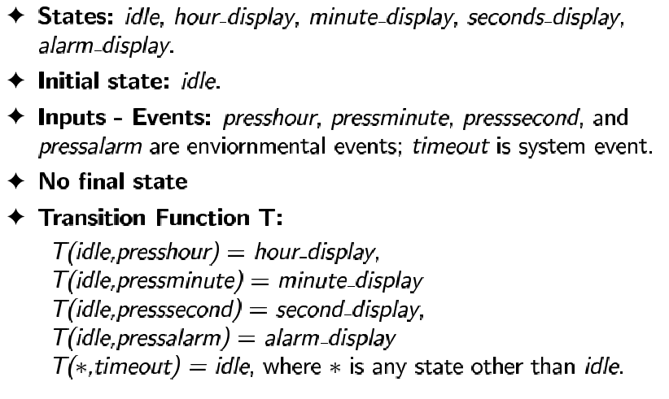
Example: Alarm Clock
Software Requirements Analysis

Slide 19
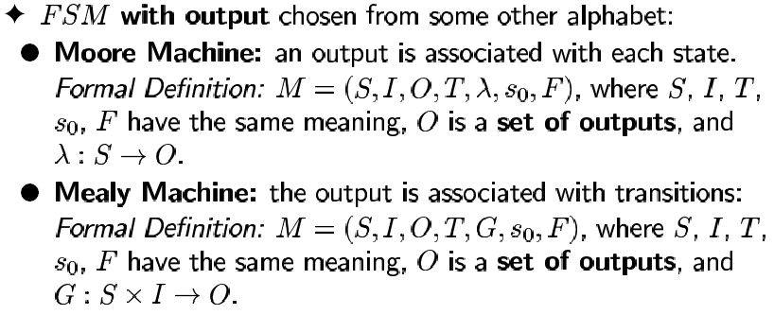
Moore and Mealy FSMs
Software Requirements Analysis

Slide 20
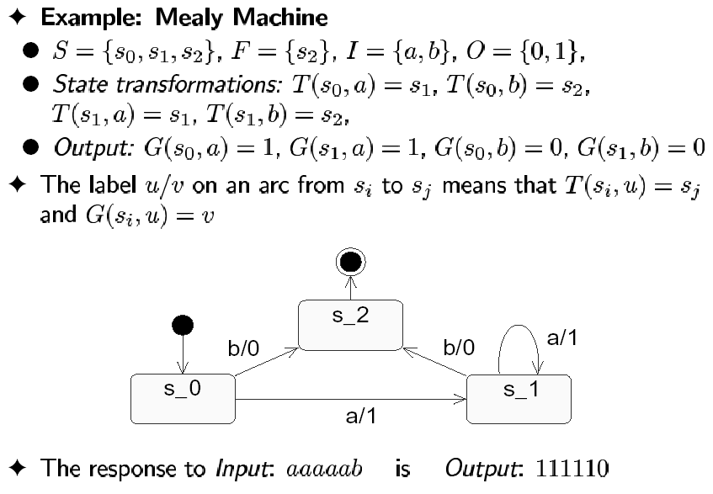
Mealy FSM: Example 1
Software Requirements Analysis

Slide 21
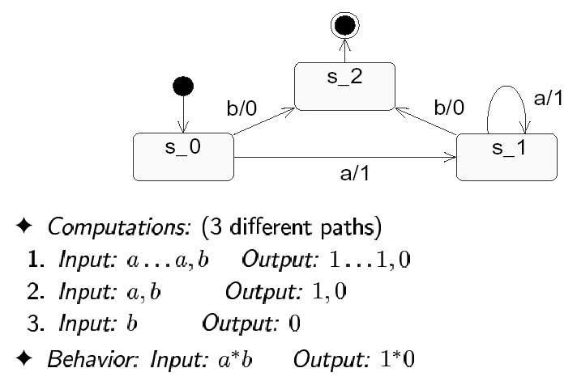
Mealy FSM: Example 1
Software Requirements Analysis

Slide 22
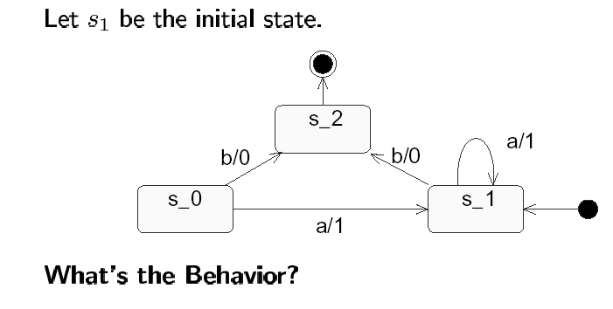
Mealy FSM: Example 2
Software Requirements Analysis

Slide 23
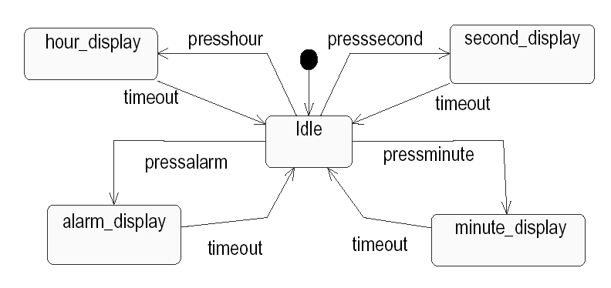
Moore FSM Example: Alarm Clock
Hour highlighted
Second highlighted
Alarm highlighted
Minute highlighted
Software Requirements Analysis

Slide 24
Synchronization of Machines
Using the extended state machine notation, specify the behavior of:
a traffic signal facing north-south (NS)
another one facing west-east (WE)
Requirements:
The red light only stays on for 25 seconds, then it is blinking for five seconds to indicate the approaching of the light change, followed by the green light.
The green light stays for 25 seconds, at which time the yellow light is on.
After 5 more seconds the yellow light gives way to the red light again, and so on.
Consider that after startup the initial light for NS is set to green and for WE is set to red, and the traffic signals start indefinitely rotate among green, yellow and red.
The traffic signals NS and WE are synchronized in time. When the traffic signal NS goes red, the traffic signal WE would go green, and vice versa.
Software Requirements Analysis

Slide 25
Composing State Machines
  Synchronization algorithm:
    Always start from an Initial State
    Use the “reachability” criteria to add new states and transitions
    The product machine is created when no more states can be reached, and no more initial states are left
Product Machine of NS and WE:
States? (combinations of the simple states in NS and WE.
Events? (union of NS and WE events)
Transitions? (due to change of state in NS or WE (due to internal, or individual, events), or in both NS and WE (if the event is shared, or common)
Software Requirements Analysis

Slide 26
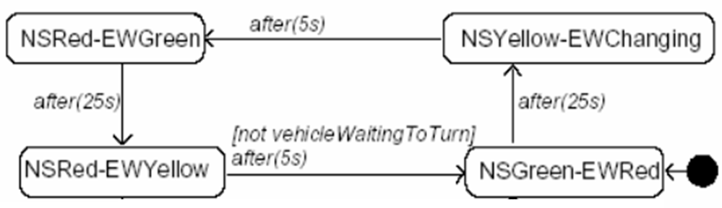
Synchronization:
Product Machine of NS and WE
Software Requirements Analysis

Slide 27
UML State Machines
(former Statecharts)
Harel combined the Mealy and the Moore
automaton and extended this combination
by
 Conditional Transitions
 Hierarchical States
 States with History
 Parallel States
Software Requirements Analysis

Slide 28
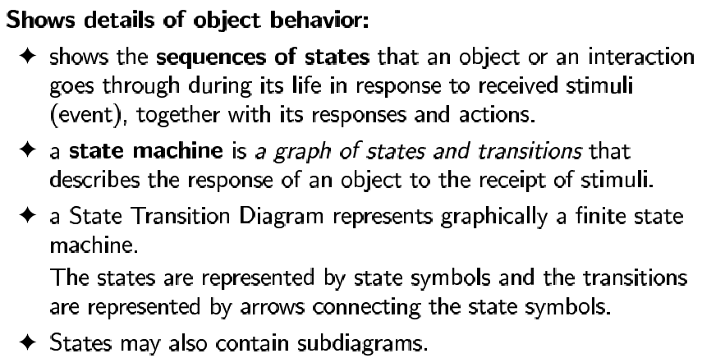
State Machine
Software Requirements Analysis

Slide 29
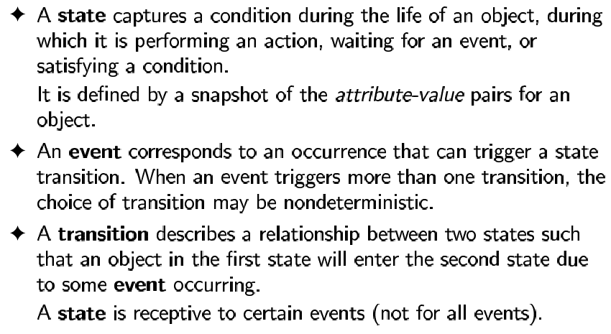
UML State Machine
(Former Statechart)
Software Requirements Analysis

Slide 30
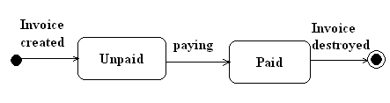
Initial-Final States: UML Notation
Software Requirements Analysis

Slide 31
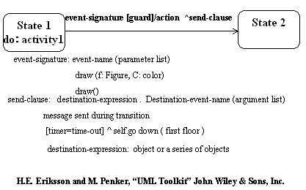
State Transition: UML Notation
Software Requirements Analysis

Slide 32
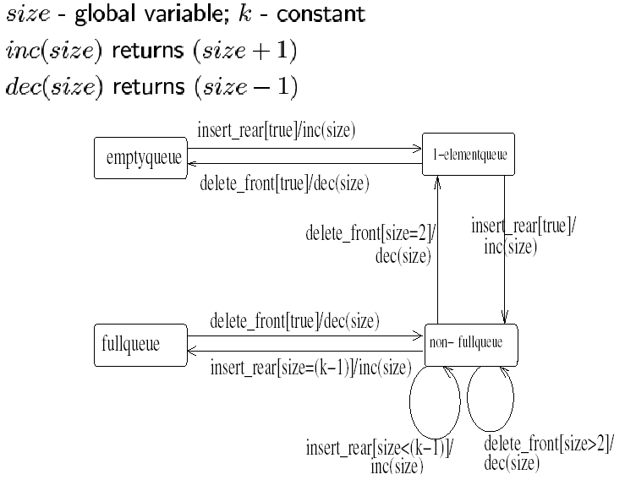

Queue Specification Example
Software Requirements Analysis

Slide 33
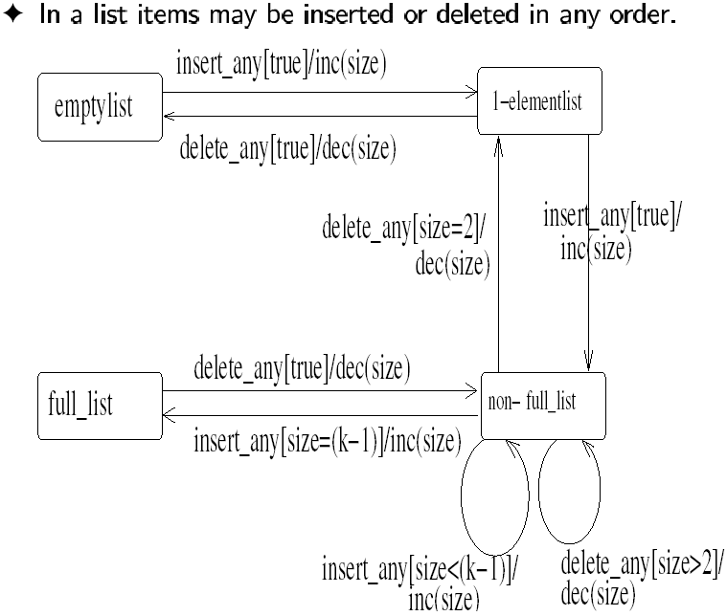
List Specification Example
Software Requirements Analysis

Slide 34
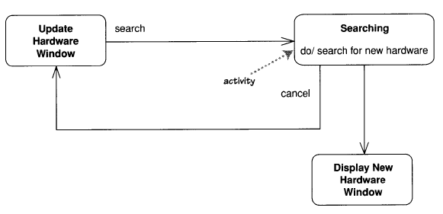
Activity States
Software Requirements Analysis

Slide 35
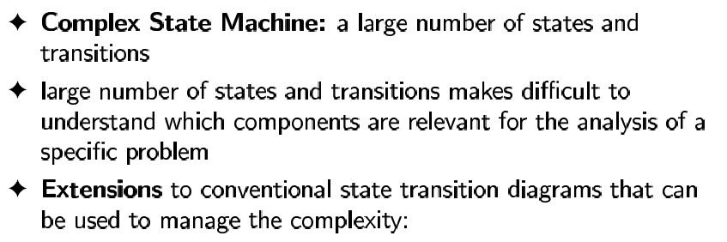
Modeling Complex Behavior
Hierarchical states
Composition of machines for concurrency
Software Requirements Analysis

Slide 36
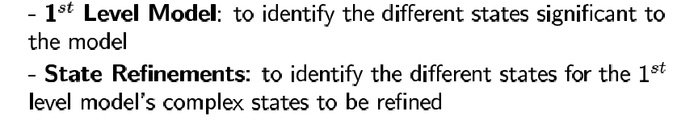
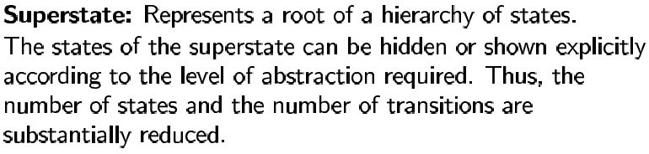
Hierarchical State Machine
Levels:
.
Software Requirements Analysis

Slide 37
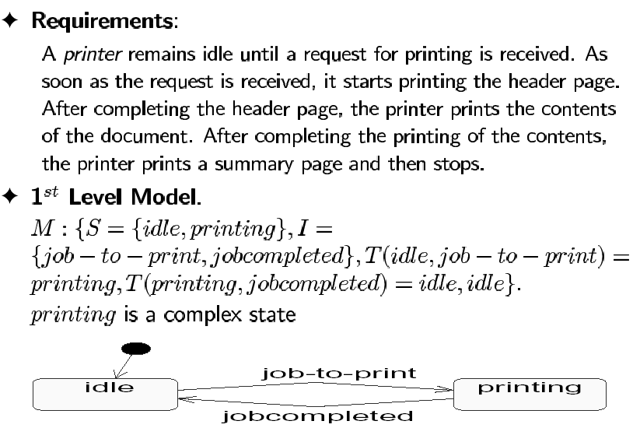
Top-Down Approach: Printer Example
Software Requirements Analysis

Slide 38
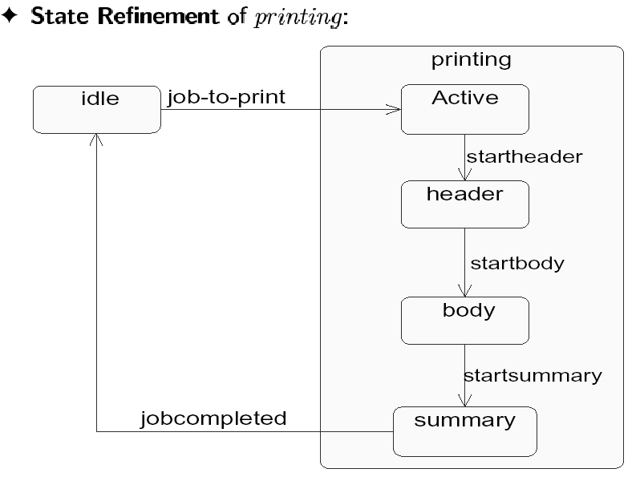
Top-Down Approach: Printer Example
Software Requirements Analysis

Slide 39
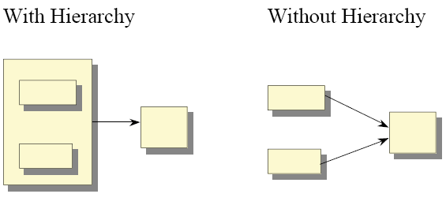
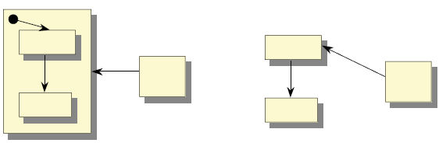
Hierarchical States
Software Requirements Analysis

Slide 40
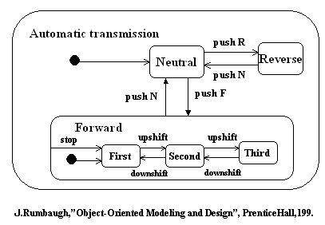
Hierarchical States: Example
Software Requirements Analysis

Slide 41
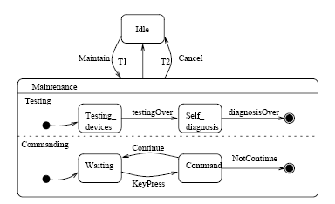
A statechart containing a composite state
Software Requirements Analysis
Notes:
The statechart contains a concurrent composite state Maintenance that is decomposed into two
concurrent substates, Testing and Commanding. Each of these concurrent substates is further decomposed
into sequential substates. When the control passes from Idle to the Maintenance state, the control then
forks to two concurrent flows – the object will be in the Testing state and the Commanding state.
Furthermore, while in the Testing state, the object will be in the Testing_devices or the Self_diagnosis
state; while in the Commanding state, the object will be in the Waiting or the Command state. When the
Cancel event occurs, control will pass from the Maintenance to the Idle state no matter which substates
the object is in. In this case, the actual source states for the transition labeled Cancel are not explicitly
specified in the statechart. Moreover, these source states cannot be determined statically because they
depend on which substates are currently active. This example gives a flavor for the complexity that we
encounter when dealing with composite states.
The hierarchical structure of statecharts complicates the transformation of UML statecharts to other
modeling languages because the semantics associated with composite states are often not explicitly
observed in statecharts. The “implied” semantics involve the following issues: 1) transitions to and from
composite states; 2) transition priority associated with the hierarchical structure of states; 3) history states;
and 4) the event dispatcher mechanism. The first three issues concern the control flow of the state
machine when an event is dispatched. The last issue concerns how an event can be dispatched and thus be
available for driving the control flow.

Slide 42
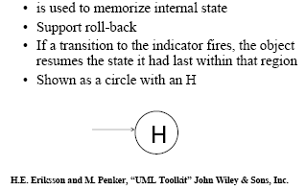
History State
Software Requirements Analysis

Slide 43
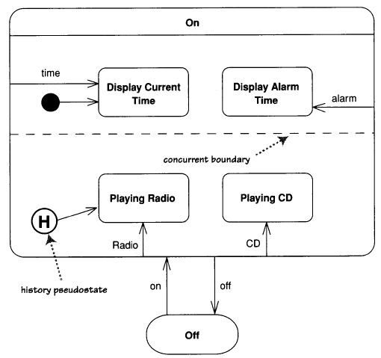
History State
Software Requirements Analysis

Slide 44
Validation of State Machines: Criteria
syntax
  "Does the diagram follow the rules?"
domain expert
  "Is the diagram correct?"
  "What else is there that is not described in this diagram?"
traceability
  "Does everything in this diagram trace back correctly and completely to its predecessor?"
  "Is everything in the predecessor reflected completely and correctly in this diagram?"
Software Requirements Analysis

Slide 45
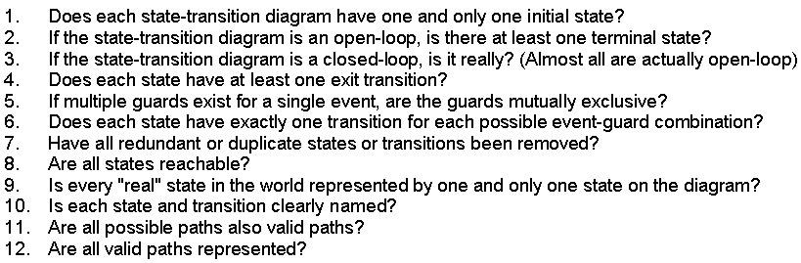
Syntax Validation Checkpoints
Software Requirements Analysis

Slide 46
Domain Expert Validation Checkpoints
Complete:
  1. Are all of the required states, events, guards, transitions, and actions shown on the diagram?
  2. Are all exceptional cases handled properly?
Correct:
  1. Are we using state-transition diagrams only for classes that have complex, interesting behaviour?
  2. Does the diagram correctly represent the open-loop/closed-loop nature of the class?
  3. Are all of the required states, events, guards, transitions, and actions properly defined?
Consistent:
  1. Does a one-to-one correspondence exist between an object’s events and its methods?
Software Requirements Analysis

Slide 47
Traceability Validation
Checkpoints
Consistent:
  Do all states, events, guards, transitions, and actions in the requirements appear in the state-transition diagram?
Software Requirements Analysis

Slide 48
Reminder:
UML Diagrams Appropriate for OO Analysis Modeling:
Use-Case Diagram
Interaction Diagrams
Class Diagram for Domain Model
Statecharts (today)
Activity Diagram (today)
Domain Model
Use Case Model
(cont.)
Software Requirements Analysis

Slide 49
UML: Activity Diagrams
Used to naturally represent flows of events in scenarios
A state transition diagram where all states are action states
Very easy to write and understand
Enables a representation of branching, repetition and process forking
Software Requirements Analysis

Slide 50
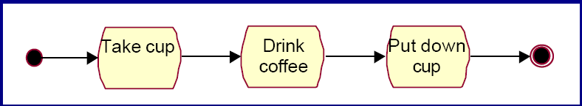
Activity diagram
Simple
Software Requirements Analysis

Slide 51
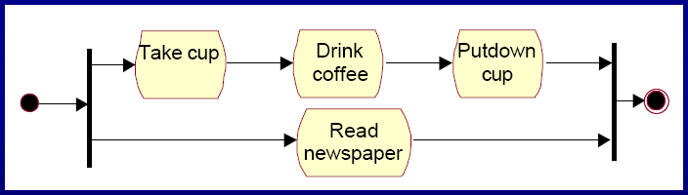
Activity diagram
Parallel activities
Software Requirements Analysis

Slide 52
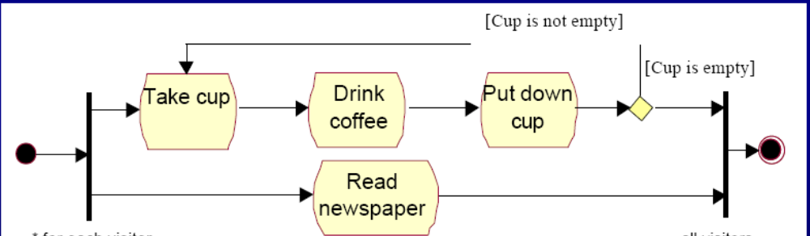
Activity diagram
Conditional
Software Requirements Analysis

Slide 53
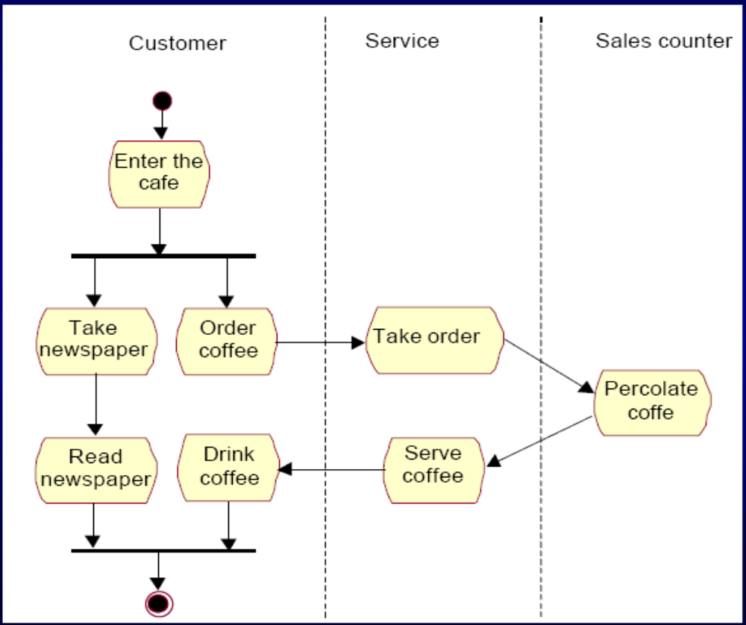
Activity diagram
Swim Lanes
Software Requirements Analysis

Slide 54
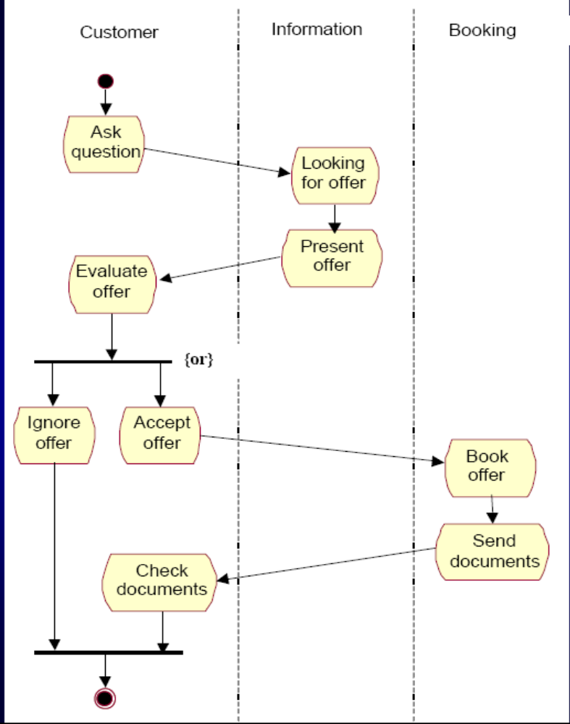
Activity diagram
Swim Lanes
Software Requirements Analysis

Slide 55
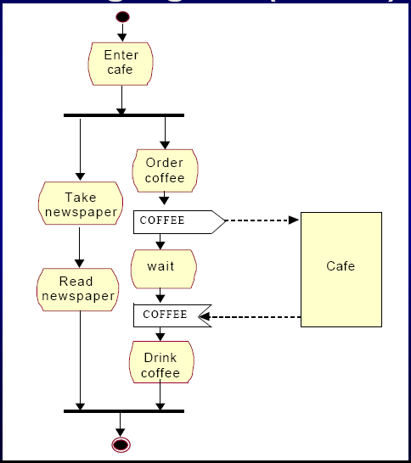
Activity diagram
Signals
Software Requirements Analysis

Slide 56
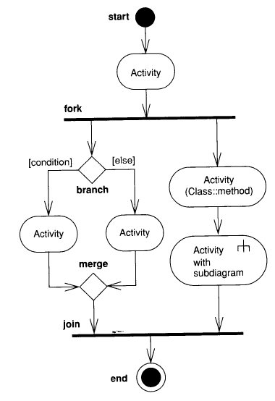
Activity Diagrams: Review
Software Requirements Analysis

Slide 57
NEXT ?
Writing Requirements
Software Requirements Analysis

Slide 58
Exercise
Draw a state diagram for a jukebox with four states. In ProposeSelection state, the system waits for the user to press a select button, selecting some music. In the MusicPlaying state, the system plays the chosen music until it comes to an end. In the AcceptingMoney state, the correct amount of money must be accepted prior to playing music. In the ReturningMoney state, the money is returned to the user when the user presses the return button, prior to playing music.
Software Requirements Analysis

