Slide 1
Large
Medium
Body
Bullet
Number
Checkbox
Code

Slide 2
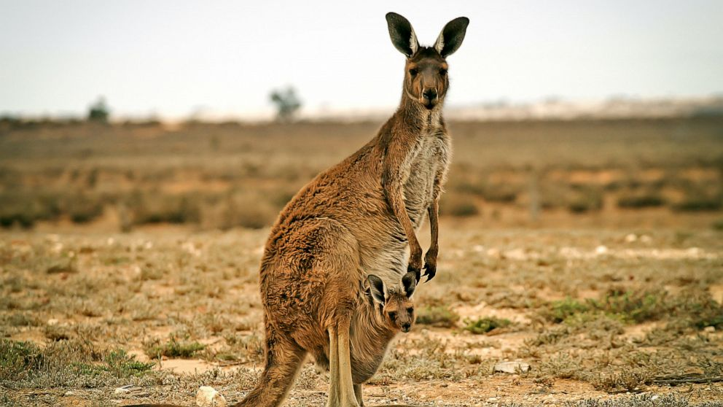
https://s.abcnews.com/images/International/kangaroo-stock-gty-jef-191003_hpMain_16x9_992.jpg

Slide 3
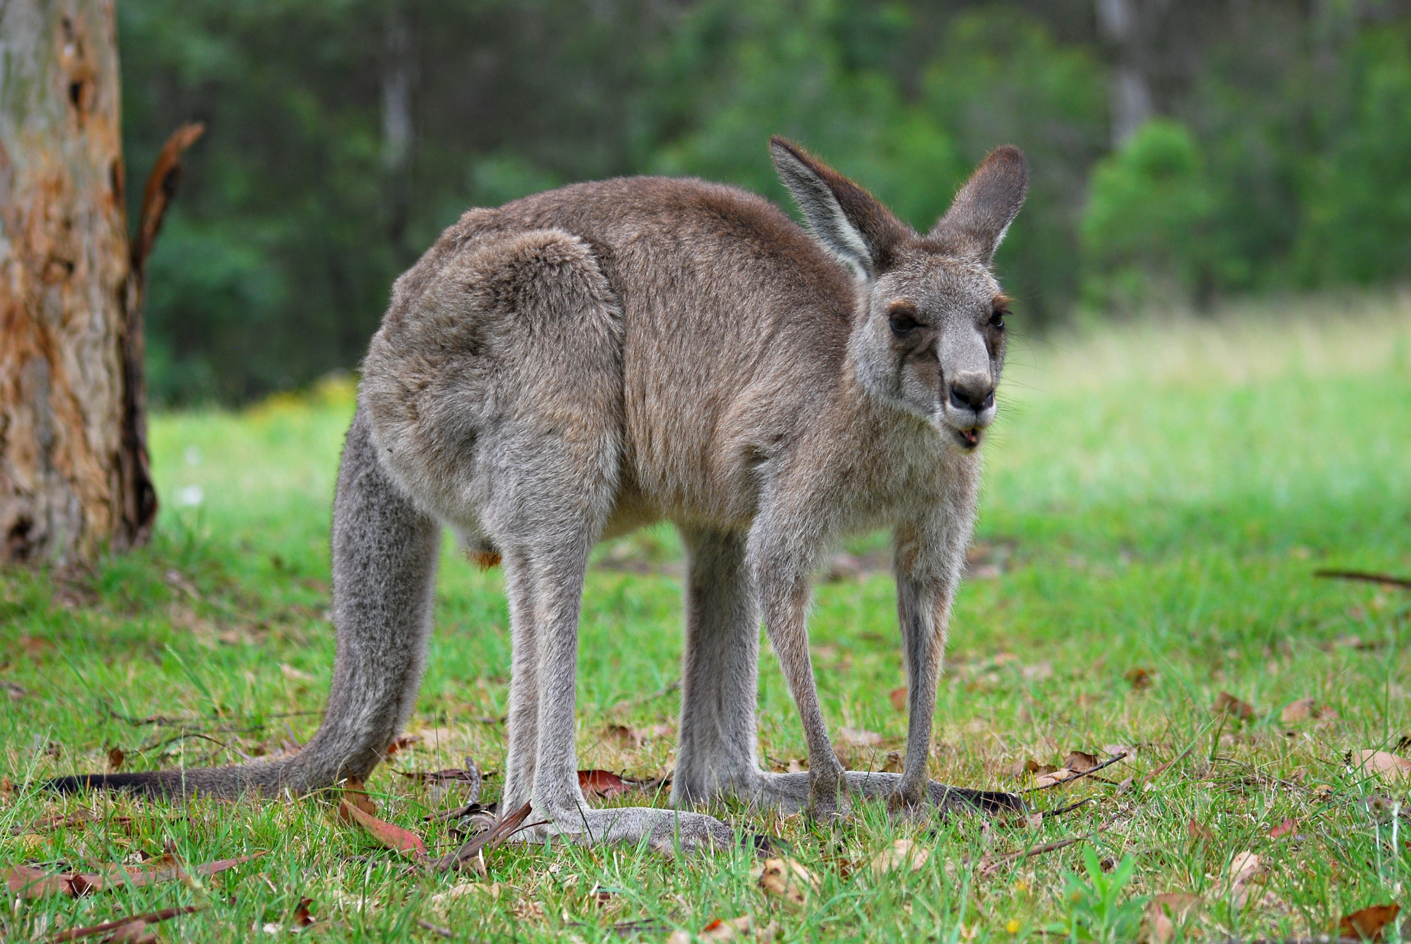
Kangaroo!
He looks tired.

Slide 4
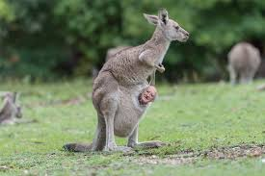
Smaller Kanga!

