Slide 1


Artificial Intelligence International Business Class in School of Electronic Information and Communications
Bang Wang (Dr., Prof.)
School of Electronic Information and Communications
Huazhong University of Science and Technology (HUST)
Notes:
Without specially mentioning, figures are credited to UC. Berkely (ai.berkeley.edu)!

Slide 2
Course Outline
Introduction (2 units)
Searching
Uninformed Search (2 units)
Informed Search (2 units)
Constraint Satisfaction Problem (4 units)
Learning
Machine Learning Introduction (2 units)
Supervised Learning (4 units)
Unsupervised Learning (2 units)
Reasoning
Markov Decision Process (4 units)
Reinforcement Learning (4 units)
Bayesian Network (4 units)
Discussion (2 units)
32 Lecturing Units
2 Credits
Grading System:
10 Class Attendance
40 Python Programming Projects
20 Class Presentation and Panel Discussion
40 Final Project with Report on Selected Topics

Slide 3
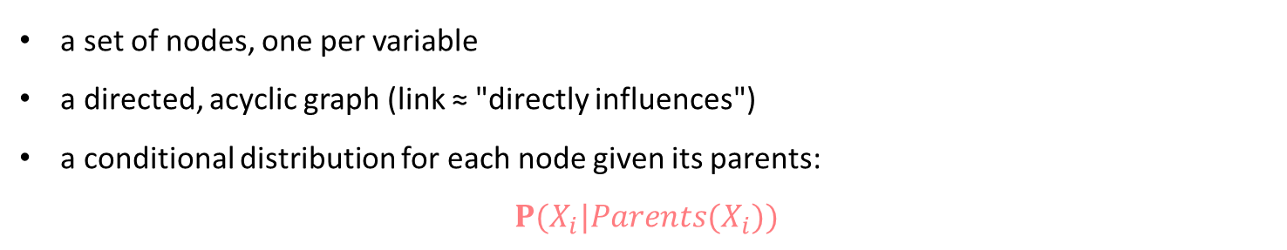
Brief introduction
A simple, graphical notation for conditional independence assertions and hence for compact specification of full joint distributions
Syntax:
a set of nodes, one per variable
a directed, acyclic graph (link ≈ "directly influences")
a conditional distribution for each node given its parents:
$$P(X_{i}|Parents(X_{i}))$$
In the simplest case, conditional distribution represented as a conditional probability table (CPT) giving the distribution over X_{i} for each combination of parent values.

Slide 4
Example
Scene description :A middle school student returned home, his parents suspected that she had attended the party and had a drink. The next day the student felt a headache. Her parents took her to the hospital for an X-ray examination of the head.
Variables : Party(PT), Hangover(HO), Brain tumor(BT), Headache(HA), Smell alcohol(SA), Positive x-ray(PX)
Network topology reflects "causal" knowledge:
PT can cause HO
HO can cause SA,HA
BT can cause HA,PX
Cause reasoning results:
If PT is true, what is the probability of SA?
If HA is true, what is the probability of BT?
Inferred reason from result:
If SA is true, what is the probability of PT?

Slide 5
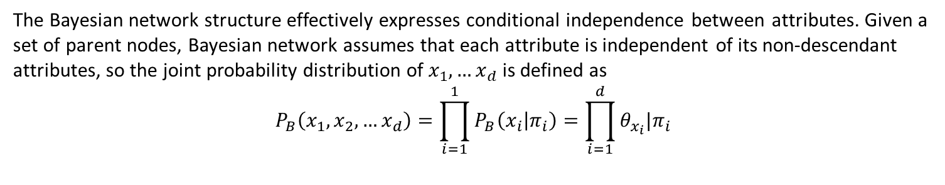
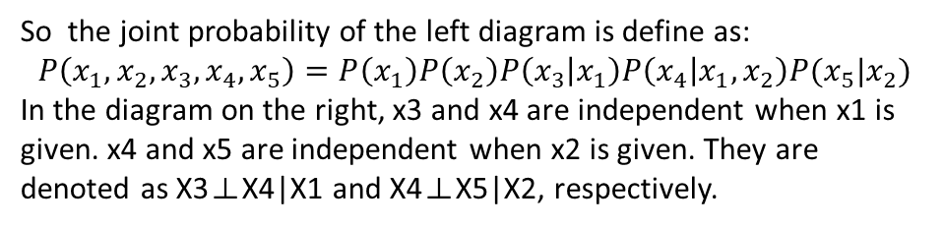
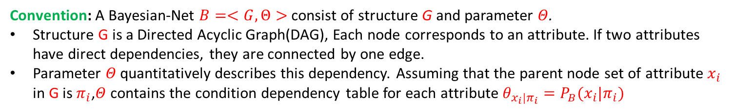
Structure
Convention: A Bayesian-Net $B=<G,Θ>$ consist of structure G and parameter $Θ$.
Structure G is a Directed Acyclic Graph(DAG), Each node corresponds to an attribute. If two attributes have direct dependencies, they are connected by one edge.
Parameter 𝛩 quantitatively describes this dependency. Assuming that the parent node set of attribute $x_{i}$ in G is $π_{i}$,𝛩 contains the condition dependency table for each attribute $θ_{x_{i}|π_{i}}=P_{B}(x_{i}|π_{i})$
The Bayesian network structure effectively expresses conditional independence between attributes. Given a set of parent nodes, Bayesian network assumes that each attribute is independent of its non-descendant attributes, so the joint probability distribution of $x_{1},…x_{d}$ is defined as
$$P_{B}\left(x_{1},x_{2},…x_{d}\right)=\prod_{i=1}^{1}{P_{B}\left(x_{i} | π_{i}\right)=\prod_{i=1}^{d}{θ_{x_{i}}|π_{i}}}$$
So the joint probability of the left diagram is define as:
$$P\left(x_{1},x_{2},x_{3},x_{4},x_{5}\right)=P\left(x_{1}\right)P\left(x_{2}\right)P\left(x_{3} | x_{1}\right)P\left(x_{4} | x_{1},x_{2}\right)P(x_{5}|x_{2})$$
In the diagram on the right, x3 and x4 are independent when x1 is given. x4 and x5 are independent when x2 is given. They are denoted as X3⊥X4|X1 and X4⊥X5|X2, respectively.
X1
X2
X3
X4
X4

Slide 6
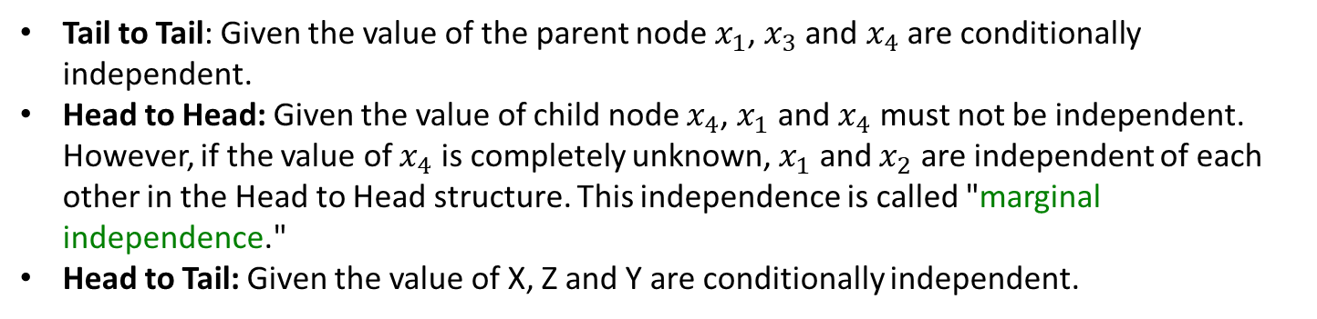
Structure
Three Typical Relationships among Variables in Bayesian Networks
X1
X1
X2
X
X3
X4
X4
Z
Y
Tail to Tail
Head to Head
Head to Tail
Tail to Tail: Given the value of the parent node $x_{1}$, $x_{3}$ and $x_{4}$ are conditionally independent.
Head to Head: Given the value of child node $x_{4}$, $x_{1}$ and $x_{4}$ must not be independent. However, if the value of $x_{4}$ is completely unknown, $x_{1}$ and $x_{2}$ are independent of each other in the Head to Head structure. This independence is called "marginal independence."
Head to Tail: Given the value of X, Z and Y are conditionally independent.

Slide 7
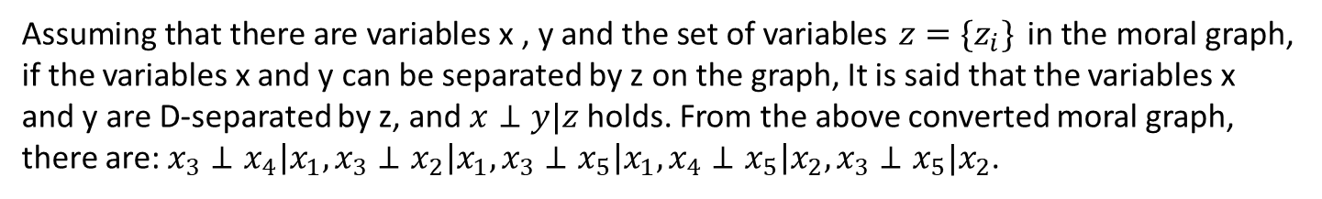
Structure
In order to analyze the conditional independence among variables in a directed graph,
D-separation can be used to convert a directed graph into an undirected graph. The resulting undirected graph is also known as the moral graph. The process of linking the parent nodes is called moralization.
Find all the Head to Head structures in the directed graph and add an undirected edge between the two parent nodes.
Turn all the directed edge into undirected.
X1
X2
D-separation
X1
X2
X3
X4
X4
X3
X4
X4
Assuming that there are variables x , y and the set of variables $z=\{z_{i}\}$ in the moral graph, if the variables x and y can be separated by z on the graph, It is said that the variables x and y are D-separated by z, and $x⊥y|z$holds. From the above converted moral graph,
there are: $x_{3}⊥x_{4}\left|x_{1}, x_{3}⊥x_{2}\right|x_{1},x_{3}⊥x_{5}\left|x_{1},x_{4}⊥x_{5}\right|x_{2},x_{3}⊥x_{5}|x_{2}$.

Slide 8
Learning
If the structure is known → Counting the training samples to estimate the probability table.
If the structure is unknown(in most instances) → To find the most appropriate Bayesian network . "Score search" is a common way to solve this problem.
1. Define a score function to evaluate the degree of fit of the Bayesian network with training data
2. Use this score function to find optimal Bayesian network structure.
The commonly used score function is usually based on the information theory criterion. The learning problem is regarded as a data compression task. The goal of the learning is to find a model that can describe the training data with the shortest code length. The code length includes the bytes needed to describe the model itself, as well as the training data.
Minimal Description Length criterion(MDL) : Choose the Bayesian network with the shortest overall coding length (including network and data).

Slide 9
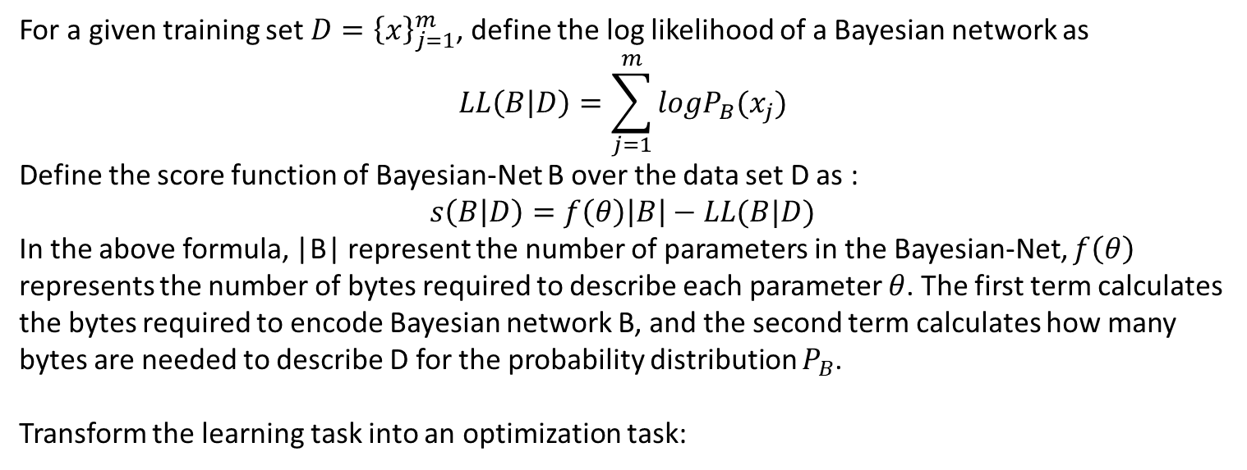

Learning
For a given training set $D={\left\{x\right\}}_{j=1}^{m}$, define the log likelihood of a Bayesian network as
$$LL\left(B | D\right)=\sum_{j=1}^{m}{logP_{B}(x_{j})}$$
Define the score function of Bayesian-Net B over the data set D as :
$$s\left(B | D\right)=f\left(θ\right)\left|B\right|−LL(B|D)$$
In the above formula, |B| represent the number of parameters in the Bayesian-Net, $f\left(θ\right)$ represents the number of bytes required to describe each parameter $θ$. The first term calculates the bytes required to encode Bayesian network B, and the second term calculates how many bytes are needed to describe D for the probability distribution $P_{B}$.
Transform the learning task into an optimization task:
Finding a Bayesian Network B to Minimize the Score Function $s(B|D)$

Slide 10
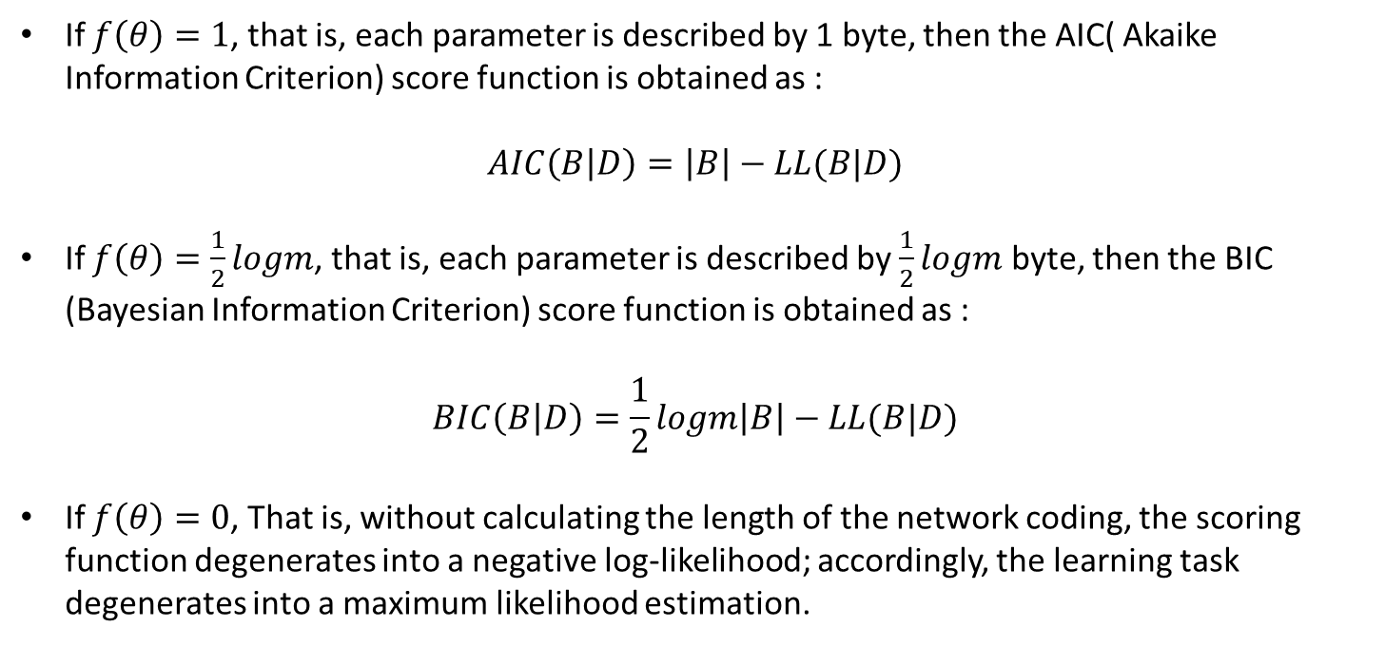
Learning
If $f\left(θ\right)=1$, that is, each parameter is described by 1 byte, then the AIC( Akaike Information Criterion) score function is obtained as :
$$AIC\left(B | D\right)=\left|B\right|−LL(B|D)$$
If $f\left(θ\right)=\frac{1}{2}logm$, that is, each parameter is described by $\frac{1}{2}logm$ byte, then the BIC (Bayesian Information Criterion) score function is obtained as :
$$BIC\left(B | D\right)=\frac{1}{2}logm\left|B\right|−LL(B|D)$$
If $f\left(θ\right)=0$, That is, without calculating the length of the network coding, the scoring function degenerates into a negative log-likelihood; accordingly, the learning task degenerates into a maximum likelihood estimation.

Slide 11
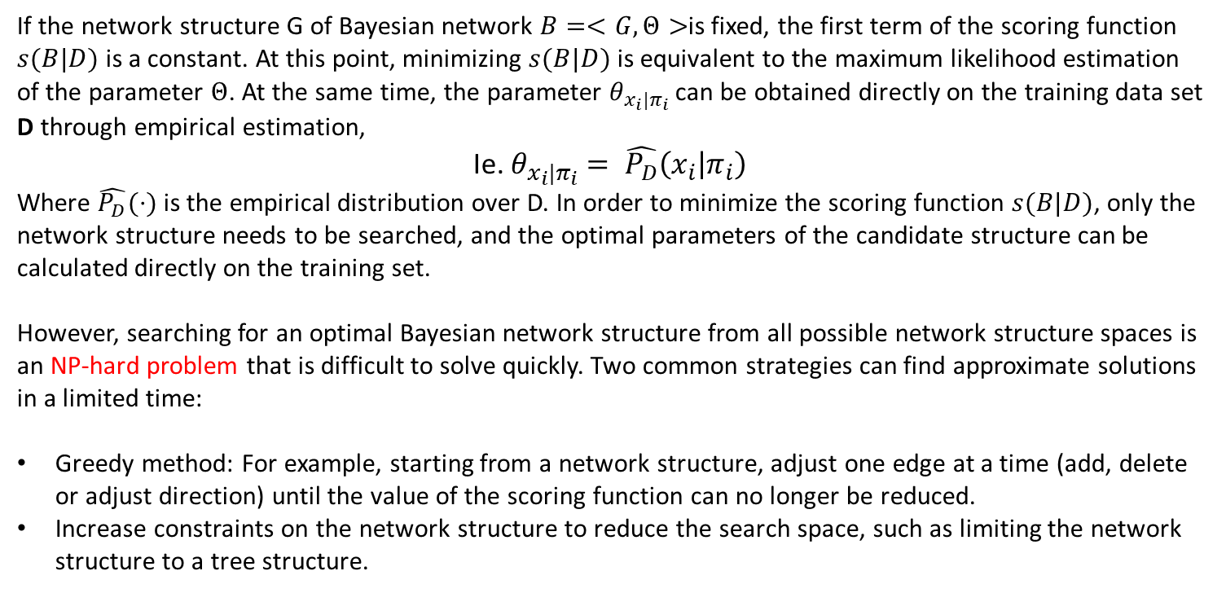
Learning
If the network structure G of Bayesian network $B=<G,Θ>$is fixed, the first term of the scoring function $s(B|D)$ is a constant. At this point, minimizing $s(B|D)$ is equivalent to the maximum likelihood estimation of the parameter $Θ$. At the same time, the parameter $θ_{x_{i}|π_{i}}$ can be obtained directly on the training data set D through empirical estimation,
Ie. $θ_{x_{i}|π_{i}}= \hat{P_{D}}\left(x_{i} | π_{i}\right)$
Where $\hat{P_{D}}(⋅)$ is the empirical distribution over D. In order to minimize the scoring function $s(B|D)$, only the network structure needs to be searched, and the optimal parameters of the candidate structure can be calculated directly on the training set.
However, searching for an optimal Bayesian network structure from all possible network structure spaces is an NP-hard problem that is difficult to solve quickly. Two common strategies can find approximate solutions in a limited time:
Greedy method: For example, starting from a network structure, adjust one edge at a time (add, delete or adjust direction) until the value of the scoring function can no longer be reduced.
Increase constraints on the network structure to reduce the search space, such as limiting the network structure to a tree structure.

Slide 12
Learning
Example review: Assume that the six nodes of the Bayesian network are:
PT (party) | HO (hangover) | BT (brain tumor)
HA (headache) | SA (smell alcohol) | PX (positive x-ray)
Establishment of Bayesian Network:
First of all, we must abstract the events in the actual problem as nodes in the network; each node must have a clear meaning, at least yes, no two states, or multiple states, and these states are complete in a probabilistic sense and mutually exclusive. That is, all states can only occur one at a time, and the sum of the probabilities of these states is 1.
Second, establish a connection between two or more nodes. Basic principles: Connections should be established between nodes that have a clear causal relationship. So as to prevent the network from being too complex to grasp the essence of the problem. Note: When establishing a connection between two nodes, the ring must be prevented because the Bayesian network is an acyclic graph.

Slide 13
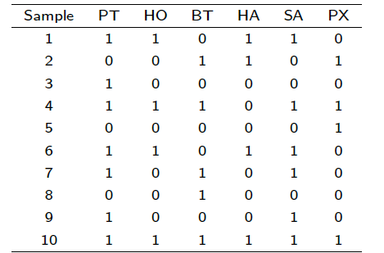
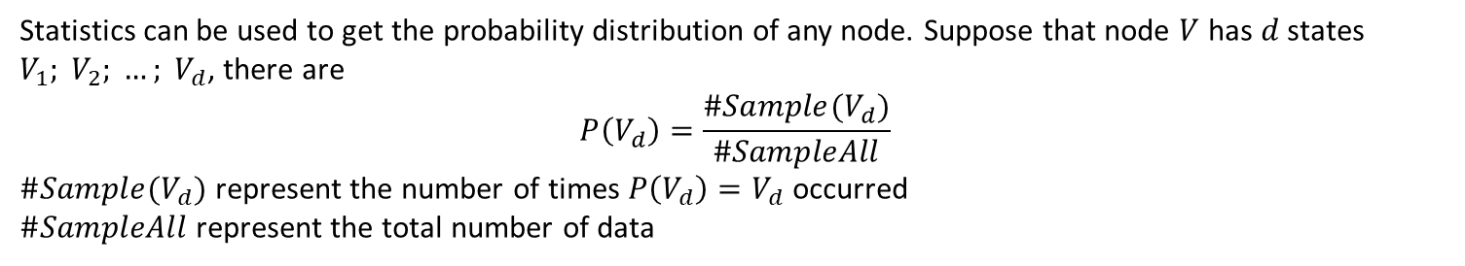
Learning
Training process of Bayesian Network:
Refers to the distribution of the probability of learning the nodes and the conditional probability distribution between the nodes. Can be filled in by expert experience, but using more methods is obtained through historical data training.
Statistics can be used to get the probability distribution of any node. Suppose that node $V$ has $d$ states $V_{1}; V_{2}; …; V_{d}$, there are
$$P\left(V_{d}\right)=\frac{\#Sample(V_{d})}{\#SampleAll}$$
$\#Sample(V_{d})$ represent the number of times $P\left(V_{d}\right)=V_{d}$ occurred
$\#SampleAll$ represent the total number of data

Slide 14
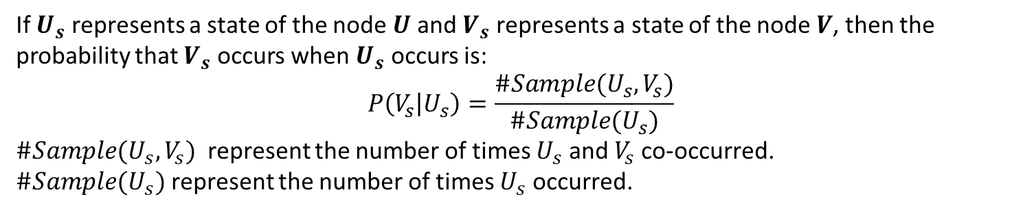
Learning
Training process of Bayesian Network:
If $U_{s}$ represents a state of the node $U$ and $V_{s}$ represents a state of the node $V$, then the probability that $V_{s}$ occurs when $U_{s}$ occurs is:
$$P\left(V_{s} | U_{s}\right)=\frac{\#Sample(U_{s},V_{s})}{\#Sample(U_{s})}$$
$\#Sample(U_{s},V_{s})$ represent the number of times $U_{s}$ and $V_{s}$ co-occurred.
$\#Sample(U_{s})$ represent the number of times $U_{s}$ occurred.
If a node is a result node or an intermediate node, there are two ways to get the probability distribution of this node.
Get statistics directly from the training data set.
(2) First obtain the probability distribution of the cause result from the table data through statistics, then obtain the conditional probability distribution or joint conditional probability distribution from the training data set through statistics, and finally use the full probability formula to calculate the probability distribution of the middle node or the result node. . It can be verified that the probability distribution obtained by these two methods is consistent.

Slide 15
Course Textbook
Review: Bayesian network is a probabilistic reasoning technique that combines probability theory and graph structure to describe the uncertainty caused by the conditions between different knowledge components.
Bayesian network training: the process of correcting prior knowledge by using existing data.
After the Bayesian network is built based on the training data set, prediction and diagnosis can be performed.
Bayesian Net Prediction: Refers to reasoning that infers a result from the cause, also known as top-down reasoning. Given a certain reason (evidence), use Bayesian network inference calculations to find out the probability of the result caused by the cause.
Bayesian Net diagnosis :Refers to the reasoning that infers a cause from the result, also called bottom-up reasoning. It is known that some results have occurred and the reason for the occurrence of the result and the probability of occurrence have been calculated based on the Bayesian network inference.

Slide 16
Course Textbook
Example review: Assume that the Bayesian network has been trained. The 6 nodes are:
PT (party) | HO (hangover) | BT (brain tumor)
HA (headache) | SA (smell alcohol) | PX (positive x-ray)
In the figure, the two nodes of Party and Brain Tumor are the cause nodes(no connection that ends with them). Their unconditional probabilities are:
 | P(PT) | P(BT)
True | 0.200 | 0.001
False | 0.800 | 0.999

Slide 17
Course Textbook
The other groups of conditional probabilities are as follows:
P(HO|PT) | PT=True | PT=False
True | 0.700 | 0
False | 0.300 | 1.000
P(SA|HO) | HO=True | HO=False
True | 0.800 | 0.100
False | 0.200 | 0.900
P(PX|BT) | BT=True | BT=False
True | 0.980 | 0.010
False | 0.020 | 0.990
Conditional probability of HA at known HO and BT:
P(HA|HO,BT) | HO = True BT = True BT = False |  | HO = False BT = True BT = False
True | 0.99 | 0.7 | 0.9 | 0.02
False | 0.01 | 0.3 | 0.1 | 0.98

Slide 18
Course Textbook
Bayesian Net Prediction: The Bayesian network can predict the probability of the resulting node
without knowing or knowing some conditional nodes.
Convention: For a node Point, P (+Point) :the probability of occurrence of Point,
P (-Point): the probability that Point does not occur.
Example 1：Calculate the probability of HA：From the diagram,
{HO,BT }→HA , {PT}→HO
Firstly, Find P(HO),Using the full probability formula:
P(+HO) = P(+ HO |+ PT)P(+ PT) + P(+ HO|- PT)P(- PT)
= 0.7 × 0.2 + 0 × 0.8 = 0.14
P(-HO) = P(- HO|+ PT)P(+ PT) + P(- HO|- PT)P(- PT)
=0.3 × 0.2 +1.0 × 0.8 = 0.86
In the absence of any node information (evidence):
P(+ HA) = 0.116
P(- HA) = 0.884
P(+HA) = P(+ HA|+ BT,+ HO)P(+ BT)P(+ HO) + P(+ HA|+ BT,- HO)P(+ BT)P(- HO)
+ P(+ HA|- BT,+ HO)P(- BT)P(+ HO) + P(+ HA|- BT,- HO)P(- BT)P(- HO)
=0.99 × 0.001 × 0.14 + × 0.9×0.001×0.86 + 0.7 × 0.999 ×0 .14 + 0.02 × 0.999 × 0.86
=0.1159944≈0.116
P(-HA) = 1 – P(+HA) = 0.884

Slide 19
Course Textbook
Example 2： Calculate the Conditional probability of SA at known PT:
From the diagram:
{HO }→SA , {PT}→HO
From the previous conditional probability table:
P(+HO|+PT) = 0.7,P(-HO|+PT) = 0.3
Therefore:
P (+SA) = P (+SA| + HO)P (+HO) + P (+SA| − HO)P (−HO)
= 0.8 × 0.7 + 0.1 × 0.3 = 0.59
Example 3： Calculate the Conditional probability of HA at known PT:
From the diagram: {HO,BT}→HA , {PT}→HO
From the previous conditional probability table: P(+HO|+PT) = 0.7,P(-HO|+PT) = 0.3
And BT is the reason node, regardless of other probabilities ; P(+BT) = 0.001, P(-BT) = 0.999. Therefore
P(+HA) = P (+HA| + HO, +BT )P (+HO)P (+BT ) + P (+HA| + HO, −BT )P (+HO)P (−BT )
+P (+HA| − HO, +BT )P (−HO)P (+BT ) + P (+HA| − HO, −BT )P (−HO)P (−BT )
= 0.99 × 0.7 × 0.001 + 0.7 × 0.7 × 0.999 + 0.9 × 0.3 × 0.001 + 0.02 × 0.3 × 0.999 = 0.496467
P(-HA) = 1 – P(+HA) = 0.503533
Note the comparison with Example 1: In the absence of any node information (evidence), the probability of a headache is 0.116 and the probability of a non-headache is 0.884.

Slide 20
Course Textbook
Bayesian network prediction algorithm steps:
Input：A given Bayesian-Net B(including N nodes and conditional/joint conditional probability between nodes), given a fact vector E (or an evidence vector) for the occurrence or absence of a cause node, given a certain node v to be predicted.
Output：The probability of occurrence of node v.
Enter the evidence vector into Bayesian-Net B.
For each unprocessed node n in B, if it has the fact (evidence) that occurred, it is marked as having been processed; otherwise continue with the following steps.
If one of its parent nodes has not been processed, this node is not processed; otherwise, continue with the following steps.
Calculate the probability distribution of node n based on the probabilities of all parent nodes of node n and the conditional or joint conditional probabilities, and mark node n as processed.
Repeat steps (2) to (4) for a total of T times. At this point, the probability distribution of node n is the probability of its occurrence/non-occurrence. The algorithm ends. It should be noted that the effect of step (5) is to make each node have the opportunity to calculate the probability distribution.

Slide 21
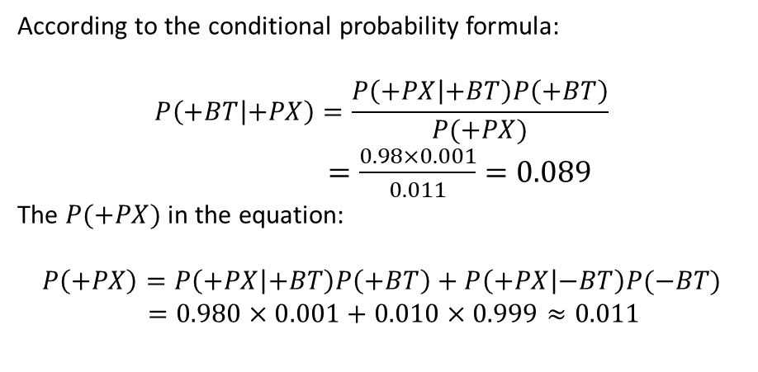
Course Textbook
Bayesian Net diagnosis: The probability of occurrence of a conditional node which
is inferred based on whether the resulting node occurs or not.
Example 4： Calculate the Conditional probability of BT at known PX：
According to the conditional probability formula:
$$P\left(+BT | +PX\right)=\frac{P\left(+PX | +BT\right)P\left(+BT\right)}{P(+PX)}$$
$=\frac{0.98×0.001}{0.011}=0.089$
The $P(+PX)$ in the equation:
$$P\left(+PX\right)=P\left(+PX | +BT\right)P\left(+BT\right)+P\left(+PX | −BT\right)P(−BT)$$
$=0.980×0.001+0.010×0.999≈0.011$
This result shows that when the X-ray examination is positive, the probability of having a brain tumor is 0.089, and the probability of not having a brain tumor is 0.911.

Slide 22
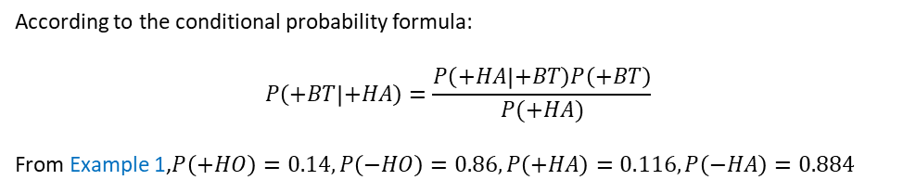

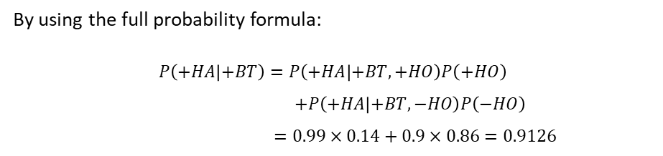
Course Textbook
Example 5： Calculate the Conditional probability of BT at known HA：
According to the conditional probability formula:
$$P\left(+BT | +HA\right)=\frac{P\left(+HA | +BT\right)P\left(+BT\right)}{P(+HA)}$$
From Example 1,$P\left(+HO\right)=0.14,P\left(−HO\right)=0.86,P\left(+HA\right)=0.116,P\left(−HA\right)=0.884$
By using the full probability formula:
$$P\left(+HA | +BT\right)=P\left(+HA | +BT,+HO\right)P\left(+HO\right)$$
$+P\left(+HA | +BT,−HO\right)P\left(−HO\right)$
$=0.99×0.14+0.9×0.86=0.9126$
P(HA|HO,BT) | HO = True BT = True BT = False |  | HO = False BT = True BT = False
True | 0.99 | 0.7 | 0.9 | 0.02
False | 0.01 | 0.3 | 0.1 | 0.98
The above calculation gives the probability of a headache in the case of known brain tumors to be 0:913. This conditional probability is an edge distribution, which is obtained by removing a conditional HO from the joint conditional probability distribution (H0, BT→HA).
Finally:
$$P\left(+BT | +HA\right)=\frac{P(+HA|+BT)P(+BT)}{P(+HA)}=\frac{0.9126×0.001}{0.116}≈0.007867$$

Slide 23
Course Textbook
Bayesian network diagnosis algorithm steps:
Input：A given Bayesian-Net B(including N nodes and conditional/joint conditional probability between nodes), given a fact vector E (or an evidence vector) for the occurrence or absence of a result node, given a certain node v to be diagnosed..
Output：The probability of occurrence of node v.
Enter the evidence vector into Bayesian-Net B.
For each unprocessed node n in B, if it has the fact (evidence) that occurred, it is marked as having been processed; otherwise continue with the following steps.
If one of its child nodes has not been processed, this node is not processed; otherwise, continue with the following steps.
Calculate the probability distribution of node n based on the probabilities of all child nodes of node n and the conditional or joint conditional probabilities, and mark node n as processed.
Repeat steps (2) to (4) for a total of T times. At this point, the probability distribution of node n is the probability of its occurrence/non-occurrence. The algorithm ends. It should be noted that the effect of step (5) is to make each node have the opportunity to calculate the probability distribution.

Slide 24
Artificial Intelligence Chapter 1: Introduction
International Business Class in School of Electronic Information and Communications

