Slide 1


Artificial Intelligence International Business Class in School of Electronic Information and Communications
Bang Wang (Dr., Prof.)
School of Electronic Information and Communications
Huazhong University of Science and Technology (HUST)
Notes:
Without specially mentioning, figures are credited to UC. Berkely (ai.berkeley.edu)!

Slide 2
Course Outline
Introduction (2 units)
Searching
Uninformed Search (2 units)
Informed Search (2 units)
Constraint Satisfaction Problem (4 units)
Learning
Machine Learning Introduction (2 units)
Supervised Learning (4 units)
Unsupervised Learning (2 units)
Reasoning
Markov Decision Process (4 units)
Reinforcement Learning (4 units)
Bayesian Network (4 units)
Discussion (2 units)
32 Lecturing Units
2 Credits
Grading System:
10 Class Attendance
40 Python Programming Projects
20 Class Presentation and Panel Discussion
40 Final Project with Report on Selected Topics

Slide 3
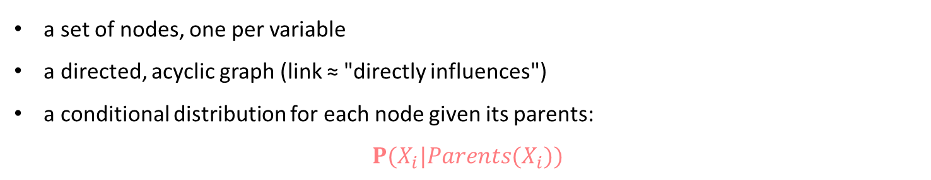
Brief introduction
A simple, graphical notation for conditional independence assertions and hence for compact specification of full joint distributions
Syntax:
a set of nodes, one per variable
a directed, acyclic graph (link ≈ "directly influences")
a conditional distribution for each node given its parents:
$$P(X_{i}|Parents(X_{i}))$$
In the simplest case, conditional distribution represented as a conditional probability table (CPT) giving the distribution over X_{i} for each combination of parent values.

Slide 4
Example
Scene description :A middle school student returned home, his parents suspected that she had attended the party and had a drink. The next day the student felt a headache. Her parents took her to the hospital for an X-ray examination of the head.
Variables : Party(PT), Hangover(HO), Brain tumor(BT), Headache(HA), Smell alcohol(SA), Positive x-ray(PX)
Network topology reflects "causal" knowledge:
PT can cause HO
HO can cause SA,HA
BT can cause HA,PX
Cause reasoning results:
If PT is true, what is the probability of SA?
If HA is true, what is the probability of BT?
Inferred reason from result:
If SA is true, what is the probability of PT?

Slide 5
Structure

Slide 6
Course Textbook

Slide 7
Course Textbook

Slide 8
Course Textbook

Slide 9
Course Textbook

Slide 10
Course Textbook

Slide 11
Course Textbook

Slide 12
Course Textbook

Slide 13
Course Textbook
Review: Bayesian network is a probabilistic reasoning technique that combines probability theory and graph structure to describe the uncertainty caused by the conditions between different knowledge components.
Bayesian network training: the process of correcting prior knowledge by using existing data.
After the Bayesian network is built based on the training data set, prediction and diagnosis can be performed.
Bayesian Net Prediction: Refers to reasoning that infers a result from the cause, also known as top-down reasoning. Given a certain reason (evidence), use Bayesian network inference calculations to find out the probability of the result caused by the cause.
Bayesian Net diagnosis :Refers to the reasoning that infers a cause from the result, also called bottom-up reasoning. It is known that some results have occurred and the reason for the occurrence of the result and the probability of occurrence have been calculated based on the Bayesian network inference.

Slide 14
Course Textbook
Example review: Assume that the Bayesian network has been trained. The 6 nodes are:
PT (party) | HO (hangover) | BT (brain tumor)
HA (headache) | SA (smell alcohol) | PX (positive x-ray)
In the figure, the two nodes of Party and Brain Tumor are the cause nodes(no connection that ends with them). Their unconditional probabilities are:
 | P(PT) | P(BT)
True | 0.200 | 0.001
False | 0.800 | 0.999

Slide 15
Course Textbook
The other groups of conditional probabilities are as follows:
P(HO|PT) | PT=True | PT=False
True | 0.700 | 0
False | 0.300 | 1.000
P(SA|HO) | HO=True | HO=False
True | 0.800 | 0.100
False | 0.200 | 0.900
P(PX|BT) | BT=True | BT=False
True | 0.980 | 0.010
False | 0.020 | 0.990
Conditional probability of HA at known HO and BT:
P(HA|HO,BT) | HO = True BT = True BT = False |  | HO = False BT = True BT = False
True | 0.99 | 0.7 | 0.9 | 0.02
False | 0.01 | 0.3 | 0.1 | 0.98

Slide 16
Course Textbook
Bayesian Net Prediction: The Bayesian network can predict the probability of the resulting node
without knowing or knowing some conditional nodes.
Convention: For a node Point, P (+Point) :the probability of occurrence of Point,
P (-Point): the probability that Point does not occur.
Example 1：Calculate the probability of HA：From the diagram,
{HO,BT }→HA , {PT}→HO
Firstly, Find P(HO),Using the full probability formula:
P(+HO) = P(+ HO |+ PT)P(+ PT) + P(+ HO|- PT)P(- PT)
= 0.7 × 0.2 + 0 × 0.8 = 0.14
P(-HO) = P(- HO|+ PT)P(+ PT) + P(- HO|- PT)P(- PT)
=0.3 × 0.2 +1.0 × 0.8 = 0.86
In the absence of any node information (evidence):
P(+ HA) = 0.116
P(- HA) = 0.884
P(+HA) = P(+ HA|+ BT,+ HO)P(+ BT)P(+ HO) + P(+ HA|+ BT,- HO)P(+ BT)P(- HO)
+ P(+ HA|- BT,+ HO)P(- BT)P(+ HO) + P(+ HA|- BT,- HO)P(- BT)P(- HO)
=0.99 × 0.001 × 0.14 + × 0.9×0.001×0.86 + 0.7 × 0.999 ×0 .14 + 0.02 × 0.999 × 0.86
=0.1159944≈0.116
P(-HA) = 1 – P(+HA) = 0.884

Slide 17
Course Textbook
Example 2： Calculate the Conditional probability of SA at known PT:
From the diagram:
{HO }→SA , {PT}→HO
From the previous conditional probability table:
P(+HO|+PT) = 0.7,P(-HO|+PT) = 0.3
Therefore:
P (+SA) = P (+SA| + HO)P (+HO) + P (+SA| − HO)P (−HO)
= 0.8 × 0.7 + 0.1 × 0.3 = 0.59
Example 3： Calculate the Conditional probability of HA at known PT:
From the diagram: {HO,BT}→HA , {PT}→HO
From the previous conditional probability table: P(+HO|+PT) = 0.7,P(-HO|+PT) = 0.3
And BT is the reason node, regardless of other probabilities ; P(+BT) = 0.001, P(-BT) = 0.999. Therefore
P(+HA) = P (+HA| + HO, +BT )P (+HO)P (+BT ) + P (+HA| + HO, −BT )P (+HO)P (−BT )
+P (+HA| − HO, +BT )P (−HO)P (+BT ) + P (+HA| − HO, −BT )P (−HO)P (−BT )
= 0.99 × 0.7 × 0.001 + 0.7 × 0.7 × 0.999 + 0.9 × 0.3 × 0.001 + 0.02 × 0.3 × 0.999 = 0.496467
P(-HA) = 1 – P(+HA) = 0.503533
Note the comparison with Example 1: In the absence of any node information (evidence), the probability of a headache is 0.116 and the probability of a non-headache is 0.884.

Slide 18
Course Textbook
Bayesian network prediction algorithm steps:
Input：A given Bayesian-Net B(including N nodes and conditional/joint conditional probability between nodes), given a fact vector E (or an evidence vector) for the occurrence or absence of a cause node, given a certain node v to be predicted.
Output：The probability of occurrence of node v.
Enter the evidence vector into Bayesian-Net B.
For each unprocessed node n in B, if it has the fact (evidence) that occurred, it is marked as having been processed; otherwise continue with the following steps.
If one of its parent nodes has not been processed, this node is not processed; otherwise, continue with the following steps.
Calculate the probability distribution of node n based on the probabilities of all parent nodes of node n and the conditional or joint conditional probabilities, and mark node n as processed.
Repeat steps (2) to (4) for a total of T times. At this point, the probability distribution of node n is the probability of its occurrence/non-occurrence. The algorithm ends. It should be noted that the effect of step (5) is to make each node have the opportunity to calculate the probability distribution.

Slide 19
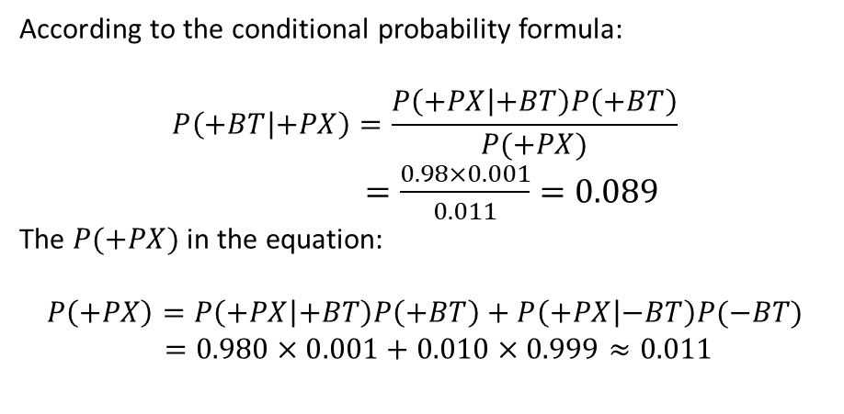
Course Textbook
Bayesian Net diagnosis: The probability of occurrence of a conditional node which
is inferred based on whether the resulting node occurs or not.
Example 4： Calculate the Conditional probability of BT at known PX：
According to the conditional probability formula:
$$P\left(+BT | +PX\right)=\frac{P\left(+PX | +BT\right)P\left(+BT\right)}{P(+PX)}$$
$=\frac{0.98×0.001}{0.011}=0.089$
The $P(+PX)$ in the equation:
$$P\left(+PX\right)=P\left(+PX | +BT\right)P\left(+BT\right)+P\left(+PX | −BT\right)P(−BT)$$
$=0.980×0.001+0.010×0.999≈0.011$
This result shows that when the X-ray examination is positive, the probability of having a brain tumor is 0.089, and the probability of not having a brain tumor is 0.911.

Slide 20
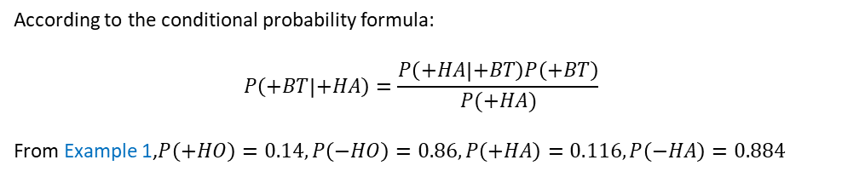

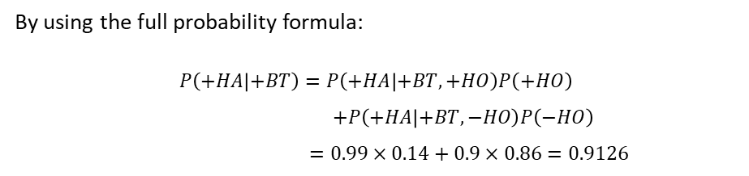
Course Textbook
Example 5： Calculate the Conditional probability of BT at known HA：
According to the conditional probability formula:
$$P\left(+BT | +HA\right)=\frac{P\left(+HA | +BT\right)P\left(+BT\right)}{P(+HA)}$$
From Example 1,$P\left(+HO\right)=0.14,P\left(−HO\right)=0.86,P\left(+HA\right)=0.116,P\left(−HA\right)=0.884$
By using the full probability formula:
$$P\left(+HA | +BT\right)=P\left(+HA | +BT,+HO\right)P\left(+HO\right)$$
$+P\left(+HA | +BT,−HO\right)P\left(−HO\right)$
$=0.99×0.14+0.9×0.86=0.9126$
P(HA|HO,BT) | HO = True BT = True BT = False |  | HO = False BT = True BT = False
True | 0.99 | 0.7 | 0.9 | 0.02
False | 0.01 | 0.3 | 0.1 | 0.98
The above calculation gives the probability of a headache in the case of known brain tumors to be 0:913. This conditional probability is an edge distribution, which is obtained by removing a conditional HO from the joint conditional probability distribution (H0, BT→HA).
Finally:
$$P\left(+BT | +HA\right)=\frac{P(+HA|+BT)P(+BT)}{P(+HA)}=\frac{0.9126×0.001}{0.116}≈0.007867$$

Slide 21
Course Textbook
Bayesian network diagnosis algorithm steps:
Input：A given Bayesian-Net B(including N nodes and conditional/joint conditional probability between nodes), given a fact vector E (or an evidence vector) for the occurrence or absence of a result node, given a certain node v to be diagnosed..
Output：The probability of occurrence of node v.
Enter the evidence vector into Bayesian-Net B.
For each unprocessed node n in B, if it has the fact (evidence) that occurred, it is marked as having been processed; otherwise continue with the following steps.
If one of its child nodes has not been processed, this node is not processed; otherwise, continue with the following steps.
Calculate the probability distribution of node n based on the probabilities of all child nodes of node n and the conditional or joint conditional probabilities, and mark node n as processed.
Repeat steps (2) to (4) for a total of T times. At this point, the probability distribution of node n is the probability of its occurrence/non-occurrence. The algorithm ends. It should be noted that the effect of step (5) is to make each node have the opportunity to calculate the probability distribution.

Slide 22
Artificial Intelligence Chapter 1: Introduction
International Business Class in School of Electronic Information and Communications

