Slide 1

WealthWise

Slide 2

Our mission
Improve
Improve Financial Literacy
Provide
Provide Accurate Information
Provide the user a complete platform without worry of information accuracy
Support
Support People
Help support people with cost of living with prudent financial practices
Provide a centralized hub for financial information on all topics

Slide 3

Target Market
With WealthWise our aim is to help as many people as possible with our target market not being limited to any demographic however we think the interface will be catered to younger generations through gamified features

Slide 4

Our X factor
With WealthWise we provide an all-in-one platform that provides users with the ability to learn finance through , interactive quizzes and personalized questions through our chatbot

Slide 5
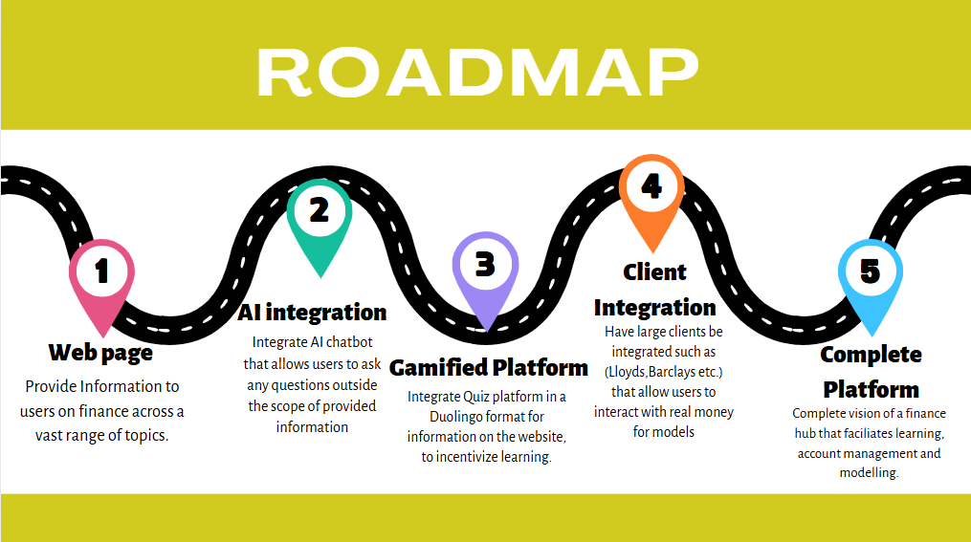

Slide 6
Conclusion
WealthWise is an educational platform that aims to incentivize a desire to learn and help anyone manage their finances
The mission is to help make financial education enjoyable and accessible to everyone
Our vision is to create a complete platform with integrated partners that allow users to learn about finance and manage their accounts.

