Slide 1
Using Volumes in Docker

Slide 2
The Challenge
All meaning application consume or produce data.
Containers are stateless applications
So how do we get a Stateless Application(Container) to become a stateful Application
The solution is to use DockerVolumes

Slide 3
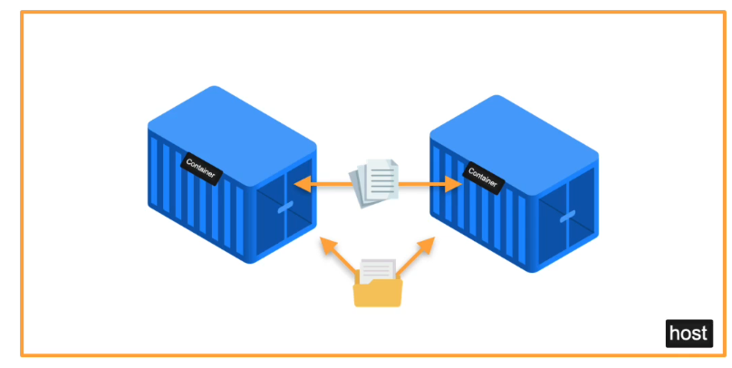
Docker Volumes and Containers
Docker volumes consume, produce & modify state.
Data can be kept after container dies. Volumes have lifecycles that go beyond the lifecycle of a container.

Slide 4
Types Of Volumes
Bind Mount(Host Volumes)
Docker Volumes
TMPFS Mount

Slide 5
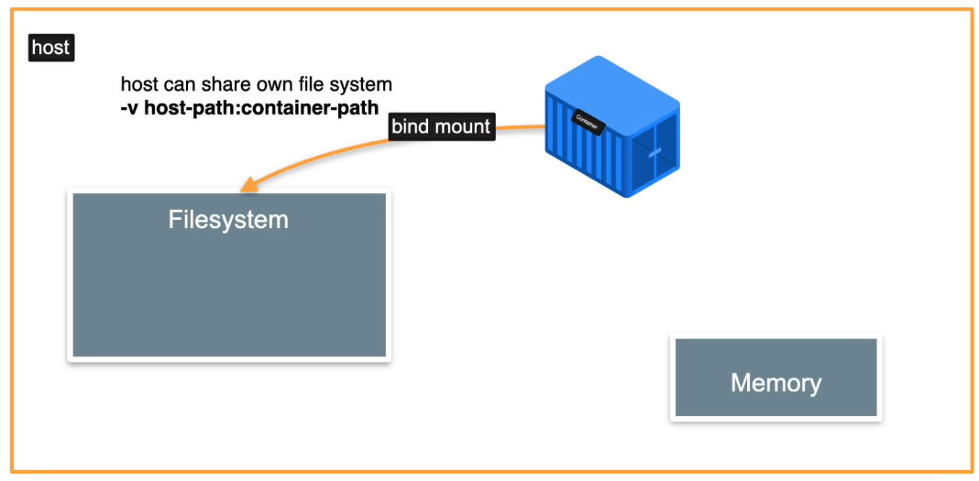
Bind Mount
Bind Mount allows the host to share its own filesystem to the container file system.

Slide 6
Docker Volumes
The are volumes that are managed by Docker
We have no control over these types of volumes

Slide 7
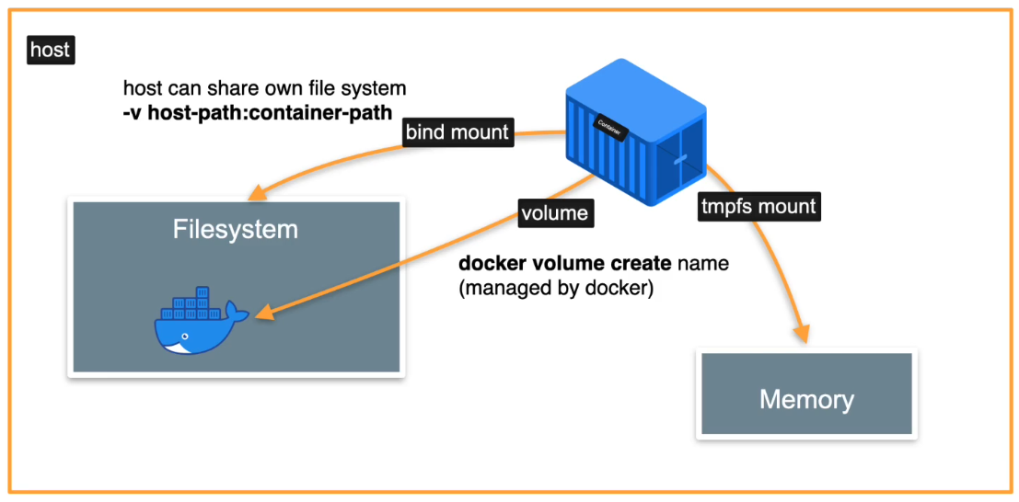
TMPFS Mount
This involves mounting your volume to the RAM.
It serves as a temporary storage file system

