Slide 1












Architecture
Stations
WWC Services
Citizen Observations
Frontend
Backend
API
API
Server

Slide 2
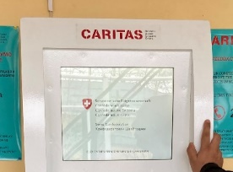
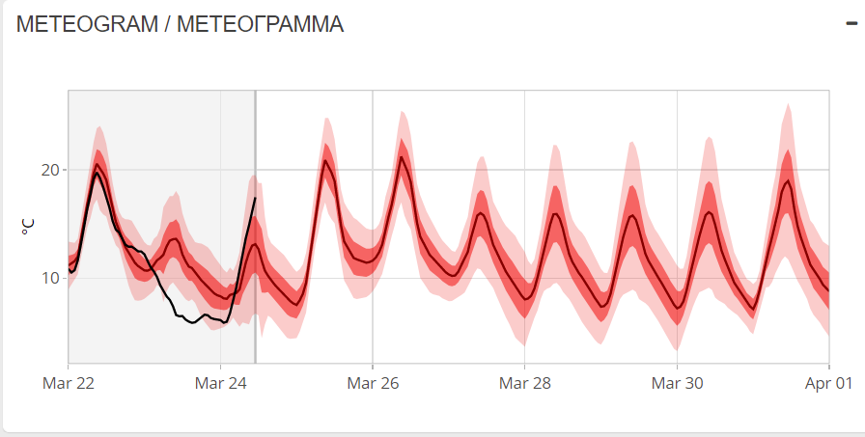
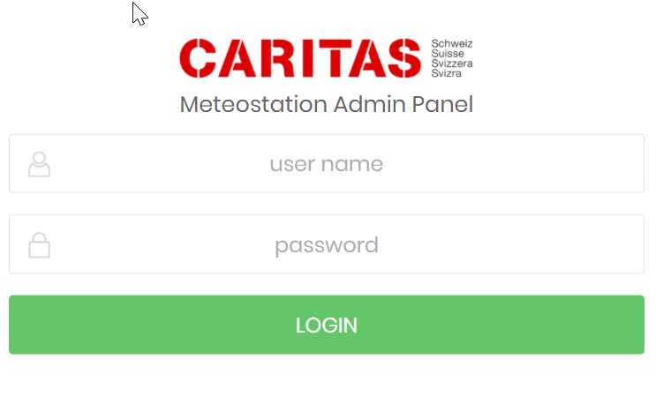
WWC Services
 | Dashboard | Kiosk | Maintenance Tool
Purpose | Check operations and identify problems of stations. Provide WWCS Services in a dashboard optimized for desktop computer. | Provide WWCS at district level in collaboration with agricultural advisors optimized for cash machine devices | Manage the deployment and maintenance of stations optimized for mobile devices.
Software | C++ for station processing Python + R for calculations based on MeteoSwiss scripts. R-Shiny to visualize the dashboard | Python + Microsoft Forms | Python + HTML (bootstrap) + JS
Focal Points | Omar, Mathias | Kushbakht, Safarali | Kushbakht, Safarali
Snapshot

Slide 3
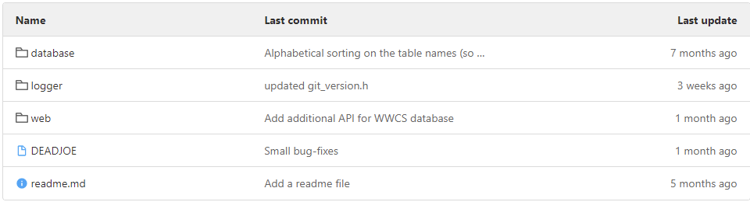
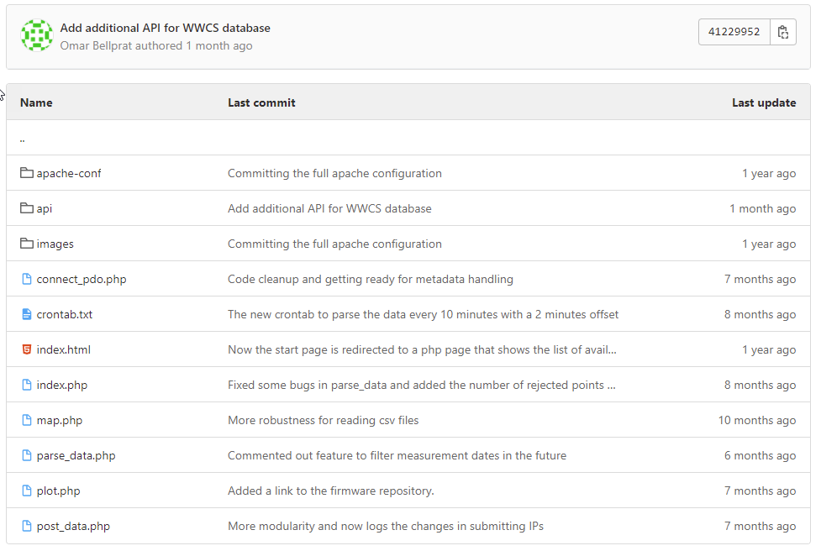
Station Monitoring
Station Monitoring
Kiosk
WSL GitLab
Current Structure
Proposed changes
Rename «logger» to «stations» to include also python scripts
Add folder «citizen» with the application that pushes the sms data
Rename «web» with «services»
Inside «services»:
«dashboard»
«kiosk»
«maintenance»
«API»
Create a «Dockerfile» for the container

Slide 4
List of tasks (GitLab Issues / Milestones)
Revise GitLab folder structure (Boris)
Push all developments to GitLab WWCS / Web (Omar, Kushbakht)
Milestone: Replace .PHP with .Python
Issue: Rewrite post_data.php / parse_data.php / connect_pdo.php in python with MAC adressing checking and cryptographic key (Kushbakht).
Issue: Replace monitoring functions map.php, plot.php, index.html into Shiny Dashboard (Omar).
Milestone: Develop python tool to push sketch on loggers using git revision number (Omar, Kushbakht)
Milestone: Develop a containerized version of the server with docker (Kushbakht)
Milestone: Development of WWC Services (Omar, ICARDA)
1. Issue: Include boundary layer as predictor in temperature forecasts (Omar)
Issue: Develop cold wave predictions using logistic regression (Omar)
Issue: Include MeteoIO for station filtering and collocation of forecasts (Omar, Mathias)

