Slide 1
Unit-7:Congestion Control and Quality of Services
Presented by:
Deepa Kumari Paneru(11)
Garima Thapa(17)
Lilawati Rana(25)
Niruta Chaudhary(29)

Slide 2
Table of Contents:
7.1:Congestion Control:Open Loop,Closed Loop
7.2:Traffic Shaping:Leaky Buacket and Token Bucket
7.3:TCP Congestion Control

Slide 3
7.1Congestion Control:Open Loop and Closed Loop
Congestion:
Congestion occurs in network when the load on network is greater than its capacity.It results delay ,slow data transmission rate and packet loss.
Congestion Control:
Congestion Control is the technique or mechnaisms to control the congestion and keep the load of network below the capacity.

Slide 4
Congestion Control Mechanism:
Congestion control can be done using two methods:
Congestion Control
Open loop
Closed Loop

Slide 5
1.Open Loop Congestion Control
Open Loop congestion Control prevents congestion before it happens.Congestion control is handled by either source or destination.
Open Loop policies
1.Retransmission Policy:
Retransimission sometimes becomes unavoidable.If sender feels that a sent packet is lost or corrupted,the packet needs to be retransmitted.It can increase the congestion in network.However a good retransmission which is designed by retransimmison policy and transmission timers to optimize efficiency and also prevent congestion at same time.Eg:Retransmission policy by TCP.

Slide 6
2.Window Policy
The type of window at sender may affect congestion.The Selective repeat Window is better than Go-Back-N.In Go-Back-N window ,when timer for a packet times out,lost or corrupted packet can be resent which reduces duplication of retransmission.
3.Acknowledgement Policy
If a receiver doesnot acknowledge every packet it receives,it may slow down the sender and help slow down congestion.A receiver send an ACK only if it has a packet to be sent or a special time expires.

Slide 7
4.Discarding Policy
A good discarding policy helps to prevent congestion.In audio transmission the less sensitive packets are discarded,while the quality of sound remains same.
5.Admission Policy
Admission policy can also p[revent congestion in virtual-circuit networks.Switches in a flow first check the resource requirements of a flow before admitting it to the network.A router can deny establishing a virtual-circuit connection if there is congestion in the network or possibility of coingestion in near future.

Slide 8
2.Closed Loop Congestion Control
Closed Loop congestion control try to reduce congestion after it happens.
Mechanism of Closed Loop Control
1.Back-Pressure
In Back Pressure a congested node stops receiving data from immediate upstream nodes.It is node ton node congestion control that starts with a node and propagates in the opposite direction of dta flow to source. It can only apply in virtual circuit networks.

Slide 9
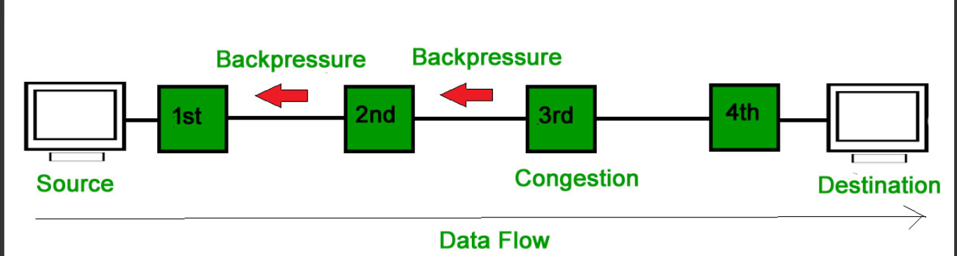
f

Slide 10
2.Choke Packet
Choke packet is a packet sent by a node to the source to inform it of congestion.Eg:ICMP
3.Implicit Signaling
In implicit signaling,there is no communication between the congested nodes and source.For example:when a source sends several packets and there is no ACK for while ,one assumption is that network is congested .

Slide 11
4.Explicit Signaling
The node that experiences congestion can explicitly send a signal to source or destination.The signal is included in the packets and carry data.It can occur forward or backward direction.

Slide 12
7.2 Traffic Shaping
Traffic shaping is a mechanism to control the amount and the rate of the traffic sent to the network.
Two techniques can shape traffic:
Leaky bucket
Token bucket.

Slide 13
1.Leaky bucket
The Leaky Bucket is a traffic control and congestion control algorithm used in computer networks. It smooths out bursts of data by sending packets at a constant rate.

Slide 14
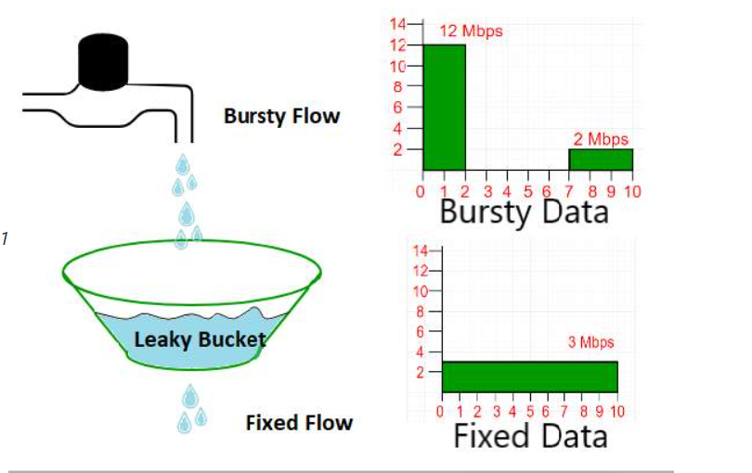
Working Mechanism
Incoming packets are stored in a bucket(buffer).
The bucket leaks packets at a constant rate, regardless of how fast packets arrive.
If the incoming rate exceeds the outgoing rate for too long ,the bucket overflows and extra packets are dropped.

Slide 15
Advantage and Disadvantage
Advantage
Controls network congestion.
Produces a smooth and constants output rate.
Improves network stability.
Prevents sudden bursts of traffic.
Disadvantage
Bursty traffic is not allowed
Can waste bandwidth if the network is not idle.
Less flexible than token bucket algorithm.

Slide 16
Example
Suppose:
Bucket capacity=10packets
Leak rate=2packets/seconds
If 15 packets are arrive at once:
10 packets are stored in the bucket. 5 packets are discarded because the bucket is full
The bucket sends 2 packets every seconds until it becomes empty.

Slide 17
Applications
Traffic shaping in routers and switches.
Networking control.

Slide 18
2.Token Bucket Algorithm
The Token Bucket Algorithm is a traffic control method where tokens are added to a bucket at a fixed rate and packets can be transmitted only if enough tokens are available.

Slide 19
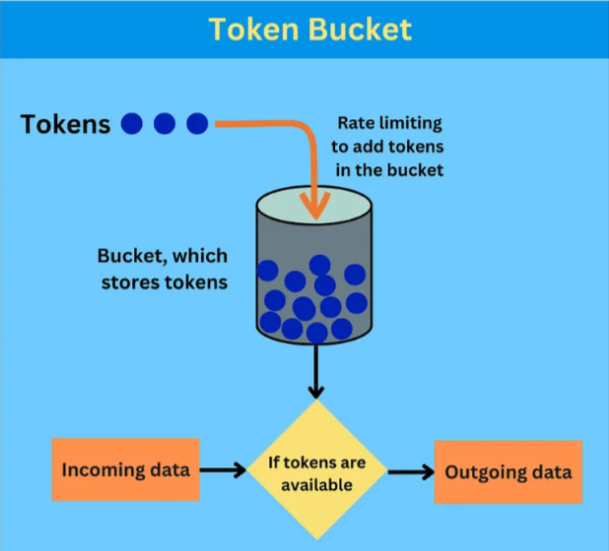
How it works
Token Generation: tokens are added to the
bucket at a fixed rate until it is full.
Data Transmission: A packet is sent only if
enough tokens are available.
Burstiness: Saved tokens allow many packets
to be sent at once.
Rate Limiting: If there are no tokens,
packets wait until new tokens are generated.

Slide 20
Advantage:
Allows burst traffic
More flexible then leaky bucket
Better bandwidth utilization
Disadvantage:
May cause packet loss during heavy congestion.
Burst traffic can create temporary congestion.
Needs proper token rate and bucket size settings.

Slide 21
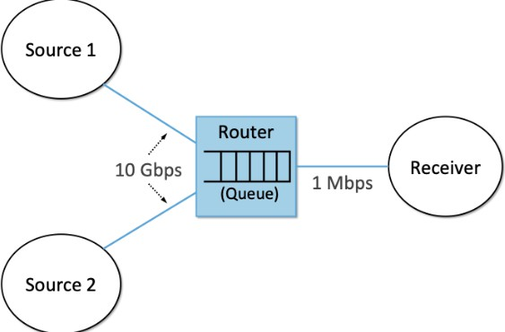
7 3 TCP Congestion Control
TCP congestion control is a mechanism used by the TCP protocol to regulate the rate of data transmission according to network conditions.
It’s main goal is to prevent network congestion while maintaining efficient and reliable communication.
fig-network diagram

Slide 22
Objective
Prevent packet loss
Improve network performance
Ensure fair bandwidth sharing
Maximize throughput

Slide 23

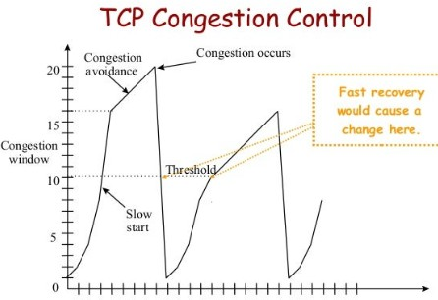
Congestion Window(cwnd)
TCP congestion control dynamically adjusts the Congestion Window (cwnd) based on network feedback, ensuring efficient and fair bandwidth usage.
Core Phases:
Slow Start – Begins with cwnd = 1 MSS and doubles it every RTT (exponential growth) until it reaches the slow start threshold (ssthresh) or packet loss occurs.
Congestion Avoidance– After reaching ssthresh, cwnd grows
linearly (cwnd = cwnd + 1 MSS per RTT) to cautiously probe for available bandwidth.

Slide 24
3.Congestion Detection
1.Triggered by timeout or 3 duplicate–ACKs: Timeout:ssthresh = cwnd / 2, cwnd = 1 MSS, restart with Slow Start.
3. Duplicate ACKs:
ssthresh = cwnd / 2, cwnd = ssthresh, enter Congestion Avoidance (Fast Recovery).
Fast Retransmit & Fast Recovery
Retransmit lost packet after 3 duplicate ACKs without waiting for timeout, then halve cwnd and avoid full slow start. Improves network efficiency after packet loss.

Slide 25
Conclusion
TCP automatically adjusts its transmission rate according to network conditions.
It uses four techniques:
1.slow start threshold(ssthresh),
2. congestion Avoidance,
3. congestion detection and,
4. fast Retransmit & fast recovery.
These mechanisms ensure efficient and reliable data transmission.

