Slide 1
Token Bucket Algorithm
The Token Bucket Algorithm is a traffic control method where tokens are added to a bucket at a fixed rate and packets can be transmitted only if enough tokens are available.

Slide 2
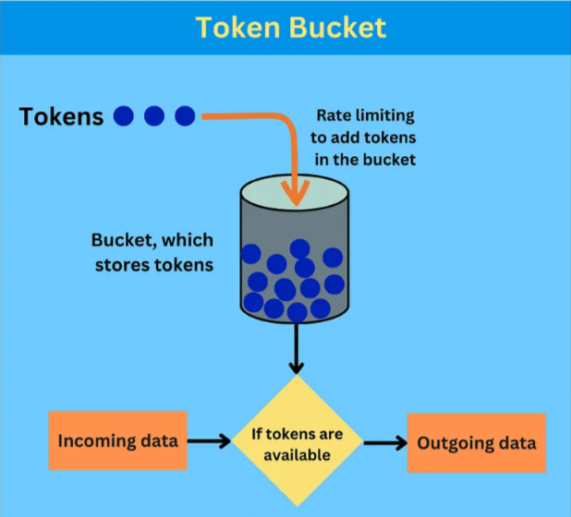
How it works
Token Generation: tokens are added to the
bucket at a fixed rate until it is full.
Data Transmission: A packet is sent only if
enough tokens are available.
Burstiness: Saved tokens allow many packets
to be sent at once.
Rate Limiting: If there are no tokens,
packets wait until new tokens are generated.

Slide 3
Advantage:
Allows burst traffic
More flexible then leaky bucket
Better bandwidth utilization
Disadvantage:
May cause packet loss during heavy congestion.
Burst traffic can create temporary congestion.
Needs proper token rate and bucket size settings.

